Slide 1
Using This Slide Deck
This presentation is designed to help superintendents and other leaders communicate how the A–F accountability system works and to explain your local district's 2024 and 2025 ratings.
Some notes on using these slides:
Slides 2 through 10 provide an overview of the A-F accountability system. This includes the beliefs and design commitments that drive an accountability system that is rigorous, transparent, and fair
Slides 13,16-18, 21-22, 26, 29, 35, 36, 38, and 41 include a star icon in the top left corner; that is your cue to input your district’s 2024 and/or 2025 data. Editable tables are provided for each domain and overall ratings, or information can be snipped directly from TXschools.gov. The yellow boxes on the slides provide additional guidance, including where data can be easily accessed
Slides 12, 14, 20, 25 and 28 have orange boxes with links to “How Accountability Works” infographics. These provide concrete examples of how ratings are calculated and are helpful for clarifying methodology with stakeholders.
Slides 42-45 provide space for you to summarize district wins, areas of opportunity and next steps
Slides 2-41 include a sample script. Please feel free to use or adapt the script to match your preferred level of detail and presentation style. The script includes statewide data summaries and transition language to help you highlight your district’s performance.
Slides 47-66 show district performance over time by ESC region. If you would like to include this data, copy the chart from your ESC slide onto slide 16.

Slide 2

Purpose of A–F

Slide 3

Expectations Matter
We believe that all students can learn and achieve at high levels.
4
Notes:
We are all here because we believe that our students can learn and achieve at high levels. Our ultimate goal is to prepare them for life after their K-12 education, by ensuring they have the tools to be College, Career, and Military ready.

Slide 4
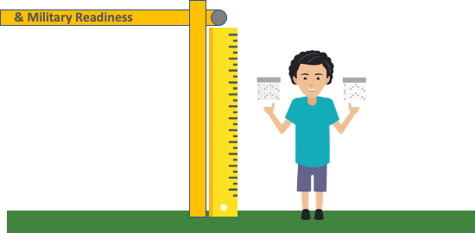

Expectations Matter, At All Grade Levels
The State Board of Education has defined what all students should know and be able to do at each grade level if they are to be well prepared for success in life. These are called the Texas Essential Knowledge and Skills (TEKS).
What does this look like in practice?
TEKS 3.5A: Represent one- and two- step problems involving addition and subtraction of whole numbers to 1,000 using pictorial models, number lines, and equations.
College, Career, & Military Readiness
ON TRACK
Notes:
We know what it takes for a student to cross the graduation stage as college, career, and military ready. We also know what the building blocks are, starting in early childhood education, for each student to get the tools that they need. At each grade level and in every subject, the state board of education has defined these expectations through the Texas Essential Knowledge and Skills (TEKS).
While 3rd grade is a long time from high school graduation, we can see the progression of knowledge and skills across each student's PK-12 career. Here we have an example of a 3rd grade math TEK, one of the things that our students must be able to know and do by the end of 3rd grade.

Slide 5

Monitoring Progress Helps Support Students
TEKS 3.5A: Represent one- and two-step problems involving addition and subtraction of whole numbers to 1,000 using pictorial models, number lines, and equations.
Actual 3rd Grade STAAR Question:
An art teacher had 736 crayons. She threw away 197 broken crayons. Then she bought 150 more crayons. Which equation shows how to find the number of crayons the art teacher has now?
A)
B)
C)
D)
736 - 197 - 150 =
736 - 197 + 150 =
736 + 197 + 150 =
736 + 197 - 150 =
Notes:
In order to ensure students are gaining those knowledge and skills, we leverage the STAAR assessment to determine to what extent students have mastered those skills. Let's take a look at the TEK and the 3rd grade STAAR question that assesses mastery of that skill.
This question lets us know whether or not the student has mastered this skill. We do not rely on what we think our students know or can do, we need concrete ways to measure their performance. This allows us to make decisions instructionally; whether it's leveraging a different curriculum, shifting teacher training, or providing targeted tutoring.

Slide 6

Clear Performance Information Helps Students
You can’t improve what you can’t see. To serve all students well, educators, parents, businesses leaders, and community members need easy access to information regarding how schools and districts are doing.
Notes:
Just as we want to know what our third graders know and can do by assessing their mastery of skills, we want to know how our schools are doing. Each of us has different experiences in school and different ideas of what makes a school "good" for our children or are community. Regardless of school models or preferences, there are universal truths that inform to what extent a school is meeting our goal of college, career, and military readiness:
Are students achieving?
Are students growing?
Are the most vulnerable students in the school community growing and achieving?
We can quantify the answers to these three crucial questions and have through the A-F accountability system. This system allows us to make informed decisions about how our schools and how are district is doing.

Slide 7

Students Are Helped In School & In Life
Monitoring performance with school ratings has been shown to have long term benefits for students:
“Our analysis reveals that pressure on schools to avoid a low performance rating led low-scoring students to score significantly higher on a high-stakes math exam in 10th grade. These students were also more likely to accumulate significantly more math credits and to graduate from high school on time.
Later in life, they were more likely to attend and graduate from a four-
year college, and they had higher earnings at age 25.”
Source: https://www.educationnext.org/when-does-accountability-work-texas-system/
Notes:
Just as we have high expectations for our 3rd grade mathematicians, we have high expectations for our schools and our district. When we set a high bar, our schools and districts can meet that bar. You will see later on today that significant gains in student growth and achievement are being made across the state. So while accountability can be uncomfortable, it sets a bar that drives all of us to get our students what they need. Research clearly shows that setting a high bar not only leads to short term gains, but better life outcomes for students.

Slide 8
A–F is a tool to help us meet continuously improved goals for children
39.053(f) … In consultation with educators, parents, and business and industry representatives, as necessary, the commissioner shall establish and modify standards to continuously improve student performance to achieve the goals of eliminating achievement gaps based on race, ethnicity, and socioeconomic status and to ensure this state is a national leader in preparing students for postsecondary success.
Fostering a culture that supports growth and continuous improvement when this performance information is public is a difficult but critical task for education leaders.
Notes:
Moreover, our legislative leaders have clearly outlined the expectation; we must continuously monitor performance to continuously improve outcomes for students. This statute outlines ensuring that Texas is "a national leader in preparing students for postsecondary success," and doing so requires all of us working together to build a culture that supports growth, even when it is challenging.

Slide 9
Balancing multiple objectives
Rigor
for students
39.053(f) “eliminating achievement gaps ... and to ensure this state is a national leader in preparing students for postsecondary success”
A-F
39.054(b) “the mathematical possibility that all districts and campuses receive an A rating”
Fair
for schools
Transparent
for the public
39.309 “website … for the public to access school district and campus accountability information”
Notes:
There are three overarching objectives for the A-F accountability system in Texas; we have discussed the need for rigor, the system must also be transparent and accessible to the public, and it must be a fair measure of campus and district performance. My goal for today is to ensure that the way our district and schools within the district are rated is transparent and that together, we action plan to ensure our students meet this rigorous bar.

Slide 10
A–F is a tool to help Texas meet continuously improved goals for children
There are several key design commitments built into A–F to help ensure it works as an effective continuous improvement tool while accurately recognizing performance:
Ratings reflect better of achievement or progress
School performance is evaluated through multiple valid measures
Ratings are based on defined criteria, not a fixed distribution
  “A” reflects performance consistent with reaching long term student goals
  “C” reflects average performance for the baseline year
The system design remains static in most years
Notes:
I also want to highlight some of the ways that the system demonstrates fairness. We will dig into many of these ideas throughout our time today, but these are the design commitments under which the A-F accountability system is built.
It's also important to highlight that while the system design is static in most years, every 5 years we raise the bar for students. Shortly, we anticipate seeing the 2028 A-F Refresh Framework, which will set the bar for our kids, schools, and districts from 2028-2033. I look forward to sharing this with you when it is released and working collaboratively for the future.

Slide 11
2025 A-F Ratings and District Results
Notes:
But for now, let's dig into the A-F accountability framework; the methodology by which scores are calculated, a glimpse into statewide performance, and our district results. We will also have time to highlight our celebrations from 2025, for you all to ask questions, to name our largest areas of opportunity, and for me to share my next steps.

Slide 12
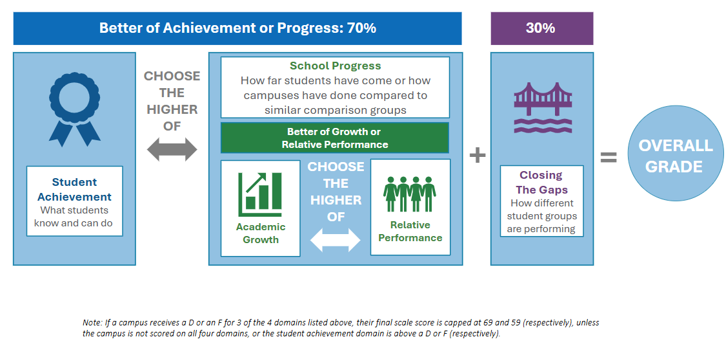
Calculating Overall A-F Results
This design reflects a commitment
to recognize high student
achievement and
to recognize the impact of
highly effective educators,
while maintaining focus on
the students most in need.
Domain 1
Domain 2
Domain 3
Student Achievement
School
Progress
Closing
the Gaps
Click for an example of how school results are calculated
Notes:
As we just discussed, the system is built on key design commitments that ensure fairness, transparency, and alignment with long-term goals for students.
Districts and campuses are evaluated across three key domains:
Domain 1: Student Achievement – measuring academic success.
Domain 2: School Progress – tracking improvement over time.
Domain 3: Closing the Gaps – focusing on equity and support for underserved student groups.
Here’s how the ratings are weighted:
70% of the rating reflects the better outcome between student achievement and school progress.
30% comes from other performance indicators.
This design ensures that:
High student achievement is recognized.
The impact of highly effective educators is visible.
And most importantly, we maintain a strong focus on students who need the most support.
One of the most encouraging aspects of this approach is that our ratings highlight the growth and achievement happening across all campuses including those serving economically diverse school communities.

Slide 13
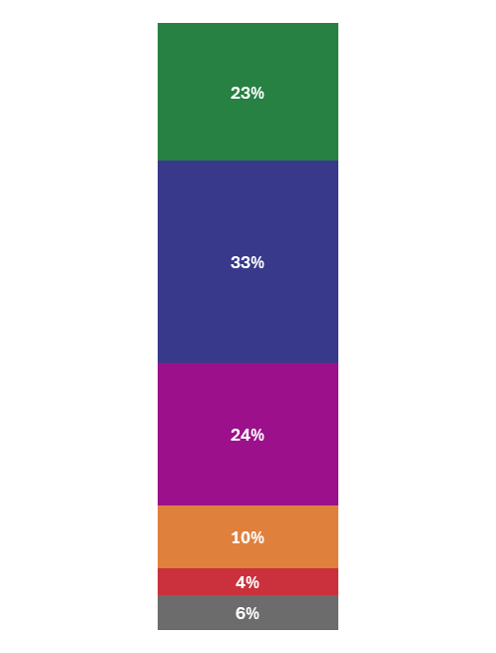
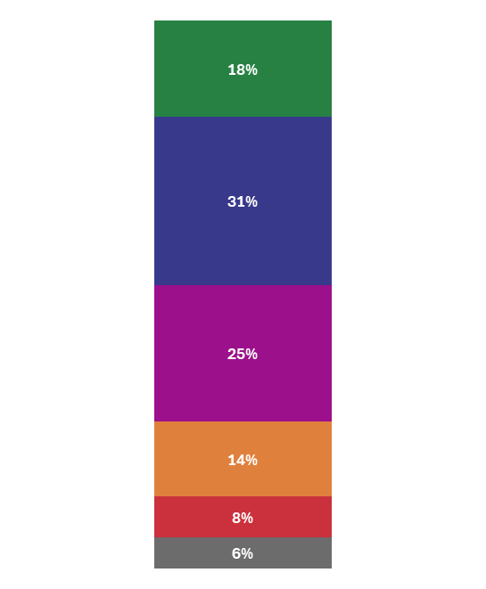
Overall Campus Ratings Results: 2024 to 2025 Comparison
Across Texas Campuses: 2024 vs 2025 Ratings
Our Campuses: 2024 to 2025 Ratings
Ratings
xx% campuses increased in ratings from the prior year.
xx% of campuses stayed in the same score or improved from the prior year.
A 90-100
31% campuses increased in ratings from the prior year.
86% of campuses stayed in the same score or improved from the prior year.
2024 | 2025
B 80-89
Stayed the Same | Increased | Decreased
Stayed the Same | Increased | Decreased
4855 | 2714 | 1290
55% | 31% | 15%
C 70-79
D 60-69
F ≤ 59
Not Rated
2024
2025
Use table above to input number of schools at each rating level in 2024 and 2025.
From the Accountability Overview on TXschools.gov, click on 2024 or 2025, to open accountability reports.
Under the Overview tab, select Summary.
9,084 campuses in 2025. May not equal 100% due to rounding.
13
Notes:
Across the state, 31% of campuses increased ratings from 2024 to 2025 and 86% of campuses maintained their rating from 2024 to 2025. Our results...

Slide 14
Calculating Overall Results for Districts
District ratings use the same methodology, with each school holding a proportional weight based on grades 3-12 enrollment
This design reflects a commitment
to recognize high student
achievement and
to recognize the impact of
highly effective educators,
while maintaining focus on
the students most in need.
Domain 1
Domain 2
Domain 3
Student Achievement
School
Progress
Closing
the Gaps
Click for an example of how district results are calculated
Notes:
District accountability ratings are calculated a little differently, but the same three domains remain:
Student achievement
School progress
Closing the gaps
This ensures consistency and fairness across the board. To calculate our district rating, each school has a proportional weight of our overall rating. We take the proportional weight of each of our schools in Domains 1 and 2, and the overall highest score accounts for 70% of our district rating. Then, the proportional weight of each school comprises our Closing the Gaps score for the remaining 30%

Slide 15
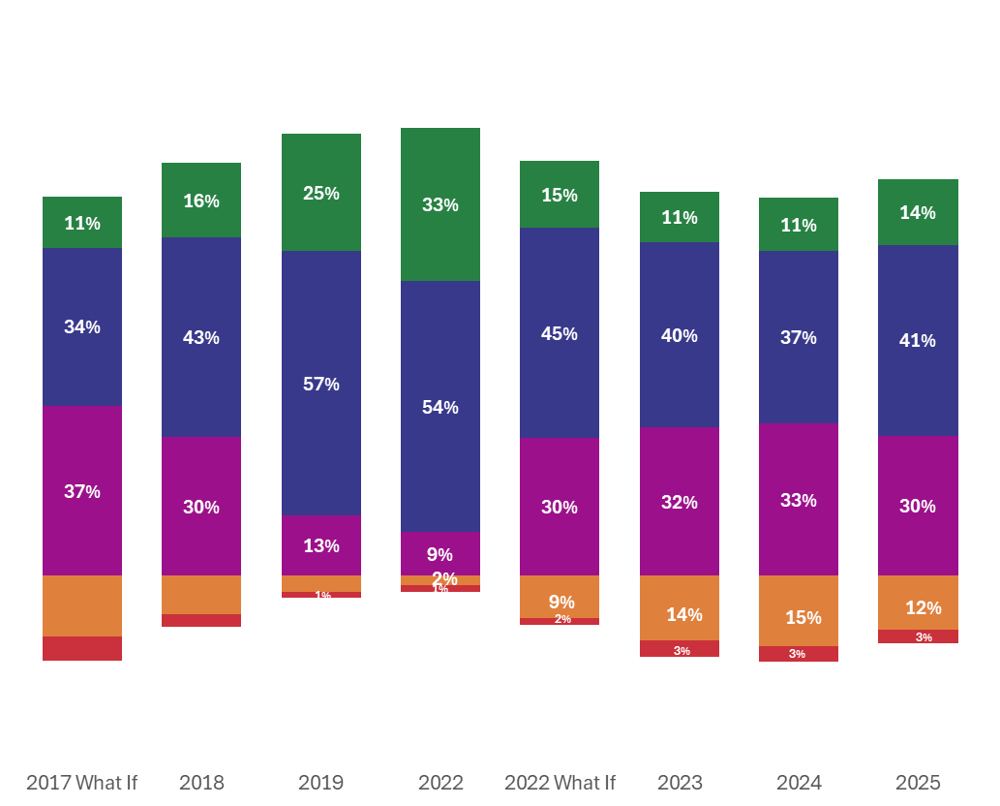





Overall District Rating Results: 2017 to 2025
A
B
C
D
F
Notes:
We also wanted to share how district performance has changed over time. 2018 reflects a refresh year, when major shifts were made to the A-F accountability framework and the 2017 "What Ifs" reflect what ratings would have been under the 2018 rating system. As you can see, the highest performance in terms of A and B rated districts was in 2022. In many cases, this reflected strong Domain 2 growth, after 2 years of no ratings due to the COVID 19 pandemic. We also expect scores to improve over the course of the 5 years between every refresh; when we set a high bar for rigor it does take time, but our kids, schools and districts can reach it. The 2022 "What If" scores reflect what accountability ratings would have been under the 2023 refresh. One major aspect, which was new for district ratings in 2023 was the proportional weighting for schools. In 2023, we had the first year of STAAR 2.0 and the 2023 accountability refresh to our current system--- so that was the first year with an updated assessment for students and a more rigorous accountability system. Growth was somewhat stagnant from 2023 to 2024, but we are now seeing more districts move into A and B ratings in 2025.

Slide 16
Overall Region Rating Results: 2017 to 2025
A
B
C
D
F
On slides 40-59, you can find region results from 2018-2025.
If you would like to include a more local snapshot of results over time, copy the graph from your regional slide here
Notes:
We also wanted to give you a glimpse into our peers within our Educational Service Center (ESC) region.

Slide 17
Overall District Rating Results: 2019 to 2025
District Performance Over Time
2019 | 2022 | 2022 "What If" | 2023 | 2024 | 2025
Input ratings from 2019-2025 on the chart above.
You can find color coding aligned to the bar graphs under "recent colors"
To find the district ratings over time, navigate to the accountability overview from TXschools.gov
Under "Change Over Time" click on any year, which will open a new tab for the accountability reports. Here, you can toggle by year
Notes:
In our district, we have seen...

Slide 18
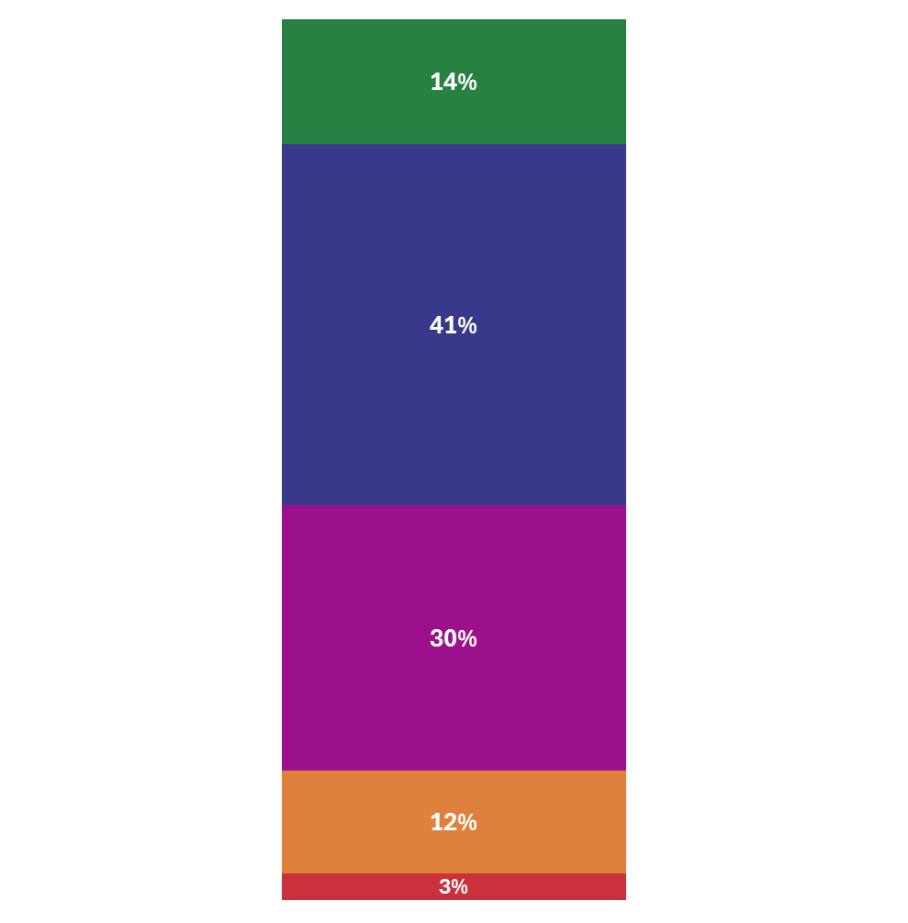
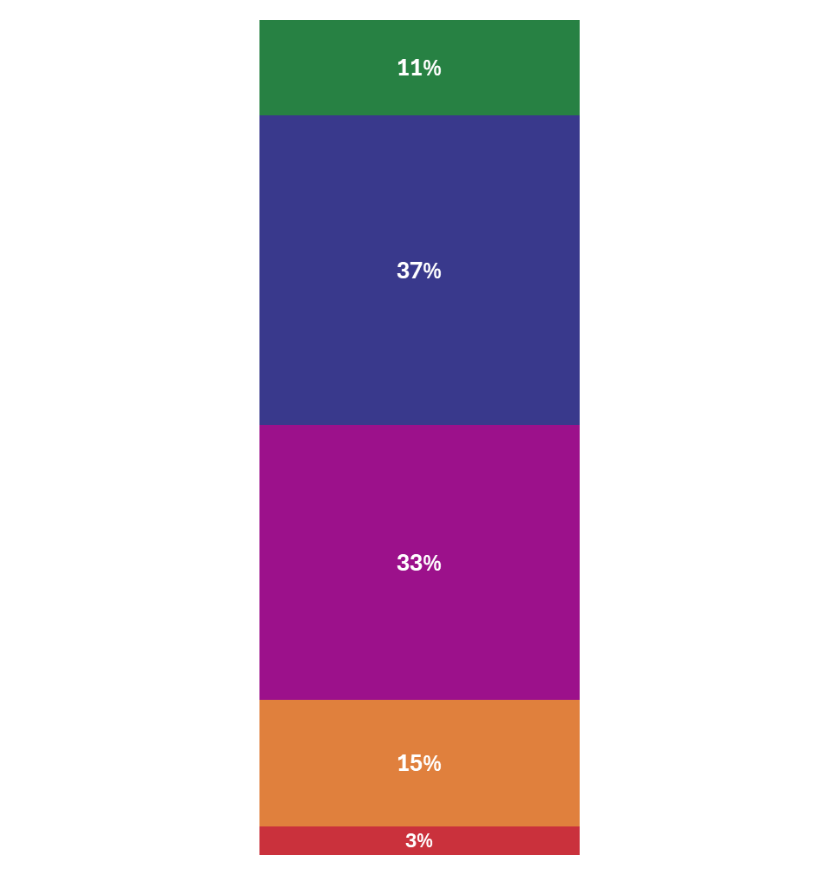
Overall District Rating Results: 2024 to 2025 Comparison
Across Texas Districts: 2024 vs 2025 Ratings
Our District: 2024 to 2025 Ratings
24% districts increased in ratings from the prior year.
88% of districts stayed in the same score or improved from the prior year.
2024 |  | 2025
Scale Score | Rating | Scale Score | Rating
A 90-100
B 80-89
Stayed the Same | Increased | Decreased
773 | 285 | 145
64% | 24% | 12%
C 70-79
Use table above to input your district's ratings and scale score in 2024 and 2025.
This data is accessible on TXschools.gov: Under the Performance Tab, click Accountability Overview to see District 2024 and 2025 scale scores and ratings
D 60-69
F ≤ 59
2024
2025
1,208 districts in 2025. May not equal 100% due to rounding.
18
Notes:
So let's zoom in on the shift from 2024 to 2025. Statewide, 13% of districts improved their ratings, and 77% either improved or stayed the same. This shows that most districts are maintaining or building on their performance, even as expectations rise. Our district’s data here show how we’re trending…

Slide 19
Domain I: Student Achievement

Slide 20
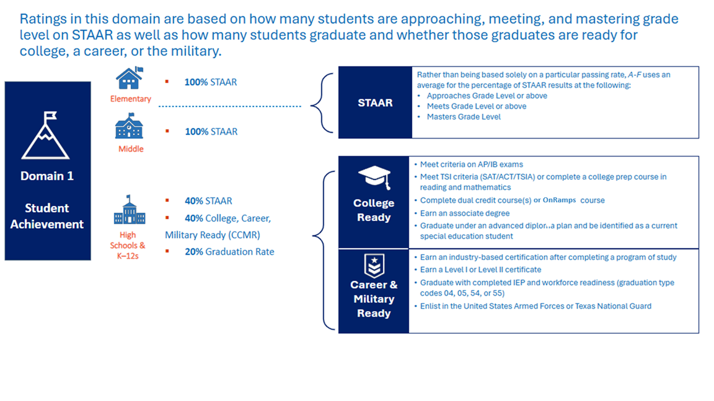
Domain 1: Student Achievement
Click here for examples for how student achievement is calculated
Notes:
Let’s now explore the data for Domain I—Student Achievement. This domain shows how well our students are performing academically and how prepared they are for life after high school, whether that’s college, career, or military service. Performance is measured through STAAR, CCMR indicators, and graduation rates. This ensures a comprehensive view of student success. For elementary and middle schools, STAAR is the primary measure. For high schools, we look at readiness indicators like AP, dual credit, and military enlistment.

Slide 21
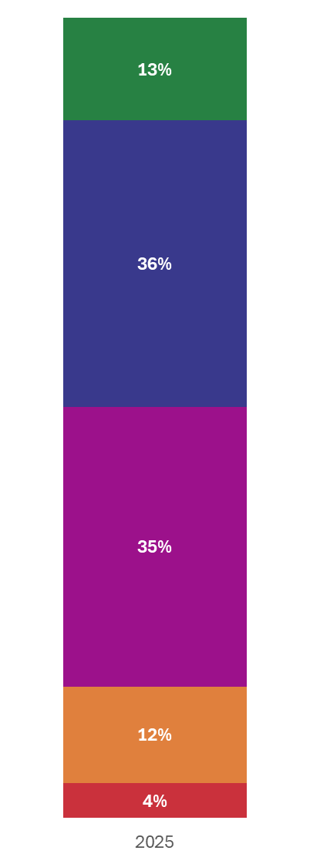
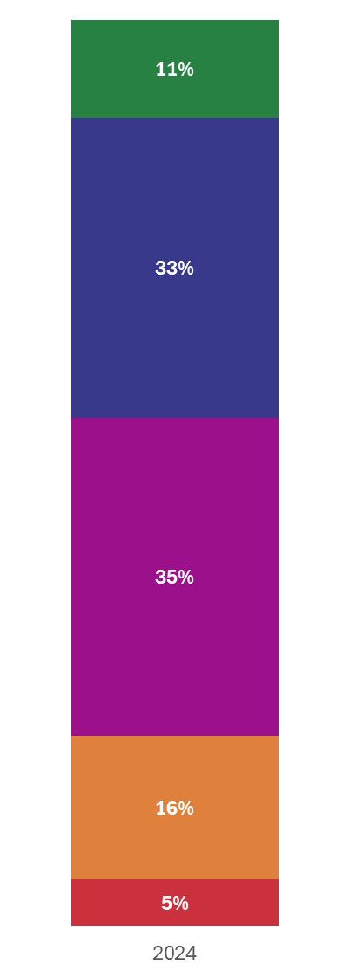
District Domain I Ratings: Comparison of 2024 vs. 2025 Results
Across Texas Districts: 2024 vs 2025 Ratings
Our District: 2024 to 2025 Ratings
19% districts increased in ratings from the prior year.
91% of districts stayed in the same score or improved from the prior year.
 | 2024 | 2025
STAAR Performance
CCMR
Graduation/ Completion Rate
Student Achievement Score
A 90-100
B 80-89
Stayed the Same | Increased | Decreased
851 | 223 | 106
72% | 19% | 9%
C 70-79
STAAR, CCMR, and Grad/Dropout data provided for districts are for informational purposes only and are not used in calculating weighted district domain scores.
D 60-69
Use table above to input your district's ratings in 2024 and 2025.
In the Student Achievement tab of TXschools.gov under STAAR Performance data, click “Dig into the Data" for STAAR performance.
All other data is available under the listed indicator on the Student Achievement tab of TXschools.gov
F ≤ 59
Notes:
Across the state, 19% of districts improved in Domain I, and 91% maintained or improved their scores. This is encouraging and shows that statewide efforts to improve academic achievement are paying off. Our district’s ratings here track our progress…

Slide 22
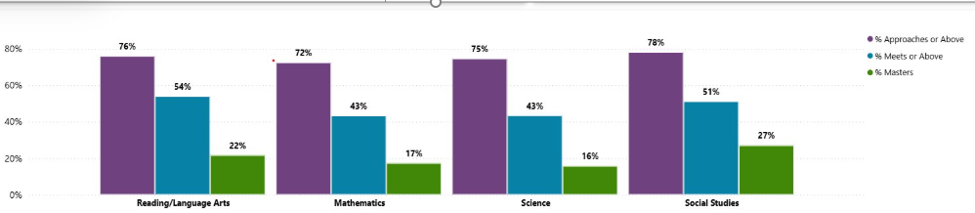
District Domain I Ratings: Zoom in on STAAR Performance
Statewide: STAAR Performance
Our District: STAAR Performance
2025 | RLA | Math | Sci | Soc. Studies
% Approaches +
% Meets +
% Masters
Use table here to input your district's STAAR performance in 2025
Find this on the Student Achievement tab of TXschools.gov under STAAR Performance data, and click “Dig into the Data"
This same graphic can also be found on Txschools.gov by selecting "Analytic Tools' under the "Tools and Reports Tab" and then selecting STAAR performance
Notes:
The data here allows us to zoom in on STAAR performance across subjects—RLA, Math, Science, and Social Studies. Our district’s data shows students are performing at approaches, meets, and masters levels…

Slide 23
Domain II: School Progress

Slide 24
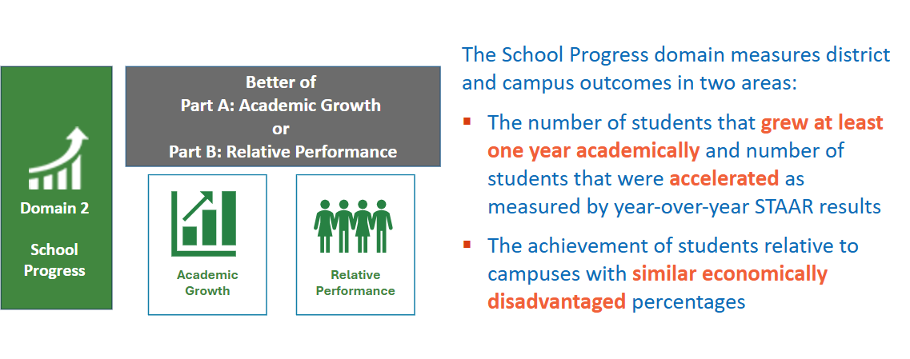
Domain 2: School Progress Part A and B
Notes:
Domain II focuses on school progress. It includes academic growth and relative performance, helping us understand how students are improving year over year

Slide 25
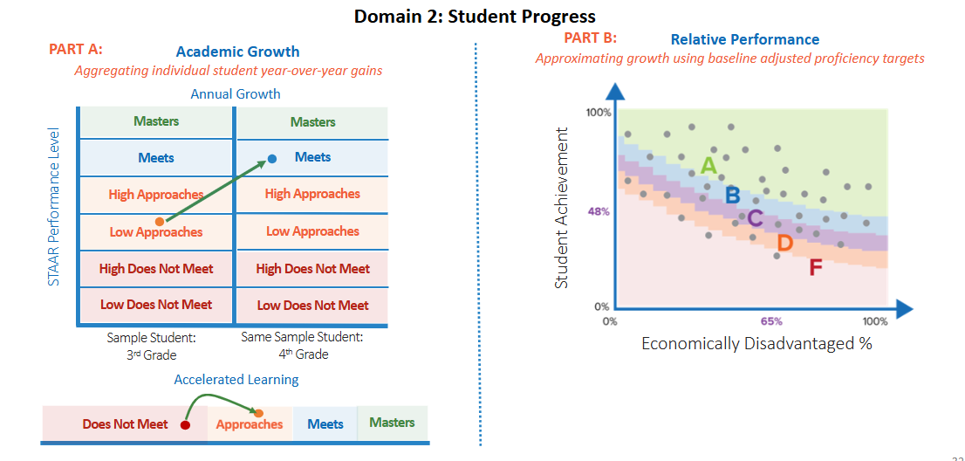
Domain 2: School Progress Part A and B
Click for a examples of how school progress domains are calculated
Notes:
In Domain II, we evaluate students learning over time—not just where they are, but how far they’ve come.
Growth measures individual student progress year over year. It looks at how students move from one performance level to the next—like from ‘Approaches’ to ‘Meets’—and rewards schools for accelerating learning, especially for students who start behind.
Relative Performance compares a school’s achievement to other schools with similar levels of economic disadvantage. This ensures fairness by recognizing schools that are outperforming peers in similar contexts.

Slide 26
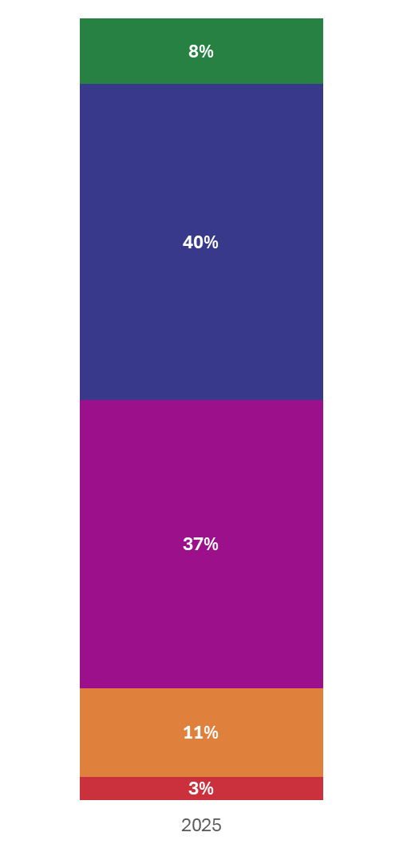
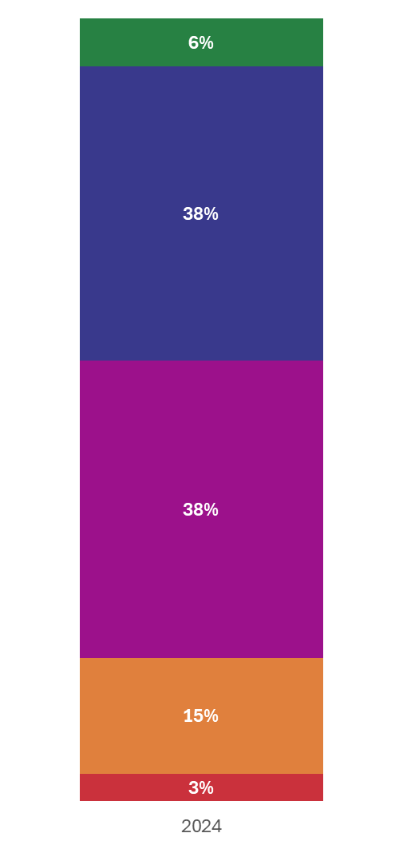
District Domain II Ratings: Comparison of 2024 vs. 2025 Results
Across Texas Districts: 2024 vs 2025 Ratings
Our District: 2024 to 2025 Ratings
A 90-100
23% districts increased in ratings from the prior year.
86% of districts stayed in the same score or improved from the prior year.
 | 2024 | 2025
Academic Growth
Relative Performance
School Progress Score
B 80-89
Stayed the Same | Increased | Decreased
748 | 277 | 164
63% | 23% | 14%
C 70-79
Academic Growth and Relative Performance data provided for districts are for informational purposes only and are not used in calculating weighted district domain scores.
Use table above to input your district's ratings in 2024 and 2025.
Recommended to highlight the higher score to best compare your results to statewide results.
On TXschools.gov, under the Performance Tab, select School Progress to see Domain 2 Part A and B results
D 60-69
F ≤ 59
1,208 districts in 2025. May not equal 100% due to rounding.
Notes:
In the state, 23% of districts improved in Domain II, and 86% maintained or improved their scores. This domain helps us recognize districts that are accelerating learning, especially for students who need it most. Our district’s ratings here show how we’re doing in terms of growth and performance…

Slide 27
Domain III – Closing the Gaps

Slide 28
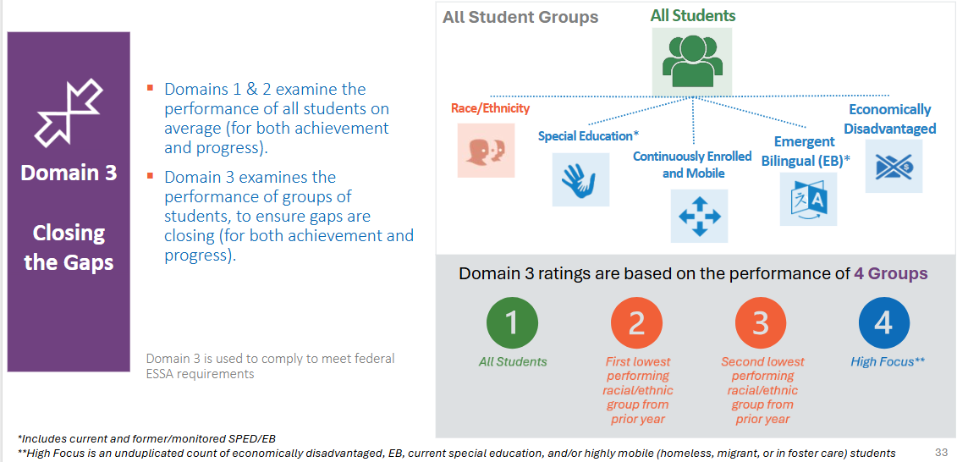
Domain 3: Closing the Gaps
Click here for examples of how closing the gaps is calculated
Notes:
Domain III evaluates how well we’re supporting historically underserved student groups and ensuring all students have the opportunity to succeed. This domain aligns with federal requirements and evaluates 18 student groups across achievement, growth, graduation, and English proficiency. Ratings are based on four groups focused on those most in need.

Slide 29
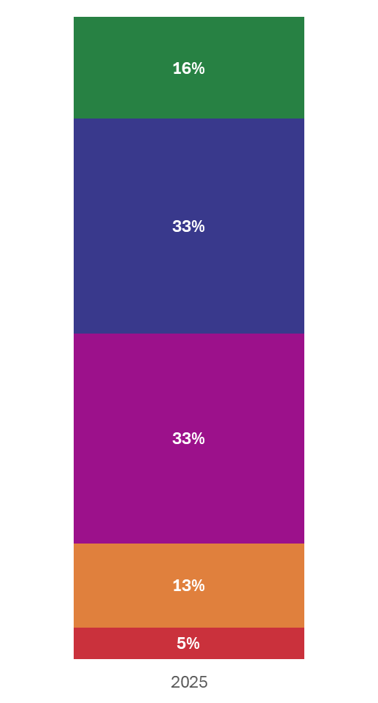
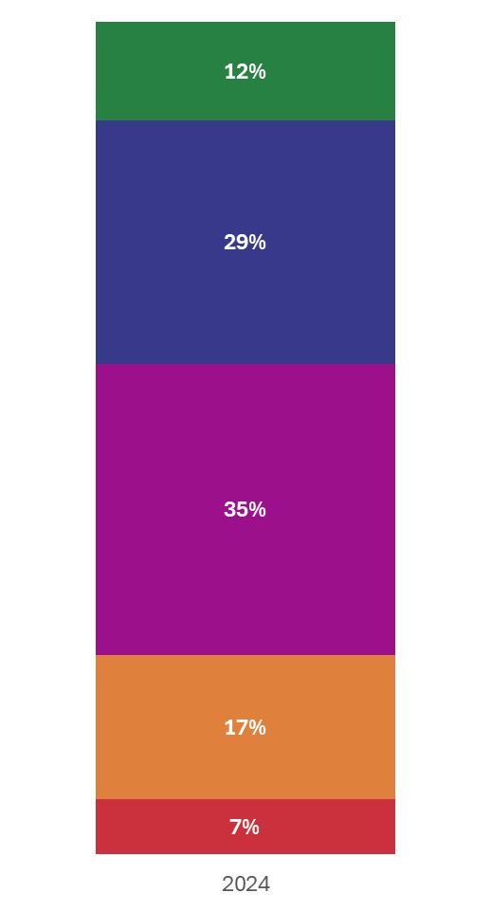
District Domain 3 Ratings: Comparison of 2024 vs. 2025 Results
Across Texas Districts: 2024 vs 2025 Ratings
Our District: 2024 to 2025 Ratings
A 90-100
33% districts increased in ratings from the prior year.
83% of districts stayed in the same score or improved from the prior year.
 | 2024 | 2025
Domain 3 Scale Score
Domain 3 Rating
B 80-89
Stayed the Same | Increased | Decreased
596 | 393 | 195
50% | 33% | 16%
C 70-79
Use table above to input your district's ratings in 2024 and 2025.
Data can be found on TXschools.gov under the Performance tab on the Closing the Gaps page.
D 60-69
F ≤ 59
1,208 districts in 2025. May not equal 100% due to rounding.
Notes:
Across the state, 33% of districts improved in Domain III, and 83% maintained or improved. This is one of the most encouraging signs. It means districts are making progress in closing gaps, aligned to federal targets, and ensuring all students have access to opportunity. Our district’s ratings in this area reflect how…

Slide 30




ES, MS, and HS/K-12 without 4-year Federal Graduation Rate:
The Closing the Gaps domain examines 4 student groups’ potential gaps to targets set across 4 components.
Domain 3 Groups
Component Weight
Sum
Domain 3 Groups are based on the performance of
4 Groups
30% | Academic Achievement STAAR RLA at Meets Grade Level STAAR Mathematics at Meets Grade Level | 0-8 4 RLA 4 Math | 0-8 4 RLA 4 Math | 0-8 4 RLA 4 Math | 0-8 4 RLA 4 Math | 0-32
50% | Growth Growth in STAAR RLA Growth in STAAR Mathematics | 0-8 4 RLA 4 Math | 0-8 4 RLA 4 Math | 0-8 4 RLA 4 Math | 0-8 4 RLA 4 Math | 0-32
10% | Progress to English Language Proficiency TELPAS Progress |  |  |  | 0-4* *Only current EB | 0-4
10% | School Quality/Student Success Average of all STAAR performance scores (ES/MS) | 0-4 | 0-4 | 0-4 | 0-4 | 0-16
 |  |  |  |  |  | 0-84
All Students
First lowest performing racial/ethnic group from prior year
Second lowest performing racial/ethnic group from prior year
High Focus**
Closing the Gaps Scoring
  4 - Met long-term target
  3 - Met interim target
  2 – Showed expected growth toward next interim target
  1 – Showed minimal growth
  0 - Did not show minimal growth
Elem would need 62/84* points to score an A
MS would need 60/84* points to score an A
HS or K12 without Grad Rate need 62/84* points for an A
*if campus meets minimum size requirements for all components
Notes:
This domain aligns with federal requirements and evaluates 18 student groups across achievement, growth, graduation, and English proficiency. Ratings are based on four groups focused on those most in need. Here you can see the total points possible for each component and the component weight for our Elementary and Middle schools (and any HS or K-12 without federal grad rates)

Slide 31
High Schools and K-12s with 4-year Federal Graduation Rate:
The Closing the Gaps domain examines 4 student groups’ potential gaps to targets set across 4 components.
Domain 3 Groups
Component Weight
Sum
Domain 3 Groups are based on the performance of
4 Groups
50% | Academic Achievement STAAR RLA at Meets Grade Level STAAR Mathematics at Meets Grade Level | 0-8 4 RLA 4 Math | 0-8 4 RLA 4 Math | 0-8 4 RLA 4 Math | 0-8 4 RLA 4 Math | 0-32
10% | Graduation Rate 4-year Federal Graduation Rate | 0-4 | 0-4 | 0-4 | 0-4 | 0-16
10% | Progress to English Language Proficiency TELPAS Progress |  |  |  | 0-4* *Only current EB | 0-4
30% | School Quality/Student Success CCMR for graduates and students in grade 12 | 0-4 | 0-4 | 0-4 | 0-4 | 0-16
 |  |  |  |  |  | 0-68
All Students
First lowest performing racial/ethnic group from prior year
Second lowest performing racial/ethnic group from prior year
High Focus**
Closing the Gaps Scoring
  4 - Met long-term target
  3 - Met interim target
  2 – Showed expected growth toward next interim target
  1 – Showed minimal growth
  0 - Did not show minimal growth
HS and K12 need 50/84* points for an A
AECs need 30/68* points for an A
*if campus meets minimum size requirements for all components
Notes:
High schools have a different methodology for domain 3, but with the same guiding principles.

Slide 32
Closing the Gaps: Zoom in on District Results
Domain 3 Results
Student Group | Academic Achievement |  | Growth Rate |  | Graduation Rate | Student Success | School Quality/ Student Success | English Language Proficiency
 | Reading/ Language Arts | Math | Reading/ Language Arts | Math
All Students
Lowest-Performing Racial/Ethnic Groups
Second Lowest-Performing Racial/Ethnic Groups
High Focus Group
Change highlighted text in first column to input your 2 lowest performing Racial/Ethnic Groups
Use table above to input your district's proficiency for each subgroup in 2025.
Data can be found on the Closing the Gaps tab of TXschools.gov under the Closing the Gaps Details.
Notes:
To zoom in our performance on Domain 3, I wanted to first highlight that our 2 lowest performing racial/ethnic subgroups are ____ and ____. This illustrates all Domain III indicators for our assessed student populations

Slide 33
Local Comparisons and Context

Slide 34
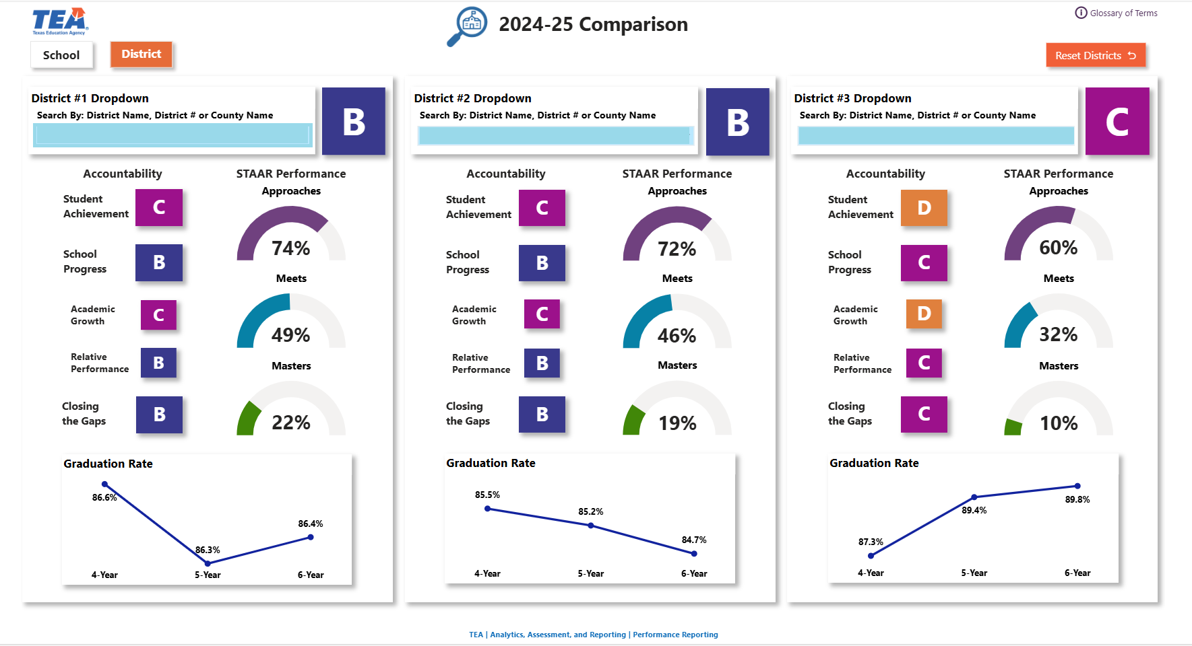
Analytics Tools on TXschools.gov
Compare tool provides side by side comparison of school or district reports
Notes:
The analytics tools on TXschools.gov provide additional and interactive views, which allow us to dig deeper into results. These are especially helpful in comparing results over time or to similar peers.
Here we can see a high level side by side comparison of 3 districts and their performance in 2025 for each of the domains, STAAR performance, and graduation rates. We are also able to quickly toggle to see profiles of each of the districts.
This can also be used to compare schools within our district

Slide 35
District Comparison
Use this space to snip a picture of the compare tool for your district
Once you are on the profile page for your district, click "Compare" on the right hand side
Use the drop down blue boxes to select three districts
You could use comparable districts (such as large urban) or nearby districts
Notes:
To compare our results, I selected us and (two other districts) You can see here...

Slide 36
Within District School Comparisons
Use this space to snip a picture of the compare tool for schools within your district
Once you are on the profile page for your one of your schools on TXschools.gov, click "Compare" on the right hand side
Use the drop down blue boxes to select three schools
Note- for smaller districts, you can use this tool with <3 schools
Notes:
Here we have three schools. Using this compare tool, we can see...

Slide 37
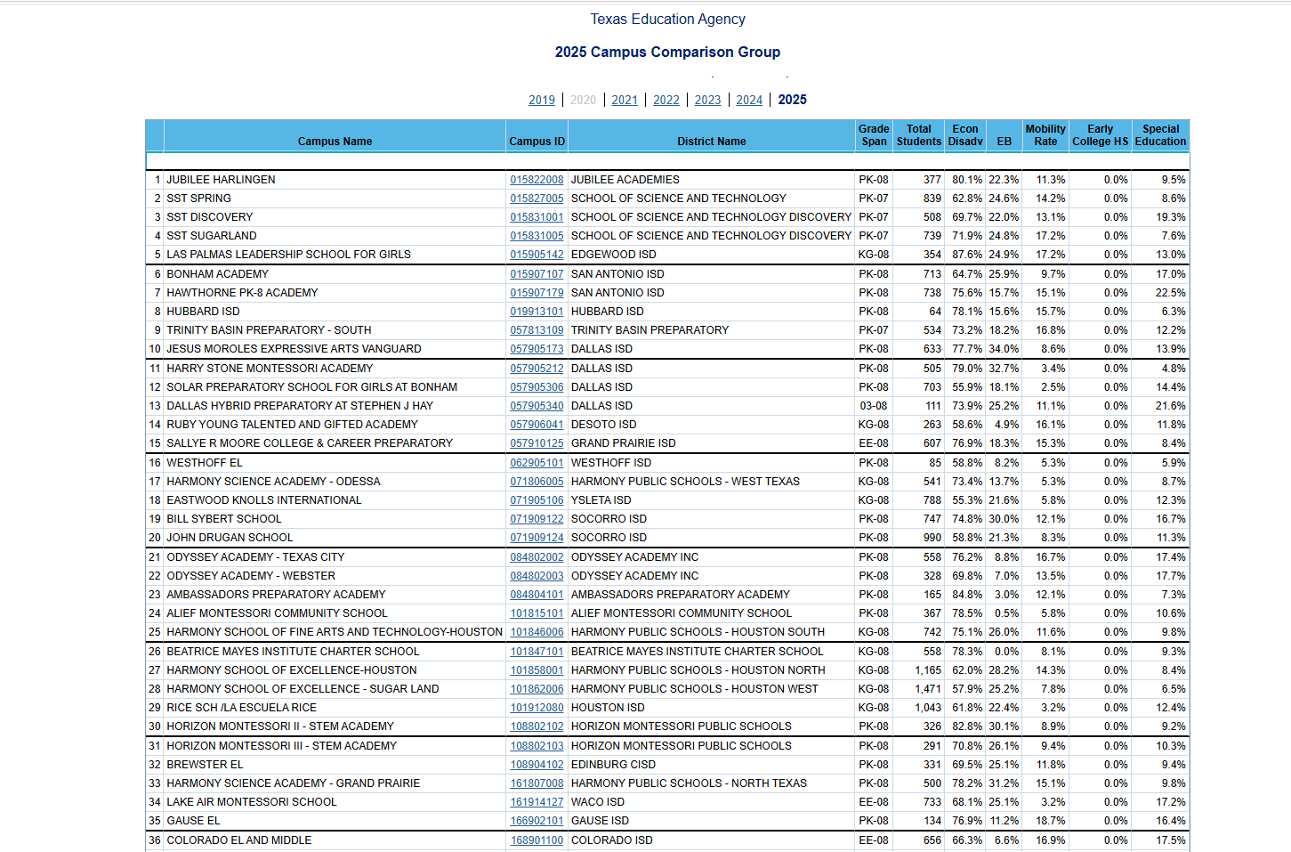

Campus Comparison Groups
Campus comparison groups are groups of schools across the state with similar demographic profiles
Schools in the top 25% on certain indicators within their campus comparison groups earn distinctions
Notes:
Each of our campuses also has a campus comparison group; which outline schools similar to each of our schools based on grade span and the percent of students that are economically disadvantaged, emerging bilinguals, highly mobile, enrolled in early college, and students served under special education. When our schools perform in the top 25% of these groups on a certain number of indicators, we are able to earn distinctions.

Slide 38
Our Campus Comparison Groups
Use this space to snip a picture of the compare tools for schools within comparison groups
Accountability Reports contains campus comparison groups. Change "report level" to see comparison groups across your district (recommend to change excel output for district reports)
Once you are on the profile page for your one of your schools on TXschools.gov, click "Compare" on the right hand side
Use the drop down blue boxes to select three schools in your campus comparison group
Notes:
We can also use the compare tool to look at performance of schools in our campus comparison groups. Here you can see our school, _________________, and then two schools in their campus comparison group.

Slide 39
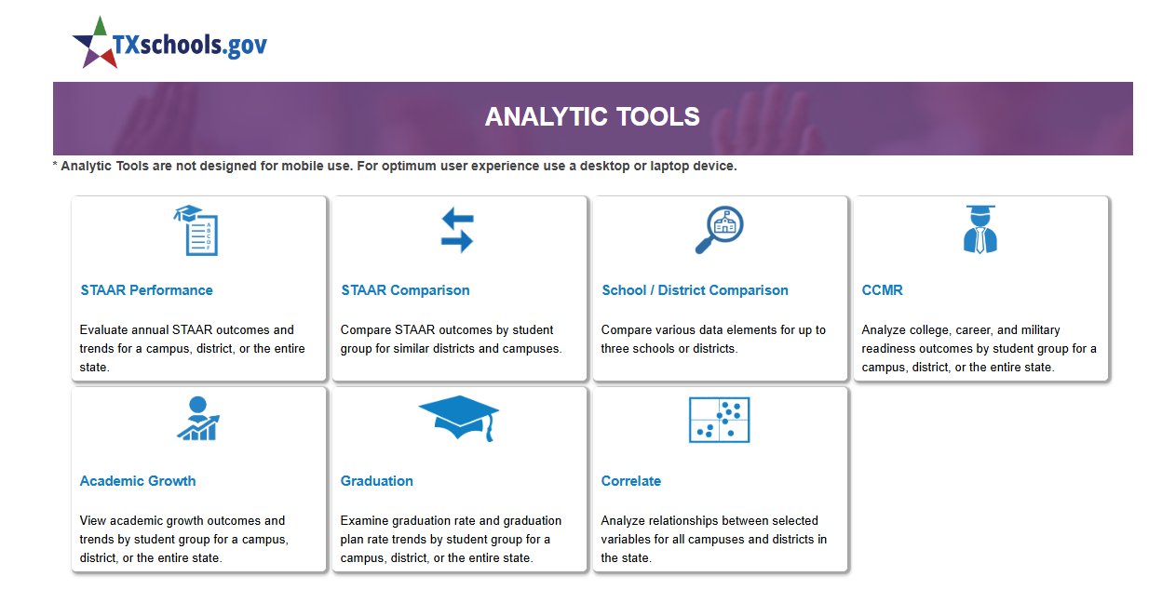
Other Analytic Tools
Notes:
By clicking on tools and reports, we can also see lots of other analytics tools that allow us to dig deeper into our performance. I encourage you to leverage these resources to gain additional insight and I will be using these in my planning. (Supts can add additional slides if you know your board is particularly interested in a specific data tool)

Slide 40
Summary, Reflection, and Next Steps

Slide 41
Overall Performance Results: 2025
Use space on this slide to summarize your overall domain scores and grades.
Then, highlight your best of domain 1, 2a, and 2b and overall rating.
Data can be found on the Overall Performance Details tab on TXschools.gov
____ out of 100
____ out of 100
____ out of 100
Better of Achievement or Progress: 70%
30%
Overall Rating
Domain ____
____ out of 100
____ out of 100
____ out of 100
Notes:
To recap, we receive a rating in three domains:
Domain 1- Student Achievement
Domain 2- School Progress and
Domain 3- Closing the Gaps
These scores are reflective of the proportional weight of each of our schools. The better score of Domain 1 or 2 accounts for 70% of our overall rating and Domain 3 accounts for 30%. Based on the 2024-2025 school year, our rating is...

Slide 42
Celebrations!

Slide 43
Questions and Clarifiers

Slide 44
Areas of Opportunity

Slide 45
Next Steps

Slide 46
Thank You

Slide 47
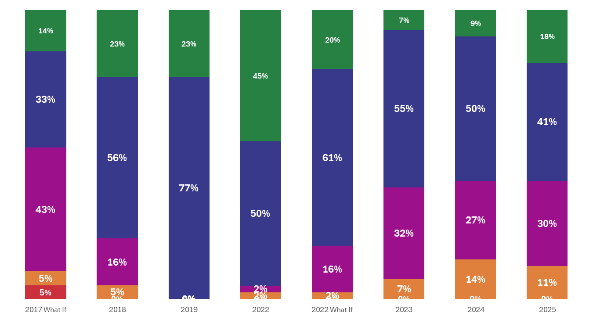
Region 1: Edinburg
A
B
C
D
F

Slide 48
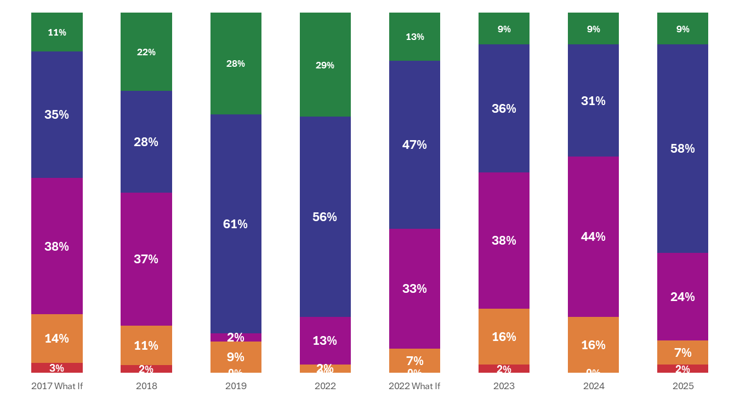
Region 2: Corpus Christi
A
B
C
D
F

Slide 49
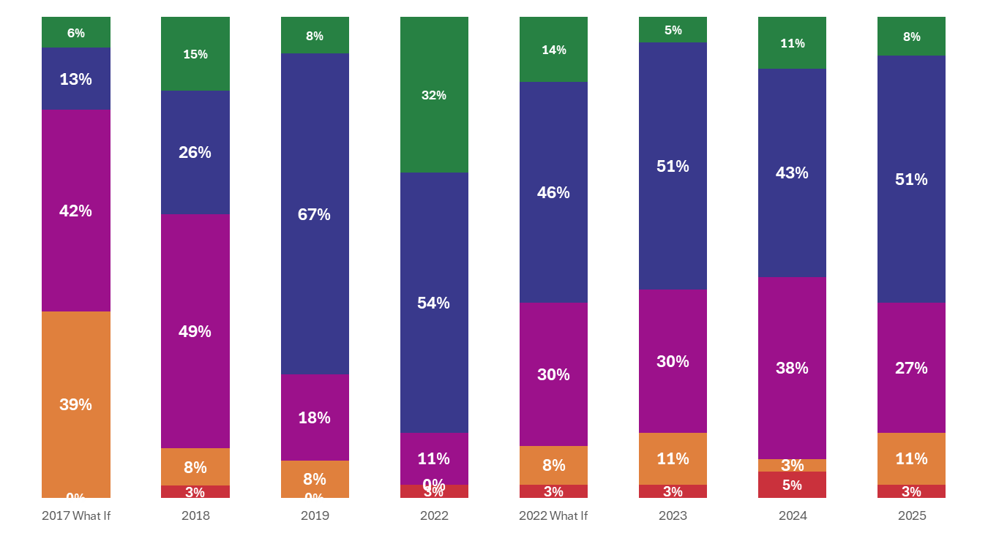
Region 3: Victoria
A
B
C
D
F

Slide 50
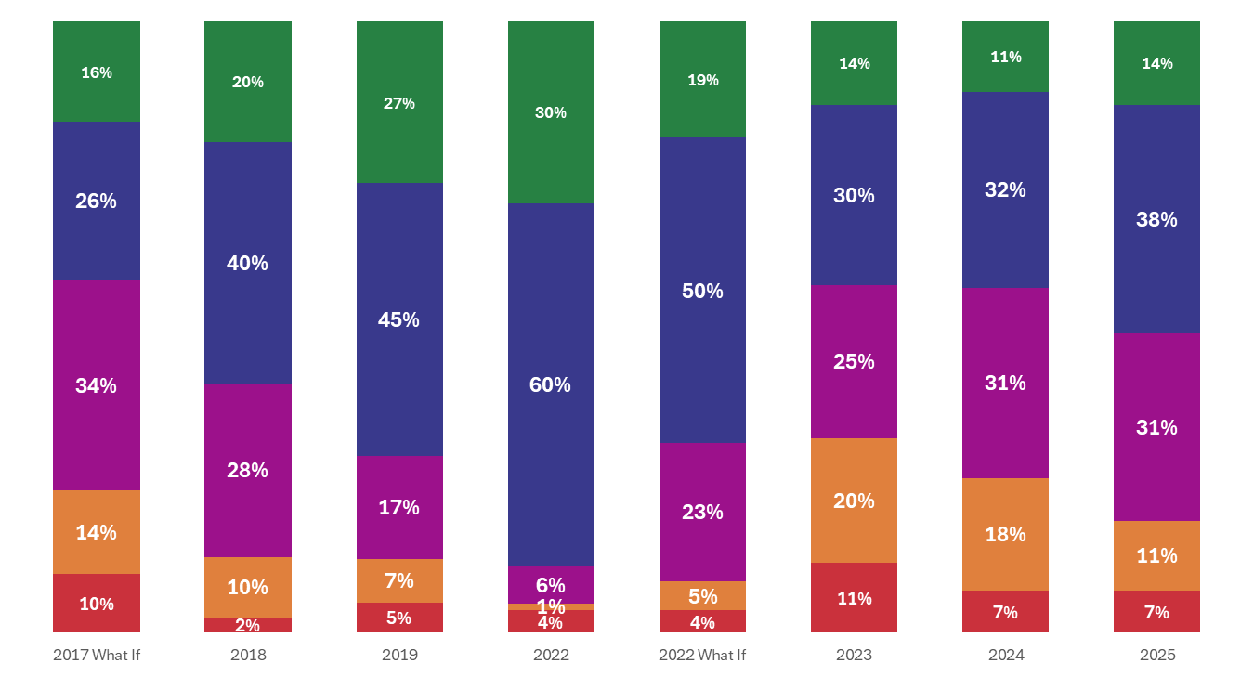
Region 4: Houston
A
B
C
D
F

Slide 51
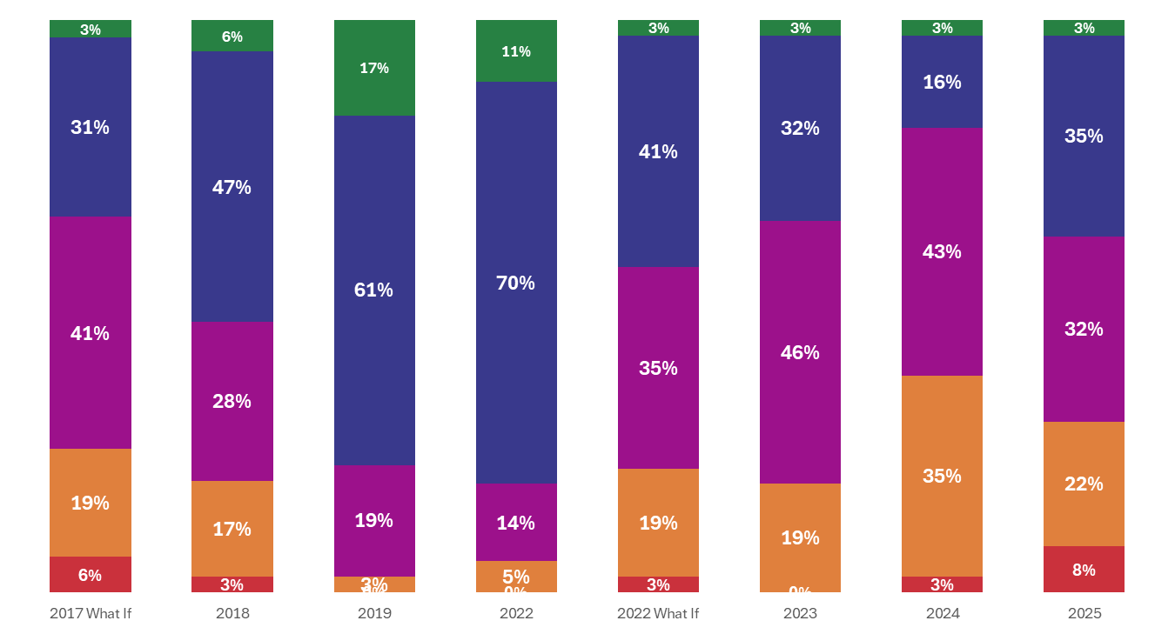
Region 5: Beaumont
A
B
C
D
F

Slide 52
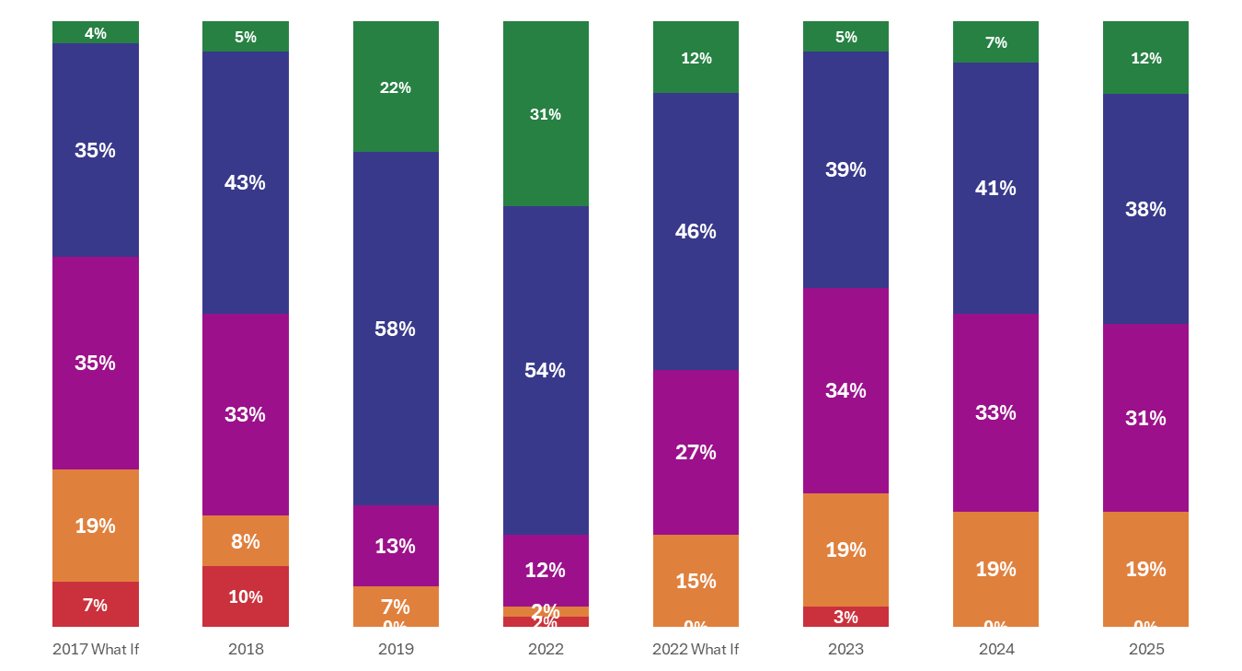
Region 6: Hunstville
A
B
C
D
F

Slide 53
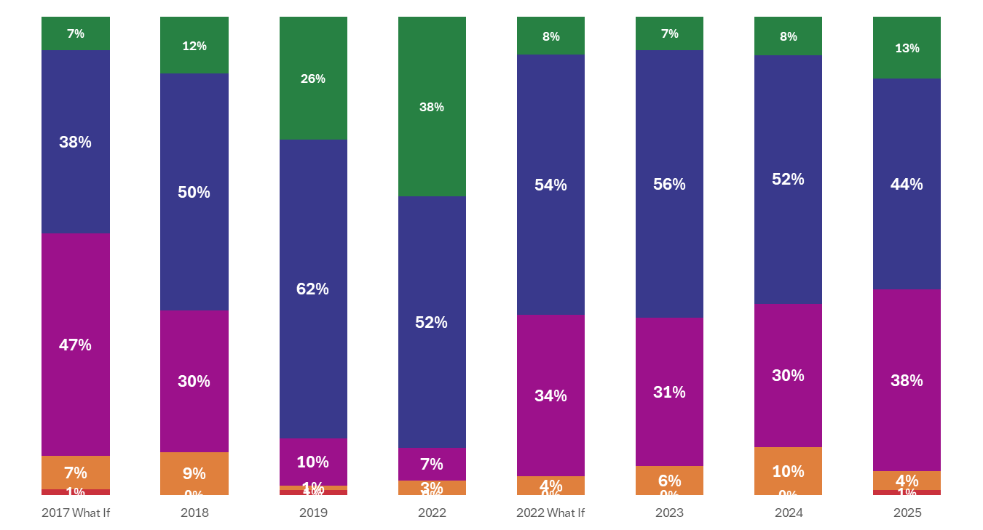
Region 7: Kilgore
A
B
C
D
F

Slide 54
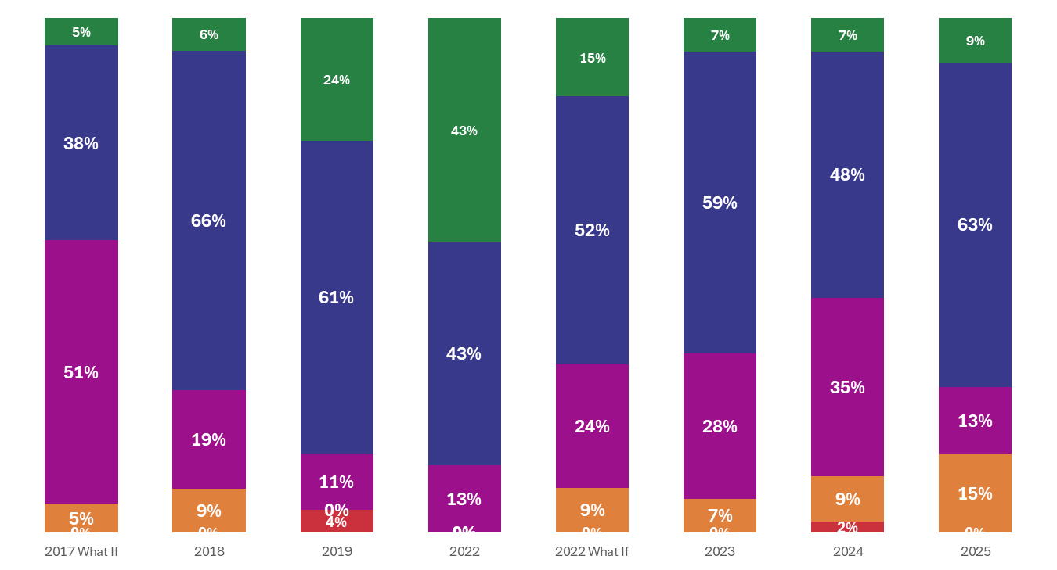
Region 8: Mt. Pleasant
A
B
C
D
F

Slide 55
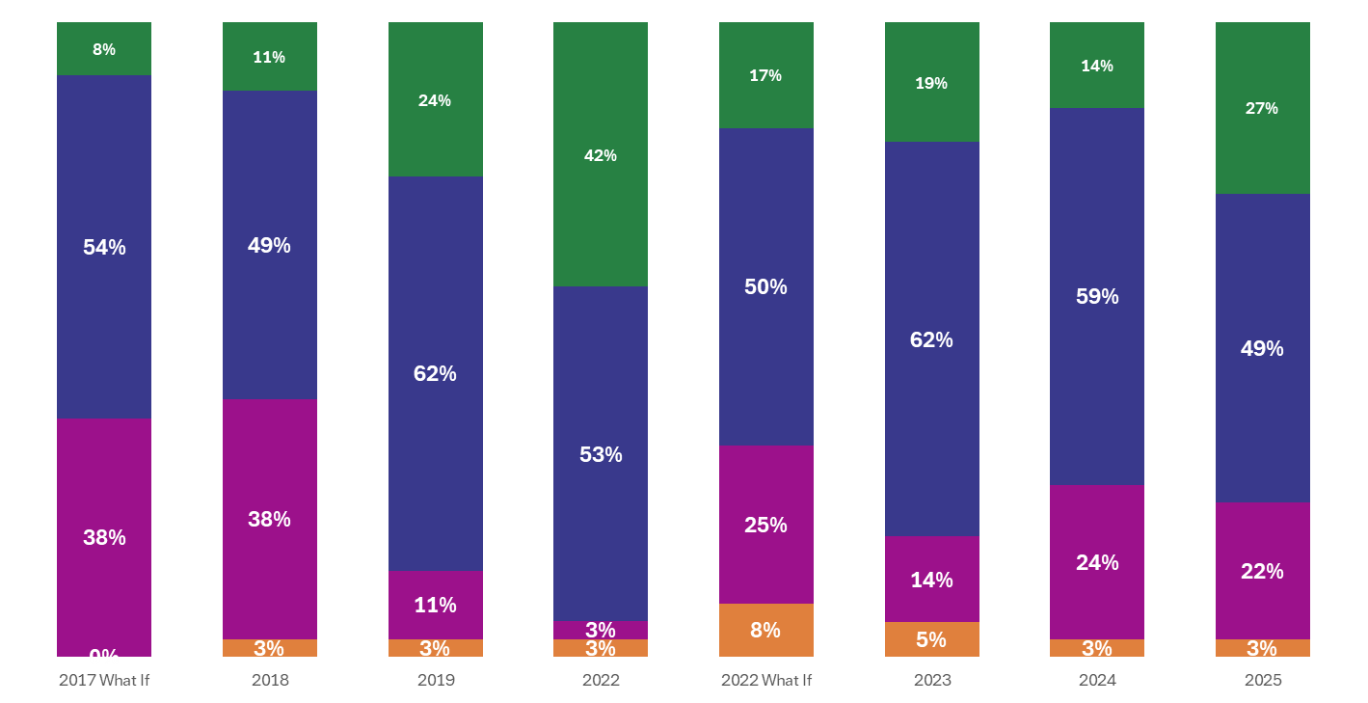
Region 9: Wichita Falls
A
B
C
D
F

Slide 56
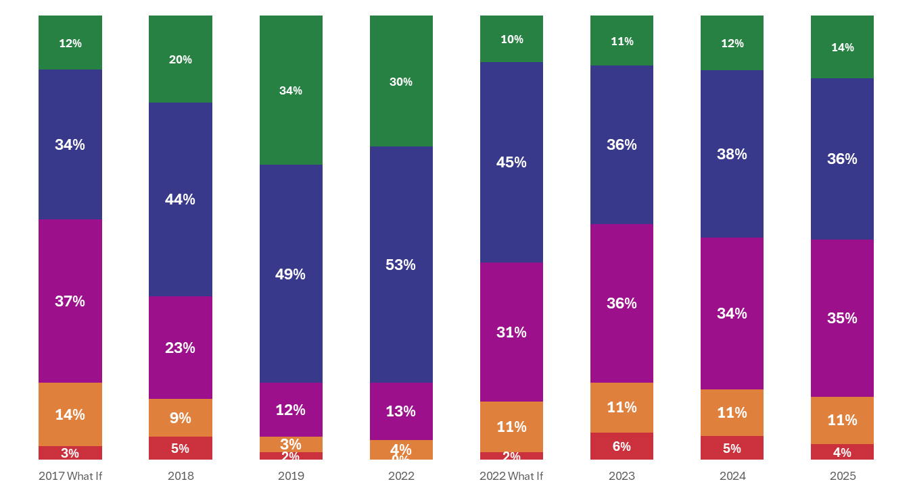
Region 10: Richardson
A
B
C
D
F

Slide 57
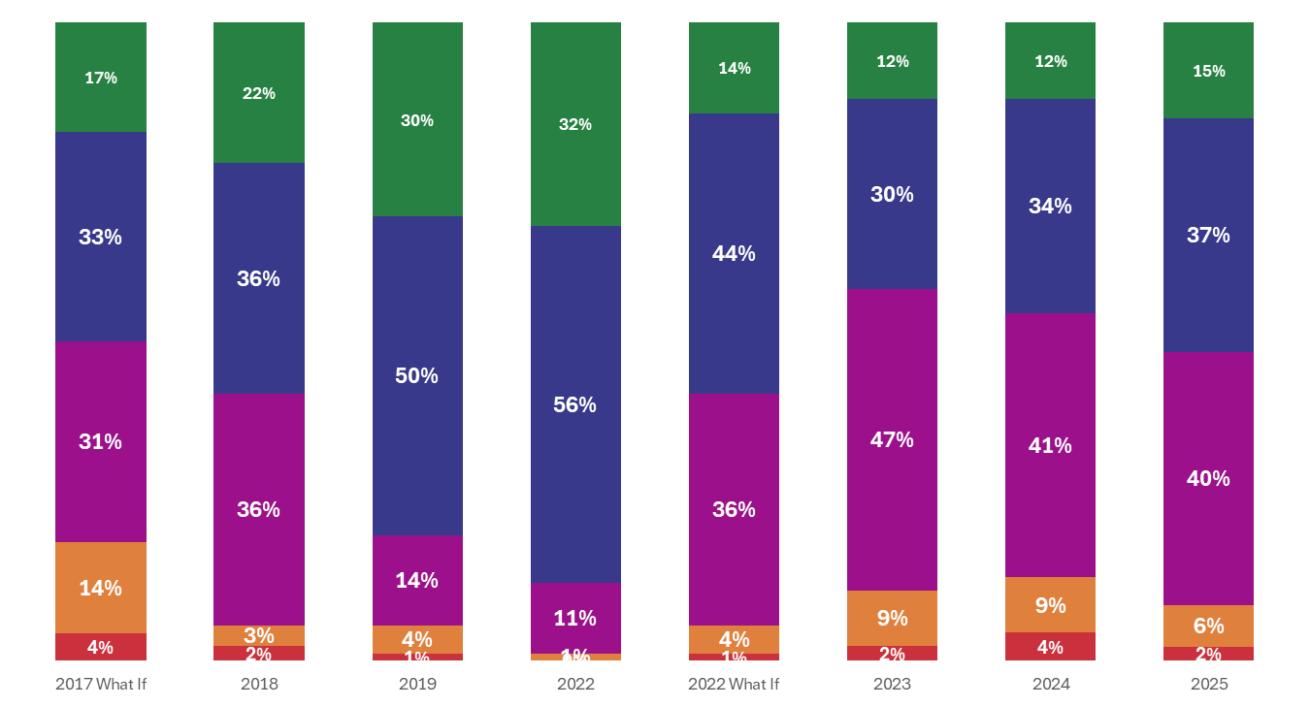
Region 11: Fort Worth
A
B
C
D
F

Slide 58
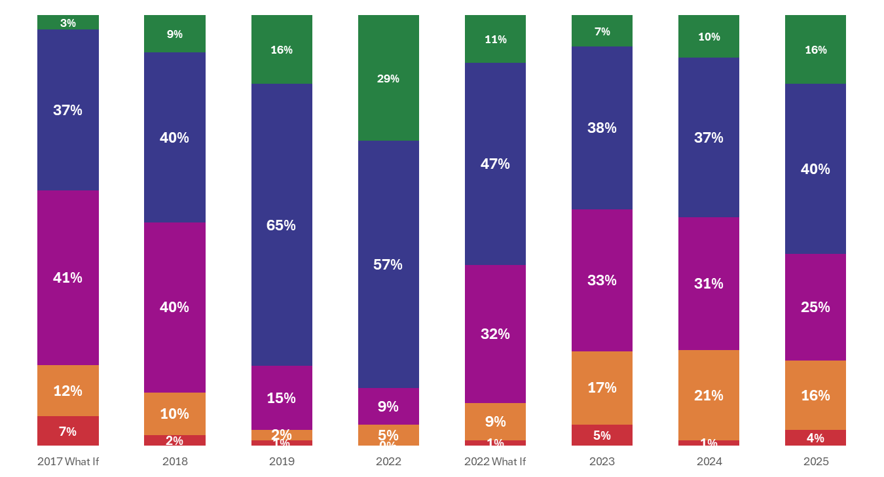
Region 12: Waco
A
B
C
D
F

Slide 59
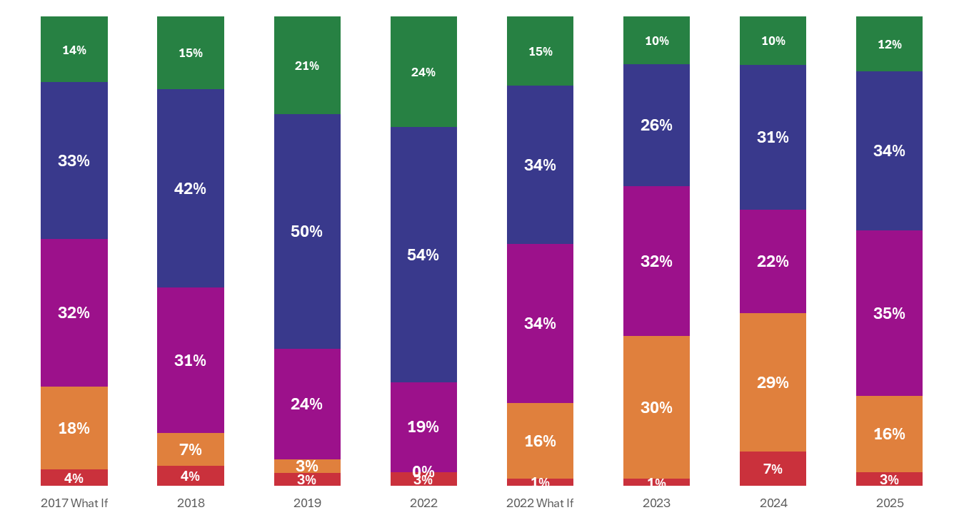
Region 13: Austin
A
B
C
D
F

Slide 60
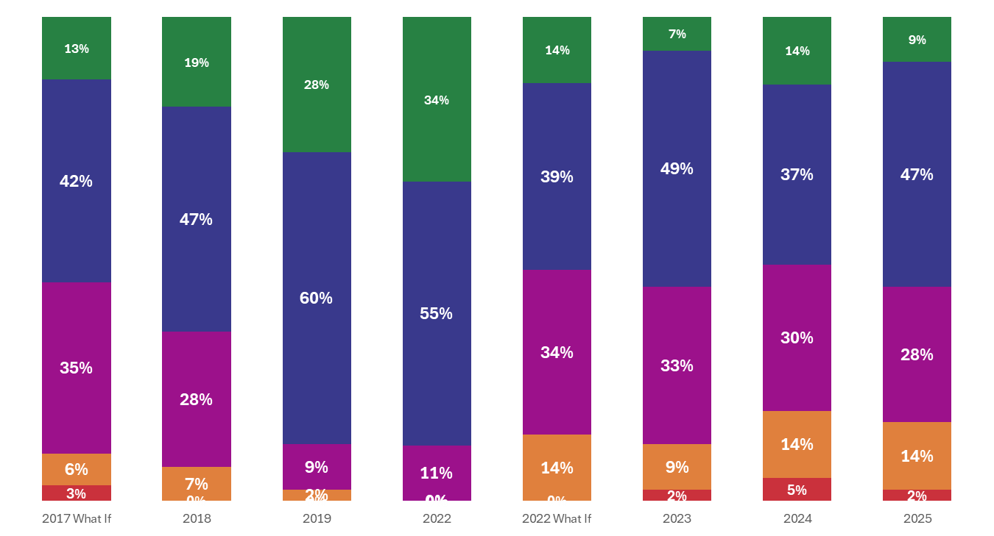
Region 14: Abilene
A
B
C
D
F

Slide 61
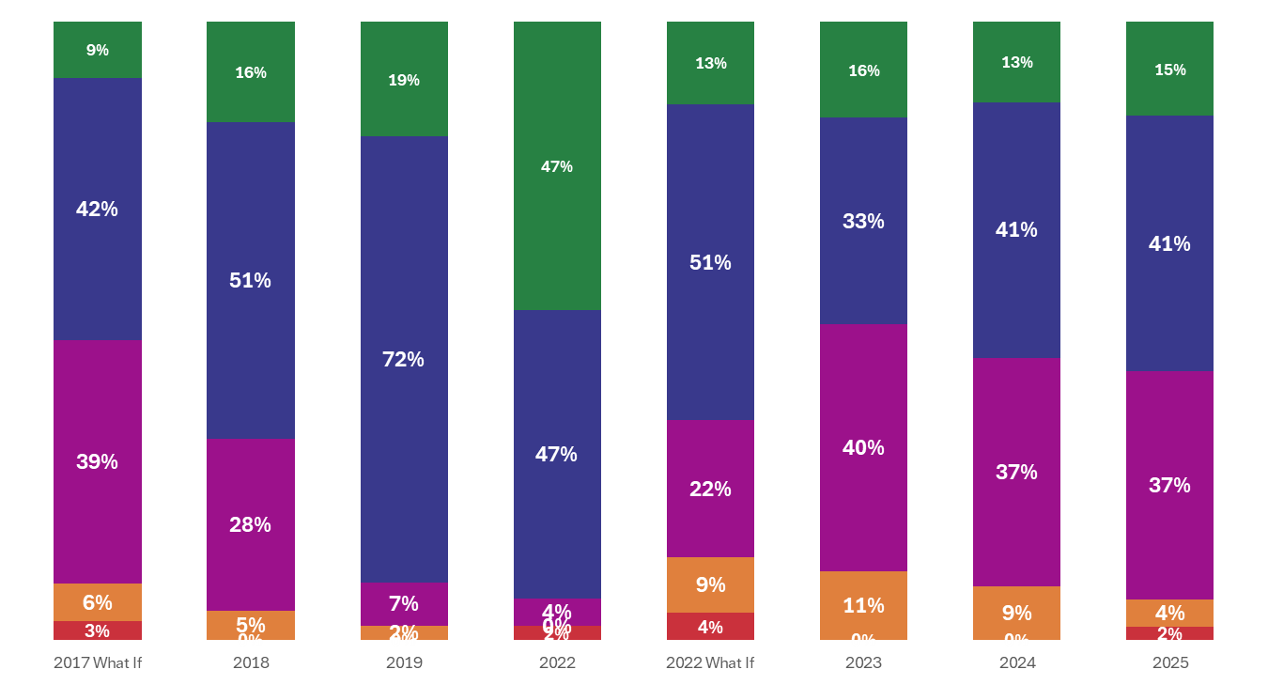
Region 15: San Angelo
A
B
C
D
F

Slide 62
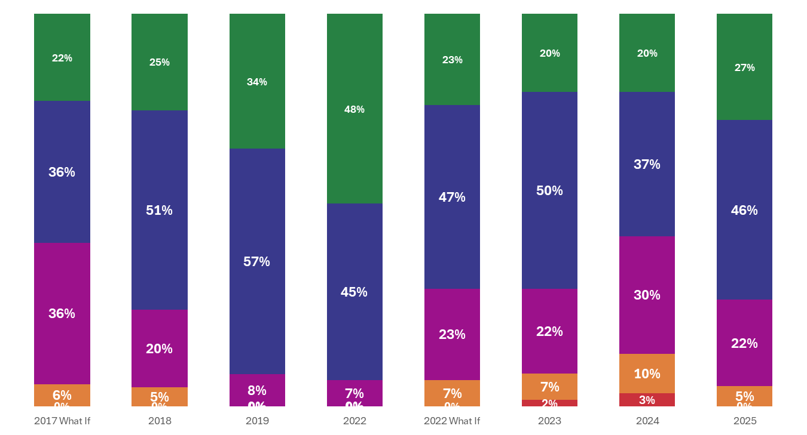
Region 16: Amarillo
A
B
C
D
F

Slide 63
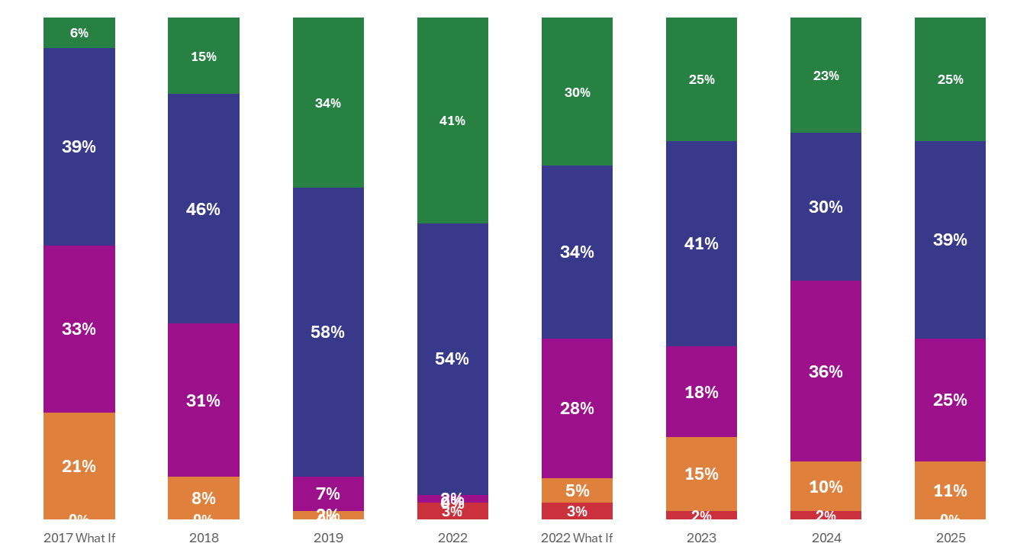
Region 17: Lubbock
A
B
C
D
F

Slide 64
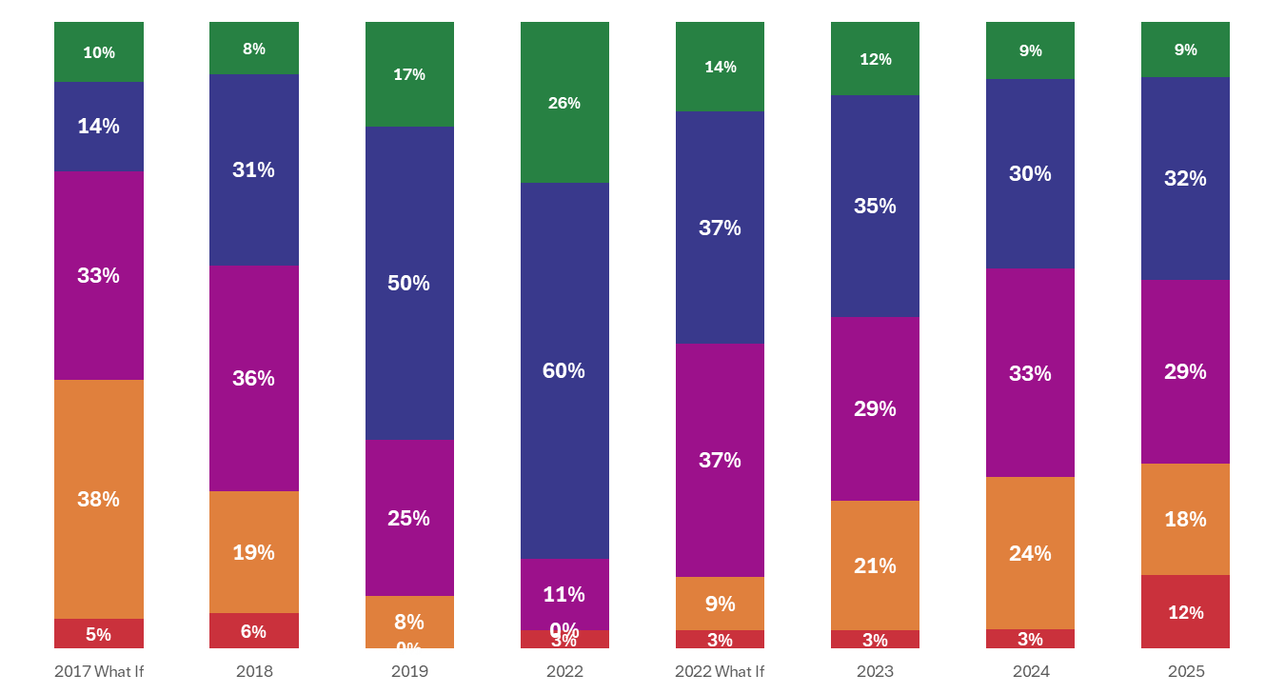
Region 18: Midland
A
B
C
D
F

Slide 65
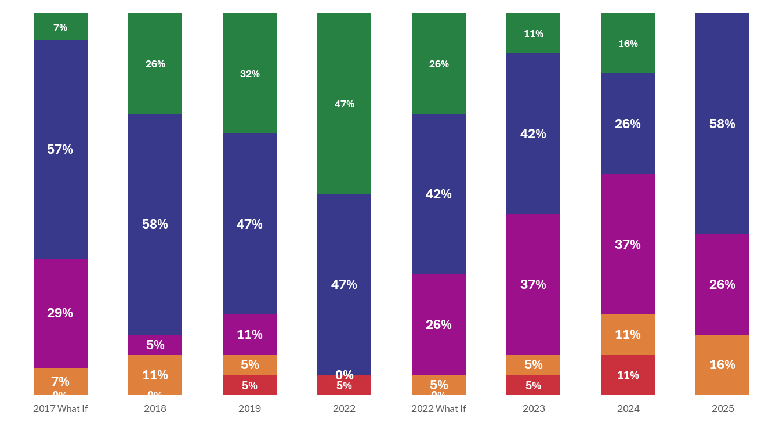
Region 19: El Paso
A
B
C
D
F

Slide 66
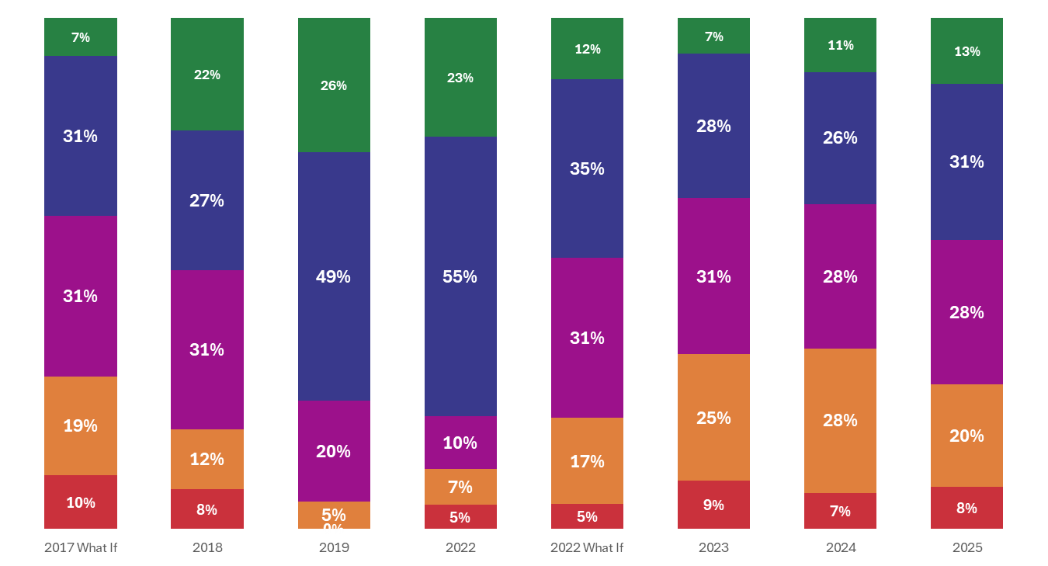
Region 20: San Antonio
A
B
C
D
F

