Slide 1
TELPAS Alternate Accessibility

Slide 2
Purpose of this TELPAS Alternate Training
Intended for assessment staff who either provide training for or administer TELPAS Alternate
Can be used by others as needed to clarify how emergent bilingual (EB) students with the most significant cognitive disabilities can access all four language domains of TELPAS Alternate
Describe how TELPAS Alternate was designed to be inclusive of a variety of communication modes in English when assessing students with significant cognitive disabilities
Explain accessibility policy for TELPAS Alternate in the domains of listening, speaking, reading, and writing

Slide 3
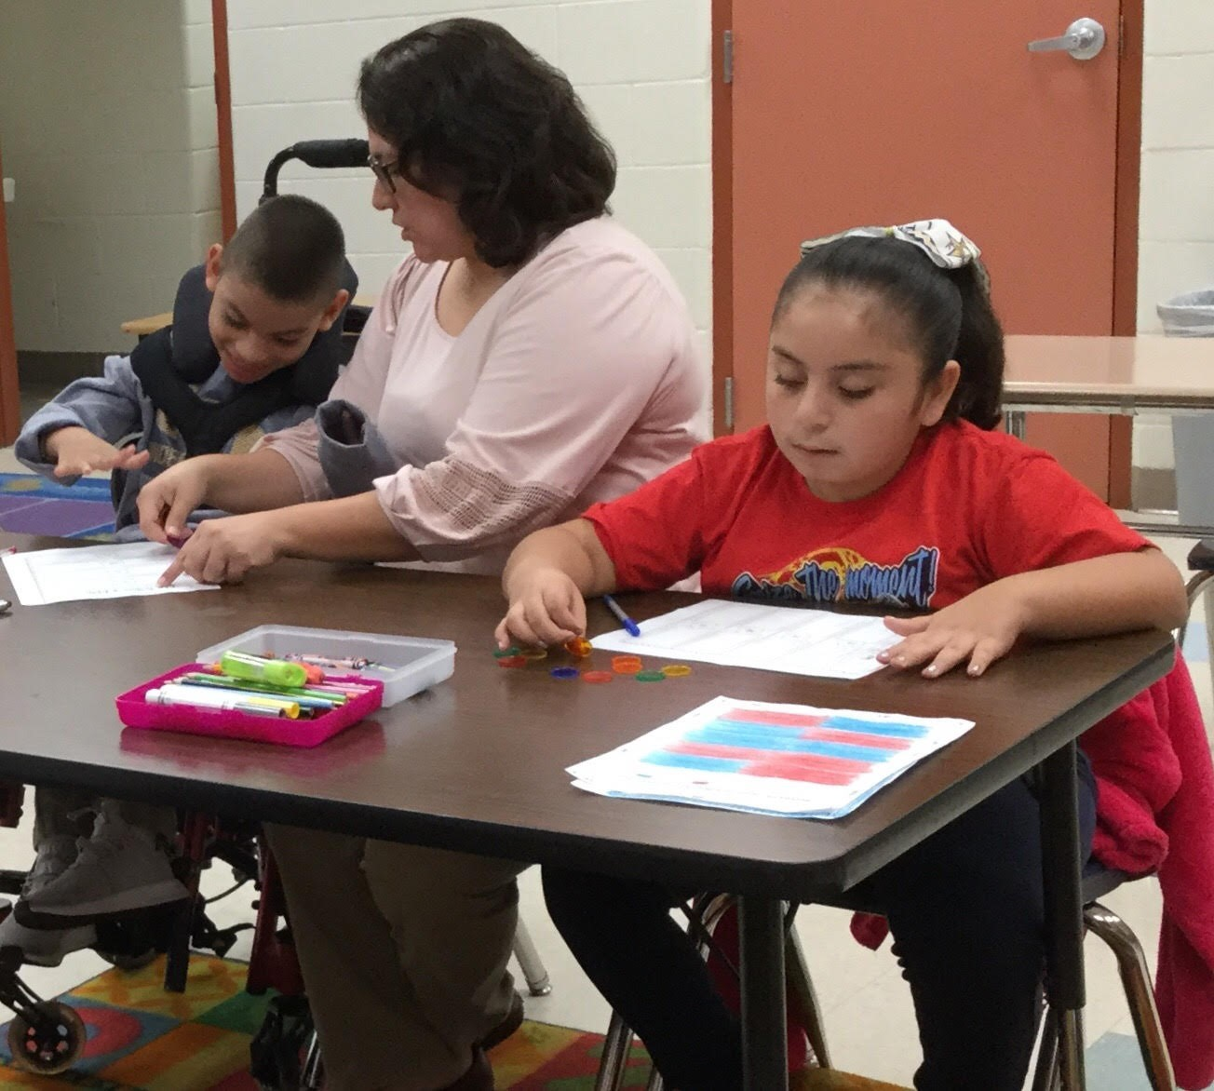
Who takes TELPAS Alternate?
Students taking TELPAS Alternate are EB students in grades 2-12 who have the most significant cognitive disabilities and who are in the process of acquiring English proficiency in listening, speaking, reading, and writing.
EB students, whose parents have declined bilingual or English as a Second Language (ESL) program services, are also required to be assessed with either TELPAS or TELPAS Alternate.

Slide 4
TEA Definition of Student with a Most Significant Cognitive Disability
A student with the most significant cognitive disability:
Exhibits significant intellectual and adaptive behavior deficits in their ability to plan, comprehend, and reason, and who also indicates adaptive behavior deficits that limit his or her ability to apply social and practical skills (e.g., personal care, social problem-solving skills, dressing, eating, using money) across all life domains.
Requires extensive, direct, individualized instruction and needs substantial supports that are neither temporary nor specific to a particular content area.

Slide 5
Language Domain Definitions
Domain | TELPAS Definition | TELPAS Alternate Definition
Listening | The ability to understand spoken language, comprehend and extract information, and follow social and instructional discourse through which information is provided. | The ability to understand spoken or signed language, comprehend and extract information, and follow social and instructional discourse through which information is provided.
Speaking | The ability to use spoken language appropriately and effectively in learning activities and social interactions. | The ability to use spoken language or alternative communication appropriately and effectively in learning activities and social interactions.
Reading | The ability to comprehend and interpret written text at the grade-appropriate level. | The ability to comprehend and interpret written text, including braille, at a modified level.
Writing | The ability to produce written text with content and format to fulfill grade-appropriate classroom assignments. | The ability to produce written text or alternative communication with content and format to fulfill classroom and community-based assignments.
The definitions of the language domains as used on TELPAS have been revised to allow for alternate forms of communication on TELPAS Alternate.

Slide 6
Accommodations
Test administrators will consider student performance described in the observable behaviors during regular classroom instruction and while students are completing instructional activities.
Students will have access to the instructional accommodations indicated in their individualized education program (IEP).
Teacher determination of English proficiency will reflect student performance in English using the same accommodations used in daily instruction.

Slide 7
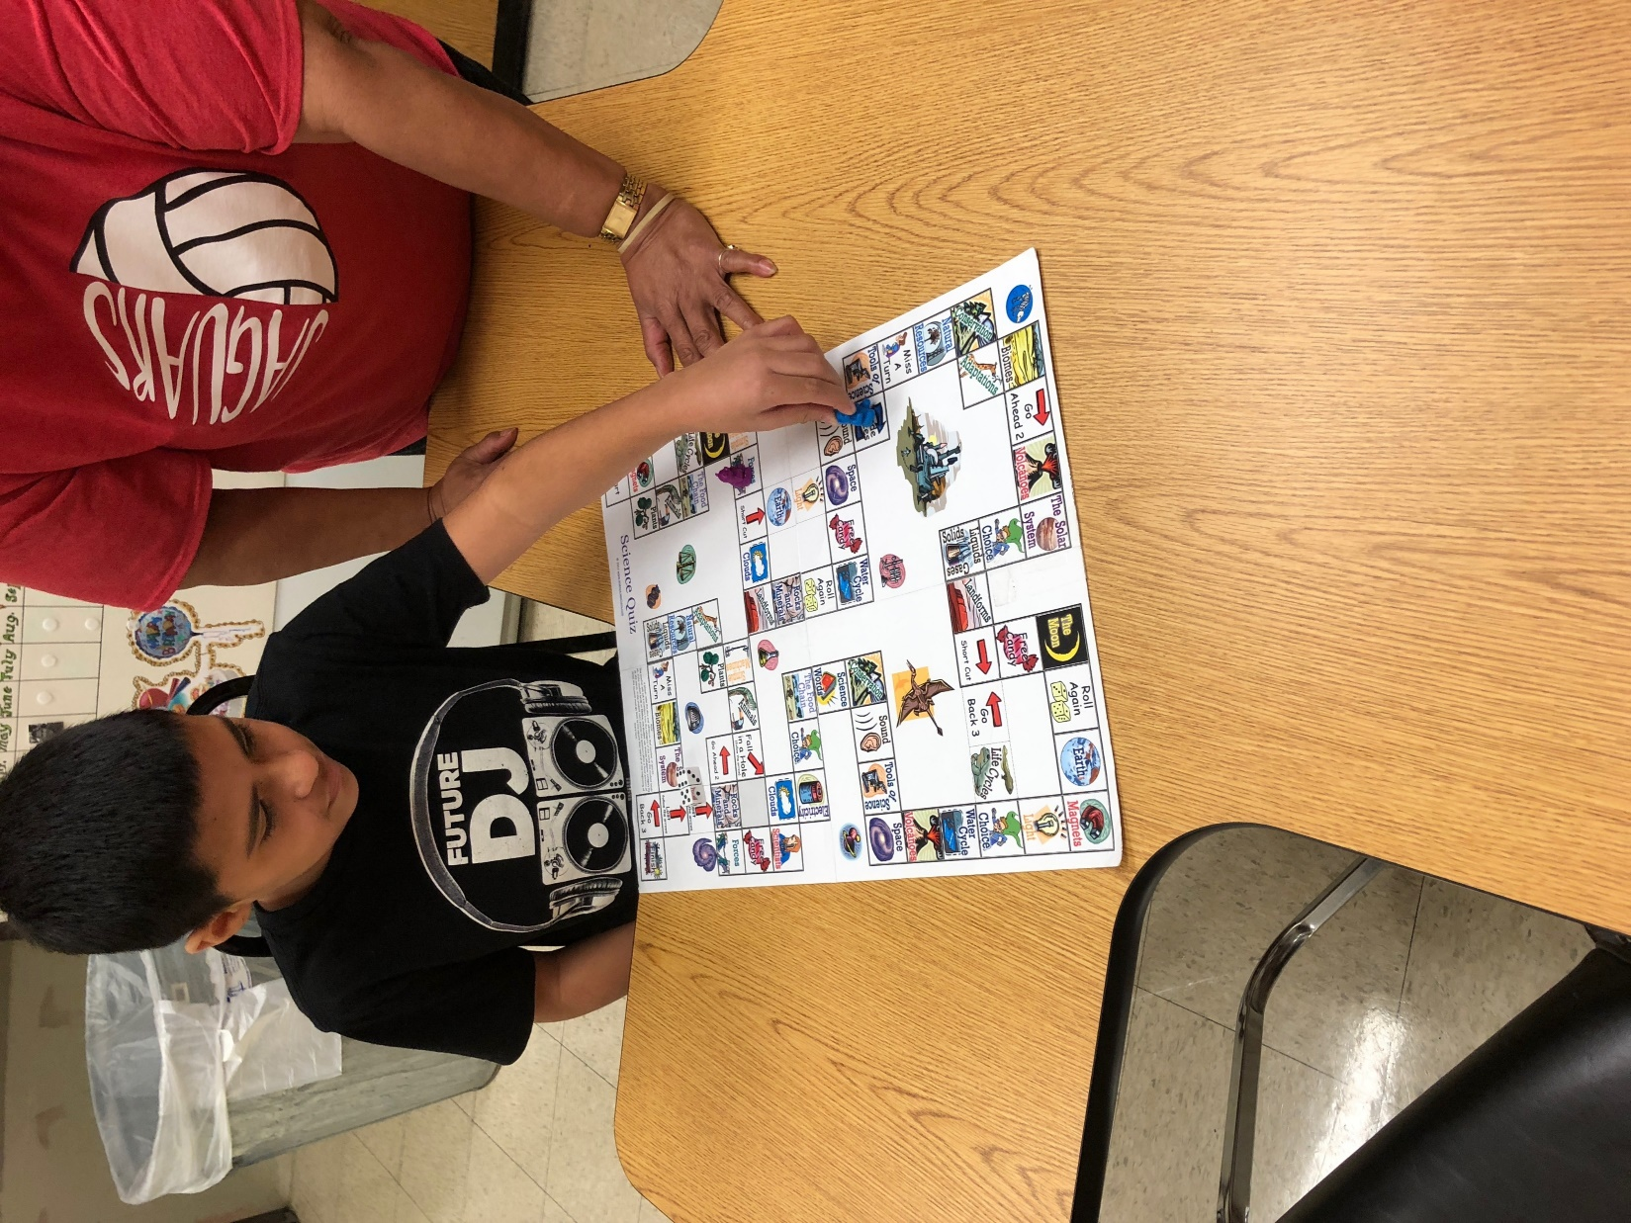
Response Modes
Some EB students may use sign language, braille, or another method of communication instead of traditional English in one or more domains.
Test administrators should allow students to use one or more alternate response modes listed on the following slides if the students regularly use the response mode(s) during instruction and in accordance with the IEP.
Alternate response modes are only intended for students who cannot listen, speak, read, or write in a traditional way. They are intended to address the communication needs of students based on their disability.

Slide 8
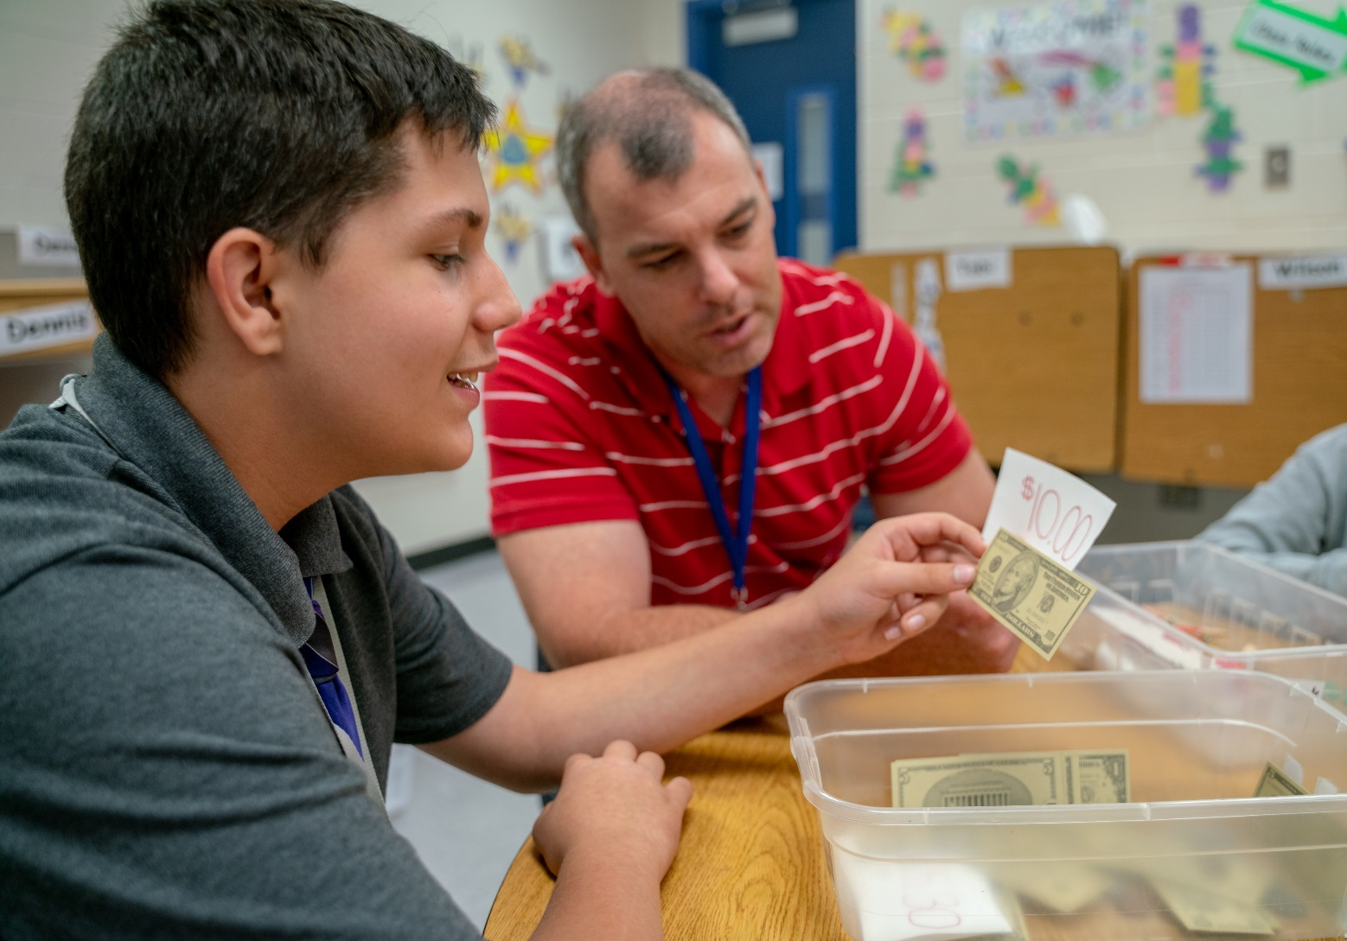
When responding to LISTENING stimulus, it is allowable for the student to…
alert to
gaze at
point to
reach for
touch or pick up
draw
circle
nod
gesture toward the targeted stimulus

Slide 9
Listening Response Modes Example
At the beginning of a unit on personal finance, students watch a short video explaining how people make deposits to their bank accounts. After the video, Mr. Forsh asks the students to tell what happened in the video.
One student gazes at a picture of a customer walking into a bank.
Two students draw a picture showing what happened at the beginning and the end of the video.
One student picks up two picture cards in order to show what happened first and next in the video.

Slide 10
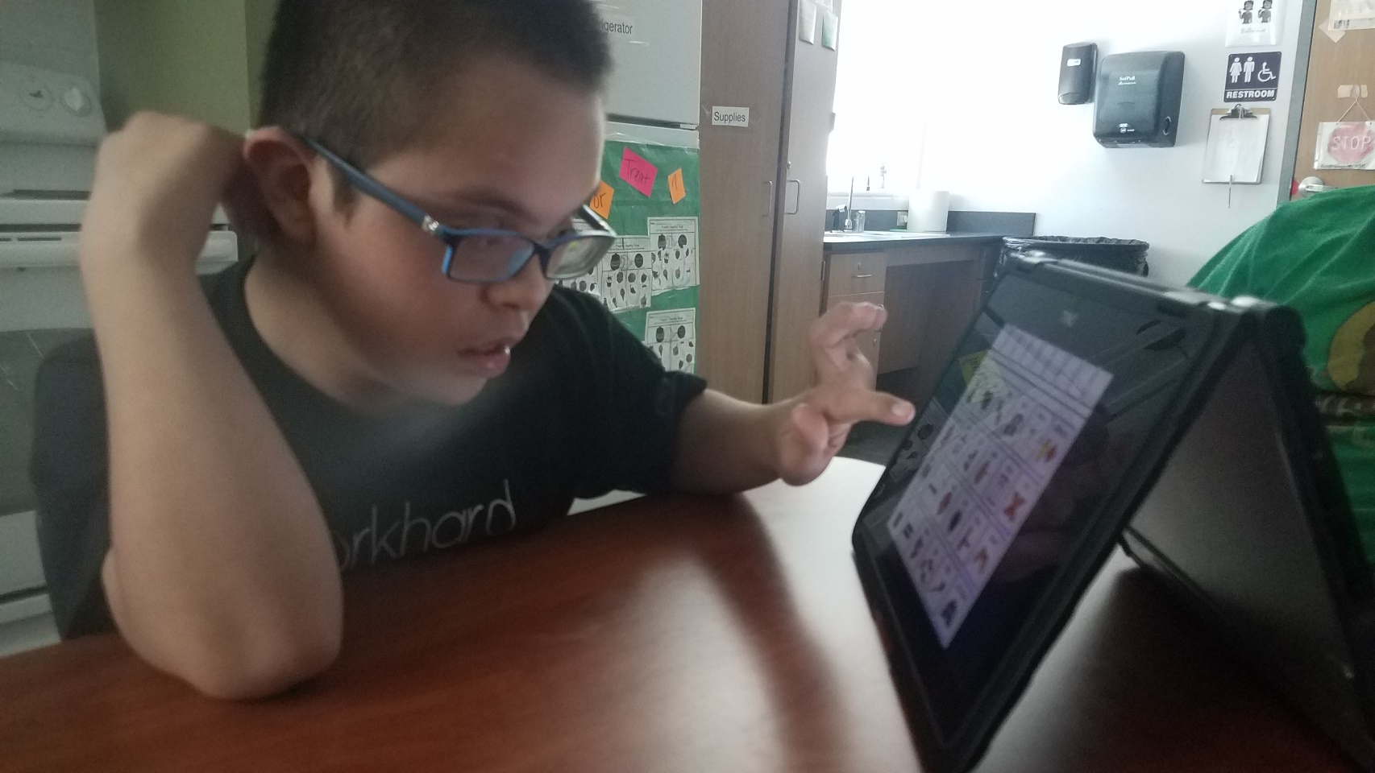
When responding to SPEAKING stimulus, it is allowable for the student to…
verbalize (i.e., speak)
form responses with the assistance of a communication device with preprogrammed familiar vocabulary or programmed student vocabulary
sign responses

Slide 11
Speaking Response Modes Example
A science teacher is conducting a lesson about planets. Mrs. Dean reviews important vocabulary using picture/word cards. She asks students to tell two things that describe planets.
One student responds by using sign language.
Two students respond by using communication devices.
Two students verbalize their response in English.

Slide 12
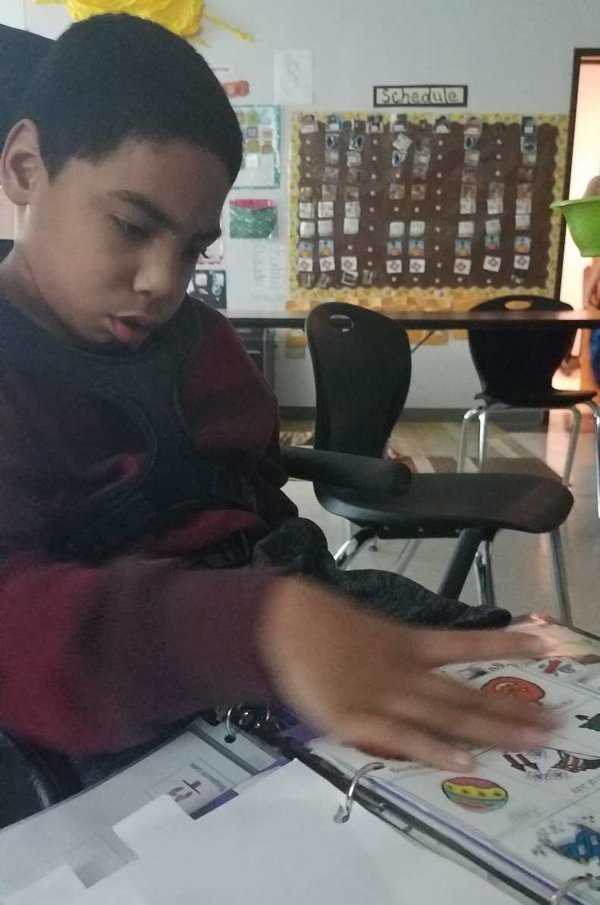
When responding to READING stimulus, it is allowable for the student to…
read
alert to
gaze at
point to
reach for
touch or pick up
draw
circle
nod
gesture toward the targeted stimulus
verbalize or sign by responding to letters, words, or numbers to form a response when a wide range of manipulatives are available
arrange letters, words, or numbers to form responses when a wide range of manipulatives are available
form responses with the assistance of a communication device with preprogrammed familiar vocabulary or programmed student vocabulary
indicate yes or no when presented with three or more choices and being asked, “Is this the ___?”

Slide 13
Reading Response Modes Example
Students in Mr. Jay’s class are reading an adapted story about a girl who wants to grow up to be a soccer player. One student with a visual impairment is reading his story with texture-supported text. When everyone is finished reading, the teacher asks the class to determine the problem in the story.
One student responds by verbally identifying the problem.
Two students use word or picture cards to identify the problem.
Another student points to pictures in the story she was reading to identify the problem.
One student gazes at a picture card of the problem.

Slide 14
When responding to WRITING stimulus, it is allowable for the student to…
write
alert to
gaze at
point to
reach for
touch or pick up
draw
circle
nod
gesture toward the targeted stimulus
use adaptive writing equipment (typing, keyboarding)
arrange letters, words, or numbers to form a response when a wide range of manipulatives are available

Slide 15
Writing Response Modes Example
Ms. McDermott is teaching her students to write more descriptively. She models writing a description of an object and the class creates a word bank of descriptive language they can use in their writing. Then the teacher asks the students to describe a new object.
Two students use a keyboard to type a description at the computer.
One student writes in a notebook with a pencil.
One student chooses some word/picture cards to describe the object.
One student points to the best of two examples of a description.

Slide 16
Augmentative and Alternative Communication
Augmentative and Alternative Communication: a means other than traditional spoken or written communication by which a student can share a message with others.
Allowable examples include but are not limited to:
gestures
facial expressions
picture cards
picture boards
sign language
speech generating devices
switch-based output devices
real objects

Slide 17
Prompting Versus Leading
Prompting is an action intended to initiate or continue a task that the student is being requested to complete. A prompt pulls the student through each step to the end of the task.
Leading is asking the student to respond in a specific way or with a specific answer. Leading is NOT allowed.
Prompting is allowed for rating the Observable Behaviors on the TELPAS Alternate assessment.
The purpose of TELPAS Alternate is to accurately measure a student’s ability to understand and use English to engage in social and academic learning environments.
Prompting a student to respond to a task so that his or her ability to understand or use English can be accurately measured is acceptable.

Slide 18
Examples of Allowable Prompting
Questions such as “What do you think comes next?”
Reminders such as “Keep on working until you have finished.”
Indicating such as
pointing to an object when a student loses eye contact to bring him or her back on task
pointing to a place in the text when the student becomes distracted to continue focus on the task
Proximity control such as
touching a student’s arm to remind him or her to activate a switch
touching a student’s shoulder to continue eye contact with the teacher or object to be viewed

Slide 19
Examples of Non-Allowable Leading
The teacher or student uses the student’s native language.
Exact directions such as, “Look at each word in the sentence. Find the name of the person. Mark the first letter in each name. Replace the letter with a capital letter.”
Due to limitations in mobility, some students may need assistance with physical access to a task as part of the supports. In these instances, the physical assistance can only help the student access the stimuli. The assistance cannot result in the teacher performing the task.
The teacher provides a hand-to-hand manipulation of the student to actually control motor movements, thus performing the task for the student.
Placing the student’s hand on a pre-programmed switch.
Pointing to the character in the story before the student can identify the character in the story.

Slide 20
Available TELPAS Alternate Training PowerPoints
Introduction to TELPAS Alternate
Student Eligibility
Speaking Domain
Listening Domain
Reading Domain
Writing Domain
Accessibility
Test Administration

Slide 21
Contact Information
TEA’s Student Assessment Division
512-463-9536
Help Desk
Helpdesk.tea.texas.gov
Texas Testing Support
833-601-8821
TexasTestingSupport@cambiumassessment.com

Slide 22
Disclaimer
These slides have been prepared by the Student Assessment Division of the Texas Education Agency. You are encouraged to use them for local training.
If any of the slides are changed for local use, please hide or remove any TEA logos, headers, or footers. (You may need to edit the Master slide.) In addition, you must remove the photographs. Only TEA has parental permission to use these photographs for training purposes.
This training is not intended to replace any materials or additional information on the TEA website.

