Slide 1
TELPAS Alternate Student Eligibility

Slide 2
Purpose of this TELPAS Alternate Training
Intended for members of ARD and LPAC committees who make decisions about student eligibility for state assessments
Can be used by others as needed to clarify different aspects of this testing program
Describes the specialized population of emergent bilingual (EB) students in grades 2-12 who will be assessed with TELPAS Alternate
Explains the eligibility criteria for student participation in TELPAS Alternate

Slide 3
TELPAS Alternate
The Every Student Succeeds Act (ESSA) requires each state to administer an alternate English language proficiency (ELP) assessment for EB students with the most significant cognitive disabilities who cannot participate in the general ELP assessment, even with allowable accommodations.
The Texas Education Agency (TEA) worked with stakeholders to develop the TELPAS Alternate to evaluate grades 2-12 students receiving special education services identified in the Public Education Information Management System (PEIMS) as an EB student and also identified with a most significant cognitive disability.

Slide 4
Who will be assessed with TELPAS Alternate?
Grades K–1 | No TELPAS Alternate for K-1. All EB students, including students receiving special education services, will take TELPAS K-1 holistically rated assessment for all four language domains.
Grade 2 | Participation requirements are available on TEA’s TELPAS Alternate Resources webpage. ARD committees, in conjunction with the LPAC, are required to review the participation requirements and determine and document student eligibility for TELPAS Alternate.
Grades 3–12 | Participation requirements are available on TEA’s TELPAS Alternate Resources webpage. ARD committees, in conjunction with the LPAC, are required to determine and document student eligibility for TELPAS Alternate. If the student is EB/EL and is eligible for STAAR Alternate 2, he or she will take TELPAS Alternate.

Slide 5
TELPAS Alternate Participation Requirements
Participation requirements (in English and Spanish) for grades 2–12 are available on TEA’s TELPAS Alternate Resources webpage and have been created to determine an EB student’s eligibility for TELPAS Alternate.
Participation requirements are intended to guide the ARD committee, in conjunction with the LPAC, when determining the appropriate English language proficiency assessment to administer to EB students.
Documentation of eligibility is different for students in grade 2 compared to students in grades 3–12.

Slide 6
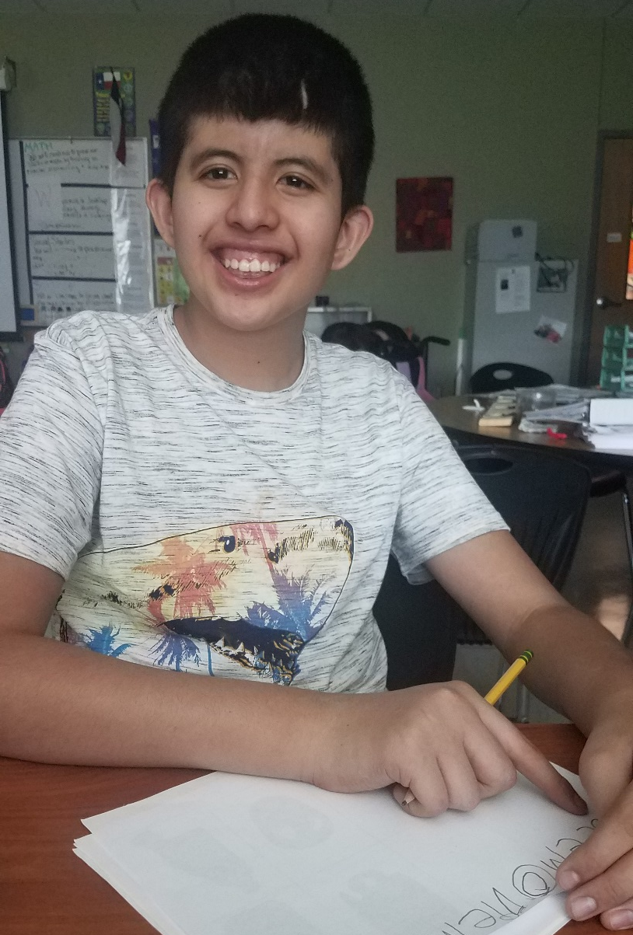
TELPAS Alternate Participation Requirements: Grades 3-12
For grades 3–12, a student must be an EB student and be eligible for STAAR Alternate 2 to take TELPAS Alternate.
Once the ARD committee has determined the EB student is eligible for STAAR Alternate 2, the LPAC will answer question 1: “Is the student identified in PEIMS as EB/EL?”, initial the assurances in Step II, and answer "Yes" in question 6.
For an EB student in high school who has completed testing requirements, documentation that the student was previously assessed with STAAR Alternate 2 and completion of the TELPAS Alternate Participation Requirements, answering Question 1, initial the assurances in Step II, and answer "Yes" in question 6.
The LPAC should document the assessments that the student will take in the permanent record file.

Slide 7
TELPAS Alternate Participation Requirements: Grade 2
For grade 2, the TELPAS Alternate Participation Requirements must be reviewed by the ARD committee in conjunction with the LPAC.
Once a determination has been made, the decision must be documented.
The assessment decision and participation requirements should be documented in the IEP.
The assessment decision should be documented in the student’s permanent record file using TEA’s LPAC Documentation Forms or a district-created form that captures the same information.
The student must meet all the eligibility criteria
to be eligible to participate in TELPAS Alternate.
All YES answers require justification based on
evaluation information.
If the answer to any question is NO, the
student will take TELPAS.
The next several slides take you through the full participation requirements.

Slide 8
Background and Instructions
Prior to reviewing the participation requirements for the TELPAS Alternate, the ARD committee, in conjunction with the LPAC, must understand all assessment options, including the characteristics of each assessment. TELPAS Alternate is a statewide assessment that may only be considered for EB students with the most significant cognitive disabilities.
A student with the most significant cognitive disability is a student who exhibits significant intellectual and adaptive behavior deficits in their ability to plan, comprehend, and reason, and who also indicates adaptive behavior deficits that limit his or her ability to apply social and practical skills (e.g., personal care, social problem-solving skills, dressing, eating, using money) across all life domains. The student requires extensive, direct, individualized instruction and needs substantial supports that are neither temporary nor specific to a particular content area.

Slide 9
Background and Instructions (continued)
If TELPAS Alternate is being considered, the ARD committee, in conjunction with the LPAC, must review these participation requirements against the supporting documentation within the individualized education program (IEP), such as in the present levels of academic achievement and functional performance (PLAAFP), to determine eligibility.
If it is determined that the student meets the participation requirements for TELPAS Alternate, this form and supporting IEP documentation may serve as the required IEP statement under 19 Texas Administrative Code (TAC) 89.1055(b) and must be available for review during cyclical and targeted monitoring.
TELPAS Alternate is only available for students in grades 2-12.

Slide 10
STEP I: Determine if the Student Meets the Participation Requirements – Question 1
1. Is the student identified in PEIMS as EB/EL? | Yes or No
Only students who have been identified in the Public Education Information Management System EB/EL are required to take an English language proficiency assessment (i.e., TELPAS or TELPAS Alternate).
This includes students whose parents have declined bilingual or English as a Second Language (ESL) program services.
If No is marked, the ARD committee should stop here. The student does not meet the participation requirements for TELPAS Alternate.
Note: Question 1 requires a response for EB students in grades 2-12.

Slide 11
Specific Instructions Based on Student’s Enrolled Grade
If the student is identified as an EB student, there are specific instructions based on the student’s enrolled grade.
Grade 2 | For EB students in grade 2, review questions 2–5 and mark Yes or No. If Yes is marked, provide a justification containing evidence that the student meets the criterion. If No is marked for any question below, stop. The student does not meet the participation requirements for TELPAS Alternate and must take TELPAS.
Grades 3–12 | For EB students in grades 3–12, if the ARD committee has followed the state guidelines and determined that the student will participate in the STAAR Alternate 2, the EB student must also take TELPAS Alternate. The STAAR Alternate 2 participation requirements satisfy the remaining participation requirements for these students; therefore, questions 2–5 do not need to be answered.

Slide 12
STEP I: Determine if the Student Meets the Participation Requirements – Question 2
2. Does the student have the most significant cognitive disability? | Yes or No
A determination of the most significant cognitive disability is made by the ARD committee and must be based on the student’s most recent full and individual evaluation (FIE). Results from the FIE must indicate a deficit in the student’s ability to plan, comprehend, and reason.
FIE results must also indicate adaptive behavior deficits that limit a student’s ability to apply social and practical skills such as personal care, social problem-solving skills, dressing, eating, using money, and other functional skills across all life domains.
Reminder: Questions 2-5 only need to be answered for EB students in grade 2.

Slide 13
STEP I: Determine if the Student Meets the Participation Requirements – Question 2 (continued)
A student does not meet the eligibility criteria as a student with the most significant cognitive disability per 34 Code of Federal Regulations (CFR) §300.8(c) if the student meets eligibility criteria for special education and related services due to:
a specific learning disability (SLD), or
a speech impairment (SI) that is the ONLY disability designation.
The ARD committee must enter a justification, which must include data from the EB student’s FIE as evidenced by intellectual and adaptive evaluation information.
Reminder: Questions 2-5 only need to be answered for EB students in grade 2.

Slide 14
STEP I: Determine if the Student Meets the Participation Requirements – Question 3
3. Does the student require ongoing, individualized, specialized supports to access the enrolled grade-level curriculum and environment? | Yes or No
Federal regulations mandate that all students have access to grade-level curriculum. A student with the most significant cognitive disability requires extensive, repeated, specialized supports and materials beyond the support typical peers require. The student uses substantially modified materials to access information in alternate ways to acquire, maintain, generalize, demonstrate, and transfer skills across all settings. AND
A student with the most significant cognitive disability demonstrates adaptive behaviors that are significantly impaired. This most likely will impact the student’s ability to live independently and will require the student to have specialized supports to function safely in daily life across all life domains, not just the school environment.
The ARD committee must enter a justification, which must include data from the EB student’s IEP, progress monitoring, or FIE.
Reminder: Questions 2-5 only need to be answered for EB students in grade 2.

Slide 15
STEP I: Determine if the Student Meets the Participation Requirements – Question 4
4. Does the student require extensive, direct, individualized instruction in all instructional settings? | Yes or No
A student with the most significant cognitive disability requires a highly specialized, individualized curriculum linked to functional and academic IEP goals and objectives. AND
A student with the most significant cognitive disability requires classroom assessments administered in alternate or non-traditional methods to demonstrate acquisition, maintenance, and generalization of discrete skills across academic settings. AND
A student with the most significant cognitive disability requires individualized instruction that is neither temporary nor limited to specific content areas.
The ARD committee must enter a justification, which must include data from the EB student’s IEP, progress monitoring, or FIE.
Reminder: Questions 2-5 only need to be answered for EB students in grade 2.

Slide 16
STEP I: Determine if the Student Meets the Participation Requirements – Question 5
5. Does the student access and participate in the grade-level Texas Essential Knowledge and Skills (TEKS) through prerequisite skills? | Yes or No
A student with the most significant cognitive disability requires a highly specialized educational program with intensive supports and modifications to the curriculum to access the TEKS through prerequisite skills that are significantly below grade-level instruction in all content areas. For example, an elementary student may be 3–4 levels below grade level, while a student in high school may be 7–9 levels below.
The ARD committee must enter a justification, which must include data from the EB student’s IEP, progress monitoring, or FIE.
Reminder: Questions 2-5 only need to be answered for EB students in grade 2.

Slide 17
STEP II: Provide Assurances and Confirmation TELPAS Alternate Participation – Assurances
All assurances must be reviewed and marked for the student to participate in TELPAS Alternate. For the last assurance, the ARD committee must enter a rationale.

Slide 18
STEP II: Provide Assurances and Confirmation TELPAS Alternate Participation – Question 6
6. Are the answers to questions 2–5 “Yes,” and have all assurances been marked? | Yes or No
If the response is “Yes”, then the student meets the participation requirements for TELPAS Alternate and must be rated in all four domains.
If the response is “No”, then the student does not meet the participation requirements for TELPAS Alternate and must take TELPAS.
Note: Question 6 requires a response for EB students in grades 2-12.

Slide 19
No Authentic Academic Response (NAAR) and Medical Exception
If the ARD committee determines that the student met eligibility criteria for TELPAS Alternate and also qualifies for “No Authentic Academic Response” or a “Medical Exception,” the student will not be required to participate in the administration of TELPAS Alternate.
The decision must be made prior to trying to administer TELPAS Alternate.
The score codes of “N” for NAAR or “M” for Medical Exception will be recorded for the student and must be submitted in TIDE during the testing window.

Slide 20
Available TELPAS Alternate Training PowerPoints
Introduction to TELPAS Alternate
Student Eligibility
Speaking Domain
Listening Domain
Reading Domain
Writing Domain
Accessibility
Test Administration

Slide 21
Contact Information
TEA’s Student Assessment Division
512-463-9536
Help Desk
Helpdesk.tea.texas.gov
Texas Testing Support
833-601-8821
TexasTestingSupport@cambiumassessment.com

Slide 22
Disclaimer
These slides have been prepared by the Student Assessment Division of the Texas Education Agency. You are encouraged to use them for local training.
If any of the slides are changed for local use, please hide or remove any TEA logos, headers, or footers. (You may need to edit the Master slide.) In addition, you must remove the photographs. Only TEA has parental permission to use these photographs for training purposes.
This training is not intended to replace any materials or additional information on the TEA website.

