Slide 1
Updated A–F Refresh Template
District Presentation to School Board
October 2023

Slide 2
[Template] Objectives and Instructions
Objective
  Provide an optional editable PowerPoint presentation template for district leaders to customize to use to communicate to School Board members and other stakeholders about this year’s ratings and the refresh of the A–F accountability system once 2023 ratings are available on Nov. 14.
  Many districts have already been communicating about the A–F refresh. This resource is intended to supplement existing conversations and resources and can be tailored based on district need.
Instructions for Template Use
Customize slides 16-17 with 2022 and final What If ratings for two campuses from your district
  Create copies of slide 16 or 17 to customize for additional campuses as needed
  Customize slide 21 with 2022 and final What If ratings for your district
  Customize slides 23-25 with final What If ratings and 2023 ratings for your district and campuses.
  Create copies of slide 24 or 25 to customize for additional campuses as needed
  Slide 5 mentions the additional deck to share to provide context on A–F purpose, design commitments, and A–F refresh changes

Slide 3
[Template] 2023 A-F Communications Timeline
May 31: Preliminary “What If” ratings / communications resources released to districts via TEAL
May 31: EOC performance levels available to districts
June 9: A–F Estimator released to districts
June 20: 2023 Accountability Manual public comment period closes
June 30: EOC results published in Family and Analytic Portals
August 11: STAAR 3-8 performance levels available to districts
August 16: STAAR 3-8 assessment results published in Family and Analytic Portals
October 30: Final 2023 Accountability Manual adopted into rule and appendices released
October 30: 2023 A–F district communications toolkit (resources for communicating 2023 accountability ratings)
November 14: 2023 A–F ratings released to districts via TEAL
November 16: 2023 A–F ratings released publicly (e.g., press release, TXschools.gov)
MAY
JUNE
AUGUST
The issuance of A-F ratings under this final rule is pending and subject to change based on judicial rulings or decisions from the 88th Legislature during a special called session.
OCTOBER
NOVEMBER
This slide template is designed to be used once 2023 ratings are available​
STAAR | A-F

Slide 4

Video Message from the Commissioner

Slide 5
[Customize] Additional A–F context to share
Supplemental A–F refresh slides include:
  Purpose of A–F Accountability System
  A–F Design Commitments that Remain Unchanged
  A–F Refresh Changes
  Supplemental A–F Refresh Info can be found on the 2023 Accountability Development webpage.

Slide 6
Why Refresh the A-F System?

Slide 7




A-F is a tool to help meet continuously improved goals for students
According to state law, the purpose of A-F accountability is:
  to continuously improve student performance​
  eliminating achievement gaps based on race, ethnicity, and socioeconomic status ​
  to ensure this state is a national leader in preparing students for postsecondary success.
Improve Student Performance
Eliminate Achievement Gaps
Prepare Students for Postsecondary Success
Fostering a culture that supports growth and continuous improvement when this performance information is public is a difficult but critical task for education leaders.

Slide 8
[Customize] As a district, we have additional information to help us inform performance
As a district, we recognize you have additional information outside of the A–F accountability system that helps inform performance and continuous improvement.
[Placeholder slide] To be replaced with additional performance indicators if determined to be of use during the update presentation.

Slide 9






Extensive feedback has been gathered on potential A-F changes
2019 | 2020 | 2021 | 2022 | 2023
July 2019 – May 2022: Gathered feedback from stakeholders
June
Nov.
Jan.
March
Multiple rounds of proposed frameworks for the refreshed A-F system were published in the last year, with updates based on feedback

Slide 10
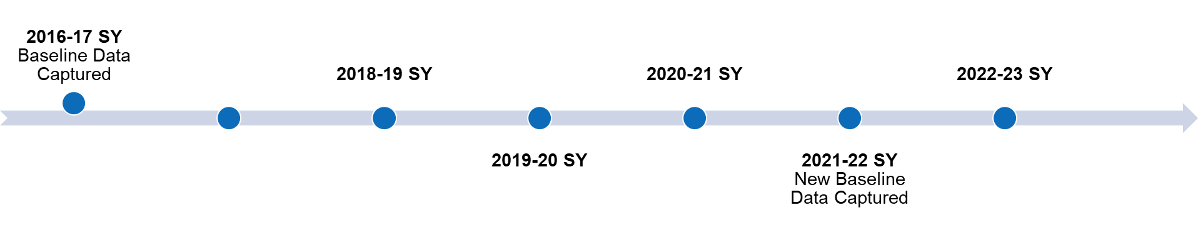

The A-F system has stayed the same during the past 5 years, but statute requires updates to meet goals for students
To help school leaders reflect on performance improvements, A-F cut points have remained unchanged since launched in 2017.
But A-F indicators must be updated given statutory requirements guiding the goals of the system. 2023 is the year for those changes.
A-F Refresh Year

Slide 11
What is “What If”?

Slide 12
Evaluating performance will be different this year
2022 ratings and 2023 ratings are using different methodologies.
  SY 2022-23 ratings are based on a different set of rules than previous A-F ratings.
  2022 ratings and 2023 ratings cannot be compared side-by-side.
The 2023 A-F Refresh methodology shows more differences in campus performance, with a more distributed result.
  It is possible a campus with an A rating in 2022 may improve in 2023 and yet receive a B rating.
  It is also possible that a campus with an A rating in 2022 may decline in 2023 and yet maintain an A rating.
It’s not a simple apples-to-apples comparison this year.

Slide 13
Because of this, TEA is providing districts “What If” ratings
“What If” ratings use the new A-F methodology from the Final 2023 Accountability Manual in order to view 2022 results under the refreshed framework.
“What If” ratings do not replace 2022 ratings. They are another tool to support continuous improvement moving forward.

Slide 14


TEA is publicly sharing “What If” ratings with 2023 ratings
“What If” versions of campus and district ratings from 2022, using the new A-F methodology are shared alongside 2023 ratings.
This will allow board members, educators, parents and the public to get a sense of whether performance ratings issued in 2023 represent higher, lower, or similar performance as ratings issued in 2022 to support continuous improvement moving forward.
”WHAT IF” RATING
2023 RATING
AND
TXSchools.gov provides an apples-to-apples comparison of ratings under the refreshed cut points & methodology.

Slide 15
“What If” Ratings
Let’s get familiar with changes to A-F

Slide 16
[Customize] “What If” ratings for [campus A - elementary]
 | 2022 Score | What If Score (2022 data & 2023 methodology) | Changes to methodology
Domain 1 Student Achievement | [enter] | [enter] | No change for elementary and middle schools. High schools and K-12s have increased standards for college, career, and military readiness and graduation rates.
Domain 2 Student Progress | [enter] | [enter] | No change in methodology. Continues to be best of Domain 2a and 2b.
Domain 2a Academic Growth | [enter] | [enter] | Updates methodology to capture growth for more students and includes learning acceleration.
Domain 2b Relative Performance | [enter] | [enter] | No change for elementary and middle schools. High school recalculated given recent improvements in college, career, and military readiness.
Best of Domain 1 and Domain 2 | [enter] | [enter] | No change in methodology. 70% of overall rating continues to be the best of Domain 1 and 2.
Domain 3 Closing the Gaps | [enter] | [enter] | Includes more students with a minimum size of 10. Moves from a yes/no to a 0-4 methodology to improve differentiation. Tabulations now focus on just the student groups most in need. Aligned with updated long-term targets.
Overall | [enter] | [enter] | If a school has <70 in 3 out of the 4 areas (Domain 1, Doman 2a, Domain 2b, Domain 3), the highest overall they can receive is a 69.*
*This doesn’t apply to dropout recovery schools or if Domain 1 is the one area with a score of 70+.

Slide 17
[Customize] “What If” ratings for [campus B – high school]
 | 2022 Score | What If Score (2022 data & 2023 methodology) | Changes to methodology
Domain 1 Student Achievement | [enter] | [enter] | No change for elementary and middle schools. High schools and K-12s have increased standards for college, career, and military readiness and graduation rates.
Domain 2 Student Progress | [enter] | [enter] | No change in methodology. Continues to be best of Domain 2a and 2b.
Domain 2a Academic Growth | [enter] | [enter] | Updates methodology to capture growth for more students and includes learning acceleration.
Domain 2b Relative Performance | [enter] | [enter] | No change for elementary and middle schools. High school recalculated given recent improvements in college, career, and military readiness.
Best of Domain 1 and Domain 2 | [enter] | [enter] | No change in methodology. 70% of overall rating continues to be the best of Domain 1 and 2.
Domain 3 Closing the Gaps | [enter] | [enter] | Includes more students with a minimum size of 10. Moves from a yes/no to a 0-4 methodology to improve differentiation. Tabulations now focus on just the student groups most in need. Aligned with updated long-term targets.
Overall | [enter] | [enter] | If a school has <70 in 3 out of the 4 areas (Domain 1, Doman 2a, Domain 2b, Domain 3), the highest overall they can receive is a 69.*
*This doesn’t apply to dropout recovery schools or if Domain 1 is the one area with a score of 70+.

Slide 18






New methodology for District Ratings
Prior to 2023, district ratings mirrored the K-12/High School campus system.​
Starting in 2023, district ratings will instead be weighted by enrollment of grade 3-12 students on each campus. The campus weight determines how much a campus grade proportionally impacts the district rating.
Better of Achievement or Progress: 70%
30%
Student Achievement
STAAR – 40%
CCMR – 40%
Grad. Rate – 20%
School
Progress
Academic Growth
or
Relative Performance
Closing
the Gaps
Academic Achievement - 50%
CCMR – 30 %
Grad. Rate – 10%
EL Performance – 10%
K-12/High School System

Slide 19
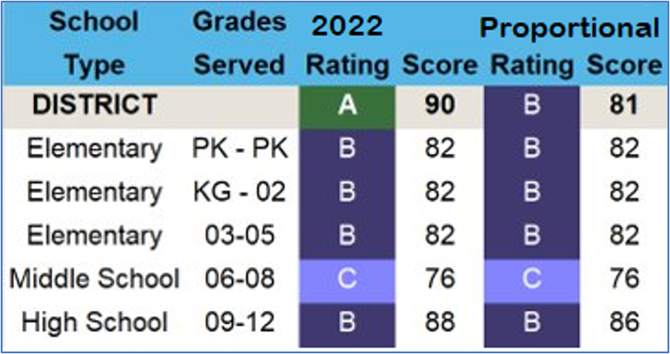
Impacts of new methodology for District Ratings
Increases alignment of district outcomes with campus outcomes: In 2019, 30% of district ratings were not aligned with their campuses’ ratings​.​
Decreases disproportionate emphasis on high school performance: ​ Specifically, high school CCMR and graduation rates were 60% of Domain 1: Student Achievement scores and an additional 40% of Domain 3: Closing the Gaps scores, making them a significant factor in district ratings that was not reflective of all students within a district. ​
A district could be A-Rated even when no campus was A-Rated, because of the higher outcomes of one High School.

Slide 20
Example of disproportionate emphasis on HS performance
Under the previous methodology, high school performance was over-represented for both Domain 1: Student Achievement and Domain 3: Closing the Gaps.
The following illustrates over-representation in Domain 1 for an example high school with 36% of the total district enrollment. For this example, Armadillo HS had a “C” rating, Big Bend MS received a “B”, and all 3 elementary schools received an “A”.
Under the old methodology, the district would receive a “C” rating because of the influence of low CCMR performance and graduation rates at Armadillo HS (which affects 60% of the Domain 1 score). Under the new methodology, the district would receive a “B” rating because the weight is based on enrollment and Armadillo HS is only 36% of the student enrollment.
Domain 1 Weighting
Old Methodology
(Weighted by Components)
New Methodology
(Weighted by Enrollment)
100%

Slide 21
[Customize] “What If” ratings for [district name]
* District ratings are now calculated using a weighted average of campus ratings, as opposed to calculating the district as a single K-12 campus. This increases alignment of district ratings with campus ratings.
Domain Roll-up from Campuses* | 2022 Score | What If Score (2022 data & 2023 methodology) | Changes to methodology
Domain 1 Student Achievement | [enter] | [enter] | No change for elementary and middle schools. High schools and K-12s have increased standards for college, career, and military readiness and graduation rates.
Domain 2 Student Progress | [enter] | [enter] | No change in methodology. Continues to be best of Domain 2a and 2b.
Domain 2a Academic Growth | [enter] | [enter] | Updates methodology to capture growth for more students and includes learning acceleration.
Domain 2b Relative Performance | [enter] | [enter] | No change for elementary and middle schools. High school recalculated given recent improvements in college, career, and military readiness.
Best of Domain 1 and Domain 2 | [enter] | [enter] | No change in methodology. 70% of overall rating continues to be the best of Domain 1 and 2.
Domain 3 Closing the Gaps | [enter] | [enter] | Includes more students with a minimum size of 10. Moves from a yes/no to a 0-4 methodology to improve differentiation. Tabulations now focus on just the student groups most in need. Aligned with updated long-term targets.
Overall | [enter] | [enter] | If a school has <70 in 3 out of the 4 areas (Domain 1, Doman 2a, Domain 2b, Domain 3), the highest overall they can receive is a 69.*
*This doesn’t apply to dropout recovery schools or if Domain 1 is the one area with a score of 70+.

Slide 22
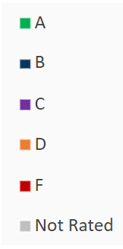
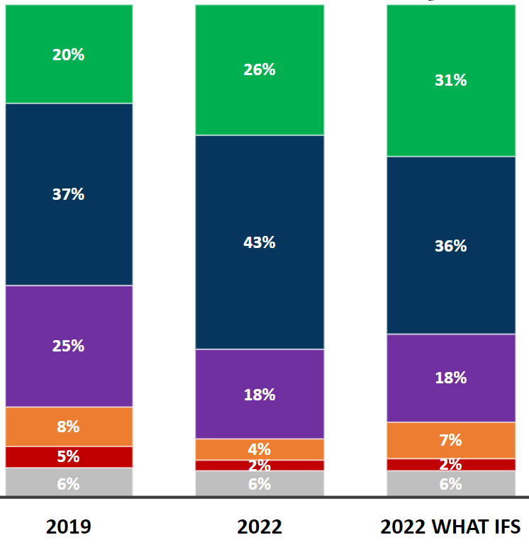
“What If” ratings viewed statewide for context
All Campuses | 2021-22 Ratings Stay the Same​ | 2021-22 Ratings Decrease ​ | 2021-22 Ratings Increase ​
Number | 5973 | 1303 | 1170
Percentage | 71% | 15% | 14%
Across the state, when viewing “What If” ratings:
  Applying the A-F Refresh methodology to 2021-22 performance causes some campus ratings to go up, some ratings to go down, and some ratings to remain unchanged.
  1170 campuses have a higher final “What If” rating than their actual 2022 final rating.
Excludes 520 Not Rated
All Campuses - Overall Ratings

Slide 23
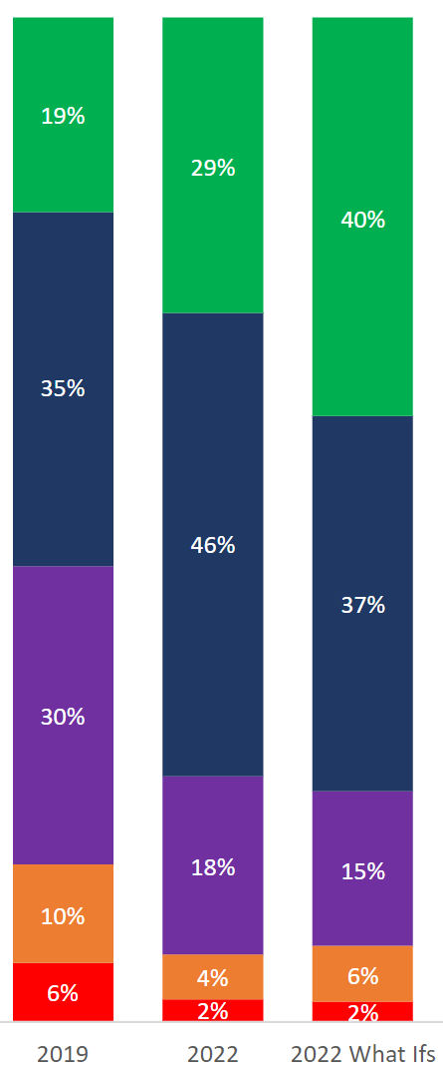
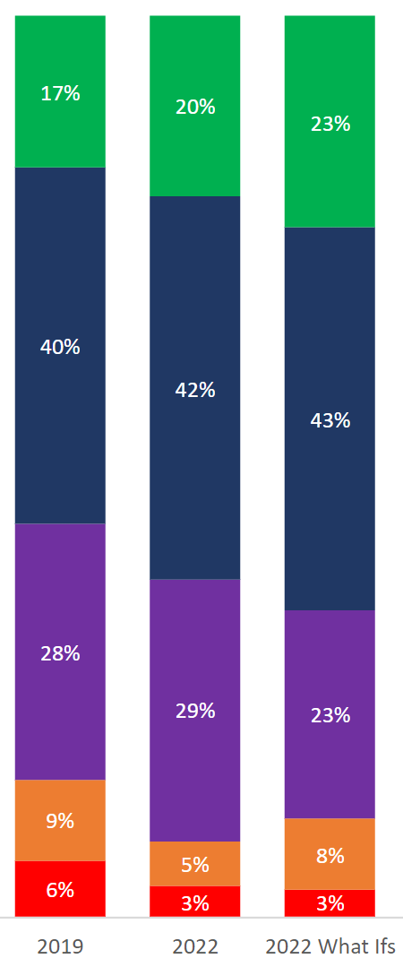
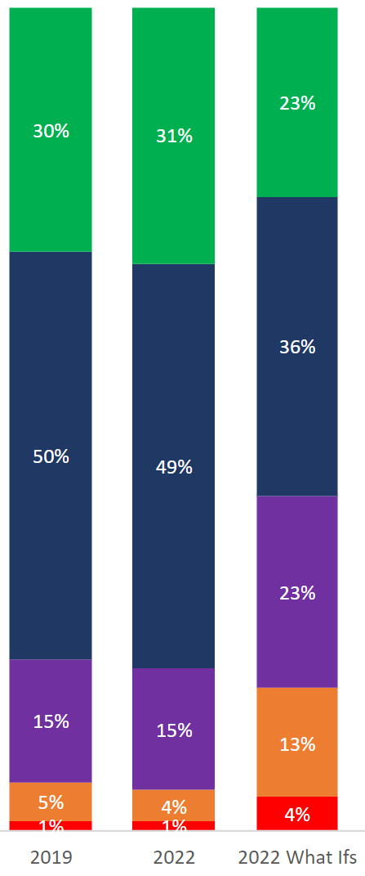
“What If” ratings viewed statewide for context
Campus Type | 2021-22 Ratings Stay the Same​ | 2021-22 Ratings Decrease | 2021-22 Ratings Increase
Elementary | 3565 | 345 | 911
 | 74% | 7% | 19%
Middle | 1416 | 94 | 177
 | 84% | 6% | 10%
High | 740 | 709 | 63
 | 49% | 47% | 4%
K-12 | 252 | 155 | 19
 | 59% | 36% | 5%
Elementary
Middle
High & K-12

Slide 24
[Customize] 2023 ratings for [district]
 | 2022 “What If” Score (2022 data & 2023 methodology) | 2023 Score | Notes
Domain 1 Student Achievement | [enter] | [enter] | [Add notes or additional context]
Domain 2 Student Progress | [enter] | [enter] | [Add notes or additional context]
Domain 2a Academic Growth | [enter] | [enter] | [Add notes or additional context]
Domain 2b Relative Performance | [enter] | [enter] | [Add notes or additional context]
Best of Domain 1 and Domain 2 | [enter] | [enter] | [Add notes or additional context]
Domain 3 Closing the Gaps | [enter] | [enter] | [Add notes or additional context]
Overall | [enter] | [enter] | [Add notes or additional context]

Slide 25
2023 A–F ratings and 2022 “What If” Ratings
Let’s see how we did this year

Slide 26
[Customize] 2023 ratings for [campus A]
 | 2022 “What If” Score (2022 data & 2023 methodology) | 2023 Score | Notes
Domain 1 Student Achievement | [enter] | [enter] | [Add notes or additional context]
Domain 2 Student Progress | [enter] | [enter] | [Add notes or additional context]
Domain 2a Academic Growth | [enter] | [enter] | [Add notes or additional context]
Domain 2b Relative Performance | [enter] | [enter] | [Add notes or additional context]
Best of Domain 1 and Domain 2 | [enter] | [enter] | [Add notes or additional context]
Domain 3 Closing the Gaps | [enter] | [enter] | [Add notes or additional context]
Overall | [enter] | [enter] | [Add notes or additional context]

Slide 27
[Customize] 2023 ratings for [campus B]
 | 2022 “What If” Score (2022 data & 2023 methodology) | 2023 Score | Notes
Domain 1 Student Achievement | [enter] | [enter] | [Add notes or additional context]
Domain 2 Student Progress | [enter] | [enter] | [Add notes or additional context]
Domain 2a Academic Growth | [enter] | [enter] | [Add notes or additional context]
Domain 2b Relative Performance | [enter] | [enter] | [Add notes or additional context]
Best of Domain 1 and Domain 2 | [enter] | [enter] | [Add notes or additional context]
Domain 3 Closing the Gaps | [enter] | [enter] | [Add notes or additional context]
Overall | [enter] | [enter] | [Add notes or additional context]

Slide 28
[Customize] 2023 ratings in context
[Placeholder slide] If desired, replace this with 2023 ratings of similar or nearby districts or statewide summary information to be shared by TEA when ratings are released.

Slide 29
TEA’s communications about 2023 ratings include the use of “What If” ratings to communicate growth
TEA is providing comparisons of 2023 ratings to the “What If” version of 2022 ratings, rather than actual 2022 ratings:
  In the TEA Press Release in November
  In TEA Communications with members of the media
  On TXschools.gov, TEA shows 2023 ratings alongside 2022 “What If” ratings
Downloadable statewide accountability ratings excel file also includes “What If” ratings.
TXSchools.gov provides an apples-to-apples comparison of ratings under the refreshed cut points & methodology.

Slide 30
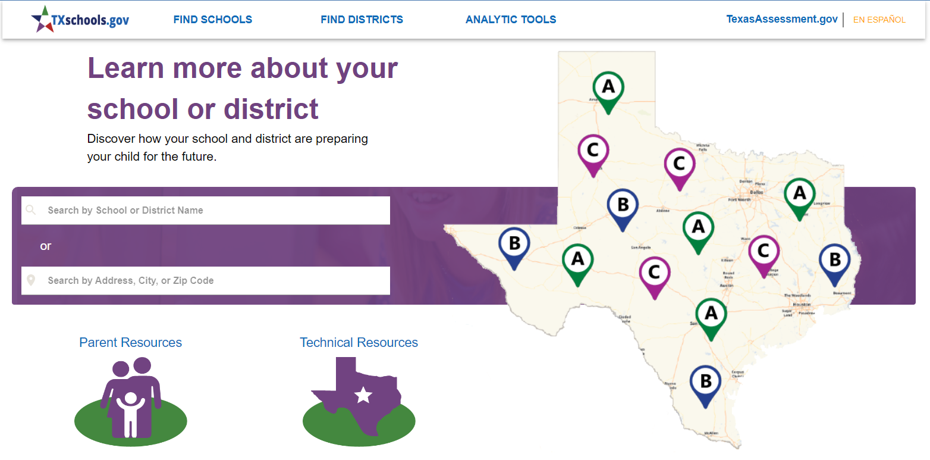
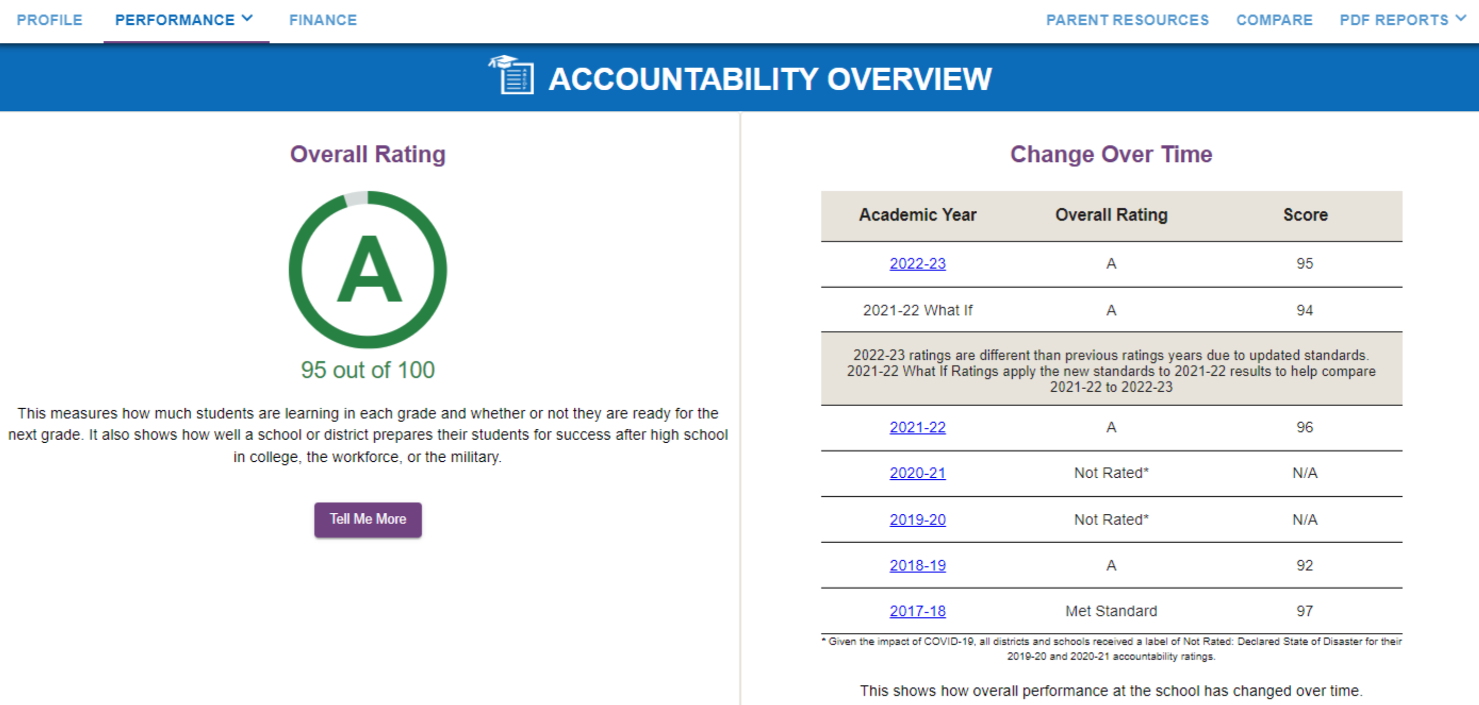
TEA’s communications about 2023 ratings include the use of “What If” ratings to communicate growth
”WHAT IF” RATING
2023 RATING
AND

Slide 31
Thank You

