Slide 1
District Request for Indirect Cost Rates For 2023─2024 School Year Indirect Cost Rate Proposal (ICRP) Additional Costs Workbook (ACW) and Certification Completing the ICRP ACW and Certifying the ICRP Texas Education Agency Federal Fiscal Compliance and Reporting Division
1

Slide 2
Disclaimer
This presentation is intended solely to provide general information and guidance to Texas local educational agencies (LEAs) and reflects the Texas Education Agency’s (TEA’s) current understanding of the Indirect Cost Rate Proposal (ICRP) process, requirement and applicable federal guidance. The content of this presentation is subject to change as a result of further potential information and guidance provided by federal agencies with regulatory oversight of Indirect Cost Rate. This presentation does not constitute legal advice, and LEAs are, therefore, advised to seek legal counsel regarding the information and guidance provided in this presentation before acting on such information and guidance.

Slide 3
Agenda
Role of the United States Department of Education (USDE)
ICRP and ICRP ACW Overview
Timeline
Completing the ICRP ACW
Submitting the ICRP ACW
ICRP Next Steps
Reviewing and Certifying the ICRP

Slide 4
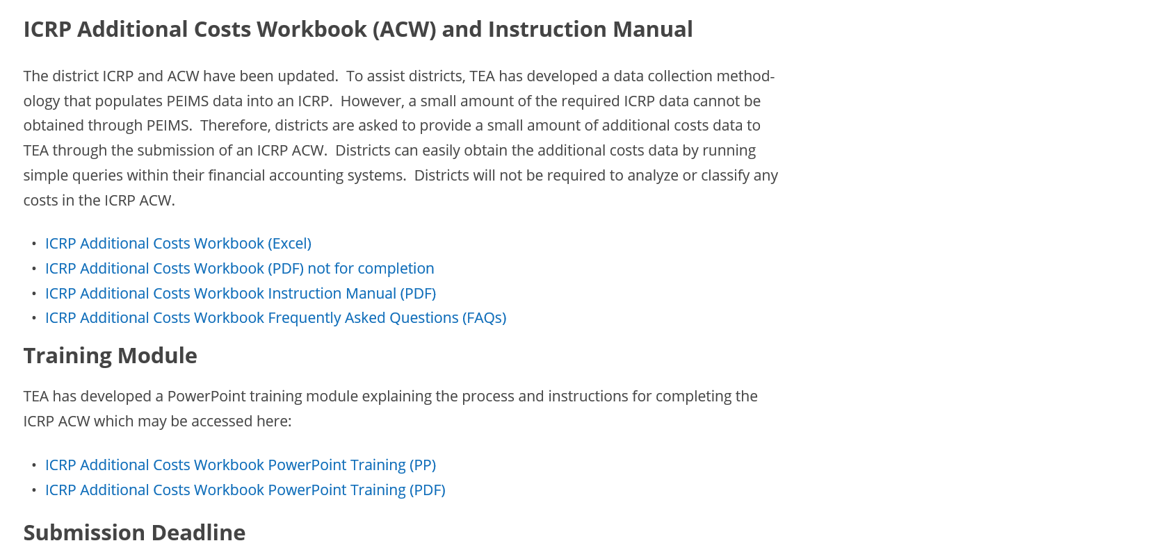
Indirect Cost Rates Webpage

Slide 5
USDE Methodology Overview
Indirect cost rate calculation methodology is dictated by federal laws and USDE
USDE designates TEA as the cognizant agency for indirect costs for local educational agencies (LEAs) and education service centers (ESCs)
USDE/TEA Delegation Agreement for calculating indirect cost rates changed as of 2018–2019 school year (SY)
Newest Delegation Agreement received 11/29/19 in effect for 5 years (through 2024–2025)
Notes:
USDE Methodology Overview
The methodology for calculating indirect cost rates is dictated by federal laws and by the US Department of Education (USDE).
By designating TEA as the cognizant agency for indirect costs, USDE authorizes TEA to issue indirect cost rates to independent school districts (districts), open-enrollment charter schools, education service centers (ESCs), and other government agencies (OGAs i.e. Harris County Dept. of Ed., Texas juvenile Justice Dept., and Windham School District) that are educational in nature.

Slide 6
USDE Delegation Agreement Overview
For school year 2020-2021 and beyond, TEA received a new Delegation Agreement from USDE that specifies the approved indirect cost rate calculation methodology.
Re-affirms and clarifies current procedures in the LEA Plan
Prohibited indirect cost rates extensions
Rescinded all current indirect cost rates extensions
Required that rates be requested by independent school districts (districts) every year
Required that TEA calculates rates every year
Required 3 years of financial data to calculate the one-year rates
6
Notes:
USDE Delegation Agreement Overview
No indirect cost rates extensions are allowed, and all indirect cost rates extensions beyond 2017–2018 were rescinded.
Rates must be requested by districts every year, and then calculated by TEA every year.
Three years of financial data must be used to calculate indirect cost rates (for instance, to calculate rates for 2023–2024 school year or fiscal year 2024, financial data from 2019–2020, 2020–2021 and 2021-2022 will be utilized).
TEA has 5-year LEA Plan and Delegation Agreement from USDE. The Plan and Agreement re-affirm and clarify the LEA procedures for requesting/certifying state-issued indirect cost rates and state procedures for calculating/issuing rates to LEAs.

Slide 7
Rate Types
TEA issues two indirect cost rates to LEAs, an unrestricted rate and a restricted rate.
Unrestricted Rates
Unrestricted rates are applied to grants not subject to the federal supplement, not supplant requirement.
Restricted Rates
Restricted rates are used for grant programs where the supplement, not supplant requirement applies.
Most of the grants that TEA administers are subject to supplement, not supplant, and the restricted indirect cost rate is applied to them.
Notes:
The supplement, not supplant requirement means grant funds must be used only to enhance and support existing state or locally funded activities. The grant funds must not be used to replace state or locally funded activities. Most of the federal grants that TEA administers are subject to this requirement, and the restricted indirect cost rate is applied to them.

Slide 8
Indirect Cost Rate Proposal Overview
Indirect cost rate proposal (ICRP) was updated to accommodate three years of financial data
Districts no longer complete the ICRP – instead, complete the ICRP Additional Costs Workbook or ICRP ACW
TEA will prepopulate an ICRP for each district that requests indirect cost rates through submission of the ICRP ACW
8
Notes:
Indirect Cost Rate Proposal Overview
Because of the size, amount, and complexity of data required by the ICRP, TEA has developed a data collection methodology that utilizes PEIMS data. However, a small amount of the required data cannot be obtained through PEIMS. Thus, districts will be asked to provide a small amount of additional costs data to TEA. Districts can easily obtain this additional costs data by running simple queries within their financial accounting systems. Districts will not be required to analyze or classify any costs.
Because districts are required to request rates, and because TEA needs a small amount of additional costs information for the ICRP, the procedure is for districts to request indirect cost rates for school year 2023–2024 through the submission of the ICRP Additional Costs Workbook (ACW).

Slide 9
ICRP Additional Costs Workbook
22–23 SY ICRP was streamlined (23–24 follows same format)
Districts must complete and submit the ICRP ACW to request indirect cost rates
To receive rates for the 2023–2024 SY, the due date to submit the ICRP ACW is January 19, 2023
9
Notes:
ICRP Additional Costs Workbook
Thus, for rates effective beginning with 2018–2019 school year, districts have been required to request indirect cost rates each year by completing and submitting the ICRP Additional Costs Workbook (ACW).
The submission of the ACW serves as the district’s official request for indirect cost rates. If a completed ACW is not submitted by a district, TEA will not calculate or issue rates for that district for the upcoming school year.
Once the ACW is submitted, TEA will merge the ACW data with the PEIMS data to produce the completed ICRP, which will then be made available to districts. The final step for districts will be ICRP review/certification.

Slide 10
ICRP – Prepopulated Data
TEA will prepopulate the ICRP with the following data:
10%* will be prepopulated from the ICRP ACW submitted by the district
90%* will be prepopulated from PEIMS data
Districts will review and certify the complete ICRPs
*Percentages are approximate
10
Notes:
The district-submitted ICRP ACW will provide approximately 10% of the data required in a completed ICRP. TEA will obtain the remaining data needed for the ICRP from a district’s certified Public Education Information Management System (PEIMS) data. TEA will populate an ICRP for each district that submits an ICRP ACW by merging PEIMS data with data submitted by the district in the ICRP ACW. TEA will then provide the complete ICRPs to districts for review and certification.
Remember: TEA is requesting this additional data via the ACW because that data is required for the indirect cost rate calculation and cannot be obtained through the PEIMS system. Most of the expenditure data submitted in the ICRP ACW are for costs that are considered excluded costs for the indirect cost rate calculation. Leaving these costs in the calculation causes the resulting rates to be much lower than it should be. These costs distort the expenditure base.
Districts should maintain a copy of all financial records used to complete the ICRP ACW.

Slide 11
Indirect Cost Rates Timeline
Date | Action
November 3, 2022 | ICRP ACW is made available via the Indirect Cost Rates webpage and the secure GFFC Reports and Data Collections application, accessible through TEAL.
January 19, 2023 | Due date for districts to submit the ICRP ACW requesting indirect cost rates.
January – April 2023 | TEA reviews all submitted ICRP ACWs and requests clarification and/or re-submissions, as needed.
April 20, 2023 | TEA provides complete ICRPs to districts for review and certification.
May 19, 2023 | Due date for districts to submit ICRP Certification in GFFC Reports and Data Collections
July 1, 2023 | Notification Letter - Indirect Cost Rate posted in GFFC Reports and Data Collections, accessible through TEAL. Rates become effective.
Notes:
Indirect Cost Rates Timeline
The ACW will be available to districts by November 3, 2022, through the Indirect Cost Rates website and GFFC Reports and Data Collections. The due date is January 19, 2023.
TEA will post the complete ICRPs by April 20, 2023, in GFFC Reports and Data Collections. Districts will be required to review and certify acceptance of the resulting indirect cost rates by May 19, 2023.
TEA will post official rates by July 1, 2023.

Slide 12
Completing the ICRP ACW
LEA Information Worksheet
Notes:
Tab 1: LEA Information and Certification of Additional Costs.
Enter the following information for the ISD to certify that all submitted data is true and accurate.
• Name of LEA –Select ISD name in the pulldown field
• Once an LEA name is selected- County-District Number (CDN) – will populate
*** The Name of LEA and CDN number will also populate to the header of each worksheet.
• Name of Primary Contact (person completing the worksheet). If we have questions regarding the data submitted in the ACW, this will be the person we will contact.
• Title
• Phone Number
• Email
• Date of completion/submission

Slide 13
Completing the ICRP ACW
Checklist to Assist LEAs
Notes:
Checklist tab was added to assist LEA's answer and clarify some of the questions that might come up when completing the workbook.
And, our hope is, LEAs will use this tab to review their data entry before submitting their ICRP ACW . It highlights all the tabs and sections of the ACW that need to be completed by LEAs before they submit their workbook to TEA.

Slide 14
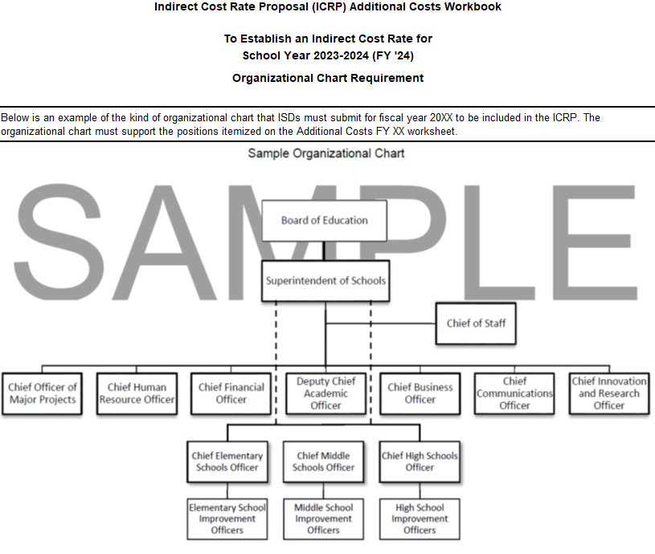
Completing the ICRP ACW
Organizational Chart Sample Worksheet
Notes:
The Organizational Chart Sample tab contains an example of the kind of organizational (org) chart that districts must submit for fiscal year 2021.

Slide 15
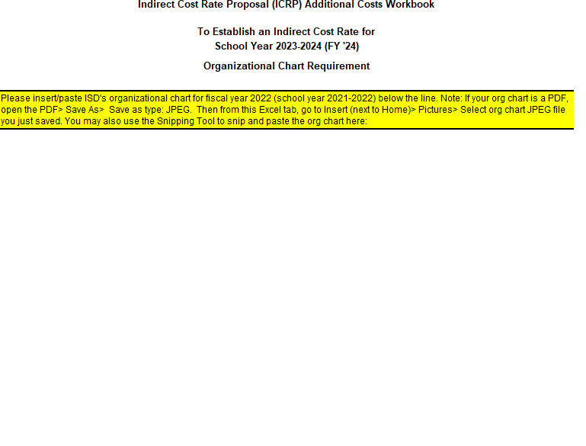
Completing the ICRP ACW
Organizational Chart Worksheet
The process for submitting the Org Chart is the same as last year. Districts can insert their org chart into this worksheet/tab.
Districts will not submit a separate document in GFFC Reports and Data Collections.
Notes:
Organizational Chart Worksheet
The process for submitting the Org Chart is the same as last year. Districts can insert their org chart into this worksheet and how to insert the org chart is found within the highlighted section in the tab.
Districts will not submit a separate document in GFFC reports and Data Collections.
The org chart must support the Chief Executive Officer Information on the Additional Costs FY 22 tab. Therefore, this year LEAs need to submit FY 2022 (school year 2021-2022) org chart in this tab.

Slide 16
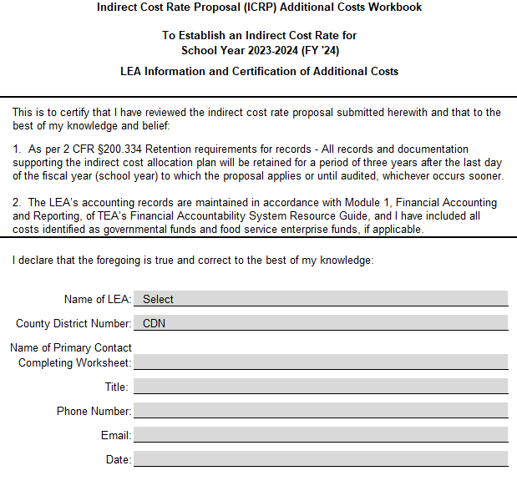
Completing the ICRP ACW
Additional Costs Worksheet(s)
If your district received indirect cost rates for 22–23 SY and is requesting again for 23–24 SY, you will only have to submit 1 Additional Costs Worksheet for FY 22 (21–22 SY data) because TEA has retained the data you’ve already submitted for the previous 2 years (19–20 and 20–21).
Notes:
The 2018–2019 SY was the first year TEA implemented the required 3 years of financial data to calculate the one-year rates. If you district requested rate since the new process has been implemented, you would have seen 3 Additional Costs Worksheets, one for each fiscal year required to be included in the ICRP during your ICRP review process.
If your district received indirect cost rates for 22–23 SY and is requesting again for 23–24 SY, you will only have to submit 1 Additional Costs Worksheet for FY 22 (21–22 SY data) because we have retained the data you already submitted for the previous 2 years (19–20 and 20-21).
If your district did not receive rates for 22–23 SY, then you will have to submit 3 years worth of additional costs data (FY 20, 21, & 22) or for whichever years TEA does not have data for your district. If that is the case, you will need to reach out to us so that we can provide you with the 3-year workbook.
Please note: the fiscal year noted in the heading of the worksheet matches the data you will enter.

Slide 17
Completing the ICRP ACW
First year a district requests indirect cost rates is the only year it is required to submit three years’ worth of additional costs data
In subsequent years, the district will be required to provide data only for the year(s) not previously-submitted
Districts should run accounting system queries to retrieve most of the requested information
Additional Costs Worksheet(s)
Notes:
Like I mentioned in the previous slide, first year is the only year districts are required to submit three years’ worth of data.
In subsequent years, the district will be required to provide data only for the year(s) not previously submitted
Districts should run accounting system queries to retrieve most of the requested information.

Slide 18
Completing the ICRP ACW
Additional Costs Worksheet(s)
A staff member familiar with accounting system queries should complete the workbook
Indicate $0.00 if there are no expenditures (it will show as “$ -” in Excel); do NOT leave sections blank
Notes:
A staff member familiar with accounting system queries should complete the workbook. No cost analysis or classification of costs is required by the district.
Leaving a section blank or incomplete could result in the delay of the district receiving indirect cost rates due to incomplete information. If there are no costs to report in a section, indicate $0.00 as the expenditure amount.
The next few slides will provide examples of types of queries to run.

Slide 19
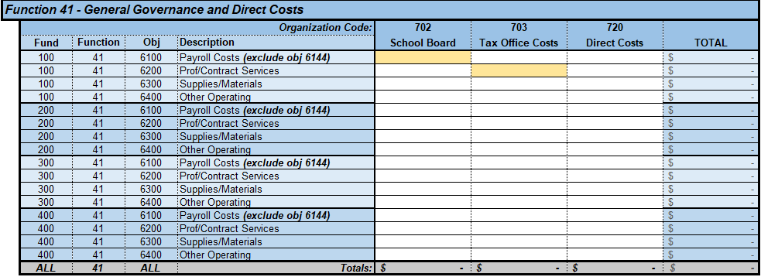
Completing the ICRP ACW
Function 41 - General Governance and Direct Costs
Enter expenditures for org codes 702, 703, and 720 – by fund, function, and object code
Notes:
Function 41 - General Governance and Direct Costs
In this section, enter the expenditures for Org codes 702, 703, and 720 – by fund, function and object code as requested here in the worksheet.
Except for excluded costs and Org 720 direct costs, expenditures within Function 41 are treated as indirect costs for the indirect cost rate calculation. When calculating indirect cost rates, expenditures within Function 41 are treated as follows:
Org 702 School Board – Excluded
Org 703 Tax Office – Excluded
Org 720 Direct Costs – Direct Costs
Two examples of simple queries in this section:
Line item 1, Fund 100, Function 41, Object 6100, for 702 School Board:
Two queries are needed. Query expenditures for:
Fund 1XX, Function 41, Object 61XX, Org 702
Fund 1XX, Function 41, Object 6144, Org 702
From the resulting amounts, deduct the Object 6144 total from the Object 61XX total, and report the amount in corresponding line-item cell.
Line item 2, Fund 100, Function 41, Object 6200, for 703 Tax Office:
One query is needed. Query expenditures for:
Fund 1XX, Function 41, Object 62XX, for Org 703
Report the amount in corresponding line-item cell.

Slide 20
Completing the ICRP ACW
TRS On-Behalf Payments/ Medicare Part D Payments
Enter expenditures by the appropriate fund, function, and object (6144) code
Notes:
TRS On-Behalf Payments AND/OR Medicare Part D Payments
Enter the expenditures for all TRS On-Behalf Payments and/or Medicare Part D Payments made during the applicable fiscal year by the appropriate fund, function, and object (6144) code as requested in the worksheet.
These payments are considered excluded in the indirect cost rate calculation.
An example query:
Line item 1, Fund 100, Object 6144, for Function 1X:
One query is needed. Query expenditures for:
Fund 1XX, Function 1X, Object 6144
Report the amount in corresponding line-item cell.

Slide 21
Completing the ICRP ACW
Food and Milk Costs of Food Service Program
Enter expenditures by the appropriate fund, function, and object (6341) code
Notes:
Food and Milk Costs of Food Service Program
Enter all Food and Milk expenditures in a Food Service Program made during the applicable fiscal year by the appropriate fund, function, and object (6341) code as requested in the worksheet.
*New* - We added back in the Food Service Enterprise Fund line. If the district has food and milk costs coded to fund 700, you will enter that amount under Food Service Enterprise Fund.
An example query:
Line item 1, Fund 100, Object 6341, for Function 3X:
One query is needed. Query expenditures for:
Fund 1XX, Function 3X, Object 6341
Report the amount in corresponding line-item cell.
Expenditures for food and milk in a food service program are considered excluded costs.

Slide 22
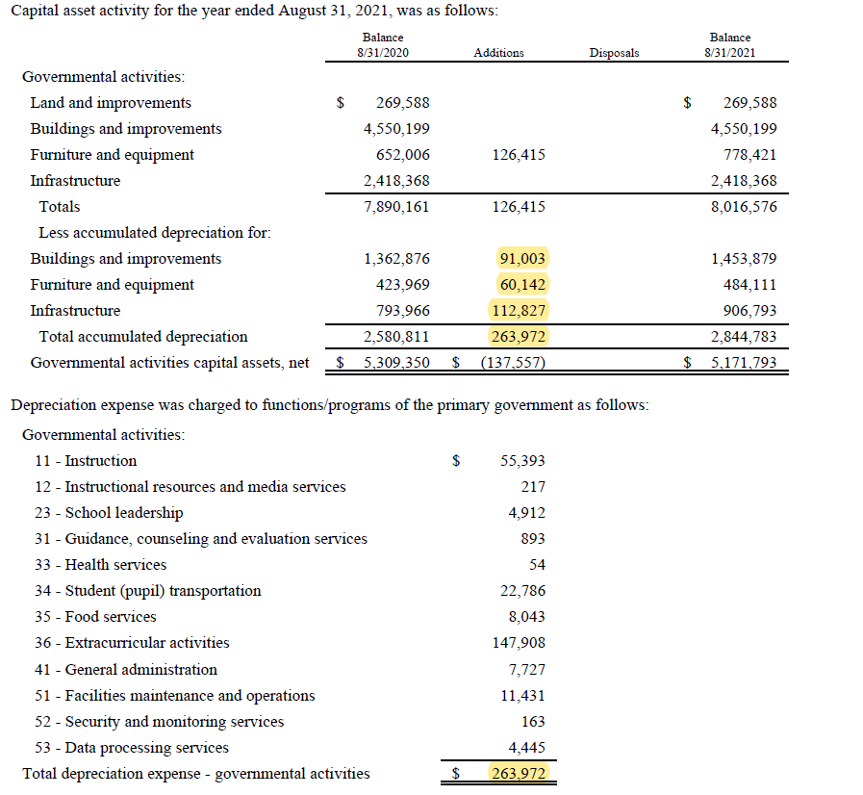
Completing the ICRP ACW
Depreciation Expense Amounts
The information needed to complete the Depreciation Expense Amounts section can be found in the Notes to the Financial Statements section of your district’s AFR, under “Capital Assets” or “Capital Asset Activity”
Notes:
Depreciation Expense Amounts
Enter the total depreciation expenses charged to governmental activities for buildings/improvements and furniture/equipment/vehicles.
Depreciation expense is a critical expense to report and is required. Under- or over-reporting the depreciation amounts can distort the indirect cost rates considerably.
The district must enter the depreciation amounts for:
The Total Costs for both buildings/improvements and furniture/equipment/vehicles and it cannot exceed the net depreciation amounts listed for the assets as reported in the Notes to the Financial Statements section.
The information needed to complete the Depreciation Expense Amounts section can be found in the Notes to the Financial Statements section of your district’s AFR, under “Capital Assets” or “Capital Asset Activity.”
Here is an example of the Capital Asset Activity from a sample district and how the costs are broken down and reported.
Determine the “increases” for buildings and improvements (and capital leases if applicable and itemized)
Determine the ”increases” for furniture, equipment, and vehicles
Ensure the total increases are equal to amount of depreciation charged to governmental activities. Review the expenses charged to governmental activities and note any charged to federal funds. Remove any federal funds and then report the rest in this section.

Slide 23
Completing the ICRP ACW
Payments to Fiscal Agent/Member Districts of Shared Services Arrangements (SSAs) (report only federal funds))
Enter full payment amount made with federal funds
Notes:
Payments to Fiscal Agent/Member Districts of Shared Services Arrangements (SSAs) (report only federal funds)
Answer “yes” or “no” to the question “Did the LEA make payments to a fiscal agent and/or member district of an SSA funded with federal grant funds from FN 93?”
Please note the question is asking about payments from federal grant funds. Many districts are participating in non-federally funded SSAs.
If your answer is “No”, proceed to the next section as no further data entry is required.
If your answer is “Yes”, complete the section by providing the requested details on any payments made to fiscal agents and/or member districts of an SSA, for federally-funded SSAs.
The best query to gather this data is a query of payment history for Function 93, Object 649X. This report will provide the SSA payments by fund. Itemize the payments in the worksheet based on funding source.
It is important to include the CFDA # as this number confirms that the payment was made with federal funds. If there is no CFDA #, then the payment was not likely made from federal funds and should not be reported here.
These payments are considered excluded costs in the indirect cost rate calculation, except for the first $25,000 of each payment (which is counted as direct costs). Although you will input the total amount of the SSA payments, the final ICRP will calculate as direct costs only the first $25,000 of each of the payments – the remainder of each payment will be considered excluded.

Slide 24
Completing the ICRP ACW
Federal Subrecipient Items - Federal Subgrants and Federal Grant Pass-Through Funds (report only federal funds)
Do not include subgrants or subcontracts that are less than $25,000, and do not include the first $25,000 of payments in subgrants or subcontracts that are greater than $25,000
Notes:
Federal Subrecipient Items - Federal Subgrants and Federal Grant Pass-Through Funds (report only federal funds)
A subrecipient item is the disbursement of federal grant funds by the district to another entity to carry out a portion (or all) of a federal grant program. A subrecipient “payee” is the entity to which you distribute funds in a subgrant.
The Federal Subrecipient section is used if your district issued a subgrant for food service program and/or other pass-through funds (funds given to other entities that are not fiscal agents or member districts of SSAs).
Highlight: For the purpose of the ICRP ACW, we have separated Payments to FA/SSAs from other Federal Subrecipient Items to define costs.
Answer “yes” or “no” to the question “Did the school district distribute federal grant funds as a subgrant or as federal grant pass-through funds?”
If your answer is “No”, proceed to the next section as no further data entry is required. Most districts will answer “No” to this question.
If the answer is “Yes”, complete the section by providing the requested details on the subrecipient items.
Enter all Federal Subgrants and/or Other Federal Grant Pass-Through Funds by selecting the fund, function, and object codes under which the payment was made, and then enter the Payee name, a description of the subrecipient item, the CFDA #, the begin and end dates, and then finally the amount.
Here again, it is important to include the CFDA # as this number confirms that the payment was made with federal funds. If there is no CFDA #, then the payment was not likely made from federal funds and should not be reported here.
For the purpose of the ICRP, TEA is only concerned with major subgrants and has adopted the accepted definition that a major subgrant is one that exceeds $25,000 in expenditures per year. For this reason, do not include subgrants or subcontracts that are less than $25,000, and do not include the first $25,000 of payments in subgrants or subcontracts that are greater than $25,000.
Note: Districts will not have subgrants or grant pass-through funds on educational grants; however, districts may have subgrants or grant pass-through funds on non-educational grants awarded by another agency. TEA is not expecting to see items entered in this section, unless a district has issued a subgrant for their food service program.
Federal Subrecipient Items are considered excluded costs in the indirect cost rate calculation except for the first $25,000 of each payment for a major subgrant (>$25,000). The first $25,000 of a major subgrant will be considered as direct costs in the calculation because these funds still have direct/administrative costs associated with them.
USDE and TEA have agreed (through the Delegation Agreement) to capture these direct costs by counting the first $25,000 of each payment >$25,000 (reported in the workbook as $1 or more) as direct costs in the indirect cost rate calculation.
Note:
Subgrant item- is when a distribution is made as a result of a federal award to a school district, then to another entity (the subrecipient) to carry-out part of a federal program.
Pass-through funds- is when the funds are transferred to other entities.
An examples is payment to fiscal agent or member districts of an SSA which was described in previous slide.

Slide 25
Completing the ICRP ACW
Contingencies
Select the fund, function, and object code from the pull-down lists
Enter a description and the amount of the contingency
Notes:
Contingencies – these are funds set-aside for possible future expenses, such as lawsuit settlements or refunds to TEA (example: a monetary judgement against the district) and are excluded costs in the indirect cost rate calculation.
Select the fund, function, and object code from the pull-down lists and enter a description and the amount of the contingency.

Slide 26
Completing the ICRP ACW
Chief Executive Officer Information
Enter all expenditures for Chief Executive Officers and their immediate support person(s) – state/local salaries and fixed costs by function and position name. These positions should correspond to the organizational chart that you will be inserting/pasting within the ICRP ACW Organizational Chart tab.
Notes:
Chief Executive Officer Information
Enter all expenditures for Chief Executive Officers and their immediate support person(s) – state/local salaries and fixed costs by function and position name. These positions should correspond to the organizational chart that you will be inserting/pasting within the ICRP ACW Organizational Chart tab. TEA will review and verify that the org chart(s) support the position titles and details entered in this section.
In this section, the district enters costs related to the superintendent and chief executive officers within the school . The costs (facilities and administrative) associated with these positions are indirect costs when paid with state/local funds. However, when calculating the restricted indirect cost rate, these costs must be moved from the indirect cost pool to the modified total direct costs (MTDC) base. MTDC consists of direct and unallowable costs.
The positions that must be reported in this section include:
The superintendent
The immediate employee(s) who serve as the executive or administrative assistant to the superintendent
All staff members who act as CEOs of any component of the district, regardless of their actual titles (this include members of your district-wide strategic planning and/or executive management team or superintendent’s cabinet).
Note: A component is an organizational unit that benefits the entire district. On a district’s organizational chart, CEOs are generally one level below the superintendent, although in large districts, CEOs may be two levels below the superintendent. They generally hold job titles such as assistant superintendent, deputy superintendent, chief financial officer, and human resource executive director.
The immediate employee (or employees) who serve as the executive/administrative assistant(s) to CEOs
For each position, enter the following information:
Select the function code(s) from which the indirect salary/fixed costs are paid from the pull-down list
The position title
The salary amount paid from state/local funds
The fixed costs amount paid from state/local funds
The staff count for the position*
*If the position is funded from multiple functions, enter multiple line items for the position and enter only 1 on one line item under staff count (Number of Positions).
The indirect (facilities and administrative) costs associated with these positions include the following:
Salaries classified as indirect costs for the unrestricted rate
Fixed costs classified as indirect costs for the unrestricted rate
Fixed costs are the costs your district pays for fringe benefits and similar costs associated with employment.
Ex. Employee retirement matching
Pension fund payments
Unemployment compensation
Unused leave (for separating employees)

Slide 27
Completing the ICRP ACW
Terminal leave
Terminal leave payments are amounts paid to departing employees outside of normal routine payments for either the accumulation of vacation leave or as part of an employment contract.
Notes:
Terminal Leave
Terminal leave is leave paid to departing employees, outside of the normal routine payments for either the accumulation of vacation leave or as part of an employment contract.
Answer “yes” or “no” to the question “Did the LEA make payments to one or more departing employees for terminal leave?”
If your answer is “No”, the section is complete. No further data entry is required.
If the answer is “Yes”, complete the section by providing the requested expenditures for each employee by providing the fund, function, and object from which the payment was made and the location/job title/name of the employee. Also, select from the pull-down the direct/indirect nature of the employee and the amount paid.
Most districts do not have terminal leave because most do not provide formal vacation leave.

Slide 28
Common Mistakes
Depreciation Expense- Blank or wrong amount reported
Payments to Fiscal Agent/Member Districts of Shared Services Arrangements (SSAs)- Incomplete data

Slide 29
Common Mistakes
Federal Subrecipient Items - Federal Subgrants and Federal grant pass-through funds - Incomplete data and no selection from pull-down list
Contingencies – No selection from pull-down list

Slide 30
Common Mistakes
Chief Executive Officer Information - No selection from pull-down list, number of position(s), positions listed that should NOT be under CEO section (see #s 10 & 11 in the FAQ)
What are some examples of positions that should NOT be listed:
Campus Principals
Special Education Programs
Federal Programs
Transportation Programs
Food Service Programs
Art Programs
Board of Trustees

Slide 31
Submitting the ICRP ACW
Log on to the TEA Login, (TEAL)
Select GFFC Reports and Data Collections
Select Upload Response Documents
Select ICRP Additional Costs Workbook from the “Response Template Title” pulldown menu
Workbook must be submitted in Excel format
31
Notes:
Submitting the ICRP ACW
Complete the following steps to submit your district’s completed ICRP ACW to TEA:
Log on to the TEA Login, TEAL
Select GFFC Reports and Data Collections.
Select Upload Response Documents.
Select ICRP Additional Costs Workbook from the “Response Template Title” pulldown menu
Workbook must be submitted in Excel format

Slide 32
Submitting the ICRP ACW (continued)
Select Response Document from the “Response Doc Type” pulldown menu
Select the school year for which you are requesting indirect cost rates from the “School Year” pulldown menu (if you are submitting in the fall of 2022 or spring of 2023, select the 2023–2024 school year)
Select Upload Document
32
Notes:
Submitting the ICRP Additional Costs Workbook
Submission steps continued:
Select Response Document from the “Response Doc Type” pulldown menu.
Select the school year for which you are requesting indirect cost rates from the “School Year” pull-down menu (if you are submitting in the fall of 2022 or spring of 2023, select the 2023–2024 school year)
Select Upload Document

Slide 33
ICRP Next Steps
Districts that want 2023–2024 indirect cost rates must submit the ICRP ACW by January 19, 2023
For those districts that submit the ICRP ACW, TEA will collect PEIMS data in the spring when 2021–2022 final certified data is available
TEA will merge district-submitted ICRP ACW data with PEIMS data to create/prepopulate the complete ICRP
33
Notes:
To receive indirect cost rates for 2023–2024, districts must submit the ICRP ACW by January 19, 2023.
TEA’s Federal Fiscal Compliance and Reporting (FFCR) Division will collect final 2021–2022 PEIMS data in the spring of 2023 to complete the data needed to create an ICRP.

Slide 34
ICRP Next Steps (continued)
TEA will post the complete ICRPs in GFFC Reports for district review
Districts will be required to review and certify acceptance of the resulting indirect cost rates
New rates will become effective July 1, 2023

Slide 35
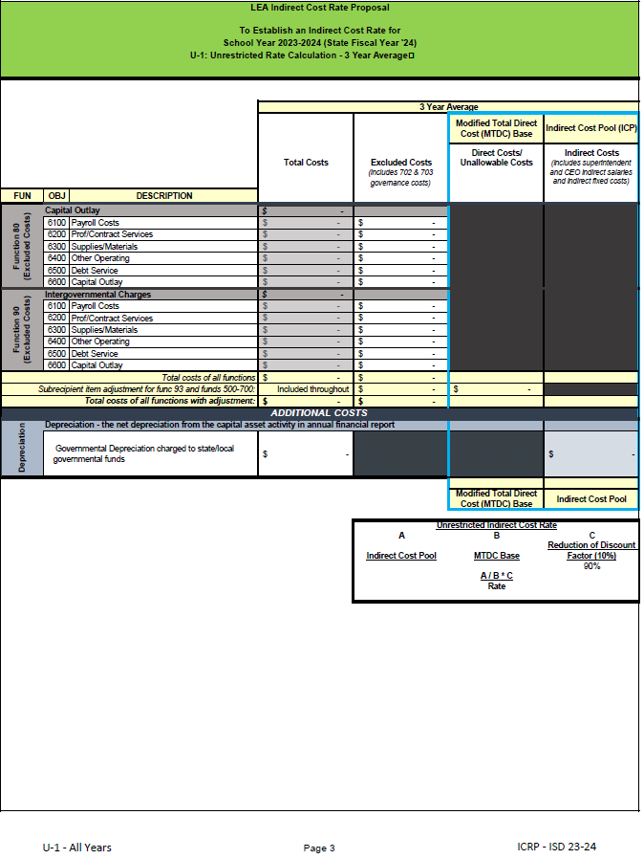
Reviewing the ICRP – Financial Worksheets
The pages of the ICRP are labeled at the bottom of each page. The specific data contained within the worksheets is summarized below:
U-1 All Years (pages 2-3) Summary of the unrestricted rate’s data average for all 3 years
R-1 All Years (pages 5-6) Summary of the restricted rate’s data average for all 3 years
Notes:
Reviewing the ICRP – Financial Worksheets
When first generated the ICRP is an Excel form which will be converted into a PDF. If your district would like the Excel version, please email FFCR at compliance@tea.texas.gov.
When reviewing the ICRP, you will notice that the pages are labeled on the bottom of each page.
U-1 All Years (pages 2-3) Summary of the unrestricted rate’s data average for all 3 years
R-1 All Years (pages 5-6) Summary of the restricted rate’s data average for all 3 years

Slide 36
Reviewing the ICRP – Financial Worksheets (continued)
Restricted Rate Adj All
Summary of the restricted rate adjustment average for all 3 years (page 4)
Notes:
Reviewing the ICRP – Financial Worksheets
Restricted Rate Adj All
This page will show the average for all 3 years of indirect cost adjustments , these are the costs that are moved from the Indirect Cost Pool to the Modified Total Direct Cost (MTDC). MTDC consists of direct and unallowable costs.
On the U-1 ISD’s expenditures are classified as either excluded, unallowable/direct, or indirect costs, based on fund, function, and object.
Costs classified as indirect costs on the U-1 tab used for the unrestricted rate calculation are adjusted to determine the restricted rate.
Section 4 of the Restricted Rate Adj all provides the average amount that is moved from the Indirect Cost Pool to the MTDC on the Restricted Rate calculation tab.
Sections 1-3 provide a visual average and not the actual amounts applied. The actual % and amounts were applied on each FY (respectively).
Then the resulting Section 4 of each FY were added together and divided by 3 in this Section 4 of Restricted Rate Adjustments to 3 Year Average Financial Information.

Slide 37
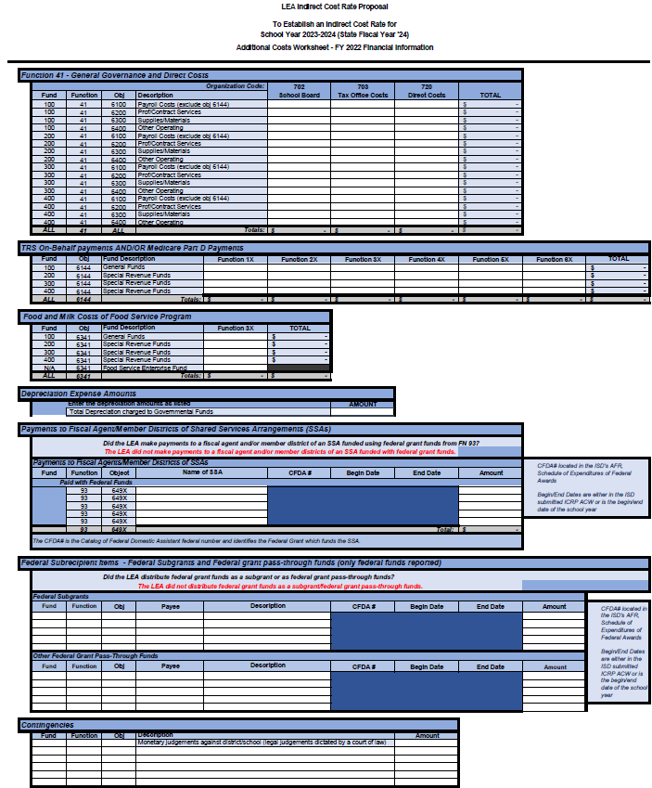
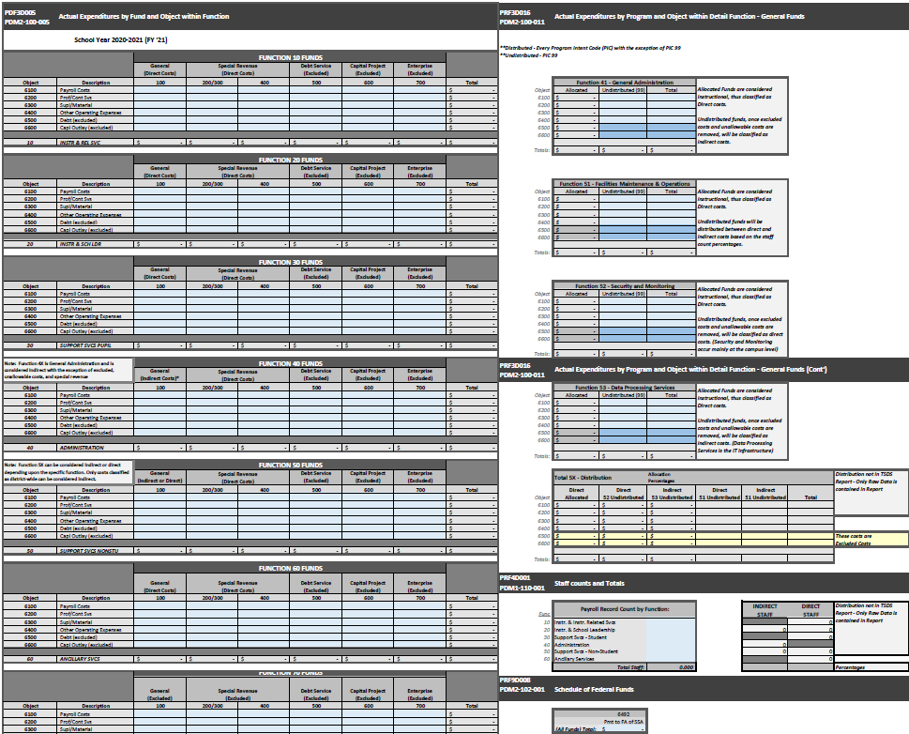
Reviewing the ICRP – Financial Worksheets (continued)
Supporting data for each of the 3 fiscal years used in the calculation (Additional Costs and TSDS/PEIMS Financial Data)
Year 1 – 2020 (pages 7-10)
Year 2 – 2021 (pages 11-14)
Year 3 – 2022 (pages 15-18)
Notes:
The following pages contain the supporting data for each of the 3 fiscal years and show the averaged data elements which were used to produce the resulting rates.
(Additional Costs and TSDS/PEIMS Financial Data)
Year 1 – 2020 (pages 7-10)
Year 2 – 2021 (pages 11-14)
Year 3 – 2022 (pages 15-18)

Slide 38
Filling Out the ICRP Certification
District’s certification of the information contained within the proposal (page 1)
The certification must be signed by the school district’s superintendent, chief executive officer (CEO), or chief financial officer (CFO)
Certification must be for the correct school year (2023–2024)
Notes:
Note that the ICRP Certification is different from the ACW certification.
ACW certification will certify that all submitted data is true and accurate and has the contact information of the person completing the workbook.
The ICRP certification is District’s certification of the information contained within the proposal (page 1)
To accept and finalize your district’s rates, this “Certification of Indirect Costs” (page 1 of the ICRP) must be completed, signed, and submitted back to TEA.
The certification must be signed by the school district’s superintendent, chief executive officer (CEO), or chief financial officer (CFO)
Certification must be for the correct school year (2023–2024)

Slide 39
Filling Out the ICRP Certification (continued)
To complete the certification:
Print the certification page
Enter the required information
Have the Superintendent, CEO, or CFO sign and date the printed page
Scan the signed and dated page
Upload the scanned certification into GFFC Reports as
“ICRP Certification”
Notes:
Submission of this ICRP Certification is the district’s last step to be issued indirect cost rates for 2022–2023.
To complete the certification:
Print the certification page
Enter the required information
Have the Superintendent, CEO, or CFO sign and date the printed page
Scan the signed and dated page
Upload the scanned certification into GFFC Reports as
“ICRP Certification”

Slide 40
Submitting the ICRP Certification
Complete the following steps to submit your school district’s completed ICRP Certification:
Log on to the TEA Login, (TEAL)
Select GFFC Reports and Data Collections
Select Upload Response Documents
Select ICRP Certification from the “Response Template Title” pulldown menu
Select Response Document from the “Response Doc Type” pulldown menu
Select the school year 2023–2024 from the “School Year” pulldown menu
Select Upload Document
Notes:
Submit the ICRP Certification in GFFC Reports and Data Collections by May 21.
In order to do that complete the following steps :
Log on to the TEA Login, (TEAL)
Select GFFC Reports and Data Collections
Select Upload Response Documents
Select ICRP Certification from the “Response Template Title” pulldown menu
Select Response Document from the “Response Doc Type” pulldown menu
Select the school year 2023–2024 from the “School Year” pulldown menu
Select Upload Document
TEA will subsequently post the approved/certified indirect cost rates on the Indirect Cost Rates webpage and upload individual district notification letters into GFFC Reports and Data Collections (refer to the timeline of events).

Slide 41
Questions
Federal Fiscal Compliance and Reporting Division
compliance@tea.texas.gov

Slide 42
Copyright
The materials are copyrighted © and trademarked ™ as the property of the Texas Education Agency (TEA) and may not be reproduced without the express written permission of TEA, except under the following conditions:
Texas public school s, charter schools, and Education Service Centers may reproduce and use copies of the Materials and Related Materials for the s’ and schools’ educational use without obtaining permission from TEA.
Residents of the state of Texas may reproduce and use copies of the Materials and Related Materials for individual personal use only without obtaining written permission of TEA.
Any portion reproduced must be reproduced in its entirety and remain unedited, unaltered and unchanged in any way.
No monetary charge can be made for the reproduced materials or any document containing them; however, a reasonable charge to cover only the cost of reproduction and distribution may be charged.
Private entities or persons located in Texas that are not Texas public school s, Texas Education Service Centers, or Texas charter schools or any entity, whether public or private, educational or non-educational, located outside the state of Texas MUST obtain written approval from TEA and will be required to enter into a license agreement that may involve the payment of a licensing fee or a royalty.
For information contact: Texas Education Agency, 1701 N. Congress Ave., Austin, TX 78701-1494; email: copyrights@tea.state.tx.us.

