Slide 1
District Request for Indirect Cost Rates For 2022─2023 School Year Indirect Cost Rate Proposal (ICRP) Additional Costs Workbook (ACW) and Certification Completing the ICRP ACW and Certifying the ICRP Texas Education Agency Federal Fiscal Compliance and Reporting Division
1

Slide 2
This presentation is intended solely to provide general information and guidance to Texas local educational agencies (LEAs) and reflects the Texas Education Agency’s (TEA’s) current understanding of the Indirect Cost Rate Proposal (ICRP) process, requirement and applicable federal guidance. The content of this presentation is subject to change as a result of further potential information and guidance provided by federal agencies with regulatory oversight of Indirect Cost Rate. This presentation does not constitute legal advice, and LEAs are, therefore, advised to seek legal counsel regarding the information and guidance provided in this presentation before acting on such information and guidance.

Slide 3
Q&A

Slide 4
Agenda
Role of the United States Department of Education (USDE)
ICRP and ICRP ACW Overview
Timeline
Completing the ICRP ACW
Submitting the ICRP ACW
ICRP Next Steps
Reviewing and Certifying the ICRP

Slide 5
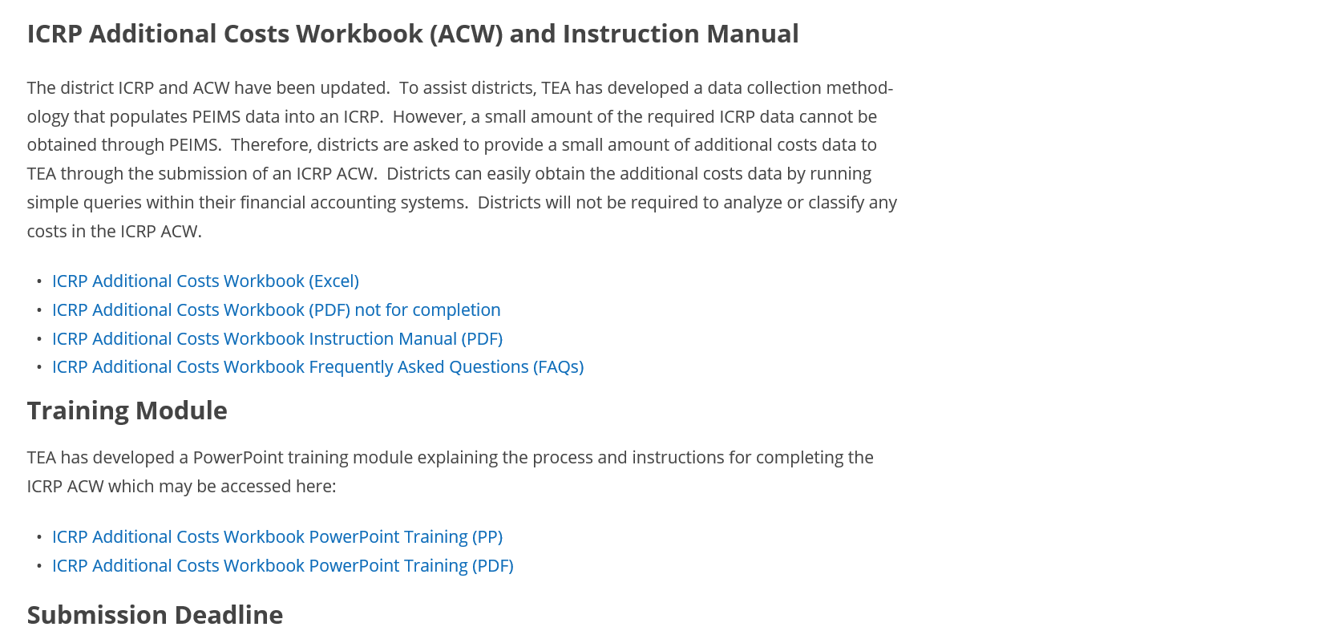
Indirect Cost Rates Webpage

Slide 6
USDE Methodology Overview
Indirect cost rate calculation methodology is dictated by federal laws and USDE
USDE designates TEA as the cognizant agency for indirect costs for local educational agencies (LEAs) and education service centers (ESCs)
USDE/TEA Delegation Agreement for calculating indirect cost rates changed as of 2018–2019 school year (SY)
Newest Delegation Agreement received 11/29/19 in effect for 5 years (through 2024–2025)

Slide 7
USDE Delegation Agreement Overview
For school year 2020-2021 and beyond, TEA received a new Delegation Agreement from USDE that specifies the approved indirect cost rate calculation methodology.
Re-affirms and clarifies current procedures in the LEA Plan
Prohibited indirect cost rates extensions
Rescinded all current indirect cost rates extensions
Required that rates be requested by independent school districts (districts) every year
Required that TEA calculates rates every year
Required 3 years of financial data to calculate the one-year rates
7

Slide 8
Rate Types
TEA issues two indirect cost rates to LEAs, an unrestricted rate and a restricted rate.
Unrestricted Rates
Unrestricted rates are applied to grants not subject to the federal supplement, not supplant requirement.
Restricted Rates
Restricted rates are used for grant programs where the supplement, not supplant requirement applies.
Most of the grants that TEA administers are subject to supplement, not supplant, and the restricted indirect cost rate is applied to them.

Slide 9
Indirect Cost Rate Proposal Overview
Indirect cost rate proposal (ICRP) was updated to accommodate three years of financial data
Districts no longer complete the ICRP – instead, complete the ICRP Additional Costs Workbook or ICRP ACW
TEA will prepopulate an ICRP for each district that requests indirect cost rates through submission of the ICRP ACW
9

Slide 10
ICRP Additional Costs Workbook
21–22 SY ICRP was streamlined (22–23 follows same format)
Districts must complete and submit the ICRP ACW to request indirect cost rates
To receive rates for the 2022–2023 SY, the due date to submit the ICRP ACW is January 19, 2022
10

Slide 11
ICRP – Prepopulated Data
TEA will prepopulate the ICRP with the following data:
10%* will be prepopulated from the ICRP ACW submitted by the district
90%* will be prepopulated from PEIMS data
Districts will review and certify the complete ICRPs
*Percentages are approximate
11

Slide 12
Indirect Cost Rates Timeline
Date | Action
November 4, 2021 | ICRP ACW is made available via the Indirect Cost Rates webpage and the secure GFFC Reports and Data Collections application, accessible through TEAL.
January 19, 2022 | Due date for districts to submit the ICRP ACW requesting indirect cost rates.
January – April 2022 | TEA reviews all submitted ICRP ACWs and requests clarification and/or re-submissions, as needed.
April 21, 2022 | TEA provides complete ICRPs to districts for review and certification.
May 20, 2022 | Due date for districts to submit ICRP Certification in GFFC Reports and Data Collections
July 1, 2022 | Notification Letter - Indirect Cost Rate posted in GFFC Reports and Data Collections, accessible through TEAL. Rates become effective.

Slide 13
Completing the ICRP ACW
LEA Information Worksheet

Slide 14
Completing the ICRP ACW
Checklist to Assist LEAs

Slide 15
Completing the ICRP ACW
Organizational Chart Sample Worksheet

Slide 16
Completing the ICRP ACW
Organizational Chart Worksheet
The process for submitting the Org Chart is the same as last year. Districts can insert their org chart into this worksheet/tab.
Districts will not submit a separate document in GFFC Reports and Data Collections.

Slide 17
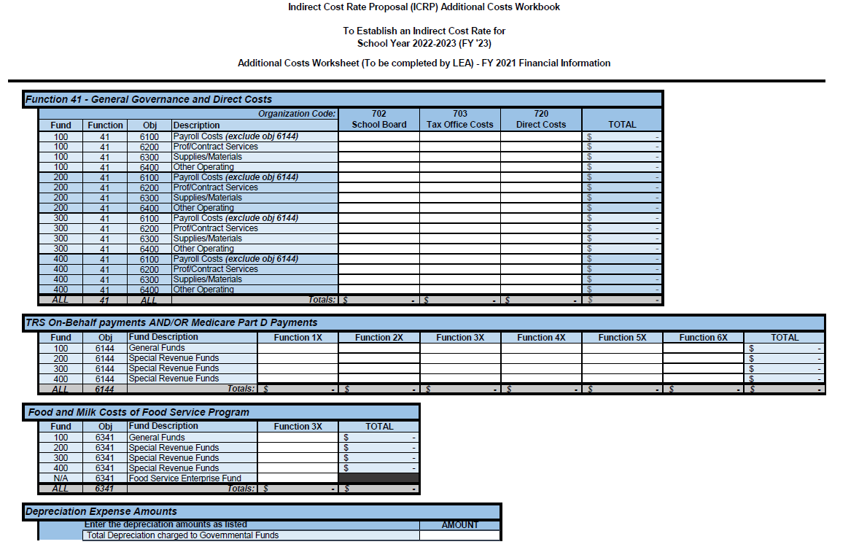
Completing the ICRP ACW
Additional Costs Worksheet(s)
If your district received indirect cost rates for 21–22 SY and is requesting again for 22–23 SY, you will only have to submit 1 Additional Costs Worksheet for FY 21 (20–21 SY data) because TEA has retained the data you’ve already submitted for the previous 2 years (18–19 and 19–20).

Slide 18
Completing the ICRP ACW
First year a district requests indirect cost rates is the only year it is required to submit three years’ worth of additional costs data
In subsequent years, the district will be required to provide data only for the year(s) not previously-submitted
Districts should run accounting system queries to retrieve most of the requested information
Additional Costs Worksheet(s)

Slide 19
Completing the ICRP ACW
Additional Costs Worksheet(s)
A staff member familiar with accounting system queries should complete the workbook
Indicate $0.00 if there are no expenditures (it will show as “$ -” in Excel); do NOT leave sections blank

Slide 20
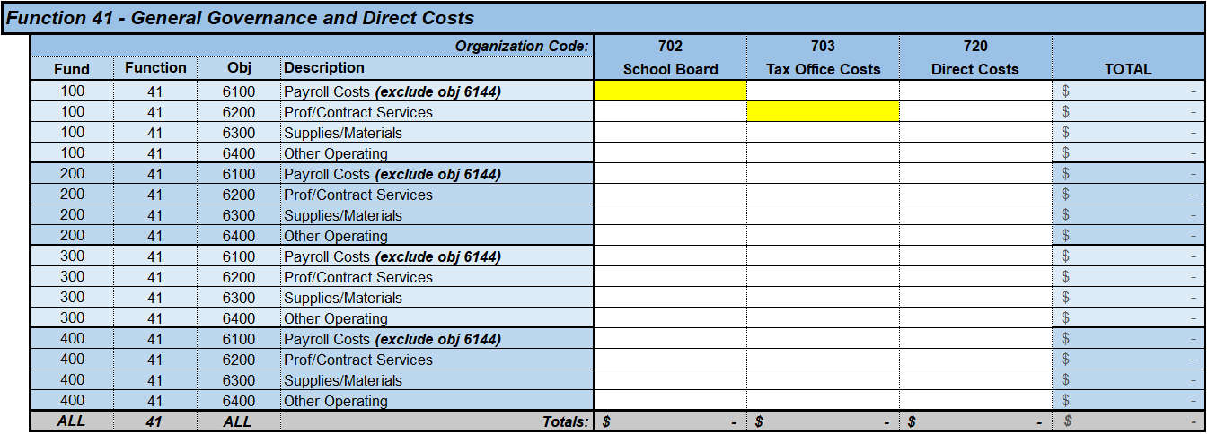
Completing the ICRP ACW
Function 41 - General Governance and Direct Costs
Enter expenditures for org codes 702, 703, and 720 – by fund, function, and object code

Slide 21
Completing the ICRP ACW
TRS On-Behalf Payments/ Medicare Part D Payments
Enter expenditures by the appropriate fund, function, and object (6144) code

Slide 22
Completing the ICRP ACW
Food and Milk Costs of Food Service Program
Enter expenditures by the appropriate fund, function, and object (6341) code

Slide 23
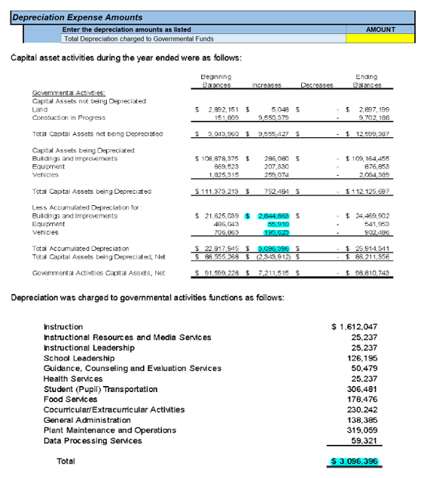
Completing the ICRP ACW
Depreciation Expense Amounts
The information needed to complete the Depreciation Expense Amounts section can be found in the Notes to the Financial Statements section of your district’s AFR, under “Capital Assets” or “Capital Asset Activity”

Slide 24
Completing the ICRP ACW
Payments to Fiscal Agent/Member Districts of Shared Services Arrangements (SSAs) (report only federal funds))
Enter full payment amount made with federal funds

Slide 25
Completing the ICRP ACW
Federal Subrecipient Items - Federal Subgrants and Federal Grant Pass-Through Funds (report only federal funds)
Do not include subgrants or subcontracts that are less than $25,000, and do not include the first $25,000 of payments in subgrants or subcontracts that are greater than $25,000

Slide 26
Completing the ICRP ACW
Contingencies
Select the fund, function, and object code from the pull-down lists
Enter a description and the amount of the contingency

Slide 27
Completing the ICRP ACW
Chief Executive Officer Information
Enter all expenditures for Chief Executive Officers and their immediate support person(s) – state/local salaries and fixed costs by function and position name. These positions should correspond to the organizational chart that you will be inserting/pasting within the ICRP ACW Organizational Chart tab.

Slide 28
Completing the ICRP ACW
Terminal leave
Terminal leave payments are amounts paid to departing employees outside of normal routine payments for either the accumulation of vacation leave or as part of an employment contract.

Slide 29
Common Mistakes
Depreciation Expense- Blank or wrong amount reported
Payments to Fiscal Agent/Member Districts of Shared Services Arrangements (SSAs)- Incomplete data

Slide 30
Common Mistakes
Federal Subrecipient Items - Federal Subgrants and Federal grant pass-through funds - Incomplete data and no selection from pull-down list
Contingencies – No selection from pull-down list

Slide 31
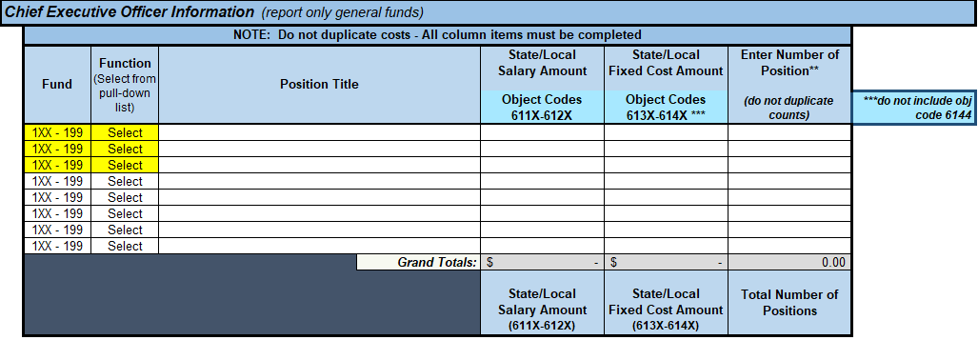
Common Mistakes
Chief Executive Officer Information - No selection from pull-down list, number of position(s), positions listed that should NOT be under CEO section (see #s 10 &11 in the FAQ)
What are some examples of positions that should NOT be listed:
Campus Principals
Special Education Programs
Federal Programs
Transportation Programs
Food Service Programs
Art Programs
Board of Trustees

Slide 32
Submitting the ICRP ACW
Log on to the TEA Login, (TEAL)
Select GFFC Reports and Data Collections
Select Upload Response Documents
Select ICRP Additional Costs Workbook from the “Response Template Title” pulldown menu
Workbook must be submitted in Excel format
32

Slide 33
Submitting the ICRP ACW (continued)
Select Response Document from the “Response Doc Type” pulldown menu
Select the school year for which you are requesting indirect cost rates from the “School Year” pulldown menu (if you are submitting in the fall of 2021 or spring of 2022, select the 2022–2023 school year)
Select Upload Document
33

Slide 34
ICRP Next Steps
Districts that want 2022–2023 indirect cost rates must submit the ICRP ACW by January 19, 2022
For those districts that submit the ICRP ACW, TEA will collect PEIMS data in the spring when 2020–2021 final certified data is available
TEA will merge district-submitted ICRP ACW data with PEIMS data to create/prepopulate the complete ICRP
34

Slide 35
ICRP Next Steps (continued)
TEA will post the complete ICRPs in GFFC Reports for district review
Districts will be required to review and certify acceptance of the resulting indirect cost rates
New rates will become effective July 1, 2022

Slide 36
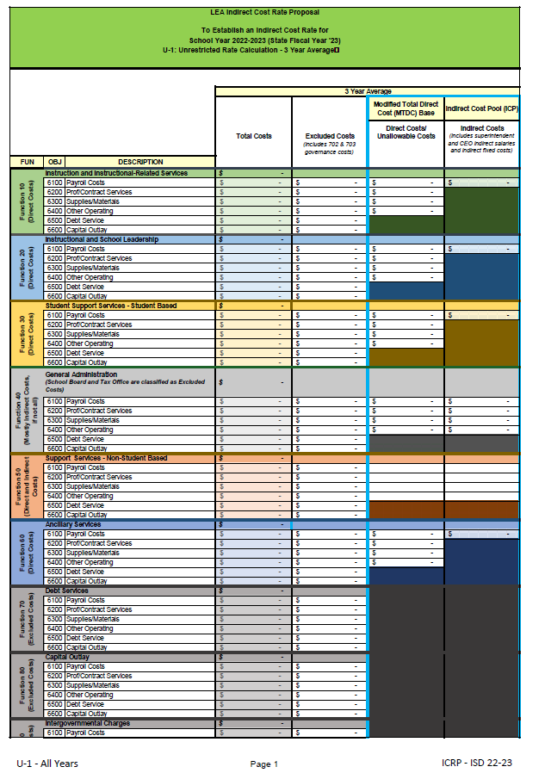
Reviewing the ICRP – Financial Worksheets
The pages of the ICRP are labeled at the bottom of each page. The specific data contained within the worksheets is summarized below:
U-1 All Years (pages 2-3) Summary of the unrestricted rate’s data average for all 3 years
R-1 All Years (pages 5-6) Summary of the restricted rate’s data average for all 3 years

Slide 37
Reviewing the ICRP – Financial Worksheets (continued)
Restricted Rate Adj All
Summary of the restricted rate adjustment average for all 3 years (page 4)

Slide 38
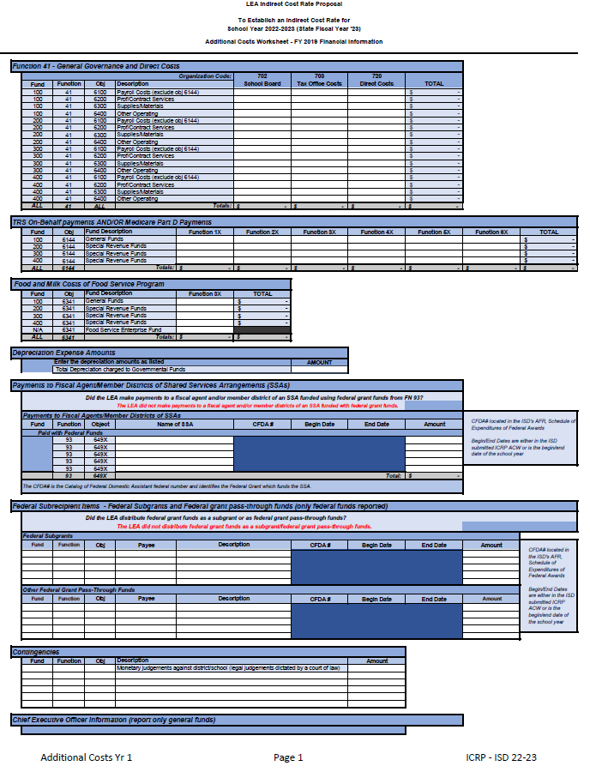
Reviewing the ICRP – Financial Worksheets (continued)
Supporting data for each of the 3 fiscal years used in the calculation (Additional Costs and TSDS/PEIMS Financial Data)
Year 1 – 2019 (pages 7-10)
Year 2 – 2020 (pages 11-14)
Year 3 – 2021 (pages 15-18)

Slide 39
Filling Out the ICRP Certification
District’s certification of the information contained within the proposal (page 1)
The certification must be signed by the school district’s superintendent, chief executive officer (CEO), or chief financial officer (CFO)
Certification must be for the correct school year (2022–2023)

Slide 40
Filling Out the ICRP Certification (continued)
To complete the certification:
Print the certification page
Enter the required information
Have the Superintendent, CEO, or CFO sign and date the printed page
Scan the signed and dated page
Upload the scanned certification into GFFC Reports as
“ICRP Certification”

Slide 41
Submitting the ICRP Certification
Complete the following steps to submit your school district’s completed ICRP Certification:
Log on to the TEA Login, (TEAL)
Select GFFC Reports and Data Collections
Select Upload Response Documents
Select ICRP Certification from the “Response Template Title” pulldown menu
Select Response Document from the “Response Doc Type” pulldown menu
Select the school year 2022–2023 from the “School Year” pulldown menu
Select Upload Document

Slide 42
Questions
Federal Fiscal Compliance and Reporting Division
compliance@tea.texas.gov

Slide 43
Copyright
The materials are copyrighted © and trademarked ™ as the property of the Texas Education Agency (TEA) and may not be reproduced without the express written permission of TEA, except under the following conditions:
Texas public school s, charter schools, and Education Service Centers may reproduce and use copies of the Materials and Related Materials for the s’ and schools’ educational use without obtaining permission from TEA.
Residents of the state of Texas may reproduce and use copies of the Materials and Related Materials for individual personal use only without obtaining written permission of TEA.
Any portion reproduced must be reproduced in its entirety and remain unedited, unaltered and unchanged in any way.
No monetary charge can be made for the reproduced materials or any document containing them; however, a reasonable charge to cover only the cost of reproduction and distribution may be charged.
Private entities or persons located in Texas that are not Texas public school s, Texas Education Service Centers, or Texas charter schools or any entity, whether public or private, educational or non-educational, located outside the state of Texas MUST obtain written approval from TEA and will be required to enter into a license agreement that may involve the payment of a licensing fee or a royalty.
For information contact: Texas Education Agency, 1701 N. Congress Ave., Austin, TX 78701-1494; email: copyrights@tea.state.tx.us.

