Slide 1
Texas Home Learning Model:
Phase Recap and Plans for 2020-2021
June 16, 2020

Slide 2
Recap: What is Texas Home Learning?
Texas Home Learning provides school districts with optional home learning models that provide continued instruction for students.
Texas Home Learning IS:
Texas Home Learning IS NOT:
Completely optional to use
Designed to engage students in meaningful content and mitigate student gaps in learning
Daily activities aligned to the TEKS
Family and student-facing resources for guiding students outside of classroom, without support of a full-time teacher
Customizable for districts to adapt and integrate into any remote learning plans
A requirement of the state
A continuation of any particular district’s annual scope and sequence or a bridge to the next grade level
Alignment to the TEKS Resource System
An endorsement or recommendation of any particular resource or text

Slide 3
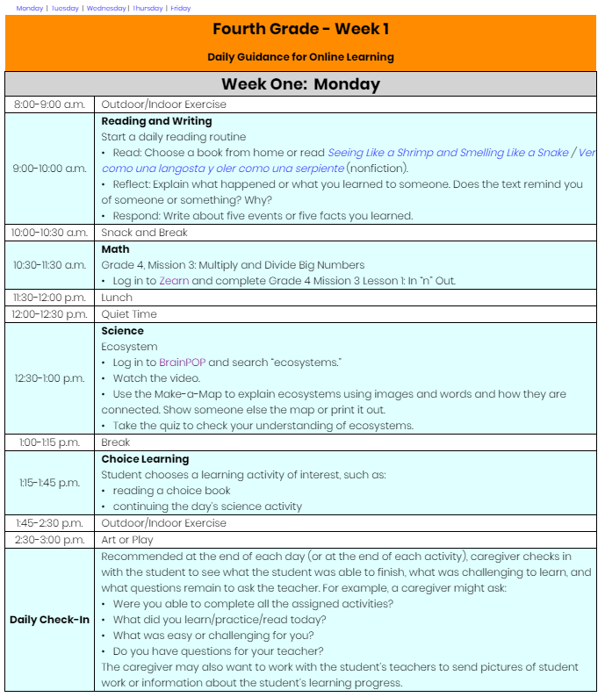

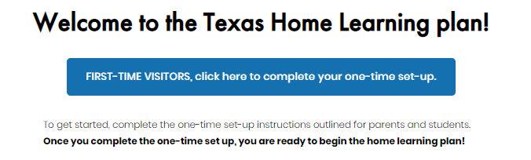
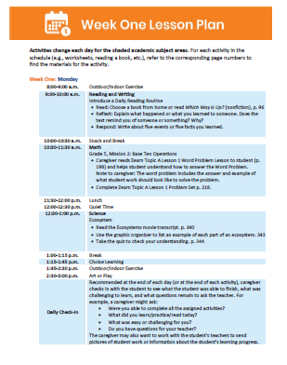

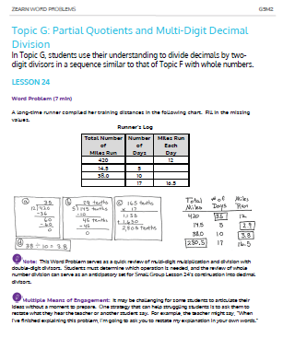
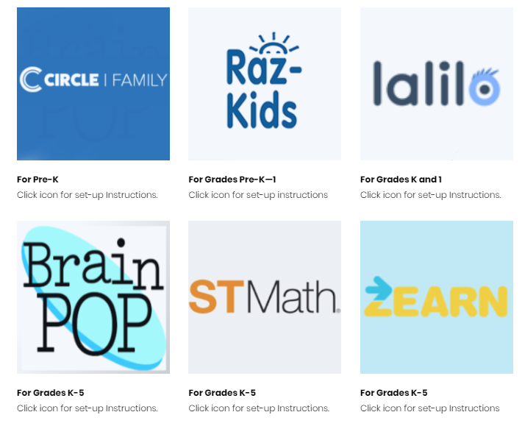

THL Phase 1: Access to Online and Printable Materials
THL Phase 1 Purpose: Provide a plug and play option to support students in finishing out the school year with daily lessons available online and in print format.
Online Materials
Printable Packets
Daily Digital Lessons
No Cost Access to Online Curriculum
PDF Packets w/ Daily Plans and Materials
Direct Shipping to Families
*All materials available in both English and Spanish*

Slide 4

Recap Phase 1 - 2: What Was Right & What We Learned
The THL team conducted district outreach to learn about improvements that could be made to THL Phase 2. Districts liked the plug and play nature and quality of curriculum of Phase 1 but want more options for customization and ELAR improvements.
What Districts Liked
Plug and play nature of THL Phase 1 for both online and printed options
No cost and simple access to high quality curriculum included in THL Phase 1
Materials developed for in-home use and provided in both English and Spanish
What Could be Improved
Shortened and simplified learning plans for students and parents
Guidance for district customization to suit unique needs and to support for all learners
Improved text access for all grade levels including access to phonics instruction, anchor texts, and novels
Support implementation for teachers and administrators and provide guidance for special populations

Slide 5
Summer Reminders and New Resources Next Week
Progress Monitoring for Summer
District Quick Start Guide
Step-by-step guidance
Links for easy access
Resources Availability
All digital and print materials available through July 31
Some digital access through August
New materials and professional development opportunities forthcoming next week!
RLA extension materials still available!

Slide 6
Phase 3

Slide 7
Texas Home Learning Phase Overview
Vision: Create multiple home learning models that meet specific district needs and allow for contingency planning during school closures.
Home Learning 1.0
Finish out School Year
Home Learning 2.0
At-Home Summer School
Home Learning 3.0
2020-21 School Year
Purpose: To launch new school year in situation where Home Learning is continued into the fall.
Approach: Improve 2.0 version by providing districts plug and play options to support continuous, remote learning during closures.
Timing: Prepare from start of school year or at any point during school year to follow full-year scope and sequence.

Slide 8
What is Texas Home Learning 3.0?
Texas Home Learning provides school districts with optional home learning models that provide continued instruction for students.
Texas Home Learning IS:
Texas Home Learning IS NOT:
Completely optional to use
Designed to engage students in meaningful content and mitigate student gaps in learning
Daily activities aligned to the TEKS
Resources for guiding students inside and outside of the classroom, designed to be supported by district staff
Customizable for districts to adapt and integrate into any remote learning plans
A requirement of the state
A continuation of any particular district’s annual scope and sequence or a bridge to the next grade level
Alignment to the TEKS Resource System
An endorsement or recommendation of any particular resource or text
A full-time virtual school run by TEA

Slide 9
What We’ve Heard Preparing for Phase 3
What Districts Liked
Plug and play nature of THL
No cost and simple access to high quality curriculum
Materials provided in both English and Spanish
Improved text access for all grade levels including access to phonics instruction, anchor texts, and novels
What Could be Improved
Provide platforms and access: allow content modules to exist in a Learning Management System so districts can import to their own platform and/or access through single sign on
Provide a scope and sequence: knowing what’s included makes it easier for districts to customize and leverage for local contexts, including easy transition between face to face, online and blended settings
Better progress monitoring: include shorter and more formative assessment options
Create parent supports: additional parent supports to familiarize with the resources, such as short video clips

Slide 10



Introducing Texas Home Learning 3.0
THL 3.0 builds of the existing Texas Home Learning work to provide totally optional tools that districts may use any part of and customize to fit their needs.
Plug and Play Resources
Fully Customizable
Implementation Support
Full sets of resources in core subjects, including college prep math and English, with technology support that can be delivered in a variety of virtual and/or hybrid settings
Strategic and technical guidance to adapt learning plans for unique scheduling, academic, or student-specific needs
Support for district planning, launch, and implementation with guidance for supporting all learners and a particular emphasis on supporting progress monitoring

Slide 11
We’d Like Additional Feedback!
What else did you like?
What components of the current site are most useful for you?
What else could be improved?
What changes or additions would improve Texas Home Learning and make it more useful for you?
What other feedback or considerations would you like to share?
Please take our survey – we’d like your input on Phase 3!

Slide 12
Texas Home Learning 3.0: Timeline
August 1 & Beyond
June
July 6
July 13
July 20
July 27
Solicit input and stakeholder feedback
Share full scope of offerings for THL 3.0
Launch optional implementation supports
Initial THL 3.0 offerings available

Slide 13
Thank You!

