Slide 1
Texas Home Learning Model Phase 2: Text Updates May 14, 2020

Slide 2
What is Texas Home Learning?
Texas Home Learning provides school districts with optional home learning models that provide continued instruction for students.
Texas Home Learning IS:
Texas Home Learning IS NOT:
Complete optional to use
Designed to engage students in meaningful content and mitigate student gaps in learning
Daily activities aligned to the TEKS
Family and student-facing resources for guiding students outside of classroom, without support of a full-time teacher
Customizable for districts to adapt and integrate into summer learning plan
A requirement of the state
A continuation of any particular district’s annual scope and sequence or a bridge to the next grade level
Alignment to the TEKS Resource System
An endorsement or recommendation of any particular resource or text

Slide 3
2020 Summer Learning in Texas
Engaging students in summer learning can help mitigate learning loss from COVID-19.
Districts
Families
All Users
Districts have the option to decide whether or not to use at all; districts may also decided to provide resources without structured summer school.
Summer school expectations must be feasible for parents and families to implement.
THL is designed for a light touch by teachers and simple implementation for parents making it an easy plug and play resources to support during summer.

Slide 4
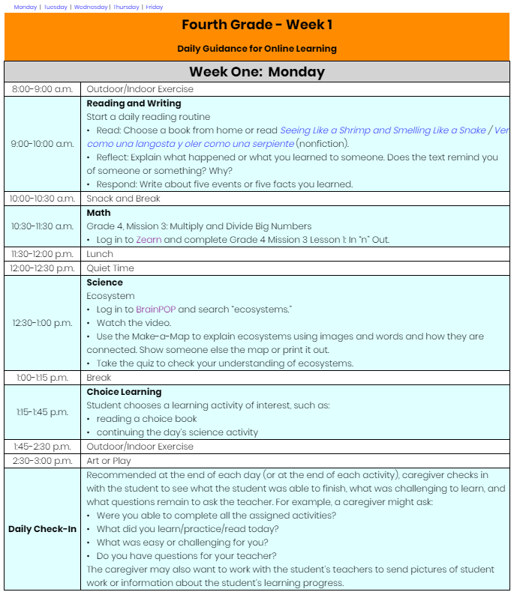
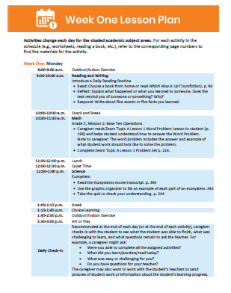
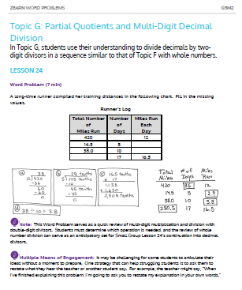
THL Phase 1: Access to Online and Printable Materials
THL Phase 1 Purpose: Provide a plug and play option to support students in finishing out the school year with daily lessons available online and in print format.
Online Materials
Printable Packets
Daily Digital Lessons
No Cost Access to Online Curriculum
PDF Packets w/ Daily Plans and Materials
Direct Shipping to Families
*All materials available in both English and Spanish*

Slide 5
Introducing Texas Home Learning 2.0
THL 2.0 provides optional at-home summer learning resources to keep students engaged with and connected to high quality content
Shortened and Simplified Learning Plans
Guidance for District Customization
Implementation Support
Learning plans and schedules shortened to 4 weeks, organized by subject, and simplified for parents
Strategic and technical guidance to adapt learning plans for unique scheduling, academic, or student-specific needs
Support for district planning, launch, and implementation with guidance for supporting all learners
Improved Text Access

Slide 6
2.0 Sample Packet
Sample schedules for full day learning
Sample schedules for reading and math only
Sample schedules for reading only

Slide 7
Updated THL Online and Print Packets Forthcoming!
www.TexasHomeLearning.org

Slide 8
Improved Text Access

Slide 9
THL 2.0: Improved RLA Options for Districts and Students
Curated RLA information and options to assist districts in review and adoption of high quality RLA materials
Anchor texts and text sets available from curated and organized vendor list for deeper RLA engagement and access to TEA-negotiated prices and services
1
Phonics instruction packages for early learners available from curated and organized vendor list with access to TEA-negotiated prices and services
2

Slide 10
First, Get Texas Reading!
Students across the state who are not already using myON will get immediate access to authentic reading materials they can access anytime, anywhere.
Students need only a device and access to the Internet to read high-quality texts, novels, news articles, and much more on myON—anytime and anywhere.
They can also download up to 20 books at a time for offline reading using free mobile apps.
Texts are supported with audio!

Slide 11
Get Texas Reading with myON from Renaissance
Flyer linked on our Texas Home learning page includes instruction to access myON
myON will be linked from Texas Home Learning site for digital RLA extension

Slide 12
Get Texas Reading with myON from Renaissance is live!

Slide 13
Reading Language Arts Print Extension Options
Additionally, the following materials for Reading Language Arts extension in the Summer At-Home Learning model are available to be shipped directly to student homes at statewide negotiated rates. All presented options include:
Caregiver friendly- language and guidance for family use
Grade level appropriate books and/or readings
Materials for a 4-week program
Direct shipping to student homes
Negotiated rates for materials

Slide 14
Negotiated Prices for Districts to Ship to Parents
Grade Level | Resource | Spanish Version? | Cost
Pre-K | Teaching Strategies: Pre-K Summer Soar for Texas | Yes | $40 includes shipping
 | Frog Street: Family Learning Fun | Yes | $50 does not include shipping
K-1 | Learning Dynamics | Instructions Only | $35 includes shipping
K-5 | HMH: THL ELA K-5th Grade | Yes | $32 includes shipping
6-12 | HMH: Close Reading 6th-12th Grade | Yes | $25 includes shipping
Look for more sample products and ordering information next week!

Slide 15
Teaching Strategies: Pre-K Summer Soar for Texas
Includes learning materials, books, and progress monitoring tools linked to TPG and TEKS
Digital option available (mobile app)
Includes option for manipulatives add-on
Meant to build capacity in families
$40 – includes shipping

Slide 16
Frog Street
Familiar to many children
Focused on literacy and math and aligned to TPG
Workbooks and learning materials in one package
$50 – does not include shipping

Slide 17
Learning Dynamics
Phonics program includes 52 books
Designed as a family-led program
Daily lessons designed to fit easily into family schedule
Includes an app for parents with print materials to reduce screen time
$35 – includes shipping

Slide 18
Houghton Mifflin Harcourt: K-5
For students from K-5th Grade
Real texts, includes 6 total books that are mixture of fiction and nonfiction
Books contain family-facing instructions in the front and back materials to support engagement with the books included
$32 – includes shipping

Slide 19
Houghton Mifflin Harcourt: 6-12
For students from K-5th Grade
Real texts, includes 6 total books that are mixture of fiction and nonfiction
Books contain family-facing instructions in the front and back materials to support engagement with the books included
$32 – includes shipping

Slide 20
TEA Will Provide Initial Access to Some Texts
Districts that have student populations that where more than 50% of students are classified as economically disadvantaged are eligible to have TEA cover up to 50 sets per grade of the following products on a first-come first-served basis.
All districts have access to the TEA negotiated rates for all products.
Again, more information on ordering will be available next week.
Product Type | Resource | Spanish Version?
Pre-K Program | Teaching Strategies: Pre-K Summer Soar for Texas | Yes
Phonics Program | Learning Dynamics | Instructions Only
Text Sets | HMH: THL ELA K-5th Grade | Yes

Slide 21
Implementation

Slide 22
District Implementation Support
Support for district planning, launch, and implementation with guidance for supporting all learners
Implementation Support for Planning, Launch, and Implementation
Guidance to Support for All Learners
To assist districts in implementation and to support for all learners, TEA will provide the following :
THL 2.0
Webinar Series
Training Tools, Guidance Documents, and Templates
Access to Curriculum-specific Resources

Slide 23
Upcoming Implementation Webinars
Webinar 1, May 21: Planning for Summer
Outline the consideration for determining summer learning approach.
Provide an overview of the approach and details for the Texas Home Learning summer option.
Preview tools and resources to support district planning for summer learning.
Hear from a district leader considering the Texas Home Learning summer option.
Provide a planning template with guiding questions and example
Webinar 2, May 26: Preparing to use Texas Home Learning
Provide an overview of content and associated products (includes criteria for how products were selected).
Provide an overview of various use options and considerations for local context.
Outline training considerations and publishers supports (connect to CPE credit).
Preview tools and resources to support district planning for summer learning.
Preview the text set packages.
Both webinars are at 8:30 am and will be announced through the superintendent’s listserv. They will also be recorded and posted on TEA’s site.

Slide 24
Next Steps and Questions
Book order information to come next week
Pre-Order Summer Learning Packets Now!
To Pre-Order, Districts should
Complete the Phase 2 Pre-Order Form tab of the online order form at bit.ly/THLOrderForm
Enter the Subject: “Phase 2 Pre-Order”
Submit the online order form to TexasPackets@XanEdu.com
Questions?
Reach out to curriculum@tea.texas.gov with questions or feedback

Slide 25
Thank You!

