Slide 1
Introduction to State Funding for New Charter Schools Texas Education Agency, State Funding Division The 2018 Charter School Summer Summit --- June 28 ,2018
Believe in Rainbows Kimber Croley / Beaumont ISD
Spring is in the Air Dana Smith/ Livingston ISD

Slide 2
Agenda Topics
What’s New in Charter School Finance
Foundation School Program (FSP) System
FSP Reports and Deadlines
Understanding Purpose of FSP Reports
Summary of Finances (SOF) and Key Publication Dates
Estimate of State Aid Template
Payments
State Funding Website and Contact Information

Slide 3
What’s New in Charter Finance
House Bill 21 – Charter School Facility Funding
Review TTAA dated May 1, 2018 - Subject: Charter School Facility Funding
Effective with 2018-2019 school year, new “per ADA” facilities funding allotment.
At least an acceptable performance rating is required to receive allotment based on the “most recent overall performance rating.”

Slide 4
What’s New in Charter Finance
House Bill 21 – Charter School Facility Funding
A Commissioner’s rule will define the “most recent” rating year and once the rule is in effect, the 2018-2019 SOF report will be updated to incorporate preliminary estimates of the funding allotment.
The 2018-2019 Charter School Estimate of State Aid template will incorporate the calculation of the new facilities per ADA allotment funding.
For planning purposes, budget approximately $200 dollars per refined ADA.

Slide 5
What’s New in Charter Finance
TEA Review of Expiring Accelerated Payment Schedules
Each June, TEA’s State Funding Division will review accelerated payment schedules that end August 31st (i.e., expiration of 3 year minimum locked period under Payment Class 5)
Following review, TEA will email contacts provided in the FSP Charter School module (i.e., Superintendent and FSP Program contact listed).
Either, continuation of Payment class 5 (accelerated schedule) for additional three school years,
or
Reset to Payment class 4 (regular schedule) effective as of September 1st, unless Payment class 5 eligibility is reestablished.

Slide 6
What’s New in Charter Finance
TEA Review of Expiring Accelerated Payment Schedules
To receive automatic three year extension, Fall PEIMS enrollment of current school year must have an increase of at least 10% from the prior school year Fall PEIMS enrollment.
(Fall 2017 enrollment compared to Fall 2016 enrollment).
If not automatically extended, charter has opportunity to reestablish Payment Class 5 eligibility by reporting at least a 10% increase in enrollment from 1st day enrollment with prior school year Fall PEIMS enrollment.
(August xx 2018 compared to Fall 2017 enrollment)

Slide 7
FSP System: Access through TEA Login secure portal
The Foundation School Program (FSP) system is the online system that charter schools use to report data so that the Texas Education Agency may determine initial allotments and allocations.
District users access the FSP System application through TEA Login (TEAL)
TEAL login webpage: https://tealprod.tea.state.tx.us

Slide 8
FSP System: Access through TEA Login secure portal
Don’t have a TEAL Account?: Click on Request New User Account

Slide 9
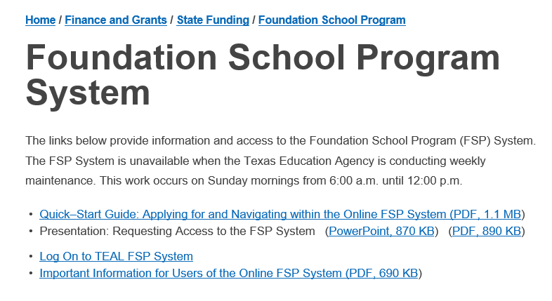
FSP System: Access through TEA Login secure portal
Go to Foundation School Program System webpage for tutorials:

Slide 10
FSP System: Program Modules and User Roles
User Roles
Charter Schools User
NIFA User
Transportation User
State Comp Ed User
Staff Salary User
District Approver

Slide 11
FSP System: Reminders and Best Practices
Data submitted through this system affect state aid payments
The modules are set up to include multiple roles: user and approver
The TEA does not use data until it has been submitted by district approver and approved by TEA.
We do not recommend that the user and approver be the same person
We do recommend:
Checking TEAL access periodically to be sure that current staff are included and staff that no longer work with the district are not included.
Making sure that major submissions are completed and submitted to TEA on time.

Slide 12
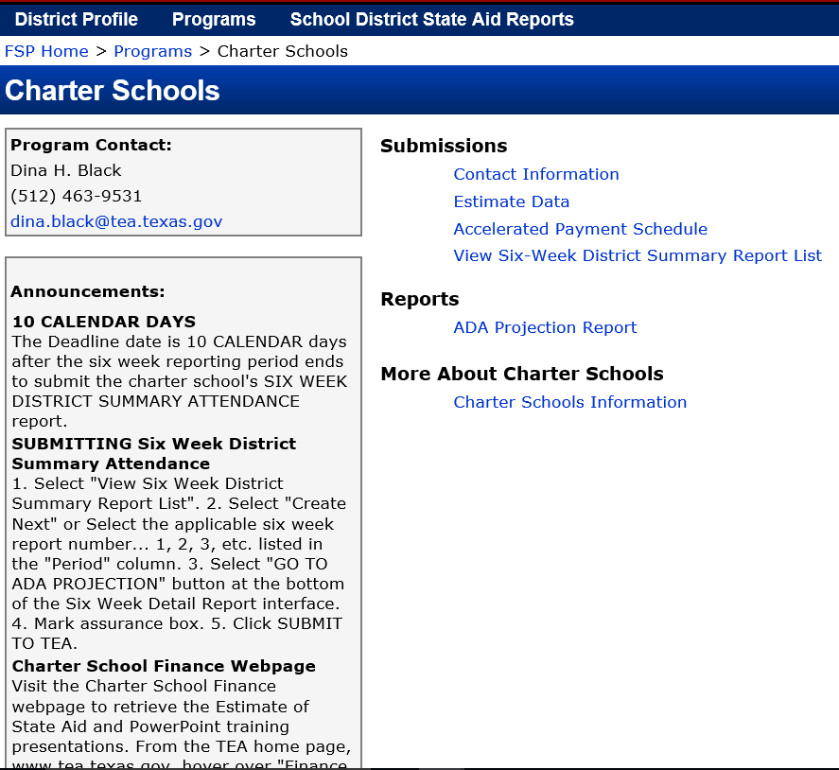
FSP system: Charter School Module
Read Announcements section
Update Contact Information
Superintendent
Secondary Program Contact
Access Reports:
Estimate Data Report
Accelerated Payment Schedule
Six-Week District Summary Report

Slide 13
FSP Reports and Deadlines
2018-2019 Deadline
First-time Transportation applications July 15, 2018
New Facility Instructional Allotment (NIFA) Tentatively, July 16, 2018
Estimate Data Report August 1, 2018
Accelerated Payment Schedule September 1, 2018
Six-Week District Summary Attendance Report 10 calendar days after reporting period ends
State Compensatory Alt. Basic Monthly Claim November 30, 2018
Transportation Route Services August 1, 2019
Staff Salary Report August 31, 2019 & March 31, 2020
Transportation Operations December 1, 2019

Slide 14
Understanding Purpose of FSP Reports
Estimate Data Report (Late submissions not accepted)
Estimate Data Report opens July 1st with firm deadline of August 1st.
2018-2019 Estimate Data Report
This report is used by TEA to determine state-aid for the charter school until Six-week District Summary Attendance reports are submitted and approved by TEA.
When the report becomes available it will be loaded with Approved data from the previous school year.
Submission of the Estimate Data Report is required for new open enrollment charter schools and optional for all other charter schools.
State-aid payments based on report until Six-Week District Summary reports are submitted and approved by TEA.

Slide 15
Understanding Purpose of FSP Reports
Accelerated Payment Schedule (Late submissions not accepted)
APS schedule opens August 20th with firm deadline of September 1st.
Apply to receive Foundation School Funding (FSF) payments on a accelerated schedule (known as Payment Class 5).
Distributes 49.5% of FSF remaining balance in first three payments and 50.5% over last 9 payments.
To be eligible, requires 10% or greater enrollment growth. Compares school’s first day enrollment with the prior year PEIMS Fall enrollment.
Locks Payment Class 5 schedule for three schools years.
Charter may apply to reestablish eligibility every three years.

Slide 16
Understanding Purpose of FSP Reports
Six-Week District Summary Attendance Report
Enter six-week attendance detail after all tracks completed for six-weeks.
Comply with Student Attendance Accounting Handbook Section II audit requirements.
The FSP System will not permit the user to submit a six-week report until all the prior six-week reports have been submitted.
Submit your report by clicking Go to ADA Projections button.
Carefully review ADA Projection Report before submitting to TEA.
Only six-week attendance reports in Approved status will be used to determine your charter school's state aid.

Slide 17
Understanding Purpose of FSP Reports
Six-Week District Summary Attendance Report
Review all reports for accuracy and completeness and reconcile reports to each other:
Student Detail Reports
Campus Summary (Principal’s) Report
District Summary (Superintendent’s) Report - required for Six-Week District Summary Attendance reporting
Obtain the Six-Week District Summary Attendance Report, signed by Superintendent, for the applicable reporting period (1, 2, 3, 4, 5, or 6).
Do not enter attendance data into the FSP System from a Six-week District Summary/Superintendent's Report that has not been signed by the Superintendent.

Slide 18
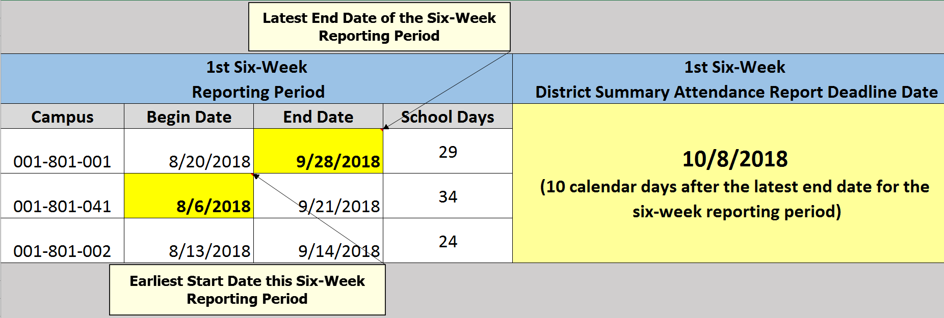
Understanding Purpose of FSP Reports
Six-Week District Summary Attendance Report
Deadline Date – 10 Calendar Days after last track for the six-week period ends.
Example of Deadline Date:

Slide 19
Understanding Purpose of FSP Reports
ADA Projection Report interface
The purpose of the ADA Projection Report is to compare your data to the prior six-week reporting periods **BEFORE** sending the report to TEA.
Before submission, carefully review the current Six-week District Summary Attendance Report for reasonableness, accuracy, and missing data.
Will be used to generate the Summary of Finances report and calculate the charter school’s estimated state aid and payment each month.

Slide 20
Understanding Purpose of FSP Reports
ADA Projection Report interface
The "Average " is calculated by taking the Approved data for the 1st through 6th, Six-Week District Summary Attendance reports.
The latest Approved Six-Week District Summary Attendance report column data is carried forward for reporting periods that are not in Approved status.

Slide 21
Understanding Purpose of FSP Reports
State Compensatory Alternative Basic Monthly Claim
One of the eligible data sources for State Compensatory Education allotment:
National School Lunch Program (NSLP)
Contract with Texas Department of Agriculture to provided NSLP
Contract with a district to provide NSLP
State Compensatory Alternative Basic Monthly Claim
The SCE allotment is based on the highest six-months average of the of the data sources above reported for the prior federal fiscal year of October through September.
New schools whose first year of operation is the upcoming school year may estimate their first year’s SCE eligibility.

Slide 22
Understanding Purpose of FSP Reports
State Compensatory Alternative Basic Monthly Claim
Applies to campuses who are not participants in the National School Lunch and Breakfast Program through Texas Department of Agriculture.
Critical reporting for charter schools that were new charters in the 2017-2018 school year.
Alternative reporting procedures available on the Charter School Finance webpage of TEA website.
Note: Access report through the FSP “Programs” menu and clicking the “State Compensatory Education” program module.

Slide 23
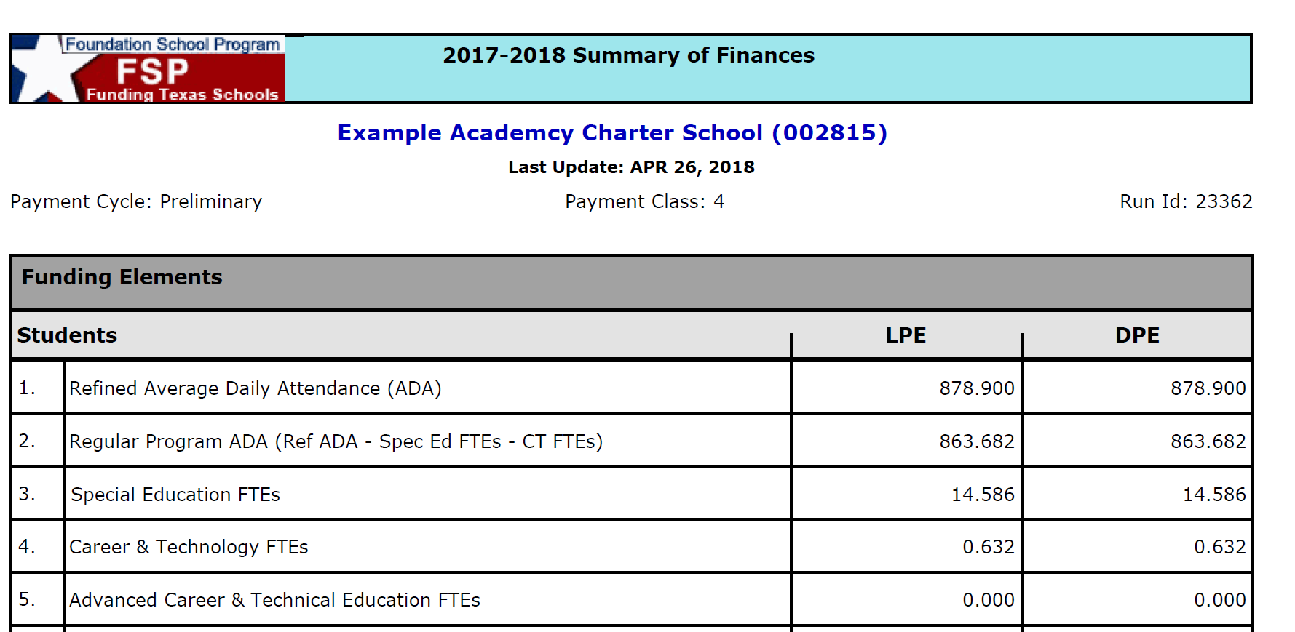
Summary of Finances (SOF) and Key Publication Dates
Describes funding elements and Foundation School Program (FSP) state aid.
Several SOF reports are published throughout the school year with updated data.
ADA Projection Report used to generate SOF.
Payments based on LPE (Legislative Payment Estimate) column.
Earnings based on DPE (District Planning Estimate) column.

Slide 24
Understanding Purpose of FSP Reports
Staff Salary Report
Generates Staff Salary Allotment.
Only applies to charter holders who participated in Texas Retirement System (TRS) Active Care program in 2005-2006 and continue to be an active contributing member of TRS. Thus, not applicable to new-open enrollment charter schools.
Reporting on full and part-time staff not subject to Minimum salary schedule (MSS).
Allotment generates $500 per full-time staff and $250 for part-time staff.
Visit Staff Salary Subsystem webpage for more information.

Slide 25
Summary of Finances (SOF) and Key Publication Dates
Preliminary
SOF Publication Date | SOF Publication Description
Prior to June 19, 2018 | Based on biennial Attendance Projection Data collected December 2016 and reported to Texas Legislature March 2017.
July 29, 2018 (anticipated) | Approved data from 2017-2018 ADA Projection Report rolled over into the 2018-2019 Estimate Data Report.
September 10, 2018 | Based on 2018-2019 Estimate Data Report submitted by charter on or before August 1, 2018 deadline date.
10th of each month (may fall on 8th or 9th if the 10th is holiday or weekend) | FSP Six-week ADA Projection Average calculated with current six-week district attendance.
January 2019 (anticipated) | New Instructional Facilities Allotment estimated posted.
March 2019 | ACTUAL State Compensatory Education Enrollment data from Texas Department of Agriculture NSLBP and FSP Alternative Monthly Claims of prior Federal Fiscal Year (October 2017 – September 2018).

Slide 26
Summary of Finances (SOF) and Key Publication Dates
Settle-up
A settle-up is calculation to determine how much state-aid was paid to the charter school versus how much was state-aid that the charter school earned based on a nearly complete (Near Final) or complete (Final) set of data for the finished school year. Results in either a payment to the charter school or a balance amount to transfer to the current year’s FSP payment ledger. Near Final – happens in September after the school year ends. Some Estimated Data Some Actual Data Final occurs in April after the school year ends. All Actual Data

Slide 27
Summary of Finances (SOF) and Key Publication Dates
Near Final (settle-up)
SOF Publication Date | SOF Publication Description
September 2019 | PEIMS summer attendance collection (Optional Flexible School Year, Advanced Career and Technology, Virtual Schools) Actual Transportation (if in Approved status) Actual Staff Salary (if in Approved status) High School ADA School District Tax Collection Survey estimate updated Positive ledger balance generates a payment to charter school Negative ledger balance generates an adjustment to 2019-2020 ledger

Slide 28
Summary of Finances (SOF) and Key Publication Dates
Final (settle-up)
SOF Publication Date | SOF Publication Description
April 2020 | PEIMS extended year attendance collection (Special Education Extended Year Services, Optional Flexible School Year credit recovery) State Compensatory Education (if new charter in prior year) School district audited tax collections (actual) Actual Transportation (allotment zeroed if not approved) Actual Staff Salary (allotment zeroed if not approved) Actual NIFA Instructional allotment (allotment zeroed if not approved) Positive ledger balance generates a payment to charter school Negative ledger balance generates an adjustment to 2019-2020 ledger

Slide 29
Estimate of State Aid Template (six worksheets)
Data Elements to prepare submission of your FSP Estimate Data Report
SCE Worksheet to prepare accurate estimate of the highest 6-month average of State Compensatory Education (SCE) enrollment for FSP Estimate Report
State Aid to reconcile to the latest Summary of Finance (SOF); to assist with budgeting, to update projections of state-aid allotment/cash flow
Membership Report Tool to demonstrate membership calculation
Payment Calculator To determine payments based on approved six-week district summary attendance reports and the FSP ADA Projection Report
ADA Projection Models the FSP ADA Projection Report interface

Slide 30
Going Live to Estimate of State Aid Template

Slide 31
Payments
Payments direct deposited on the 25th of each month.
If the 25th falls on a weekend or holiday, payments are deposited the prior banking day
Payments deposited September through August for 12 payments with payments distributed according to charter school’s payment class:
Payment Class 4 for regular (this is the default payment class)
Payment Class 5 for accelerated
For new charters 13 deposited payments, with 2 payments in September:
September 15th
September 25th
Reports
Payment Ledgers (Foundation and Available School Fund (ASF))
TEA Payment Report

Slide 32
Payments
Payment Ledger versus TEA Payment Report
Payment Ledgers: foundation school fund or ASF payment information
Payment Report: All payment information (Foundation, ASF, federal, etc.)

Slide 33
Contact Information
Dina Black
Charter School Funding Specialist, State Funding
Dina.Black@tea.texas.gov
(512) 463-9531

