Slide 1
Turnaround Plan Implementation
Statewide Partners Institute
July 19-20, 2016

Slide 2
How does a campus implementing a turnaround plan complete its targeted improvement plan?
Template changes
Focus on plan foundation

Slide 3
Updates
Notes:
-what we’ve accomplished
-where we are going
-commissioner approval
-what happens if you become FIR
-submission dates

Slide 4
Integration of Plans
WHAT
HOW
Notes:
Next step is to turn turnaround plan in to a targeted implementation plan

Slide 5
Guiding principles
Same Targeted Improvement Plan template, but with a Targeted Implementation Plan tab
Notes:
Both plans are developed and implemented under the TAIS framework
Both have a 4 piece foundation
No need to re-invent the wheel: Campuses implementing a turnaround plan will use the same Targeted Improvement Plan template (new tab). Thought about adjusting current tab, but this made the process better. Reduce duplication of efforts.

Slide 6
DRAFT

Slide 7
Alignment
Problem Statement
Root Cause
Strategy
Annual Goal
Notes:
Familiar structures: plan foundation

Slide 8
Problem Statements
Targeted Improvement Plan | Turnaround Plan | Targeted Implementation Plan
Developed as a result of data analysis | Assumed: Persistent IR | Missed Index Targets Every missed index must have at least one problem statement A missed index can have more that 1 problem statement
Notes:
In the targeted improvement plan, the problem statement clarifies and identifies gaps in the data
Data analysis is reported in targeted improvement plan tab
In the targeted implementation plan, problem statements are based on index calculations
Assumed larger problem statement (Persistent IR)
Avoiding duplication of effort: data analysis that was done in turnaround planning
Template change

Slide 9
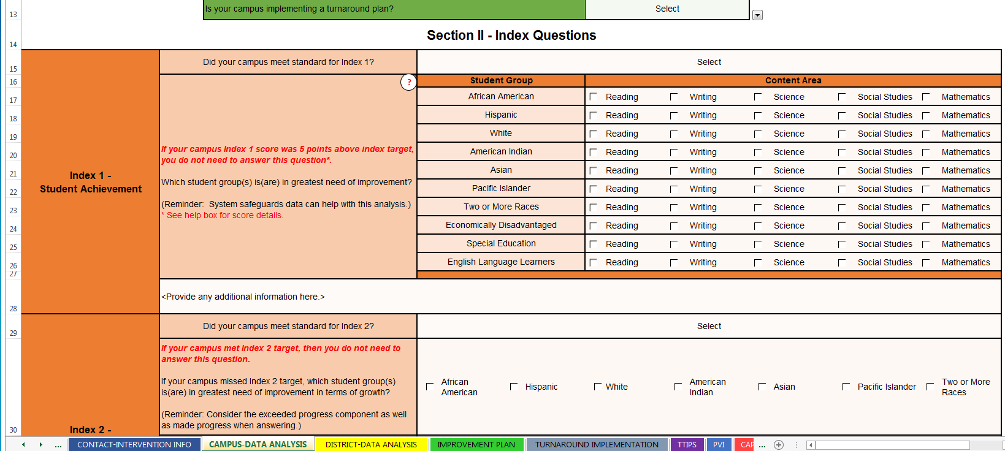
DRAFT
Notes:
On data analysis tabs, note that the index data still has to be analyzed…thinking beyond Index 1, demonstrating understanding of what the index measures
Data analysis tab isn’t different, just don’t have to do CSF chart

Slide 10
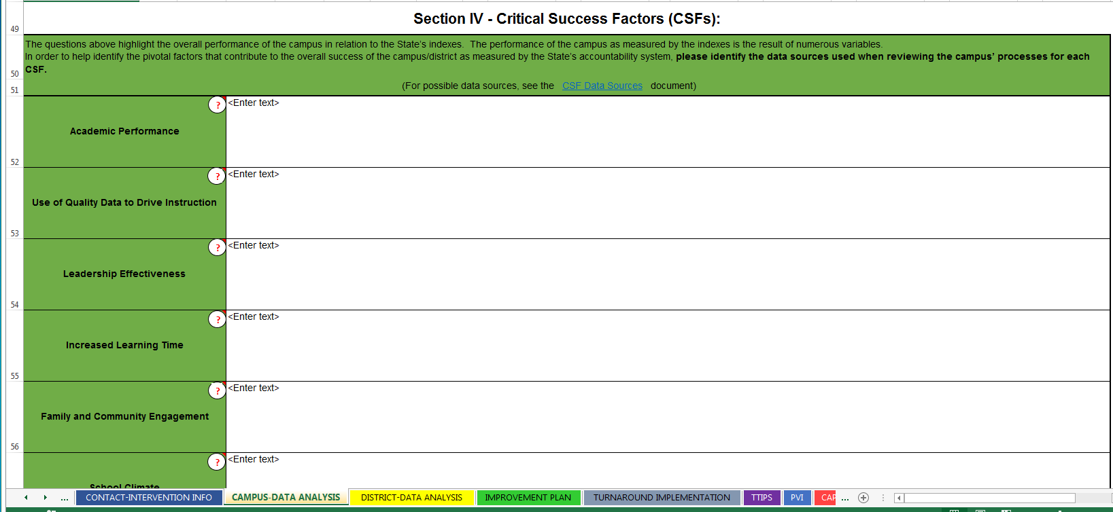
DRAFT
Notes:
On data analysis tabs, note that the index data still has to be analyzed…thinking beyond Index 1, demonstrating understanding of what the index measures
Data analysis tab isn’t different, just don’t have to do CSF chart

Slide 11
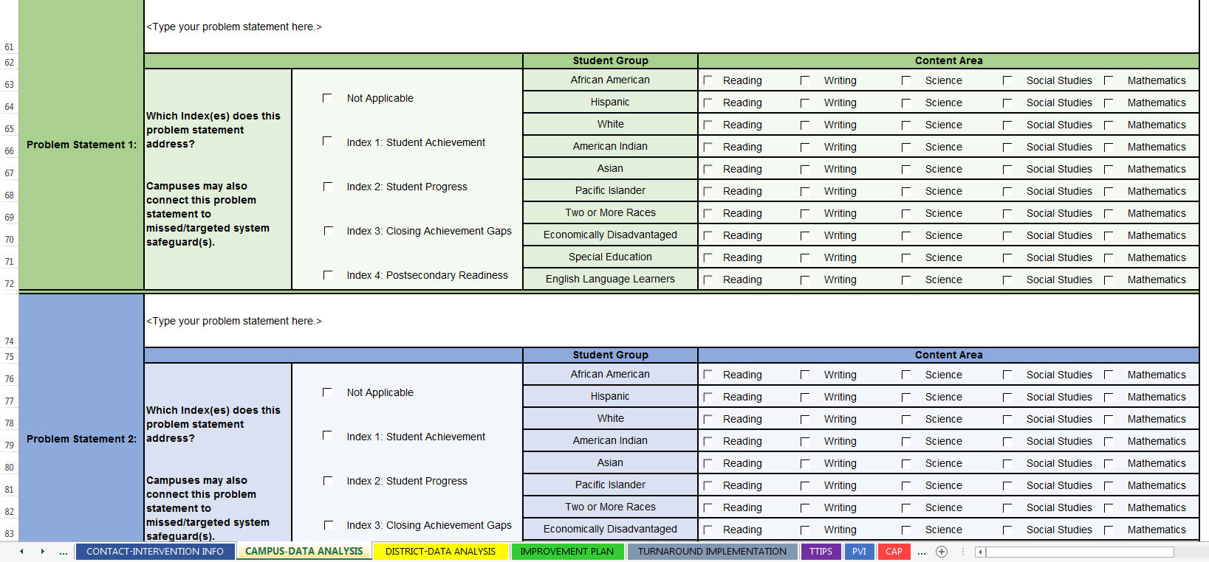
DRAFT
Notes:
On data analysis tabs, note that the index data still has to be analyzed…thinking beyond Index 1, demonstrating understanding of what the index measures
Data analysis tab isn’t different, just don’t have to do CSF chart

Slide 12
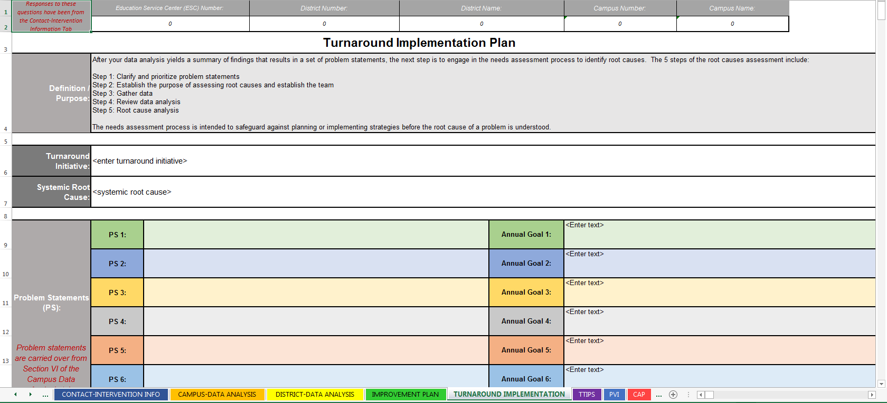
DRAFT

Slide 13
Root Causes
Targeted Improvement Plan | Turnaround Plan | Targeted Implementation Plan
Developed as a result of root cause analysis | Systemic Root Cause | Systemic Root Cause
Notes:
In the targeted improvement plan, the root cause is what needs to be fixed to keep the problem statement from happening
Developed as a result of the work in the data analysis tab
In the targeted implementation plan, the root cause is what needs to be fixed to keep the problem statement from happening
But this work has already been done in turnaround planning
Carry over the systemic root cause

Slide 14
DRAFT

Slide 15
“Strategies”
Targeted Improvement Plan | Turnaround Plan | Targeted Implementation Plan
Overarching approach to resolve the root cause | Turnaround Initiative | Initiative Components These actions create systemic change and impact all problem statements
Notes:
In quotes, because a bit of a shift…
In the targeted improvement plan, the strategy is the overall approach to addressing the root cause
In the targeted implementation plan, the strategy is replaced with turnaround initiative components
CIT evaluates the initiative to determine the major action steps needed for full implementation of turnaround plan
These actions create systemic change and impact all problem statements
Keep vision in mind when identifying these components

Slide 16
Initiative Component
Quarterly Planning in Targeted Improvement (Implementation) Plan
Turnaround Initiative
Initiative Component
Quarterly Planning in Targeted Improvement (Implementation) Plan
Initiative Component
Quarterly Planning in Targeted Improvement
(Implementation) Plan
Notes:
Tie to PLC Example

Slide 17
Student intervention system
Quarterly Planning in Targeted Improvement (Implementation) Plan
Use PLCs to provide structure for teacher collaboration in using data and making instructional decisions
Walkthrough process that includes verbal feedback loop
Quarterly Planning in Targeted Improvement (Implementation) Plan
Structured PLC meeting protocol
Quarterly Planning in Targeted Improvement (Implementation) Plan

Slide 18
DRAFT

Slide 19
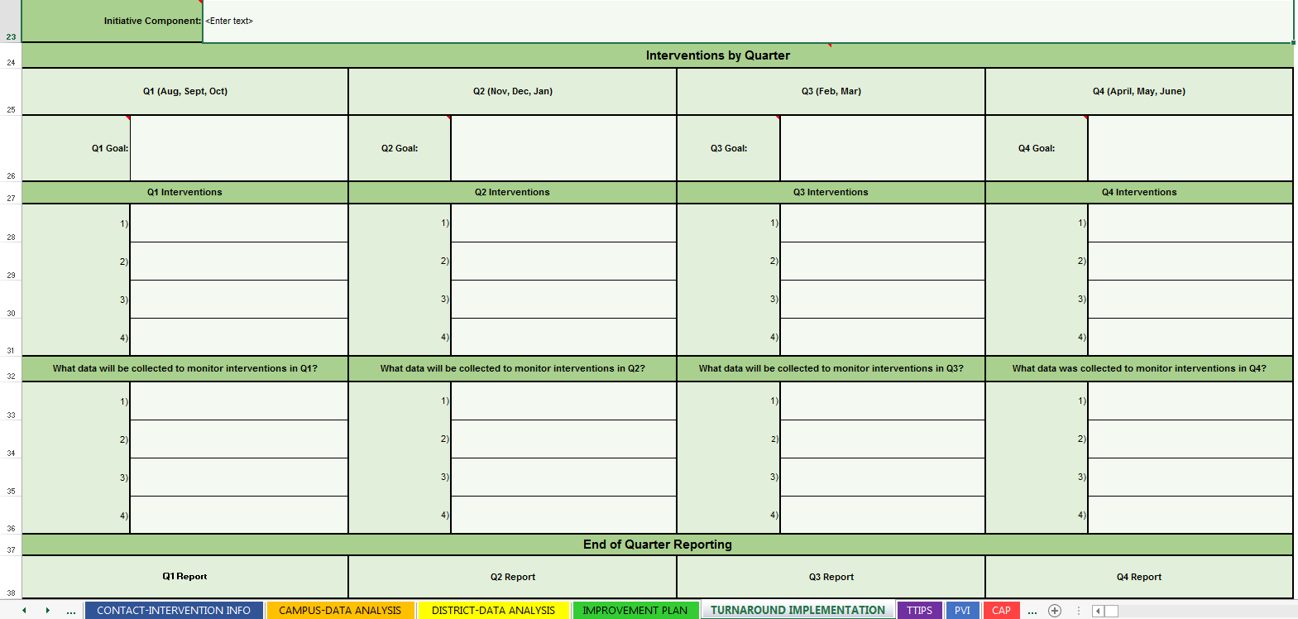
DRAFT
Notes:
Quarterly goals break out the impl/monitoring of initiative components

Slide 20
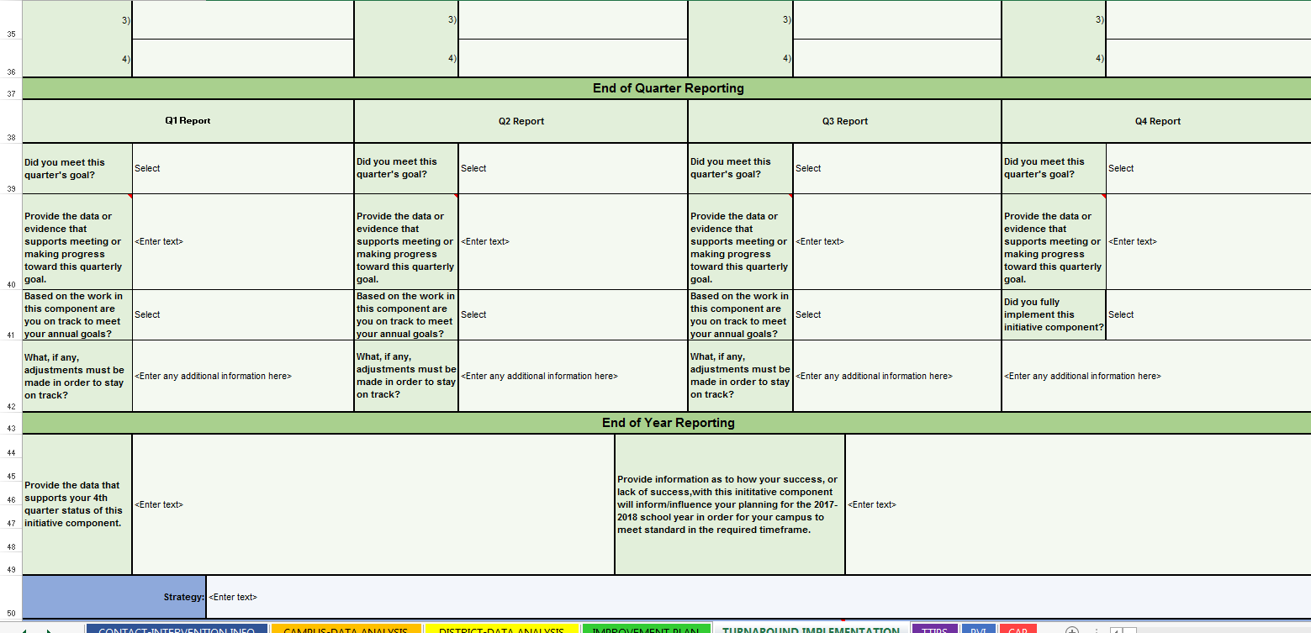
DRAFT
Notes:
Quarterly goals break out the impl/monitoring of initiative components
Balancing implementation of initiative (quarterly goals, with student outcomes) with accountability targets

Slide 21
Annual Goals
Targeted Improvement Plan | Turnaround Plan | Targeted Implementation Plan
Resolves issue in Problem Statement | Assumed: Met Standard Rating in 2 years | Half-way checkpoint* Based on Index scores Doesn’t have to be 50%
Notes:
In the targeted improvement plan, the annual goal resolves the issues identified in the problem statement
In the targeted implementation plan, the annual goal is a half way checkpoint toward meeting standard in 2 years
Assumed goal of meeting standard in 2 years
The annual goal is still linked to the problem statement (so will be index-based)
Doesn’t have to be 50% (ambitious/attainable)

Slide 22
DRAFT

Slide 23
DRAFT
Notes:
Quarterly goals break out the impl/monitoring of initiative components
Balancing implementation of initiative (quarterly goals, with student outcomes) with accountability targets

Slide 24
Summary
In the targeted implementation plan:
Problem statements are missed index targets
Root cause is systemic root cause from turnaround plan
Strategies are components of the initiative
Annual goals are half-way check in points
Notes:
Additional guidance and webinars to come

Slide 25
Questions/Discussion
Email: turnaroundplan@tea.texas.gov
Notes:
All questions will help the entire state and will be addressed in the weeks and months ahead through published Q&As and guidance updates

