Slide 1
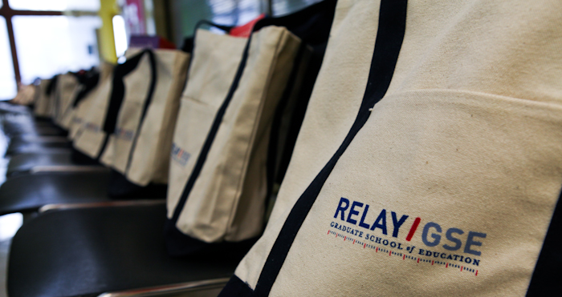
Relay
Graduate School of Education
Chris Fraser, Dean of Relay Texas
cfraser@relay.edu

Slide 2
About Us

Slide 3
Our Mission
Grow the number of great teachers and school leaders who are preparing their PK-12 students for success in college and career.

Slide 4
Education creates freedom.
Studies affirm that highly effective teachers not only raise student achievement in the short term — but they also significantly improve their students’ long-term life outcomes.
*Jordan, Mendro, and Weerasinghe (1997)
Notes:
Study Link: http://www.dallasisd.org/cms/lib/TX01001475/Centricity/Shared/evalacct/research/articles/Jordan-Teacher-Effects-on-Longitudinal-Student-Achievement-1997.pdf

Slide 5
Great teachers are made, not born.
Our goal is to become the place where a new generation of dedicated, continuously-improving teacher-heroes can fulfill their destiny in the world’s greatest profession.

Slide 6
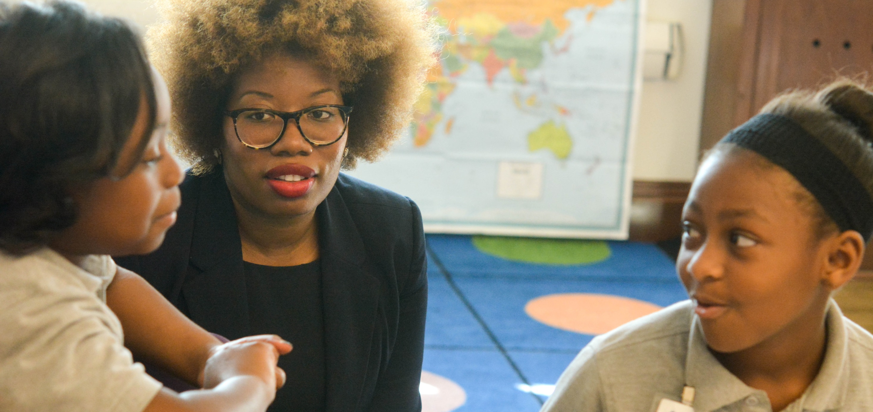
Teaching is an expression of love.
Every child needs a champion:
Teachers are heroes serving students
and their communities.

Slide 7
This year, Relay is preparing teachers at 12 campuses and developing school leaders in 24 U.S. states and D.C.
Chicago
Bay Area
Denver
Nashville
Connecticut
Memphis
Newark
Dallas Fort Worth
New York
Philadelphia & Camden
Baton Rouge
Delaware
New Orleans
Campuses
San Antonio
Houston
Washington, D.C.
Future Campuses
Leadership Program Fellows

Slide 8
Relay is rapidly expanding in scope and impact, in response to high demand for quality training programs for teachers and school leaders across the country.
3,300
2,850
2,400
1,740
1,380
Teacher U at Hunter College
1,010

Slide 9
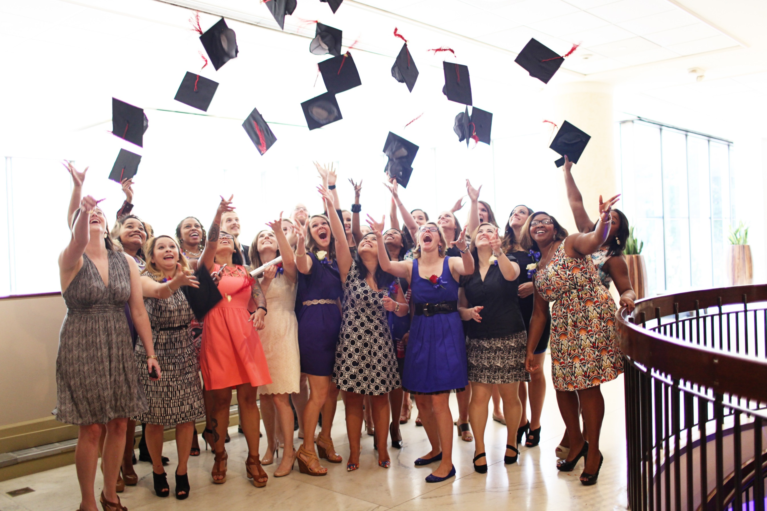

Slide 10
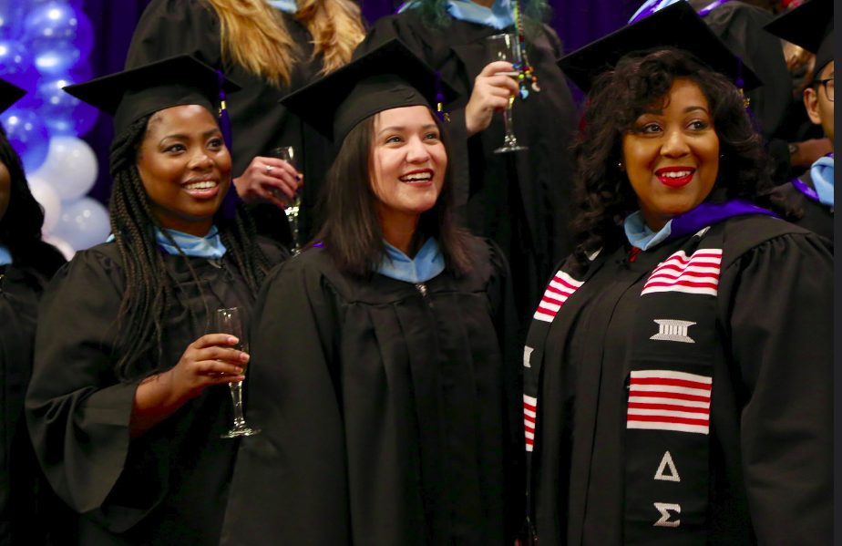

Slide 11
Our Approach

Slide 12
The Relay Approach: Learn. Practice. Perform.
Just as doctors and athletes must train for years to become expert professionals, we know that it takes meticulous practice, feedback, and repetition to become a skilled teacher or principal.
Learn
Practice
Perform

Slide 13
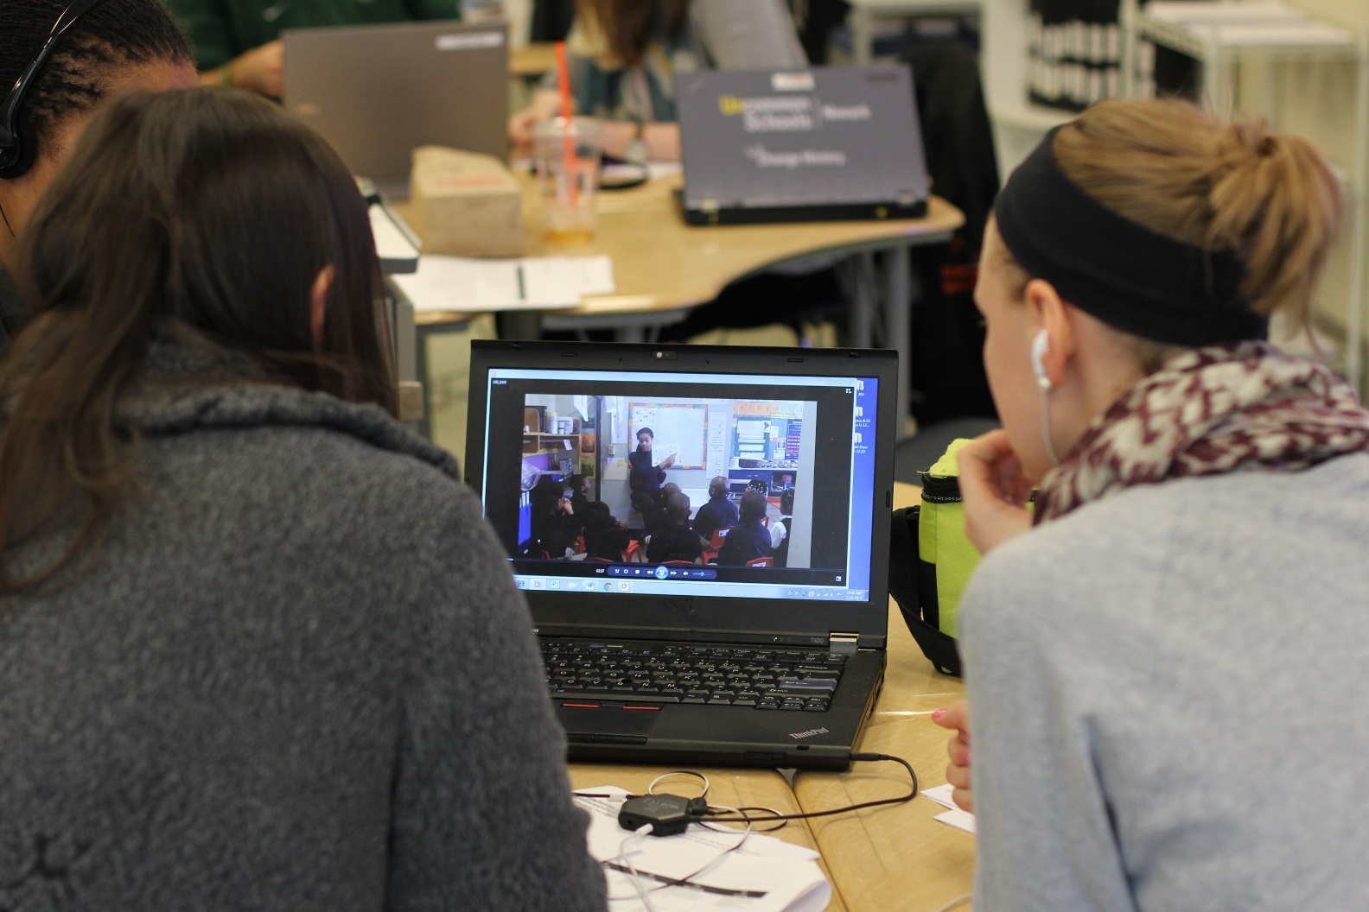
The Relay Approach: Learn
Practical techniques that can be used the next day in the classroom
Champion professors who were themselves outstanding teachers
Curriculum is delivered 60% in-person, 40% online

Slide 14
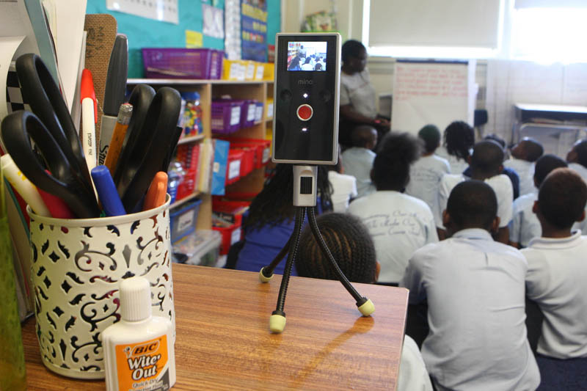
The Relay Approach: Practice
Unparalleled opportunities for practice with faculty and peer teachers
Use of video to record and analyze teaching in action
Immediate feedback to help refine techniques

Slide 15
The Relay Approach: Perform
Learnings applied directly to teaching in the classroom
PK-12 student data analyzed to inform instruction and continuously improve performance
Teachers drive PK-12 student success in academics and personal character development

Slide 16
What It Will Take

Slide 17
Focus on Retention
Almost all new teachers leave the profession within five years.
Schools in low-income communities have DOUBLE the turnover rate of schools in high-income communities.

Slide 18
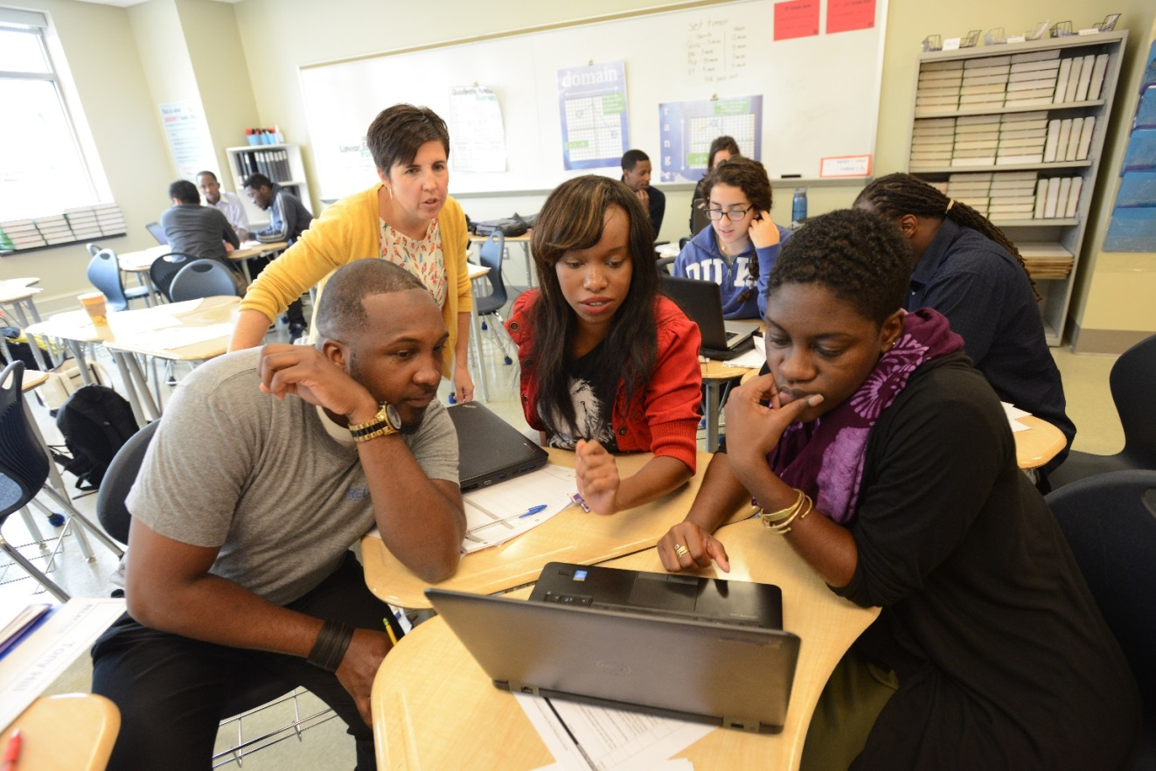
Focus on Diversity
Through the Residency, Relay is working together with PK-12 school partners to attract local young people of color to join the teaching profession.

Slide 19
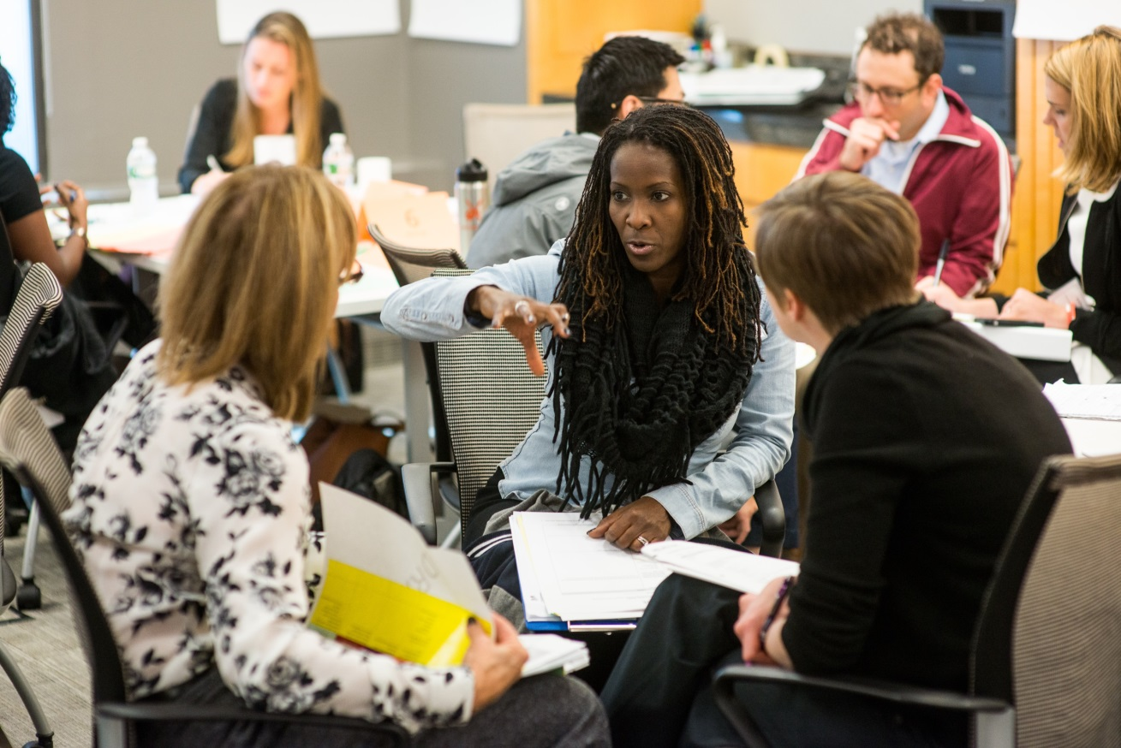
Allow Principals to be Instructional Leaders
The average principal only spends 6 minutes a day observing and giving feedback to teachers.

Slide 20
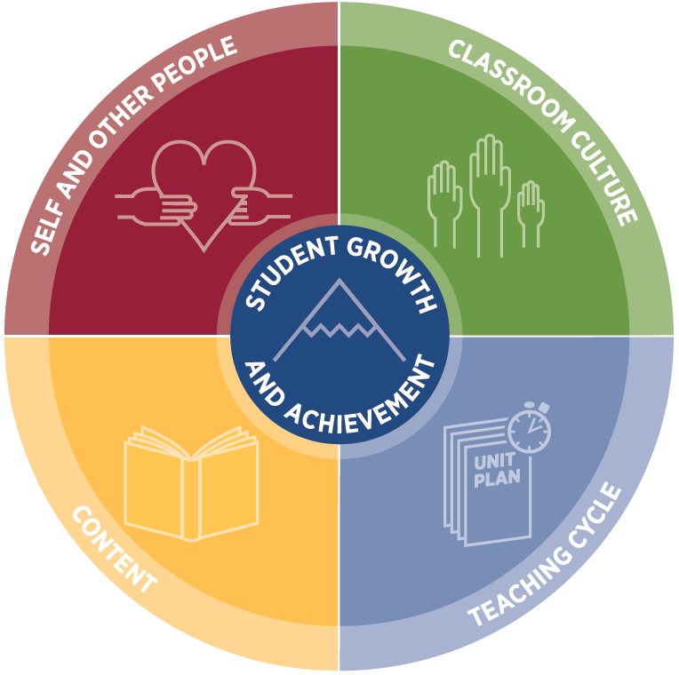
The Relay: From One Great Teacher to the Next
By recruiting, preparing, and supporting great educators at all levels, we will ensure that many more PK-12 students receive a high-quality education.
An innovative approach centered around practice
A focus on student achievement and character growth
A growing network of committed teachers and school leaders

Slide 21
Relay Programs
ASPIRING TEACHERS
CURRENT TEACHERS
SCHOOL LEADERS
Relay Teaching Residency
A gradual on-ramp into the teaching profession through a structured apprenticeship with extra opportunities for deliberate practice
Teacher Pathways
New programs to engage undergrads in hands-on experiences that ignite interest in teaching; in Houston this includes the Relay Tutor Corps, a semester-long structured tutoring program
Master of Arts in Teaching
A two-year degree program focused on practical skills that prepare candidates to effectively support PK-12 students
Alternate Route Certification
A one-year program for new teachers and career changers seeking state certification
Accelerated Master of Arts in Teaching A one-year program for experienced teachers looking to grow their impact and earn an advanced degree
National Principals Academy & National Principal Supervisors Academy
A practical one-year fellowship program focused on high-leverage instructional leadership that includes differentiated tracks for principals and principal supervisors

