Slide 1
MANUEL JARA ELEMENTARY Creating a Culture of Excellence!
Manuel Jara El. is a TITLE I Campus serving 679 students in grades 1 – 5
The school has MET STANDARD for each of the last two years of STAAR
Minority enrollment is 98% Hispanic
Attendance rate is 96%
LEP – 497 students 73%
Economically Disadvantaged – 672 students 98%
Special Education / LINC– 37 students .05%
Dual Language program – 490 students 72%

Slide 2
“If we empower the parent, we change the home life, if we change the home life, we empower our kids”. 2016 Graduates

Slide 3
The Vision= Use a research based curriculum that empowers parents to be full partners in their student’s educational success .
Parent University was established in 2013 by Principal, Marta Plata to help parents at Manuel Jara Elementary learn skills that will enable them to become a part of their student’s educational success.
It is our desire that what parents learn by attending Parent University will help their children succeed now, and for the rest of their lives.

Slide 4
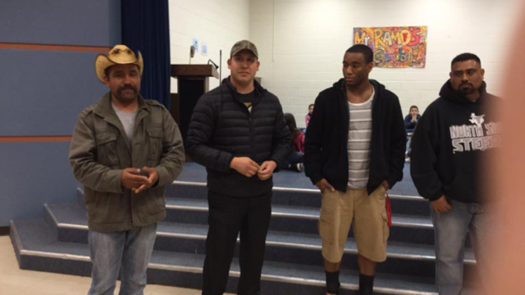
Imagine parents coming to school, committed to learn together across all cultures to improve their children’s education.

Slide 5
#101- Raising Highly Capable Kids Curriculum by RezelientKids.org
Raising Highly Capable Kids® serves as the introductory course for MJE’s Parent University. It is the first course parents take and it is a prerequisite for all other courses.
Raising Highly Capable Kids® course #101 is a 13-week curriculum that is based on the Search Institute’s 40 Developmental Assets. The Search Institute has found that there are 40 building blocks that every child needs to mature and succeed in life. The more of these assets that a child has in their life, the more successful they will be in school and in life.

Slide 6
Search Institute has identified 40 building blocks of healthy development—known as Developmental Assets—that help young children grow up healthy, caring, and responsible. These Assets are embedded in Raising Highly Capable Kids Curriculum.
Positive Behaviors | 0-10 Assets | 11-20 Assets | 21-30 Assets | 31-40 Assets
Exhibits Leadership | 48% | 66% | 78% | 87%
Good Health | 27% | 48% | 69% | 88%
Values Diversity | 39% | 60% | 76% | 89%
School Success | 9% | 19% | 34% | 54%
NEGATIVE Behaviors | 0-10 Assets | 11-20 Assets | 21-30 Assets | 31-40 Assets
Problem Alcohol Use | 45% | 26% | 11% | 3%
Violence | 62% | 38% | 18% | 6%
Illicit Drug Use | 38% | 18% | 6% | 1%
Sexual Activity | 34% | 23% | 11% | 3%

Slide 7
Raising Highly Capable Kids™ Program
Evaluation
Public Information Brief
Parents considered Raising Highly Capable Kids™ to be a high-quality parent program. On both surveys and in focus groups, parents rated the program as highly informative and enjoyable and would recommend the program to a friend. Parents particularly saw the value of promoting commitment to learning, promoting positive values through communication and modeling, and understanding the importance of having neighbors and other adults in their children’s lives who care about them. Parents increased their knowledge and skill level of all eight assets, as shown in the graph below:
Not really To a large extent
Children whose parents participated in the program were observed by their parents to have changed and acquired assets as a result of parents changing their behaviors. Parents reported their children used time more constructively, were more motivated to learn, had stronger positive values, learned to plan ahead, felt better prepared to resist peer pressure, and assumed a more positive identity.

Slide 8
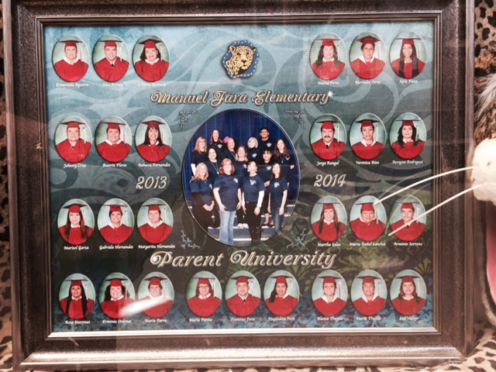
First Parent University Graduation 2013-2014
29 Graduates – 19 with Perfect Attendance

Slide 9
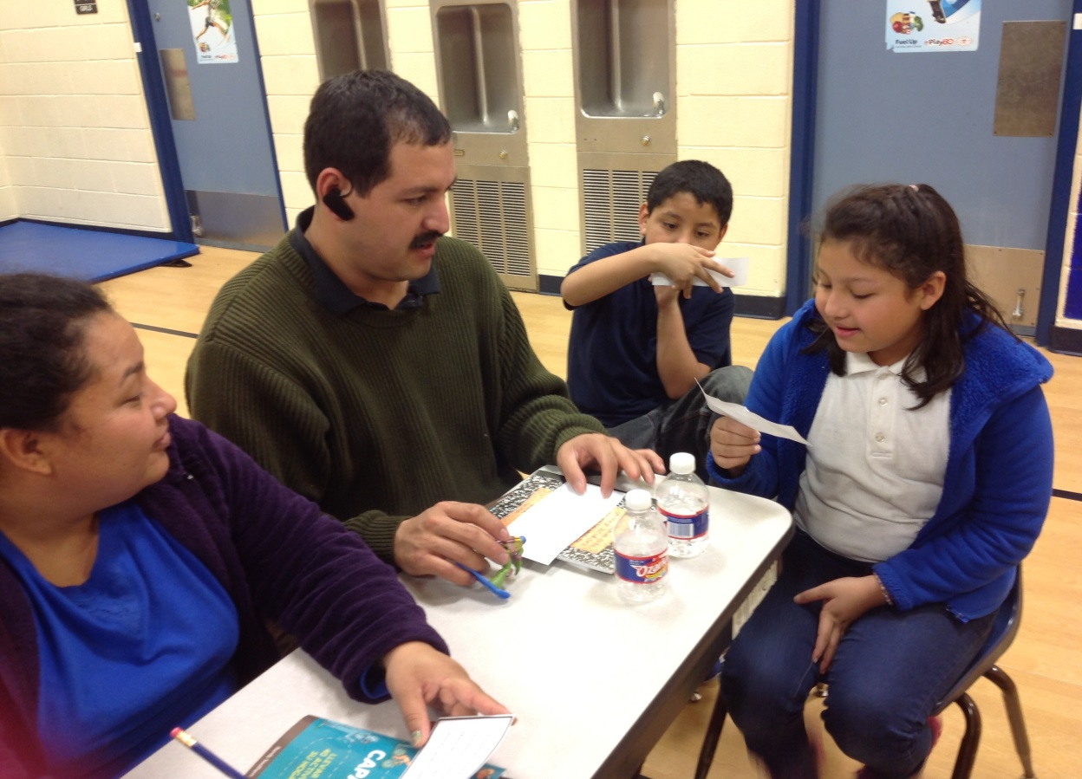
Catch The Vision
Imagine a school that not only prepares children for success, but also empowers parents to raise successful children.

Slide 10
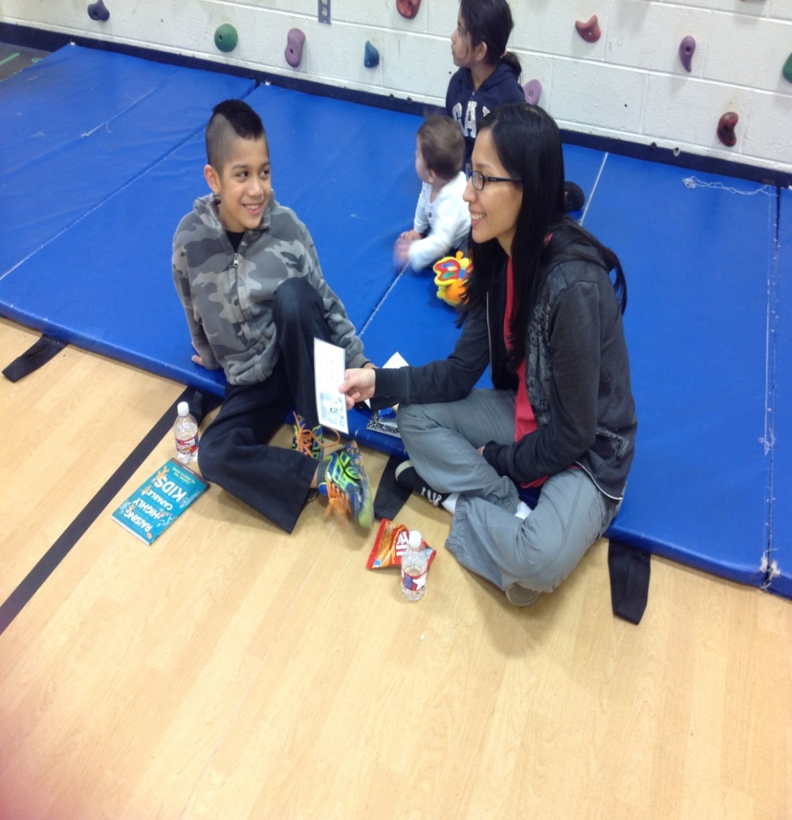
Imagine parents sitting with their kids as they learn together, how to live a more healthy, caring and responsible family life.

Slide 11
#201- Second Year Continuing Parents Parent & Child Application of #101
This is the second level of courses in MJE’s Parent University. The classes were written and designed by Marta Plata and intended to facilitate good parent/child communication while applying concepts learned in #101 Raising Highly Capable Kids.
The first ten classes are for parent and one or two children learning together to create trust that will in turn allow for better parent/child communication.
The last three classes are designed for parents only. Intervention techniques will be discussed for common problems that children face.

Slide 12
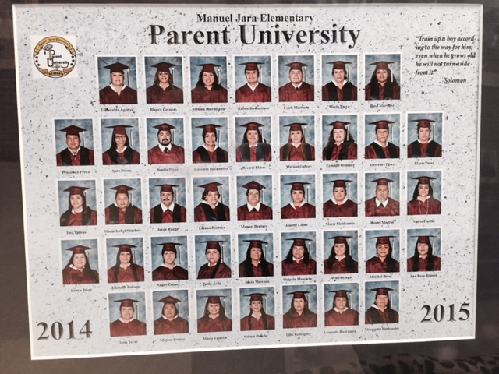
Parent University Graduation Year Two - 2014-2015
41 Graduates/ 101 kids / 21 Perfect Attendance

Slide 13
Imagine parents coming to school, committed to improve their own education.

Slide 15
#301-Third Year Continuing Parents MJE/TCC Parent Leadership Academy
This is the third level of MJE Parent University. The 13 week course was written and designed by Marta Plata to facilitate parent leadership skills that will empower parents as leaders of their school and community. The classes are facilitated at MJE on the same night as the rest of Parent University classes.
Parents are dual-enrolled as MJE and Tarrant County College students. This provides the added opportunity for continuing education credit through Tarrant County College.

Slide 16
TCC Partnership
Robert Muñoz, Ed.D.
Vice President for Continuing Education

Slide 17
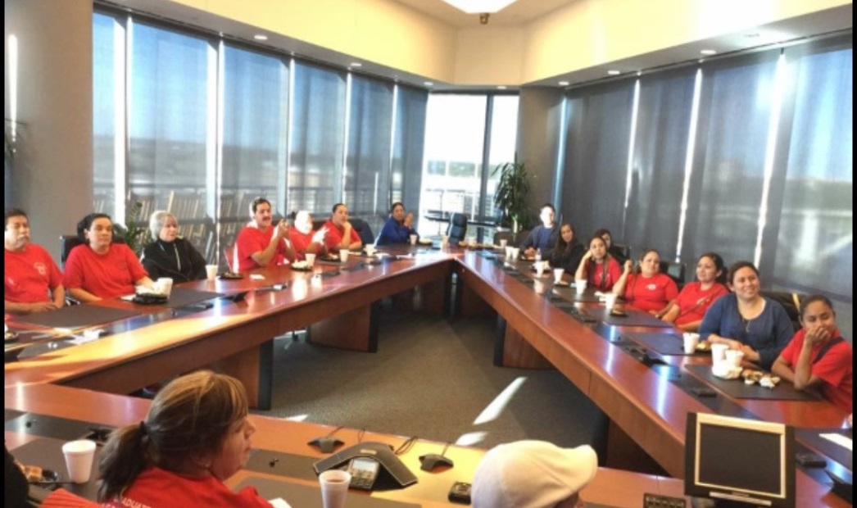
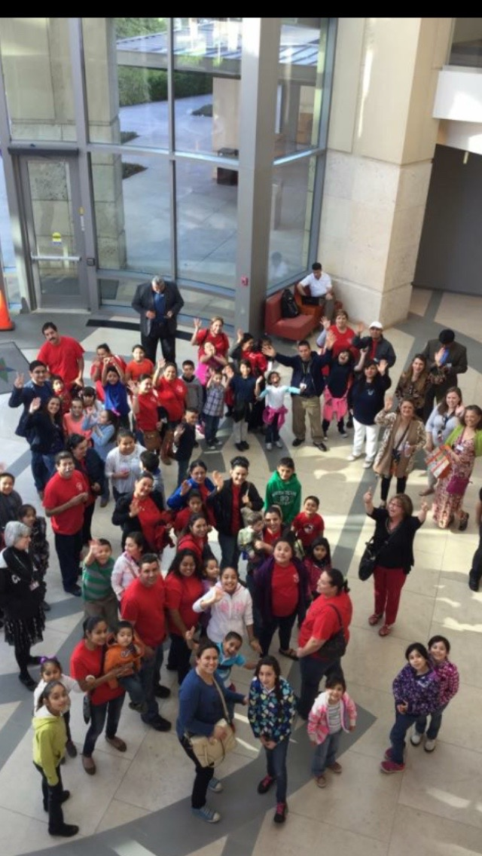
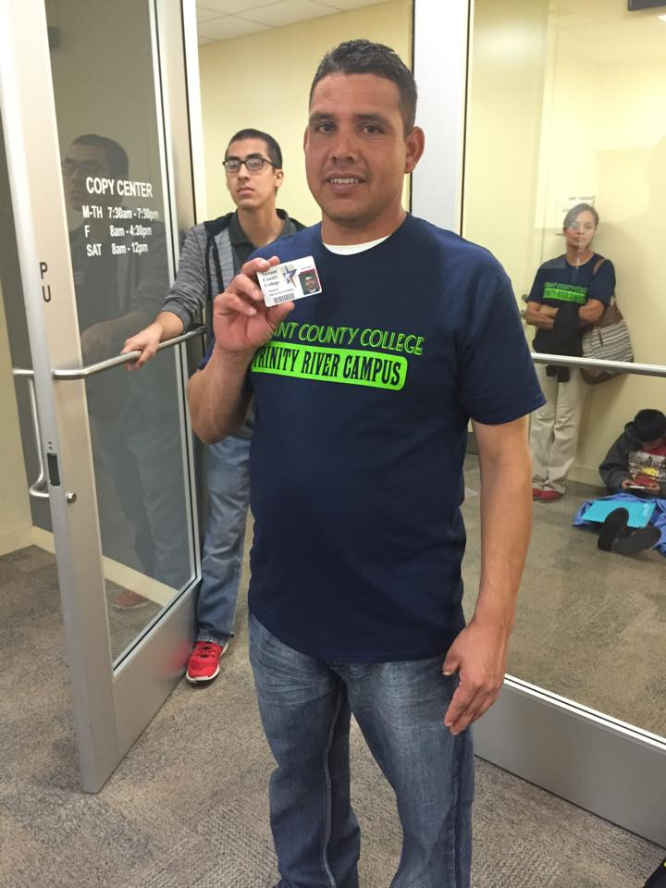
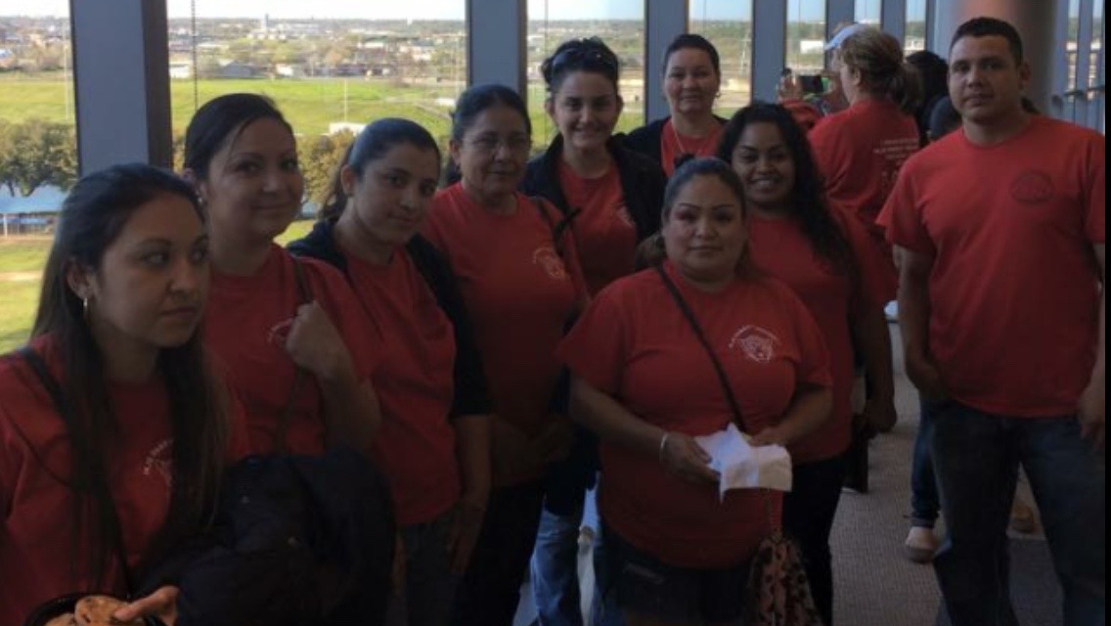
TCC FIELD TRIP

Slide 18
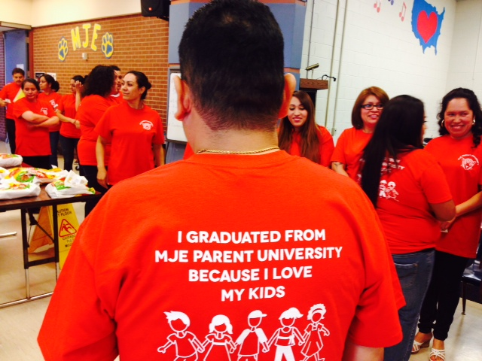
Manuel Jara Elementary PARENT UNIVERSITY
Class Patches Designed by Participants

Slide 19
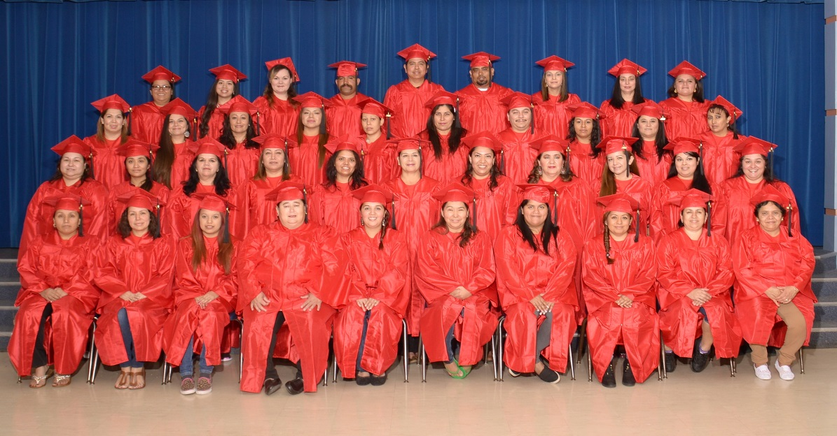
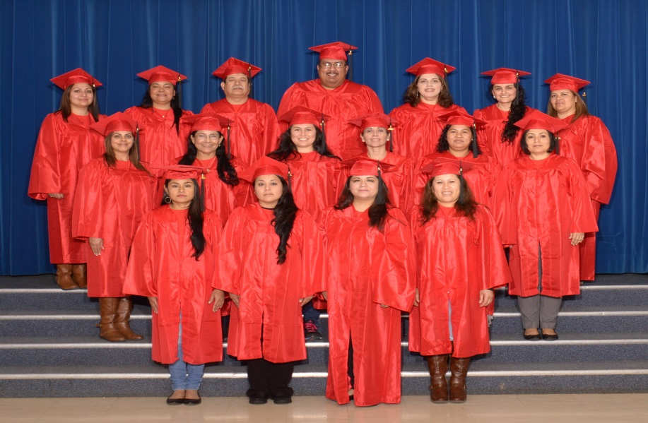
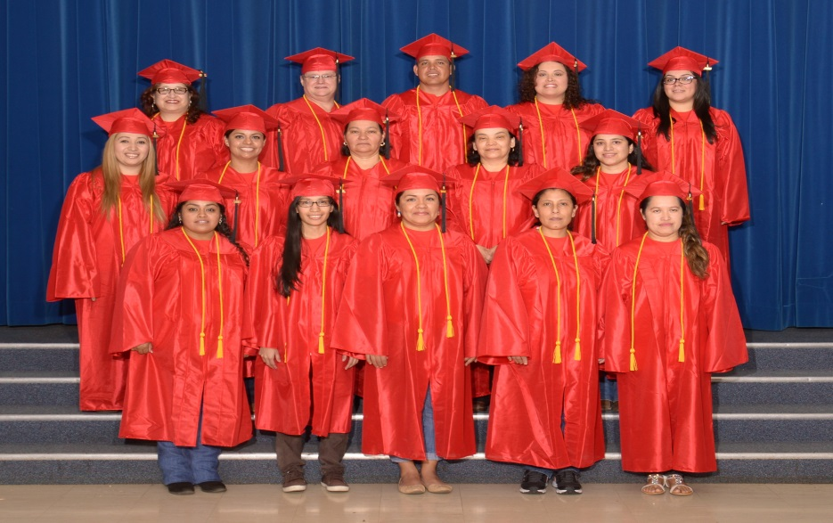
57 Parents in course #101
2015 2016
90
GRADUATES
28 with Perfect Attendance
18 Parents in course #201
15 Parents in course #301

Slide 20
Testimonials from Parents & Kids
“We have been attending for two years and we love it. We have learned how to help our kids and how to discipline them. Our kids are getting better grades and they like to see us at school”
‘I have Dyslexia and my parents didn’t know how to help me and now that they come to parent university they help me and my grades are better’

Slide 21
Parent Enrollment Trajectory
YEAR | COURSE 101-Raising Highly Capable Kids | COURSE 201- Parent Child Application of #101 | COURSE 301- MJE/TCC Parent Leadership Academy | Total Enrollment
2013-14 | 29 |  |  | 29
2014-15 | 20 | 21 |  | 41
2015-16 | 57 | 18 | *15 | 90
21 parents returned after the first year
36 returned after the second year
Enrollment almost doubles each year
100% of #301 graduates will continue their education at Tarrant County College
Continuing education career plans
4-Associates Degrees
3-GED
8-ESL

Slide 22
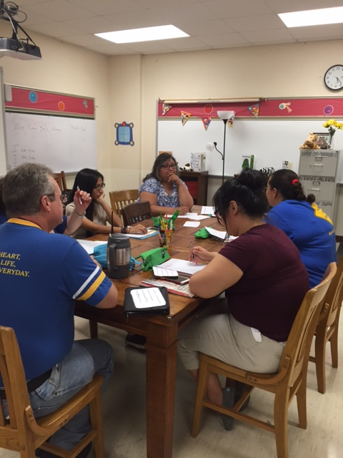
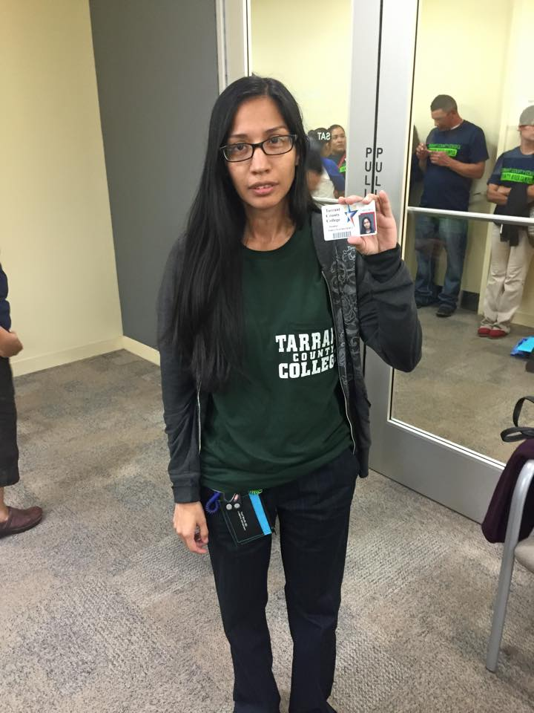
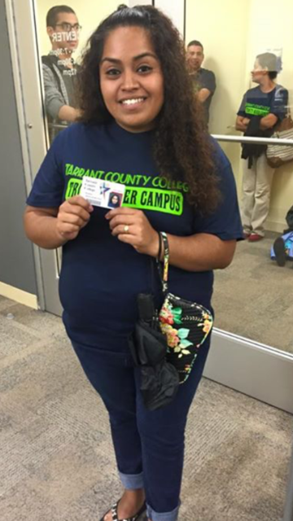
#401- Parent Leadership Academy Graduates Give Back Parent to Parent Learning

Slide 23
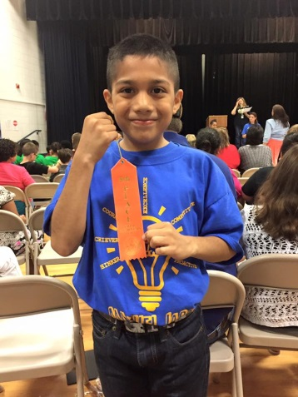
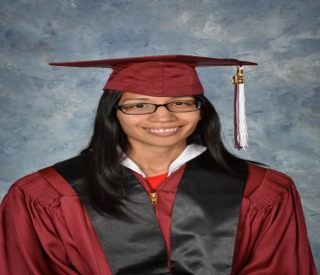
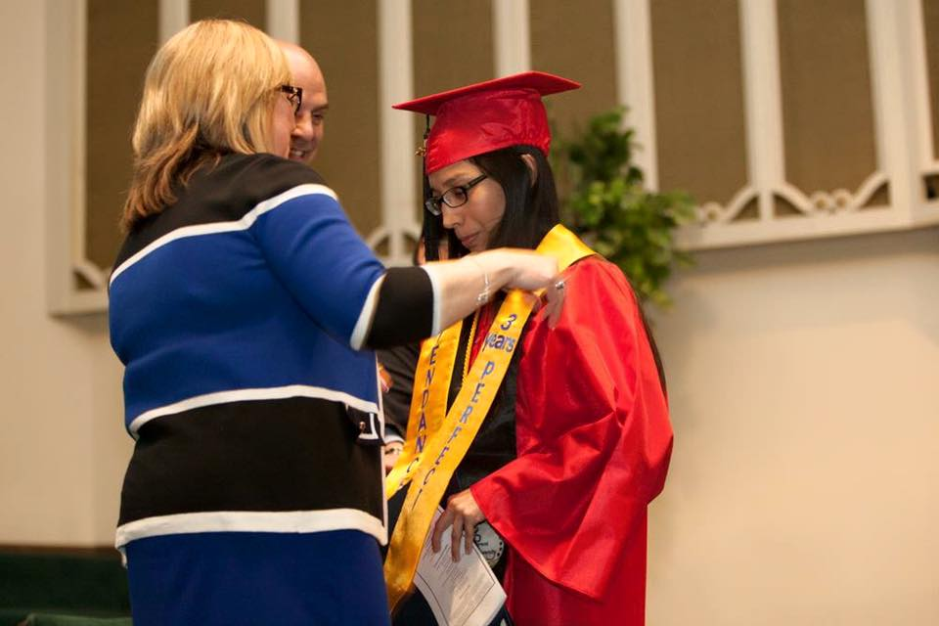
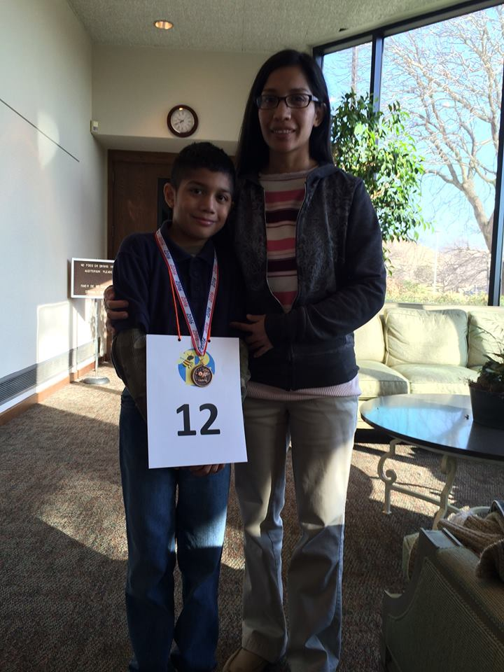
Success Stories
Sara Perez 3 yrs Perfect Attendance
Richard Perez 3 years Perfect Attendance & Spelling Bee Champion

Slide 24
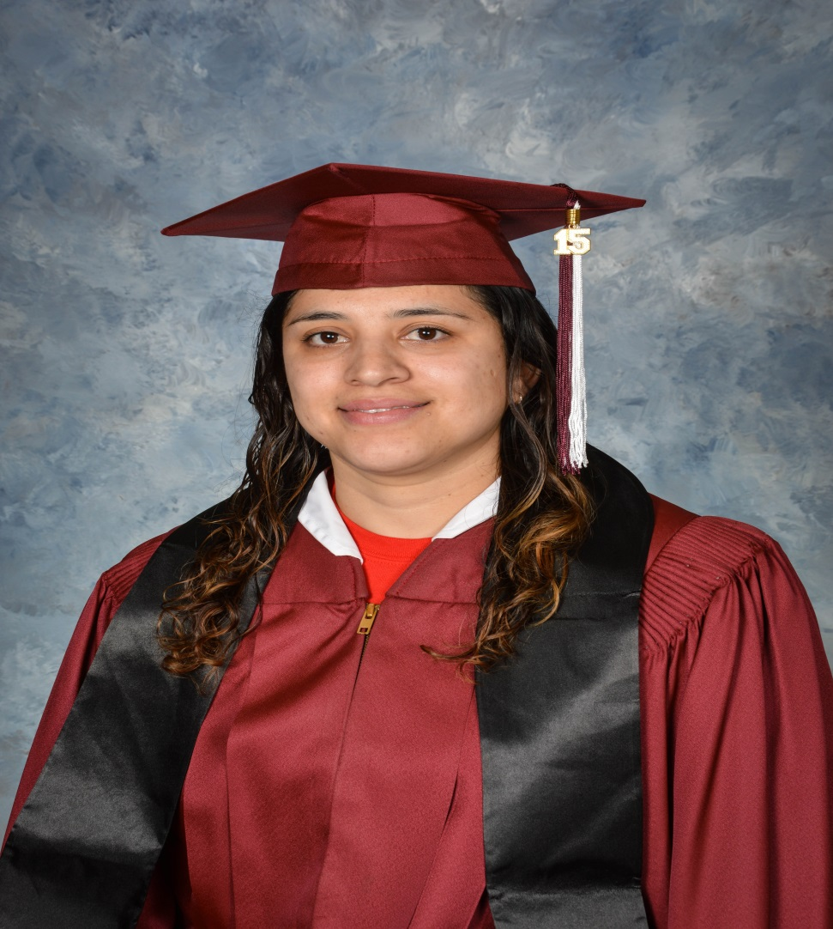
Luz Vallejo- Success Story

Slide 25
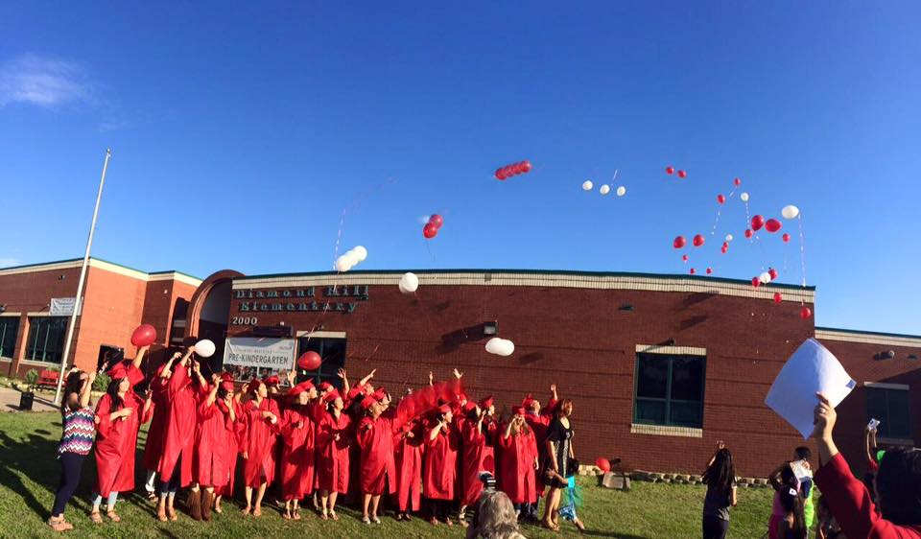
Diamond Hill Elementary- Success Story ‘ New Beginning’

Slide 26
Parent University Student I-SIP Reading Data
Above grade level 81% 66
On reading level 19% 15
Total Number of Students 81

Slide 27
Discipline DATA
Discipline DATA for PU students

Slide 28
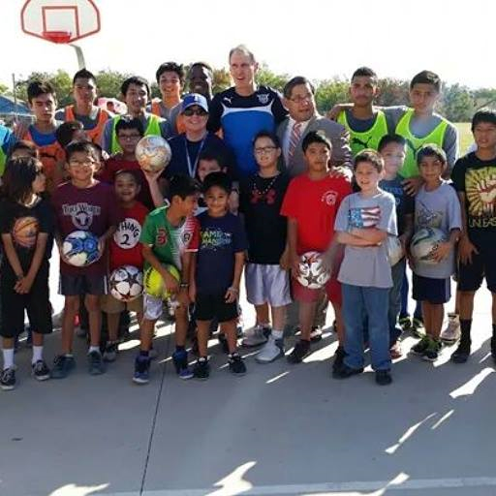
Imagine community partners, like churches, therapists or the city soccer team working alongside the schools to help parents learn parenting skills.
Zoricelis Davila , MA, LPC

Slide 29
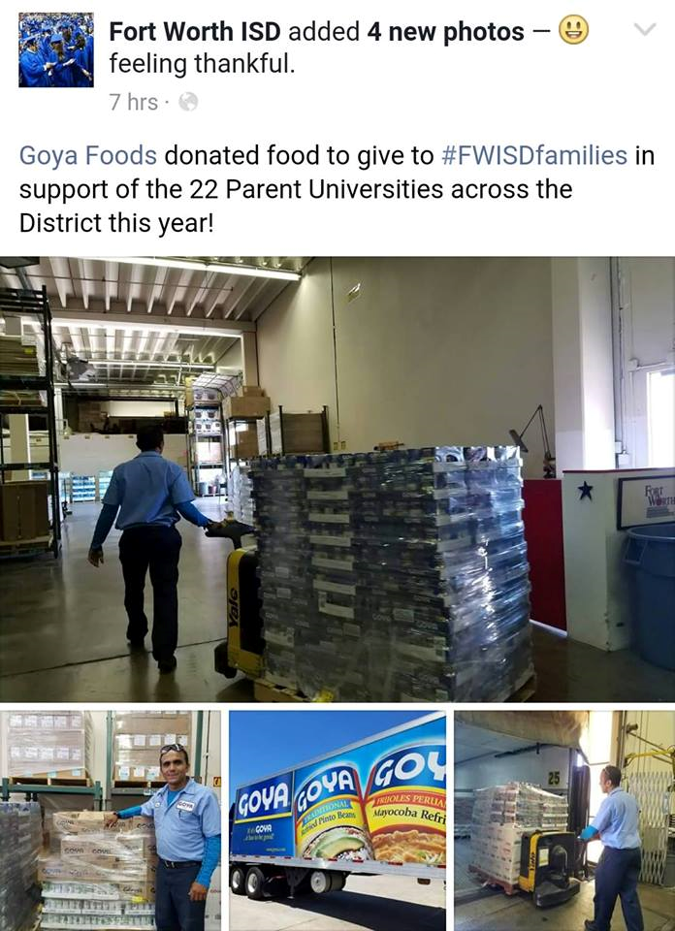
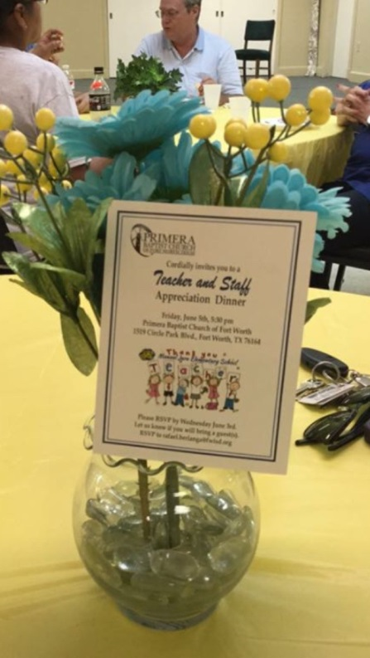
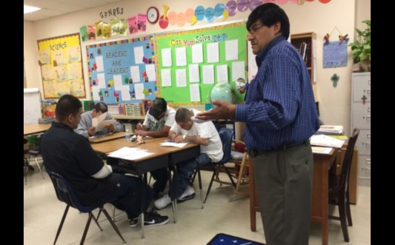
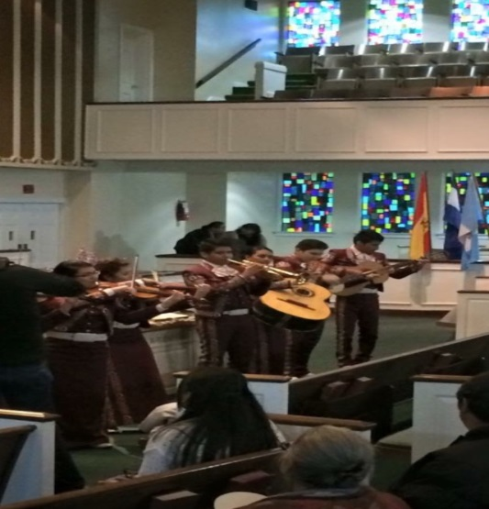
Our Faith Based & Business Partners

Slide 30
INCENTIVES
ATTENDANCE RAFFLES
DOOR PRIZES

Slide 31
Manuel Jara Elementary Neighborhood Family Partners
Jo Linda Jara
Amador Molina Family Scholarship

Slide 32
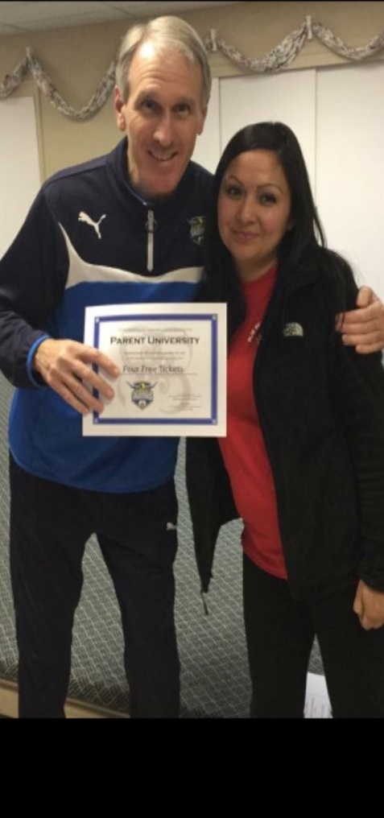
Community Support
Mayor Betsy Price
Mark Snell, Head Coach

Slide 33
Parent University Cost Analysis
Manpower
@40 volunteers per 100 parents & 140 children
Approx. $180 per participant for 13 weeks.
Itemized cost per class:
• $15 Classroom supplies
• $10 Class Shirt
• $15 Cap & Gown
• $10 Patch & Stole
• $5 Certificate & Tassel
• $25 Snacks
= $ 80.00 + Individual Course materials
Course #101 – Raising Highly Capable Kids Maximum 15 participants per class
• $25 English Teachers Guide $26 Spanish Teacher’s Guide
• $18 English workbook $20 Spanish Workbook
Course #201 – Parent & Child Application of #101 Maximum 10 families per class
• $5 workbook
• $8 Taking the 40 Assets Home Resource
• $2 Conversation Wheel Resource
• $100 set of children’s books
Course # 301- MJE/TCC Parent Leadership Academy No maximum
• $5 workbook
• $120 Field Trip bus fee
•
Logistical Costs:
Childcare – $300 – 13 weeks of activities
• $65 per volunteer for 13 weeks of light dinner snacks ( 1 volunteer per 15 kids / we had 40 volunteers =$2600)
• $26 – per child for snacks (we had 140 children =$ 3640)
Incentives:
• $100 (Wal-Mart gift card) Perfect Attendance Raffle
• $1040 ( 4 -$20 value ) Attendance Door Prizes per class

