Slide 1
Using This Slide Deck
This presentation is designed to help school leaders communicate how the A–F accountability system works and to explain your school’s 2026 rating.
Some notes on using these slides:
Slides 2 through 10 provide an overview of the A-F accountability system. This includes the beliefs and design commitments that drive an accountability system that is rigorous, transparent, and fair
Slides 13-15,17, 20-21, 25, 30-31, 34, 36, 38 and 41 include a star icon in the top left corner; that is your cue to input your school’s 2025 and/or 2026 data. Editable tables are provided for each domain and overall ratings or information can be snipped directly from TXschools.gov The yellow boxes on the slides provide additional guidance, including where data can be easily accessed
Slides 12, 16, 19, 24 and 27 have orange boxes with links to our “How Accountability Works” infographics. These provide concrete examples of how ratings are calculated and are helpful for clarifying methodology with stakeholders.
Slides 28 and 29 are specific to specific school types. Use 28 if you are an elementary/middle school. High schools and K12s should use 29.
Slides 42-45 provide space for you to summarize your wins, areas of opportunity and next steps
Slides 2-41 include a sample script. Please feel free to use or adapt the script to match your preferred level of detail and presentation style. The script includes statewide data summaries and transition language to help you highlight your campus’s performance.
Slides 47-50 show statewide performance over time by campus type. If you would like to include this data, copy the chart for your campus type onto slide 16.

Slide 2
Purpose of A-F

Slide 3

Expectations Matter
We believe that all students can learn and achieve at high levels.
4
Notes:
We are all here because we believe that our students can learn and achieve at high levels. Our ultimate goal is to prepare them for life after their K-12 education, by ensuring they have the tools to be College, Career, and Military ready.

Slide 4
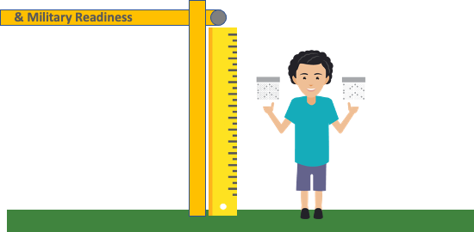

Expectations Matter, At All Grade Levels
The State Board of Education has defined what all students should know and be able to do at each grade level if they are to be well prepared for success in life. These are called the Texas Essential Knowledge and Skills (TEKS).
What does this look like in practice?
TEKS 3.5A: Represent one- and two- step problems involving addition and subtraction of whole numbers to 1,000 using pictorial models, number lines, and equations.
College, Career, & Military Readiness
ON TRACK
Notes:
We know what it takes for a student to cross the graduation stage as college, career, and military ready. We also know what the building blocks are, starting in early childhood education, for each student to get the tools that they need. At each grade level and in every subject, the state board of education has defined these expectations through the Texas Essential Knowledge and Skills (TEKS).
While 3rd grade is a long time from high school graduation, we can see the progression of knowledge and skills across each student's PK-12 career. Here we have an example of a 3rd grade math TEK, one of the things that our students must be able to know and do by the end of 3rd grade.

Slide 5

Monitoring Progress Helps Support Students
TEKS 3.5A: Represent one- and two-step problems involving addition and subtraction of whole numbers to 1,000 using pictorial models, number lines, and equations.
Actual 3rd Grade STAAR Question:
An art teacher had 736 crayons. She threw away 197 broken crayons. Then she bought 150 more crayons. Which equation shows how to find the number of crayons the art teacher has now?
A)
B)
C)
D)
736 - 197 - 150 =
736 - 197 + 150 =
736 + 197 + 150 =
736 + 197 - 150 =
Notes:
In order to ensure students are gaining those knowledge and skills, we leverage the STAAR assessment to determine to what extent students have mastered those skills. Let's take a look at the TEK and the 3rd grade STAAR question that assesses mastery of that skill.
This question lets us know whether or not the student has mastered this skill. We do not rely on what we think our students know or can do, we need concrete ways to measure their performance. This allows us to make decisions instructionally; whether it's leveraging a different curriculum, shifting our daily schedule, or providing targeted tutoring.

Slide 6

Clear Performance Information Helps Students
You can’t improve what you can’t see. To serve all students well, educators, parents, businesses leaders, and community members need easy access to information regarding how schools and districts are doing.
Notes:
Just as we want to know what our third graders know and can do by assessing their mastery of skills, we want to know how our schools are doing. Each of us has different experiences in school and different ideas of what makes a school "good" for our children or are community. Regardless of school models or preferences, there are universal truths that inform to what extent a school is meeting our goal of college, career, and military readiness:
Are students achieving?
Are students growing?
Are the most vulnerable students in the school community growing and achieving?
We can quantify the answers to these three crucial questions and have through the A-F accountability system. This system allows us to make informed decisions about how our schools and how are district is doing.

Slide 7

Students Are Helped In School & In Life
Monitoring performance with school ratings has been shown to have long term benefits for students:
“Our analysis reveals that pressure on schools to avoid a low performance rating led low-scoring students to score significantly higher on a high-stakes math exam in 10th grade. These students were also more likely to accumulate significantly more math credits and to graduate from high school on time.
Later in life, they were more likely to attend and graduate from a four-
year college, and they had higher earnings at age 25.”
Source: https://www.educationnext.org/when-does-accountability-work-texas-system/
Notes:
Just as we have high expectations for our 3rd grade mathematicians, we have high expectations for our schools and our district. When we set a high bar, our schools and districts can meet that bar. You will see later on today that significant gains in student growth and achievement are being made across the state. So while accountability can be uncomfortable, it sets a bar that drives all of us to get our students what they need. Research clearly shows that setting a high bar not only leads to short term gains, but better life outcomes for students.

Slide 8

A–F is a tool to help us meet continuously improved goals for children
According to state law, the purpose of A-F accountability is:
  to continuously improve student performance
  to eliminate achievement gaps based on race, ethnicity, and socioeconomic status
  to ensure Texas is a national leader in preparing students for postsecondary success
  TEC §39.053(f)
Improve Student Performance
Eliminate Achievement Gaps
Prepare Students for Postsecondary Success
Fostering a culture that supports growth and continuous improvement when this performance information is public is a difficult but critical task for education leaders.
Notes:
Moreover, our legislative leaders have clearly outlined the expectation; we must continuously monitor performance to continuously improve outcomes for students. This statute outlines ensuring that Texas is "a national leader in preparing students for postsecondary success," and doing so requires all of us working together to build a culture that supports growth, even when it is challenging.

Slide 9
Balancing multiple objectives
39.053(f) “eliminating achievement gaps ... and ensuring this state ranks nationally in the top five states in preparing students for postsecondary success and on the National Assessment of Educational Progress or its successor assessment”
Rigor
for students
A-F
39.054(b) “the mathematical possibility that all districts and campuses receive an A rating”
Fair
for schools
Transparent
for the public
39.309 “website … for the public to access school district and campus accountability information”
Notes:
There are three overarching objectives for the A-F accountability system in Texas; we have discussed the need for rigor, the system must also be transparent and accessible to the public, and it must be a fair measure of campus and district performance. My goal for today is to ensure that the way our school is rated is transparent and that together, we action plan to ensure our students meet this rigorous bar.

Slide 10
A–F is a tool to help Texas meet continuously improved goals for children
There are several key design commitments built into A–F to help ensure it works as an effective continuous improvement tool while accurately recognizing performance:
Ratings reflect better of achievement or progress
School performance is evaluated through multiple valid measures
Ratings are based on defined criteria, not a fixed distribution
  “A” reflects performance consistent with reaching long term student goals
  “C” reflects average performance for the baseline year
The system design remains static in most years
Notes:
I also want to highlight some of the ways that the system demonstrates fairness. We will dig into many of these ideas throughout our time today, but these are the design commitments under which the A-F accountability system is built.
It's also important to highlight that while the system design is static in most years, every 5 years we raise the bar for students. Shortly, we anticipate seeing the 2028 A-F Refresh Framework, which will set the bar for our kids, schools, and districts from 2028-2033. I look forward to sharing this with you when it is released and working collaboratively for the future.

Slide 11
2026 A-F Ratings and Campus Results

Slide 12
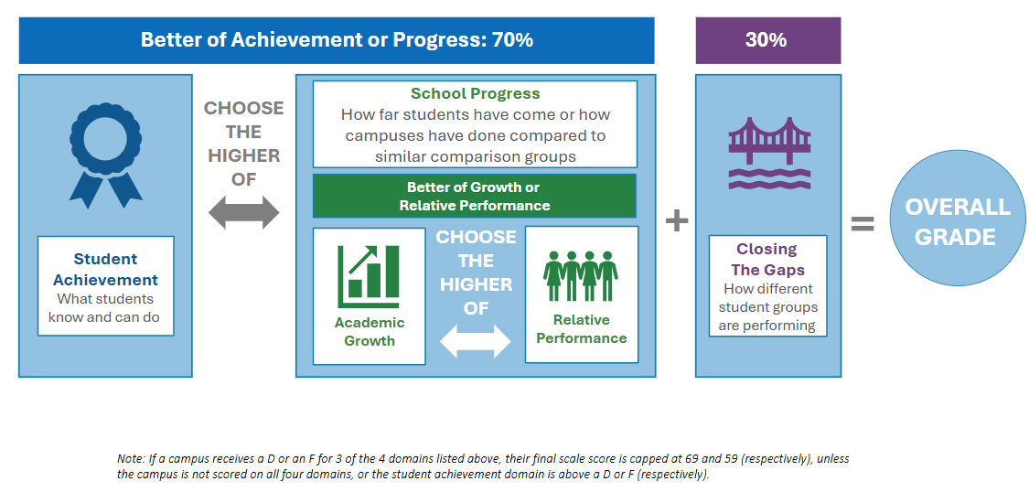
Calculating Overall A-F Results
Click for an example of how school results are calculated
Notes:
As we just discussed, the system is built on key design commitments that ensure fairness, transparency, and alignment with long-term goals for students.
Districts and campuses are evaluated across three key domains:
Domain 1: Student Achievement – measuring academic success.
Domain 2: School Progress – tracking improvement over time.
Domain 3: Closing the Gaps – focusing on equity and support for underserved student groups.
Here’s how the ratings are weighted:
70% of the rating reflects the better outcome between student achievement and school progress.
30% comes from other performance indicators.
This design ensures that:
High student achievement is recognized.
The impact of highly effective educators is visible.
And most importantly, we maintain a strong focus on students who need the most support.
One of the most encouraging aspects of this approach is that our ratings highlight the growth and achievement happening across all campuses including those serving economically diverse school communities.

Slide 13
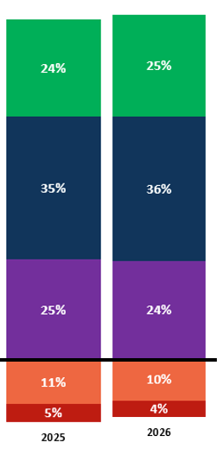
Overall Campus Ratings Results: 2025 to 2026 Comparison
Across Texas Campuses: 2025 vs 2026 Ratings
Our Campus: 2025 to 2026 Ratings
A 90-100
24% of campuses increased in ratings from the prior year.
78% of campuses stayed in the same score or improved from the prior year.
2025 |  | 2026
Scale Score | Rating | Scale Score | Rating
B 80-89
Stayed the Same | Increased | Decreased
4593 | 2004 | 1824
55% | 24% | 22%
C 70-79
Use table above to input your campus rating level in 2025 and 2026.
You can find this on the accountability overview on TXschools.gov
D 60-69
F ≤ 59
9,105 campuses in 2026. May not equal 100% due to rounding,
560 received a rating of Not Rated and are not included in this visual.
13
Notes:
Across the state, 24% of campuses increased ratings from 2025 to 2026 and 78% of campuses maintained their rating from 2025 to 2026. Our results...

Slide 14
Overall Campus Rating Results: 2023 to 2026
Use one of the charts on slides 47-50 that represent your campus type
Results and trends vary over time, so this view will allow your staff to see schools more similar to yours
Notes:
We also wanted to share how district performance has changed over time. One major aspect, which was new for district ratings in 2023 was the proportional weighting for schools. In 2023, we had the first year of STAAR 2.0 and the 2023 accountability refresh to our current system--- so that was the first year with an updated assessment for students and a more rigorous accountability system.

Slide 15
Overall School Rating Results: 2023 to 2026
School Performance Over Time
2023 | 2024 | 2025 | 2026
Input ratings from 2023-2026 on the chart above.
You can find color coding aligned to the bar graphs under "recent colors"
To find the school ratings over time, navigate to the accountability overview from TXschools.gov
Under "Change Over Time" click on any year, which will open a new tab for the accountability reports. Here, you can toggle by year
Notes:
We also wanted to share how our performance has changed over time. In our school...

Slide 16
Calculating Overall Results for Districts
District ratings use the same methodology, with each school holding a proportional weight based on grades 3-12 enrollment
This design reflects a commitment
to recognize high student
achievement and
to recognize the impact of
highly effective educators,
while maintaining focus on
the students most in need.
Domain 1
Click for an example of how district results are calculated
Notes:
District accountability ratings are calculated a little differently, but the same three domains remain:
Student achievement
School progress
Closing the gaps
This ensures consistency and fairness across the board. To calculate our district rating, each school has a proportional weight of our overall rating. We take the proportional weight of each of our schools in Domains 1 and 2, and the overall highest score accounts for 70% of our district rating. Then, the proportional weight of each school comprises our Closing the Gaps score for the remaining 30%. While our work today is focused on school level results, I did want to share insight into the district ratings and methodology and how our work contributes.

Slide 17
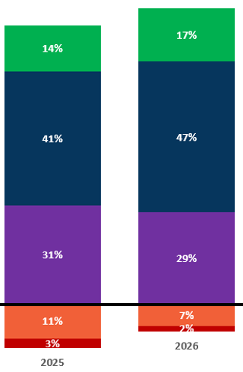
Overall District Rating Results: 2025 to 2026 Comparison
Across Texas Districts: 2025 vs 2026 Ratings
Our District: 2025 to 2026 Ratings
24% of districts increased in ratings from the prior year.
89% of districts stayed in the same score or improved from the prior year.
2025 |  | 2026
Scale Score | Rating | Scale Score | Rating
A 90-100
B 80-89
Stayed the Same | Increased | Decreased
770 | 284 | 127
65% | 24% | 11%
C 70-79
Use table above to input your district's ratings and scale score in 2025 and 2026.
This data is accessible on TXschools.gov: Under the Performance Tab, click Accountability Overview to see District 2025 and 2026 scale scores and ratings
D 60-69
F ≤ 59
1,202 districts in 2026. May not equal 100% due to rounding.
16 received a rating of Not Rated and are not included in this visual.
17
Notes:
So let's zoom in on the shift from 2025 to 2026. Statewide, 24% of districts improved their ratings, and 89% either improved or stayed the same. This shows that most districts are maintaining or building on their performance, even as expectations rise. Our district’s data here show how we’re trending…

Slide 18
Domain 1: Student Achievement

Slide 19
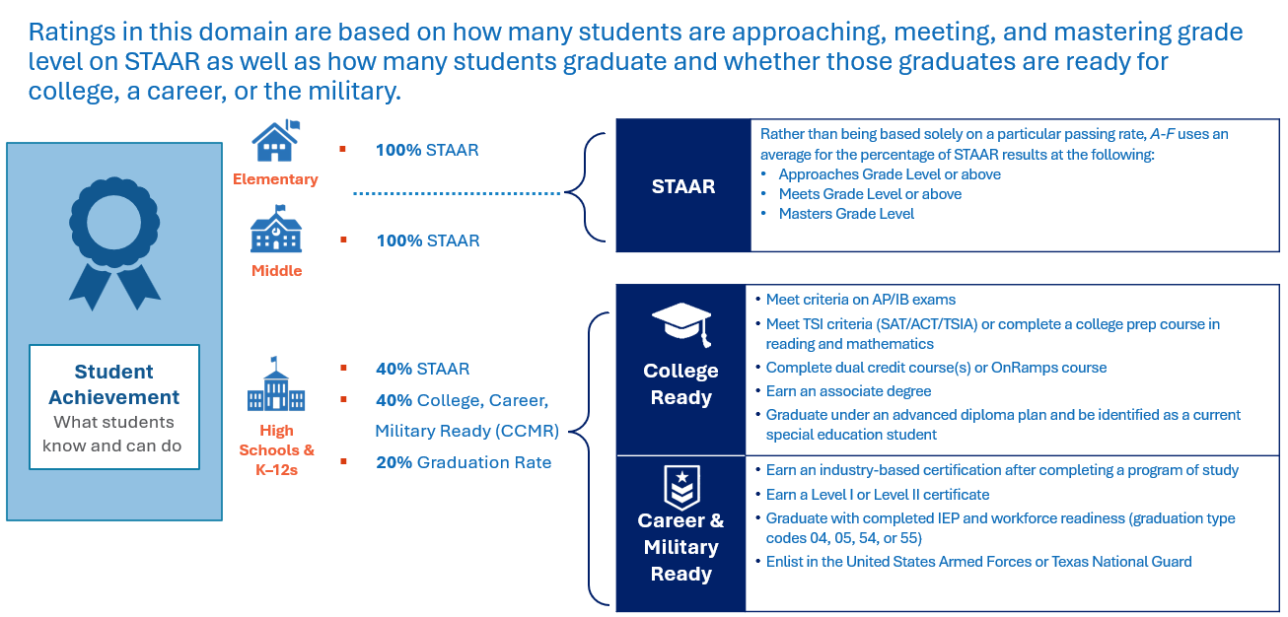
Domain 1: The Student Achievement Domain
Click here for examples for how student achievement is calculated
Notes:
Let’s now explore the data for Domain I—Student Achievement. This domain shows how well our students are performing academically and how prepared they are for life after high school, whether that’s college, career, or military service. Performance is measured through STAAR, CCMR indicators, and graduation rates. This ensures a comprehensive view of student success. For elementary and middle schools, STAAR is the primary measure. For high schools, we look at readiness indicators like AP, dual credit, and military enlistment.

Slide 20
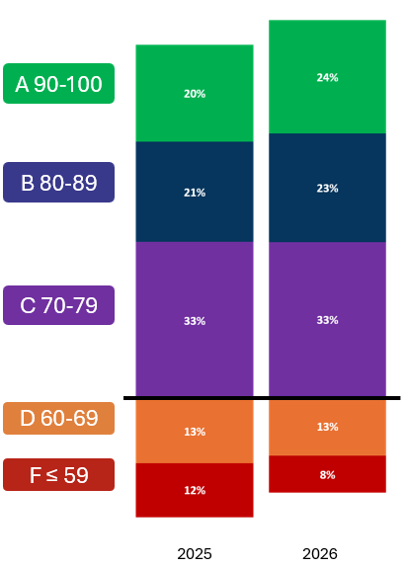
Campus Domain 1 Ratings: Comparison of 2025 vs. 2026 Results
Across Texas Campuses: 2025 vs 2026 Ratings
Our Campus: 2025 to 2026 Ratings
23% of campuses increased in ratings from the prior year.
91% of campuses stayed in the same score or improved from the prior year.
 | 2025 | 2026
STAAR Performance
CCMR
Graduation/ Completion Rate
Student Achievement Score
Stayed the Same | Increased | Decreased
5494 | 1859 | 693
68% | 23% | 9%
Use table above to input your campus rating in 2025 and 2026. Only STAAR performance applicable for ES/MS.
Navigate to the "Student Achievement" tab of TXschools.gov and under STAAR Performance data, click "dig into the data" for STAAR performance.
All other data for secondary schools is available under the listed indicator on the Student Achievement tab of TXschools.gov
9,105 campuses in 2026. May not equal 100% due to rounding,
Campuses that received a rating of Not Rated and are not included in this visual.
Notes:
Across the state, 23% of campuses improved in Domain 1, and 91% maintained or improved their scores. This is encouraging and shows that statewide efforts to improve academic achievement are paying off. Our campus ratings here track our progress…

Slide 21
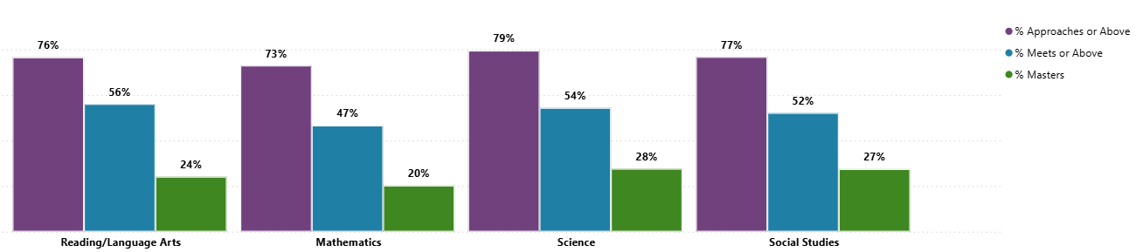
Campus Domain 1 Ratings: Zoom in on STAAR Performance
Statewide: STAAR Performance
Our Campus: STAAR Performance
2026 | RLA | Math | Sci | Soc. Studies
% approaches
% meets
% masters
Use table to the right to input your STAAR performance in 2026.
You can find this on the "Student Achievement" tab of TXschools.gov. Under STAAR Performance data, click "Dig into the Data"
This same graphic can also be found on Txschools.gov by selecting "Analytic Tools' under the "Tools and Reports Tab" and then selecting "STAAR Performance"
Notes:
The data here allows us to zoom in on STAAR performance across subjects—RLA, Math, Science, and Social Studies. Our campus data shows students are performing at approaches, meets, and masters levels…

Slide 22
Domain 2: School Progress

Slide 23
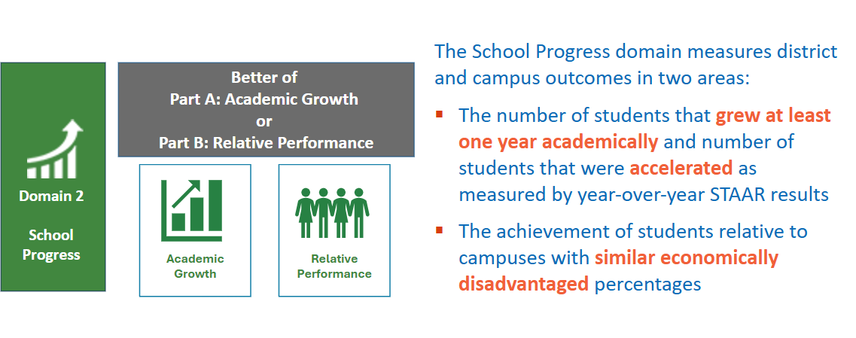
Domain 2: School Progress Part A and B
Notes:
Domain 2 focuses on school progress. It includes academic growth and relative performance, helping us understand how students are improving year over year

Slide 24
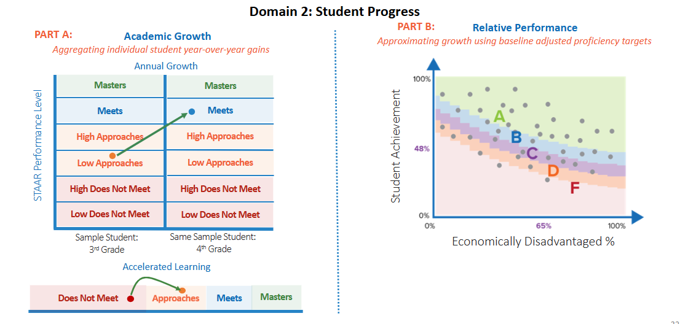
Domain 2: School Progress Part A and B
Click for a examples of how school progress domains are calculated
Notes:
In Domain 2, we evaluate students learning over time—not just where they are, but how far they’ve come.
Growth measures individual student progress year over year. It looks at how students move from one performance level to the next—like from ‘Approaches’ to ‘Meets’—and rewards schools for accelerating learning, especially for students who start behind.
Relative Performance compares a school’s achievement to other schools with similar levels of economic disadvantage. This ensures fairness by recognizing schools that are outperforming peers in similar contexts.

Slide 25
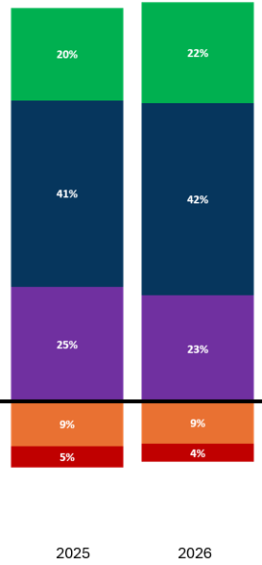
Campus Domain 2 Ratings: Comparison of 2025 vs. 2026 Results
Across Texas Campuses: 2025 vs 2026 Ratings
Our Campus: 2025 to 2026 Ratings
A 90-100
26% of campuses increased in ratings from the prior year.
80% of campuses stayed in the same score or improved from the prior year.
 | 2025 | 2026
Academic Growth
Relative Performance
School Progress Score
B 80-89
Stayed the Same | Increased | Decreased
4347 | 2056 | 1608
54% | 26% | 20%
C 70-79
Use table above to input your ratings in 2025 and 2026.
Recommended to highlight the higher score to best compare your results to statewide results.
On TXschools.gov, under the Performance tab, select School Progress to see your Domain 2: Part A and B results
D 60-69
F ≤ 59
9,105 campuses in 2026. May not equal 100% due to rounding, Campuses that received a rating of Not Rated and are not included in this visual.
Notes:
In the state, 26% of campuses improved in Domain 2, and 80% maintained or improved their scores. This domain helps us recognize districts that are accelerating learning, especially for students who need it most. Our ratings here show how we’re doing in terms of growth and performance as compared to other schools with similar social economic status…

Slide 26
Domain 3 – Closing the Gaps

Slide 27
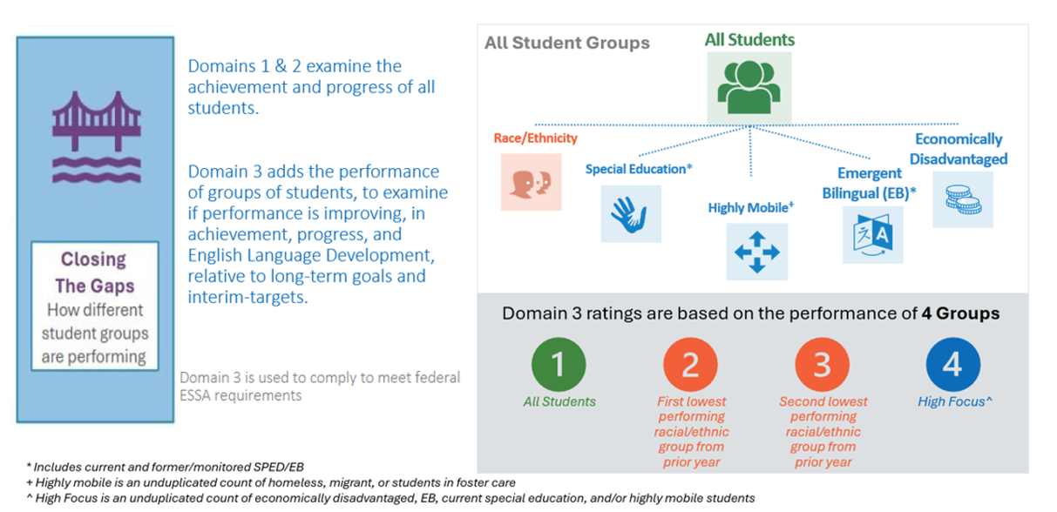
Domain 3: Closing the Gaps
Click here for examples of how closing the gaps is calculated
Notes:
Domain 3 evaluates how well we’re supporting historically underserved student groups and ensuring all students have the opportunity to succeed. This domain aligns with federal requirements and evaluates 16 student groups across achievement, growth, graduation, and English proficiency. Ratings are based on four groups focused on those most in need.

Slide 28
Elementary and Middle Schools:
The Closing the Gaps domain examines 4 student groups’ potential gaps to targets set across 4 components.
Domain 3 Groups
Component Weight
Sum
Domain 3 Groups are based on the performance of
4 Groups
30% | Academic Achievement STAAR RLA at Meets Grade Level STAAR Mathematics at Meets Grade Level | 0-8 4 RLA 4 Math | 0-8 4 RLA 4 Math | 0-8 4 RLA 4 Math | 0-8 4 RLA 4 Math | 0-32
50% | Growth Growth in STAAR RLA Growth in STAAR Mathematics | 0-8 4 RLA 4 Math | 0-8 4 RLA 4 Math | 0-8 4 RLA 4 Math | 0-8 4 RLA 4 Math | 0-32
10% | Progress to English Language Proficiency TELPAS Progress |  |  |  | 0-4* *Only current EB | 0-4
10% | School Quality/Student Success Average of all STAAR performance scores | 0-4 | 0-4 | 0-4 | 0-4 | 0-16
 |  |  |  |  |  | 0-84
All Students
First lowest performing racial/ethnic group from prior year
Second lowest performing racial/ethnic group from prior year
High Focus**
Closing the Gaps Scoring
  4 - Met long-term target
  3 - Met interim target
  2 – Showed expected growth toward next interim target
  1 – Showed minimal growth
  0 - Did not show minimal growth
Elementary Schools would need to earn 74% of points possible to score an A
Middle Schools would need to earn 71% of points possible to score an A
Notes:
This domain aligns with federal requirements and evaluates 16 student groups across achievement, growth, graduation, and English proficiency. Ratings are based on four groups focused on those most in need. Here you can see the total points possible for each component and the component weight for our school.

Slide 29
High Schools and K-12s:
The Closing the Gaps domain examines 4 student groups’ potential gaps to targets set across 4 components.
Domain 3 Groups
Component Weight
Sum
Domain 3 Groups are based on the performance of
4 Groups
50% | Academic Achievement STAAR RLA at Meets Grade Level STAAR Mathematics at Meets Grade Level | 0-8 4 RLA 4 Math | 0-8 4 RLA 4 Math | 0-8 4 RLA 4 Math | 0-8 4 RLA 4 Math | 0-32
10% | Graduation Rate 4-year Federal Graduation Rate | 0-4 | 0-4 | 0-4 | 0-4 | 0-16
10% | Progress to English Language Proficiency TELPAS Progress |  |  |  | 0-4* *Only current EB | 0-4
30% | School Quality/Student Success CCMR for graduates and students in grade 12 | 0-4 | 0-4 | 0-4 | 0-4 | 0-16
 |  |  |  |  |  | 0-68
All Students
First lowest performing racial/ethnic group from prior year
Second lowest performing racial/ethnic group from prior year
High Focus**
Closing the Gaps Scoring
  4 - Met long-term target
  3 - Met interim target
  2 – Showed expected growth toward next interim target
  1 – Showed minimal growth
  0 - Did not show minimal growth
High Schools/K-12s would need to earn 74% of points possible to score an A
If a HS/K-12 does not have a 4-year graduation rate, it is evaluated using Growth
If a HS/K-12 does not have CCMR, it is evaluated using STAAR (all subjects) performance
Notes:
This domain aligns with federal requirements and evaluates 16 student groups across achievement, growth, graduation, and English proficiency. Ratings are based on four groups focused on those most in need. Here you can see the total points possible for each component and the component weight for our school. For high schools without graduation rate or CCMR data, Domain 3 calculations are based on either STAAR growth or STAAR performance across all subjects.

Slide 30
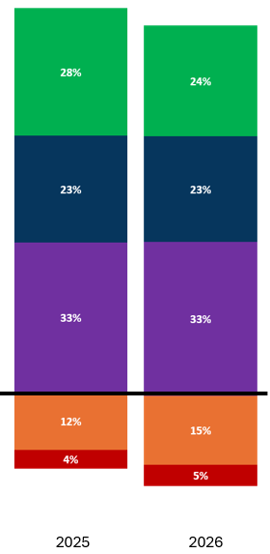
Campus Domain 3 Ratings: Comparison of 2025 vs. 2026 Results
Across Texas Campuses: 2025 vs 2026 Ratings
Our Campus: 2025 to 2026 Ratings
A 90-100
25% of campuses
increased in ratings from the prior year.
66% of campuses stayed in the same score or improved from the prior year.
 | 2025 | 2026
Domain 3 Scale Score
Domain 3 Rating
B 80-89
Stayed the Same | Increased | Decreased
3243 | 1994 | 2702
41% | 25% | 34%
C 70-79
Use table above to input your ratings in 2025 and 2026.
Color coding available under "recent colors"
Data can be found on TXschools.gov under the Performance tab on Closing the Gaps
D 60-69
F ≤ 59
9,105 campuses in 2026. May not equal 100% due to rounding. Campuses that received a rating of Not Rated and are not included in this visual.
Notes:
Across the state, 25% of campuses improved in Domain 3, and 66% maintained or improved. This is one of the most encouraging signs. It means campuses are making progress in closing gaps, aligned to federal targets, and ensuring all students have access to opportunity. Our campus ratings in this domain reflect how…

Slide 31
Closing the Gaps: Zoom in on Campus Results
Domain 3 Results
Academic Achievement
Growth Rate
 | Reading/Language Arts | Mathematics | Reading/Language Arts | Mathematics | Graduation Rate | Student Success | School Quality | English Language Proficiency
All Students
Lowest-Performing Racial/Ethnic Group
Second-Lowest Performing Racial/Ethnic Group
High Focus Group
Total Points
Use table above to input your points earned in Closing the Gaps in 2026 and your two lowest performing Racial/Ethnic Groups
Data can be found on the Closing the Gaps tab of TXschools.gov under the Closing the Gaps Details header.
Schools can delete any columns that are not applicable based on school level
Notes:
To zoom in our performance on Domain 3, I wanted to first highlight that our 2 lowest performing racial/ethnic subgroups are ____ and ____. This illustrates all Domain 3 indicators for our assessed student populations

Slide 32
Local Comparisons and Context

Slide 33
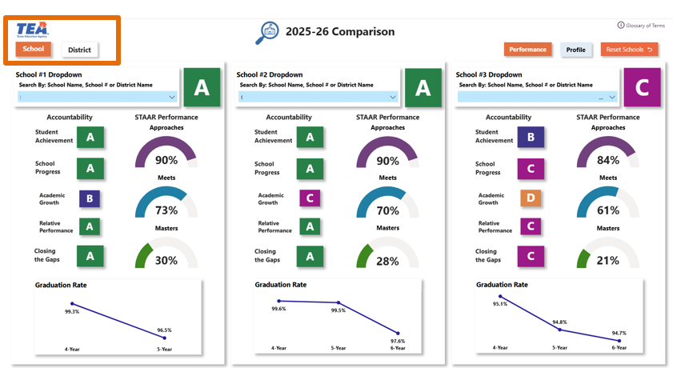
Analytics Tools on TXschools.gov
Compare tool provides side by side comparison of school or district reports
Notes:
The analytics tools on TXschools.gov provide additional and interactive views, which allow us to dig deeper into results. These are especially helpful in comparing results over time or to similar peers.
Here we can see a high level side by side comparison of 3 districts and their performance in 2026 for each of the domains, STAAR performance, and graduation rates. We are also able to quickly toggle to see profiles of each of the districts.
This can also be used to compare schools within our district.

Slide 34
Within District School Comparisons
Use this space to snip a picture of the compare tool for multiple schools across your district
Once you are on the profile page for your one of your school TXschools.gov, click "Compare" on the right hand side
Use the drop down blue boxes to select three schools
Note- for smaller districts, you can use this tool with <3 schools
Notes:
So here we have the results for our school, along with ________ and _______. You can see that...

Slide 35
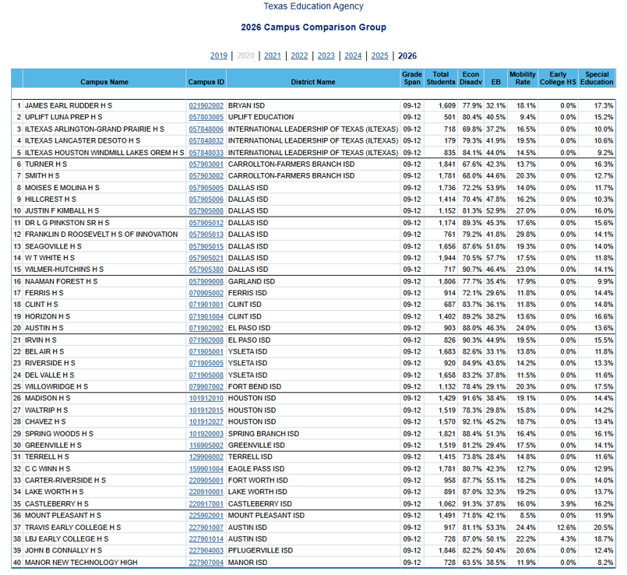

Campus Comparison Groups
Campus comparison groups are groups of schools across the state with similar demographic profiles
Schools in the top 25% on certain indicators within their campus comparison groups earn distinctions
Notes:
Our campus also has a campus comparison group; which outline schools similar to each of our school based on grade span and the percent of students that are economically disadvantaged, emerging bilinguals, highly mobile, enrolled in early college (if applicable), and students served under special education. When we perform in the top 25% of these groups on a certain number of indicators, we are able to earn distinctions.

Slide 36
Our Campus Comparison Group
Use this space to snip a picture of the compare tools for comparison group schools
Accountability Reports contains campus comparison groups. Change "report level" to see comparison groups across your district (recommend to change excel output for district reports)
Once you are on the profile page for your one of your schools on TXschools.gov, click "Compare" on the right hand side
Use the drop down blue boxes to select three schools in your campus comparison group
Notes:
We can also use the compare tool to look at performance of schools in our campus comparison groups. Here you can see our school, and then two schools in our campus comparison group.

Slide 37
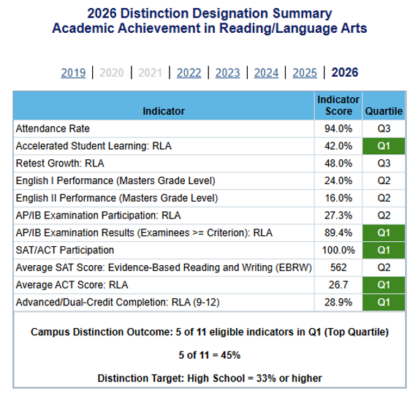

Campus Distinction Designations
Notes:
So now that we have talked a little bit about campus comparison groups, I also want to share about our distinctions. Campuses that receive an overall rating of A, B, or C are eligible to earn distinction designations and there are 6 (ES/MS) or 7 (HS and K12) distinctions that can be earned. This is our opportunity to show that we are in the best of the best of our campus comparison group. Here is an example of a distinction summary for Academic Achievement in Reading/Language arts. This is a high school, so they would need to be in the top quartile on 33% of the indicators to get this distinction. You can see here that they were in the top quartile of their comparison group for attendance rate, retest growth, AP/IB exam participation, SAT/ACT participation, and advanced/dual credit completion. That is 6/10 indicators and well above the 33% threshold, so this school earned a distinction designation in Academic Achievement for Reading/Language Arts

Slide 38
Our Campus Distinction Designations
You can find which distinctions your school earned at the bottom of the accountability overview page.
To find your distinction summaries (example on previous slide), you will need to click on 2025-2026, which will open up your accountability reports.
From there, select distinction summary to celebrate distinctions earned, set goals for next year, etc
Notes:
Let's take a look at the distinction designations we earned...

Slide 39
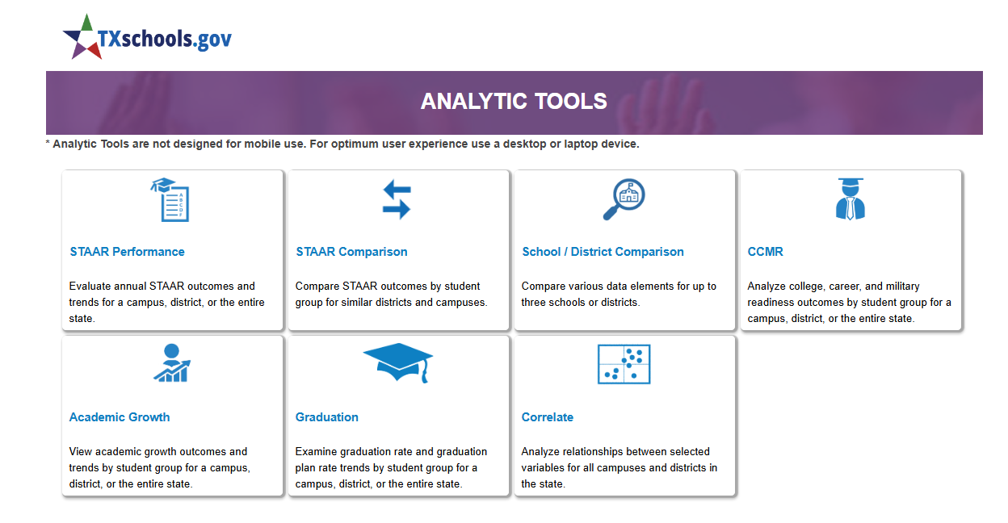
Other Analytic Tools
Notes:
By clicking on tools and reports, we can also see lots of other analytics tools that allow us to dig deeper into our performance. I encourage you to leverage these resources to gain additional insight and I will be using these in my planning. (Leaders can add additional slides if you know your school is particularly interested in a specific data tool)

Slide 40
Summary, Reflection, and Next Steps

Slide 41
Overall Performance Results: 2026
Use space on this slide to summarize your overall domain scores and grades.
Then, highlight your best of domain 1, 2a, and 2b and overall rating.
Data can be found on the overall performance details tab on TXschools.gov
____ out of 100
____ out of 100
____ out of 100
Better of Achievement or Progress: 70%
30%
Overall Rating
Domain ____
____ out of 100
____ out of 100
____ out of 100
Notes:
To recap, we receive a rating in three domains:
Domain 1- Student Achievement
Domain 2- School Progress and
Domain 3- Closing the Gaps
The better score of Domain 1 or 2 accounts for 70% of our overall rating and Domain 3 accounts for 30%. Based on the 2025-2026 school year, our rating is...

Slide 42
Celebrations!

Slide 43
Questions and Clarifiers

Slide 44
Areas of Opportunity

Slide 45
Next Steps

Slide 46

Thank You

Slide 47




Statewide Results: Elementary Schools
Rating
A
B
C
D
F

Slide 48




Statewide Results: Middle Schools
Rating
A
B
C
D
F

Slide 49




Statewide Results: High Schools
Rating
A
B
C
D
F

Slide 50




Statewide Results: K-12 Schools
Rating
A
B
C
D
F

