Slide 1
PREP Data Management for LEAs
Grow Your Own, Mentorship,
& Residency Programs
June 23, 2026
Training for Data Managers
Notes:
Thank you for joining us today. My name is Lorrie Ayers and I will be your presenter today. The information presented today is for PREP Data Managers from LEAs who have approved LASO 4 applications with one or more PREP areas that may be recipients of the PREP allotment in 2026-2027. Today’s presentation will introduce Data Managers to the functionality of the user interfaces in ECOS where you will report PREP data on behalf of your organization.
As we move through the information today, keep in mind that the PREP data entry and the role of the PREP Data manager are important because the PREP allotment dollars will be allocated and awarded based on the data you report for your LEA using the process we will review today.

Slide 2
Agenda
FYIs
PREP Program Overview
Submit questions during the webinar using the Zoom Q&A
Webinar slides and recordings will be posted on the PREP Allotment Information page
Submit Questions to the PREP Support Portal
Managing Data & ECOS Access
Grow Your Own (GYO)
Mentorship
Residency (RSD)
Additional Resources
Notes:
The agenda for today includes a quick overview of PREP relevant to PREP data collection and then I will focus on each specific PREP area and the unique requirements of each. The goal for today is that attendees feel confident on how to apply for the PREP Data Manager role in ECOS and feel confident using the interfaces to enter data.
For future reference, this presentation is being recorded and will be posted on the PREP Allotment information page on the tea.texas.gov website. Please place any questions that you have related to this data entry informational session in the ZOOM Q & A feature and we will try to respond to them today, if time, or will produce an FAQ from all questions and publish it with the recording. At any point, you may submit questions to the PREP Support portal. The link for the portal is embedded on this slide.
As always, we are here to support you, as needed.
There are some quick quizzes built into the presentation today so if you want to participate, please keep your phones handy. To participate in the quiz, use your phone to grab the QR code on the quiz screen and respond. The results should show up on the screen for everyone to see.

Slide 3
Key Words to Know Today
LEA – local education agency such as school district or approved charter campus
EPP – educator preparation program responsible for preparing and recommending candidates for educator certification
Entity/Organization – generically referencing LEA, EPP, or both
Legal Authority – the person at the entity/organization with ultimate responsibility for that entity and it’s operation (e.g. the Superintendent of a school district or the Dean/Director/Owner of an EPP)
ECOS – The Educator Certification Online System that is an application accessed via TEAL and that houses all of the educator data across the state
  ECOS for Educators – educator accounts containing certification data
  ECOS for Entities – LEAs and EPPs process requests and document and access entity specific records for educators and educator candidates.
  ECOS for Admins – TEA access to all data
PREP Data Manager – The person responsible for entering PREP data into ECOS and verifying its accuracy
Notes:
If you attended the overview session several weeks ago, you may remember this slide of key terms. Just to refresh our thinking, as well as to inform those who may be new, let’s review the key terms relevant to the Data Manager role and to the processes we will review today.
[Review slide]

Slide 4
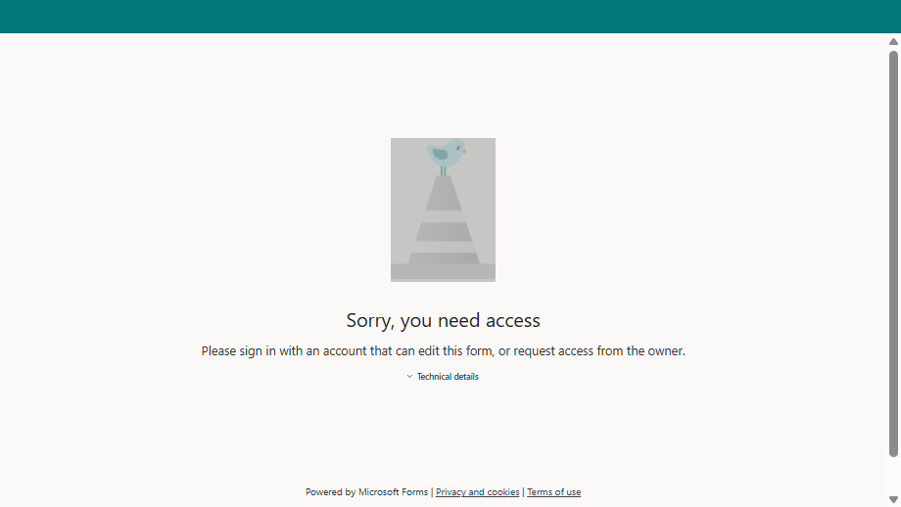
Form
Notes:
Lets take our first quiz. Please share your role in your organization. The data will be displayed in whole and no names will be displayed with the responses. Use your phone camera to engage with the QR code and simply then respond to the quick quiz. I’ll pause and give everyone a moment.

Slide 5
PREP Programs Overview & Managing Data
Notes:
Let’s cover a quick refresh on the overall PREP data management process and the structure of data that will be captured in ECOS related to participation in PREP.

Slide 6
PREP Programs Overview
Five Programs to Support Teacher Preparation and Retention
PREP Grow Your Own Program (GYO)
PREP Mentorship Program
PREP Preservice Residency Program
PREP Pre-service Alternative Certification
PREP Traditional
District employees earning bachelor's degree and EPP admission while employed.
Beginning teachers (1st-2nd year) receiving structured mentoring support with certified mentors
EPP Candidates participating in a full-year residency experience at a partnering LEA.
EPP Candidates participating in clinical teaching prior to a full year internship at a partnering LEA.
EPP Candidates completing clinical teaching in a partnering LEA
Notes:
Of the 5 PREP programs established by House Bill 2 passed in the 89th Texas Legislature, we will focus on the three in the red box because they will be live for 2026-2027. Data reporting will begin for these three PREP areas this summer. Specifically, the interfaces you will use to report PREP data will open on July 1 and all initial data required to qualify your LEA for the fall payout must be entered and accurate by August 28.
Note that PREP Grow Your Own and Mentorship programs are LEA specific programs where the PREP Residency program happens through a partnership between the LEA and one or more EPPs. This is important in our context today because the LEA and EPP will share responsibility for entering various data points into a shared screen.

Slide 7
PREP Activity/Data Will be Managed in ECOS
LEA
LASO App Approval
      TEA
      ECOS Admins
      Manager
  LEA Role: District_PREP
    GYO Screen
    Mentorship Screen
    Residency Partner Page
    P-ALT Partner Page
    Traditional Partner Page
  EPP Role: EPP_Partnership_View
    Residency Partner Page
    P-ALT Partner Page
    Traditional Partner Page
EPP
SBEC Route Approval
Partnership pages enable interactive data sharing between LEA and EPP
Notes:
This graphic represents the overall structure of PREP data management in ECOS. The data from the approved LASO IV applications and the SBEC approved Residency programs has been collected by our Admin data team at TEA and added into the TEA ECOS Admin interface represented in the purple box at the top of the hierarchy. That data entry enables the interfaces for the three PREP programs, GYO, Mentorship, and Residency for both the LEA and for the EPP user.
Because there are some differences in PREP data entered by LEA’s and EPPs, the data entry interfaces are slightly different. Also, LEAs may see all 5 PREP options including GYO, Mentorship, Residency, Pre-service Alternative Certification, and Traditional Certification, where as EPPs will see only 3 which are the partnership pages that include Residency, Pre-service Alternative Certification, and Traditional Certification. When the LEA and the EPP partner, they will have shared access to the partner page for the specific area, where each entity will have specific required data entry, and each can view the shared data. They cannot edit each other’s data.
It is especially important to understand this structure if you are an LEA that also has an approved EPP, such as a school district like Houston ISD, Dallas ISD, Katy ISD and the others. It will be critical that data managers for these organizations are careful when entering the LEA-specific and EPP –specific data. We have suggested to those organizations that, if possible, they assign different data managers, one to manage the LEA data and one to manage the EPP data.

Slide 8
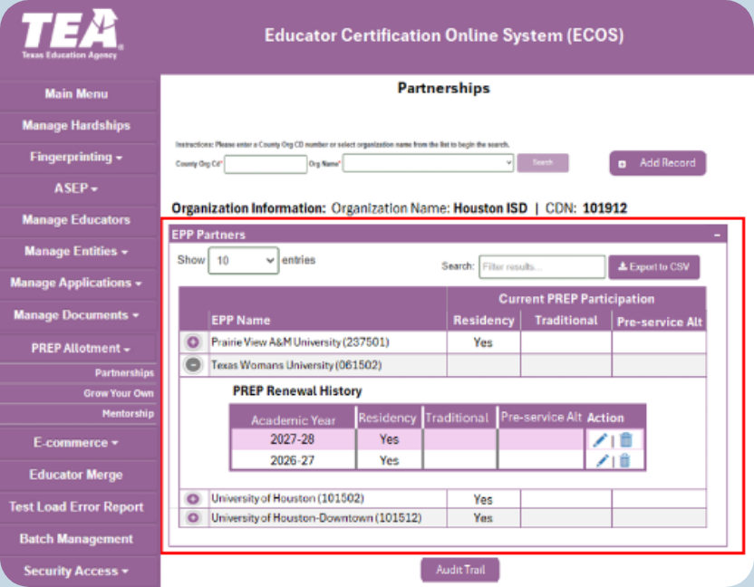
Managing PREP Programs – TEA Admin Screen
TEA Manages Partnerships
Data from LASO Approvals & SBEC Approvals Used to Populate This Screen
Enables LEA & EPP Entity Screens
Notes:
This is a screen shot of a TEA Admin screen. You can see the district is identified at top and then the EPP partnerships and the approval year for each are entered. This is important for you to know as the LEA Data manager because in a given year, if you don’t see the related drop down menu populate on your Entity screen, it could be that there is no approval entered into this Admin screen. A technical assistance request to TEA would initiate the TEA Admin to verify the information.
Note the district and EPPs listed here are for test purposes only and do not reflect any actual approvals or partnerships between these entities.

Slide 9
Key Start-up Dates & Deadlines
7/1/2026
Data Entry Screens Live
LEA/EPP Data Entry
8/28/2026
Data Due for Allotment
Notes:
We will reinforce these important dates throughout, and as I have already mentioned in this presentation, your deadline for entering the initial data related to participants in your various PREP routes into ECOS is August 28, 2026. Data will be collected at that point to determine the initial PREP allotment payout in the fall. The next slides will help LEA entities enter data to meet this deadline.

Slide 10
ECOS Access to Manage PREP Requires Approval
Data Managers for LEAs and EPPs must establish the role to access the data entry interfaces in ECOS for Entities:
  Entity role for authorized PREP Data Managers:
    LEA Role: District_PREP
    EPP Role: EPP_Partnership_View
  Entity legal authority controls and approves user access
  Partnership pages enable interactive data sharing between LEA and EPP
Do not select other roles. Submit requests for other roles separately.
Apply for PREP Role
Entity Legal Authority Approval
TEA Approval
Access Granted
Notes:
Not everyone at your entity will have access to the PREP data management screens. The person or persons at your entity that will be responsible for managing PREP and/or data entry for PREP in the ECOS system must request the new role through TEAL, similar to the way you requested your current roles in ECOS Entities. You will request approval to add the role, the request will go to your entity Legal Authority who will approve the request, then the request will bounce to the TEA for approval. Once TEA approves the access, the person who requested the role will have access to the PREP menu options.
On Thursday, June 25 this week, the roles will be deployed into ECOS. Likely in the evening. Thereafter, you should be able to apply for the role.

Slide 11

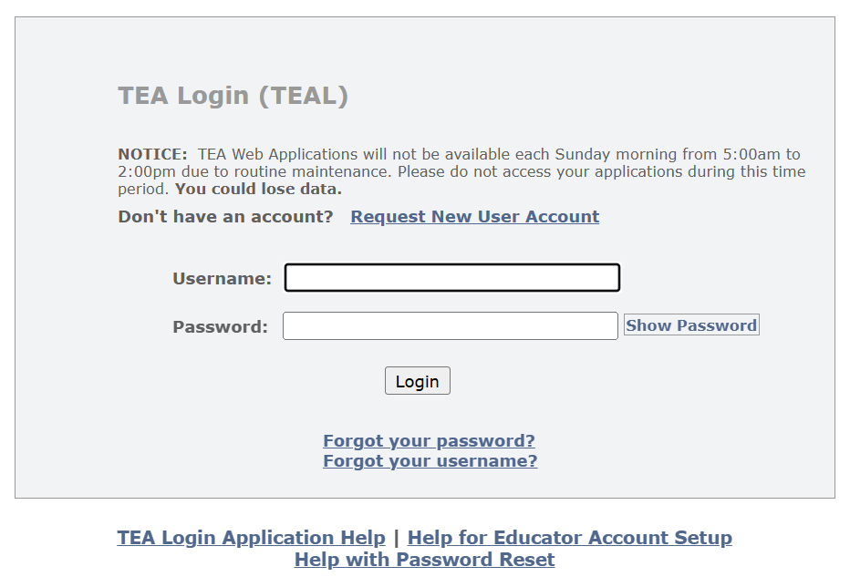
Request Access to the Data Manger Role via TEAL
Go to TEAL Login Link on the tea.texas.gov website
You must use your entity email address to request the role
Notes:
I’ll walk you through the steps to request the role with some screen shots.
First, log onto the tea.texas.gov website. Be sure to use your email address that is associated with your entity. Your access will not be approved if you are using a private email address that is not your entities address.
At the top of the landing page on the TEA website, toward the right side, you will see the Login menu. From the drop down, you can select TEAL Log in which will generate the screen at bottom. If you have a TEAL account, you can log in from here.
Use the “forgot password” and / or “forgot username” links, as needed, if you have not logged into your account recently. If you don’t have a TEAL account, you can request a new account from this screen also.
Either way, you must have a TEAL account to access the ECOS applications that reside behind the TEAL portal, including ECOS for Entities for your entity.
As a reminder, if you are at an LEA that has an approved EPP, we strongly encourage you to have two Data managers, one for each role, LEA and EPP. We have seen that wonky things are happening in our Test environment when one data manger has access to both menus, for LEA and EPP. The system gets confused apparently.

Slide 12
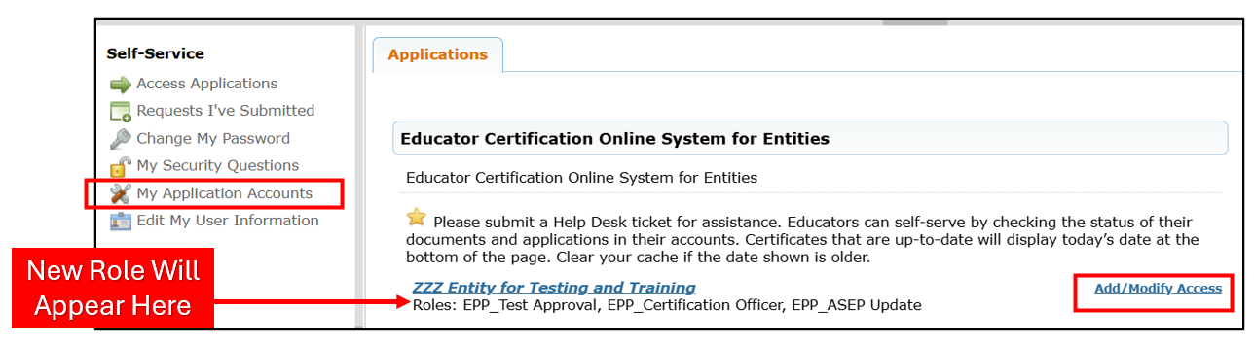
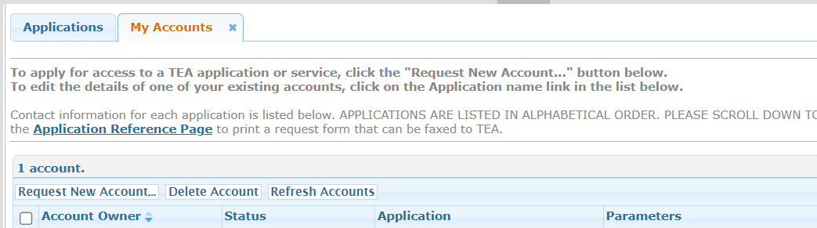
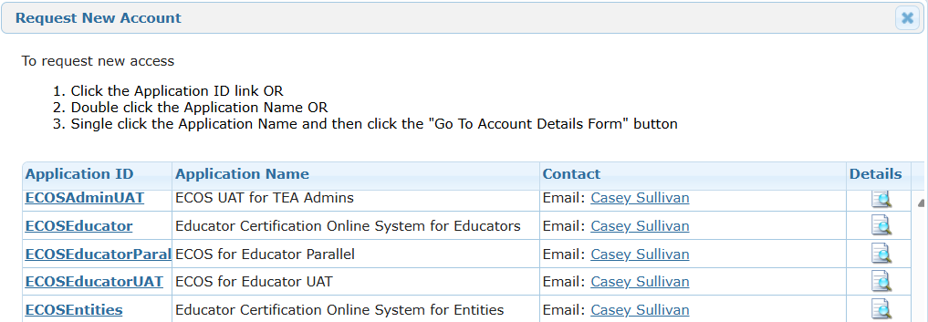
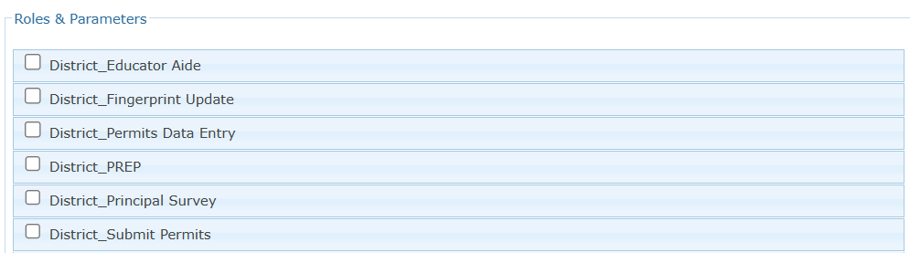
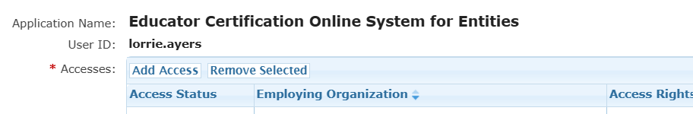
Request Access to the Data Manger Role
Notes:
When you successfully log in, the landing page will look like the screen shot at top. You will see a menu on the left and in the center you will see links to your approved applications such as ECOS for Entities if you are already a user in ECOS for your entity and/or ECOS for educators if you have pursued or achieved certification as an educator in Texas.
To add the Data Manager role, use either the Add/Modify Access button at right or use the My Application Accounts link on the menu at left. In the screen shot at top, I used My Application Accounts to generate these screen shots for someone that does not have any roles for my entity. If I already have access to at least one role in my entity, I need to use the Add/Modify Access option which omits one of the steps from this series you see on the bottom half of this slide. From the resulting screen shown in the first box in the 4 step process at bottom left, I selected “Add Access”.
You’ll get a pop-up window where you will select the ECOS for Entities option and then “Request New Account” . This is the screen you will not see if you use the Add/Modify Access button because you already have your Entity account established. When you select the Add New Account option you get another pop up window that allows you to select the data manager role specific for a district. When you check that role, a window will open that will require you to enter your organization identity two times. If you start typing your district name, the system should auto-populate. Be cautious because some districts have the same name so check the CDN attached to your district to ensure you are selecting the correct district. From there, continue to “save”, “accept”, “Bless”, and any other button that needs to be selected to advance the screens. You should ultimately get a message in green font at top of screen that you successfully submitted.
The request will go to your entity Legal Authority for approval, so you may want to check in with that person and let him or her know to approve the request. After that, the request comes to TEA for final approval.

Slide 13
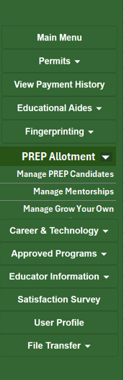
Managing PREP Programs – LEA User Access in ECOS for Entities
Access PREP Management Screens through the ECOS Entities Menu
  Add data
  Update data
  Review/Verify data
LEA
Access
Notes:
When the PREP approval and/or partnership relationship is established via the TEA Admin “purple” screen on the slide we viewed earlier, approved data manager(s) at the LEA, will see the PREP data management menu options at left in their Entity “green” screen. The Data Manager for your entity will use this menu to access the data entry interfaces.
To access this menu, log into TEAL as I showed you earlier, and on the landing page click on your entity access link. It will open ECOS for Entities, aka the green screen, for your organization. You will have access to the meu options for the areas that you are approved for, including the PREP allotment option if you are approved for the Data Manager role.
Even though these interfaces will not open until July 1 to enter 2026-2027 data, you should be able to view the interfaces and click through some of the screens after Thursday, June 26 this week. Feel free to go in and look around and acquaint yourselves with the interfaces. If you do find a screen that has an active button on it, just don’t save and you won’t hurt anything while you are looking around.

Slide 14
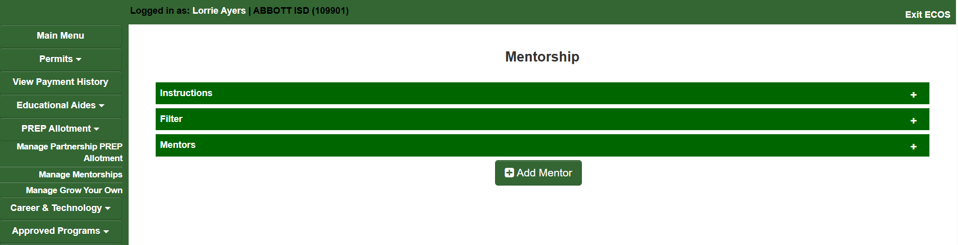
Structure of Interface
Structure of Each Page (3 Collapsable Sections):
  Instructions
  Filter
  List of Participants
Notes:
When you select the PREP option from the menu at left, you will land on the page related to that option. For example, I selected Manage Mentorships. Note the Mentorship is at the top of the page. Then on that page you’ll see three collapsable sections. You can expand each section by clicking on the + sign at the far right of the green bar for that section. The first section contains Instructions that provide the user information about how to enter data for that PREP area. The second section allows you to filter the page by cohort year. The third section shows the LEA the participant list for that PREP area. Since this is the Mentorship interface, the third section will show a list of mentors and beginning teachers, or “mentees”, for a given cohort year. From that list you can edit a record and from that page you can add a record.
You will see the same overall structure across each of the PREP area interfaces.

Slide 15
LEA: Grow Your Own (GYO)
Notes:
Let’s take a more detailed look at the three PREP areas that will be active for 2026-2027 and the functionality of the related data entry interfaces. First, we will look at Grow Your Own or GYO.

Slide 16
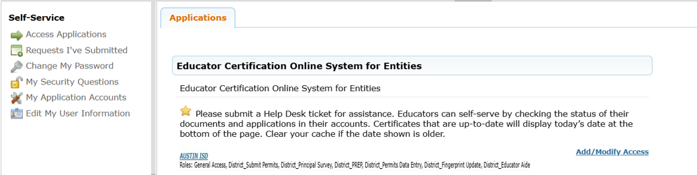
Managing PREP Programs – LEA Data Manager Access in ECOS for Entities (GYO)
Log in to Your Entity
Select: Manage Grow Your Own
Notes:
To enter data for Grow Your Own if your entity is approved for GYO PREP, data managers will log into your ECOS for Entities “green screen” via the TEAL Login link on the TEA website and select Manage Grow Your Own from the menu at left.

Slide 17
Validations (GYO)
New Year Opens - July 1, 20XX
Year Locks for New Entries- January 31, 20XX
TEA ID Not Valid- Error message
No Duplicate Entries- Error message
Limit 40 Participants / Year- Error Message
Notes:
Before you begin, note there are some validations built into the data management in ECOS. Validations typically align functionality with business rules, and / or, ensure accurate data entry. Knowing the validations ahead of time helps the data manager be more efficient with data entry and will help you problem solve in some situations.
These are some important validations built into the GYO interfaces
[Read through the slide]
Note that error messages prevent the record or action from saving. If you happen to get a message that is a warning instead of an error, note that the action may have saved but the system is warning you to take a second look at what you are entering to ensure accuracy.

Slide 18
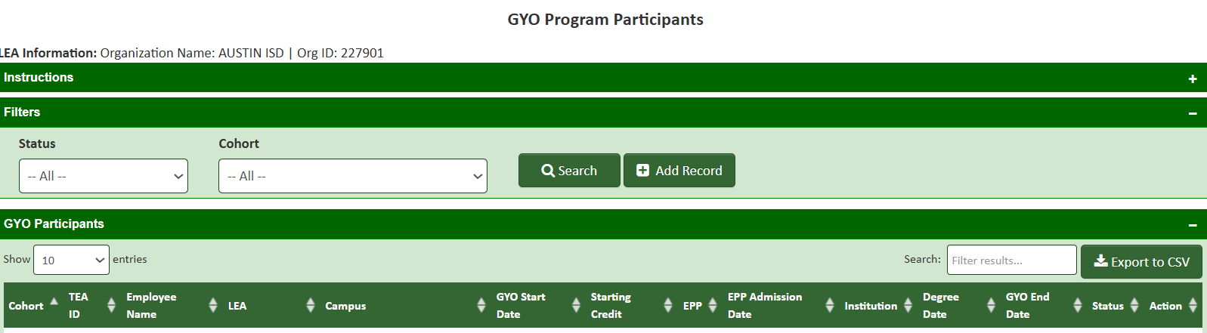
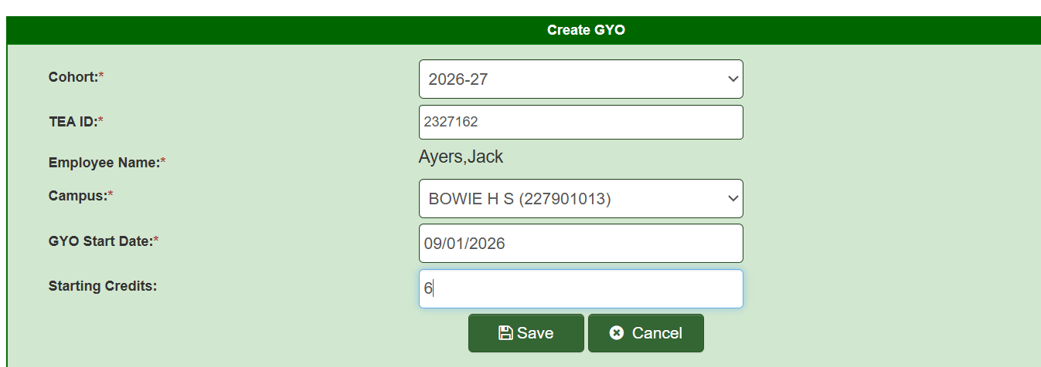
Enter a GYO Participant
Notes:
Now you have your list of GYO participants data that you have collected since our last overview webinar and you want to enter the data for each into the GYO portal in ECOS. The first time you log in you will not see a participant list in your ECOS PREP interface. To add the first participant, click on Add Record and it will generate the screen you see at bottom. Create a new record by adding the participant’s TEA ID. The GYO participant name should auto-populate. Verify the name is correct by ensuring that name is linked on your list to that TEA ID number. If that TEA ID number and name don’t exist in the ECOS data base, you will get an error message. At the end of this presentation, we will review some common data entry problems and what to do to solve them, so I won’t go into that now.
After you have the correct person, enter the campus on which that participant is assigned, and enter the GYO PREP program start date. Any college credits that person has earned can be entered into the last field. Then use the Save button to save the record. Congratulations! You’ve just started your first PREP program list for GYO!
You will continue to enter GYO participants in this manner until all of the participant names on your list are entered into the GYO PREP interface in ECOS. Remember you have a limit of 40 GYO participants in a year so if you try to enter a 41st name, you will get a system error message, and the entry will not save.
You should have an entry for every candidate participating in GYO for 2026-2027 by August 28, 2026.
Looking ahead, note that a planned system enhancement for 2027-2028 is to create a bulk upload option for data entry into the PREP interfaces.

Slide 19
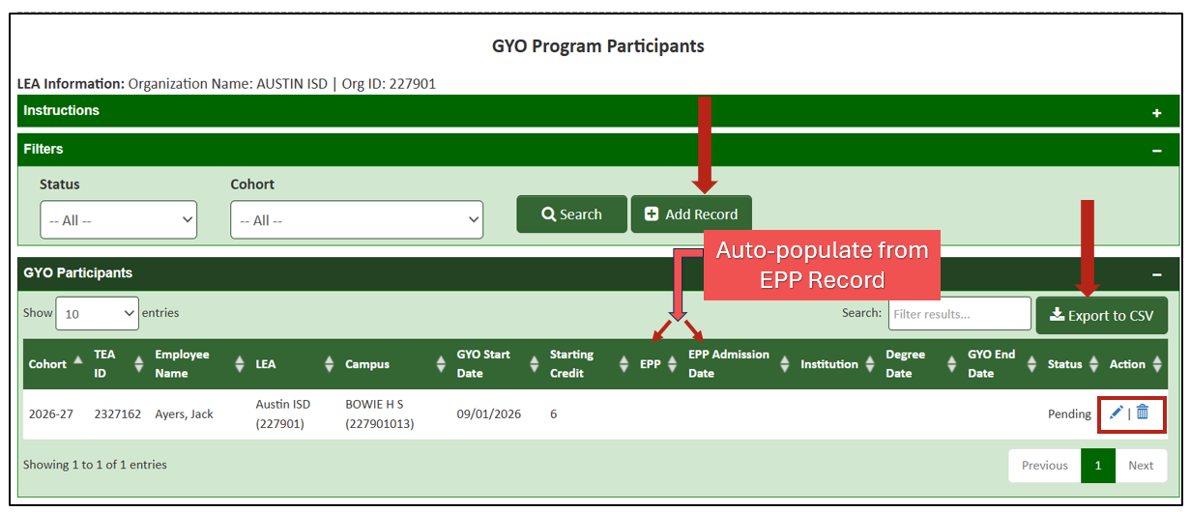
Generate a List of all Participants
Notes:
This shows you that I now have my participant list. This view currently shows one participant but will ultimately reflect all of my participants that I will add for the upcoming cohort year. You can use this interface to
add a new record,
review your data entry to make sure all participants have been entered accurately, and
you can update existing records using the pencil icon at right to pull up the record for the individual participant.
Note you can export the list to an Excel csv file if needed, such as for a quality control review by another person in your organization.
The list you see here reflects the initial data entry required for the fall allotment payout: however, note that ongoing data collection will need to happen to finish out the requirements for your GYO participants. Note that there are two fields that will auto-populate from an admission record created by an EPP. This data collection aligns with the requirement for GYO PREP that a participant must be admitted into an EPP. When you see data show up in these two EPP fields, you will know your participant has completed that GYO requirement.
So let’s say we want to update the record for my test subject Jack Ayers. I will click on the pencil icon at the right of Jack’s record and it will open up the data entry screen for Jack.
By the way my test subject, Jack, is my German Shepherd dog who would be a GYO participant, if he could read and write…

Slide 20
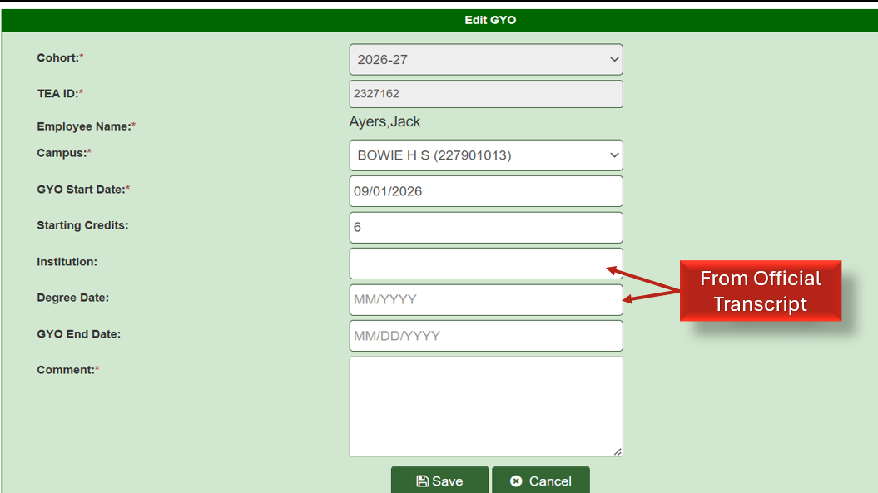
Check Your Work / Edit Participant Information
Notes:
Note that I will have to enter the degree information for Jack once his degree confers. This data collection also aligns with a requirement for completing the GYO PREP program.
Ultimately you will type in the GYO end date either when all requirements are complete or if the participant leaves the program before completing requirements. When you type in an end date, the comments section must be complete with a note about why the GYO participation was ended.
Two important reminders here:
You should use an official transcript to enter the degree data. That will require you to communicate with the GYO participant who must request a final transcript be sent from the university to your district HR. Your HR should be set up to receive transcripts since they most likely request them when hiring new faculty and staff. You should provide instructions to your participants on the process your HR uses for submitting transcripts.
If you have 40 GYO participants and one drops out of the GYO program and you type in an end date before the January 31 system lock, that will give you 39 participants so you should be able to enter another participant for a total of 40 for that year. Note you will not delete the first participant, just enter an end date and reason.
Note any participants for the 2026-2027 year must be entered into the ECOS interface we just reviewed by August 28, 2026 for the initial 2026-2027 allotment payout or later by January 31 for the settle up payout which we will talk about at the end of this presentation. Ultimately, all data for a participant must be complete to qualify for any success-based funding tied to the GYO PREP allotment.

Slide 21
LEA Next Steps: Update GYO Data
LEA enters at initial setup
  Cohort (defaults to current academic year)
  TEA ID/Name of participant
  Campus
  GYO start date
  Starting college credits
LEA updates later
  Institution where degree is earned
  Degree completion date (MM/YYYY)
  GYO end date (triggers status changes)
  Comment required when editing records
  Participant status:
    (Pending, GYO Complete, Ineligible, Inactive)
ECOS automatically generates and/or tracks
  Employee name (from TEA ID)
  LEA/CDN
  EPP Name (from admission record)
  EPP Admission Date (from admission record)
  Audit Trail Record created/modified date and user (audit log)
Data for Records Update
Notes:
So in summary, the Data Manager WILL have additional data to update periodically until the participant has finished the GYO program. The green box on this slide shows you what you can expect for ongoing data entry for a GYO candidate.

Slide 22
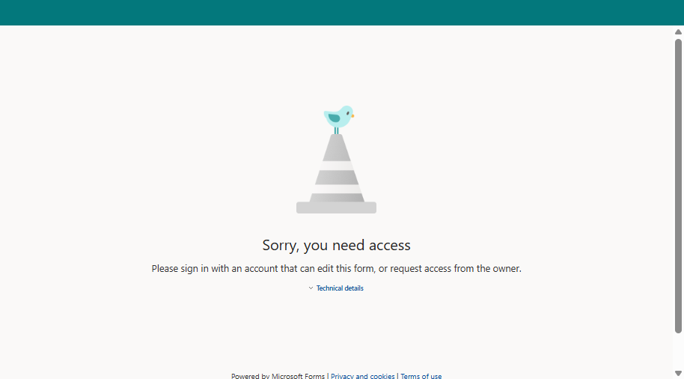
Quick Check-in: GYO
Notes:
Time for a quick quiz. How many GYO participants will you enter into ECOS for 2026-2027? If you are a data manager that has been collecting this data since our over view webinar, this will be readily at your fingertips. If not, you sill have some work to do to gather the initial data before you can begin data entry starting July 1.

Slide 23
LEA: Mentorship Program
Notes:
Let’s now look at the PREP mentorship requirements for LEA data entry. These are slightly different than GYO due to the different requirements for that PREP allotment. And remember this data collection in ECOS is aligned with Requirements in Code or Law or with business rules, or all of them.

Slide 24
Managing PREP Programs – LEA Data Manager Access in ECOS for Entities (Mentorship)
Log in to Your Entity
Select: Manage Mentorships
Notes:
When the PREP mentorship approval is established for your entity via the TEA Admin screen, the approved data manager at your LEA can access the Manage Mentorship screen.
To do so, the data manager will log into TEAL and then click on the link to the ECOS for entity screen access.
From the menu at left in the green screen, select the Manage Mentorships link.

Slide 25
Other Validations (Mentorship)
New Year Opens
  July 1, 20XX
Year Locks for New Entries
  January 31, 20XX
TEA ID Not Valid
  Error message
No Duplicate Entries
  Error message
Limit 40 Mentees / Year
  Error Message
Mentor-Limits on Number Mentees
  Error Message
Mentor Teaching Experience
  Must be 3 or more years
Notes:
There are some validations built into the Mentorship interfaces and functionality. Consistently across all PREP programs, the new year opens for data entry on July 1 and locks against new entries for that year on January 31. Note for all PREP programs, GYO, Mentorship, and Residency, the data manager can edit existing entries after January 31, just can’t enter new participants.
Additionally, across all programs, we have the validations that promote accurate reporting that the TEA ID must exist in an individual Educator record, and the system will prevent duplicate entries.
Some validations specific to the PREP Mentorship are:
There is a limit of 40 beginning teachers, or “mentees” per district per cohort year
And there is a validation that limits the number of mentees within and across districts that can be assigned to one mentor.
Also required is the mentor must have 3 or more years of teaching experience.

Slide 26
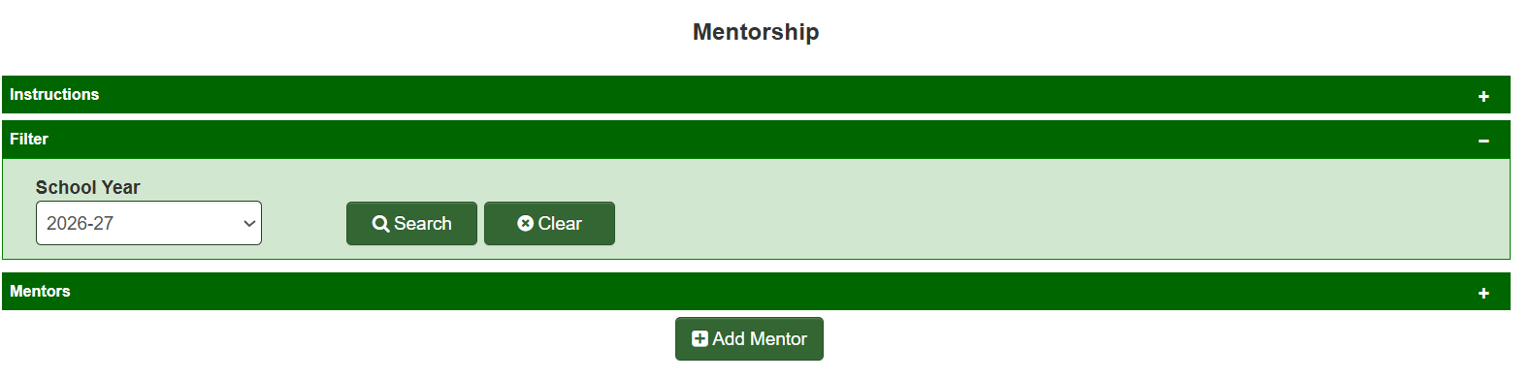
Creating your Mentor List
Notes:
When you log into the Manage Mentorship screen, you will likely see an interface that looks like this for your first time since you don’t have any records yet.
The data collection for the PREP Mentorship is structured to collect Mentor records first and then collect the records for Mentees assigned to those Mentors. That is why you can only add a record for a Mentor from this screen.
To create your first Mentor record, click on Add Mentor

Slide 27
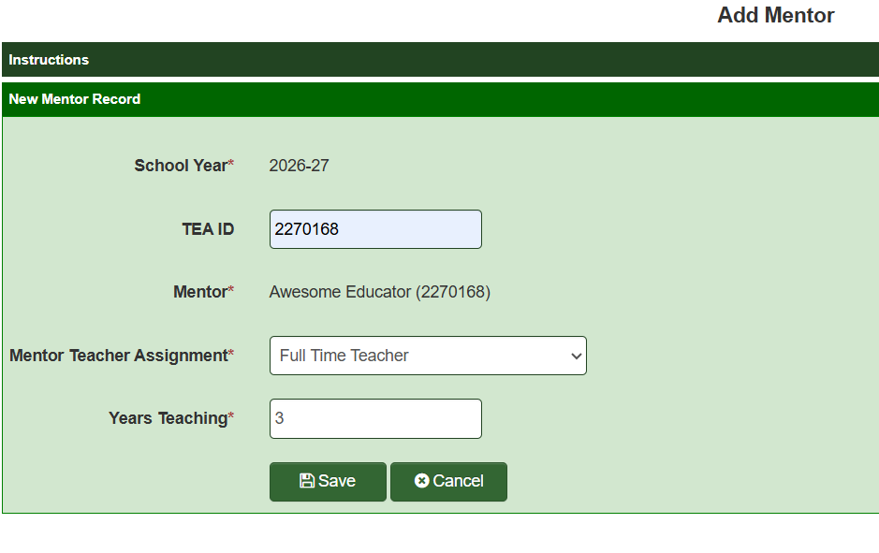
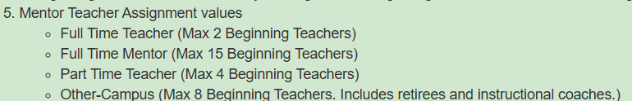
Enter a Mentorship Participant: Mentor
Notes:
This interface allows you to enter data for your first mentor. You’ll type in the TEA ID of your mentor and verify the name that auto-populates. Then you will identify the Mentor Teacher Assignment value. The value you select will trigger a validation that limits the number of mentees you can enter for a mentor in a year and is aligned with requirements for mentorship in Texas Administrative Code. Note this limit on mentees is across all districts in the state, so if you have a Mentor that is assigned a value of “full time mentor” and who is supporting mentees in 3 different districts, then the limit for that mentor is 15 mentees across 3 districts which is an average of 5 mentees / district. So, if you get the related error message when you attempt to enter a mentee it is because that person may have mentees assigned in other districts that you are not aware of. If this happens, you should consult with your program coordinator and the mentor to figure out your next steps. Please begin your data entry early so that you have time to work out these types of issues before the August 28 deadline for reporting participants.
You must also enter the number of years of teaching experience the mentor has because the asterisk by the Years Teaching field means it is a required field. The record will not save if the required fields are not complete.
After you have entered the data for one mentor, save the record. You will not have to enter another record for that mentor for the cohort year.

Slide 28
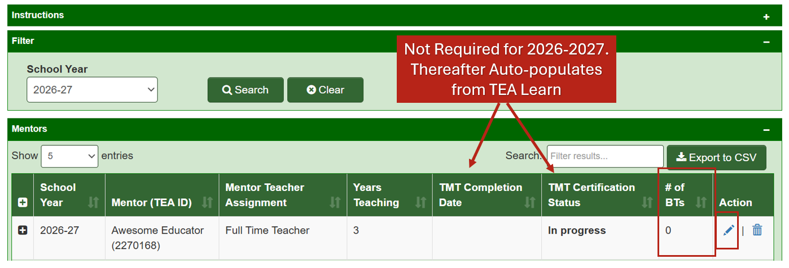
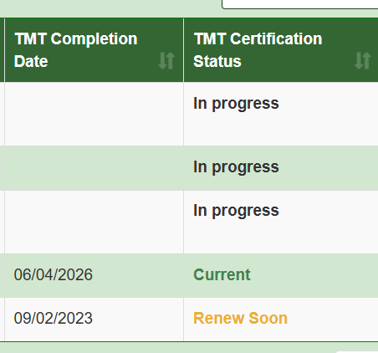
Check Your Work / Edit Participant Information continued
Notes:
Now, when you return to the Manage Mentorship interface, you will see the mentor record is populated there. Before we add a mentee for this mentor, let’s look at some of the features of this screen. First you will see the data you populated. You also see the pencil icon and trash icon at the far right of the row which allows you to edit the record ongoing or delete the record if you’ve made a mistake and need to start over and make a new record (recall the system will throw an error message if you try to create two records for one person). Next you will see The TMT Completion Date and the TMT Certification Status fields. These should be blank for 2026-2027 but will auto-populate in future years. These fields record that the Mentor completed the Texas Mentorship Training which is required for the PREP Mentorship program. Because this training must be renewed on a specific cadence, ECOS will track that. The Mentor will be either Current on the training, in progress of completing training, or is close to the expiration date of the training. The other status not pictured here is “Expired” which means the Mentor is not qualified to have a mentee until that training is renewed. The person in your district that coordinates the PREP Mentorship program should be aware of the TMT requirements, but it would be a good idea for the Data Manager and the PREP Mentorship program coordinator for your organization to communicate in future when these fields show the Mentor is approaching the renewal date for that training.
So now we want to enter a beginning teacher, or mentee, who will be supported by this mentor in 2026-2027. The + sign at left on the mentor’s record will open a drop down window that will contain the mentee list for that mentor. It will also provide a link to enter mentee data. Let’s do it.

Slide 29
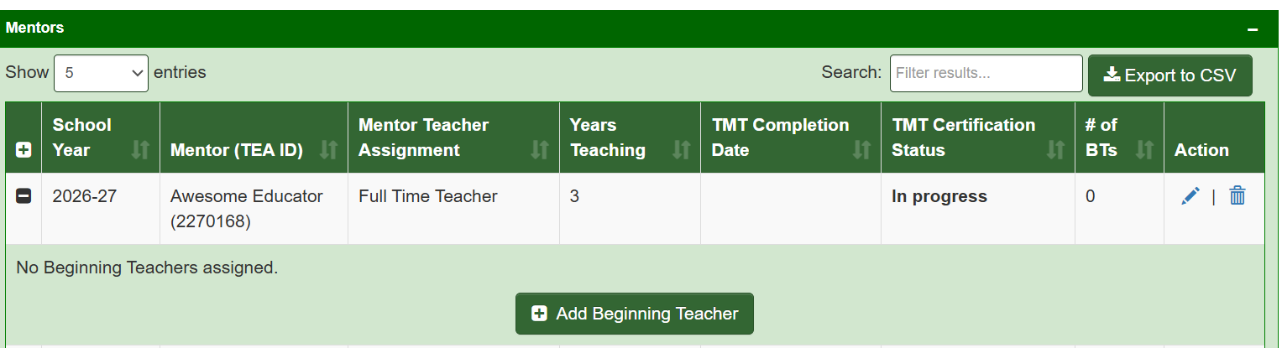
Enter a Mentorship Participant: Mentee
Notes:
Entering mentees through this process is required by August 28 for your LEA to receive the fall payout for the 2026-2027 mentorship allotment. To pull up a data entry screen, click on the plus sign at the far left on the Mentor’s row. This will open the drop down list of Beginning Teachers, or Mentees, assigned to that Mentor To add the first Mentee, click the button that says Add Beginning Teacher.

Slide 30
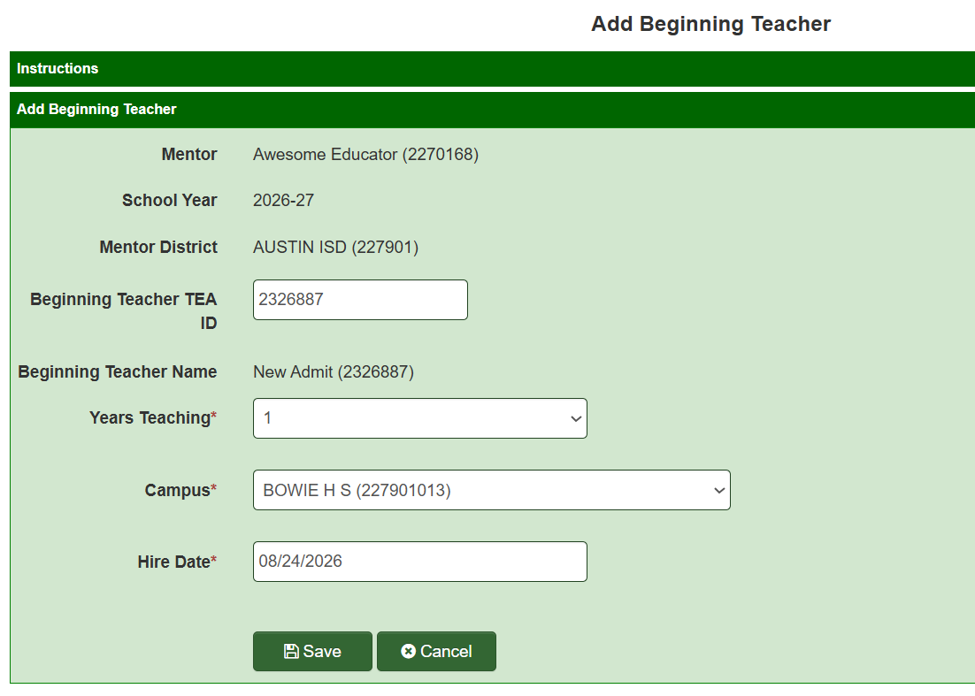
Adding the Mentee
Notes:
You will begin this record by typing in the TEA ID of the mentee and then verifying the name that auto-populates is correct. Then you will enter the data in the required fields for the mentee. Note you will identify if the mentee is a first-year teacher or a second-year teacher which is aligned with the requirements for Mentorship. And you will identify the campus on which the mentee is teaching and the hire date for that mentee in your district. Then save the record.
Note that because I pulled up this window using the drop down for my mentor, Awesome Educator, that mentor’s information auto-populated on the mentee record as did the cohort year.

Slide 31
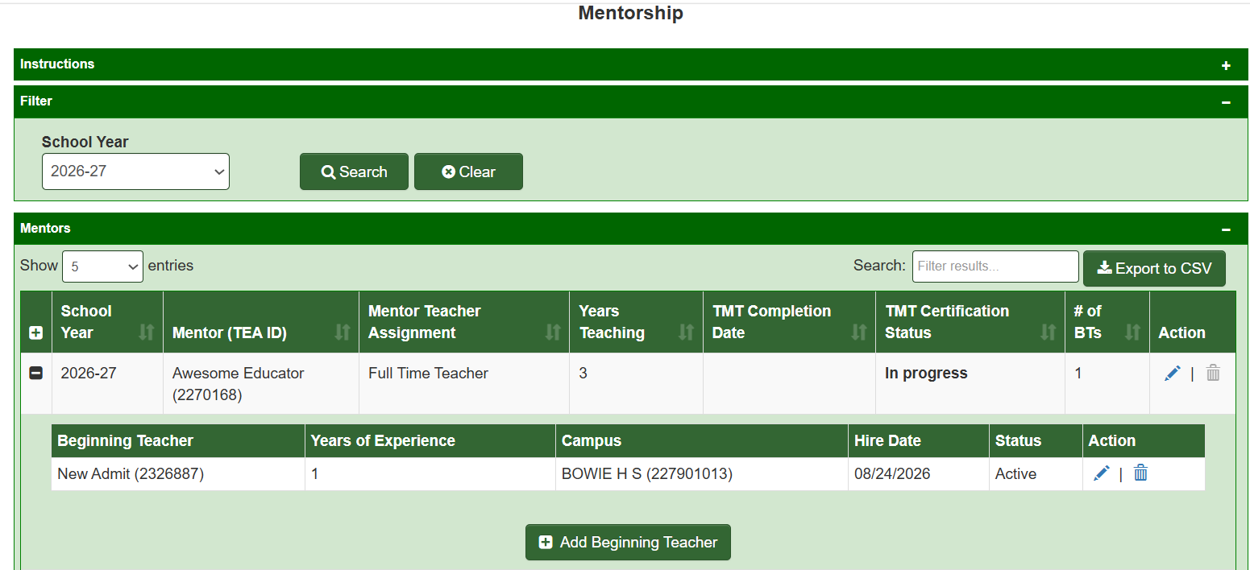
Mentorship
Notes:
After you save, the resulting record will reflect the data you just entered. The Minus sign at the left of the Mentor row means the drop-down menu showing mentees assigned to the mentor is open. If I click on the Minus sign, the window will close and I will no longer see the mentees assigned to this mentor. A Plus sign will show again. This feature keeps your list clean and concise.
If the Mentor has been assigned two mentees, I can add the second mentee record by clicking on the Add Beginning Teacher button and creating the second record as I did for the first mentee. Both mentee records will then populate on the drop down for that Mentor.
As you are entering data, if you have entered the mentee for a mentor and that mentee gets re-assigned to a new mentor before August 28, just delete the mentee record for the first mentor using the trash icon at right on the mentee row and then create a new record for the mentee with the new mentor. Remember, no duplicate records are allowed so if this becomes necessary to correct your records before August 28, delete the incorrect record before you create the new correct record.

Slide 32
LEA Next Steps: Update Mentorship Data
Mentor Information
  Mentor Name
  TEA ID
  Yrs teaching experience
  Texas Mentorship Training completion or renewal status
Mentee Information
  Mentee name
  TEA ID
  Campus name / CDCN
  Beginning teacher status (1st–2nd year)
  Mentee status (Active / Inactive)
Mentoring Activity Tracking
  Number of mentoring hours per semester(12 hours per semester minimum required)
  Fall and spring hours tracked separately
  School system duties and release time
  EPP Name-if candidate
  Additional data:
    Tracking mentor duties surveys
Data for Records Update
Notes:
This slide was from the overview webinar held earlier that summarizes the total data entry required. The first two blue boxes represent initial data entry required before August 28 and that we just walked through. The initial data will be used to calculate the initial payout of the allotment in the fall. But, the data collection for your program does not end there and will be ongoing until the program is complete for the participants identified in the records you have created. The additional data you will collect and must maintain in your auditable onsite records is aligned with requirements in the Texas Administrative Code and or law and is evidence the program requirements were completed successfully to qualify for the success-based funding.
Note that future enhancements of the ECOS data collection screens may roll these data points into the ECOS but for now evidence that those requirements in the green box are met should be retained in your onsite records.

Slide 33

Form again
Notes:
Let’s take a quick quiz, do you know how many mentees your district will have this year? Select the option that applies to your district.
Note, if you don’t know, you have some work to do between now and July 1 to gather that information and get it entered into ECOS before August 28.

Slide 34
LEA & EPP: Residency (RSD)
Notes:
The Residency PREP partnership route will be the only one of the three PREP partnerships available in 2026-2027 for approved LEAs and EPPs. This section pertains to both LEA and EPP since both have a role in this program and in the related data entry. To support alignment in understanding, your EPP partners will be receiving the same information in a separate EPP-focused webinar.

Slide 35
Managing PREP Programs – LEA Data Manager Access in ECOS for Entities (Residency Partnership)
Log in to Your Entity
Select: Manage PREP Candidates
Notes:
When the PREP approval and partnership relationship is established via the TEA Admin screen, approved data manager(s) at the LEA, will see the Manage PREP Candidates menu option in the PREP Allotment section at left in their ECOS for Entities green screen. The EPP partner will also have personnel who have approval as data managers who will see the Manage PREP Candidates option on the EPP Entity screen to manage their PREP data. Entities who are not approved via the ECOS Admins screen will not see these options in their Entity menu, or if they do, the fields will be inactive.
To enter your PREP Residency data, log into TEAL and select the link to your ECOS for Entities green screen. From the menu at left, select Manage PREP candidates.

Slide 36
PREP Residency (RSD) Partnership Overview
EPP-LEA Partnership
Approved LEA/EPP partnerships through LASO decision for PREP Residency
Candidate populates on LEA partner page:
  When EPP enters partnering district name in Clinical Experience Record; or
  When LEA starts a record for the candidate (EPP record will over-write)
Partners cannot edit each others’ data
Notes:
As with GYO and Mentorship, PREP Residency has specific requirements and parameters that must be met so the data collection screens for both LEA and EPP are aligned with those requirements and parameters.
Data reporting for the PREP residency program is truly a shared responsibility between LEA and EPP partners. The resulting interface, or screen, that holds the Residency data for a given cohort year is shared between the EPP and the LEA where both partners can access the same page. There are two ways that a Residency participant can be entered onto your shared partner page. And there are limitations on what data can be edited. With one exception, the data one partner enters can be viewed but not edited by the other partner.
Note in bold that identifies the participant will be populated on the Residency partner page for the LEA when the EPP creates the clinical experience record for that participant which is an EPP candidate. So it is your EPP partner that will initially enter their candidate onto your participant data list. That is because the EPP candidate must meet the requirements for educator preparation and issuance of the standard certificate so the EPP must track those processes. The candidate must meet the pre-clinical requirements at the EPP before the candidate can begin the Residency portion of the training. The EPP is the keeper of requirements met by the candidate so the EPP enters the first record that places the residency candidate on your shared partner page of PREP Residency participants. In this partnership, the term “candidate” and “participant” are the same individual.
This means it will be important for the EPP to be efficient entering the Residency clinical experience records ahead of the August 28 deadline for submitting initial data so that the partnering LEA has time to verify the participants by August 28 for the purposes of the initial allotment payout.
Because relying on another entity to create your initial list of Residency participants could be problematic for a couple of different reasons, our developers are creating a “back door” enhancement that will allow the LEA to start a record for a Residency candidate on the LEA partner page which will then update when the EPP adds the Clinical Experience Record.
It will be important for LEA and EPP partners to plan and communicate related to PREP data reporting.

Slide 37
Other Validations (Residency PREP Partnership)
New Year Opens - July 1, 20XX
Year Locks for New Entries- January 31, 20XX
TEA ID Not Valid- Error message
No Duplicate Entries- Error message
Limit 40 Participants / Year- Error Message
Notes:
Before we look at the data entry interface, let’ s visit the key validations in this interface. Again, the validations are aligned with rules and/or business processes. There are validations around the year unlocking for new entries on July 1 and locking against new entries on January 31. The system validates a TEA ID and also disallows duplicate entries which helps you keep your data clean. There is also a limit on the number of residency participants that can be claimed for the Residency PREP allotment in a cohort year. We will see in a bit how you can potentially work around this if needed.

Slide 38
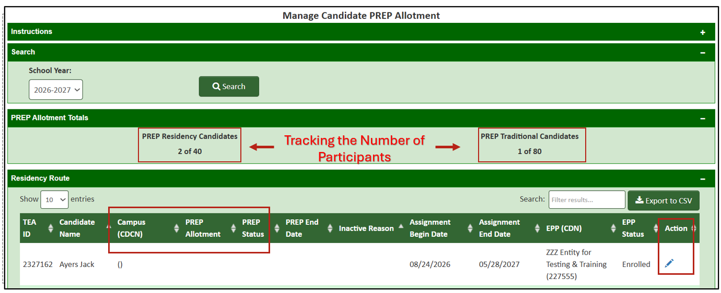
Partner Page for Residency
Notes:
When you log into your Residency partner page the first time you may or not see participant data. If you do, then great, your EPP partner is on top of things. If you don’t see data, then reach out to your EPP partner with a gentle reminder to get on with the data entry. Also note on this screen that there are 4 collapsable sections instead of the three we saw on the previous GYO and Mentorship interfaces. The additional section here is a handy counter that tracks the number of allotments you have used. You can view your partner page by cohort year and you can export it to an Excel csv file, if needed. You’ll also note the edit button at the far right of the participant’s row that allows you to edit the record. The LEA cannot delete the record but you can change the status of the residency candidate and/or remove the candidate from being a participant in the allotment.
The participant entered here is Jack Ayers who was entered by my partnering EPP, the ZZZ Entity for Testing & Training. I recognize Jack Ayers who is also a participant in my GYO program. Hmmmmm, but I know that’s acceptable.
Jack was populated onto this shared “Partner page” by the clinical experience record created by the EPP. The “clinical experience record” is a record that EPPs customarily enter for all candidates completing a clinical experience and not just for Residency candidates. So, the good news is this is not a new record keeping process for EPPs. Your EPP partners should be able to get these done efficiently as long as they know the name and TEA ID number of the Host teacher in whose classroom the participant will be placed for the residency.
The Residency participant will populate on your partner page when the EPP identifies your district as the location for the residency assignment. ECOS will validate that location against the partnerships entered into the Admin screens by TEA Admins.
Your initial data entry responsibility as a partner is to enter your LEA portion of the initial data onto that partner page before the August 28 deadline for the fall allotment payout. For example, you must identify the campus on which the Residency participant is placed, and you must identify/authorize the allotment .

Slide 39
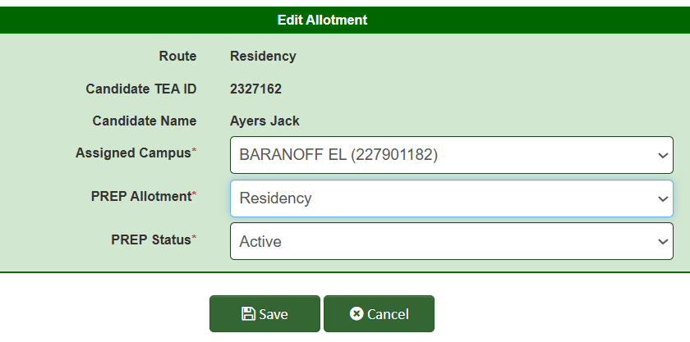
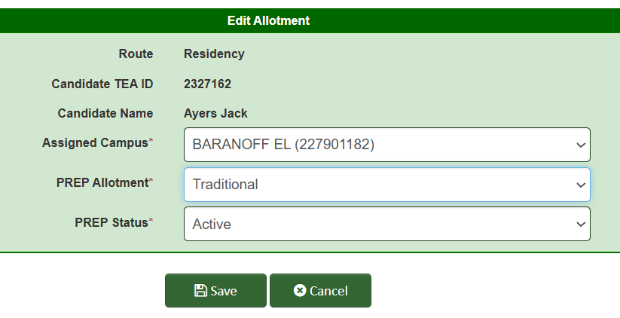
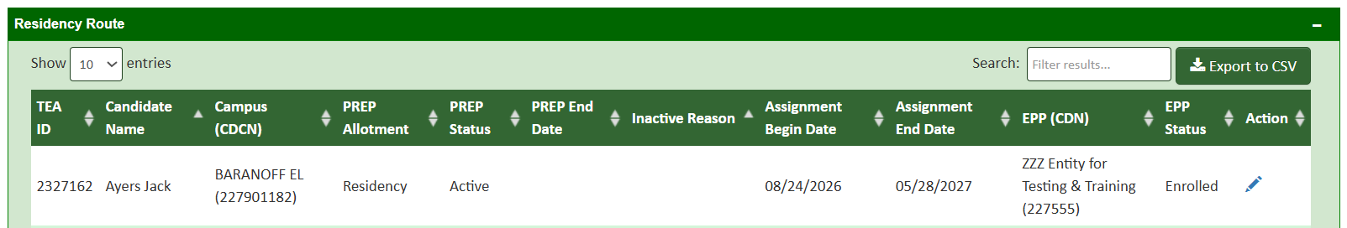
LEA Update Record for Residency Candidate
Notes:
So now that the EPP has generated a record for this Residency candidate, the LEA must edit the record and complete the LEA portion of the initial data entry. To do so, click on the pencil icon to open up the data entry screen for that participant. At top left, you can see I’ve identified the EPP candidate will be a participant in the Residency allotment and I’ve marked him as Active in that program. Then I’ll save.
On the right side of the screen, you see the same participant but instead I’ve created an alternate record where I’ve identified Jack as a participant in the Traditional instead of the Residency allotment. I created this screen shot to show you that if you use up your 40 allotments for Residency, but you have a 41st EPP candidate completing a residency in your district, you can identify that candidate as a participant in the Traditional allotment which is funded at a lower rate. Hence the reason for the handy allotment tracker on this interface. Note: To be clear, you cannot report the same candidate for both allotments-no duplicate records within a PREP program.
The resulting screen that is now updated and ready for the August 28 initial data entry deadline is in the screen shot at bottom. As your partner EPP or EPPs add Residency participants to this list, it will get longer. Just make sure your LEA does their part and completes the required portion of the LEA initial data entry by the August 28 deadline so that all of your participants will be included in the initial fall allotment payout.
It would likely be a healthy quality control step to have both partners review the final list to ensure all participants are on it and their initial data is complete.

Slide 40
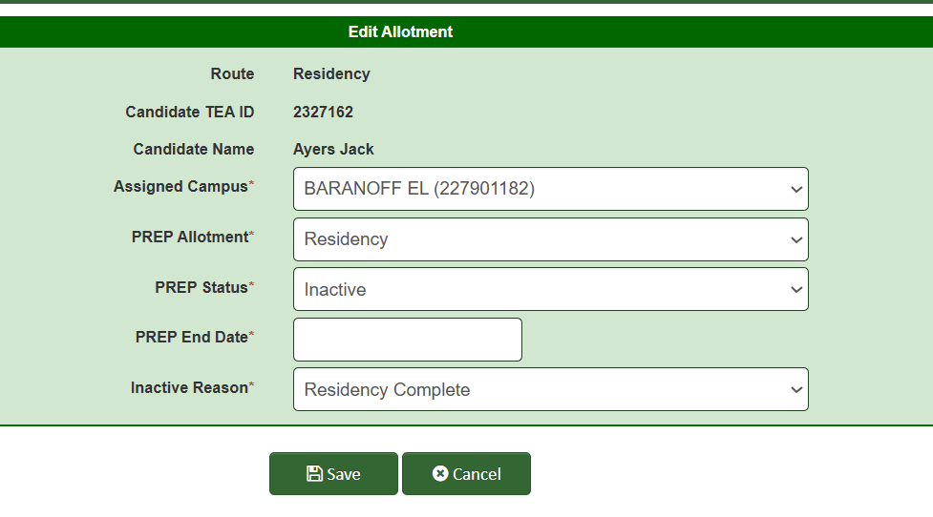
Removing an Active Status
Clinical Experience Record Deleted
District Changed by EPP
Dropped Out
EPP Changed
No Show
Removed by EPP
Residency Complete
Residency Experience w/LEA Complete
Notes:
The next time you will need to access and edit a record for a Residency participant after the initial data entry is when the participant’s status changes in your LEA. You will identify the PREP status as “Inactive” and provide the effective date of that inactivity, identified as PREP End Date, and then the reason for the inactivation. You will use these fields if the candidate leaves the Residency for any reason before it’s complete or when the candidate completes everything/all requirements.

Slide 41
LEA Enter a Residency Participant: No EPP Record
This feature is not going to be ready for the initial data entry this summer.
TEA will provide a list of contacts for each EPP so that the LEA has a hotline to a person at the EPP if records don’t get entered timely by the EPP.
TEA can also assist with records and connecting you with the EPP.
Notes:
As previously noted, maybe your EPP partner is not getting their records created timely and you need to get your residents on the list by August 28 to qualify for the initial allotment payout. We are building a back door that will allow the LEA to enter the candidate onto your partner page as a place holder record that will be overwritten by the EPP when the actual clinical experience record is created by the EPP as you saw on the previous slide. Unfortunately, the back door option will not be ready for use before the August 28 deadline this summer. This means you and your EPP partners will need to communicate so that each partner can efficiently get initial data entered by August 28. For example, LEA’s can timely provide their EPP partners the names and TEA ID numbers of host teachers and provide the first and last day of school dates from the district calendar since those data are required for the EPP to create the clinical experience record. Likewise, the EPP will need to make sure the LEA has all of the names of the Residency participants that are expected to complete residencies in that LEA.
TEA will communicate with EPPs to get a contact name and email just in case the LEA partner needs assistance. LEA’s will be able to submit a request for that EPP contact information for their partnering EPP, if needed, through the PREP Support Portal linked on the TEA website.

Slide 42
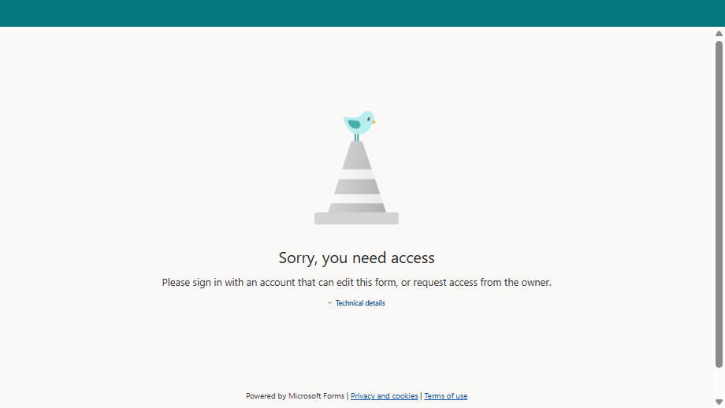
Form
Notes:
Time for another quick quiz. Do you know how many partner EPPs will place Residency participants in your district in 2026-2027?
One thing to think about here is if you have multiple EPP partners and you have a limit on 40 residents. What will you do if you have reached your district limit of 40 residents across all EPP partners and one of your partners has additional candidates to place? What internal business process will you or do you have in place to manage such a situation?

Slide 43
Resources / Technical Assistance
Notes:
When this system for reporting PREP data was developed, we intentionally used the system that ECOS for Entities users are accustomed to using with interfaces that have familiar design and functionality. This was done to streamline the data reporting processes for PREP, both for data entry but also for problem solving.
But, we know that learning anything new may generate questions and the need for assistance, we want to assure you that you are not alone as you navigate this process.

Slide 44
Problem Solving – Requires Communication
You don’t see your menu options in ECOS Entities.
  Return to the TEAL landing page and verify you have the correct access for your entity type (LEA or EPP)
  Log out of TEAL, empty your internet cache, refresh your browser, then log in to TEAL again
The screen options are on your menu, but the screens don’t populate or data entry fields are greyed out.
  Verify you have an approved LASO IV application (see TEA website or submit request to PREP Support Portal)
  Verify TEA Admins has entered your approval and/or partnership (submit request to TEA Help Desk > Preparation Programs > Data Reporting)
You don’t have the correct TEA ID number for the participant.
  Ask the participant to log into TEAL and get the number for you (listed on the TEAL landing page under the link to the Educator account)
  HR can use File Transfer in ECOS to get the TEA ID number attached to a Social Security Number
When you save a mentee record, ECOS throws an error message that the mentee limit is met for the mentor.
  Verify the mentor teacher assignment value is correct (ask the mentor if he/she is mentoring in any other districts)
You don’t see a specific Residency participant on your partner page
  Contact your EPP partner.
Information is missing or incorrect in your Residency participant’s record.
  Contact your EPP partner.
Notes:
Consider there are hundreds of LEA and EPP users across the state but only a handful of TEA Admins to provide technical assistance so we encourage you to attempt to solve problems yourself if possible. You should have other ECOS Entities users at your organization that may be able to assist with general user problems such as TEAL log in errors, etc. There are also some common PREP-specific issues that could come up that you may be able to figure out without contacting the TEA for assistance. Let’s look at some of those now.
[Read through slide]

Slide 45
System Validations – Data Entry Timeline
July 2026 | Aug 2026 | Sep 2026 | Oct 2026 | Nov 2026 | Dec 2026 | Jan 2027 | Feb 2027 | Mar 2027 | Apr 2027 | May 2027 | Jun 2027 | Jul 2027 | Aug 2027 | Sep 2027 | Oct 2027
7/1 26-27 Cohort Opens | 8/28 26-27 Data Due |  | 26-27 Initial $$ Payout |  |  | 1/31 26-27 Cohort Locks |  |  |  |  |  |  |  | 26-27 Settle up $$ Payout
 |  |  |  |  |  |  |  |  |  |  |  | 7/1 27-28 Cohort Opens | 8/28 27-28 Data Due |  | 27-28 Initial $$ Payout
Notes:
We’ve said in each program that the cohort year opens in ECOS on July 1 each year, with initial data entry of participants for that year entered into ECOS by August 28 so the LEA can receive the initial PREP allotment payout in the fall. We’ve also seen the system validation that locks the cohort year against new data entry on January 31 during that cohort year. Well then, what happens in the remainder of the year and how does this process play out across the years?
On the first row in this picture, the green square represents the new year open for initial data entry. The red square represents the January 31 lock date for initial data entry. The first thing to note here is the participants that are not entered by August 28, can still be entered up to January 31. Examples would be if you forgot to enter someone or if you have a late comer to the program. The initial allotment payout for those additions will happen at settle up time in September at the start of the next cohort year.
Second, any participants that pop up after January 31, must be entered onto the next cohort year that opens up on July 1 during that summer. You see the 2027-2028 cohort year unlocks on the green square on the second row in the picture.
So in this pictoral representation, starting with the 2027-2028 cohort year, in the fall (September and October) the LEA will have both a settle up time for the previous cohort year 2026-2027 and an initial payout time for the new cohort year 2027-2028. As we move through the years, success-based funding will also be rolled into one or both of these payouts. Note that success-based funding is triggered when you identify your participants as complete through your ongoing data entry in the ECOS interfaces we just viewed.
The key to all of this is the LEA and EPP must complete their data entry according to timelines and deadlines. TEA Admins will harvest whatever data you have entered into ECOS in a given year and submit that data on your behalf to be used to calculate the allotment payouts. This takes us back to the importance of your role as a data manager for your entity. You must be efficient, both timely and accurate, so that your organization can receive the allotment money they are due.

Slide 46



Additional Resources
Find PREP Information & Supports - timelines, webinars, and planning tools
LASO Cycle 4 Grant and Programs
PREP Allotment Information page
Technical Manual (In Draft-Release Date TBD)
PREP Support Portal
Recorded training and FAQ published on TEA website
TEA Help Desk at tea.texas.gov
Check Newsletters for Important Information
Notes:
Here are some resources that will be helpful for you.

Slide 47
Thank you!
Notes:
We have reached the end of our time together today. We hope you found this training useful and comprehensive to allow you to begin data reporting around the PREP program activities. If you do have questions, please either submit them now or send them into the PREP Support Portal linked on the second slide in this presentation.
Please take a moment and complete a short survey about this presentation. Your feedback will help us improve future webinars and communications.

