Slide 1
PREP Data Management for EPPs
PREP Residency Programs
June 23, 2026
Training for EPP PREP Data Managers
Notes:
Thank you for joining us today. The information presented today is for PREP Data Managers from EPPs who are partnering with an LEA that has an approved LASO 4 application and will be participating in the PREP Residency allotment in 2026-2027. Today’s presentation will introduce Data Managers to the functionality of the user interfaces in ECOS where you will report PREP data on behalf of your organization.
As we move through the information today, keep in mind that the PREP data entry and the role of the PREP Data manager are important because the PREP allotment dollars will be allocated and awarded based on the data you report for your EPP using the process we will review today.

Slide 2
Agenda
FYIs
PREP Program Overview
Submit questions during the webinar using the Zoom Q&A
Webinar slides and recordings will be posted on the PREP Allotment Information page
Submit Questions to the PREP Support Portal
Managing Data & ECOS Access
LEA - Grow Your Own (GYO)
LEA/EPP - Residency (RSD)
Additional Resources
Notes:
The agenda for today includes a quick overview of PREP relevant to PREP data collection and then I will focus on the specific PREP area and the unique requirements of each related to the EPPs responsibility for data. The goal for today is that attendees feel confident on how to apply for the PREP Data Manager role in ECOS and feel confident using the interfaces to enter data.
For future reference, this presentation is being recorded and will be posted on the PREP Allotment information page on the tea.texas.gov website. Please place any questions that you have related to this data entry informational session in the ZOOM Q & A feature and we will try to respond to them today, if time, or will produce an FAQ from all questions and publish it with the recording. At any point, you may submit questions to the PREP Support portal. The link for the portal is embedded on this slide.
As always, we are here to support you, as needed.

Slide 3
Key Words to Know Today
LEA – local education agency such as district or approved charter campus
EPP – educator preparation program responsible for preparing and recommending candidates for educator certification
Entity – generically referencing LEA, EPP, or both
Legal Authority – the person at the entity with ultimate responsibility for that entity and it’s operation (e.g. the Superintendent of a school district or the Dean/Director/Owner of an EPP)
ECOS – The Educator Certification Online System that is an application accessed via TEAL and that houses all of the educator data across the state
  ECOS for Educators – educator accounts containing certification data
  ECOS for Entities – LEAs and EPPs process requests and document and access entity specific records for educators and educator candidates.
  ECOS for Admins – TEA access to all data
PREP Data Manager – The person responsible for entering PREP data into ECOS and verifying its accuracy.
Notes:
If you attended the overview session several weeks ago, you may remember this slide of key terms. Just to refresh our thinking, as well as to inform those who may be new, let’s review the key terms relevant to the Data Manager role and to the processes we will review today.
[Review slide]

Slide 4
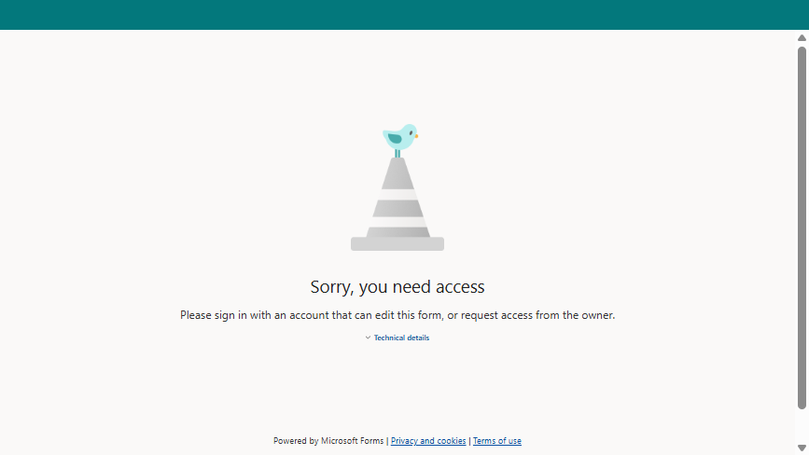
Image of Form

Slide 5
PREP Programs Overview & Managing Data
Notes:
Let’s cover a quick refresh on the overall PREP data management process and the structure of data captured in ECOS for PREP.

Slide 6
PREP Programs Overview
Five Programs to Support Teacher Preparation and Retention
PREP Grow Your Own Program (GYO)
PREP Mentorship Program
PREP Preservice Residency Program
PREP Pre-service Alternative Certification
PREP Traditional
District employees earning bachelor's degree and EPP admission while employed.
Beginning teachers (1st-2nd year) receiving structured mentoring support with certified mentors
EPP Candidates participating in a full-year residency experience at a partnering LEA.
EPP Candidates participating in clinical teaching prior to a full year internship at a partnering LEA.
EPP Candidates completing clinical teaching in a partnering LEA
Notes:
Of the 5 PREP programs established by House Bill 2 passed in the 89th Texas Legislature, we will focus on the three in the red box because they will be live for 2026-2027. Data reporting will begin for these three PREP areas this summer. Specifically, the interfaces you will use to report PREP data will open on July 1 and all initial data required to qualify your LEA for the fall payout must be entered and accurate by August 28.
Note that PREP Grow Your Own and Mentorship programs are LEA specific programs where the PREP Residency program happens through a partnership between the LEA and one or more EPPs. This is important in our context today because the LEA and EPP will share responsibility for entering various data points into a shared screen.

Slide 7
PREP Activity/Data Will be Managed in ECOS
LEA
LASO App Approval
      TEA
      ECOS Admins
      Manager
  LEA Role: District_PREP
    GYO Screen
    Mentorship Screen
    Residency Partner Page
    P-ALT Partner Page
    Traditional Partner Page
  EPP Role: EPP_Partnership_View
    Residency Partner Page
    P-ALT Partner Page
    Traditional Partner Page
EPP
SBEC Route Approval
Partnership pages enable interactive data sharing between LEA and EPP
Notes:
This graphic represents the overall structure of PREP data management in ECOS. The data from the approved LASO IV applications and the SBEC approved Residency programs has been collected by our Admin data team at TEA and added into the TEA ECOS Admin interface represented in the purple box at the top of the hierarchy. That data entry enables the interfaces for the three PREP programs, GYO, Mentorship, and/or Residency for the LEA and for the EPP user as applicable to the approval.
Because there are some differences in PREP data entered by LEA’s and EPPs, the data entry interfaces are slightly different. Also, LEAs may see all 5 PREP options including GYO, Mentorship, Residency, Pre-service Alternative Certification, and Traditional Certification, where as EPPs will see only 3 which are the partnership pages that include Residency, Pre-service Alternative Certification, and Traditional Certification. When the LEA and the EPP partner, they will have shared access to the partner page for the specific area, where each entity will have specific required data entry, and each can view the shared data. They cannot edit each other’s data.
It is especially important to understand this structure if you are a district-based EPP, such as a school district like Houston ISD, Dallas ISD, Katy ISD and the others. It will be critical that data managers for these organizations are careful when entering the LEA-specific and EPP –specific data. We have suggested to those organizations that, if possible, they assign different data managers, one to manage the LEA data and one to manage the EPP data.

Slide 8
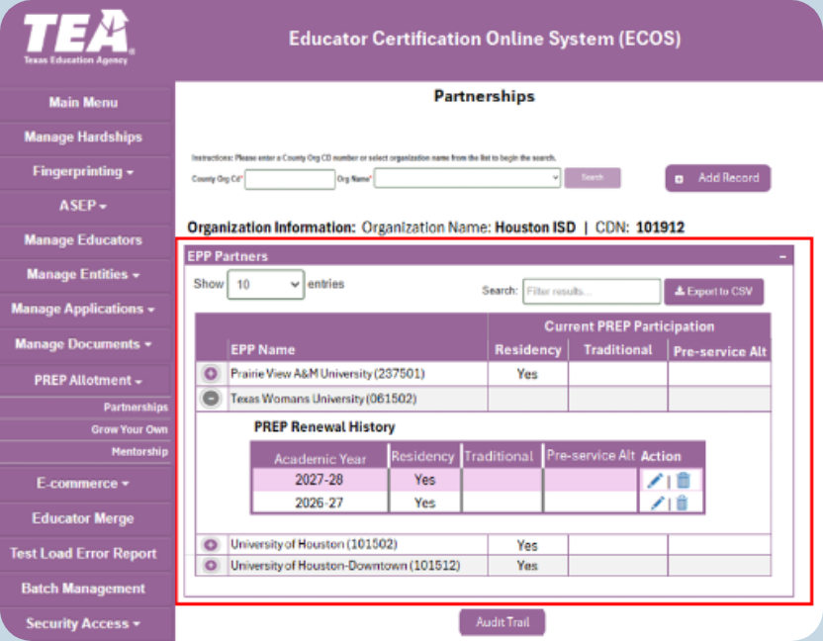
Managing PREP Programs – TEA Admin Screen
TEA Manages Partnerships
Data from LASO Approvals & SBEC Approvals Used to Populate This Screen
Enables LEA & EPP Entity Screens
Notes:
This is a screen shot of a TEA Admin screen. You can see the district is identified at top and then the EPP partnerships and the approval year for each are entered for that LEA. This is important for you to know as the Data manager because in a given year, if you don’t see the related drop down menu populate on your Entity screen, it could be that there is no approval entered into this Admin screen. A technical assistance request to TEA would initiate the TEA Admin to verify the information.
Note the district and EPPs listed here are for test purposes only and do not reflect any actual approvals or partnerships between these entities.

Slide 9
Key Start-up Dates & Deadlines
7/1/2026
Data Entry Screens Live
LEA/EPP Data Entry
8/28/2026
Data Due for Allotment
Notes:
We will reinforce these important dates throughout, and as I have already mentioned in this presentation, your deadline for entering the initial data related to participants in your Residency PREP route into ECOS is August 28, 2026. Data will be collected by TEA staff at that point to determine the initial PREP allotment payout in the fall. The next slides will help EPPs enter data to meet this deadline.

Slide 10
ECOS Access to Manage PREP Requires Approval
LEAs & EPPs will use ECOS to manage PREP programs:
  Entity role must be assigned to authorized users to update PREP pages
    LEA Role: District_PREP
    EPP Role: EPP_Partnership_View
  Entity legal authority controls and approves user access
  Partnership pages enable interactive data sharing between LEA and EPP
Do not select other roles. Submit requests for other roles separately.
Apply for PREP Role
Entity Legal Authority Approval
TEA Approval
Access Granted
Notes:
Not everyone at your entity will have access to the PREP data management screens. The person or persons at your entity that will be responsible for managing PREP and/or data entry for PREP in the ECOS system must request the new role through TEAL, similar to the way you requested your current roles in ECOS Entities. You will request approval to add the role, the request will go to your entity Legal Authority who will approve the request, then the request will bounce to the TEA for approval. Once TEA approves the access, the person who requested the role will have access to the PREP menu options.
Something to note for EPPs is that the data entry requires the EPP to create a clinical experience record for the Residency candidate. That function is under the ASEP drop down menu which requires the EPP user to have the ASEP_Update role. Consider whether the PREP Data Manager should also have this role or if the PREP Data Manager should not have the ASEP_Update role but should establish processes with others in your EPP who will create the clinical experience records.

Slide 11

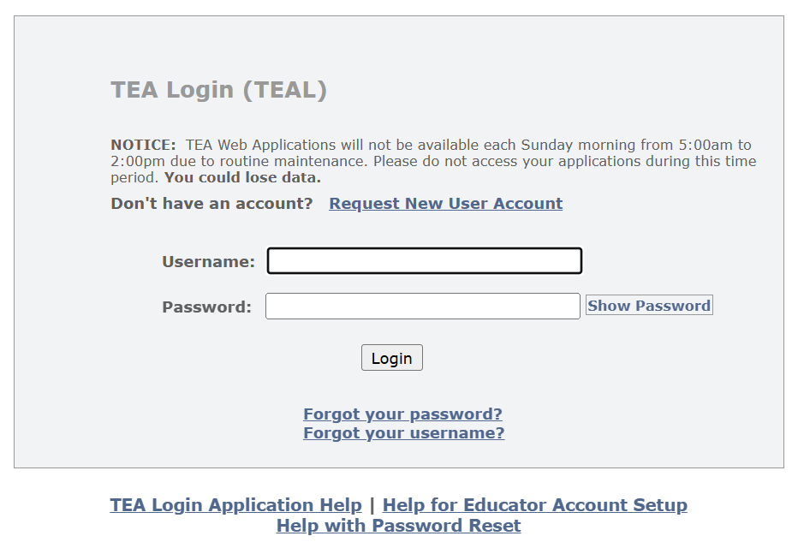
Request Access to the Data Manager Role via TEAL
Go to TEAL Login Link on the tea.texas.gov website
You must use your entity email address to request the role
Notes:
I’ll walk you through the steps to request the role with some screen shots.
First, log onto the tea.texas.gov website. Be sure to use your email address that is associated with your entity. Your access will not be approved if you are using a private email address that is not your entities address.
At the top toward the right side, you will see the Login menu. If you use the drop down, you can select TEAL Log in which will generate the screen at bottom. If you have a TEAL account, you can log in from here, using the “forgot password” and / or “forgot username” links, as needed, if you have not logged into your account recently. If you don’t have a TEAL account, you can request a new account from this screen also.
Either way, you must have a TEAL account to access the ECOS applications that reside behind the TEAL portal, including ECOS for Entities for your entity.
As a reminder, if you are at an EPP that is within an LEA, we strongly encourage you to have two Data managers, one for each role, LEA and EPP. We have noted that wonky things are happening when one data manger has access to both menus, for LEA and EPP. The system gets confused apparently.

Slide 12
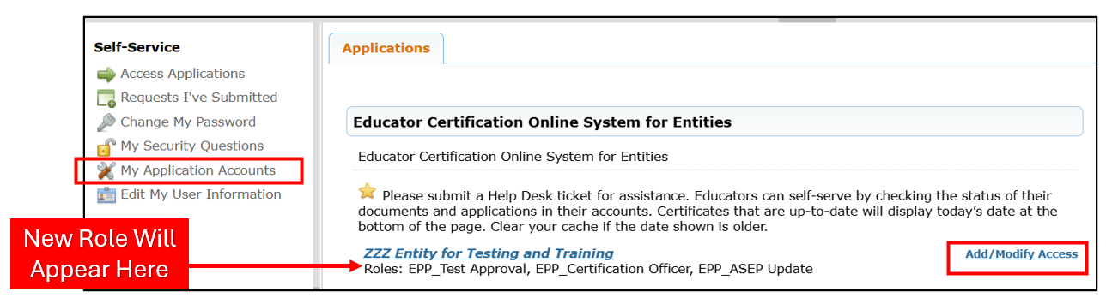
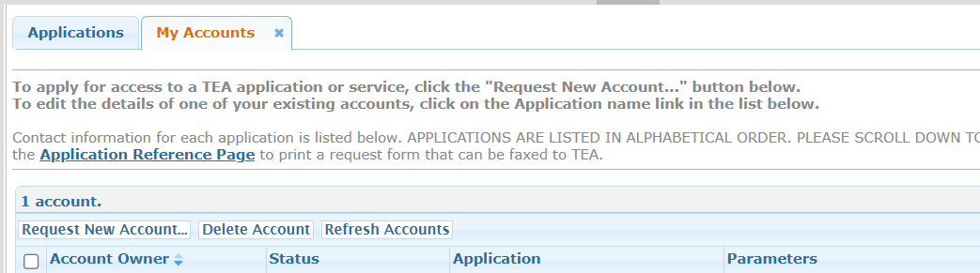
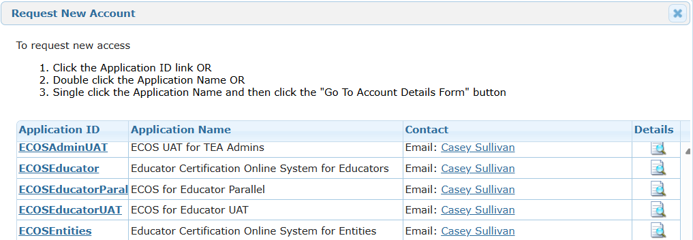
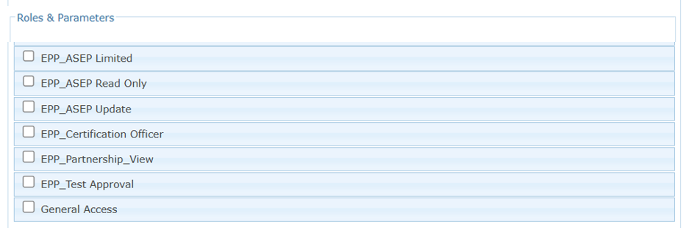
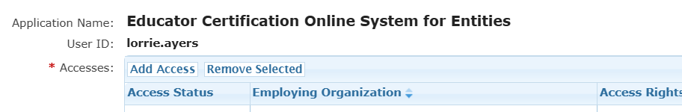
Request Access to the Data Manager Role
Notes:
When you successfully log into TEAL, the landing page will look like the screen shot at top. You will see a menu on the left and in the center you will see links to your approved applications such as ECOS for Entities if you are already a user in ECOS for your entity and/or ECOS for educators if you have pursued or achieved certification as an educator in Texas.
To add the Data Manager role, use either the Add/Modify Access button at right or use the My Application Accounts link on the menu at left. In the screen shot above, I used My Application Accounts to generate these screen shots for someone that does not have any roles for my entity. If I already have access to at least one role in my entity, I need to use the Add/Modify Access option which omits one of the steps from this series you see here. From the resulting screen shown in the first box in the 4 step process at bottom left, I selected “Add Access”.
From the pop-up window, select the ECOS for Entities option and then “Request New Account” . This is the screen you will not see if you use the Add/Modify Access button because you already have your Entity account established. When you select the Add New Account option you get another pop up window that allows you to select the data manager role specific for an EPP. When you check that role, a window will open that will require you to enter your organization identity two times. If you start typing your EPP name, the system should auto-populate. Be cautious because some entities have similar names so check the CDN attached to your EPP name to ensure you are selecting the correct entity. From there, continue to “save”, “accept”, “Bless”, and any other button that needs to be selected to advance the screens. You should ultimately get a message in green font at top of screen that you successfully submitted.
The request will go to your entity Legal Authority for approval, so you may want to check in with that person and let him or her know to approve the request. After that, the request comes to TEA for final approval

Slide 13
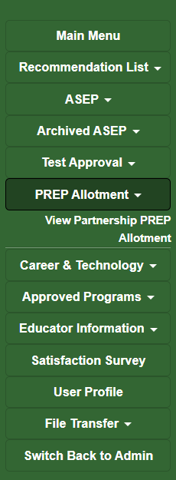
Managing PREP Programs – EPP User Access in ECOS for Entities
Access PREP Management Screens through the ECOS Entities Menu
  Add data
  Update data
  Review/Verify data
EPP
Access
Notes:
When the PREP approval and/or partnership relationship is established via the TEA Admin “purple” screen in the slide I showed you earlier, approved data manager(s) at the EPP, will see the PREP data management menu options at left in their Entity “green” screen. The Data Manager for your entity will use this menu to access the data entry interfaces.
To access this menu, log into TEAL as I showed you earlier, and on the landing page click on your entity access link. It will open ECOS for Entities for your organization. You will have access to the meu options for the areas that you are approved for, including the PREP Data Manager.

Slide 14
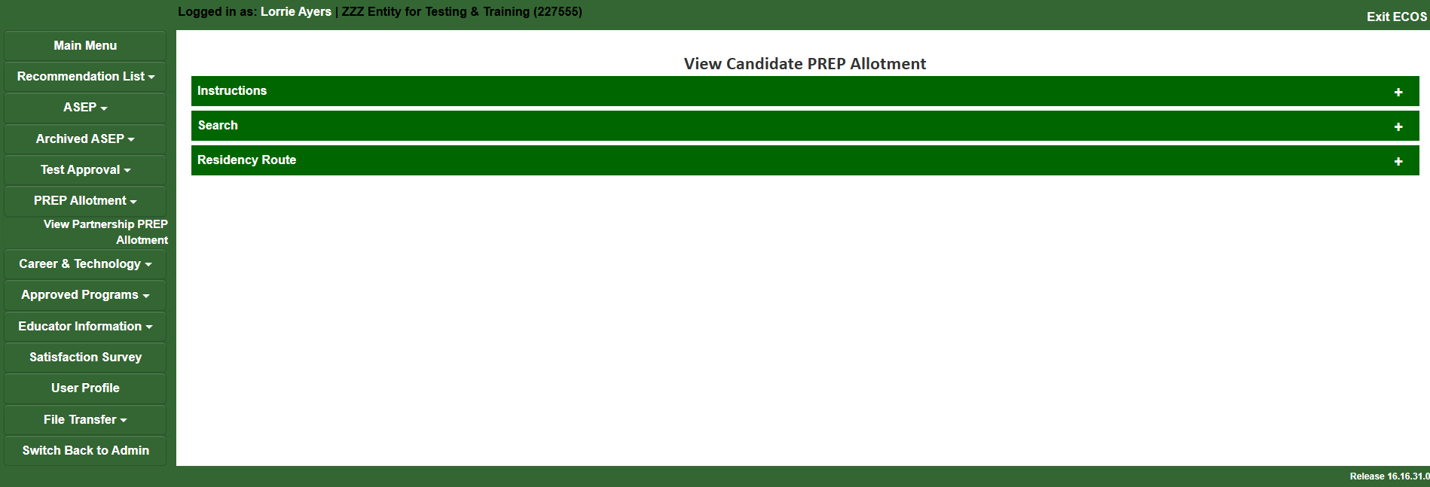
Structure of Interface
Structure of Each Page (3 Collapsable Sections):
  Instructions
  Search
  Approved PREP Route(s) (Residency Shown Here)
Notes:
When you select the “View Partnership PREP Allotment” from the PREP Allotment drop down on the menu at left, you will land on this page which is the interface you will use to view your PREP activity. Note the structure of this page. There are three collapsable sections. The first section contains Instructions that give the user information about how to enter data for that PREP area. The second section allows you to search the page by cohort year and by district partner (which is helpful if your Residency program partners with multiple districts that are participating in the PREP allotment. The third section shows the LEA the list of participants for a given cohort year. From that list you can edit a record.
Note that I used the term “Participant”. The LEAs view your “candidates” on their PREP lists as their allotment “Participants”. You will see on a later screen shot that the LEA actually has to designate which of your candidates on your shared list will be participants in the PREP allotment.

Slide 15
LEA: Grow Your Own (GYO)
Notes:
Let’s take a quick look at the two PREP areas that will be active for 2026-2027, for which the EPP will be responsible for data. specifically focusing on some detail related to data management. First, we will look at Grow Your Own or GYO.

Slide 16
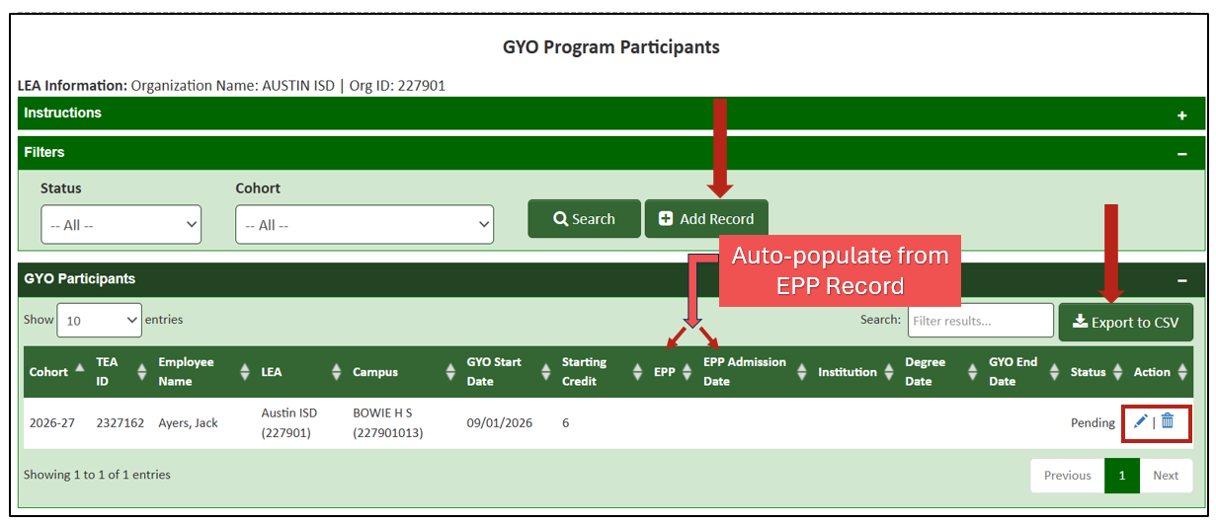
Generate a List of all Participants
Notes:
As you know, the Grow Your Own, or GYO, PREP program is an LEA program but as you can see above, there are portions of the LEA data that are auto-populated from records the EPP creates in ECOS. This screen shot is of the GYO participant list accessed by LEAs. Your EPP will not see this interface. I’m showing this to you today so you understand where your data is needed to support GYO.
One of the requirements for successful completion of the PREP GYO is the participant must enroll in an EPP. Evidence the GYO participant has done so is populated from the Admission record you create when the GYO participant enrolls in your EPP. Because this is required data for success-based funding for the LEA, it is important that the EPP create these admission records efficiently. Note that this should not be a problem since our rules in Texas Administrative Code require the EPP to report a candidate’s admission within 7 days of the date of admission. The EPP “reports” that admission by creating the admission record in ECOS. So, to clarify, there is nothing new that the EPP needs to do here, you only need to enter admission records timely and ECOS will transfer the data to the LEA GYO data record for you.
By the way you will see Jack Ayers used as my test subject throughout these screen shots. Jack is my German Shepherd dog who would pursue preparation as an educator but likely would not pass your admission screen.

Slide 17
LEA & EPP: Residency (RSD)
Notes:
The Residency PREP partnership route will be the only one of the three PREP partnerships available in 2026-2027 for approved LEAs and EPPs. This section pertains to both LEA and EPP since both have a role in this program and in the related data entry. To support alignment in understanding, your LEA partners will be receiving the same information in a separate LEA-focused webinar.

Slide 18
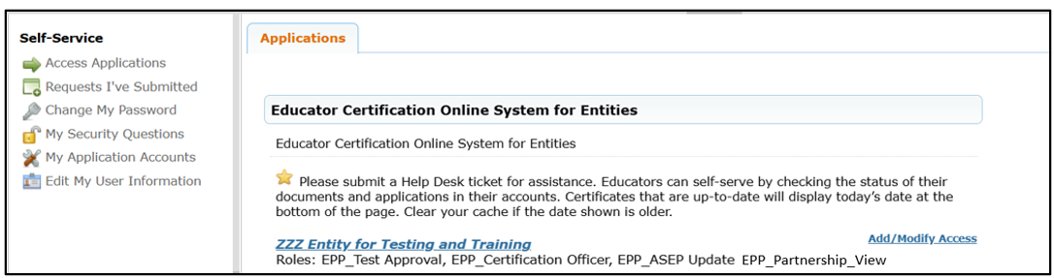
Managing PREP Programs – EPP Data Manager Access in ECOS for Entities (Residency Partnership)
Log in to Your Entity
Select: View Partnership PREP Allotment
Notes:
When the PREP approval and partnership relationship is established via the TEA Admin screen, approved data manager(s) at the EPP, will see the View Partnership PREP Allotment menu option in the PREP Allotment section at left in their ECOS for Entities green screen. The LEA partner will also have personnel who have approval as data managers who will see a similar option to manage PREP Candidates on the LEA Entity screen to manage their portion of the PREP data. Entities who are not approved via the ECOS Admins screen will not see these options in their Entity menu, or if they do, the fields will be inactive.
To view your PREP Residency shared data, log into TEAL and select the link to your ECOS for Entities green screen. From the menu at left, select View Partnership PREP Allotment.

Slide 19
PREP Residency (RSD) Partnership Overview
EPP-LEA Partnership
Approved LEA/EPP partnerships through LASO decision for PREP Residency
Participant populates on LEA partner page:
  When EPP enters partnering district name in Clinical Experience Record for the EPP candidate
Partners cannot edit each others’ data but can update their own data ongoing
Notes:
The PREP Residency has specific requirements and parameters that must be met, so the data collection screens for both LEA and EPP are aligned with those requirements and parameters.
Data reporting for the PREP residency program is truly a shared responsibility between LEA and EPP partners. The resulting interface, or screen, that holds the Residency data for a given cohort year is shared between the EPP and the LEA where both partners can access the same page. The Residency participant is entered onto the shared partner page initially by the EPP. The data one partner enters can be viewed but not edited by the other partner.
Note in bold that identifies the participant will be populated on the Residency partner page for the LEA when the EPP creates the clinical experience record for that participant. The participant is your EPP candidate that will be completing a Residency at that LEA. It is the EPPs responsibility to initiate this record because the EPP candidate must meet the requirements for educator preparation and issuance of the enhanced standard certificate so the EPP must track those requirements met. The candidate must meet the pre-clinical requirements at the EPP before the candidate can begin the Residency portion of the training. In other words, the EPP is the keeper of requirements met by the candidate, so the EPP enters the first record that places the residency candidate on the shared partner page of PREP Residency participants. In this partnership, the term “candidate” and “participant” are the same individual.
This means it will be important for the EPP to be efficient entering the Residency clinical experience records ahead of the August 28 deadline for submitting initial data so that the partnering LEA has time to verify the participants by August 28 for the purposes of meeting the data requirements for the initial allotment payout. As such, it will be important for LEA and EPP partners to plan and communicate related to PREP data reporting.

Slide 20
Validations (Residency PREP Partnership)
New Year Opens - July 1, 20XX
Year Locks for New Entries- January 31, 20XX
TEA ID Not Valid- Error message
No Duplicate Entries- Error message
Limit 40 Participants / Year- Error Message
Notes:
Before we look at the data entry interface, let’ s visit the key validations in this interface. As with other areas where data is reported in ECOS Entities, the validations built into the interfaces are aligned with rules in Texas Administrative Code and/or business processes.
First, there are validations that unlock the cohort year to add new PREP participants on July 1 and lock the interfaces against entering new PREP participants for that cohort year on January 31. This is important for EPPs to note because this is not aligned with the customary unlocking of ASEP on 9/1 and locking ASEP on 8/31. So, if you are responsible for reporting ASEP data for your EPP and you will be responsible for reporting PREP data for your EPP, you will need to keep in mind the schedules and deadlines for each. The validations in ECOS will allow you to enter the data for each according to their timelines and deadlines.
Additionally, the system validates a TEA ID and also disallows duplicate entries which helps you keep your data clean. Meaning, if you enter a clinical experience record with a TEA ID that does not match the name in ECOS, you will get an error message as such. This is existing functionality in ECOS.
There is also a limit on the number of residency participants that can be claimed by the LEA for the Residency PREP allotment in a cohort year. We will see in a bit how the LEA partner may potentially work around this if needed.

Slide 21
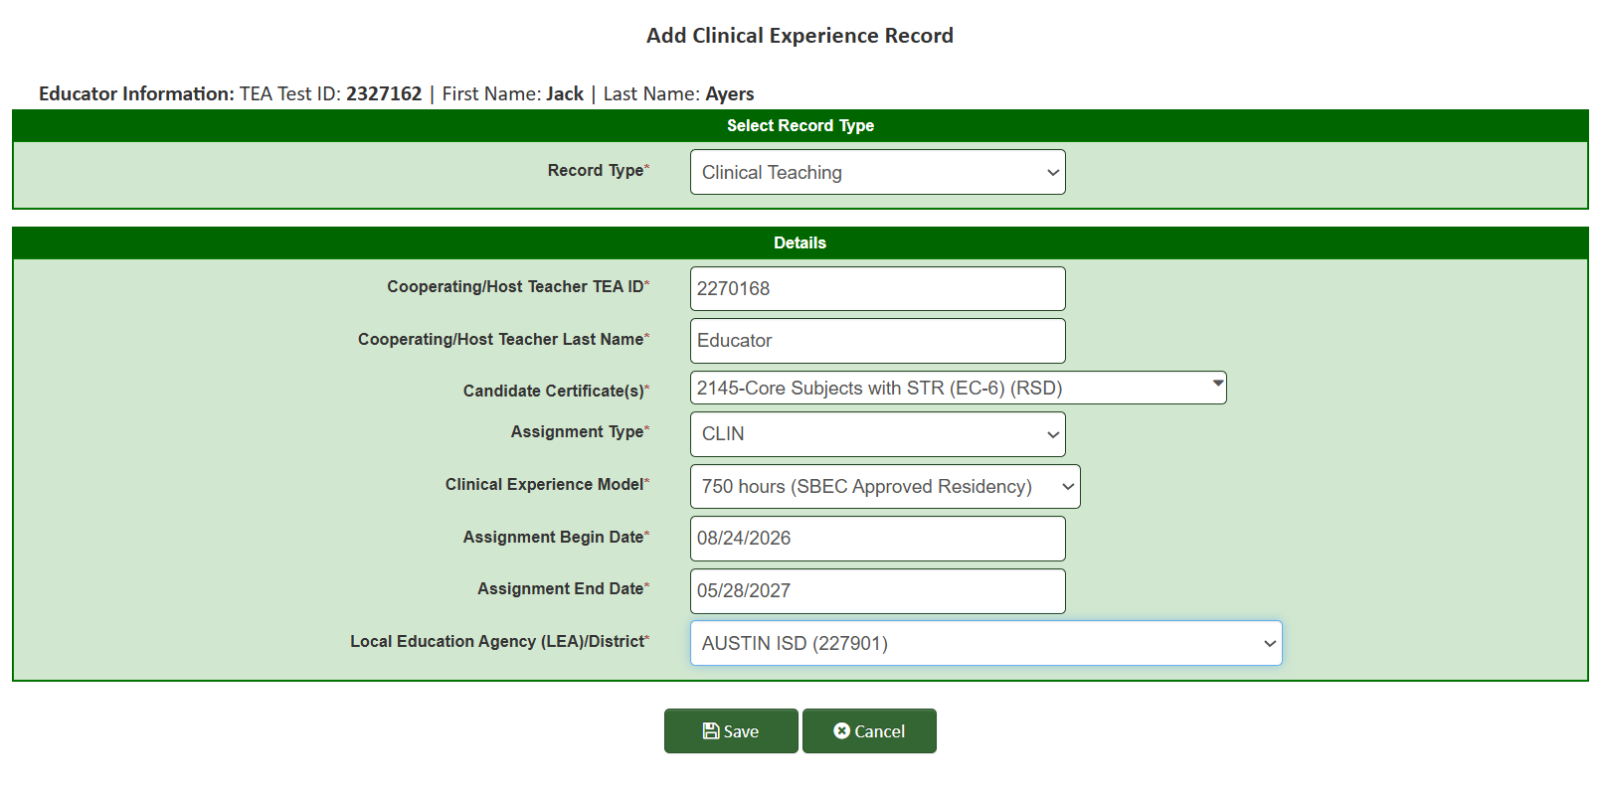
Initiate Candidate as a Residency PREP Participant
Notes:
Let’s look at the data entry interfaces for PREP Residency. First, you will recognize this interface because it is the interface used by your EPP to manually enter a clinical experience record for a candidate.
So, in my example, the EPP named ZZZ Entity for Testing & Training, is partnering with Austin ISD. The EPP and LEA are approved as partners in Residency PREP for 2026-2027. That means that either the PREP Data Manager or the person that has the ASEP Update role at the ZZZ Entity must create a clinical experience record for each candidate that will be placed on an Austin ISD campus for a Residency in the 2026-2027 school year. And the clinical experience records must be created starting July 1 this summer with enough time to allow the PREP Data Manager at Austin ISD to verify the candidates on the shared participant list.
So, the EPP has created the clinical experience record for the candidate, Jack Ayers. Jack will be completing the residency in Austin ISD with the first and last day of school in Austin ISD identified as the required duration of the Residency.
When your EPP saves the clinical experience record, ECOS validates the Local Education Agency (LEA)/District field against the approved Residency partnerships that the TEA Admins recorded in the PREP data base for 2026-2027. Once validated as an approved partnership, Jack Ayers will be entered into the partner page shared between the ZZZ Entity and Austin ISD as a possible PREP participant.

Slide 22
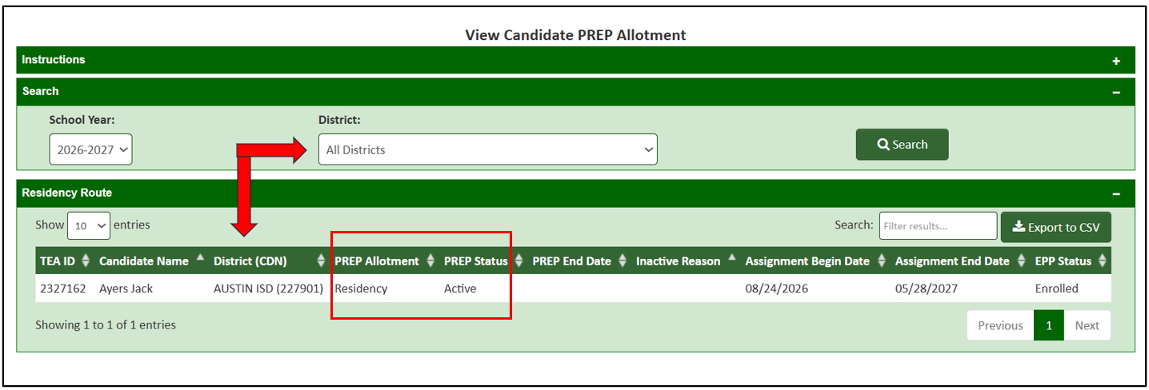
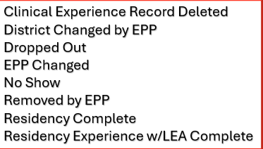
Partner Page for Residency
Inactive Reasons include:
Clinical Experience Record Deleted
District Changed by EPP
Dropped Out
EPP Changed
No Show
Removed by EPP
Residency Complete
Residency Experience w/LEA Complete
Notes:
When the EPP PREP Data Manager logs into the Residency partner page after your EPP has created your clinical experience records, the PREP Data Manager should see those candidates populated on that page. The LEA PREP Data Manager will also see those candidates. Here we see the record we created for Jack Ayers now populated on that interface.
Note some of the features of this interface.
You can view your partner page by cohort year and you can export it to an Excel csv file, if needed.
You’ll also note that your EPP cannot edit any of these records directly unless you edit the clinical experience record.
The PREP End Date field changes when the Residency end date in the clinical experience record is reached or if the LEA removes the participant for any reason.
The initial data entry responsibility for your EPP as a partner is to create your clinical experience records for Residency candidates starting July 1 and then verify those candidates appear on the partner page list for the specified partner LEA. Please do this with enough time remaining for your LEA partner to enter their data onto this page before the August 28 deadline for the fall allotment payout.
After the LEA has entered their data on this shared page, you will see the PREP Allotment and PREP status fields populated. This is where the LEA finishes the initial data entry by designating your candidate as a PREP participant. Note you should see Residency populated in the PREP Allotment field, but if you see Traditional populated there, it will likely be because the LEA reached their limit of 40 residents and had to designate the candidate as a participant in the Traditional allotment, which the LEA is allowed to do.
Note changes EPPs make to the clinical experience records ongoing will impact the partner page.

Slide 23
Candidates Starting Residency in Spring 2027
The PREP “year” locks on January 31.
No new participants for 2026-2027 can be entered after this date.
Existing records can be edited where applicable after this date.
EPPs must create clinical experience records for Residency candidates with a spring start date before January 31 with enough time for the LEA partner to verify the candidate as an active PREP allotment participant before ECOS locks the partner page at end of day on January 31.
Notes:
[Review slide]

Slide 24
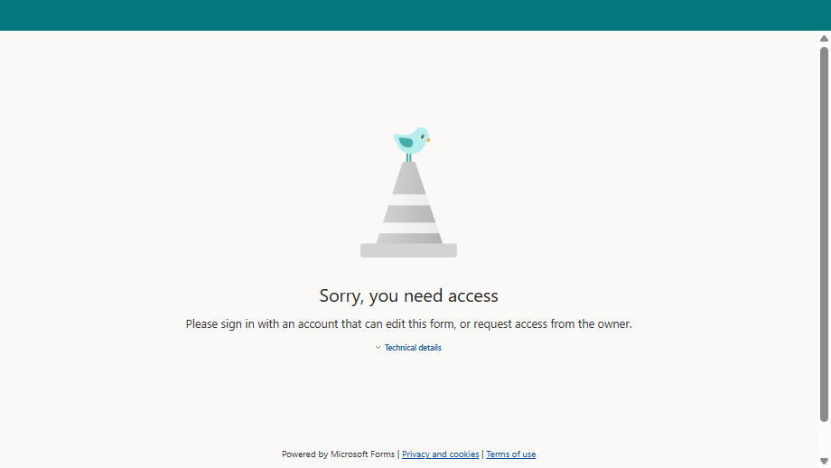
Quick Quiz-Residency Participants
Notes:
Something to think about here is, if you are partnering with LEAs who will participate in PREP, have you collected the information you need to create your clinical experience records? If not, you should reach out to your partner and collect the host teacher TEA ID and name as well as the district school start and end dates.

Slide 25
Resources / Technical Assistance
Notes:
When this system for reporting PREP data was developed, we intentionally used the system that ECOS for Entities users are accustomed to using with interfaces that have familiar design and functionality. This was done to streamline the data reporting processes for PREP, both for data entry but also for problem solving.
But, we know that learning anything new may generate questions and the need for assistance, we want to assure you that you are not alone as you navigate this process.

Slide 26
Problem Solving – Requires Communication
You don’t see your menu options in ECOS Entities.
  Return to the TEAL landing page and verify you have the correct access for your entity type (LEA or EPP)
  Log out of TEAL, empty your internet cache, refresh your browser, then log in to TEAL again
The screen options are on your menu, but the screens don’t populate or data entry fields are greyed out.
  Verify you have an approved LASO IV application (see TEA website or submit request to PREP Support Portal)
  Verify TEA Admins has entered your approval and/or partnership (submit request to TEA Help Desk > Preparation Programs > Data Reporting)
You don’t have the correct TEA ID number for the participant.
  Ask the participant to log into TEAL and get the number for you (listed on the TEAL landing page under the link to the Educator account)
  HR can use File Transfer in ECOS to get the TEA ID number attached to a Social Security Number
When you save a mentee record, ECOS throws an error message that the mentee limit is met for the mentor.
  Verify the mentor teacher assignment value is correct (ask the mentor if he/she is mentoring in any other districts)
You don’t see a specific Residency participant on your partner page
  Contact your EPP partner.
Information is missing or incorrect in your Residency participant’s record.
  Contact your EPP partner.
Notes:
Consider there are hundreds of LEA and EPP users across the state but only a handful of TEA Admins to provide technical assistance so we encourage you to attempt to solve problems yourself if possible. You should have other ECOS Entities users at your organization that may be able to assist with general user problems such as TEAL log in errors, etc. There are also some common PREP-specific issues that could come up that you may be able to figure out without contacting the TEA for assistance. Let’s look at some of those now.
[Read through slide]

Slide 27
System Validations – Data Entry Timeline
July 2026 | Aug 2026 | Sep 2026 | Oct 2026 | Nov 2026 | Dec 2026 | Jan 2027 | Feb 2027 | Mar 2027 | Apr 2027 | May 2027 | Jun 2027 | Jul 2027 | Aug 2027 | Sep 2027 | Oct 2027
7/1 26-27 Cohort Opens | 8/28 26-27 Data Due |  | 26-27 Initial $$ Payout |  |  | 1/31 26-27 Cohort Locks |  |  |  |  |  |  |  | 26-27 Settle up $$ Payout
 |  |  |  |  |  |  |  |  |  |  |  | 7/1 27-28 Cohort Opens | 8/28 27-28 Data Due |  | 27-28 Initial $$ Payout
Notes:
We’ve identified that the cohort year for PREP reporting opens in ECOS on July 1 each year, with initial data entry of participants for that year entered into ECOS by August 28 so the LEA can receive the initial PREP allotment payout in the fall. We’ve also seen the system validation that locks the cohort year against entry of new PREP participants on January 31 during that cohort year. Well then, what happens in the remainder of the year and how does this process play out across the years?
On the first row in this picture, the green square represents the new year open for initial PREP data entry. The red square represents the January 31 lock date for initial PREP data entry. The first thing to note here is the participants that are not entered by August 28, can still be entered up to January 31, such as for your candidates who will begin the residency in Spring or if you forgot to enter a candidate who had a fall start date. The initial allotment payout to the LEA for those additions will happen at settle-up time in September at the start of the next cohort year.
Second, any participants that pop up after January 31, must be entered onto the next cohort year that opens up the following July 1 during that summer. You see the 2027-2028 cohort year unlocks on the green square on the second row in the picture. Your EPP will begin creating clinical experience records for candidates completing residencies in 2027-2028 starting July 1, 2027.
So in this pictoral representation, starting with the 2027-2028 cohort year, in the fall (September and October) the LEA will have both a settle up time for the previous cohort year 2026-2027 and an initial payout time for the new cohort year 2027-2028. As we move through the years, success-based funding for LEA and EPP will also be rolled into one or both of these payout periods. Note that success-based funding is triggered when the LEA identifies the participants as complete through ongoing data entry in the ECOS interfaces we just viewed.
The key to all of this is the LEA and EPP must complete their data entry according to timelines and deadlines. TEA Admins will harvest whatever data you have entered into ECOS in a given year and submit that data on your behalf to be used to calculate the allotment payouts. This takes us back to the importance of your role as a data manager for your entity. You must be efficient, both timely and accurate, so that PREP entities and participants can receive the allotment money they are due.

Slide 28



Additional Resources
Find PREP Information & Supports - timelines, webinars, and planning tools
LASO Cycle 4 Grant and Programs
PREP Allotment Information page
Technical Manual (In Draft-Release Date TBD)
PREP Support Portal
Recorded training and FAQ published on TEA website
TEA Help Desk at tea.texas.gov
Check Newsletters for Important Information
Notes:
Here are some resources that will be helpful for you.

Slide 29
Thank you!
Notes:
We have reached the end of our time together today. We hope you found this training useful and comprehensive to allow you to begin data reporting around the PREP program activities. If you do have questions, please either submit them now or send them into the PREP Support Portal linked on the second slide in this presentation.
Please take a moment and complete a short survey about this presentation. Your feedback will help us improve future webinars and communications.

