Slide 1
Insects: All Around
GRADE 2 UNIT 6 | Lesson 2: What Makes an Insect an Insect?

Slide 2
Acknowledgement

Slide 3
Grade 2 Unit 6 | Lesson 2 | What Makes an Insect an Insect?
Butterfly, grasshopper, lice, and fleas (clockwise)
Image 2A-3

Slide 4
Core Vocabulary (1 of 5)
Ant with three sections labeled
abdomen, n.
the end part of an insect’s body that contains the digestive and reproductive structures
Example: The abdomen is the largest part of most insects.
Variation(s): abdomens
Cognate: abdomen
Image 2A-4

Slide 5
Core Vocabulary (2 of 5)
Variety of insect antennae
antennae, n.
feelers on the heads of insects
Example: The mosquito's feathery antennae provide it with a highly developed sense of smell.
Variation(s): antenna
Cognate: antenas
Image 2A-9

Slide 6
Core Vocabulary (3 of 5)
Detail from Insect’s exoskeleton and suit of armor
exoskeletons, n.
the hard body covering of insects
Example: The thick exoskeletons on beetles protect them from being squashed by
larger animals.
Variation(s): exoskeleton
Image 2A-18

Slide 7
Core Vocabulary (4 of 5)
Detail from Butterfly, grasshopper, lice, and fleas (clockwise)
microscopic, adj.
very small
Example: Microscopic bugs live in the pond behind my house, and I use a magnifying glass to watch them.
Variation(s): none
Cognate: microscópico/a
Image 2A-3

Slide 8
Core Vocabulary (5 of 5)
Ant with three sections labeled
thorax, n.
the middle part of an insect’s body between the head and the abdomen that contains the heart and the leg attachments
Example: Demarco’s favorite dragonflies have a bright,
green thorax.
Variation(s): thoraxes, thoraces
Cognate: tórax
Image 2A-4

Slide 9
Primary Focus of Lesson
Speaking and Listening: Students will review how insects interact with their habitats.
Reading: Students will identify the common characteristics of insects.
Language: Students will demonstrate an understanding of the Tier 3 word microscopic.
Writing: Students will write an explanation of why certain animals are or are not insects.
Notes:
TEKS 2.7.D Retell and paraphrase texts in ways that maintain meaning and logical order;
TEKS 2.7.F Respond using newly acquired vocabulary as appropriate;
TEKS 2.9.D.i Recognize characteristics and structures of informational text, including the central idea and supporting evidence with adult assistance;
TEKS 2.3.D Identify, use, and explain the meaning of antonyms, synonyms, idioms, and homographs in context;
TEKS 2.12.B Compose informational texts, including procedural texts and reports.

Slide 10
What Have We Already Learned? (1 of 2)
In what large water habitat are insects unable to survive?
10

Slide 11
Check for Understanding (1 of 11)
Turn and Talk
Name an insect and describe how it lives in its habitat.

Slide 12
Check for Understanding (2 of 11)
Grasshopper, leafhopper, aphids
Image 1A-7

Slide 13
Check for Understanding (3 of 11)
Ladybug, lacewing, ambush bug
Image 1A-8

Slide 14
Check for Understanding (4 of 11)
Pine trees and bark beetle
Image 1A-9

Slide 15
Check for Understanding (5 of 11)
Swarm of army ants
Image 1A-10

Slide 16
Check for Understanding (6 of 11)
Army ant
Image 1A-11

Slide 17
Check for Understanding (7 of 11)
Rhinoceros beetle
Image 1A-12

Slide 18
Check for Understanding (8 of 11)
Tundra and crane fly
Image 1A-13

Slide 19
Check for Understanding (9 of 11)
Dragonfly hovering above water
Image 1A-14

Slide 20
What Have We Already Learned? (2 of 2)
Insect collage
Can you name some ways in which these insects are different from one another?
Can you name some ways in which these insects are similar to one another?
Image 1A-16

Slide 21
Purpose for Listening
Listen carefully for the things all insects have in common to find out what makes an insect an insect.

Slide 22
Read Aloud: “What Makes an Insect an Insect?” (1 of 19)
Cockroach
Image 2A-1
15

Slide 23
Read Aloud: “What Makes an Insect an Insect?” (2 of 19)
Fly and cockroach
Image 2A-2

Slide 24
Read Aloud: “What Makes an Insect an Insect?” (3 of 19)
Butterfly, grasshopper, lice, and fleas (clockwise)
Image 2A-3

Slide 25
Read Aloud: “What Makes an Insect an Insect?” (4 of 19)
Ant with three sections labeled
Image 2A-4

Slide 26
Read Aloud: “What Makes an Insect an Insect?” (5 of 19)
Insect heads
Image 2A-5

Slide 27
Read Aloud: “What Makes an Insect an Insect?” (6 of 19)
Cricket’s head
Image 2A-6

Slide 28
Read Aloud: “What Makes an Insect an Insect?” (7 of 19)
Bush cricket’s head with focus on its mouth
Image 2A-7

Slide 29
Read Aloud: “What Makes an Insect an Insect?” (8 of 19)
Cockroach, aphids, mosquito, and bee (clockwise)
Image 2A-8

Slide 30
Read Aloud: “What Makes an Insect an Insect?” (9 of 19)
Variety of insect antennae
Image 2A-9

Slide 31
Read Aloud: “What Makes an Insect an Insect?” (10 of 19)
Cricket antennae
Image 2A-10

Slide 32
Read Aloud: “What Makes an Insect an Insect?” (11 of 19)
Cricket’s thorax and front legs
Image 2A-11

Slide 33
Read Aloud: “What Makes an Insect an Insect?” (12 of 19)
Grasshopper, bee, and backswimmer beetle
Image 2A-12

Slide 34
Read Aloud: “What Makes an Insect an Insect?” (13 of 19)
Caterpillar with focus on true legs and prolegs
Image 2A-13

Slide 35
Read Aloud: “What Makes an Insect an Insect?” (14 of 19)
Dragonfly wings
Image 2A-14

Slide 36
Read Aloud: “What Makes an Insect an Insect?” (15 of 19)
Cricket wing
Image 2A-15

Slide 37
Read Aloud: “What Makes an Insect an Insect?” (16 of 19)
Cricket’s abdomen with spiracles
Image 2A-16

Slide 38
Read Aloud: “What Makes an Insect an Insect?” (17 of 19)
Ant with three sections labeled
Image 2A-17

Slide 39
Read Aloud: “What Makes an Insect an Insect?” (18 of 19)
Insect’s exoskeleton and suit of armor
Image 2A-18

Slide 40
Read Aloud: “What Makes an Insect an Insect?” (19 of 19)
Cockroach
Image 2A-19

Slide 41
Comprehension Questions (1 of 3)
In this Read Aloud, you heard about and saw pictures of many different insects. Based on what you heard and the pictures you saw, what do you think the author was trying to explain in this Read Aloud?
10

Slide 42
Check for Understanding (10 of 11)
Make a List
Let’s make a list as a group. What do all insects have, or what makes an insect an insect?

Slide 43
Comprehension Questions (2 of 3)
In what ways is an insect’s skeleton different from yours? In what ways is it the same?

Slide 44
Comprehension Questions (3 of 3)
Caterpillar with focus on true legs and prolegs
How many legs do insects have? This caterpillar has many more legs than that. Is it an insect? Why or why not?
​​Think-Pair-Share: If you could choose any insect feature (antennae, special mouth parts, more legs, wings, etc.) to add to your own body, what would it be? How would it help you?
Image 2A-13

Slide 45
Word Work: Microscopic
Butterfly, grasshopper, lice, and fleas (clockwise)
Microscopic
“Some insects, like butterflies and grasshoppers, have wings whereas others, like fleas and microscopic lice, don’t.”
Image 2A-3
5

Slide 46
Am I an Insect? (1 of 4)
Ant with three sections labeled
Identify the three body parts of all insects.
Image 2A-4
5

Slide 47
Am I an Insect? (2 of 4)
Insect heads
Identify parts of insect heads, including antennae (used for touch and smell) and any mouthparts with specially developed uses.
Image 2A-5

Slide 48
Am I an Insect? (3 of 4)
Cricket’s thorax and front legs
Identify the parts of the insect’s body visible in this image where legs and wings are attached.
Identify the part of the body not visible in this image that is responsible for digestion, egg production, and breathing.
Image 2A-11

Slide 49
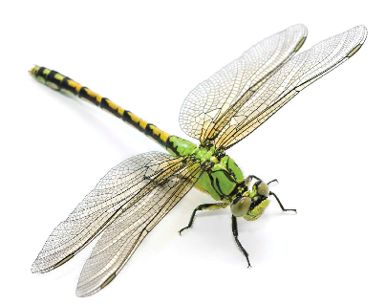
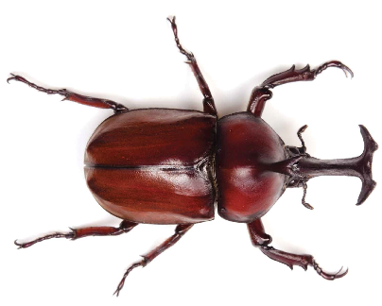
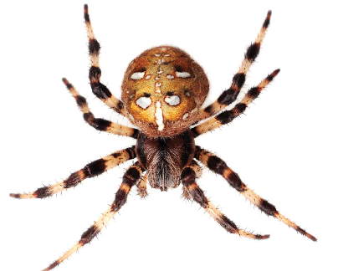
Am I an Insect? (4 of 4)
Cockroach; Dragonfly; Beetle; Spider
Identify and then compare and contrast the four animals in the images.
What body parts do each of these animals have? How are they similar? How are they different?
How is the animal in Image Card 5 different from the animals in the other images?
So, is a spider an insect? How can you tell?
Image Card 2; Image Card 3; Image Card 4; Image Card 5

Slide 50
Insects Journal: Is It an Insect?
Rhinoceros beetle
Image Card 4

Slide 51
Check for Understanding (11 of 11)
Check In
Is the animal you are drawing and writing about an insect?
How can you tell?

Slide 52
Resource Bank

Slide 53
All vocabulary
All vocabulary slides are included in the
instructional sequence.

Slide 54
Image Sources
Images from Grade 2 Unit 6 Resources

Slide 55
Copyright 2024 Texas Education Agency
© 2024. Texas Education Agency. Portions of this work are adapted,
with permission, from originals created by
Amplify Education, Inc. (amplify.com) and the Core Knowledge
Foundation (coreknowledge.org).
This work is licensed under a
Creative Commons Attribution-NonCommercial-ShareAlike
4.0 International License.
You are free:
to Share—to copy, distribute, and transmit the work
to Remix—to adapt the work
Under the following conditions:
Attribution—You must attribute any adaptations of the work in the
following manner:
This work is based on original works of the Texas Education Agency,
as well as prior works by Amplify Education, Inc. (amplify.com) and
the Core Knowledge Foundation (coreknowledge.org) and is made
available under a Creative Commons Attribution-NonCommercial-
ShareAlike 4.0 International License. This does not in any way imply
endorsement by those authors of this work.
Noncommercial—You may not use this work for commercial
purposes.
Share Alike—If you alter, transform, or build upon this work, you may
distribute the resulting work only under the same or similar license
to this one.
With the understanding that:
For any reuse or distribution, you must make clear to others the
license terms of this work. The best way to do this is with a link to
this web page:
https://creativecommons.org/licenses/by-nc-sa/4.0/
Trademarks and trade names are shown in this book strictly for
illustrative and educational purposes and are the property of their
respective owners. References herein should not be regarded as
affecting the validity of said trademarks and trade names.
This work is based on prior works of Amplify Education, Inc.
(amplify.com) and the Core Knowledge Foundation
(coreknowledge.org) made available under a Creative Commons
Attribution- NonCommercial-ShareAlike 4.0 International License.
This does not in any way imply endorsement by those authors of
this work.
Printed in the USA

Slide 56
Back Cover
BLRLA_G2_U6_L2_DCS_ENG

