Slide 1
Insects: All Around
GRADE 2 UNIT 6 | Lesson 1: Insects Everywhere!

Slide 2
Acknowledgement

Slide 3
Grade 2 Unit 6 | Lesson 1 | Insects Everywhere!
Insect Collage
Image 1A–1

Slide 4
Core Vocabulary (1 of 4)
Detail from Tundra and crane fly
habitats, n.
the specific environments in which plants and animals live and thrive
Example: Desert habitats are home to plants and animals that can survive without
regular rainfall.
Variation(s): habitat
Cognate: hábitats
Image 1A–13

Slide 5
Core Vocabulary (2 of 4)
Detail from Insect collage
insects, n.
small animals with six legs and three main body parts
Example: Mackenzie likes all kinds of insects,
especially butterflies.
Variation(s): insect
Cognate: insectos
Image 1A–1

Slide 6
Core Vocabulary (3 of 4)
Swarm of army ants
social, adj.
living together in organized communities
Example: The social honeybees worked hard to take care of the queen bee.
Variation(s): none
Cognate: social
Image 1A–10

Slide 7
Core Vocabulary (4 of 4)
Dragonfly hovering above water
solitary, adj.
living alone or in pairs
Example: The solitary fly circled the food-covered table alone before landing on my
ham sandwich.
Variation(s): none
Cognate: solitario/a
Image 1A–14

Slide 8
Primary Focus of Lesson
Speaking and Listening: Students will describe insects and their habitats.
Reading: Students will describe insects and their habitats.
Language: Students will demonstrate an understanding of the Tier 3 word habitats.
Writing: In a journal, students will write about a past experience with an insect.
Notes:
TEKS 2.1.D Work collaboratively with others by following agreed-upon rules for discussion, including listening to others, speaking when recognized, making appropriate contributions, and building on the ideas of others;
TEKS 2.6.G Evaluate details read to determine key ideas;
TEKS 2.3.B Use context within and beyond a sentence to determine the meaning of unfamiliar words;
TEKS 2.1.A Listen actively, ask relevant questions to clarify information, and answer questions using multi-word responses;
TEKS 2.12.B Compose informational texts, including procedural texts and reports.

Slide 9
Core Connections (1 of 2)
Life Cycle of a Butterfly
5
Grade 1 Unit 5 Poster 6

Slide 10
Core Connections (2 of 2)
What do you know about habitats?
What is our local habitat? Do you know of any other habitats?

Slide 11
Unit Introduction (1 of 2)
What is the smallest animal you have ever seen?
Do you know of any small animals that have six legs?
Think about the times you have interacted personally with insects. What did the insect look like, where did you see the insect, and how did the insect interact with you?
5

Slide 12
Unit Introduction (2 of 2)
Insect collage
Do you recognize any of the insects pictured in this image?
Do any of these insects live in the area in which you live?
What do you know about the insects in the picture?
Image 1A-1

Slide 13
Purpose for Listening
Listen carefully to find out about insects that live all over
the world.

Slide 14
Read Aloud: “Insects Everywhere!” (1 of 15)
Common housefly
Image 1A–2
15

Slide 15
Read Aloud: “Insects Everywhere!” (2 of 15)
Different types of flies
Image 1A–3

Slide 16
Read Aloud: “Insects Everywhere!” (3 of 15)
Planet Earth
Image 1A–4

Slide 17
Read Aloud: “Insects Everywhere!” (4 of 15)
Alfalfa field in bloom
Image 1A–5

Slide 18
Read Aloud: “Insects Everywhere!” (5 of 15)
Insect eggs on a leaf
Image 1A–6

Slide 19
Read Aloud: “Insects Everywhere!” (6 of 15)
Grasshopper, leafhopper, aphids
Image 1A–7

Slide 20
Read Aloud: “Insects Everywhere!” (7 of 15)
Ladybug, lacewing, ambush bug
Image 1A–8

Slide 21
Read Aloud: “Insects Everywhere!” (8 of 15)
Pine trees and bark beetle
Image 1A–9

Slide 22
Read Aloud: “Insects Everywhere!” (9 of 15)
Swarm of army ants
Image 1A–10

Slide 23
Read Aloud: “Insects Everywhere!” (10 of 15)
Army ant
Image 1A–11

Slide 24
Read Aloud: “Insects Everywhere!” (11 of 15)
Rhinoceros beetle
Image 1A–12

Slide 25
Read Aloud: “Insects Everywhere!” (12 of 15)
Tundra and crane fly
Image 1A–13

Slide 26
Read Aloud: “Insects Everywhere!” (13 of 15)
Dragonfly hovering above water
Image 1A–14

Slide 27
Read Aloud: “Insects Everywhere!” (14 of 15)
Planet Earth
Image 1A–15

Slide 28
Read Aloud: “Insects Everywhere!” (15 of 15)
Insect collage
Image 1A–16

Slide 29
Comprehension Questions
What is the largest group or category of animals on Earth?
In what large water habitat are insects unable to survive?
Many insects depend on host plants to stay alive. In what ways do these host plants help the insects?
If you were a farmer, which would you rather see on your crops: a ladybug or a grasshopper? Why?
10

Slide 30
Check for Understanding (1 of 2)
Think-Pair-Share
Name an insect and the habitat it lives in. Then, describe how the insect lives in that habitat.

Slide 31
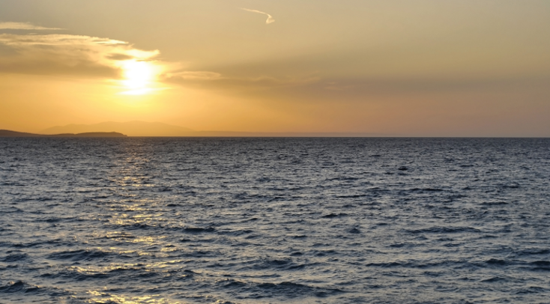
Word Work: Habitats
Sunrise
Habitats
“Oceans are the world's biggest habitat, yet no insects live there.”
Grade 1 Unit 4 Image 2A-1​
5

Slide 32
Sayings and Phrases
Eaten out of house and home

Slide 33
Insects Journal: Narrative
How did the insect look?
Where did you see the insect?
What did you do? What did the insect do?

Slide 34
Check for Understanding (2 of 2)
What kind of insect did you see?

Slide 35
Resource Bank

Slide 36
All vocabulary
All vocabulary slides are included in the
instructional sequence.

Slide 37
Image Sources
Images from Grade 1 Unit 4 Resources
Images from Grade 1 Unit 5 Resources
Images from Grade 2 Unit 6 Resources

Slide 38
Copyright 2024 Texas Education Agency
© 2024. Texas Education Agency. Portions of this work are adapted,
with permission, from originals created by
Amplify Education, Inc. (amplify.com) and the Core Knowledge
Foundation (coreknowledge.org).
This work is licensed under a
Creative Commons Attribution-NonCommercial-ShareAlike
4.0 International License.
You are free:
to Share—to copy, distribute, and transmit the work
to Remix—to adapt the work
Under the following conditions:
Attribution—You must attribute any adaptations of the work in the
following manner:
This work is based on original works of the Texas Education Agency,
as well as prior works by Amplify Education, Inc. (amplify.com) and
the Core Knowledge Foundation (coreknowledge.org) and is made
available under a Creative Commons Attribution-NonCommercial-
ShareAlike 4.0 International License. This does not in any way imply
endorsement by those authors of this work.
Noncommercial—You may not use this work for commercial
purposes.
Share Alike—If you alter, transform, or build upon this work, you may
distribute the resulting work only under the same or similar license
to this one.
With the understanding that:
For any reuse or distribution, you must make clear to others the
license terms of this work. The best way to do this is with a link to
this web page:
https://creativecommons.org/licenses/by-nc-sa/4.0/
Trademarks and trade names are shown in this book strictly for
illustrative and educational purposes and are the property of their
respective owners. References herein should not be regarded as
affecting the validity of said trademarks and trade names.
This work is based on prior works of Amplify Education, Inc.
(amplify.com) and the Core Knowledge Foundation
(coreknowledge.org) made available under a Creative Commons
Attribution- NonCommercial-ShareAlike 4.0 International License.
This does not in any way imply endorsement by those authors of
this work.
Printed in the USA

Slide 39
Back Cover
BLRLA_G2_U6_L1_DCS_ENG

