Slide 1
Grade K Foundational Skills | Unit 2 | Lesson 3

Slide 2
Acknowledgement

Slide 3
Prerequisite Skills:
Blending and Prewriting
Grade K Foundational Skills | Unit 2 | Lesson 3

Slide 4
Primary Focus of Lesson
Prerequisite Foundational Skills: Students will identify and blend syllables and sounds to form multisyllabic words by using hand gestures, large motor gestures, and visual supports; students will blend spoken onsets, rimes, and phonemes to form one-syllable words.
Prerequisite Writing Skills: Students will identify and use words that name categories such as colors, shapes, textures, and locations; students will hold a writing utensil with a tripod (or pincer) grip and draw zigzags; students will use spatial words, such as top, bottom, left, right, and middle, while practicing handwriting.
Notes:
TEKS K.1.B Restate and follow oral directions that involve a short, related sequence of actions;
TEKS K.2.A Demonstrate phonological awareness by (iv) identifying syllables in spoken words; (v) blending syllables to form multisyllabic words; (viii) blending spoken phonemes to form one-syllable words; (ix) manipulating syllables within a multisyllabic word; (vii) blending spoken onsets and rimes to form simple words;
TEKS K.3.C Identify and use words that name actions; directions; positions; sequences; categories such as colors, shapes, and textures; and locations.

Slide 5
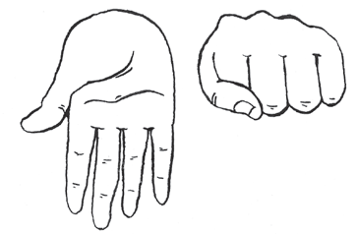
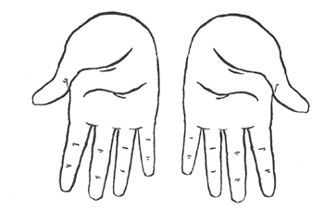
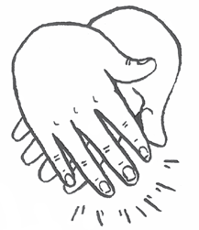


Warm-Up
Syllable and Sound Blending
5
Teacher Guide p. 28

Slide 6
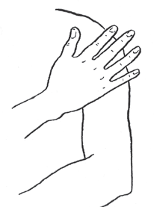
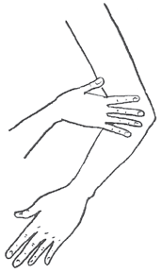
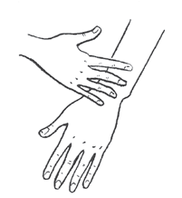
Practice Blending (1 of 4)
Blending Gestures
20
Teacher Guide p. 30

Slide 7


Practice Blending (2 of 4)
/s/ … /u/ … /n/ > sun,
/m/ … /ou/ … /th/ > mouth
Blending Picture Cards 1–2

Slide 8
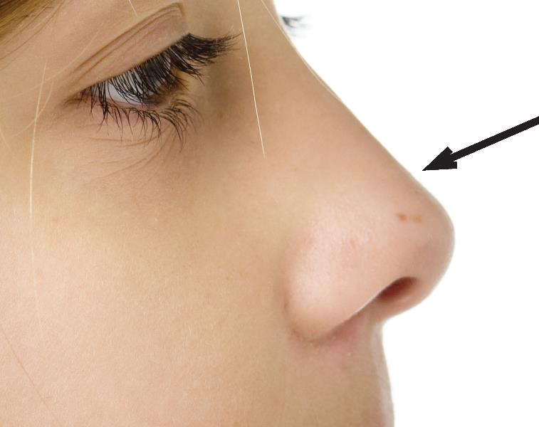
Practice Blending (3 of 4)
/n/ … /oe/ … /z/ > nose
Blending Picture Card 3

Slide 9
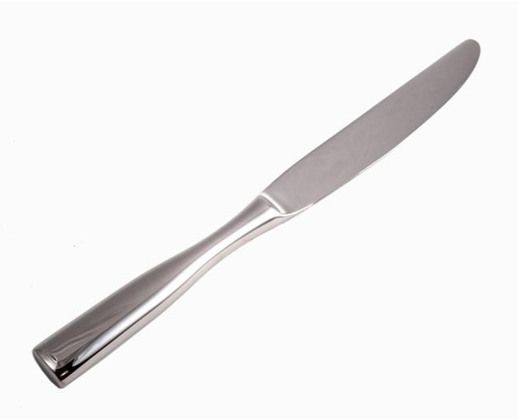
Practice Blending (4 of 4)
/n/ … /ie/ …, /f/ > knife
Blending Picture Card 4

Slide 10
Observation: Oral Blending Observation Record
Blend the sounds.

Slide 11
Draw Zigzags on a Vertical Surface
10
10
Teacher Guide p. 32

Slide 12
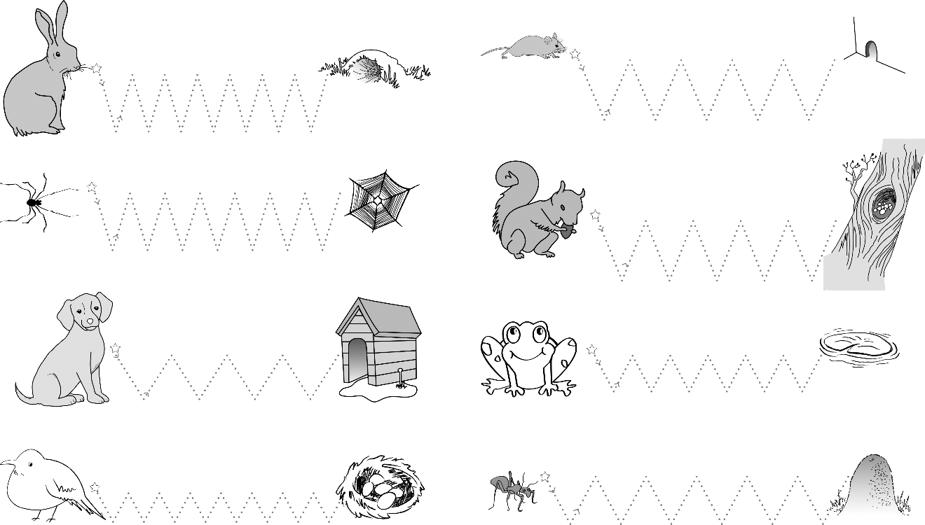
Zigzag Practice
Activity Page 3.1
15
Digital Component 3.1

Slide 13
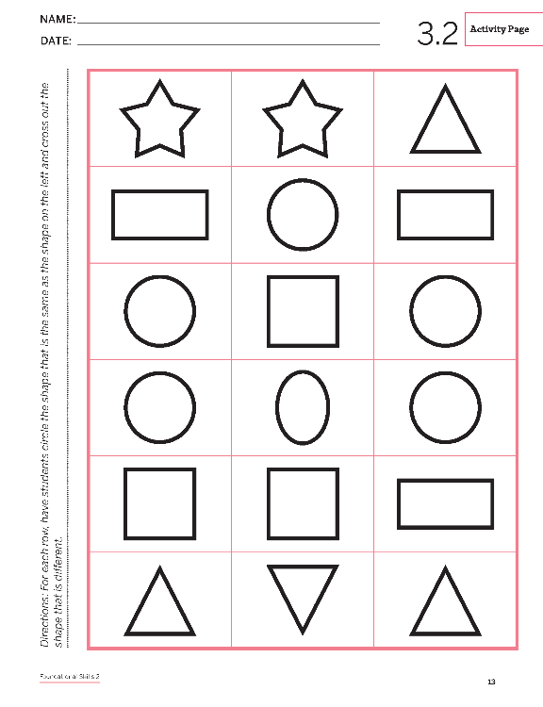
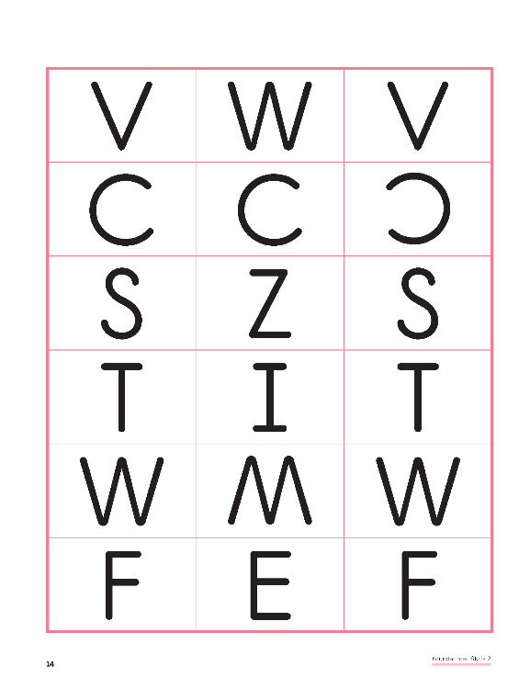
Differentiate Shapes
Activity Page 3.2
10
Activity Book pp. 13–14

Slide 14
Activity Page 3.2: Differentiating Shapes
Hand in Activity Page 3.2.

Slide 15
Resource Bank

Slide 16
Additional Support
Additional support for skills remediation can be found
at the end of this lesson.

Slide 17
Image Sources
Images from Grade K Unit 2 Resources

Slide 18
Copyright 2024 Texas Education Agency

Slide 19
Back Cover
BLFS_GK_U2_L3_DCS_ENG

