Slide 1
Grade K Foundational Skills | Unit 2 | Lesson 2

Slide 2
Acknowledgement

Slide 3
Prerequisite Skills:
Blending and Prewriting
Grade K Foundational Skills | Unit 2 | Lesson 2

Slide 4
Primary Focus of Lesson
Prerequisite Foundational Skills: Students will blend syllables and sounds to form words by using hand gestures and by playing a game involving large motor skills.
Prerequisite Writing Skills: Students will strengthen fine motor muscles by shaping modeling clay into humps and by holding a writing utensil with a tripod (or pincer) grip and drawing humps; students will use spatial words, such as top and bottom, while practicing handwriting.
Notes:
TEKS K.1.B Restate and follow oral directions that involve a short, related sequence of actions;
TEKS K.2.A Demonstrate phonological awareness by (v) blending syllables to form multisyllabic words; (viii) blending spoken phonemes to form one-syllable words; (ix) manipulating syllables within a multisyllabic word;
TEKS K.3.C Identify and use words that name actions; directions; positions; sequences; categories such as colors, shapes, and textures; and locations.

Slide 5
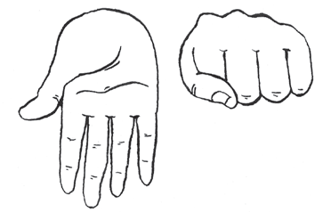
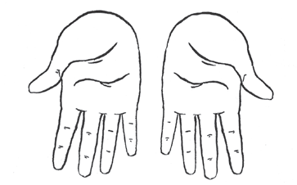
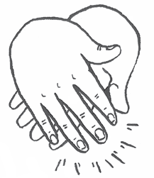
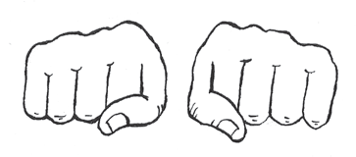
Warm-Up
Syllable Blending
5
Teacher Guide p. 20

Slide 6
Practice Blending (1 of 2)
Tap and Chase
20

Slide 7
Practice Blending (2 of 2)
Blend Syllables and Sounds

Slide 8
Observation: Oral Blending Observation Record
Blend the syllables and sounds.

Slide 9
Fine Motor Skills
Make Humps with Modeling Clay
10
10
Teacher Guide p. 23

Slide 10
Draw Humps on a Vertical Surface
10
10
Teacher Guide p. 23

Slide 11
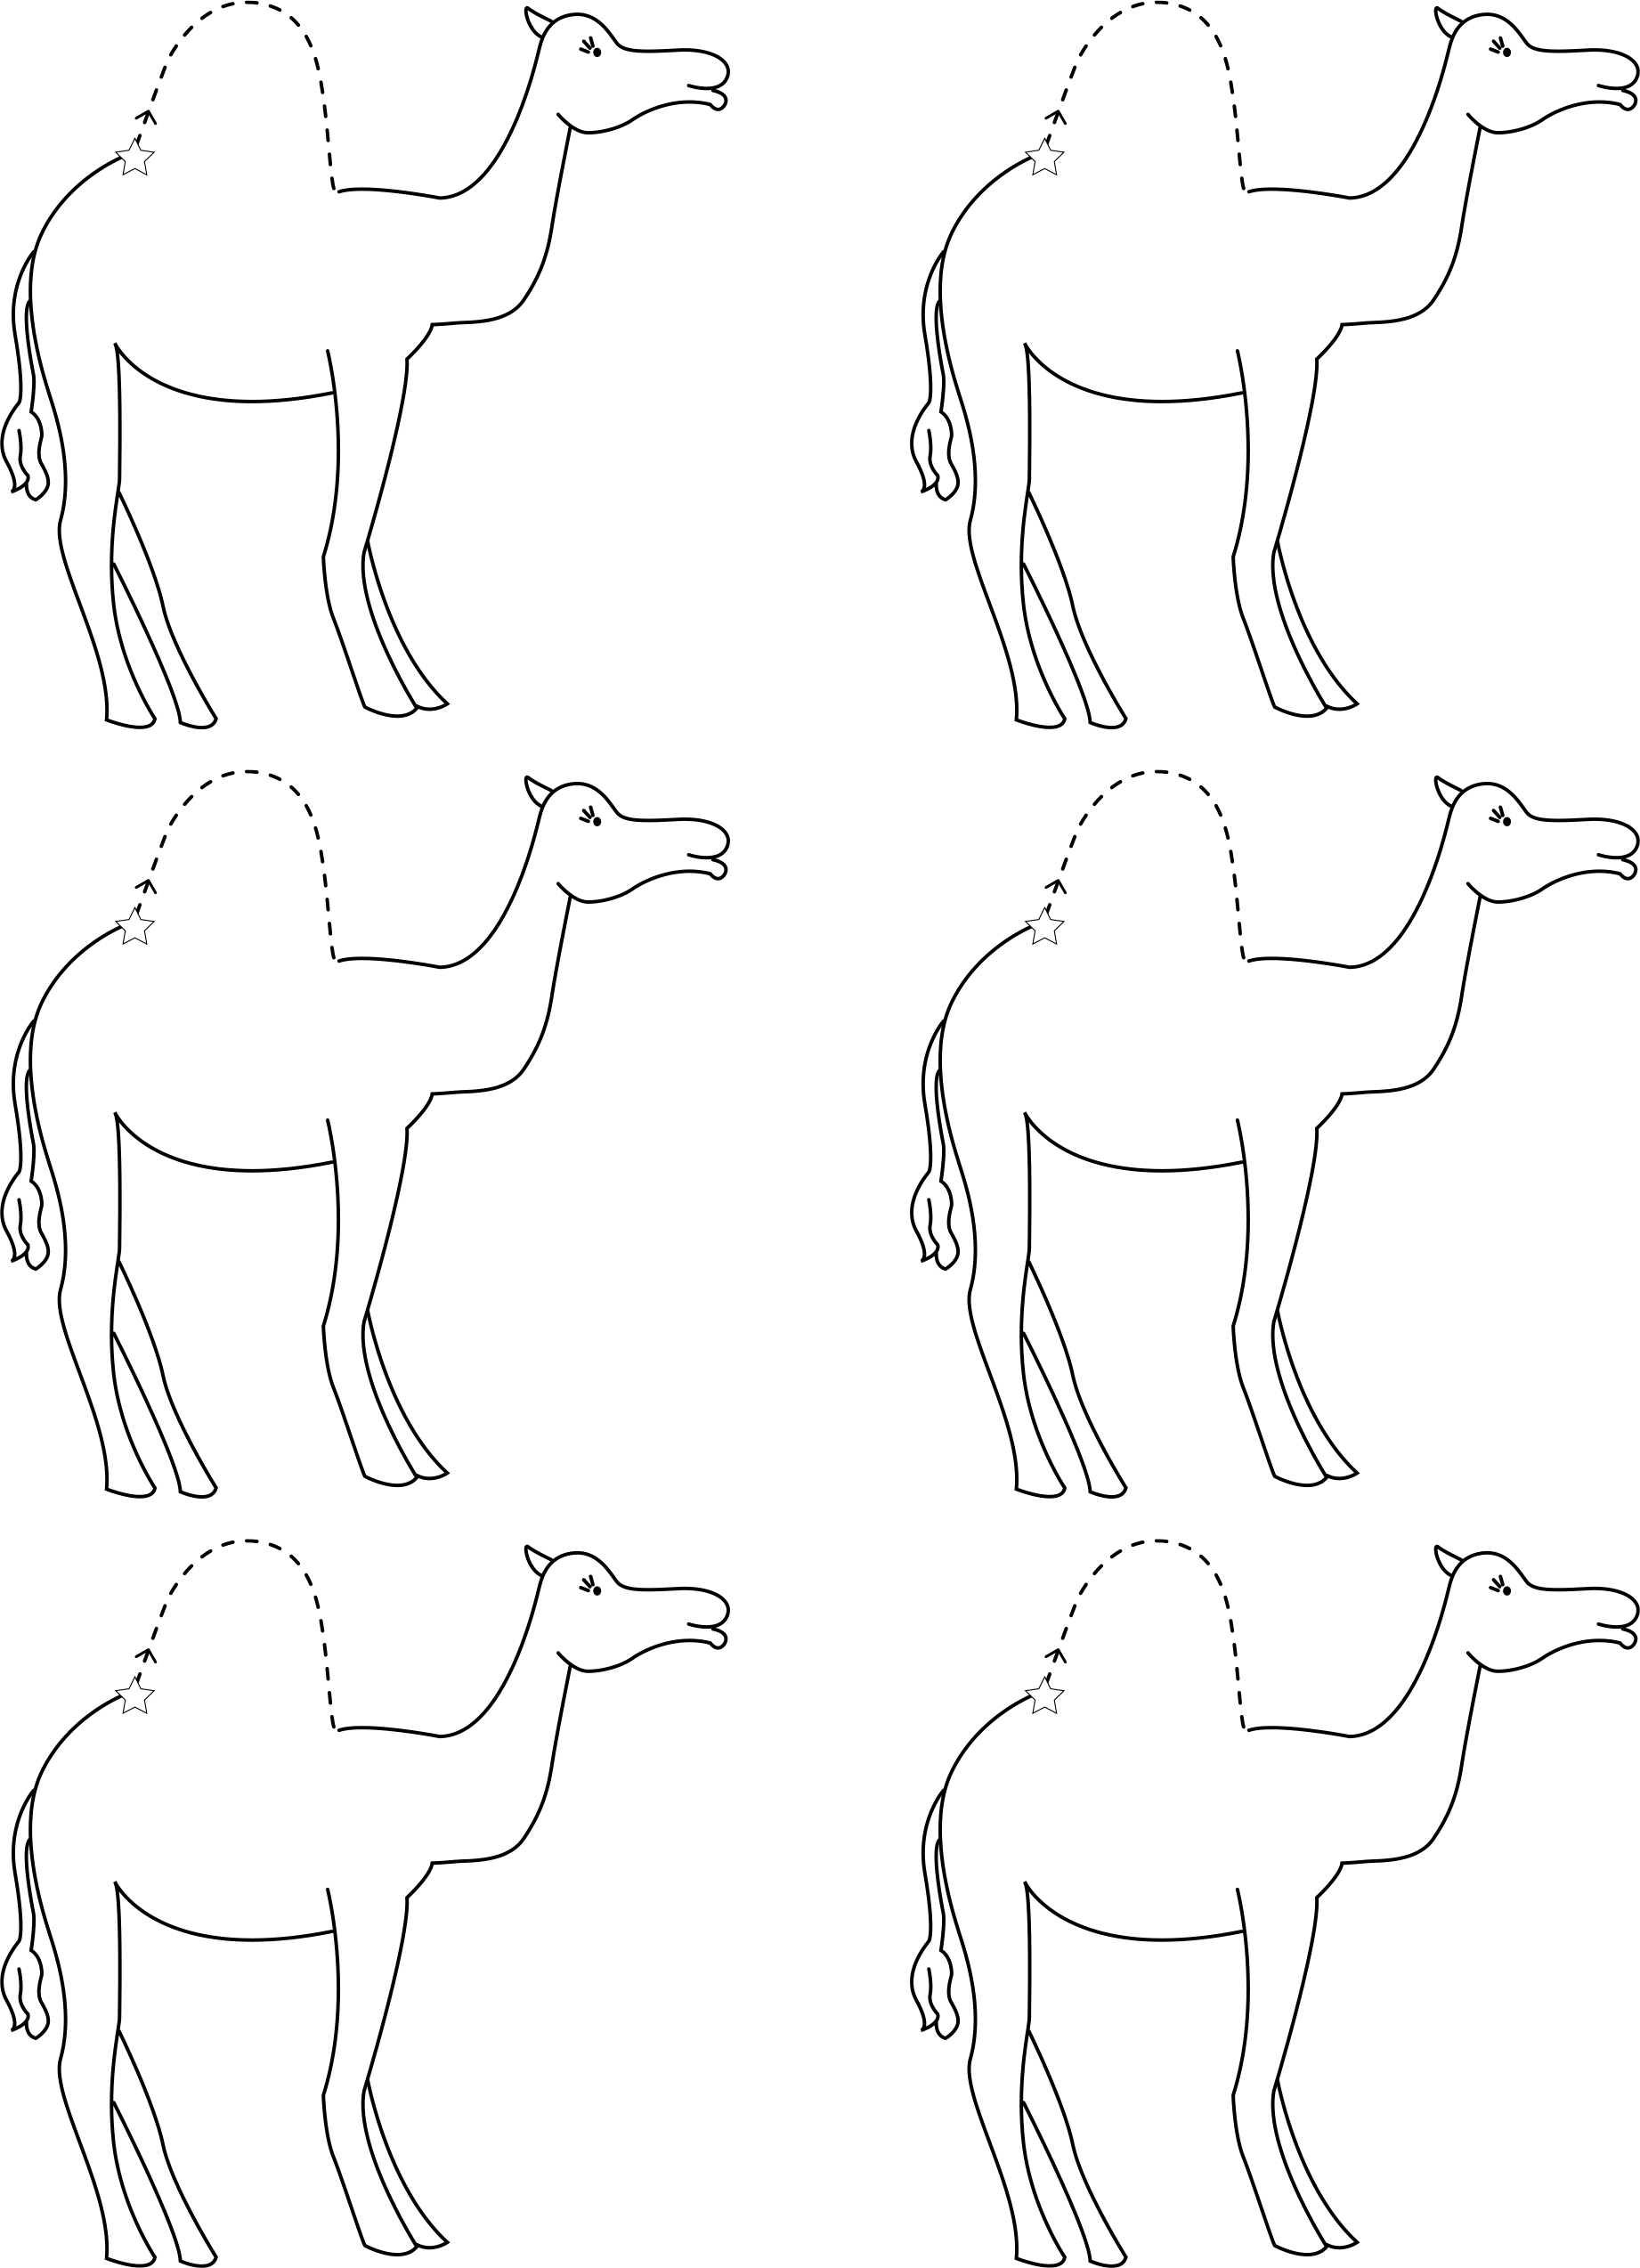
Hump Practice
Activity Page 2.1
15
Digital Component 2.1

Slide 12
Activity Page 2.1: Hump Practice
Hand in Activity Page 2.1.

Slide 13
Resource Bank

Slide 14
Additional Support
Additional support for skills remediation can be found
at the end of this lesson.

Slide 15
Image Sources
Images from Grade K Unit 2 Resources

Slide 16
Copyright 2024 Texas Education Agency

Slide 17
Back Cover
BLFS_GK_U2_L2_DCS_ENG

