Slide 1
Grade K Foundational Skills | Unit 2 | Lesson 1

Slide 2
Acknowledgement

Slide 3
Prerequisite Skills:
Blending and Prewriting
Grade K Foundational Skills | Unit 2 | Lesson 1

Slide 4
Primary Focus of Lesson
Prerequisite Foundational Skills: Students will identify, blend, and manipulate syllables to form multisyllabic words by using hand gestures and by playing a game involving large motor skills; students will demonstrate print awareness by tracking pictures on a page left to right with return sweep.
Prerequisite Writing Skills: Students will strengthen fine motor muscles by shaping modeling clay into cups and by holding a writing utensil with a tripod (or pincer) grip and drawing cups; students will use spatial words, such as top and bottom, while practicing handwriting.
Notes:
TEKS K.1.B Restate and follow oral directions that involve a short, related sequence of actions;
TEKS K.2.A Demonstrate phonological awareness by (iv) identifying syllables in spoken words; (v) blending syllables to form multisyllabic words; (ix) manipulating syllables
within a multisyllabic word;
TEKS K.2.D.ii Demonstrate print awareness by holding a book right side up, turning pages correctly, and knowing that reading moves from top to bottom and left to right with
return sweep;
TEKS K.3.C Identify and use words that name actions; directions; positions; sequences; categories such as colors, shapes, and textures; and locations.

Slide 5
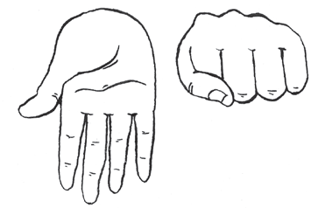
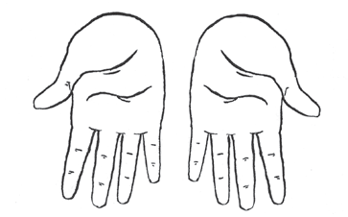
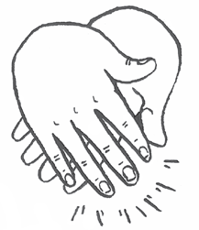
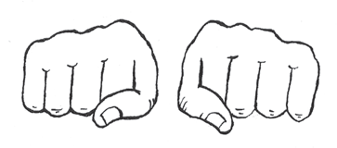
Warm-Up
Syllable Blending
5
Teacher Guide p. 11

Slide 6
Practice Blending
Tap and Chase
10

Slide 7
Observation: Oral Blending Observation Record
Blend the syllables.

Slide 8
Track from Left to Right and Top to Bottom
Activity Page 1.1
10
Activity Book pp. 1–2

Slide 9
Fine Motor Skills
Make Cups with Modeling Clay
10
10
Teacher Guide p. 13

Slide 10
Draw Cups on a Vertical Surface
10
10
Teacher Guide p. 13

Slide 11
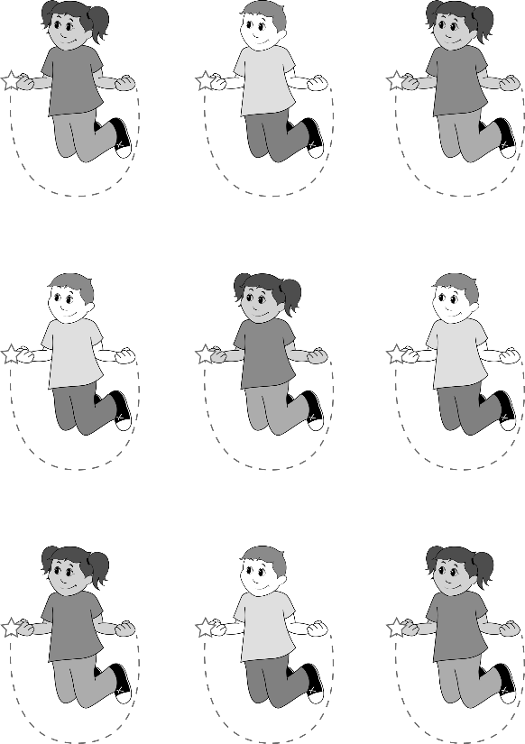
Cup Practice
Activity Page 1.2
15
Digital Components 1.1

Slide 12
Activity Page 1.2: Cup Practice
Hand in Activity Page 1.2.

Slide 13
Resource Bank

Slide 14
Additional Support
Additional support for skills remediation can be found
at the end of this lesson.

Slide 15
Image Sources
Images from Grade K Unit 2 Resources

Slide 16
Copyright 2024 Texas Education Agency

Slide 17
Back Cover
BLFS_GK_U2_L1_DCS_ENG

