Slide 1
Focused Data Analysis
© 2018 by the Texas Education Agency
Notes:
06/28/18

Slide 2
Introduction
Notes:
ESC staff add introduction and training logistics/norms here
Say (2 mins): Over the next 2 hours, we will practice analyzing state accountability data and practice developing problem statements and annual goals that will be the foundation for improvement planning for the year. We will focus on analyzing state accountability data during this session to ensure that we have a deep understanding of why the campus did not meet standard. We will review other data sources during the root cause analysis.
06/28/18

Slide 3
Vision Reflection
In your note-taking guide, answer (2 minutes):
How can data-driven improvement planning help our campus achieve this vision?
Notes:
Before we begin, let’s take a moment to think about what we need to achieve this year. You brought your vision statement with you today; this vision should drive the improvement planning work that you do this year.
Individually, take 2 minutes to answer the first question in your note-taking guide (show Slide 3):
How can data-driven improvement planning help our campus achieve this vision?
[Potential responses: Answers will vary; planning with data lets us know how far we are from the vision/if we are getting closer to achieving it]
06/28/18

Slide 4
Improvement Planning with Data
In your note-taking guide, answer (2 minutes):
Why is data analysis the first step in creating a plan?
Notes:
Say (1 min): We know that we need both a vision AND a plan to get our schools to improve. In order to anchor our plan in data, we are going to begin our planning work with Data Analysis. Individually, take one minute to answer question 2 in your note taking guide (show Slide 4):
Why is data analysis the first step in creating the plan? [Potential responses: because it helps us measure how far we are from our targets or from achieving our vision]
Say (1 min): Do a quick turn and talk with someone next to you about your answer. (Wait 2 minutes)
Say (2 mins): Let’s share whole group. Why is data analysis step one? (Have 1-2 people respond whole group)
06/28/18

Slide 5
Key Idea
Analyzing data first tells us where we are now and how much we need to do to get to where we want to go.
Notes:
Say (1 min): (show Slide 5) Key Idea: Analyzing our data as a first step lets us know exactly what we need to plan for and how much we need to accomplish.
06/28/18

Slide 6
Objectives
Identify why a campus did not meet standard and where the performance gaps are
Write data-driven problem statements and annual goals on which to base improvement planning
Notes:
Say (5 mins): (show Slide 6) Today, you are going to practice doing 2 things so that you can return to your campus ready to conduct your own Data Analysis:
Identify why a campus did not meet standard and where the performance gaps are
Write data-driven problem statements and annual goals on which to base improvement planning
We will look at a couple of case studies to determine why these actions are important for planning, and then we will practice using tools to conduct a sample data analysis.
06/28/18

Slide 7
Identifying Key Actions for Data Analysis: Case Study A
Read the case study. In your note-taking guide, answer (10 minutes):
What actions did Campus A take to determine why they didn’t meet standard?
What actions did the campus take to identify where their performance gaps are?
What is the purpose of the problem statement and annual goal?
How will these actions set them up for successful improvement planning?
Notes:
Say (1 min): Before we practice doing a data analysis, let’s look at two case studies from sample campuses to identify what the key actions for data analysis are.
We are going to look at two case studies. (Show Slide 7) Pull Case Study A from your packet. Individually, read the case study and answer the questions in your note taking guide. Take 10 minutes for this.
What actions did Campus A take to determine why they didn’t meet standard? [Potential answers: reviewed the data used to create accountability rating from the performance reporting website]
What actions did the campus take to identify where their performance gaps are? [Potential answers: determined why they didn’t meet standard by looking at each domain by grade level and content area]
What is the purpose of the problem statement and annual goal? [Potential answers: tells you where you are and what you need to do to meet standard]
How will these actions set them up for successful improvement planning? [Potential answer: the campus will focus on the data/areas that show that they are underperforming; will be able to track progress toward goal more easily]
Say (1 min): Turn and talk to your table group and discuss your answers. Take 3 minutes for this. (Facilitators monitor table talk to make sure discussions are on track with the answers above)
Say (5 min): Let’s do a whole group share out. (Ask for 3-4 volunteers to share their responses)
06/28/18

Slide 8
Key Idea
Knowing why you didn’t meet standard and where the performance gaps come from keeps you focused on planning actions that will close those gaps.
Notes:
Say (3 min): (show Slide 8) Key idea: Knowing why you didn’t meet standard and where the performance gaps come from keeps you focused on planning actions that will close those gaps.
06/28/18

Slide 9
Improving Practices: Case Study B
Read the case study. In your note-taking guide, answer (7 minutes):
Why might Campus B’s Problem Statement/Annual Goal lead to a less effective plan?
What steps would you recommend Campus B take to improve their Problem Statement/Annual Goal?
Notes:
Say (1 min): (show Slide 9) Let’s look at another campus. This campus missed the same accountability targets, but they took a different approach to their data analysis. Individually, read the case study and answer the two questions in your note taking guide. Take 7 minutes for this.
Why might Campus B’s Problem Statement/Annual Goal lead to a less effective plan? [Potential answers: they aren’t aligned to state accountability targets, they are not measurable]
What steps would you recommend campus B take to improve their problem statement/annual goal? [Potential answers: narrow the data sources, maintain focus on state accountability targets]
Say (1 min): Turn and talk to your table group and discuss your answers. Take 3 minutes for this. (Facilitators monitor table talk to make sure discussions are on track with the answers above)
Say (5 min): Let’s do a whole group share out. (Ask for 3-4 volunteers to share their responses)
06/28/18

Slide 10
Key Idea
Campuses that…
focus on why they did not meet standard,
identify where the performance gaps are, and
write data-driven problem statements
…are set up for more effective improvement planning.
Notes:
Say (2 min): (show Slide 10) Key idea: Campuses that focus on why they did not meet standard, identify where the performance gaps are, and write data driven problem statements are set up for more effective improvement planning.
06/28/18

Slide 11
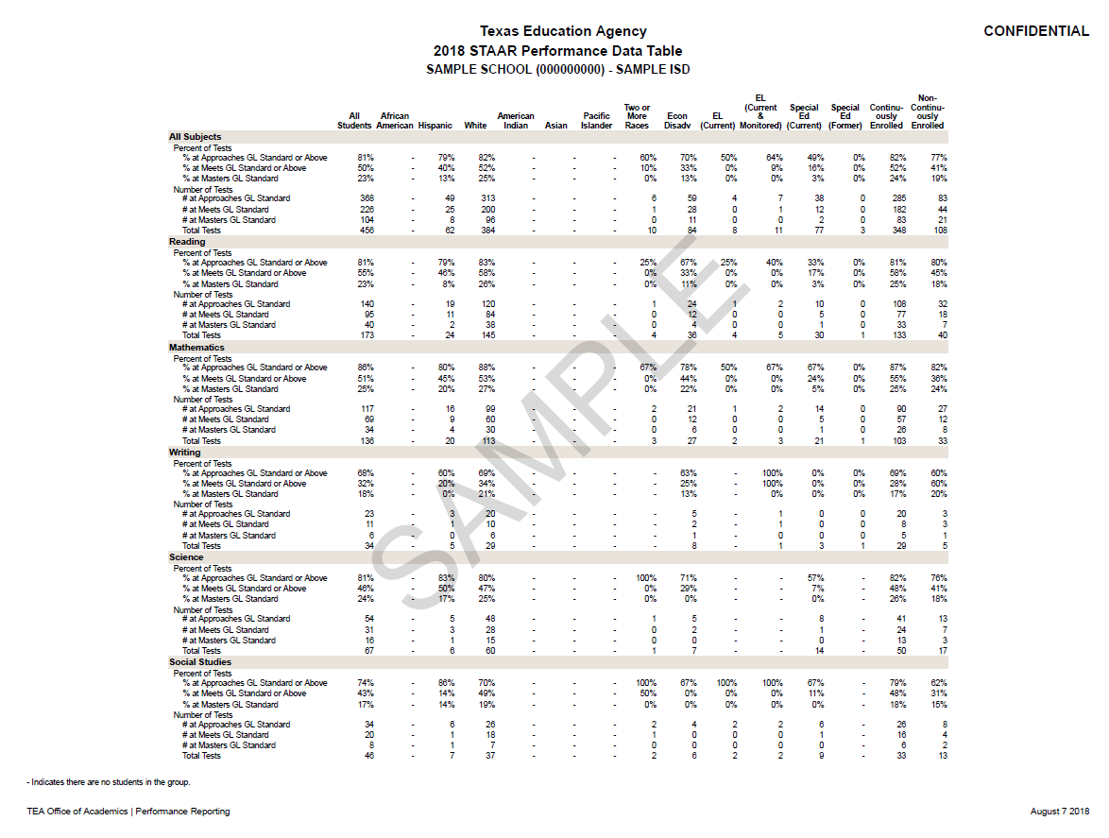
Identifying Data Trends
Practicing a data analysis: (20 minutes)
-Sample campus (different from case studies!), Domains 1 and 3
-Complete Steps 1a and 3a-3g in your Data Analysis Guided Discussion packet
-Review the other steps in the Data Analysis Guided Discussion packet and answer in your note-taking guide:
What is our plan to complete this data analysis at our campus?
Who is responsible for the work, and who will hold them accountable?
Notes:
Say (2 mins): (show Slide 11) Now we are going to practice conducting a data analysis and writing data-driven problem statements and annual goals. You are going to work with your campus team on a sample set of data. (Facilitator note: if a campus team has more than 4, divide them into groups of 4-5.)
Take out your Data Analysis Guided Discussion packet. This worksheet is meant to help teams uncover performance gaps and synthesize data into problem statements and should be used when you return to your campus to conduct your own data analysis.
Use the sample data packets on your table to complete the worksheet. You will also answer the two reflection questions on the slide in your note-taking guide. Take 20 minutes. (Facilitators note: during this time, circulate among tables to ensure that participants are using the worksheet correctly)
Domain 1: Teams should start by looking at the content areas, student subgroups, and performance levels. [Conversations should be taking place around the achievement by content area and student groups. To understand the grade level breakdown for each content area, the campus will use the student performance report that lists students’ individual results.]
Domain 3: Teams look at the Closing the Gaps table. The first table will help the campus with an overview of Domain 3. The second table provides a break down actual achievement numbers for Domain 3. [Conversations should be taking place around the Academic Achievement and Growth Status categories. The campus failed to meet many of the targets in these categories. Make sure that campuses understand the difference between the two tables and how they are used to help the campus understand the Domain 3 data.]
06/28/18

Slide 12
Identifying Data Trends
Why didn’t the campus meet standard? (2-4 bullets per missed Domain target) – 7 minutes with table team; record responses on chart paper
Notes:
Say: (show Slide 12) Now that you have reviewed the data, let’s summarize why the campus didn’t meet standard.
With your table team, write 2-4 bullets for each domain the campus missed that describe WHY they missed the domain target.
Record your data summary statements on the chart paper near your table. Take 10 minutes for this. (Facilitators note: circulate to ensure responses are aligned to expected responses; ask questions to redirect as needed)
Potential responses:
Domain 1:
Only 33% of students reached the Approaches Grade Level standard in Writing.
Only 33% of Economically Disadvantaged students reached the Approaches Grade Level standard in Writing.
Lead teams to think about the Next steps: Identify the 4th grade teacher who had the lowest levels of achievement in Writing.
Only 45% of Current EL students reached the Approaches Grade Level standard in Mathematics.
Lead teams to think about the Next steps: Identify the grade level that had the lowest level of achievement in Math for Current EL students. Identify the teacher who had the lowest level of achievement in Math in that grade level for Current EL students.
Other Potential Answers:
• 44% of African American students reached the Approaches GL standard in Math.
• 34% of Hispanic students reached the Approaches GL standard in Writing.
•47% of Economically Disadvantaged students reached the Approaches GL standard on all tests taken.
Domain 3:
No Academic Achievement Status targets were met in Math and ELA.
In ELA, the student groups with the largest gaps are: Hispanic, Continuously Enrolled, and All Students.
In Math, the student groups with the largest gaps are: All Students, Hispanic, and Non-Continuously Enrolled.
Lead teams to think about Next Steps: Identify the grade levels that had the largest academic achievement gaps. Focus in on the specific student groups that most contributed to targets not being met. Identify the teachers who most contributed to the targets not being met.
Only 12% of African American and Hispanic achieved the Masters Grade Level standard.
Lead teams to think about Next Steps: Identify the subject area that had the lowest number of African American and Hispanic students achieve the Master GL standard. Identify the grade level that had the lowest number of African American and Hispanic students achieve the Master GL standard. Focus on the teacher who had the lowest number of African American and Hispanic students achieve the Master GL standard.
Other potential responses:
No growth status measures (the most heavily weighted component in Domain 3) were achieved by student groups in ELA or Math.
Student Success Status targets were not reached by any measurable subgroup with the exception of Current Special Education.
There is a large gap between the number of growth points earned by African American students and growth points earned by other student groups.
06/28/18

Slide 13
Data Trends: Findings
Some trends we identified:
The campus overall is struggling with student growth.
Writing is an area of concern for the campus.
There are disparities in the performance of student groups that aren’t explained by the data tables:
African American and Hispanic students on campus are not achieving at the Masters level.
White students and Current Special Ed students underperformed in Math and ELA when compared to the other subgroups.
Notes:
Say (5 mins): (show Slide 13) So we can look around the room and see what some of the data trends for this campus are. Here are some of the trends that we surfaced: (read from slide. If the trends on the chart paper around the room don’t match, open for discussion).
06/28/18

Slide 14
Key Idea
When looking at state accountability data, evaluate by content area, grade level, teacher level, and student group to uncover where performance gaps really are.
Notes:
(show Slide 14) Key Idea: When looking at state accountability data, evaluate by content area, grade level, teacher level, and student group to uncover where performance gaps really are.
06/28/18

Slide 15
Practice: Writing Problem Statements and Annual Goals
In your note-taking guide, answer (3 minutes):
What is missing in Campus B’s problem statement and annual goal?
Notes:
Say (2 min): (show slide 15) We have identified the trends in our example data, but now we need to turn these trends into measurable problem statements and annual goals, which will serve as the foundation of our improvement plans.
First, let’s take a minute to look back at the problem statements and annual goals from our case studies. On page 4 of your note-taking guide, the problem statements and annual goals for each campus are listed. In your notes, answer the reflection question:
What is missing in Campus B’s problem statement and annual goal?
[Potential responses: problem statement is not based on accountability data (not clear why this is the primary reason they didn’t meet standard), annual goal is not measurable]
Say (4 mins): (Ask for volunteers to share responses)
06/28/18

Slide 16
Key Idea
A good problem statement is:
Substantiated by data
A key reason why the campus did not meet standard
A good annual goal is:
Based on measurable results
Attainable and ambitious
Notes:
(show slide 16) Key idea: Here are our criteria for problem statements and annual goals:
A good problem statement is:
Substantiated by data
A key reason why the campus did not meet standard
A good annual goal is:
Based on measurable results
Attainable and ambitious
In your note-taking guide, take a minute to write your understanding of what makes a good problem statement and annual goal.
Say: (leave slide 16 up) Now let’s practice using the data trends we just uncovered in the sample data to write a problem statement and annual goal.
Individually, take 5 minutes to write one problem statement and a corresponding annual goal for one of the data trends in your note-taking guide. Keep in mind our criteria for problem statements and annual goals!
(After 5 mins) Say: We are going to review each other’s problem statements and annual goals now. Find a partner from another table/campus. You are going to take 3 minutes to read each other’s problem statements and annual goals and evaluate them against the criteria. You will then each have 2 minutes to provide your partner feedback, and then you will take one minute to revise. I’ll walk you through the timeline as we go. For now, take 1 minute to find a new partner!
(After everyone is settled) Ok, now you have 3 minutes to read each other’s problem statements and annual goals and evaluate them against the criteria. Record your feedback on page 4 of your note-taking guide. You may begin.
(After 3 mins) Take turns giving the feedback on the problem statement/annual goal. The person who has the closest birthday to today gives feedback first. You have 2 minutes to give your feedback. Begin! (Facilitator will walk around while partners are giving feedback; ask those with strong problem statement/annual goals to share out once the activity is over.)
(After 2 mins) Now let’s switch. Partner 2, give your feedback. You have 2 minutes!
(After 2 mins) Take one minute and make any revisions to your Problem Statement/Annual Goal that your partner suggested.
(After 1 min) Let’s return to our original seats. (Wait for people to get re-settled.) I heard a couple of great examples of problem statements and annual goals while walking around. (Facilitator asks selected participants to share and asks the room for their thoughts or feedback.)
06/28/18

Slide 17
Final Reflection
In your note-taking guide, answer:
What are the key actions I need to keep in mind when I do this work at my campus?
Notes:
(show Slide 17) We have practiced reviewing data and synthesizing it into something on which we can base our improvement plans. Before we leave, in your note taking guide, take a minute to reflect on the last question in your note taking guide:
What are the key actions I need to keep in mind when I do this work at my campus?
06/28/18

Slide 18
Facilitator enters follow up/contact information here
Notes:
(show slide 18) This concludes the Data Analysis for Improvement Planning training! (Facilitator note: include your contact info/follow up method here)
06/28/18

