Slide 1
IDEA-B LEA MOE Calculation Tool
TETN - October 2016
Federal Fiscal Compliance and Reporting
Texas Education Agency (TEA)

Slide 2
Topics
Compliance Standard
Subsequent Years Rule
Original Required Level of Effort
Actual Level of Effort
Amount of Cumulative Exceptions/Adjustments, Intervening Years

Slide 3
Topics (cont.)
Layout of IDEA-B LEA MOE Calculation Tool
Data Entry/Sources for Calculation Tool
Example of Calculation Tool Completed
Example Alternate Calculation Tool – Charter Schools Only
Summary
Contact and Resource Information

Slide 4
Compliance Standard
34 CFR §300.203
Expenditure test to determine whether an LEA met the requirement to maintain fiscal effort in a particular school year.
Prohibits the reduction of expenditures, for the education of children with disabilities, below the level of expenditures made for the preceding school year, except for statutory exceptions and the adjustment to fiscal effort provision.

Slide 5
Subsequent Years Rule
Establishes the comparison year and the level of effort required in the subsequent school year following an MOE failure.
Comparison year is the “preceding fiscal year”; however, the “subsequent years rule” clarifies that “preceding fiscal year” means the last fiscal year (school year) in which the LEA met MOE.
Based on this rule, the IDEA-B LEA MOE Calculation Tool compares “original required level of effort” to “actual level of effort.”

Slide 6
Original Required Level of Effort
“Original Required Level of Effort” is the level of effort at which the LEA last established compliance (achieved a “Passing” result) for each test method:
Test 1: local only expenditures
Test 2: state and local expenditures
Test 3: local only per-capita
Test 4: state and local per-capita

Slide 7
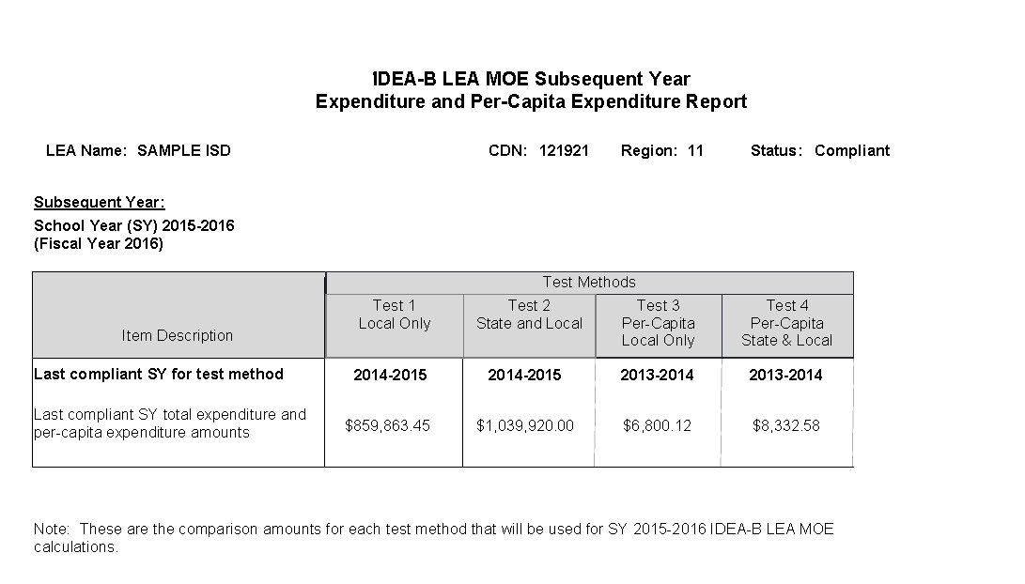
Original Required Level of Effort = Last Compliant SY Total Expenditures and Per-Capita Expenditure Amounts

Slide 8
Actual Level of Effort
“Actual Level of Effort” is the actual amount expended for each test method during the school year under compliance review.
Test 1: local only expenditures
Test 2: state and local expenditures
Test 3: local only per-capita
Test 4: state and local per-capita

Slide 9
Amount of Cumulative Exceptions/ Adjustments, Intervening Years
“Amount of Cumulative Exceptions/Adjustments, Intervening Years” includes the exceptions and/or adjustment to fiscal effort amounts that the LEA submitted in an intervening year and were validated by TEA, but did not bring the LEA into compliance for a test method.
Becomes a “carry-forward” used in the next compliance review as demonstrated in the next example.

Slide 10
Amount of Cumulative Exceptions/ Adjustments, Intervening Years
Example: 2014-2015 IDEA-B LEA MOE Compliance Review, Test Method 2: State and Local Expenditures
$30 is the “carry-forward” to be applied in determining preliminary 2015-2016 IDEA-B LEA MOE compliance review for Test 2.
Original Level of Effort (2013-2014) | $450
Actual Level of Effort (2014-2015) | $400
Variance (preliminary deficiency) | $(50)
Exceptions submitted by LEA and validated by TEA | $30
Refund | $20
Final Compliance Result | “Fail"

Slide 11
Amount of Cumulative Exceptions/ Adjustments, Intervening Years
Example continued for subsequent year: 2015-2016 IDEA-B LEA MOE Compliance Review, Test Method 2: State and Local Expenditures
 | Example 1 | Example 2 | Example 3
Original Level of Effort (2013-2014) | $450 | $450 | $450
Actual Level of Effort (2015-2016) | $420 | $450 | $410
Variance (negative only)/preliminary deficiency | $(30) | $0 | $(40)
Amount of Cumulative Exceptions/ Adjustments, Intervening Years | $30 | $30 | $30
Refund | $0 | $0 | $10
Preliminary compliance result | “Pass” | “Pass” | “Fail”

Slide 12
Layout of Calculation Tool
Excel spreadsheet with 3 tabs:
Instructions
IDEA-B LEA MOE
Local Only (No Data Entry)
(Note: tab 3 not included in the alternate tool)
The 2nd tab, IDEA-B LEA MOE, is only worksheet into which the LEA enters data

Slide 13
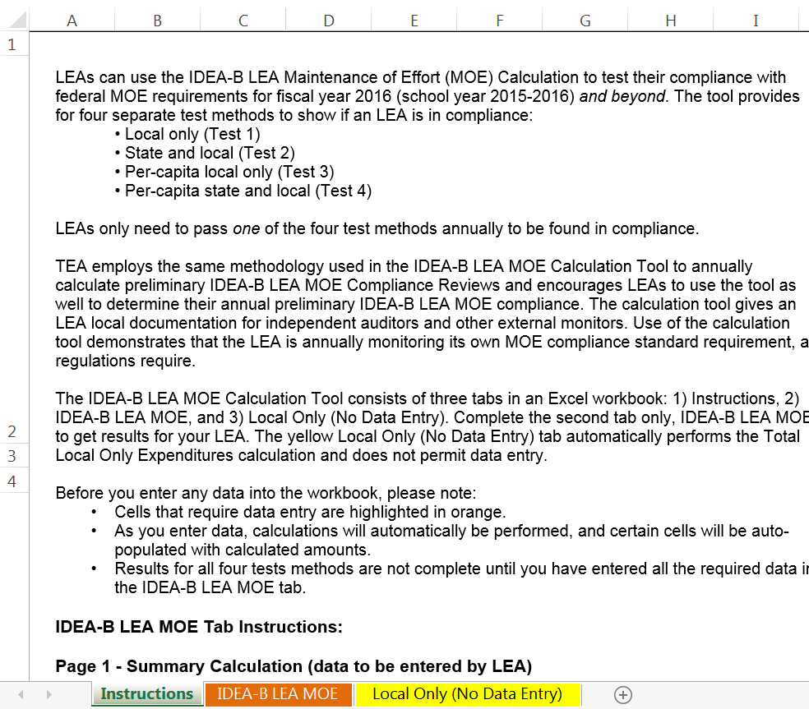
Layout of Calculation Tool
1st tab – Instructions

Slide 14
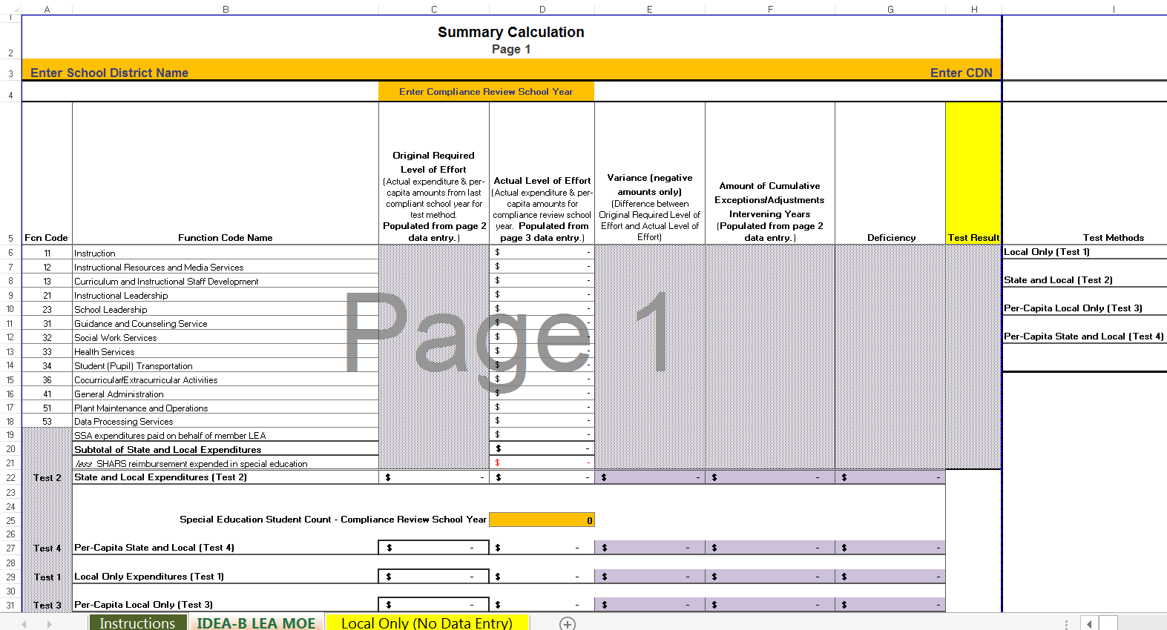
Layout of Calculation Tool
2nd tab – IDEA-B LEA MOE (for data entry)

Slide 15
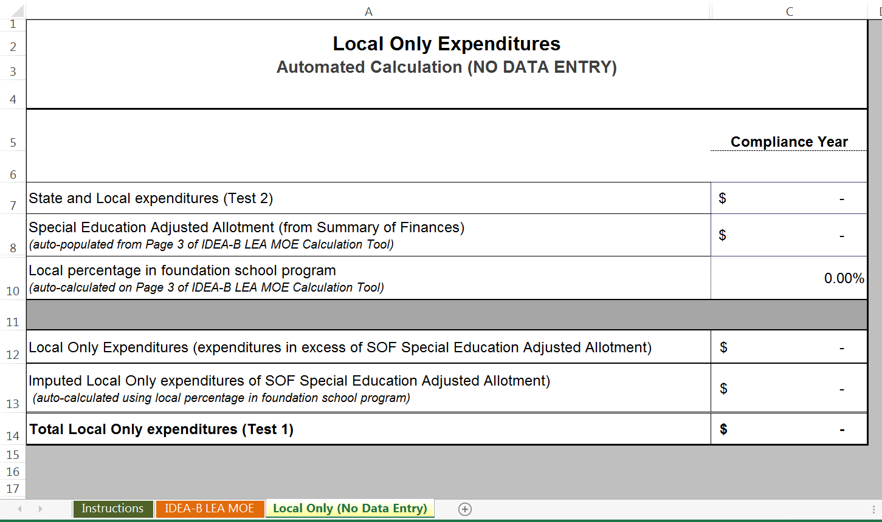
Layout of Calculation Tool
3rd tab – Local Only (No Data Entry – not on alt tool))

Slide 16
Layout of Calculation Tool IDEA-B LEA MOE Tab
IDEA-B LEA MOE tab has three sections:
Page 1: Summary Calculation,
Page 2: Last Compliant School Year, and
Page 3: Compliance Review School Year Info.
Data entry required in each section (i.e. page)

Slide 17
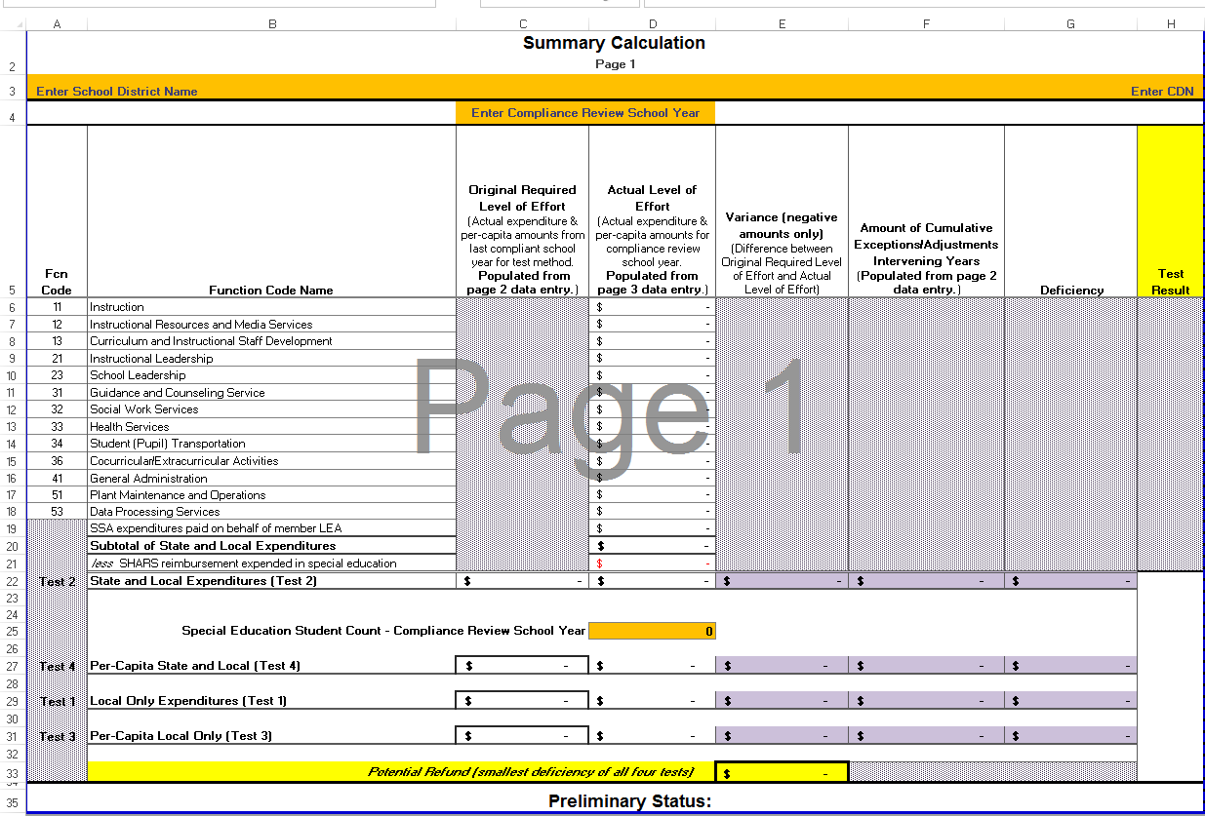
Layout of Calculation Tool IDEA-B LEA MOE Tab
Summary Calculation, Page 1

Slide 18
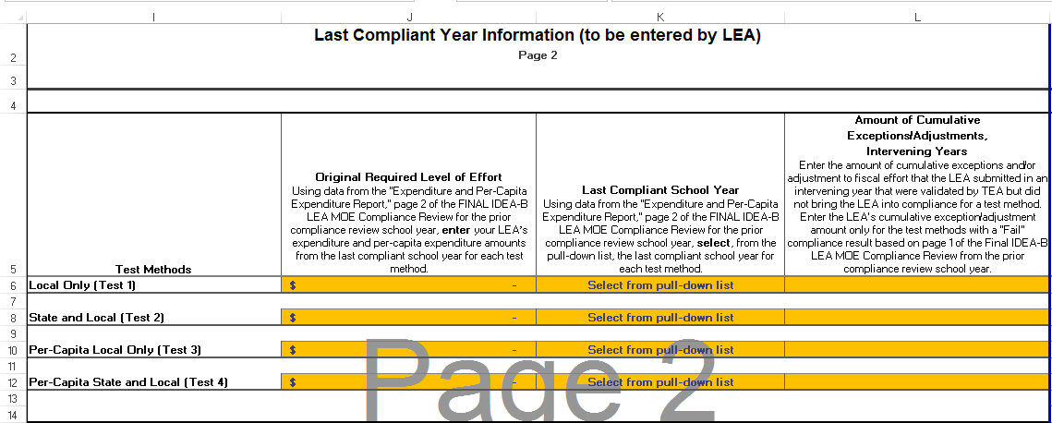
Layout of Calculation Tool IDEA-B LEA MOE Tab
Last Compliant Year Info, Page 2

Slide 19
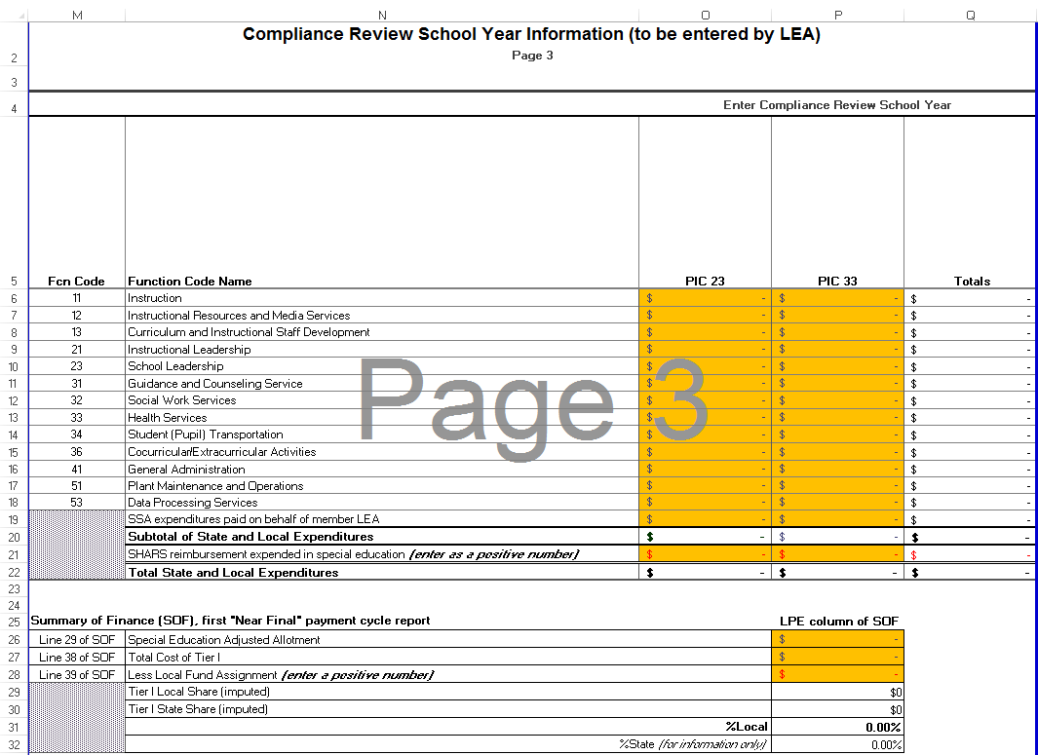
Layout of Calculation Tool IDEA-B LEA MOE Tab
Compliance Review School Year Info, Page 3

Slide 20
Data Entry/Sources for Calculation Tool
IDEA-B LEA MOE tab Summary Calculation, Page 1
Data Entry | Data Sources
LEA name LEA’s 6-digit CDN Compliance Review School Year
Special Education Student Count – Compliance Review School Year | PEIMS Fall Data Collection PRF5D010, Special Education Child Counts by Funding Type or PDM1-121-003, Special Education Students by Grade and Instructional Setting and Funding Type

Slide 21
Data Entry/Sources for Calculation Tool
IDEA-B LEA MOE tab Last Compliant School Year, Page 2
Data Entry | Data Source
Original Required Level of Effort for: Local only (Test 1) State and Local (Test 2) Per-Capita Local Only (Test 3) Per-Capita State and Local (Test 4) and Last Compliant School Year for: Local only (Test 1) State and Local (Test 2) Per-Capita Local Only (Test 3) Per-Capita State and Local (Test 4) | FINAL IDEA-B LEA MOE Compliance Review of the prior compliance review school year. Use page 2, “Expenditure and Per-Capita Expenditure Report“.

Slide 22
Data Entry/Sources for Calculation Tool
IDEA-B LEA MOE tab Last Compliant School Year, Page 2
Data Entry | Data Source
Amount of Cumulative Exceptions/Adjustments, Intervening Years | FINAL IDEA-B LEA MOE Compliance Review of the prior compliance review school year. Use page 1, line item “Total exceptions and/or adjustment to fiscal effort validated by TEA.”

Slide 23
Data Entry/Sources for Calculation Tool
IDEA-B LEA MOE tab Compliance Review School Year Information, Page 3
Data Entry | Data Source
Expenditures for specific function codes: Fund Code 199 and/or 420 Program Intent Code 23 and 33 | PEIMS Mid-Year Data Collection: PRF1D008, Actual Compliance Report General Fund Unallocated or PDM2-101-002, TSDS PEIMS Actual Compliance Report, LEA-level Data/Unallocated Funds Only, Campuses: ALL

Slide 24
Data Entry/Sources for Calculation Tool
IDEA-B LEA MOE tab Compliance Review School Year Information, Page 3
Data Entry | Data Source
Shared services arrangement expenditures paid on behalf of member LEA Fund Code 437 | PEIMS Mid-Year Data Collection: PRFBD001 Actual SSA Financial Summary by Fund and SSA Type or PDM1-121-003 Actual SSA Financial Summary by Fund and SSA Type

Slide 25
Data Entry/Sources for Calculation Tool
IDEA-B LEA MOE tab Compliance Review School Year Information, Page 3
Data Entry | Data Source
SHARS reimbursement expended in special education | SHARS Reimbursement Report Form
Special Education Adjusted Allotment, Total Tier I Less Local Fund Assignment | Summary of Finance (SOF), first "Near Final" payment cycle report, LPE column

Slide 26
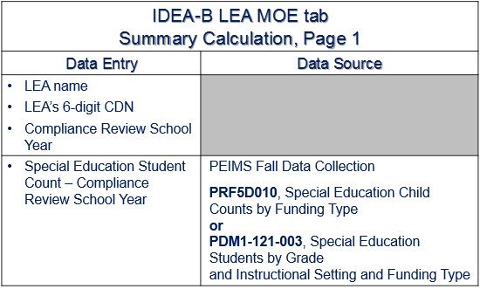
Example Calculation Tool Completed
Reminder of Data Entry Summary Calculation Page 1

Slide 27
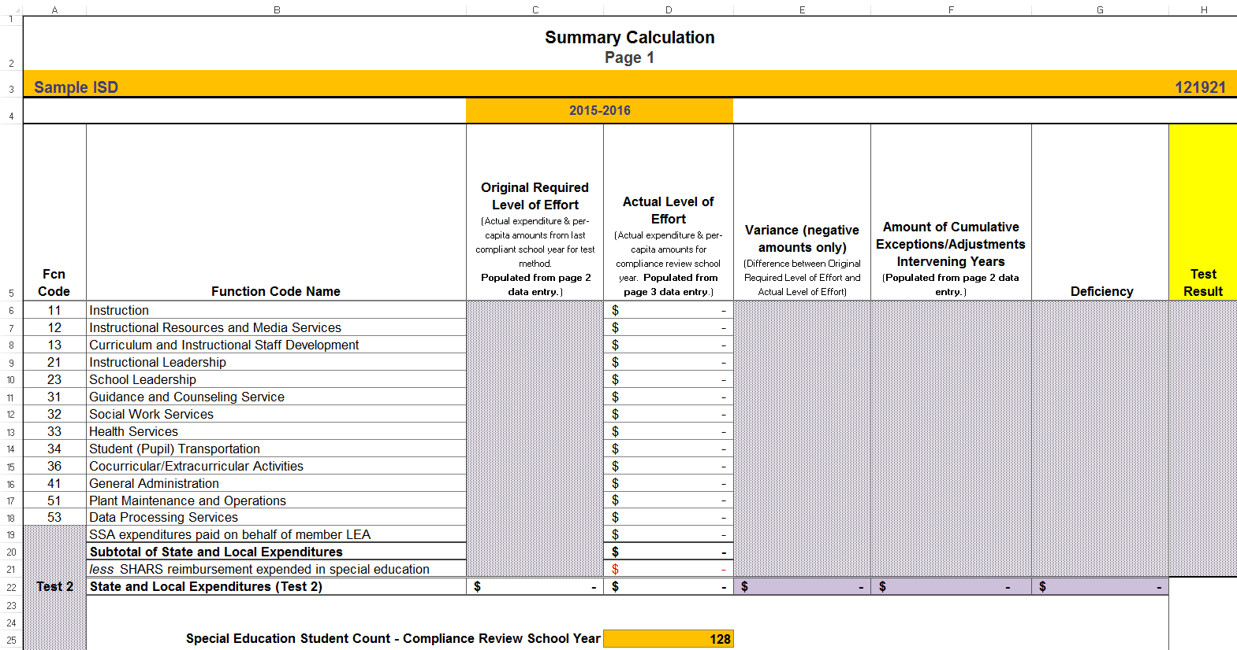
Example Calculation Tool Completed
LEA Name
LEA 6-digit CDN
Compliance Review School Year
Special Ed Student Count Compliance Review SY

Slide 28
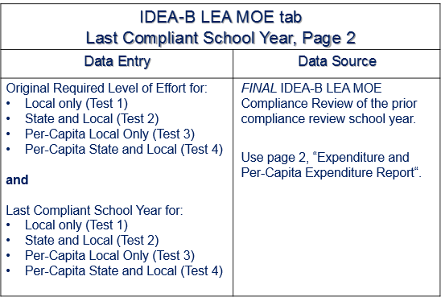
Example Calculation Tool Completed
Reminder of Data Entry Last Compliant School Year Page 2
Last Compliant SY
Original Required Level of Effort

Slide 29
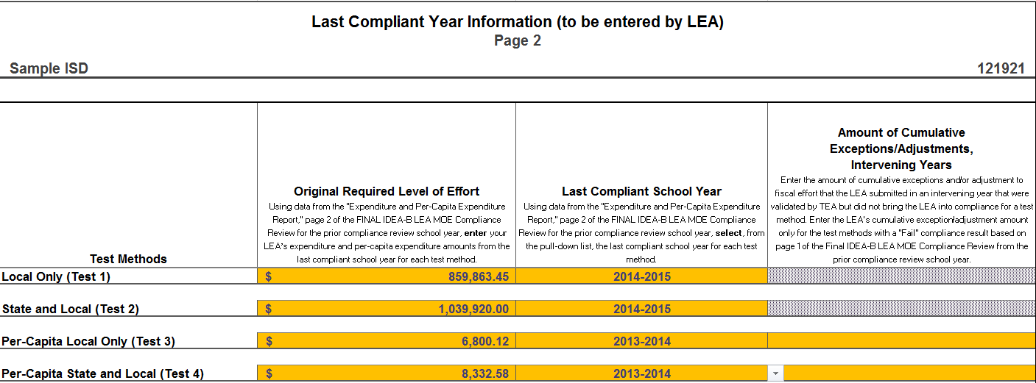
Example Calculation Tool Completed

Slide 30
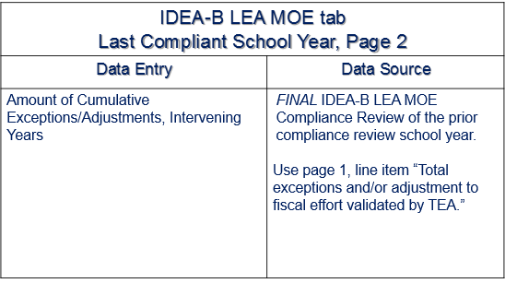
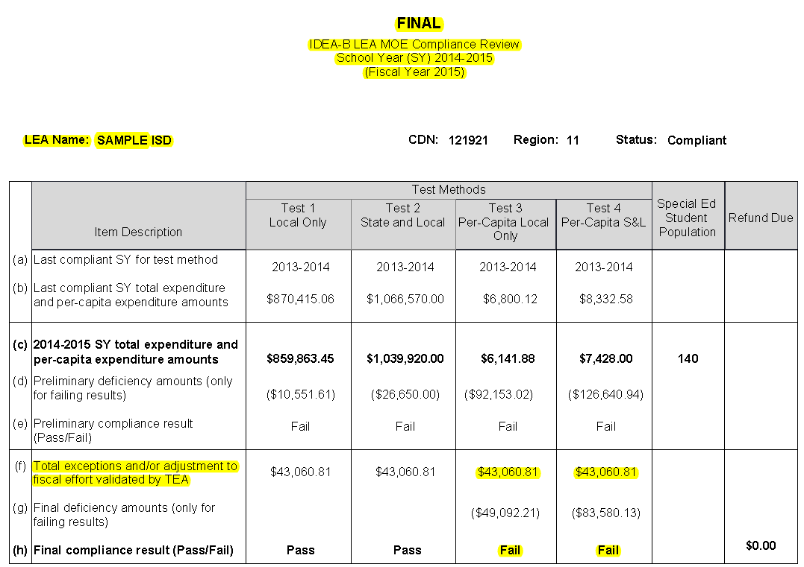
Example Calculation Tool Completed
Reminder of Data Entry Last Compliant
School Year Page 2
Total exceptions and/or adjustment to fiscal effort validated by TEA

Slide 31
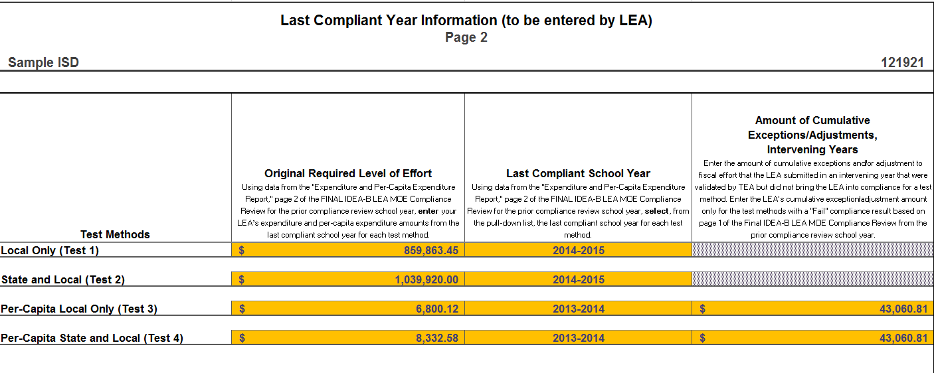
Example Calculation Tool Completed

Slide 32
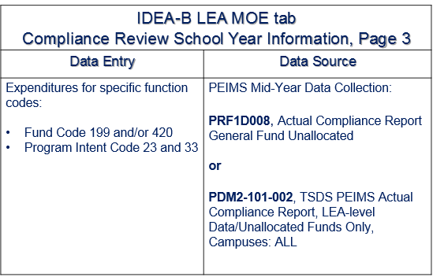
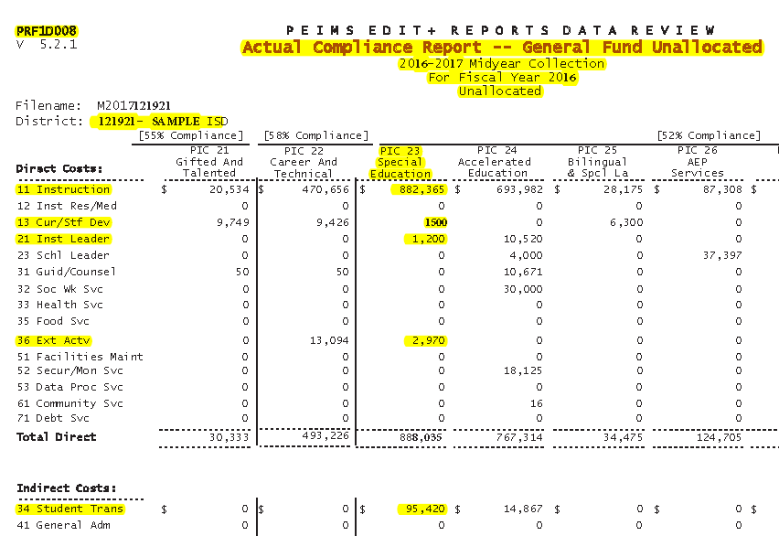
Example Calculation Tool Completed
Compliance Review School Year Information Page 3

Slide 33
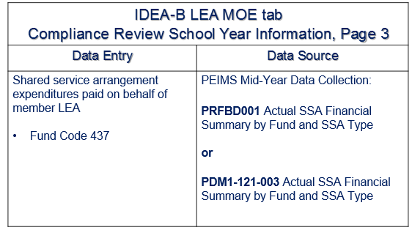
Example Calculation Tool Completed
Compliance Review School Year Information Page 3

Slide 34
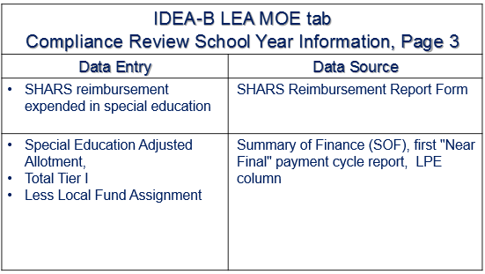
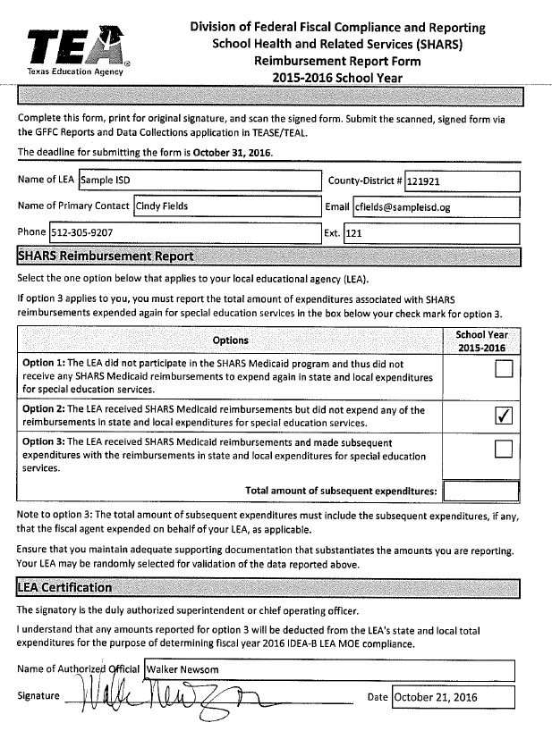
Example Calculation Tool Completed
Compliance Review School Year Information Page 3

Slide 35
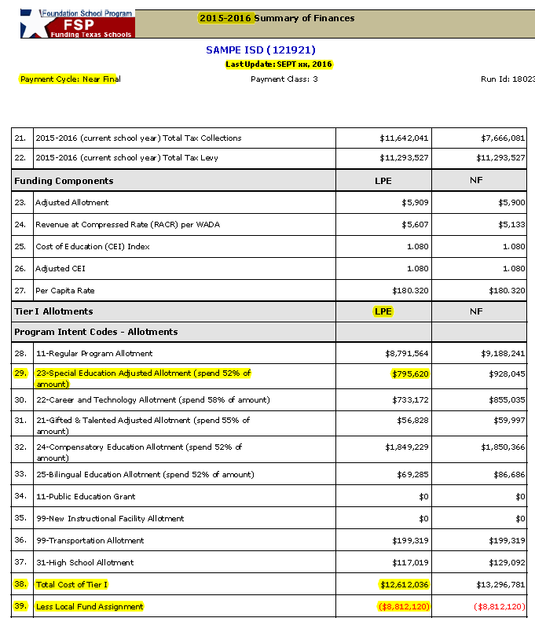
Example Calculation Tool Completed
Compliance Review School Year Information Page 3

Slide 36
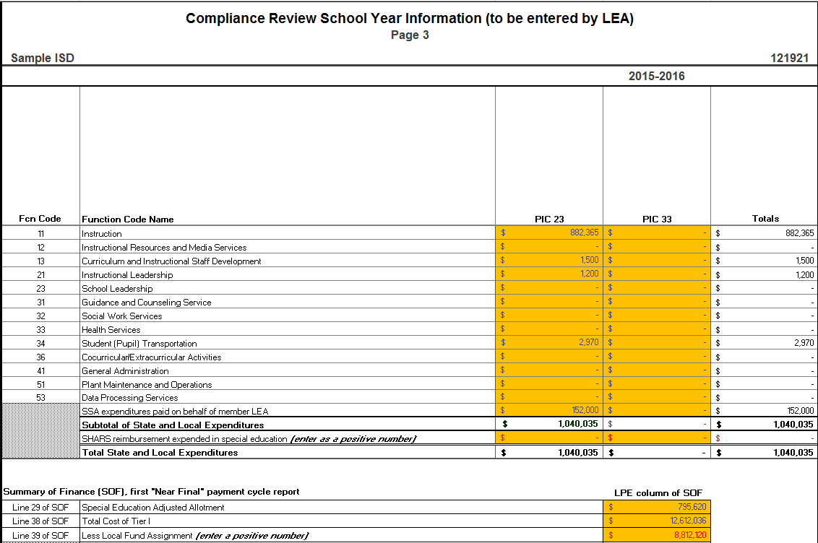
Example Calculation Tool Completed
Expenditures
SSA on behalf
SHARS
SOF

Slide 37
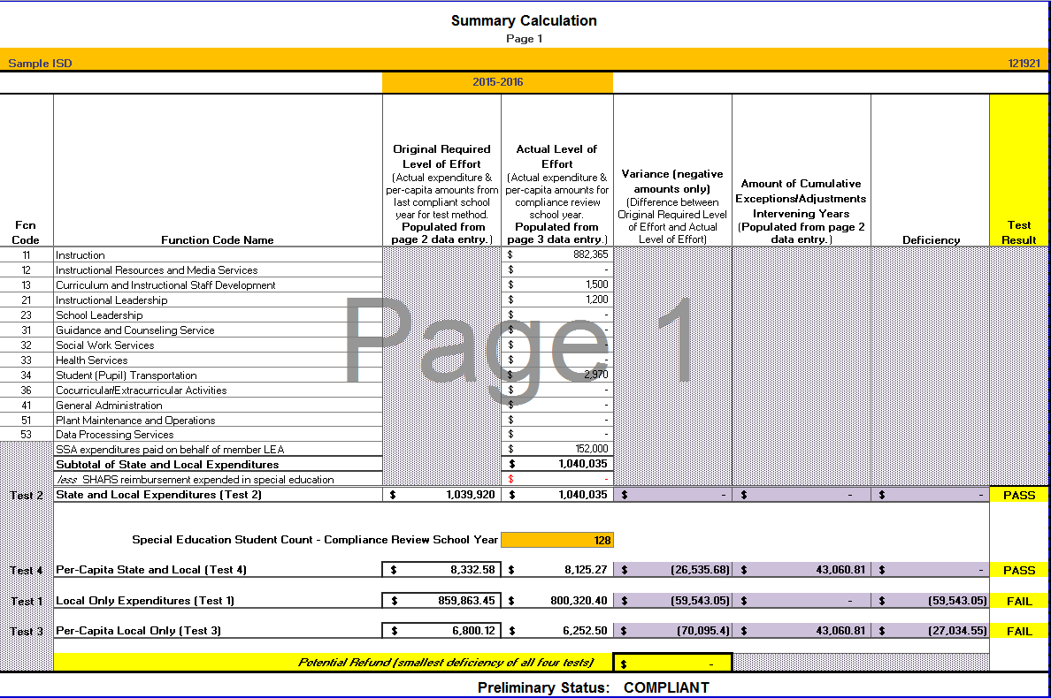
Example Calculation Tool Completed

Slide 38
Example Alternate Calculation Tool – Charter Schools Only

Slide 39
Summary
Revised tools are available on the IDEA-B LEA MOE webpage for use by LEAs to perform their own IDEA-B LEA MOE calculations:
IDEA-B LEA MOE Calculation Tool –
for school districts, and
Alternate IDEA-B LEA MOE Calculation Tool – for charter schools that use Fund Code 199 for local only.
LEA results should be compared to TEA’s preliminary IDEA-B LEA MOE compliance reviews in the spring.

Slide 40
Contact and Resource Information
Federal Fiscal Compliance and Reporting Division
Compliance@tea.texas.gov
Phone: 512-463-9127
IDEA-B LEA MOE webpage

