Slide 1
Residential Facility Monitoring
Informal Workgroup
March 24-25, 2015

Slide 2
Purpose
Review information related to the RF monitoring system
Ensure that the agency meets its ongoing obligation to have a monitoring system that addresses the unique circumstances of students with disabilities residing in residential facilities
Advise the agency on revisions for improvements to the RF monitoring system

Slide 3
Results
Participants will gain an understanding of the purpose, history and litigation of the RF monitoring system.
Participants will provide recommendations on revisions to the RF monitoring system.

Slide 4
Roles and Responsibilities
Stakeholder Member
Texas Education Agency Staff
Serve as a stakeholder member of the group
Represent an identified perspective to the group
Participate in discussion and provide feedback related to review of information, effectiveness of proposed activities and recommendations for the future
Follow meeting guidelines
Serve as resource to the stakeholders
Follow meeting guidelines
Facilitate the process

Slide 5
Tuesday
March 24, 2015

Slide 6
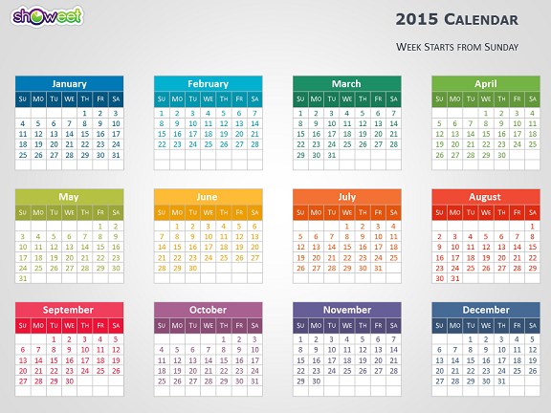
Walking Through a Year in RF Monitoring
Notes:
This morning we want to take some time to talk about the system as it is now. In the general feedback last time, some mentioned that they would like a little more background into how the system is now. Starting this afternoon and tomorrow, we will be asking the group to provide recommendations to modifying the current system and we want everyone to fully understand how it works at this time.
This morning, we will take time to walk through a year in RFM –both for the agency and for a district. Debbie Roybal is helping me with this and providing information about what her district –Denton ISD—does.

Slide 7
TEA
April | Post TAA letter to website informing district of the end of year collection for RF Tracker Special Education Monitoring TETN will review end of year collection requirements for RFT with districts and ESCs Continued on-site visits and desk reviews that include RF Continue on-site visits and desk reviews that include RFM Staff available for questions and concerns about RFM and RFT
May | Continue on-site visits and desk reviews that include RFM Staff available for questions and concerns about RFM and RFT
June | After RFT closes at midnight of June 5, TEA staff review each district in RFT to determine if end of year data has been completed Contact districts who have not completed RFT; Reopen RFT for those district needed to complete data entry Continue monitoring the completion of RFT until all districts have finished
July | Beginning running reports to determine staging Make any revision, if needed, to intervention documents or guidance documents
August | Train ESC staff on changes or revision to RFM Continue working on staging/selection
Notes:
Starting in April---right where we are almost now.

Slide 8
September | Complete staging process with development of individual district’s rubric for staging SPED Monitoring TETN reviews beginning of 2015-2016 RFM and data collection for RFT
October | Staging is posted in ISAM Staff available for questions concerning RFM and RFT
November | On-site visits and reviews of improvement plans that include RFM begin Staff available for questions concerning RFM and RFT
December | On-site visits and reviews of improvement plans that include RFM begin Staff available for questions concerning RFM and RFT
January | On-site visits and reviews of improvement plans that include RFM begin Staff available for questions concerning RFM and RFT
February | On-site visits and reviews of improvement plans that include RFM begin Staff available for questions concerning RFM and RFT
March | On-site visits and reviews of improvement plans that include RFM begin Staff available for questions concerning RFM and RFT

Slide 9
A District’s Yearly Walk
Through RF Monitoring

Slide 10
Staging Process
Students who reside in the RF for less than 30 days are not counting in calculation
District with less than 6 students who contribute to the calculations are not staged.
****************
For 2014-2015 Staging
Calculations are obtained from RF Tracker on 3 indicators used
% of students in settings of 01, 02, 30, 43, 44, 84, 85, 94, 95, 96
% of RF students receiving a full school day
% of RF students receiving less than half school day
Categorized district:
1= All facilities served by the district met the definition/students prevented from leaving
2= None of facilities served by district met the definition/students NOT prevented from leaving
3=Had both types of facilities
Notes:
Also want everyone to understand how we have been selecting districts for the selection / staging process.
Under the consent decree, 30 districts per year were selected for on-site reviews. The selection of these visits was calculated completely by RF Tracker. Performance indicators that contributed to the selection were: LRE, commen day, ESY, related services, certified/qualified staff, participation in state assessment (TAKS)
All data collection relevant to the performance indicators and subindications were used to rank RF districts. Ranking was based upon a 10 point weighting system that assigned 4 points to LRE and 1.2 to 2 points to each other performance indicator.
RFT ranked districts by the total points earned. The 30 districts with the least points were selected. (If we had already gone on a performance visit in the prior year, that district was skipped and moved up).
Talk about now—In an attempt to align RFM with PBM went to a staging system. Have had this for 3 year. The selection has been one of the most continuous things about RF for past 3 years. In response to districts suggestion, some changes were made this year.

Slide 11
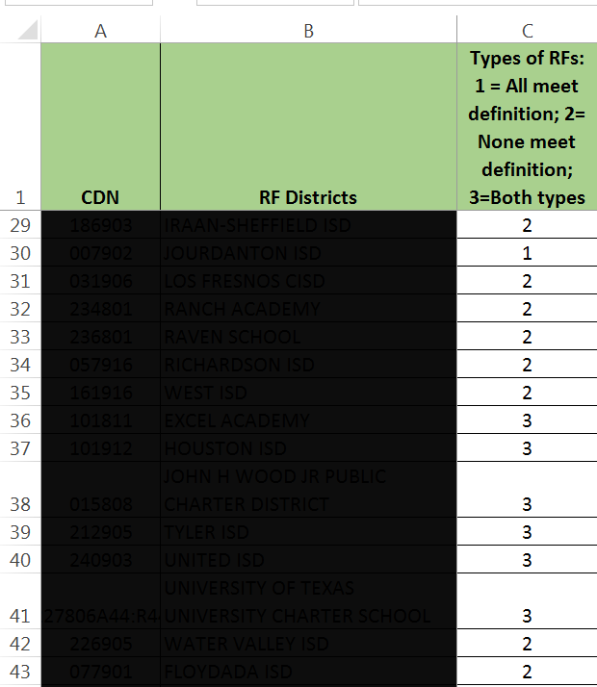
Notes:
Started by dividing RF districts into 3 categorizes—based on facilities within districts.

Slide 12
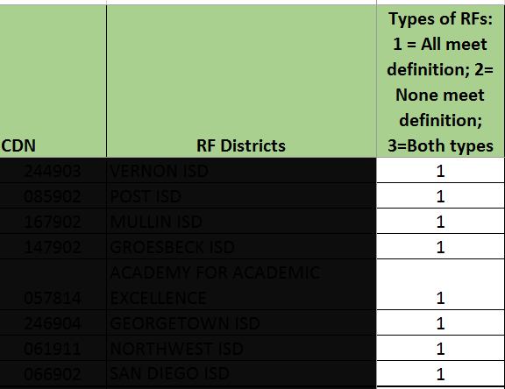
Districts who only
had RFs that
prevented students
from leaving were
put into a pool for
cyclical monitoring.

Slide 13
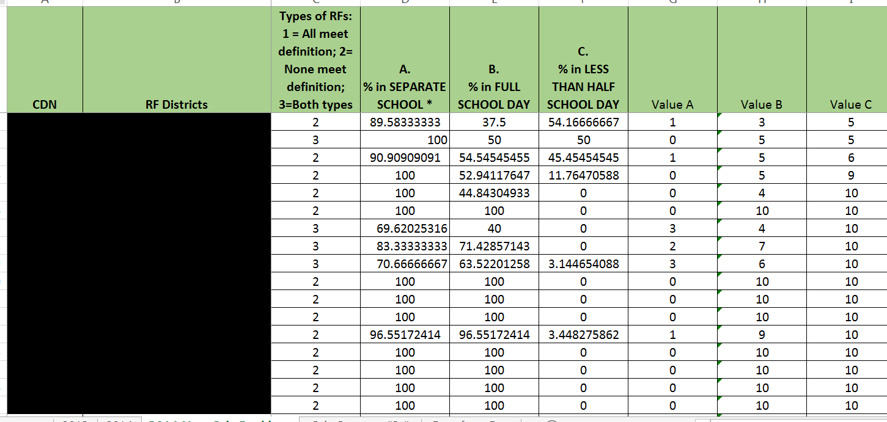
Notes:
Only used 3 calculations from RFT this year.
Converted to value scores because for indicators A and C, the ideal calculation for these would be a low number.

Slide 14
Conversion of RFT Calculations to Value Points
For indicators A and C
For indicator B
99-100% = 0 points
greater than 89, but less than 99 = 1
greater than 79, but less than 89 = 2
greater than 69, but less than 79 = 3
greater than 59, but less than 69 = 4
greater than 49, but less than 59 = 5
greater than 39, but less than 49 = 6
greater than 29, but less than 39 = 7
greater than 19, but less than 29 = 8
greater than 9, but less than 19 = 9
less than 9 = 10
99-100% = 10 points
greater than 89, but less than 99 = 9
greater than 79, but less than 89 = 8
greater than 69, but less than 79 = 7
greater than 59, but less than 69 = 6
greater than 49, but less than 59 = 5
greater than 39, but less than 49 = 4
greater than 29, but less than 39 = 3
greater than 19, but less than 29 = 2
greater than 9, but less than 19 = 1
less than 9 = 0
Notes:
For indicator B, the ideal calculation would be a high number.
Therefore, the higher the value points, the better a district was performing.

Slide 15
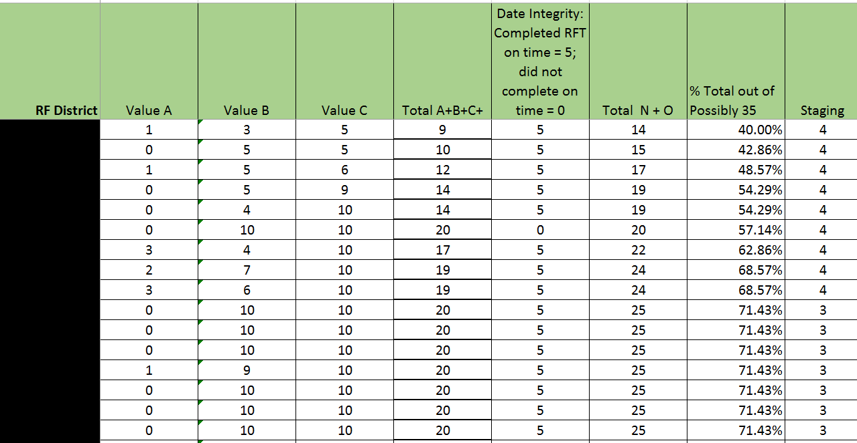
Notes:
Value A, B, and C were added. A data integrity value was given. If district completed RFT last June on time, the district received 5 points. If not, the district did not receive any points.
The total value points + data integrity points divided by 35 (the highest possible points available) = districts’ percentage points.

Slide 16
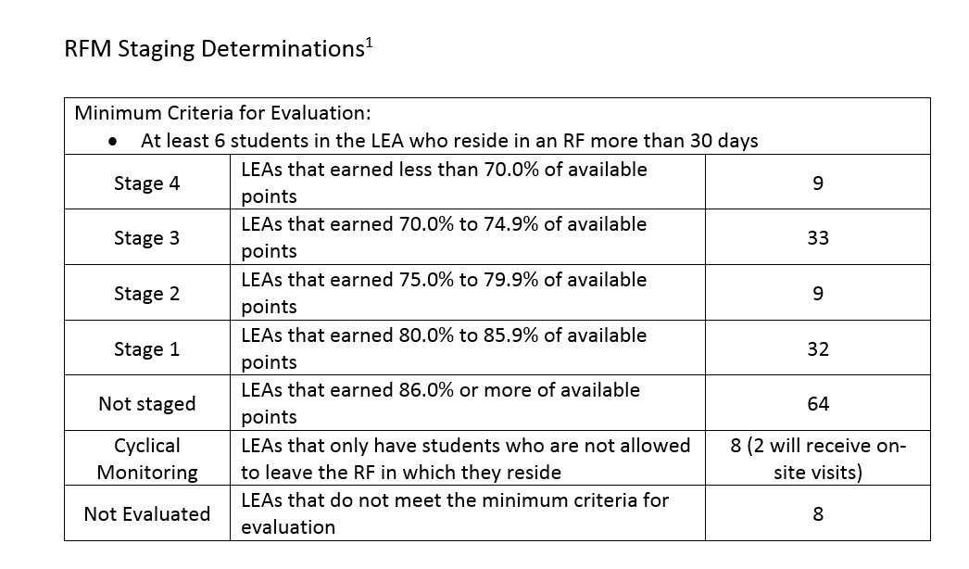
Notes:
163 districts had more than 5 students who met the 30 day filter.
Breakdown of districts staged this year

Slide 17
Notes:
Questions?
Depending on time---lunch or guiding principals
Lunch---1 ½ hours places available

Slide 18
Guiding Principals

Slide 19
How Do We Build a
Monitoring System
to Effectively Measure The Characteristics of an Appropriate Education for Students with Disabilities Residing in RFs?
Types of Facilities
Indicators
Data System
Selection Criteria
Interventions
Notes:
Last time discussed what areas under the umbrella of RFM we wanted this group to discuss and make recommendations to the agency concerning.

Slide 20
How Do We Build a
Monitoring System
To effectively measure the characteristics
of students with disabilities residing in RFs?
Types of Facilities
Data Systems
Notes:
What we discussed last meeting
By the next meeting, will work with the other agencies in attendance and try to give a definition to each type of facilities. Will be one of the topics discussed in April
But today, we want to talk further about data systems

Slide 21
How Do We Build a
Monitoring System
to effectively measure the characteristics of an appropriate education for students with disabilities residing in RFs?
Data Systems
PEIMS vs RF Tracker
Notes:
At this time the systems available to us are PEIMS and RF Tracker
You generated pros and cons for each and we will look at those again shortly.
Down the road, there may be an opportunity to create a totally different system from PEIMS and RF Tracker, but due to resources at this time, we must use one of these to collect data concerning RF students and RF facilities.

Slide 22
RF Tracker
Through the consent decree, TEA was tasked with developing a separate data collection system for RF students to be completed by January 31, 2006.
The data collection system was used to :
Identify all school districts, including charter schools, serving RF students;
Identify all RF districts in which any RF students were educated at the RF facility;
Identify all RF district in which any RF students were educated in school district settings with only other RF students; and
Categorize all RF districts by size of RF population (small= less than 30 RF students; medium= 31-80 RF students; large= more than 80 RF students). Was used in the selection process for RF districts to receive on-site visits
Notes:
I want to begin this discussion with talking about RF Tracker.

Slide 23
RF Tracker
The consent decree included indicators and sub-indicators that would be used to measure a district’s performance.
The indicators were:
Least restrictive environment
Commensurate school day
ESY services
Certified and qualified staff
Rate of Participation in State Assessment (TAKS)
Related Services

Slide 24
LRE
% RF students in “separate school” settings (e.g., separate campus or RF setting)
% RF students in hospital, homebound, and state school setting
% RF students in self-contained classes
# RF students moved to more restrictive settings during the school year
# RF students moved to less restrictive settings during the school year
Commensurate School Day
# minutes in district’s school day for non-disabled, full-time students
# minutes in the school day for each RF student
% and # RF students receiving a full school day
% and # RF students receiving more than a half school day, but less than a full school day
% and# RF students receiving less than half of the full school day
Notes:
All of these subindicators contributed to calculations from RFT to rank districts under the consent decree.
Now we only utilize the ones in bright green.

Slide 25
ESY Services
% and # RF students receiving ESY services
% and # RF students receiving more than 8 weeks of ESY services
% and # RF students receiving between 6 and 8 weeks of ESY services
% and # RF students receiving ESY services 4-5 days per week
% and # RF students receiving ESY services 3 days per week
% and # RF students receiving ESY services less than 3 days per week
% and # RF students receiving ESY services more than 3 contact hours per day
% and # RF students receiving ESY services less than 3 contact hours per day
% and # RF students receiving ESY instruction and related services
% and # RF students receiving ESY instruction only
% and # RF students receiving ESY related services only
% and # RF students receiving ESY services in “separate school” setting
% and # RF students receiving ESY services in hospital, homebound, and state school settings
% and # RF students receiving ESY services in self-contained classes

Slide 26
Certified and qualified staff
# and % of teachers, paraprofessionals, and related services personnel providing instructional and/or related services to RF student either in local school district or at the RF, who are considered highly qualified, certified, and/or licensed in accordance with NCLB, IDEA, and applicable state licensing and certification requirements
Participation in TAKS (This information was collected from PEIMS)
% and # RF students taking TAKS compared to % and # of non-RF students receiving special education services taking TAKS
% and # RF students by disability category taking TAKS compared to % and # of non-RF students receiving special education services taking TAKS

Slide 27
Related Services
# RF students with orthopedic disabilities, other health impairments, or multiple disabilities
# RF students receiving direct physical and/or occupational therapy services
# minutes per day of direct physical and/or occupational therapy
# RF students with speech/language disabilities
# RF students receiving direct speech therapy
# of minutes per week of direct speech therapy
# RF students with emotional/behavioral disabilities, autism, and traumatic brain injury
# RF students receiving direct social work services, psychological services, or school counseling services
# of minutes per week of direct social work services, psychological services, or school counseling services
Total # of students with orthopedic disabilities, other health impairments, or multiple disabilities compared to the number of full time equivalent physical therapists and number of FTE occupational therapists, whether employed or contracted
Total # of students with speech/language disabilities compared to the number of FTE speech therapists, whether employed or contracted.

Slide 28
Implications of sub-indicators
More information was collected in RF Tracker
District Maintenance page included the number of FTEs for OTs, PTs, STs
Information about certified/qualified teachers
ESY information that included the type of services and the time
Related services information concerning the amount of time for each DIRECT related service
More of RF Tracker data used in calculations for selection of districts

Slide 29
Revisions to RF Tracker Calculations and Data
As results of agreements with plaintiffs during the consent decree
As results of what we saw during a visit vs what was reflected in RFT
As a results of expiration of the consent decree with adopting rule TAC §97.1072

Slide 30
Things to Remember About RFT
Collects some data that is not collected in any other agency system
Facility where student resides
Identifies facilities in each district and whether students are prevented from leaving or not
Students who have surrogate parents
Length of individual student’s school day
Does not require district to enter data into a system each time an element changes. Collects student data only at 2 times--
At the beginning of the year or when student enters the RF
At the time student leaves the RF or as of date for end of year collection
Information that affects selection for interventions is withdrawal/end of year data.

Slide 31
RF Tracker
Retains each year’s data so district can access past years of data, if needed
Uses the student’s social security number to access the student in PEIMS--- the most precise way to make sure the district has gotten the right “John Smith”. Social security number is now masked, with only the last 4 digits seen.
Information collected throughout the 9 years of RFM implementation has been streamlined
System produces reports of student data
Access to data is immediate
Selection for interventions for the year is dependent on student information that was collected the previous year.
Can make changes more easily because we own the system

Slide 32
What would RF Monitoring look like if RF Tracker is not utilized?
Would not have data on current students
Would not be able to collect the data that no other agency system collects
Selection for interventions would be based on data from 2 years past;
Would not be able to track the movement of students from setting to setting and other changes for RF students
Making changes to the system would be more difficult and a longer process--- the decision to make the changes could be rejected

Slide 33
Recommendation Needed:
Should RF Tracker continue to be used to collect data concerning RF students and facilities?

Slide 34
Pros and Cons of PEIMS and RF Tracker

Slide 35
Activity---Is more data needed in RF Tracker?
Choose a member of the group to be the scribe.
In your group, discuss what changes are needed to RF Tracker if we continue to use it .
Record recommendations on chart tablet
Each group will report out. TEA may ask clarifying questions to understand exactly what is recommended.

Slide 36
If some or all of these changes can be incorporated into RF Tracker, should it be used to collect data for RF Monitoring?

Slide 37
Characteristics of an Appropriate Education for Students with Disabilities Residing in an RF
Homework Assignment:
Take the handout with you tonight. Read and study.
Begin thinking about how effective special education programs demonstrate implementation of these characteristics?

Slide 38
Questions and Reflections

Slide 39
Wednesday
March 25, 2015

Slide 41
What do we monitor routinely?
Health---check blood pressure, temperature, have well
checks, run tests, check weight, etc.
Condition of your car---check tire pressure,
change filters, run diagnostician tests, etc
Finances---bank account, stocks, 401K/retirement
plans, etc
Concrete indicators that can be observe, provide evidence, measured, etc.

Slide 42
We’ve determined the pieces or characteristics of
an appropriate education for RF students.

Slide 43
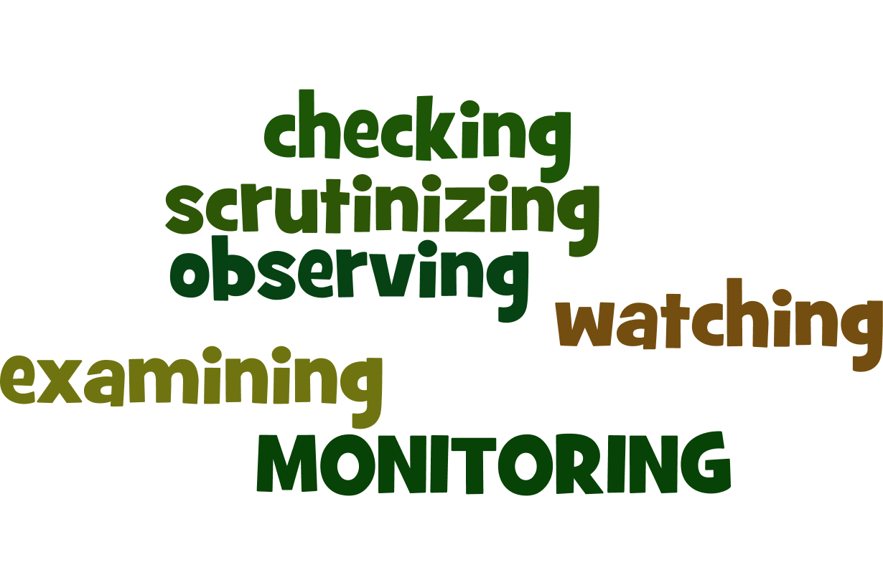
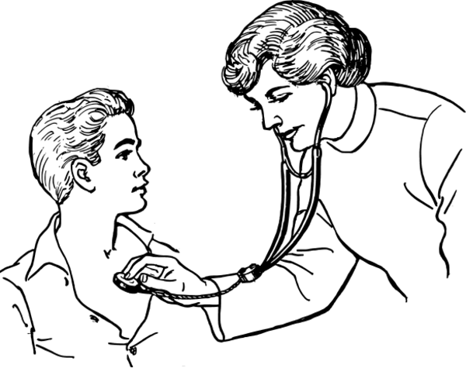
Now how will we monitor these pieces to determine if students are receiving that appropriate education? What will those concrete indicators be? “observable, measurable, provides evidence”

Slide 44
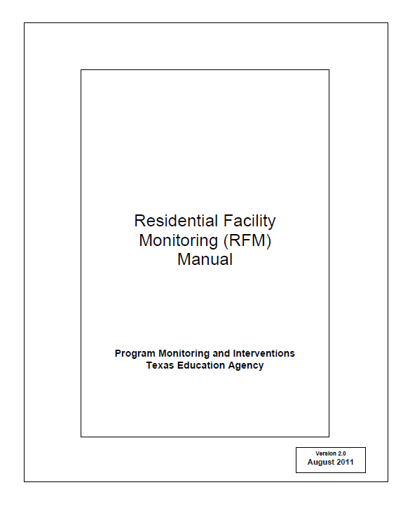
How do we monitor these characteristics under the current system?

Slide 45
Group Activity
Brainstorm what other ways we can monitor the implementation of these characteristics?
Record recommendations on chart tablet.
Each group will report out. TEA
will ask clarifying questions,
if needed.

Slide 46
How Do We Build a
Monitoring System
to effectively measure the characteristics of an appropriate education for students with disabilities residing in RFs?
Indicators
Reviewed what indicators RFM currently uses; then brainstormed what other ways could used to determine if students receiving FAPE
Data Systems
Looked at RF Tracker and made recommendations on other information could be added
Selection Criteria

Slide 47
Changes to Selection Criteria for 2014
Categorized districts by facilities:
Only have facilities that prevent students from leaving
Only have facilities that DO NOT prevent students from leaving
Have both types of facilities
For district that have only facilities that prevent students from leaving, the districts were moved to a cyclical monitoring system.
Added values to RFT calculations because the desired % of students in a full day should be a large number while students served in more restrictive environment and % of students with less than ½ school day should be small number
Did not include RFT calculations for related services
Removed the factors for having a new facility and continuing noncompliance

Slide 49
Districts who only
had RFs that
prevented students
from leaving were
put into a pool for
cyclical monitoring.

Slide 51
Conversion of RFT Calculations to Value Points
For indicators A and C
For indicator B
99-100% = 0 points
greater than 89, but less than 99 = 1
greater than 79, but less than 89 = 2
greater than 69, but less than 79 = 3
greater than 59, but less than 69 = 4
greater than 49, but less than 59 = 5
greater than 39, but less than 49 = 6
greater than 29, but less than 39 = 7
greater than 19, but less than 29 = 8
greater than 9, but less than 19 = 9
less than 9 = 10
99-100% = 10 points
greater than 89, but less than 99 = 9
greater than 79, but less than 89 = 8
greater than 69, but less than 79 = 7
greater than 59, but less than 69 = 6
greater than 49, but less than 59 = 5
greater than 39, but less than 49 = 4
greater than 29, but less than 39 = 3
greater than 19, but less than 29 = 2
greater than 9, but less than 19 = 1
less than 9 = 0

Slide 54
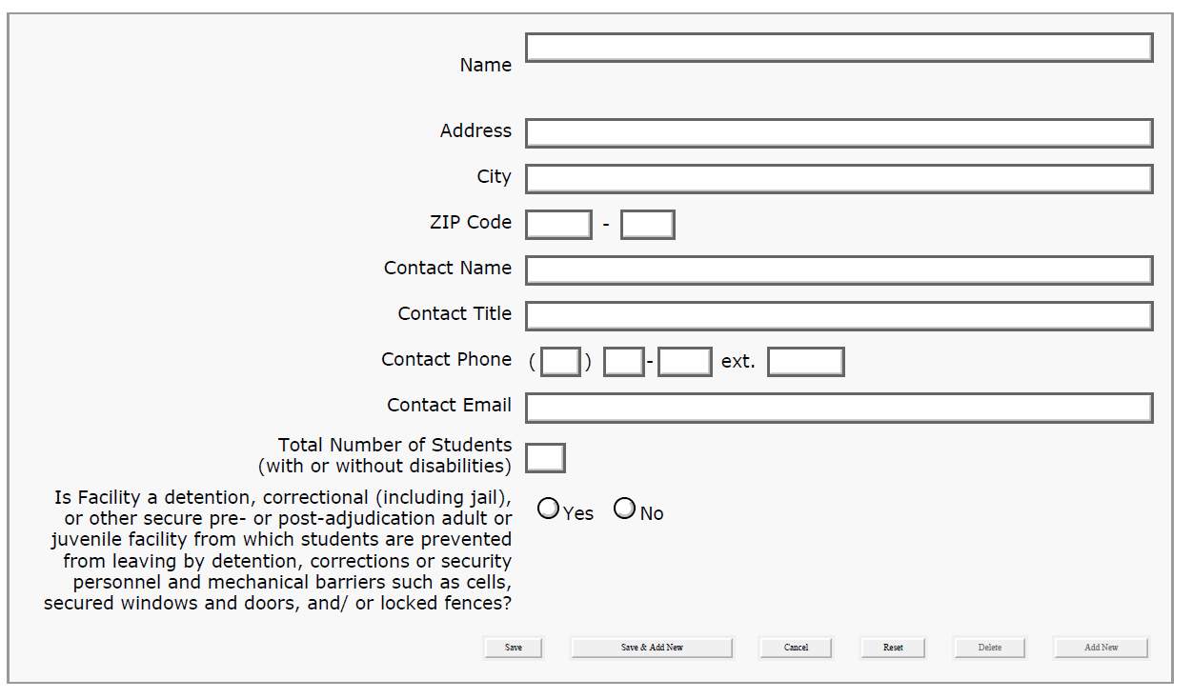
RFT Facility Information

Slide 55
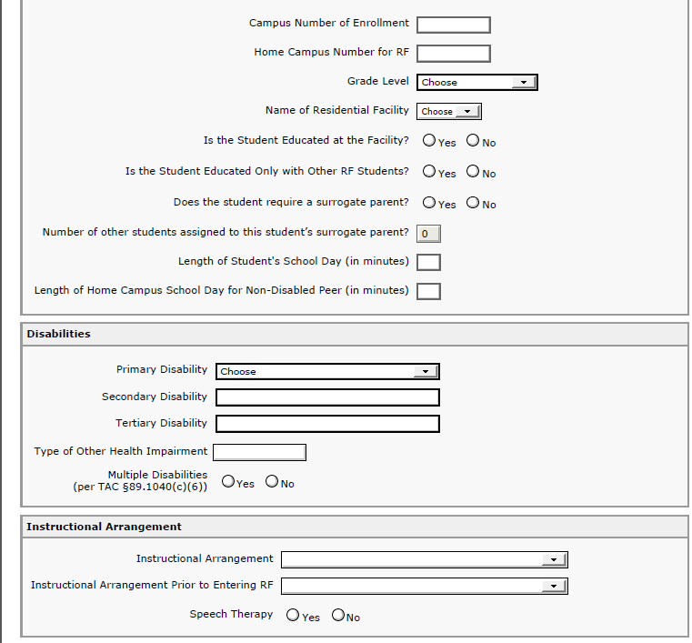
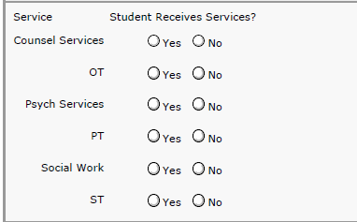
Student Data

Slide 56
Homework
Thinking about what has been recommended as changes to RFT and how the selection criteria was changed for 2014
Make recommendations concerning what changes in the selection criteria do you recommend?
Mail the handout in the attached envelope to the agency or send your response by email by April 1.

Slide 57
Reminders
Complete your vouchers and return in the other enclosed envelope. See Melissa’s checklist so that you can be repaid asap!
Next meeting is April 29 and 30. We would like to have 2 full days for this meeting. Plan to be back at ESC 13 at 10:00 on the 29th and stay until 5:00 on the 30th.
We appreciate you making the commitment and taking your valuable time in helping us with this endeavor!

Slide 58
Questions
and
Reflections

