Slide 1
Residential Facility Monitoring
Informal Workgroup
February 4, 2015

Slide 2
Purpose
Review information related to the RF monitoring system
Ensure that the agency meets its ongoing obligation to have a monitoring system that addresses the unique circumstances of students with disabilities residing in residential facilities
Advise the agency on revisions for improvements to the RF monitoring system

Slide 3
Results
Participants will gain an understanding of the purpose, history and litigation of the RF monitoring system.
Participants will provide recommendations on revisions to the RF monitoring system.

Slide 4
Roles and Responsibilities
Stakeholder Member
Texas Education Agency
Serve as a stakeholder member of the group
Represent an identified perspective to the group
Participate in discussion and provide feedback related to review of information, effectiveness of proposed activities and recommendations for the future
Follow meeting guidelines
Serve as resource to the stakeholders
Follow meeting guidelines
Facilitate the process

Slide 5
Meeting Guidelines
Listen to each other with respect
Respect the diversity in the group
One person speaks at a time
Brevity, please!
Be open and honest
Observe confidentiality
Work hard toward the goal
Please set cell phones o vibrate or turn off

Slide 6
RF Monitoring

Slide 7
How Did We Get Here?

Slide 8
21 Years, 1 Month, and 23 Days Ago…

Slide 11
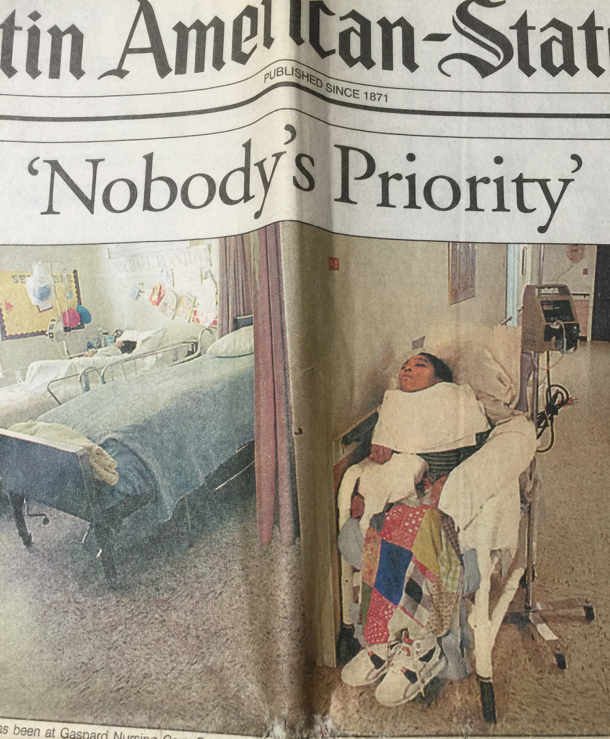

Slide 12
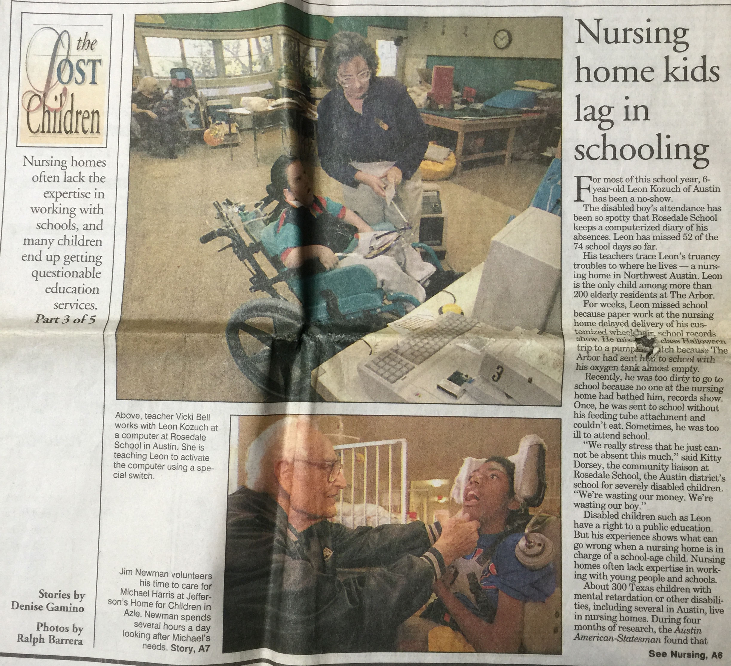

Slide 13
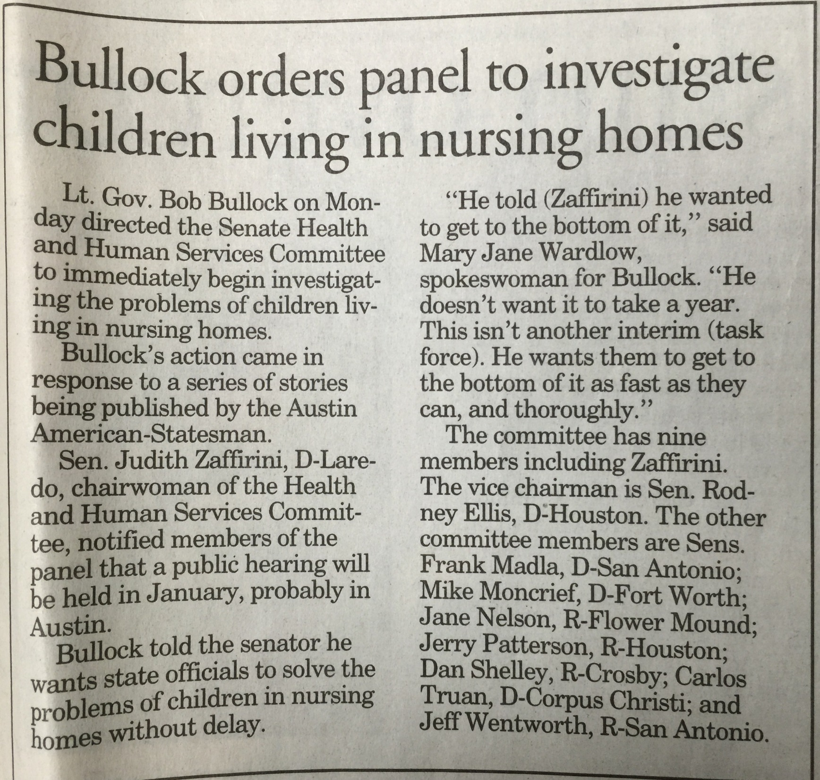

Slide 14
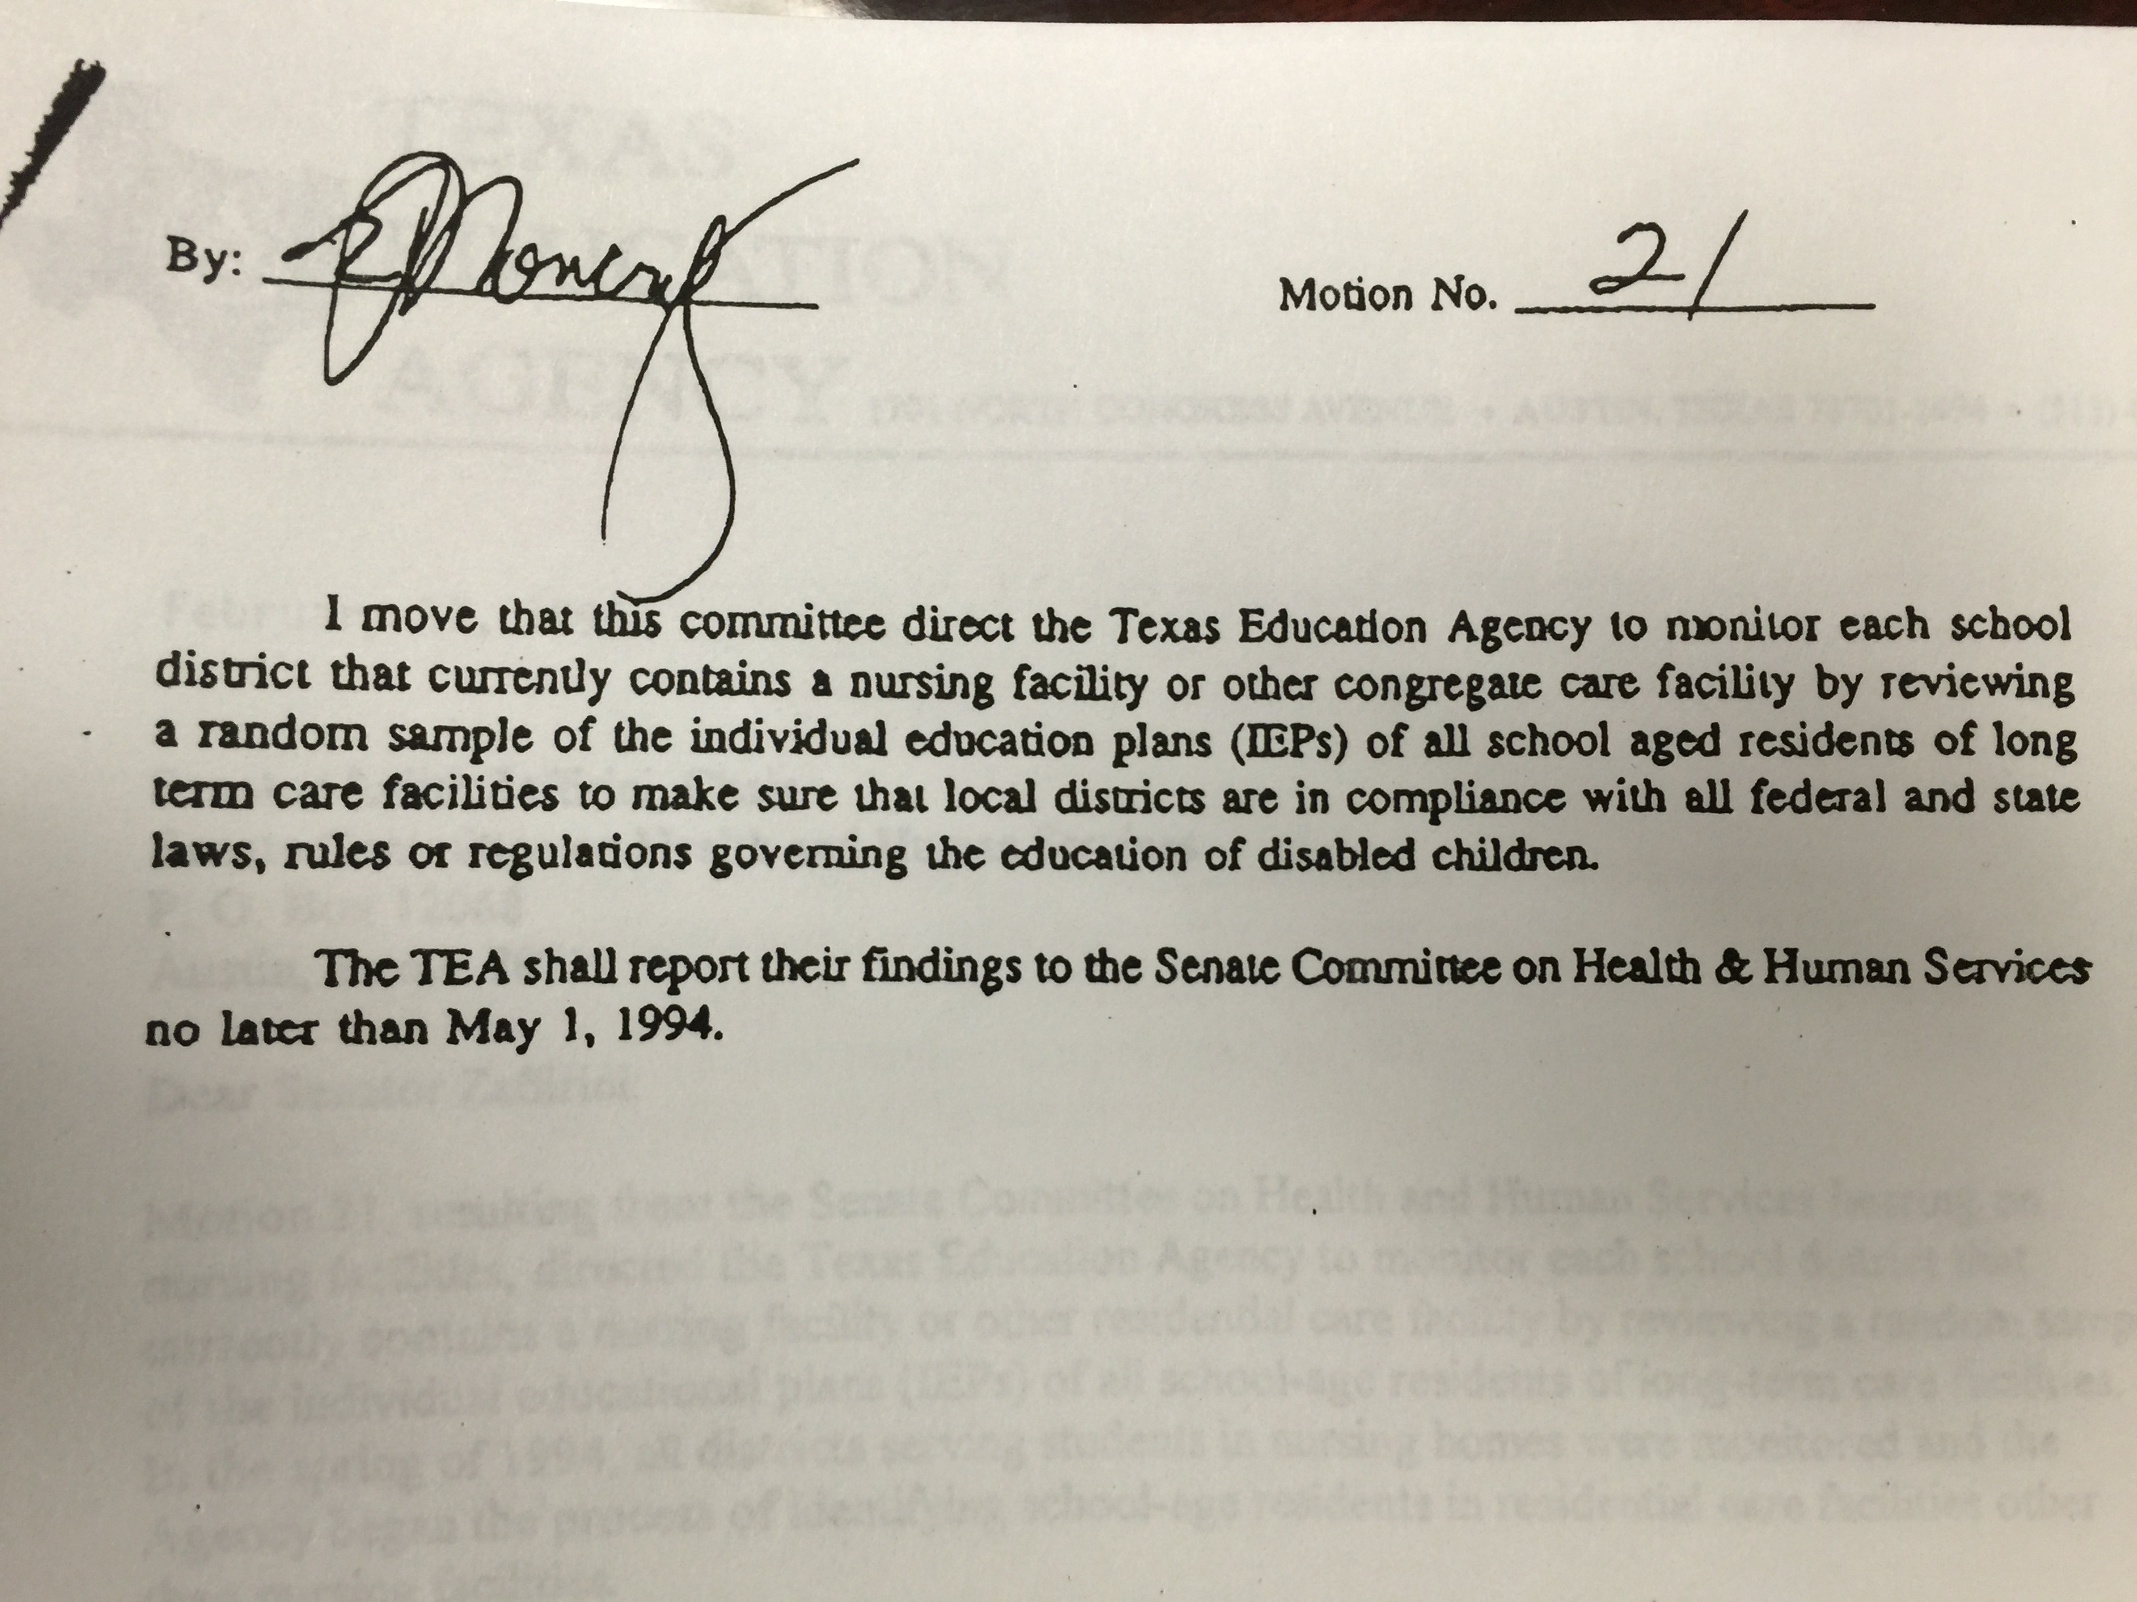

Slide 15
59
March-April 1994
203
Dec-Dec
1994-95

Slide 16
January 24, 1994

Slide 17
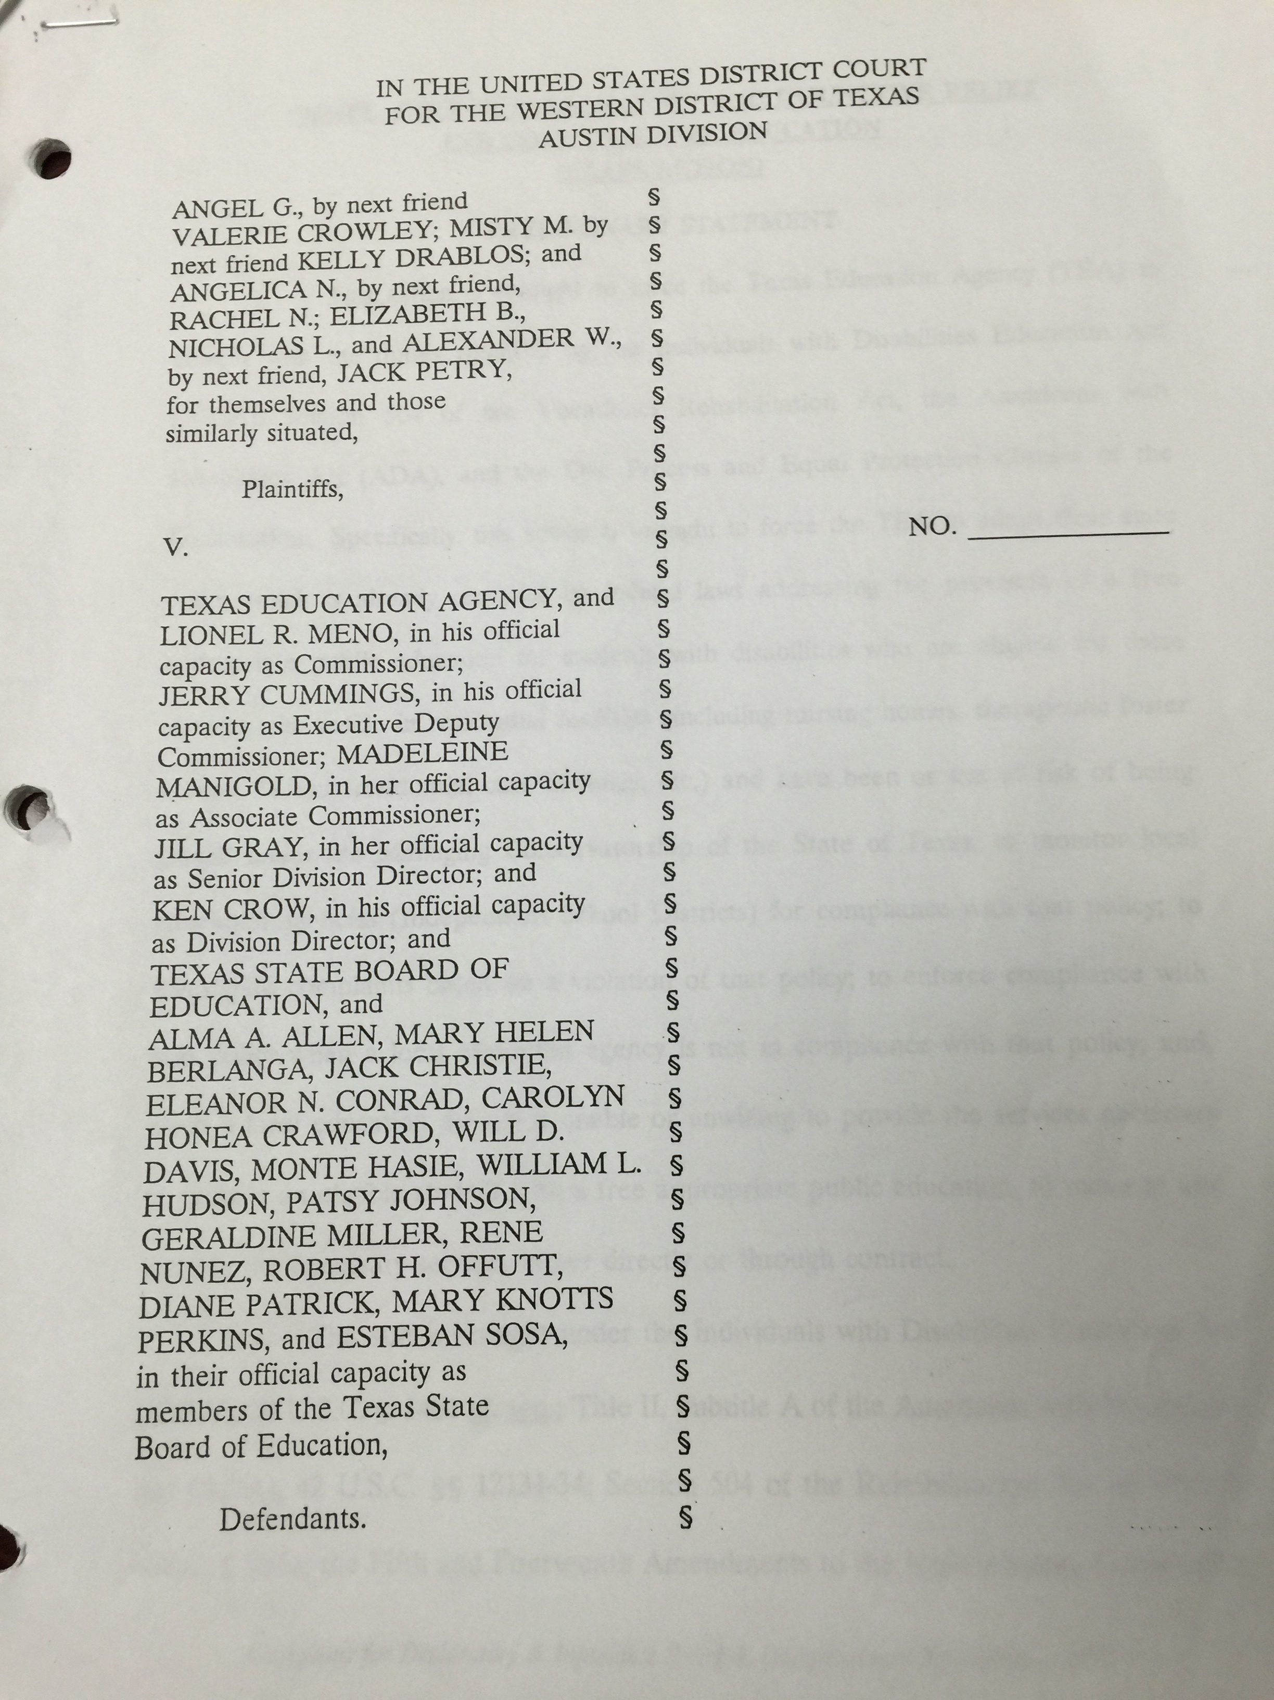

Slide 18
8 Days in
June 2000

Slide 19
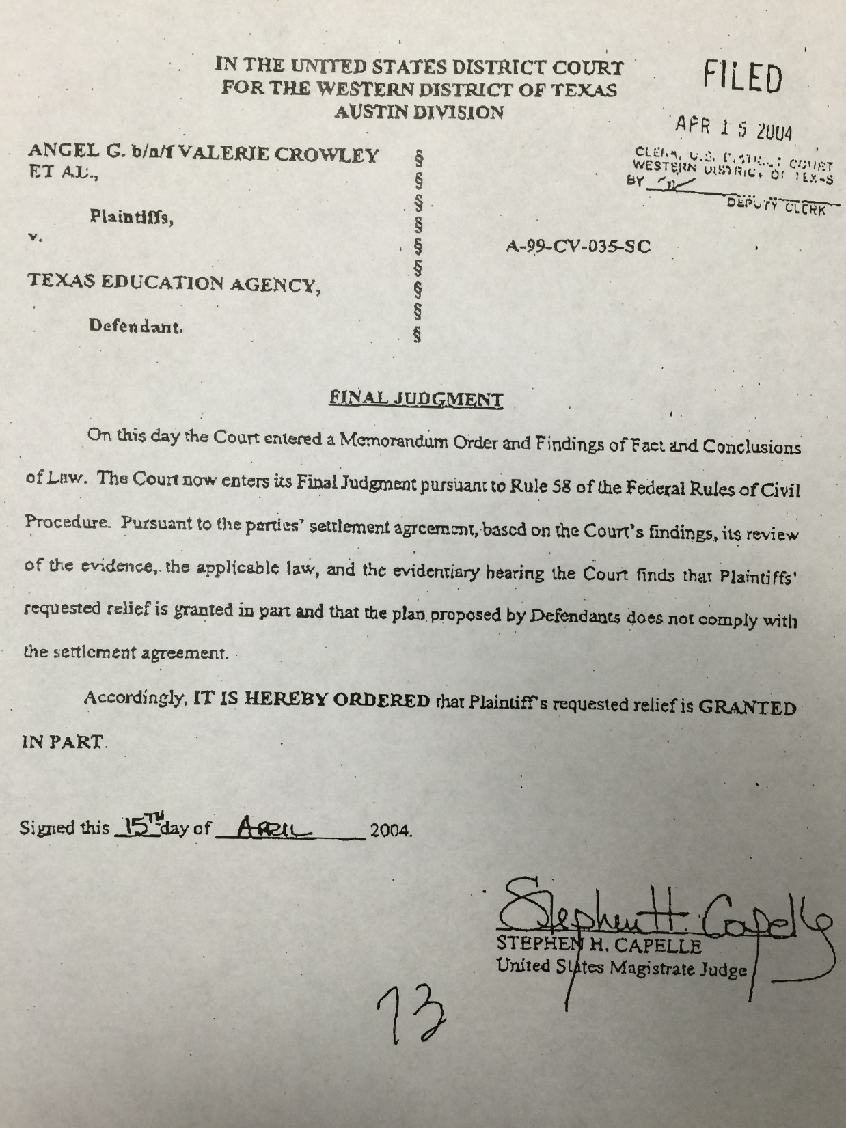

Slide 20
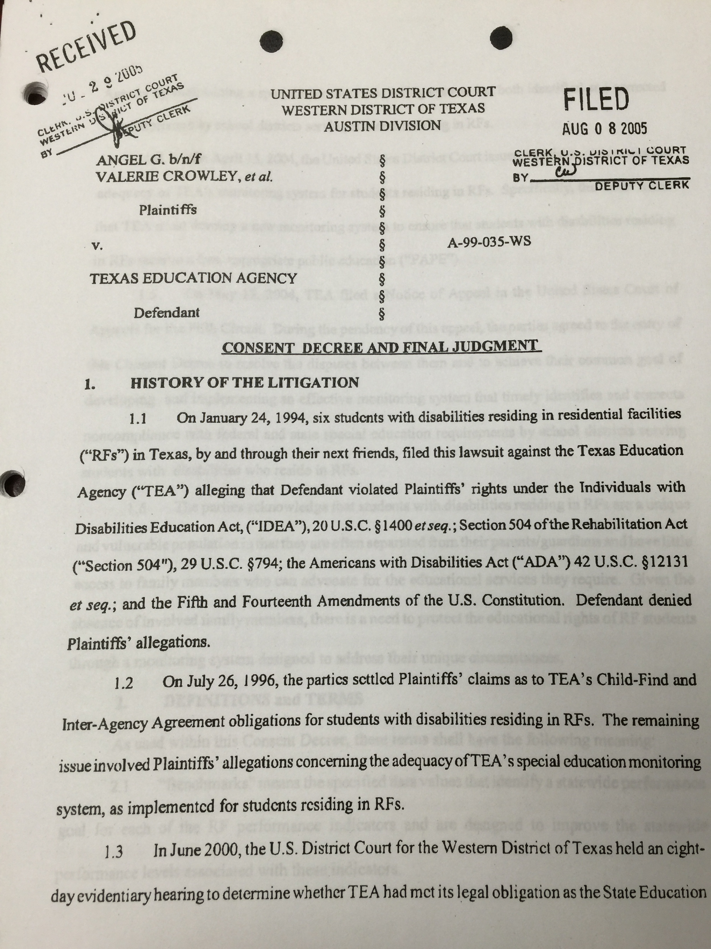

Slide 21
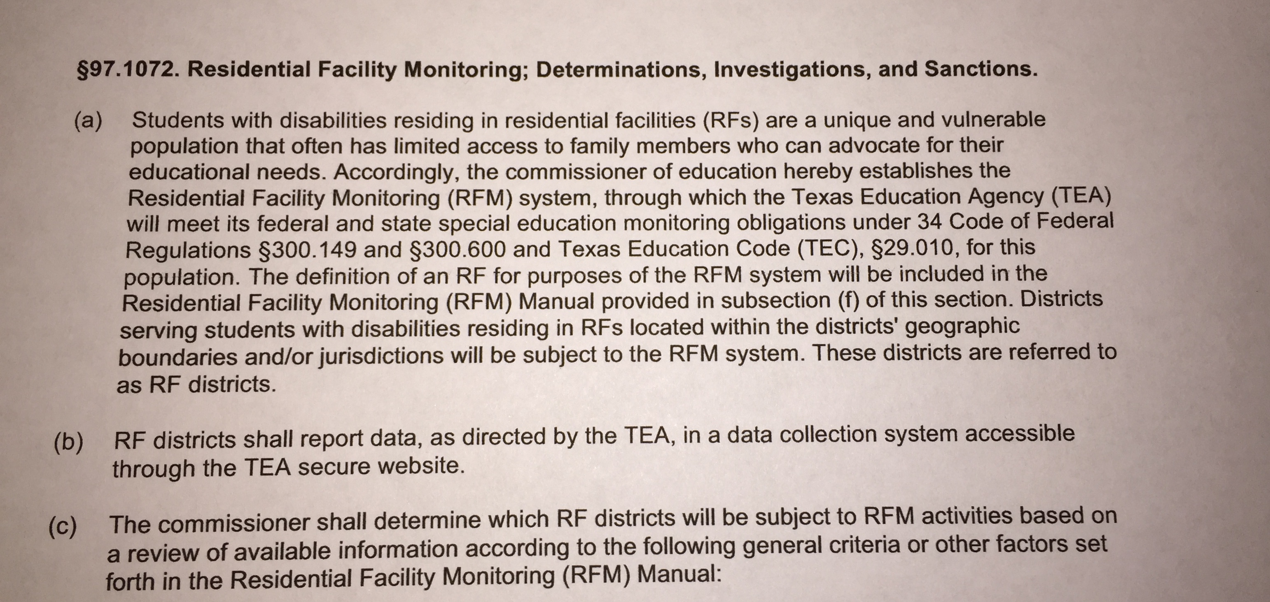

Slide 22
2005 – 2010
2011 – 2015

Slide 23
83rd Legislative Regular Session

Slide 25
Rider 70 Report - Recommendation #12

Slide 26
Rider 70 Report - Other Considerations #4

Slide 27
Wednesday, February 4, 2015

Slide 28
Perspective of Plaintiffs
Advocacy, Inc.
Southern Disability Law Center

Slide 30
Lessons Learned From RF Monitoring
2006-2014

Slide 31
2014-2015 RF Tracker Counts as of 1/29/2015
# of Students with Disabilities | 6,419
# of Districts Serving RF Students | 241
# RFs Serving Students with Disabilities Currently | 1180
# RFs Without Current Students with Disabilities | 369

Slide 32
During Consent Decree
(2006-2011)
117 on-site reviews to 100 different districts
Types of visits:
Performance
Data validation
Corrective Action Reviews
To districts currently implementing corrective action plans
To districts who had corrected noncompliance to verify compliance had been sustained
Post Consent Decree
(2011-present)
45 on-site reviews to 45 districts;
234 districts involved with integrated
interventions which included RFM
Types of interventions
Stage 1—self-evaluation on 4 investigatory topics; development of improvement plan
Stage 2—self-evaluation on 8 investigatory topics; development of improvement plan
Stage 3– self-evaluation on 13 investigatory topics; development of development of improvement plan
Stage 4—on-site reviews

Slide 33
Investigatory Topics
Properly Constituted Admission, Review, and Dismissal (ARD) Committees
Surrogate Parents and Foster Parents
Current Evaluations
Individualized Education Program (IEP) Implementation
Least Restrictive Environment (LRE)
Educational Benefit
Certified/Qualified Staff
Commensurate School Day
Related Services
Behavior/Discipline
Transition
Extended School Year (ESY) Services
Participation in State Assessments

Slide 34
4 investigatory topics that were cited most often as systemic issues
Surrogate parent
Least restrictive environment
Certified/qualified staff
Commensurate school day

Slide 35
Properly Constituted Admission, Review, and Dismissal Committees Findings Cited the Most
RF staff signing as parent
Parents not in attendance and no evidence of attempts to obtain parent participation
Adult student not invited and not in attendance
No regular education teacher in attendance
No Career and Technical Education representative
No Language Proficiency Advisory Committee representative

Slide 36
★ Surrogate Parents and Foster Parents Findings Cited the Most 
Surrogate parent did not meet qualifications for serving as surrogate parent.
Surrogate parent needed, but RF staff served as surrogate parent.
Student had parent, but surrogate parent assigned.
Surrogate parents or foster parents not trained within 90 day timeline.
Lack of documentation that surrogate parents were fulfilling all duties.
Foster parent served as parent before the student resided in home at least 60 days.

Slide 37
Current Evaluation
Evaluation not conducted within timeline set by ARD committee
Evaluations older than 3 years
Review of existing data conducted without data from a full, individual evaluation
Evaluations being accepted from previous local education agency that had conflicting information, not signed by evaluators, and/or not addressing all required components
Eligibility discontinued without evaluation

Slide 38
Individualized Education Program (IEP) Implementation
Class schedule not matching IEP schedule of services
Teachers not being provided with relevant portions of the IEP
IEP says the general education and the special education teacher will provide service, but no evidence that the special education teacher provided any service
No present levels of academic achievement and functional performance statements
No measurable goals
Frequency/duration/location not provided for inclusion support or content mastery
Frequency/duration not clearly stated

Slide 39
★ Least Restrictive Environment (LRE) 
RF students not considered for placement at general education campus
No individual justification for placement in a more restrictive environment

Slide 40
Educational Benefit
Services not provided in timely manner
Students failing without ARD committee reviewing/revising IEP

Slide 41
★ Certified/Qualified Staff 
General education teacher not certified in area of assignment
Special education teacher not certified in special education
Special education teacher who is teaching a subject area not highly qualified in that area
Teachers serving in dual roles of general and special education simultaneously.

Slide 42
★ Commensurate School Day 
No individual student justification for a shortened day
Day lengthened by RF staff teaching a class

Slide 43
Related Services
No evidence that related service was provided
Evidence that related service was not provided as written in IEP (less time, more time)
No measurable goals for related services
Related services not provided as recommended in evaluation and no justification provided
Dropping related services that were provided in previous district and no justification for dropping and/or changing the service

Slide 44
Behavior/Discipline
Student had behavioral intervention plan (BIP) in previous district but was dropped without justification
Not reporting disciplinary removals in Public Education Information Management System (PEIMS)
Removals which constitute change in placement made without conducting manifestation determination review (MDR)

Slide 45
Transition
No measurable postsecondary goals
No evidence of parental input into the transition process
No evidence of student input into the transition process
Not all required areas addressed
No outside agency considered and/or invited

Slide 46
Extended School Year (ESY) Services
District does not have a system for collecting regression/recoupment data to determine ESY services
ESY services indicate a pattern of services—decisions not made on individual basis
No goals designated for ESY services
No frequency/duration for ESY services
No RF student was considered for and/or received ESY services

Slide 47
Participation in State Assessment
Student given the accommodated assessment with no accommodations for the assessment listed in the IEP
Student given the accommodated assessment with accommodations that are not routinely provided
Student given modified assessment without evidence of meeting participation requirements:
No present levels of academic achievement and functional performance and/or goals that indicated that the content/instruction was modified
No extensive accommodations
Accommodations listed for the assessment were not routinely provided
Student does not meet ALL participation requirements, including at least one participation requirement for the alternate assessment.

Slide 48
Participation in State Assessment (con’t)
ARD was not convened to develop an intensive program of instruction when student did not perform satisfactorily on an assessment
Student not given the assessment determined by the ARD committee

Slide 49
Other Lessons Learned
District and residential facility must work together, collaboratively, to be able to meet the regulations of each entity, while serving the students.

Slide 50
(Other Lessons Learned con’t)
Correcting systemic noncompliance for RF students can generally affect systems for all students with disabilities.
During consent decree, RF Monitoring was only able to review students residing in RFs.
However, now with the integrated process the division now uses for on-site reviews, it is possible to determine if the noncompliance is only occurring for RF students or all student with disabilities.

Slide 51
(Other Lessons Learned con’t)
LEAs must self-monitor for compliance.
When districts don’t self-monitor, they often slip back into noncompliance previously corrected.

Slide 53
Guiding Principles of a Monitoring System

Slide 54
Group Activity
Discuss the guiding principles of the systems discussed. Should any of these principles be included in the RF monitoring system?
Are there any additional guiding principles that need to be added?

Slide 55
What are characteristics of an appropriate education for students with disabilities?
What are characteristics of an appropriate education for students with disabilities residing in RFs?

Slide 56
Group Activity
Individually,
Write characteristics for Question 1 on the light yellow sticky notes---one question per sticky note
Write characteristics for Question 2 on the bright colored sticky notes---one question per sticky note

Slide 57
As a group,
Discuss and determine what the group agrees are the characteristics for an appropriate education for students with disabilities, those residing in RFs and those not.
Come to a consensus about the group’s list.

Slide 59
February 5, 2015

Slide 60
Group Activity
Each participant has a sheet of dots.
Walk around the room and review each chart. If you agree with a characteristic listed, place a dot in the space provided.

Slide 61
How Do We Build a Monitoring System to Effectively Measure These Characteristics?

Slide 62
Building a Monitoring System to Effectively Measure These Characteristics
Fundamental Assumptions
Development of a system that ensures the agency meets its ongoing obligation in addressing the unique circumstances of RF students
Recommendations will focus primarily on the recommendations for the 2015-2016 year.
System must be aligned to:
Overall PBM system;
Focused on positive results for students;
Based on data systems and data collections that are currently available; and
Feasible for implementation at the start of the 2015-2016 school year.

Slide 63
How Do We Build a
Monitoring System
to Effectively Measure These Characteristics?
Types of Facilities
Indicators
Data System
Selection Criteria
Interventions

Slide 64
How Do We Build a
Monitoring System
to Effectively Measure These Characteristics?
Types of Facilities
Data System

Slide 65
Types of Facilities Currently Monitoring in RFM
Residential Treatment Facilities
State Supported Living Centers
Juvenile Detention Facilities
Nursing Homes
Group Homes
Therapeutic Foster Homes
Emergency Shelters
Hospitals
State Hospitals
TJJD Half-way Homes
County Jails
Childrens Homes (Boy’s Ranch, Lubbock Children Home etc.)

Slide 66
Facility is a correctional or other secure pre-or post-adjudication adult or juvenile facility from which students are prevented from leaving by detention, corrections or security personnel and mechanical barriers such as cells, secured windows and doors, and/or locked fences?
Facility is not a correctional or other secure pre-or post-adjudication adult or juvenile facility from which students are prevented from leaving by detention, corrections or security personnel and mechanical barriers such as cells, secured windows and doors, and/or locked fences?

Slide 67
Recommendation Requested from the RFM Workgroup
Should the monitoring system measure these characteristics differently ( or not at all) depending on the types of facilities?

Slide 68
How Do We Build a
Monitoring System
to Effectively Measure These Characteristics?
Data System

Slide 69
Recommendation Requested from the RFM Workgroup
What is the most appropriate data system available to capture the characteristics of an appropriate education for students with disabilities residing in RFs?

Slide 70
RF Tracker
Consent decree outlined what the RF Tracker would capture and how it would be used to select district to monitor
Developed to capture the facilities within each district serving RFs and the students with disabilities residing in these facilities
Information in RF Tracker is real-time data
When student enters the RF
When student leaves the RF

Slide 71
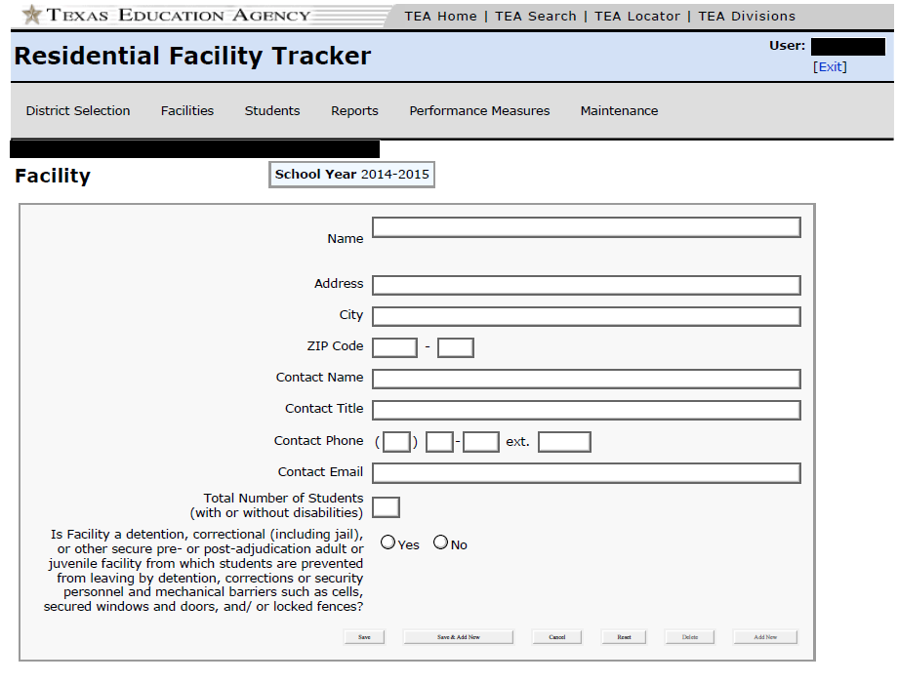

Slide 72
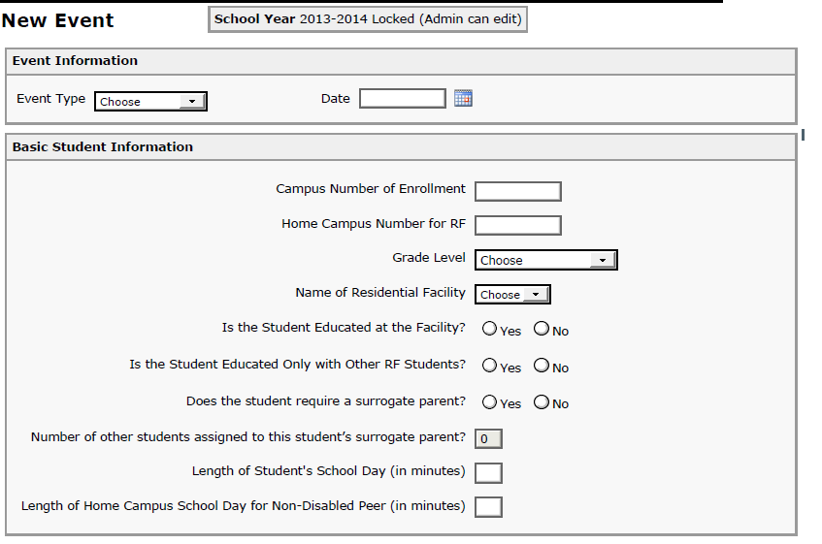

Slide 73
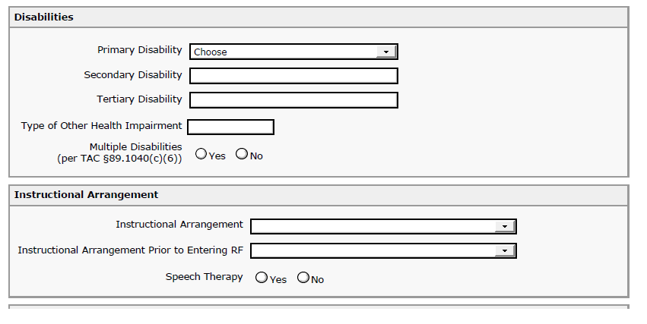

Slide 74
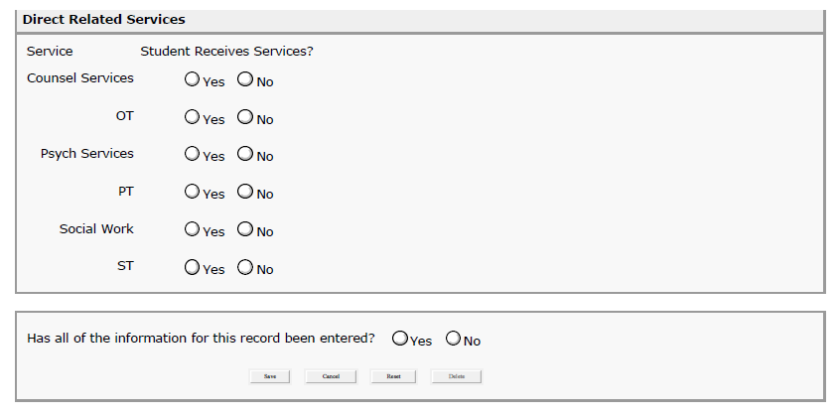

Slide 75
Public Education Information System (PEIMS)

Slide 76
Group Activity
Discuss and record the pros and cons of continuing the RF Tracker and the PEIMS to capture data concerning the characteristics of an appropriate education for students with disabilities residing in RFs?

Slide 78
Don’t forget!
Next meeting---March 24-25
Send in your vouchers asap
How much we appreciate you for serving on this workgroup!

