Slide 1
TELPAS Alternate Student Eligibility

Slide 2
Purpose of this TELPAS Alternate Training
Intended for members of ARD and LPAC committees who make decisions about student eligibility for state assessments
Can be used by others as needed to clarify different aspects of this testing program
Describes the specialized population of English learners (ELs) in grades 2-12 who will be assessed with TELPAS Alternate
Explains the eligibility criteria for student participation in TELPAS Alternate

Slide 3
TELPAS Alternate
The Every Student Succeeds Act (ESSA) requires each state to administer an alternate English language proficiency (ELP) assessment for English learners (ELs) with the most significant cognitive disabilities who cannot participate in the general ELP assessment, even with allowable accommodations.
The Texas Education Agency (TEA) worked with stakeholders to develop the TELPAS Alternate to evaluate grades 2-12 students receiving special education services identified in the Public Education Information Management System (PEIMS) as limited English proficient (LEP) and also identified with a significant cognitive disability.

Slide 4
Who will be assessed with TELPAS Alternate?
Grades K – 1 | No TELPAS Alternate for K-1 at this time. All ELs, including students receiving special education services, will take TELPAS K-1 holistically rated assessment for all four language domains.
Grade 2 | Participation requirements are available on TEA’s TELPAS Alternate Resources webpage. ARD committees, in conjunction with the LPAC, are required to review the participation requirements and determine and document student eligibility for TELPAS Alternate.
Grades 3 - 12 | Participation requirements are available on TEA’s TELPAS Alternate Resources webpage. ARD committees, in conjunction with the LPAC, are required to determine and document student eligibility for TELPAS Alternate. If the student is LEP and is eligible for STAAR Alternate 2, he or she will take TELPAS Alternate.

Slide 5
Who will be assessed with TELPAS Alternate? (continued)

Slide 6
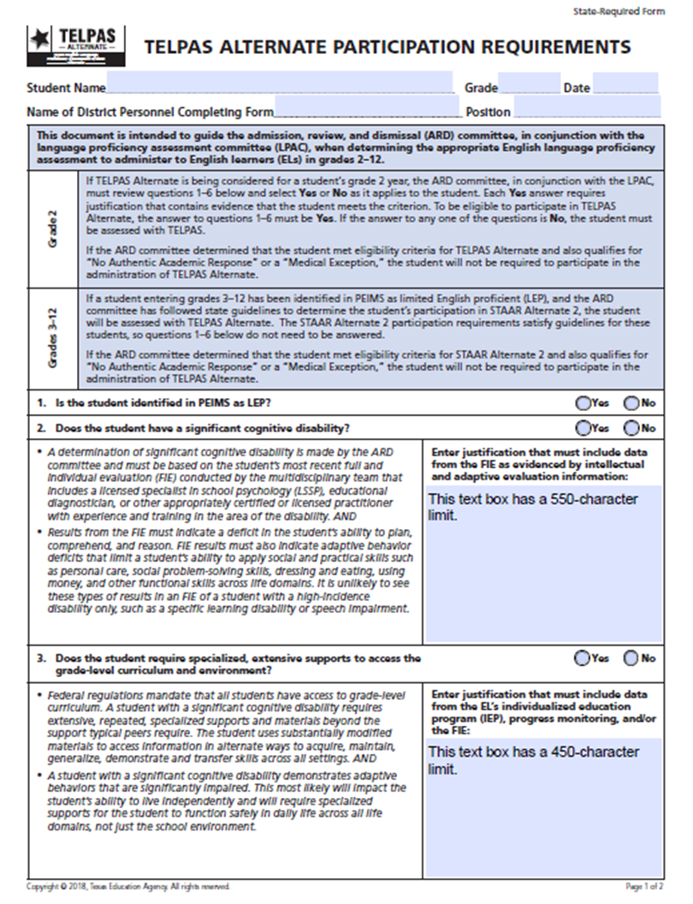
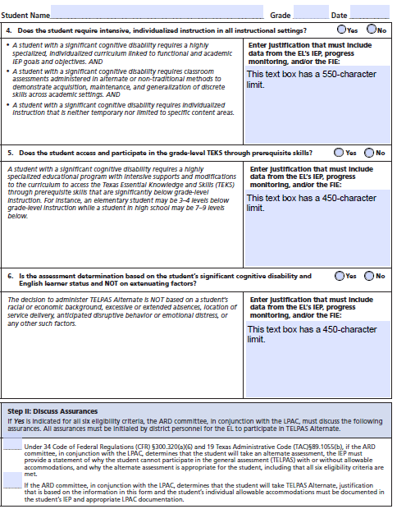
TELPAS Alternate Participation Requirements
Participation requirements (in English and Spanish) for grades 2-12 are available on TEA’s TELPAS Alternate Resources webpage and have been created to determine an EL’s eligibility for TELPAS Alternate.
Participation requirements are intended to guide the ARD committee, in conjunction with the LPAC, when determining the appropriate English language proficiency assessment to administer to ELs.
Documentation of eligibility is different for students in grade 2 compared to students in grades 3-12.

Slide 7
TELPAS Alternate Participation Requirements: Grades 3-12
For grades 3-12, a student must be LEP and be eligible for STAAR Alternate 2 to take TELPAS Alternate.
Completion of the STAAR Alternate 2 Participation Requirements and acknowledgement that the student will also participate in TELPAS Alternate is the only documentation needed in the IEP.
The LPAC should document the assessments the student will take in permanent record file using TEA’s EL Assessment Documentation Forms or a district-created form that captures the same information.
For an EL in high school who has completed testing requirements, documentation that the student previously was assessed with STAAR Alternate 2 and will now take TELPAS Alternate is sufficient for the IEP. The LPAC should document that the student will take TELPAS Alternate. The LPAC should document the assessments the student will take in permanent record file using TEA’s EL Assessment Documentation Forms or a district-created form that captures the same information.

Slide 8
TELPAS Alternate Participation Requirements: Grade 2
For grade 2, the TELPAS Alternate Participation Requirements must be reviewed by the ARD committee in conjunction with the LPAC.
Once a determination has been made, the decision must be documented.
The assessment decision and participation requirements should be documented in the IEP.
The assessment decision should be documented in the student’s permanent record file using TEA’s EL Assessment Documentation Forms or a district-created form that captures the same information.
The student must meet all 6 eligibility criteria
to be eligible to participate in TELPAS
Alternate.
All YES answers require justification based on
evaluation information.
If the answer to any question is NO, the
student will take TELPAS.
The next several slides take you through
all 6 questions.

Slide 9
TELPAS Alternate Participation Requirements: Grade 2 (question 1)
1. Is the student identified in PEIMS as LEP? | Yes or No
Only students who have been identified in the Public Education Information Management System as limited English proficient are required to take an English language proficiency assessment (i.e., TELPAS or TELPAS Alternate).
This includes students whose parents have declined bilingual or English as a Second Language (ESL) program services.

Slide 10
TELPAS Alternate Participation Requirements: Grade 2 (question 2)
2. Does the student have a significant cognitive disability? | Yes or No
This is determined by the ARD committee based on the student’s most recent full and individual evaluation (FIE) conducted by the multidisciplinary team and documented in the IEP.
The results must indicate a deficit in the student’s ability to plan, comprehend, and reason and adaptive behavior deficits that limit the student’s ability to apply social and practical skills.

Slide 11
TELPAS Alternate Participation Requirements: Grade 2 (question 3)
3. Does the student require specialized, extensive supports to access the grade-level curriculum and environment? | Yes or No
In order to answer “yes,” the student must require substantially modified materials to access information in alternate ways across all settings.
Also, the student must demonstrate adaptive behaviors that are significantly impaired and impact the student’s ability to live independently and function safely in daily life across all life domains, not just the school environment.
Examples of “specialized, extensive supports” may include:
Voice output devices | 1:1 instruction
Assistance with feeding and daily needs | Assistance with physical mobility
Regular and frequent reinforcement system | Assistance negotiating social situations

Slide 12
TELPAS Alternate Participation Requirements: Grade 2 (question 4)
4. Does the student require intensive, individualized instruction in all instructional settings? | Yes or No
In order to answer “yes,” the student must be receiving individualized instruction in every academic class. This instruction is neither temporary nor limited to specific content areas.
Intensive, individualized instruction may be provided by alternate or non-traditional methods and may include:
Alternate curriculum | Modified tasks
Modified requirements | Frequent prompting

Slide 13
TELPAS Alternate Participation Requirements: Grade 2 (question 5)
5. Does the student access and participate in the grade-level TEKS through prerequisite skills? | Yes or No
In order to answer “yes,” the student must be performing significantly below grade-level proficiency.
For example, an elementary student may perform 3 or more grade levels below peers of the same age.
For example, a high school student may perform 7-9 grade levels below peers of the same age.
Also, teaching may include the following practices beyond what is provided to non-disabled peers:
hands-on materials | new tasks broken into small steps | repeated student practice
demonstration of concepts along with verbal directions | prompting or shaping accurate performance | multiple opportunities and examples

Slide 14
TELPAS Alternate Participation Requirements: Grade 2 (question 6)
6. Is the assessment determination based on the student’s significant cognitive disability and English learner status and NOT on extenuating factors? | Yes or No
The decision to participate in TELPAS Alternate may NOT be based on a student’s racial or academic background, extensive absences, location of educational services, or anticipated disruptive behavior.

Slide 15
TELPAS Alternate Participation Requirements: Grade 2 (assurances)
If Yes is indicated for all six eligibility criteria, the ARD committee, in conjunction with the LPAC, must discuss the following assurances.
All assurances must be initialed by district personnel for the EL to participate in TELPAS Alternate.
The decision for a student to participate in TELPAS Alternate is based on the ARD committee, in conjunction with the LPAC. The decision cannot be made solely by a campus or district administrator.

Slide 16
No Authentic Academic Response (NAAR) and Medical Exception
If the ARD committee determines that the student met eligibility criteria for TELPAS Alternate and also qualifies for “No Authentic Academic Response” or a “Medical Exception,” the student will not be required to participate in the administration of TELPAS Alternate.
“N” for NAAR or “M” for Medical Exception will be recorded for the student when responses are submitted online during the testing window.

Slide 17
Available TELPAS Alternate Training PowerPoints
Introduction to TELPAS Alternate
Student Eligibility
Speaking Domain
Listening Domain
Reading Domain
Writing Domain
Accessibility
Test Administration

Slide 18
Contact Information
TEA’s Student Assessment Division
512-463-9536
assessment.specialpopulations@tea.texas.gov
Pearson’s Customer Service Center
800-627-0225
TxPearsonAccess@support.pearson.com

Slide 19
Disclaimer
These slides have been prepared by the Student Assessment Division of the Texas Education Agency. You are encouraged to use them for local training.
If any of the slides are changed for local use, please hide or remove any TEA logos, headers, or footers. (You may need to edit the Master slide.) In addition, you must remove the photographs. Only TEA has parental permission to use these photographs for training purposes.
This training is not intended to replace any materials or additional information on the TEA website.

