Slide 1
Educating Children in Poverty:
Data Driven Decisions for Leadership
Susan Dawson
President
sdawson@e3alliance.org

Slide 2
E3 Alliance is a Catalyst For Educational
Change in Central Texas
Mission
E3 Alliance uses objective data and focused community collaboration to align our education systems so all students succeed and lead Central Texas to economic prosperity
E3 serves as the Central Texas
regional P-16 Council

Slide 3
Using the Right Data to Make the Right Decisions: Four Examples
Statewide data to inform policy
Regional data to enable communities to drive action
(Highly disaggregated) regional and campus data to support improved local practices
District and campus data to
Change local policy and practice
Identify schools for transformational improvement

Slide 4
1: Pathways of Promise Math Analysis
Statewide analysis of mathematics course-taking pathways and how they correlate to later outcomes
Identify student math course-taking pathways
Might course-taking policies of HB 5 have unintended consequences?
Identify equity gaps in math course taking and how to address them

Slide 5
Gaps in Higher Education Outcome Rates by Highest Math
Outcomes of Students in HS for 4 Years, Texas 2004 First Time 9th Grade Cohort

Slide 6
Gaps in Higher Education Outcome Rates by Highest Math
Outcomes of Students in HS for 4 Years, Texas 2004 First Time 9th Grade Cohort

Slide 7
Pathways of Promise Math Analysis
Sharing with legislators to inform evolution of HB 5 and course-taking policies
Regional community of practice (9 districts ++) formed to close income gaps in math course taking
Educator development initiative launched to improve middle school math instruction
Sharing regional pipeline data with 5 other regions across state to drive regional action

Slide 8
2: Absence Reasons Study
Which students miss school, where and why?
Primary research; first of its kind study in Texas (maybe US?)
Data to drive regional decision-making:
How community systems interact with student attendance and achievement
Collected, analyzed and mapped detailed student attendance data from representative sample schools

Slide 9
Absence Reasons Study: What Did We Find?
(8124)
Source: E3 Alliance analysis of absence data
from 9 schools in PISD & HCISD, 1/14/13-3/8/13
Notes:
There were nearly 17 thousand absences in just 2 months time, nearly 2 absences per student on average
Here are the top 10 most common reasons for student absences (which account for 72% of the absences)
Nearly half of all absences were due to acute illness, such as colds, flu, stomach bugs, etc.
The next most common reasons were skipping school, chronic illness, such as asthma, diabetes, or other chronic medical conditions, and family emergencies
(give the audience time to read the rest)
Additional information to help with audience questions:
-Skipping was known, not presumed
-Family emergency includes funeral and other emergencies
-Medical and dental appointments won’t decrease the school’s funding (ie won’t be counted as an absence) if the student is at school beginning or end of day AND brings a doctor/dentist note
-Routine dental includes checkups, getting cavities filled, and othodontics
-Travel includes vacations and any other travel that wasn’t accounted for by other reasons (such as family emergencies)
-Mental health issue only refers to non-crisis mental health
-Suspension – includes out-of-school suspensions; ISS stands for in-school-suspension
-Family responsibility – typical example is older children having to miss school to watch younger children

Slide 10
Secondary ‘Flu’ Peak Matches Acute Illness Absences
Source: E3 Alliance analysis of Absence data from 9 schools in PISD & HCISD August 2012 through March 2013
Influenza-Like Illness doctor visit data from Austin/Travis County Health and Human Services
Notes:
Acute illness absences mirror overall pattern. This is due to acute illness accounting for half of absences, and due to non-illness absence reasons being consistent over time for both districts.

Slide 11
Absence Reasons Study-> Flu Immunization Campaign
Partnered with two private companies to provide flu vaccines to ALL students at no cost to districts or families
2014: Largest in-school flu immunization program in the state; 6500 vaccines in 56 schools
2016: 14 districts; 350+ schools
All elementary and middle schools in 13 CTX districts
Expanding to Houston area
Targeting ~75,000 vaccines!

Slide 12
3: Eliminating Gaps Analysis
Regional initiative responding to national challenge to address persistent opportunity gaps faced by boys and young men of color
Strong intent but lack of direction
Provide Focus: use objective data analysis to identify those metrics that will make the biggest difference in closing gaps for young men of color
Support Action: Provide comparative data sets to help institutions and our community move the needle on these metrics

Slide 13
Disciplinary Referral Rates Middle Schools
Disproportionality
Difference = 30.1%
Weighted Average 32.9%
Source: E³ Alliance analysis of PEIMS data at the UT Austin Education Research Center
Notes:
# effected: 4593 students
Percent of students who received at least one disciplinary referral.
All Types of disciplinary referrals that removed a students from regularly scheduled classes were used (this includes court assignment to JJAEP/DAEP) were included. The only available referrals that were not included were truancies and continuations from previous years/districts

Slide 14
Disciplinary Referral Rate Bright Spots Analysis
*Excludes Juvenile Justice-focused schools, schools with <10% target population, schools masked because of small populations
Notes:
The two bright spots in the <20% quintile have actual Referral rates that support being a bright spot (unmasked ~3%)
Masked Thrall at the bottom

Slide 15
Eliminating Gaps Analysis
Chose two metrics at each level of the education pipeline that will make the biggest difference in closing gaps for young men of color
Identified “Bright Spots” schools doing best for MBK target students as compared to similar schools
Committees of community leaders and educators doing qualitative studies to look for replicable practices
Regional Steering Committee supporting pilot efforts and measuring changes over time

Slide 16
4: Changing Policy & Practice Using 3D Growth
Superintendents, leaders frustrated by “one dimensional” measure of minimum passing rate
E3 Alliance adapted the most robust academic growth model in the country for Texas students
Used in 15+ states by both teacher unions and state superintendents
Provide:
a more direct measure of learning
a more equitable basis for comparing schools that serve different student populations
campuses of promising practices based on student learning

Slide 17
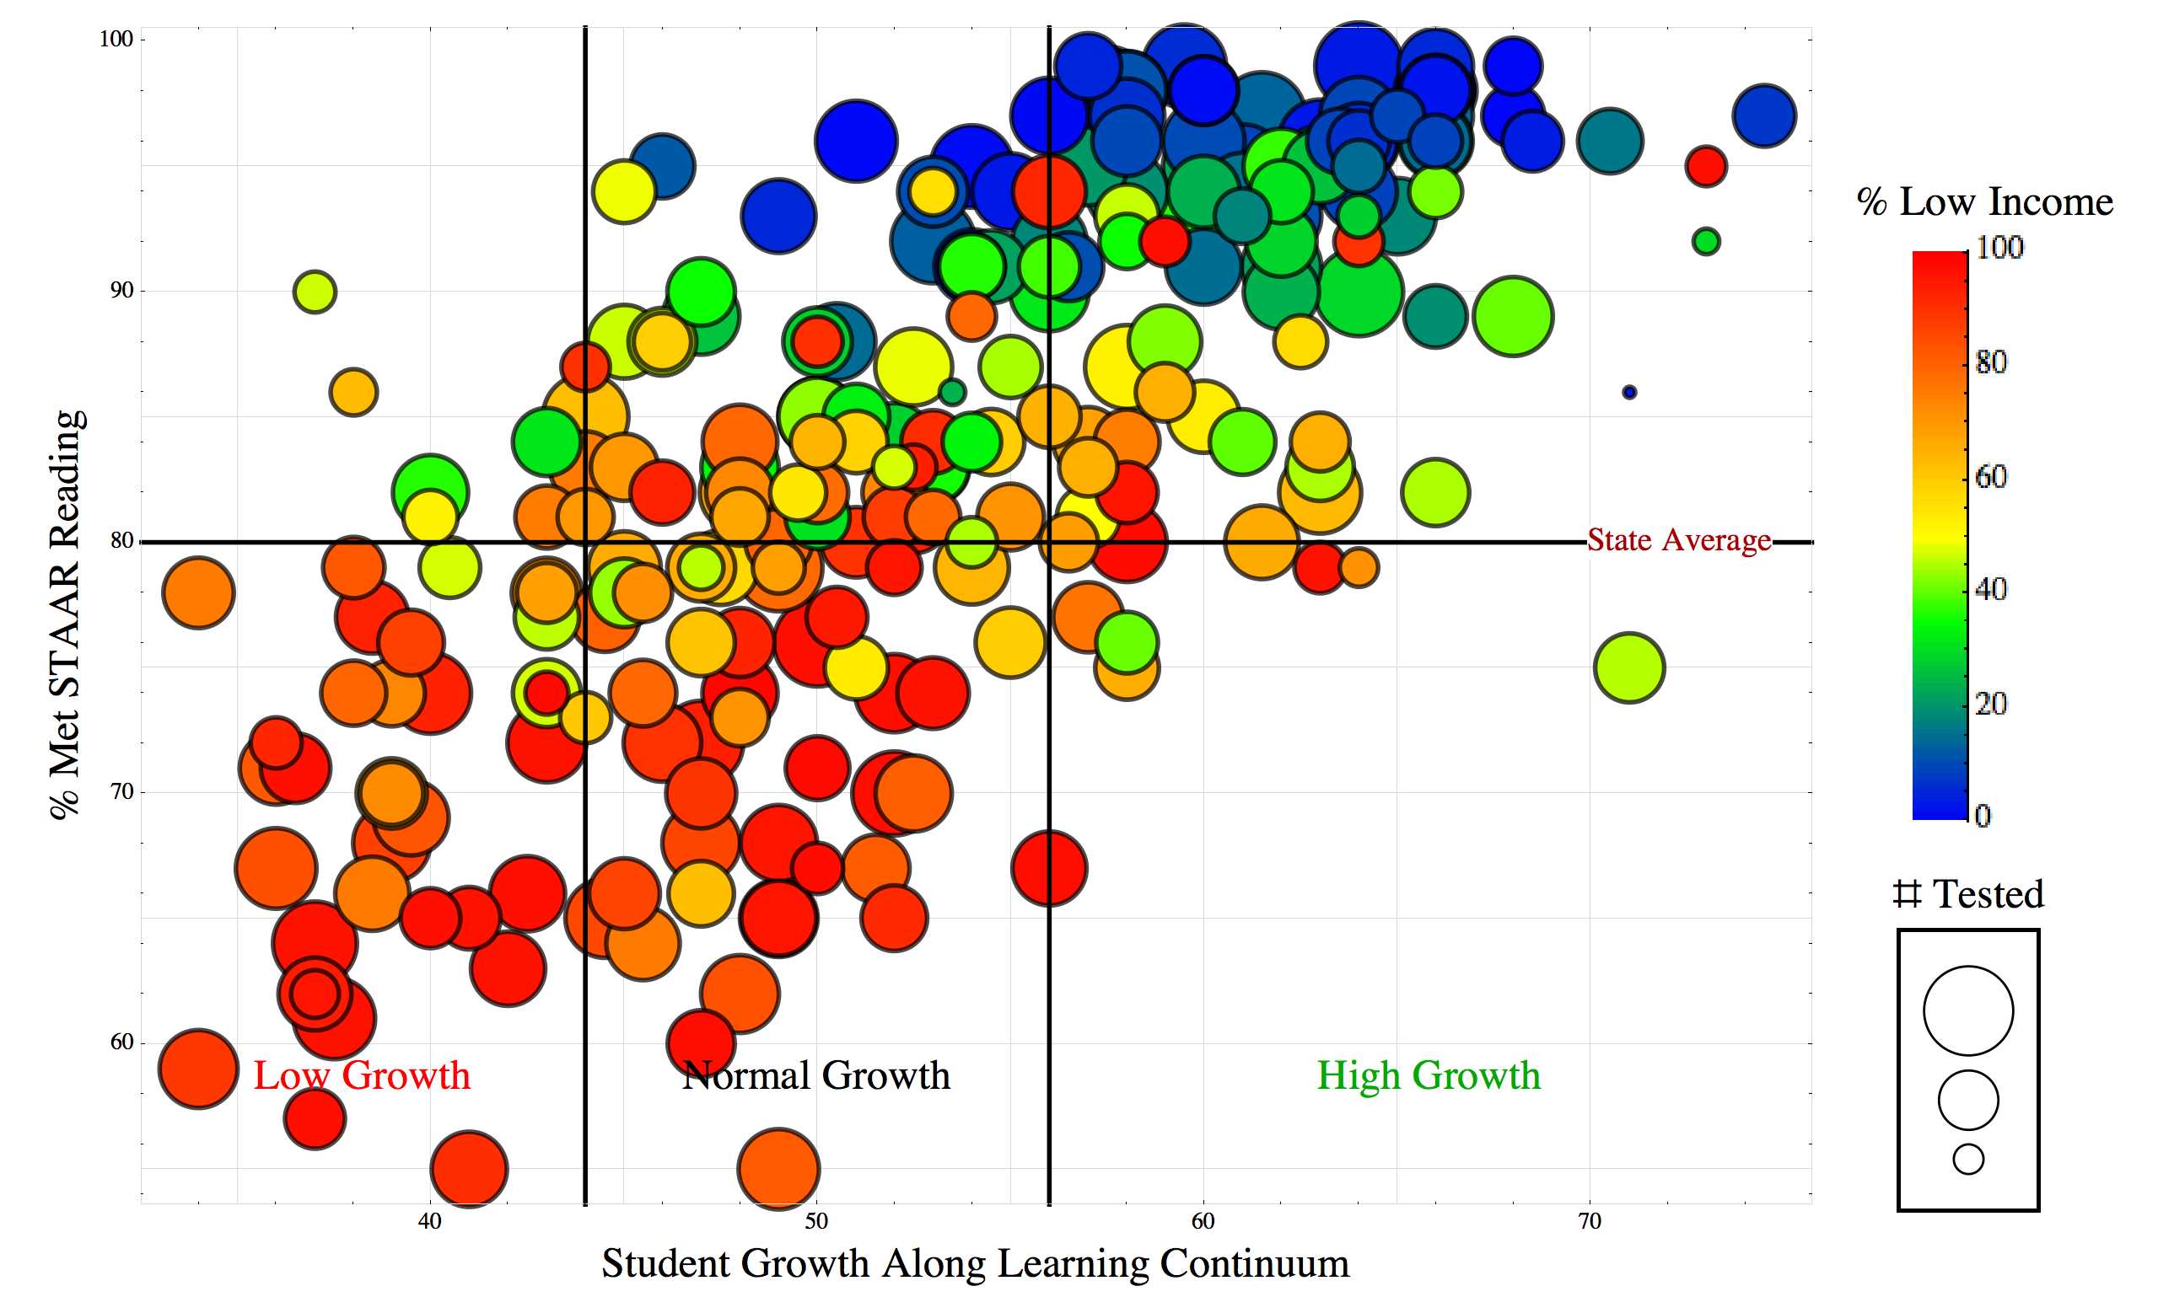
Example 3D Growth Bubble Chart
17
Notes:
This sample chart compares ELA passing rates and student academic growth rates. Each bubble represents an individual school. On the vertical axis you see what the state would normally measure, the percentage of students that passed the state assessment. The horizontal axis shows SGP-calculated student growth for that campus. The color coding in each bubble indicates the level of economic disadvantage on the given campus, with red representing the poorest campuses and blue the least poor. The size of each bubble indicates the size of the population of students tested on the campus.
For an interesting example of how this data is valuable, compare the two labeled campuses. Both have about the same percentage of low income students, close to the same passing rates, and similar campus size. Yet you can see that there is a huge difference in the growth that each campus is providing to their students. School A is in the low end of the average growth sector, ranked among the middle 50% of schools in the state in terms of growth, and School B is at the top end of the high growth sector, high among the top 25% of schools in the state.

Slide 18
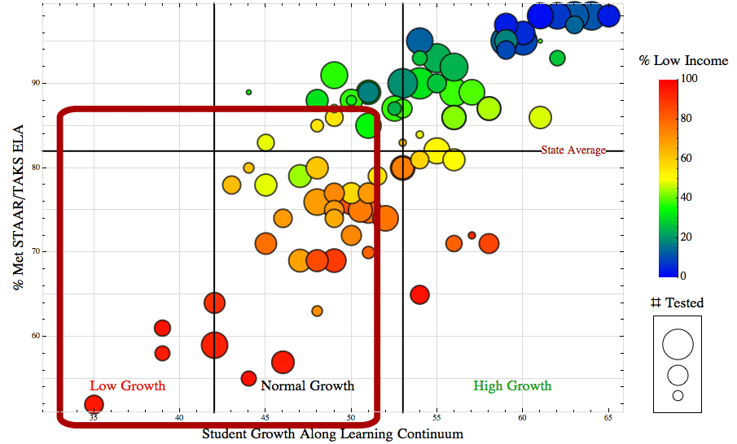
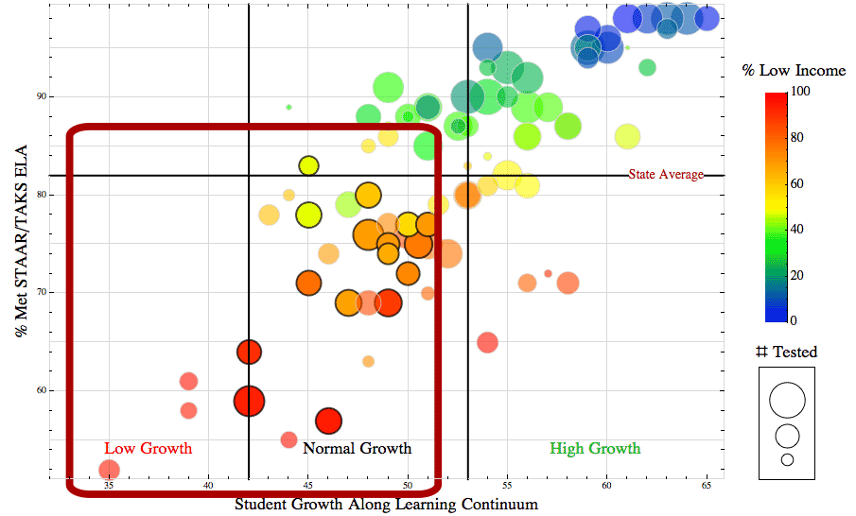
3D Growth, Central Texas Middle Schools
Notes:
These will be target schools:
Schools with high concentrations of struggling learners
Below average academic growth – not closing gaps
Large enough to make a difference in regional outcomes
About 24 schools across the region are eligible to be expansion schools based on this data

Slide 19
3D Growth, Central Texas Middle Schools
Notes:
(This slide is animated to show desired change.)
If we transform enough of the target schools – 16 over the next 5 years – we will impact enough student outcomes -helping many more students grow at high levels - to create a true tipping point for moving the needle on student success across the entire region!

Slide 20
Changing Policy & Practice Using 3D Growth
3D Growth data provided to Central Texas districts to support changes in district polices, campus practices
Now offering intensive fee-for-service district workshops to support process improvement
Working with TEA to provide for targeted turnaround schools
Used by E3 to ID schools for transformational efforts and evaluate progress

Slide 21
Using the Right Data to Make the Right Decisions
Complex data analysis is difficult and costly (and sometimes controversial) but worth it to support robust decisions
Scope of analysis depends on intended use: statewide, regional, district, campus,…
Texas has robust data sources that continue to improve… but primary research still (sometimes) required
Huge progress, but more work to do to build a truly data-driven culture in education

