Slide 1
EDUCATING THE CHILDREN OF POVERTY Data-Driven Decisions For Leadership
State Board Of Education Roundtable
September 12, 2016

Slide 2
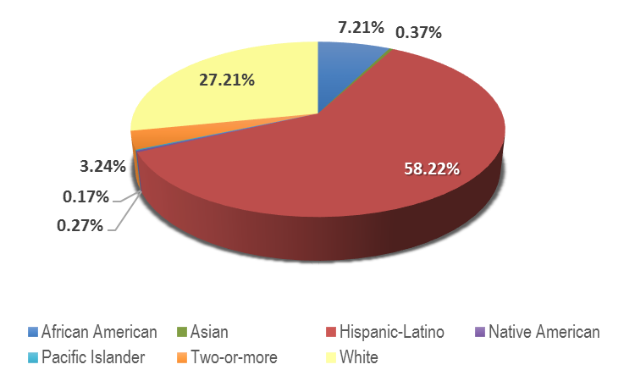
Our Students
46.19% Economically Disadvantaged
10.85% English Learners
7.22% Bilingual
5.16% English as a Second Language
9.78% Special Education
0.81% Homeless
2.46% Immigrant
0.04% Migrant
67,779
students
21.15% Career and Technical Education
5.72% Gifted and Talented
Source: Fall 2015 PEIMS Submission
Our Schools and Staff
$551.1
Million budget for the 2015-16 school year
$487.0
Million Operating Expenditures.
$7,163 per-student spending
2013-14 TEA Financial Data Report
46 Elementary
14 Middle
8 High
8 Alternative Programs
Average Elementary Class Size:
18.9 - 22.2
4,305 Teachers
9,292 Employees
Teachers> 5 years of experience
All Subjects: 53%
Moving the Needle
Accountability Ratings:
District Rating: Met Standard
Campus Rating: 100% Met Standard
North East Independent School District
2015-16 data, except where indicated

Slide 3
How to improve achievement for students in poverty…

Slide 4
How do we leverage available research and data to maximize our limited resources (financial, material, human, time)?
How do we manage the tension between the need for systematized processes, structures, and practices with the need for differentiation (and innovation and iteration) to address the unique needs of individual schools and their communities?
How do we as leaders catalyze or accelerate processes and procedures for schools with the highest risk factors?
The Leadership Challenge

Slide 5
Effective District and Schools…
Build leadership capacity
Support data-based decision making
Ensure an equitable distribution of resources
Recruit and retain high capacity teachers
Ensure high-expectation teaching
Support professional learning
Create strong instructional management systems

Slide 6
Collecting and Analyzing Data for a 360⁰ View

Slide 7
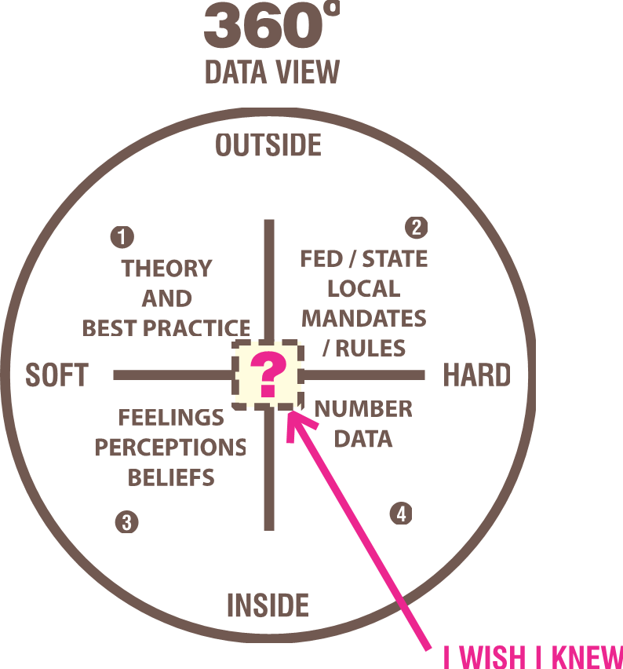

Slide 8
North East ISD Example:
Data Coaching Process
Engages campus- and district-level leaders in collaborative inquiry around identified data
Provides an opportunity for early course correction
Allows campus leaders a forum to “rehearse“ plans of action
Aligns collaborative conversations across the district

Slide 9
North East ISD Example:
Continuum of Support (Low vs. High Touch)
Distributes resources equitably
Ensures staff is strategically placed based on need
Allows for differentiated professional development plans with multiple points of entry

Slide 10
North East ISD Example:
Solution Team Principals and Specialists
Identifies and places highest capacity staff in schools of greatest need
Ensures team is nimble and responsive
Empowers the team lead with the ability to accelerate processes to quickly address campus needs
Provides flexibility in procedures and practices

Slide 11
North East ISD Example:
3-year Teaching Commitment Regulation
Adjusts hiring practices to increase recruitment and retention
Provides professional development to support teachers’ learning and growth
Allows transfers after 3 years

Slide 12
Data should help us identify needs in our system, and the system should be flexible enough to allow for adjustments, innovation, and iteration.

Slide 13
No one size fits all

Slide 14
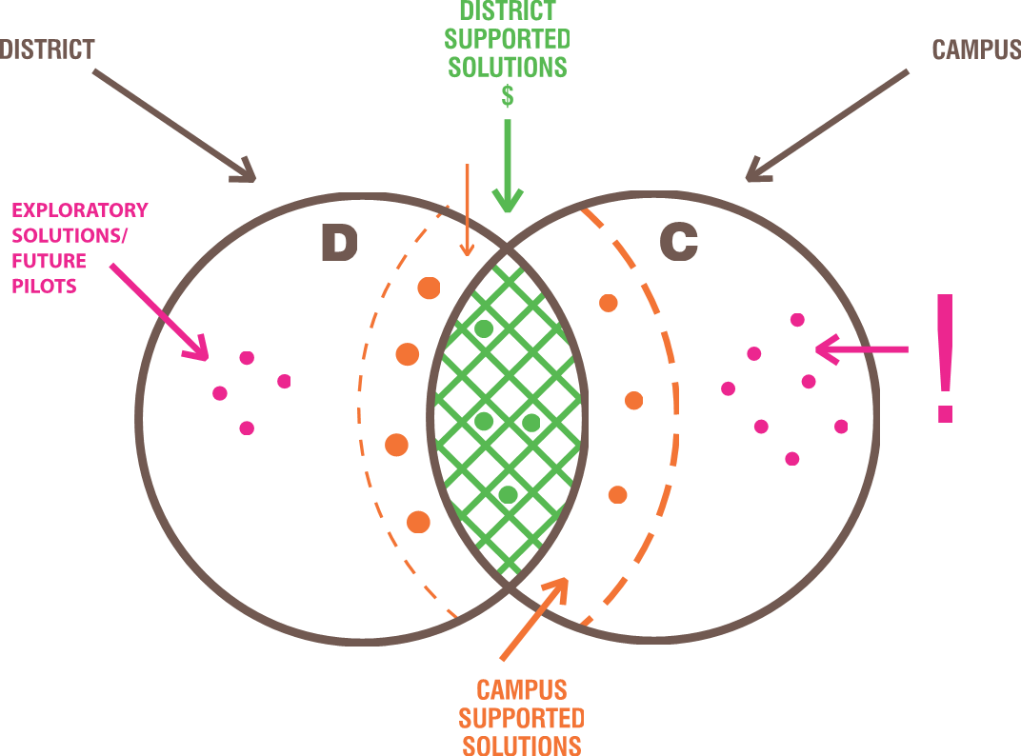
Innovation Mind Map

Slide 15
Innovation Mind Map

Slide 16
North East ISD Campus-based Example:
Computer-based Leveled Intervention for Reading
Allowed for individualized instruction using a computer-based program
Increased learning time for the most at-risk students
Leveraged the support of paraprofessionals
2015-16 STAAR data increased by 16.2%

Slide 17
High-Poverty/High Performing School Principal Example:
A Case Study at Olmos Elementary School
All STAAR first administration tests only. All subjects at the standard for that year:
2016 - 73.68% (met all System Safeguards)
2015 - 71.11% (met all System Safeguards)
2014 - 52.74% (missed 6 System Safeguards)
2013 - 45.48% (missed 9 System Safeguards)

Slide 18
Ten Strategies from a Successful Principal
Know the data
Surround yourself with a strong team
Build relationships
Make learning relevant
Set expectations
Address issues immediately
Provide time for students to apply learning (concrete to abstract)
Provide enrichment/ extension for all students
Give teachers time
Be present and visible

Slide 19
Questions/Comments
Pauline Dow, Ed.D.
Chief Instructional Officer
North East ISD
8961 Tesoro Drive
San Antonio, TX 78217
(210) 407-0545
pdow@neisd.net
@paulinedow

