Slide 1
High Quality Prekindergarten Grant and Supports from the Texas School Ready Project
Susan Landry, Ph.D.
Director, Children’s Learning Institute

Slide 2
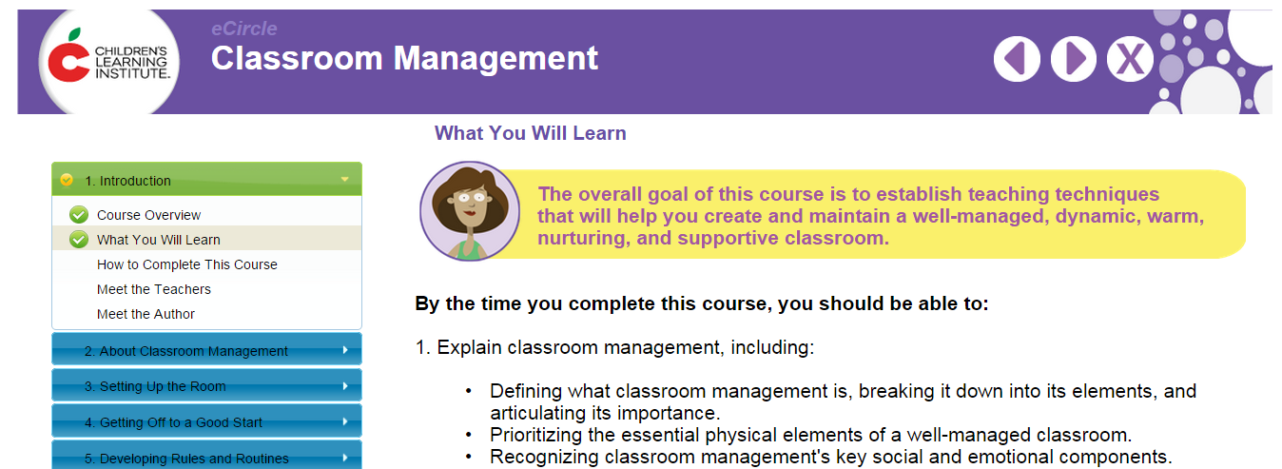
Professional Development
To be eligible … each teacher of a high-quality prekindergarten grant program must be certified … and have one of the following additional qualifications…
The grant specifies six mechanisms for satisfying the additional education requirements. CLI provides avenues to meet three of these:
Completion of the Texas School Ready Training Program (TSR Comprehensive)
Training for the Child Development Associate (CDA) credential™
Completion of professional development meeting specific requirements (eCIRCLE, CIRCLE Foundations Training)

Slide 3
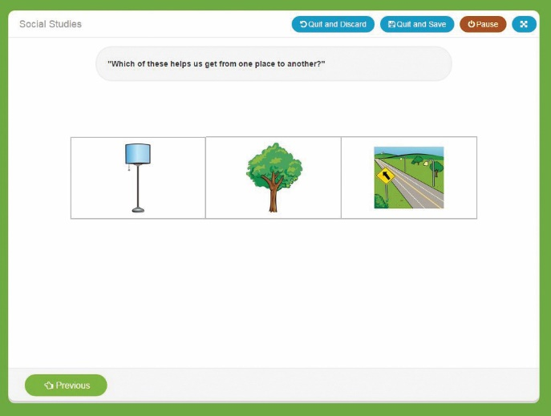
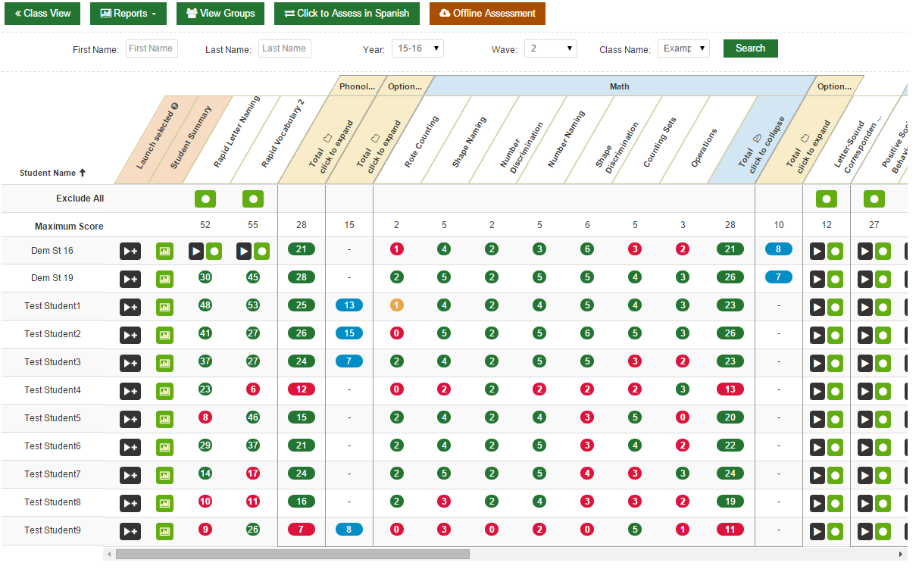
Progress Monitoring & Kindergarten Screening
… A school district shall measure the progress of each student in meeting the recommended end of prekindergarten year outcomes … using a progress monitoring tool included on the commissioner's list of approved prekindergarten instruments that measures [certain domains] and the preparation of each student for kindergarten using a kindergarten readiness instrument.
CLI’s CIRCLE Progress Monitoring System is included on the Commissioner's List of Approved Progress Monitoring Instruments.
The Texas Kindergarten Entry Assessment will launch fall 2017 and will satisfy the kindergarten screening requirement.
Both CLI assessments are available at no cost.

Slide 4
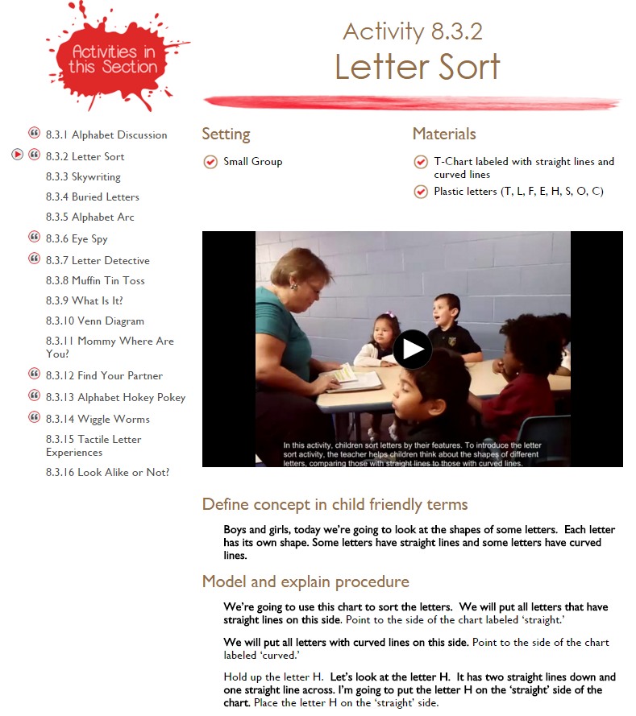
High Quality Curriculum
To be eligible … a school shall implement a curriculum . . .that addresses all of the Texas Prekindergarten Guidelines (updated 2015) in the following domains:
social and emotional development; language and communication; emergent literacy reading; emergent literacy writing; mathematics; science; social studies; fine arts; physical development and health; and technology.
To augment the use of the district/charter’s chosen curriculum, districts can use the online CIRCLE Activity Collection for supplemental classroom activities and lessons.

Slide 5
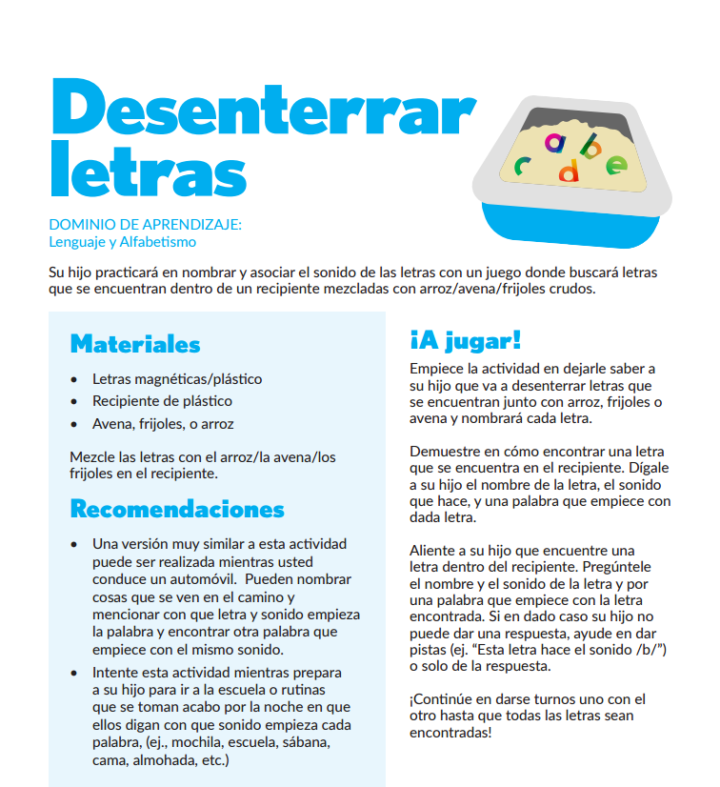
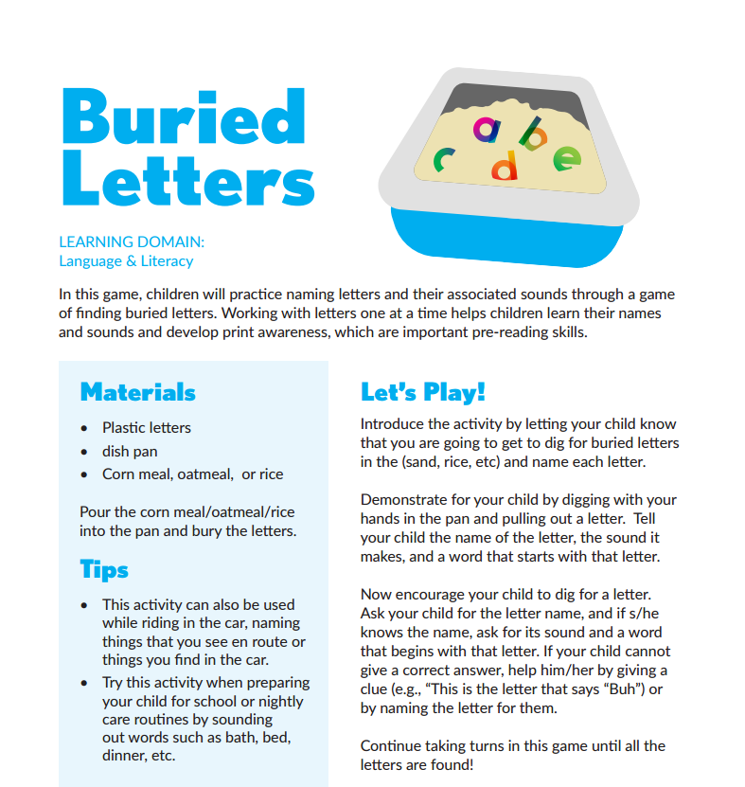
Parent Engagement
To be eligible … a school district or an open-enrollment charter school shall develop, implement, and make available … a family engagement plan to assist the district in achieving and maintaining high levels of family involvement and positive family attitudes toward education.
CLI Engage features a series of resources for parents and families:
Child progress monitoring reports
Activities
Online courses
Child Development Checklist

Slide 6
Other HB4 Quality Targets
Adult/child ratios:
Grantees must attempt to maintain an average ratio in any preK class of not less than one certified teacher or teacher's aide for every 11 students. (Note: one way to accomplish this is through integrated partnerships, below.)
School readiness integration partnerships:
Collaborations are encouraged among public preK programs and local workforce development boards, Head Start providers, college or university early childhood programs, and/or providers of private licensed child care services.

Slide 7
Integrated Partnerships
Advantages for School Districts
Collaboration with other programs may allow for expansion to full day programs
Programs can share a teacher assistant
Saved district dollars by sharing off-campus facility space
Enhanced services such as reduced ratios with co-teachers
Advantages for Childcare
Enhance quality with TEA certified teachers
Save dollars by sharing resources such as teacher assistants, facilities, and teaching curriculum/materials
Provide wrap around childcare services
Notable integrated partnerships can be found in:
Fort Worth ISD
Dallas ISD
Arlington ISD
Waco ISD

