Slide 1
TEASE – FSP
TASBO Annual Conference 2015
February 18, 2015
Al Johnson, TEASE – FSP user administrator, State Funding

Slide 2
Introduction
Al Johnson, State Funding Division
Program Specialist/TEASE Admin
With School Finance since 1991
Phone: 512-463-9260
Email: Al.johnson@tea.texas.gov

Slide 3
Agenda
TEASE – FSP Overview
Subsystems Inside TEASE - FSP
Roles Inside TEASE – FSP
Applying for TEASE – FSP Account (New Users)
Modifying TEASE – FSP Account (Current Users)
User Admin Application Inside TEASE
FAQ’s
Contact Information

Slide 4
TEASE – FSP Overview

Slide 5
TEASE – FSP Overview
The TEA Secure Environment, or TEASE, houses various TEA applications that require users to be able to securely log on and submit data to the TEA.
Whether you use one TEA application, such as the Foundation School Program (FSP), or many TEA applications, you always log on through TEASE at the same URL with the same username and password.

Slide 6
TEASE Log On: https://seguin.tea.state.tx.us/apps/logon.asp

Slide 7
Subsystems in TEASE –FSP Application

Slide 8
10 Subsystems in TEASE - FSP application
Attendance Projections
Bond Programs
Chapter 41
Charter Schools
NIFA*
Staff Salary
State Compensatory Education
Tax Information Survey
Transportation
Supplemental Attendance - Military Survey*
*Program not currently funded

Slide 9
Updating Contact Information
Most of the subsystems inside FSP will require you to complete or update your contact information. This is not automatically done when changes happen at the district.
Review your contact information at the beginning of every school year AND as soon as an employee is assigned the responsibility of entering the data.

Slide 10
Roles in FSP application

Slide 11
Roles in FSP Application
Chapter 41 User – work in Chapter 41 program module; view other programs’ data
Charter Schools User – enter and send charter school data; view others’ data
Data Survey User (Tax Information Survey) – work with tax information survey data; view other programs’ data
District Approver – usually superintendent; work in all programs and send to TEA
IFA User – district employee who creates and edits IFA applications
NIFA User – enter and send NIFA data; view other programs’ data
Pupil Projections User (Attendance Projections) – enter and send pupil projections data; view others’ data
Staff Salary User – enter and send staff salary data; view other programs’ data
State Comp Ed User – enter and send State Comp Ed data; view others’ data
Transportation User – enter and send transportation data, view others’ data
Visitor

Slide 12
Roles in FSP Application
Subsystem User
May be an assigned employee
District Approver
Usually the superintendent
User Admin for the district
Primary Request Submitter — submits all requests for the organization
Primary Request Submitter Designee — the superintendent assigns this responsibility to another person (board minutes stating the approval must be submitted to TEA)

Slide 13
Applying for a TEASE – FSP Account
(New Users)

Slide 14
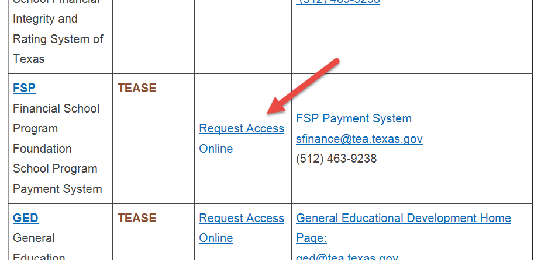
New Users
NEW USERS
Users who do not have a TEASE user name:
1.) Go to the TEA Secure Applications Information in the Popular Applications listing page on the TEA Web site at https://seguin.tea.state.tx.us/apps/logon.asp. Scroll down to the FSP section and click the link to Request Access Online from there.
2.) Scroll down to the FSP section and click the link to Request Access Online from there.

Slide 15
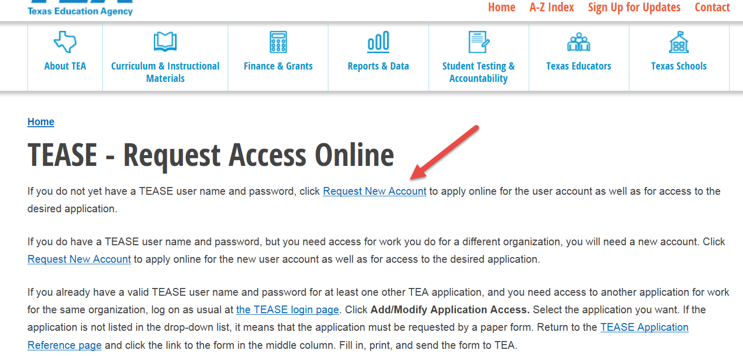
New Users
3.) From the TEASE Request Access Online page, click Request New Account.
4.) You will then be directed to the Request New TEASE User Account page.

Slide 16
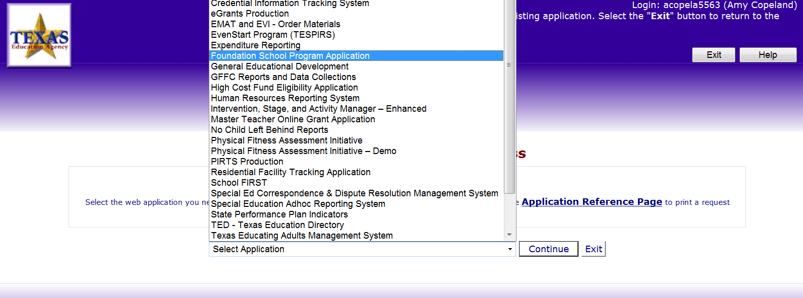
New Users
5.) Select Foundation School Program Application from the drop-down list of Web applications, and click Continue.

Slide 17
New Users
6.) Check the box(es) for the appropriate role(s)* for every program module to which you require access and click Continue.
*If you are unsure which roles to request, first contact your superintendent. For further assistance, contact sfinance@tea.texas.gov.

Slide 18
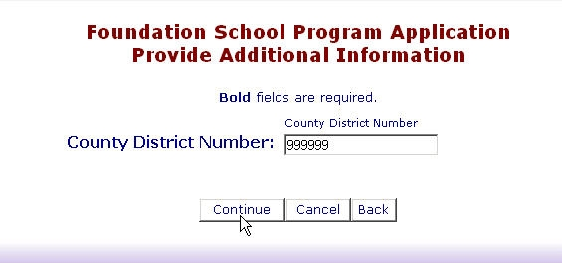
New Users
8.) Next, enter your county district number (CDN), without any spaces or dashes, and click Continue.

Slide 19
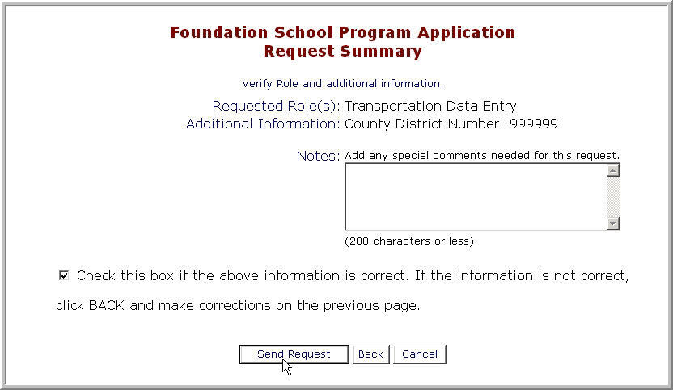
New Users
9.) Finally, review the requested role(s) on the Request Summary page, add any special notes, and check the box to verify all information is correct. If necessary, click Back to make corrections. When all information is correct, click Send Request.

Slide 20
New Users
After you send the request, your superintendent reviews it and forwards to TEA.
The TEA application owner then reviews it and sends you email notification of approval or rejection.
Once you receive email confirmation, (which may take 1–10 days), and you are approved, you are ready to log on to TEASE and go into the FSP application with your assigned privileges. If you have not received notification after 10 days, first contact your superintendent.

Slide 21
Modifying a TEASE – FSP Account
(Current Users)

Slide 22
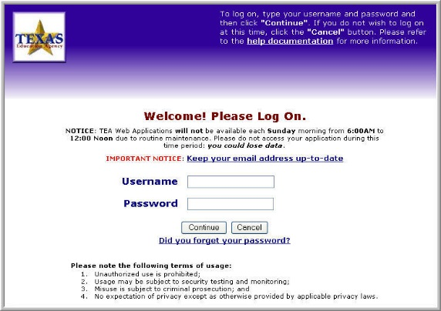
Current Users
CURRENT USERS
Users who already have a TEASE user name:
1.) Enter your current user name and password at the TEASE logon page at https://seguin.tea.state.tx.us/apps/logon.asp and click Continue.
2.) Click the Add/Modify Application Access button in the upper right portion of the Application List screen.
3.) You will then be directed to the Add/Modify Application Access page.

Slide 23
Current Users
4.) Select Foundation School Program Application from the drop-down list of Web applications, and click Continue.

Slide 24
Current Users
5.) Check the box(es) for the appropriate role(s)* for every program module to which you require access and click Continue.
*If you are unsure which roles to request, first contact your superintendent. For further assistance, contact sfinance@tea.texas.gov.

Slide 25
Current Users
6.) Next, enter your county district number (CDN), without any spaces or dashes, and click Continue.

Slide 26
Current Users
7.) Finally, review the requested role(s) on the Request Summary page, add any special notes, and check the box to verify all information is correct. If necessary, click Back to make corrections. When all information is correct, click Send Request.

Slide 27
Current Users
After you send the request, your superintendent reviews it and forwards to TEA.
The TEA application owner then reviews it and sends you email notification of approval or rejection.
Once you receive email confirmation (which may take 1-10 days) and you are approved, you are ready to log on to TEASE and go into the FSP application with your assigned privileges. If you have not received notification after 10 days, first contact your superintendent.

Slide 28
User Admin Application Inside TEASE

Slide 29
Adding TEASE – User Admin Application Access
(New Users)

Slide 30
Adding TEASE - User Admin Application
Users who already have a TEASE user name:
1.) Enter your current user name and password at the TEASE logon page at https://seguin.tea.state.tx.us/apps/logon.asp and click Continue.
2.) Click the Add/Modify Application Access button in the upper right portion of the Application List screen.
3.) You will then be directed to the Add/Modify Application Access page. Select User Administration+ from the drop-down list of Web applications and click Continue.

Slide 31
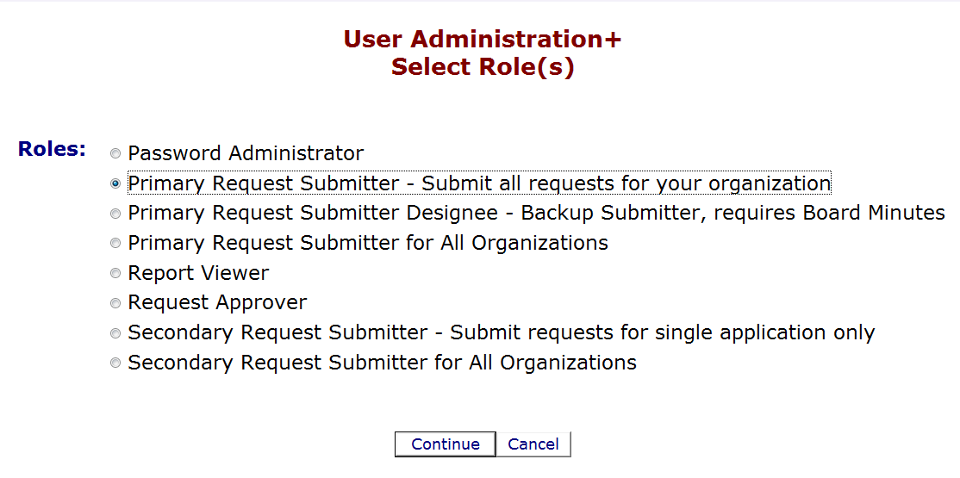
Adding TEASE - User Admin Application
4.) Select appropriate role and click Continue.

Slide 32
Adding TEASE - User Admin Application
Primary Request Submitter --- submits all requests for the organization
Primary Request Submitter Designee --- the superintendent assigns this responsibility to another person (board minutes stating the approval must be submitted to TEA)

Slide 33
Adding TEASE - User Admin Application
After you send the request, your superintendent reviews it and forwards to the TEA.
The TEA application owner then reviews it and sends you email notification of approval or rejection.
Once you receive email confirmation (which may take 1-10 days) and you are approved, you are ready to log on to TEASE and go into the FSP application with your assigned privileges. If you have not received notification after 10 days, first contact your superintendent.

Slide 34
Accessing the TEASE – User Admin Application
(Current Users)

Slide 35
Accessing TEASE – User Admin Application
Users who already have a TEASE user name and have been approved for TE ASE User Admin Application:
1.) Enter your current user name and password at the TEASE logon page at https://seguin.tea.state.tx.us/apps/logon.asp and click Continue.
2.) Click the UserAdmin – User Administration+ link in the Application List screen.

Slide 36
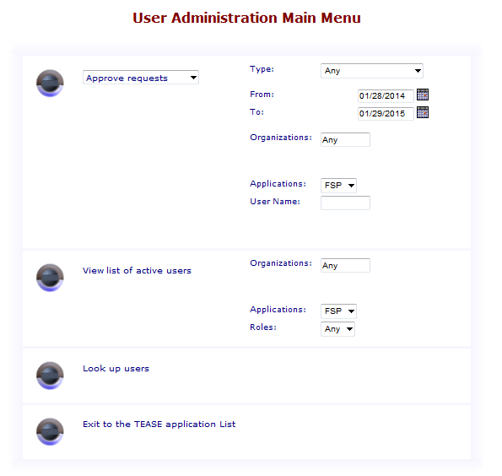
Accessing TEASE - User Admin Application
3.) You will then be directed to the User Administration Main Menu page.

Slide 37
Frequently Asked Questions

Slide 38
FAQ’s
How do I reset my password?
From the Log On page, click Did you forget your password? at the bottom of the screen.
On the Forgot Your Password? page, enter your User Name (the authorized user name provided by the TEA for logging into the application, not your first and last name) or Email address and click Continue. When prompted, enter the answer to the question. This is the question you set up when you logged on to the application for the first time. NOTE: TEASE is case sensitive, so your answer must exactly match what you initially entered.
Click Continue.
When the Change Password page appears, enter a new password. Your password must be a minimum of eight characters and must include at least one number or special character such as @, # , $.
If you have forgotten your answer or cannot reset your own password, send an e-mail message to computer.access@tea.texas.gov for assistance.

Slide 39
FAQ’s
Why can’t I see the Submit to TEA button?
Only the ACTIVE district approver can submit the data to the TEA.
How do I view data for a prior school year?
In the right top corner of each subsystem in the FSP application is a drop-down menu containing the school year. Select the school year you want to view and click Update.
What do I do if I have requested access to an application or a new role and it has not been approved?
First check with your superintendent or User Admin. The request is in the User Admin’s queue awaiting approval. If the district doesn’t have a User Admin assigned, it must apply for a User Admin account before any application requests can be approved.

Slide 40
FAQ’s
Why can’t I access a particular subsystem in the FSP application?
You may not have access to that subsystem. Review your access from the FSP application Add/Modify Application Access menu. Request a new role if applicable.
What do I do if I’m having trouble accessing the FSP application?
Check to make sure your browser is IE 10 or above.
Where is the data I entered data into an FSP application subsystem form—I can’t see it?
TEASE terminates a session when no activity has been detected for 20 minutes. If your session is terminated due to inactivity, you will lose any work that has not been saved. Save often.

Slide 41
FAQ’s
What happens after I request a TEASE account or modifying existing application access?
After a district user request is submitted, it is routed to the district User Admin for approval, modification, or rejection.
Once the district User Admin approves the request, the TEA application owner receives and reviews the request.
A Login ID is created based on a combination the first letter of the user’s first name, up to six characters of the user’s last name, and the month and year of the user’s birthday.
An e-mail notification is sent to the requestor containing the Login ID and the user can access the system.

Slide 42
FAQ’s
When are e-mail notifications sent to TEASE users who have requested access to an application?
When the organization submitter (User Admin) denies a request without sending it to the TEA.
When the TEA approves or denies a request for a new user account (the user name and a temporary password are sent in separate notification e-mails).
When the TEA approves or denies a request for access to a specific application. If you requested access to several applications, the TEA will process each application separately and will send a separate e-mail notification for each application approval or denial.

Slide 43
FSP Application Program Contact Information
Chapter 41
Kim Wall
512-463-4809 or kim.wall@tea.texas.gov
Charter Schools
Nora Rainey
512-463-7298 or nora.rainey@tea.texas.gov
Staff Salary, TEASE FSP User Admin, Attendance Projections, Tax Information Survey
Al Johnson
512-463-9260 or al.johnson@tea.texas.gov
Transportation
Danny Sanchez
State Compensatory Education
512-463-9266 or danny.sanchez@tea.texas.gov
Ashley Behnke
512-463-4834 or ashley.behnke@tea.texas.gov
Bond Programs
Jacqueline Pree
512-475-1217 or jacqueline.pree@tea.texas.gov

Slide 44
QUESTIONS ?
WE ARE HERE TO HELP YOU ☺
Thank You

