Slide 1
Intervention Stage and Activity Manager (ISAM)
Creating New and Updating Contacts

Slide 2
Instructions
ISAM
In this short PowerPoint presentation, you will learn how to enter contacts for LEA positions listed in ISAM. Visual graphics are included in the presentation. Helpful links to additional resources are provided on the last slide. After reviewing these PowerPoint slides, users should be able to:
Assign contacts to LEA(s) and campus(es). Edit existing contacts.
Locate all contacts related to LEA(s) and campus(es) in ISAM.
Add or edit the work history of contacts listed in ISAM.

Slide 3
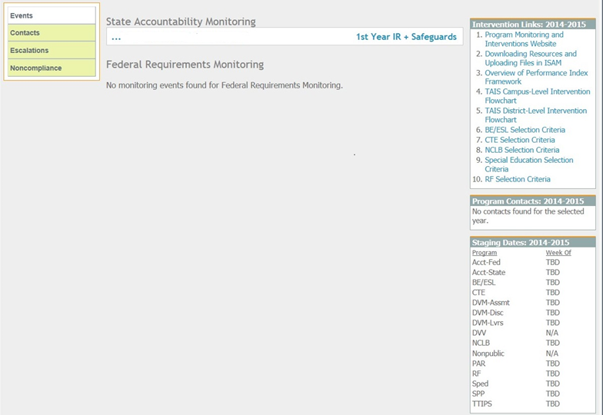
No contacts assigned
ISAM
At least one contact must be assigned for each review before submissions are accepted by the system.
If no contact is assigned, an error indicating that “no contact is assigned” will appear on the page.
One program contact must be identified before documents may be submitted to the ISAM system.
Notes:
When campuses or LEA’s are submitting documents to ISAM for the first time, the error they receive most often is “No Contact Assigned”. One program contact must be identified before documents can be submitted to the ISAM system.

Slide 4
Assigning New Program Contacts
ISAM
Current Contacts are listed on the Events Summary Page on the right-hand side of the webpage under “Program Contacts: 2014-2015.”
To add a contact from the Events Summary page, select “Contacts” to view a current contact or add a new contact.
Notes:
In order to create a new contact, open the LEA or Campus summary page and select “Contacts”. Then select “Create New”.

Slide 5
Assigning New Program Contacts
ISAM
Enter all new contacts at the LEA level, then assign the contact to specific campus(es) and specific LEA program(s).
All contacts that are expected to receive automated emails must have a profile setup in ISAM.
Select “Create New” on the “Contacts” page to add a new contact.
The page will refresh to a form to be completed.

Slide 6
Assigning New Program Contacts
ISAM
Enter all contact information for the new program contact and click “Save.”
Select the organization(s) associated with the contact.
Select the appropriate position(s).
Select the current to present year.
Select the program area(s) assigned to the contact.
Notes:
In order to enter multiple organizations click “Add Organization” and type the campus or LEA's name in the new box that appears. Finish up by entering a position and all of the programs assigned to the contact.

Slide 7
Assigning Program Contacts
ISAM
For previously-added contacts:
Assign the contact to the review (“Review Contacts” link).
Two-step process for new contacts:
Add the contact to the list (“Contacts” link located on the Events Summary Page).
Assign the contact to a review (“Review Contacts” link).
Notes:
If a new contact is to be assigned, we first need to create a Contact profile for that individual. Assign the profile to a review after it is created.

Slide 8
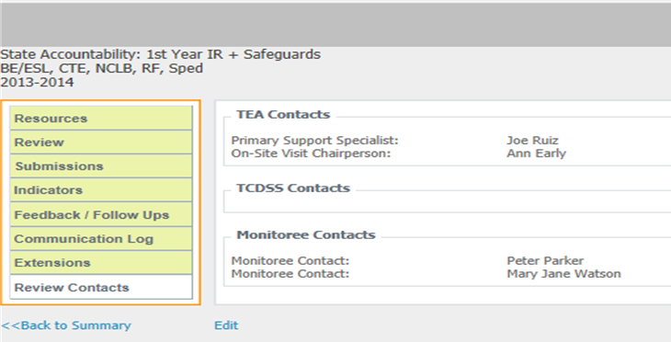
Assigning Program Contacts
ISAM
While viewing an LEA or campus review, select Review Contacts from the left-hand navigation bar.
Then, click “Edit” to add an individual as a contact.

Slide 9
Updating Contact Information
ISAM
It is important that information in the “Review Contacts” box is correct in order to receive automated emails.
Automated emails are sent to contacts once changes are made within ISAM.
Contacts assigned to specific program areas will receive automated emails regarding only those program(s).
Notes:
From time to time you may need to update contact information in ISAM. It is important that the contacts are updated if they change in order to receive automated emails from the system. All individuals listed in the Review Contacts box will receive automated notifications.

Slide 10
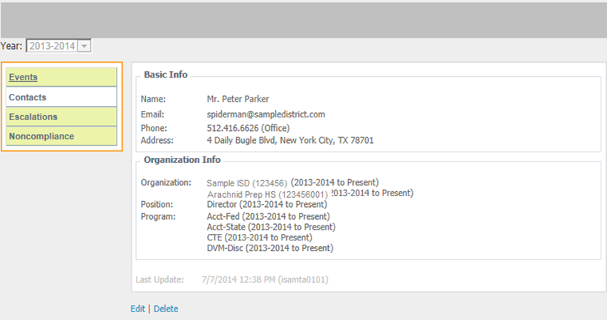
Updating Contact Information
ISAM
From the Events Summary page, Select Contacts
Select the “View” link of the profile being edited.
Select “Edit” to make revisions.
Notes:
In other cases we may need to edit the email address, program areas, or campuses for an individual. In order to edit this profile information, we will go back to the LEA’s contact page and open the profile we need to edit.

Slide 11
Updating Contact Information
ISAM
The individual must list all the campuses that they work on AND all programs that they work with in order to receive automated information from the ISAM system.
Click “Save” to update the profile with the changes.
*Note: Do not remove organization, position, or program history from ISAM. This information is stored for historical and auditing purposes.

Slide 12
Additional Resources
ISAM
Helpful links are posted in the “Intervention Links” section on the Events Summary page.
See the guide in ISAM.
Links: .
Questions regarding TEASE Access
http://www.tea.state.tx.us/index2.aspx?id=2728
Questions regarding TEAL Access
https://pryor.tea.state.tx.us/TSP/TEASecurePortal/Access/LogonServlet
Questions/Feedback related to ISAM
isam@tea.state.tx.us
Questions/Feedback related to documents
pmidivision@tea.state.tx.us
Questions/Feedback related to TEASE/TEAL
computer.access@tea.state.tx.us
Notes:
ISAM links provide a step by step handout in the intervention links panel in ISAM.

Slide 13
ISAM Team
ISAM
Kaela B. Lewis, Manager
Raj Nagarajan, Programmer
Morgan Migl, Management Analyst
Juarod Cal, Research Specialist
Jihan Hendley, Program Specialist
Nathalie Goodman, Systems Analyst
E-mail- ISAM@tea.state.tx.us
Phone- 512-463-5226

