Slide 1

Introductory Training on the
Proficiency Level Descriptors (PLDs)
Grades K–1
2023-2024
Texas Education Agency
Student Assessment Division
Notes:
This presentation is intended to be used after the Making the ELPS–TELPAS Connection: Grades K–12 Overview, which may be accessed from TEA’s TELPAS Resources webpage.
To make best use of this PowerPoint module, print the ELPS-TELPAS Proficiency Level Descriptors found on the TELPAS Resources webpage.
These PowerPoint resources, plus the TEA publication, TELPAS Educator Guide, are provided to support the effective use of the ELPS during instruction and assessment.
Note that abbreviated, reformatted, or modified proficiency level descriptors must not be used in training raters or assessing students. In support of standardization, the PLDs must be used as they have been formatted and published for TELPAS.

Slide 2


Proficiency Level Descriptors (PLDs)
The PLDs are the rubrics teachers use to determine students’ English language proficiency for ongoing formative assessment and the spring TELPAS administration.
Originally developed for TELPAS, the PLDs were incorporated into the Texas English language proficiency standards (ELPS) in the 2007-2008 school year to reinforce their use in instruction.
Notes:
The TELPAS holistically rated assessments were developed by TEA in collaboration with test development contractors, bilingual/ESL consultants, and a focus group of teachers, bilingual/ESL coordinators, test coordinators, and university professors.
The design of the assessments derives from the following language acquisition research and research-based standards, models, and assessments:
second language acquisition research of Jim Cummins concerning the
development of BICS and CALP
TESOL (Teachers of English to Speakers of Other Languages) ESL
standards
ACTFL (American Council for the Teaching of Foreign Languages)
proficiency guidelines and the ACTFL Performance Guidelines for K–12
Learners used in Texas LOTE (languages other than English) programs
similar assessment strategies used in other states

Slide 3
6 Sets of PLDs
Listening Grades K–12
Speaking Grades K–12
Reading Grades K–1
Grades 2–12
Writing Grades K–1
        Grades 2–12
Notes:
In alignment with the ELPS, TELPAS evaluates English language acquisition as it relates to grade-level expectations for understanding and using English to meaningfully engage in content area instruction.
The sets of PLDs are often referred to as rubrics for purposes of TELPAS. There is one K–12 rubric for listening and one K–12 rubric for speaking. K-1 raters consider a student’s listening and speaking proficiency levels in relation to the typical listening and speaking abilities of native English speakers at the student’s grade level.
For grades 2-12, teachers use the listening and speaking PLDs in instruction but not for TELPAS because TELPAS has an online test with a variety of item types for these grades.
For reading and writing, there are separate rubrics for K–1. The K–1 rubrics are distinct because factors associated with emergent literacy distinguish K–1 learners from students in higher grades.
For grades 2–12, teachers use the reading and writing PLDs in instruction but not for TELPAS, because TELPAS has an online test with a variety of item types to assess these grades and language domains.
Emergent bilingual (EB) students receiving special education services should be evaluated relative to their ability to understand and use English to access the general curriculum at their enrolled grade in accordance with their individualized education program (IEP). This assessment guideline aligns with federal requirements for ensuring that students with disabilities have access to the general curriculum. For EB students with the most significant cognitive disabilities, please refer to the TEA’s TELPAS Alternate Resources webpage for additional information.

Slide 4
Key Features of Each Proficiency Level
Beginning
  Little or no English ability
Intermediate
  Limited ability, simple language structures,
  high-frequency vocabulary, routine contexts
Advanced
  Grade appropriate, with second language acquisition support
Advanced High
  Grade appropriate, with minimal second language acquisition support
Notes:
This slide summarizes key features of the PLDs in terms of how well EB students can understand and/or use English in social and academic settings at each of the four levels. These key features are emphasized in the PLD summary statements for each language domain. As an example, refer to the summary statements at the top of the PLDs for listening.
Note the term second language acquisition support. This term refers to the language assistance EB students need as they learn English. It is different from the type of assistance that any student (whether an EB student or not) might need when learning academic content. Second language acquisition support is specific to the unique language assistance that EB students need.
The overall language abilities of each proficiency level are as follows:
Beginning students have little or no ability to understand/use English. They may know a little English but not enough to function meaningfully in social and academic interactions.
Intermediate students do have some ability to understand and use English. They can function in social and academic settings as long as tasks require them to understand and use simple language structures and high-frequency vocabulary within routine contexts.
Advanced students are able to engage in grade-appropriate academic instruction in English, although ongoing second language acquisition support is needed to help them understand and use grade-appropriate language. These students function beyond the level of simple, routinely used English.
Advanced high students have attained the command of English that enables them, with minimal second language acquisition support, to engage in regular, all-English academic instruction at their grade level.
Note that high academic achievement is not a prerequisite of the advanced high level of English language proficiency. Advanced high EB students exhibit a range of academic achievement just as their native English-speaking peers do.

Slide 5
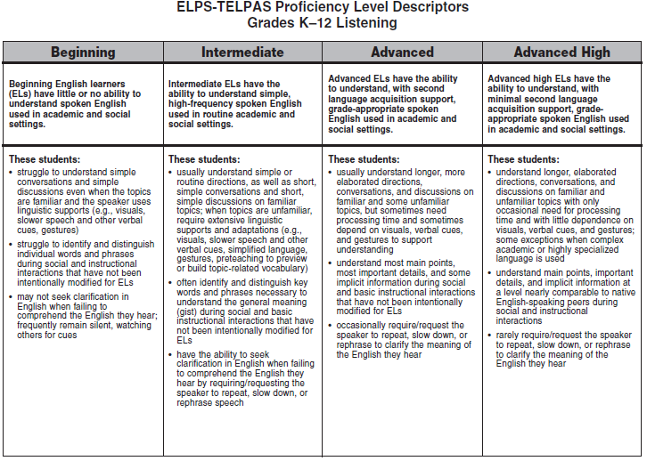
ELPS-TELPAS Proficiency Level Descriptors
Grades K–12 Listening
Notes:
The PLDs for each language domain present a set of major attributes associated with each level. The descriptors do not constitute an exhaustive list but are sufficient for identifying students’ stages of English language proficiency. Together, the summary statement and bulleted descriptors for each proficiency level form a student profile.
Review the full-size listening PLDs and note the overall English communication abilities described in the summary statement for each level.
B little or no English
I simple, high-frequency, routine
A grade-appropriate with second language acquisition support
AH grade-appropriate with minimal second language acquisition support
Examine the main features of each level. Note how the descriptors further define the summary statements and show the continuum of English language development across the proficiency levels.
1st descriptor: type of spoken English understood and extent to which understanding is dependent on supports and linguistic adaptations
2nd descriptor: degree of comprehension demonstrated when interactions are not modified to include supports and linguistic adaptations
3rd descriptor: degree of need to seek clarification to understand or confirm meaning of spoken English
In the context of second language acquisition, the term “high-frequency words” refers to commonly encountered words that a student who knows very little English can be made to understand through context, gestures, and pictures. Initially, the kinds of high-frequency words and phrases typically acquired may include, for example, greetings, numbers, objects in the classroom and around school, names of classmates, etc.
When rating a student, read each proficiency level as a whole (i.e., the whole vertical column as opposed to isolated descriptors) and determine the level that best describes the student’s current, overall level of English language acquisition.

Slide 6
Reflect on how well the student understands the English he or she hears during activities such as:
Reacting to oral presentations
Responding to text read aloud
Following directions
Cooperative group work
Informal interactions with peers
Large-group and small-group instructional interactions
One-on-one interviews
Individual student conferences
Notes:
This list of activities is not exhaustive. Teachers may identify other appropriate activities suited to the grade level(s) taught.
Think about what behaviors help indicate an emergent bilingual student’s level of English language listening proficiency and how to tell whether an EB student is struggling to understand the English used in oral presentations, directions, text read aloud, etc.

Slide 7
Beginning Listener
Nonacademic Listening Sample
What Might a Beginning Listener Understand?
I have some exciting news for you today. We are going to go on a field trip next week. On Thursday morning we will load the buses and be gone the whole day. In your take-home folders there is a note about the field trip for your parents to sign. Please remember to bring the signed note in your take-home folder back to school. You have to bring the note signed by your parents back to school or you will not be able to go with us.
Text in bold, red print represents text that might be understood.
Notes:
This sample shows classroom speech that is not academic in nature. In each listening sample presented in the upcoming slides, it should be assumed that the teacher is talking informally to a class without making linguistic accommodations designed for EB students.
In spontaneous informal speech, EB students who have learned a little English may hear some individual high-frequency words that they will be able to distinguish in highly routine classroom situations (today, buses, school, go, etc.); however, they cannot understand enough English to make sense of spoken messages delivered at a normal speed and without linguistic accommodations.
This sample exemplifies what is meant by the second beginning bullet of the PLDs for listening.
Beginning listeners:
struggle to identify and distinguish individual words and phrases during social and instructional interactions that have not been intentionally modified for EB students
These listening samples reinforce the importance of making appropriate linguistic accommodations according to the EB student’s proficiency level.
Beginners can be expected to struggle to understand what they hear even when extensive linguistic accommodations (adaptations and supports) are provided. Beginners benefit most from having a teacher or peer translate what is said into their native language.

Slide 8
In Other Words (Beginning Listener)
… today. We … go … buses … take-home folders … Please … take-home folder … school … school … go
Notes:
While this beginning student understands some very high-frequency words and phrases in English, the student is not able to make sense of the message the teacher is conveying to the class.

Slide 9
Intermediate Listener
Nonacademic Listening Sample
What Might an Intermediate Listener Understand?
I have some exciting news for you today. We are going to go on a field trip next week. On Thursday morning we will load the buses and be gone the whole day. In your take-home folders there is a note about the field trip for your parents to sign. Please remember to bring the signed note in your take-home folder back to school. You have to bring the note signed by your parents back to school or you will not be able to go with us.
Notes:
An intermediate listener is able to understand much more of the message than a student at the beginning level. Typically, students at this level are able to understand enough key words and phrases to capture the general meaning or general idea (gist) of the message.
This sample exemplifies what is meant by the second intermediate bullet of the PLDs for listening.
Intermediate listeners:
often identify and distinguish key words and phrases necessary to understand the general meaning (gist) during social and basic instructional interactions that have not been intentionally modified for EB students

Slide 10
In Other Words (Intermediate Listener)
I have … you today. We are going … go … field trip ... we will … buses … day … take-home folders … note … field trip … parents ... Please remember … bring … note … take-home folder … school. You have to bring … note … parents … school … go with us.
Notes:
In this sample, the student is able to understand a number of phrases containing simple, high-frequency words. These phrases (we are going, we will, please remember, you have to bring, go with us) are used very routinely in classroom settings, supporting the EB student’s ability to make meaning of longer segments of speech.
This student understood the basic gist of the message but few of the important details.
Intermediate listeners often require extensive linguistic accommodations to understand more than just the general idea of what they hear in class. As indicated in the PLDs, some listening accommodations include visuals, simplified language, gestures, preteaching to preview or build topic-related vocabulary, slower speech, and other verbal cues such as repetition and native language support.

Slide 11
Advanced Listener
Nonacademic Listening Sample
What Might an Advanced Listener Understand?
I have some exciting news for you today. We are going to go on a field trip next week. On Thursday morning we will load the buses and be gone the whole day. In your take-home folders there is a note about the field trip for your parents to sign. Please remember to bring the signed note in your take-home folder back to school. You have to bring the note signed by your parents back to school or you will not be able to go with us.
Notes:
This sample exemplifies what is meant by the second advanced bullet of the PLDs for listening.
Advanced listeners:
understand most main points, most important details, and some implicit information during social and basic instructional interactions that have not been intentionally modified for EB students
Advanced listeners are usually able to understand the main points and most of the details of this type of speech, even when the message is not linguistically simplified. As shown here, there are still some gaps in understanding unusual constructions and words used in unfamiliar ways.

Slide 12
In Other Words (Advanced Listener)
I have some … for you today. We are going to go on a field trip ... morning we will … the buses and be gone the … day. In your take-home folders there is a note … the field trip for your parents to sign. Please remember to bring the … note in your take-home folder back to school. You have to bring the note … parents back to school or you will not be able to go with us.
Notes:
This student is able to understand the main point of the message and most of the important details (such as having a note in the take-home folder) not understood by the intermediate listener. The student doesn’t understand, however, when the field trip is or the use of “signed” as an adjective, which may result in difficulty getting the form returned appropriately. Linguistic accommodations help a student at this level fill in these types of gaps.

Slide 13
Advanced High Listener
Nonacademic Listening Sample
What Might an Advanced High Listener Understand?
I have some exciting news for you today. We are going to go on a field trip next week. On Thursday morning we will load the buses and be gone the whole day. In your take-home folders there is a note about the field trip for your parents to sign. Please remember to bring the signed note in your take-home folder back to school. You have to bring the note signed by your parents back to school or you will not be able to go with us.
Notes:
This sample exemplifies what is meant by the second advanced high bullet of the PLDs for listening.
Advanced high listeners:
understand main points, important details, and implicit information at a level nearly comparable to native English-speaking peers during social and instructional interactions
Advanced high listeners are usually able to understand most words and details in routine spoken messages, even when the messages are not linguistically simplified.
This advanced high student understands that the class will leave on Thursday morning.
The student has difficulty understanding “signed” as an adjective. However, understanding the word “about” in the sentence beginning “In your take-home folders” allowed the student to understand that there was a note for his parents to sign and that the note must be returned in order to go on the field trip.
It is important to keep in mind that students at the advanced high level have difficulty understanding certain things they hear, particularly when low-frequency words are used. At the advanced high stage, though, students understand enough of what they hear to need only minimal second language acquisition support to engage meaningfully in academic and social interactions.

Slide 14
Beginning Listener
Academic Listening Sample
What Might a Beginning Listener Understand?
Today in science we are going to study some more about spiders. Then we will observe a few spiders in this glass vivarium for one week. One reason we will observe the spiders is to learn some important things about them. For example, we want to know what spiders eat and how they get their food. We also want to know if other animals eat spiders. Let’s go sit on the carpet and read a story about how spiders catch their food and protect themselves from getting eaten.
Notes:
These next slides show an example of speech that is academic in nature. As with the previous slides, it should be assumed that the teacher is talking to a class without making linguistic accommodations designed for EB students. These slides provide additional examples of what is meant by the second bullet of the PLDs for listening.
This sample shows speech that a student might hear in a science lesson. In the classroom, teachers give certain repeated, highly routine instructions. Beginning listeners hear such instructions regularly and begin to memorize phrases, even without understanding each of the individual words. Beginning listeners may also hear certain high-frequency words that become familiar to them (one, food, eat). Beginning level students also acquire some academic vocabulary they hear daily in highly predictable contexts.

Slide 15
In Other Words (Beginning Listener)
Today … science … spiders … spiders … one ... One … spiders … spiders eat … food … eat spiders … sit on the carpet … read a story ... spiders … food
Notes:
As shown in this example, the student understands some high-frequency academic words (science, spiders, one) associated with the lesson. The understanding of such words in spoken messages is affected by how fast the person is speaking and the emphasis given to the words.
Since this lesson is a continuation of a lesson on spiders, the beginning student has learned the meaning of the word “spider” and also understands the word when he hears it.
In the example above, the student was very accustomed to being directed to go sit on the carpet to hear the teacher read stories and, therefore, memorized what the phrases “sit on the carpet” and “read a story” meant.

Slide 16
Intermediate Listener
Academic Listening Sample
What Might an Intermediate Listener Understand?
Today in science we are going to study some more about spiders. Then we will observe a few spiders in this glass vivarium for one week. One reason we will observe the spiders is to learn some important things about them. For example, we want to know what spiders eat and how they get their food. We also want to know if other animals eat spiders. Let’s go sit on the carpet and read a story about how spiders catch their food and protect themselves from getting eaten.
Notes:
An intermediate listener understands more of the routine language heard daily in the classroom (we are going to study, we want to know) and makes sense of longer segments of speech. While students at this level are usually able to get the general meaning (gist) of routine, nonacademically complex interactions, they struggle to understand academic lessons that have not been linguistically modified.

Slide 17
In Other Words (Intermediate Listener)
Today … science we are going to study … spiders. Then we … spiders … one … One … we … the spiders is to learn … we want to know what spiders eat … food. We … want to know … animals eat spiders … go sit on the carpet … read a story … spiders … food ...
Notes:
This intermediate level student hears and understands familiar words related to the topic of study, such as spiders and animals. However, the teacher is attempting to teach students about what spiders eat and how spiders keep from getting eaten. Because this lesson has not been linguistically modified, the student does not understand enough of what the teacher is saying to grasp the idea that the lesson will be focusing on how spiders catch their food and protect themselves from other animals.

Slide 18
Advanced Listener
Academic Listening Sample
What Might an Advanced Listener Understand?
Today in science we are going to study some more about spiders. Then we will observe a few spiders in this glass vivarium for one week. One reason we will observe the spiders is to learn some important things about them. For example, we want to know what spiders eat and how they get their food. We also want to know if other animals eat spiders. Let’s go sit on the carpet and read a story about how spiders catch their food and protect themselves from getting eaten.
Notes:
Advanced level listeners have acquired enough English to understand the English used in discussing familiar academic topics and some unfamiliar topics. This helps them gain more meaning when they learn new academic concepts. However, advanced level listeners need ongoing linguistic support to (1) ensure that they are understanding correctly and (2) to add new vocabulary, expressions, and language structures to their receptive vocabulary.

Slide 19
In Other Words (Advanced Listener)
Today in science we are going to study some more … spiders. Then we will … spiders in this glass … for one … One … we will … the spiders is to learn some important things … we want to know what spiders eat and how they get … food. We … want to know … other animals eat spiders … go sit on the carpet and read a story … how spiders catch … food and protect … from getting …
Notes:
Because the teacher’s lesson is not linguistically accommodated through the use of gestures and verbal cues, this advanced level student still misses some important information. The student does not understand that part of the lesson will focus on observing spiders. The teacher does not emphasize the word “vivarium” and point to it to teach it as new vocabulary. Therefore, this advanced student does not hear “vivarium” as an isolated word in the teacher’s speech in order to begin to learn this new word.

Slide 20
Advanced High Listener
Academic Listening Sample
What Might an Advanced High Listener Understand?
Today in science we are going to study some more about spiders. Then we will observe a few spiders in this glass vivarium for one week. One reason we will observe the spiders is to learn some important things about them. For example, we want to know what spiders eat and how they get their food. We also want to know if other animals eat spiders. Let’s go sit on the carpet and read a story about how spiders catch their food and protect themselves from getting eaten.
Notes:
The level of linguistic understanding of the advanced high listener is similar, with minimal second language acquisition support, to the linguistic understanding of native English-speaking peers.
This student is able to understand almost all of what the teacher said in the introduction to this lesson. The student does not understand the term “vivarium” but still understands the point of the sentence. The fact that the student doesn’t understand the word “week” may be because even some non-EB students at this age struggle with concepts of time and the precise meanings of time-related words. It is difficult for EB students to learn the meaning of words in their second language if the words are conceptually difficult for them in their first language.
Despite these few unfamiliar words, however, the student still captures enough to get an overall understanding of this part of the lesson.

Slide 21
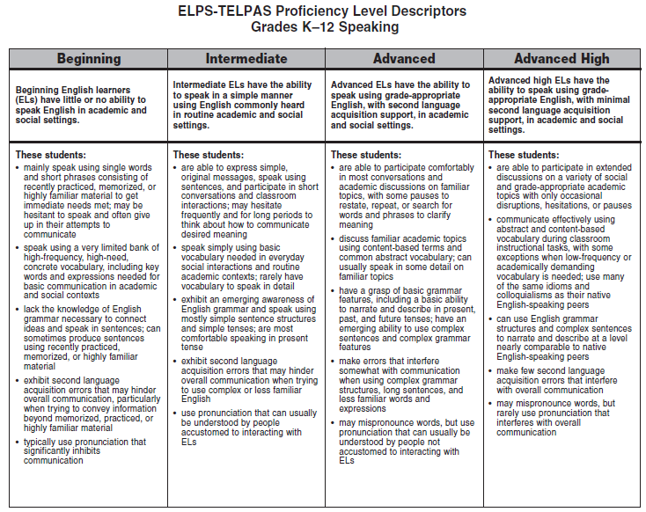
ELPS-TELPAS Proficiency Level Descriptors
Grades K–12 Speaking
Notes:
Review the speaking PLDs and note the overall English communication abilities described in the summary statement for each level.
B little or no English
I simple, commonly heard, routine
A grade-appropriate with second language acquisition support
AH grade-appropriate with minimal second language acquisition support
Examine the main features of each level and note how the descriptors further define the summary statements and show the continuum of English language development across the proficiency levels. The focus of each descriptor is shown below.
1st descriptor: discourse type and length; fluency
2nd descriptor: vocabulary
3rd descriptor: grammar structures
4th descriptor: accuracy
5th descriptor: pronunciation
Beginning vs. Intermediate. Be careful not to conclude that beginners use only single words and phrases to communicate and that students who occasionally produce sentences have reached the intermediate level. Before reaching the intermediate level, beginners will speak in sentences at times, but the sentences will be based primarily on recently practiced, memorized, or highly familiar/formulaic material. Students reach the intermediate level when sentence-length speech is no longer primarily based on recently practiced, memorized, or highly familiar/formulaic material. Students at the intermediate level can use their growing bank of English vocabulary and emerging awareness of basic grammar features to recombine learned elements and “create” with the language in order to speak simply in routine academic/social contexts.
Students Near Border Between Levels. For all language domains, remember to read each proficiency level as a whole to determine the proficiency level at which the student performs most consistently. Remember that students “peak” into the next level before performing most consistently at the new level. Likewise, students who have recently reached a new level may occasionally “spike down” to the level below and not perform entirely consistently at the new level. For students near the border between two levels, determine the level at which the student performs most consistently overall. To do this, step back and read both proficiency levels from top to bottom, making sure to go back and review the summary statement for each level.

Slide 22
Reflect on how well the student speaks English during activities such as:
Cooperative group work
Oral presentations
Informal interactions with peers
Large-group and small-group instructional interactions
One-on-one interviews
Classroom discussions
Articulation of problem-solving strategies
Individual student conferences
Notes:
This list of activities is not exhaustive. Teachers may identify other appropriate activities suited to the grade level(s) taught.
Think about activities that give you good indications of students’ speaking proficiency levels and the differences you observe when EB students with different proficiency levels speak during cooperative group work, classroom discussions, oral presentations, etc.

Slide 23
Grade 1 Intermediate Speaker (Sample 1)
Sample 1: The student and teacher are talking about pets.
Teacher: Would you like to have a duck as a pet?
Student nods.
Teacher: Tell me about it. Why?
Student: Because to feed him.
Teacher: You could feed him. Would you take care of him?
Student: Feed…feed the…feed him with the bread.
Teacher: Bread. What kind of bread? You’d have to make it in really small pieces, right?
(Student nods)
Notes:
The following slides present speech samples at the intermediate, advanced, and advanced high proficiency levels. A beginning-level set of samples is not shown. At each proficiency level represented, the speech of a single student (with the teacher’s interactions) is provided. Each student responds to several speaking tasks that require everyday spoken language as well as academic language.
The speech samples are transcribed from the students in the K–1 online basic training course. Ellipses and “uh” or “um” are shown to indicate places where the student had difficulty finding the right words to say. When “um” was used by the student casually in speech, but did not indicate difficulty with English, it is not transcribed.
These samples are intended to help show how to apply the speaking PLDs for each proficiency level. Remember that when teachers rate the speaking proficiency of their own students, they will have observed the students in a variety of speaking situations, not just on isolated speech samples.
Intermediate features of speech sample on this slide:
The student’s responses are general and lack detail.
Second language acquisition inaccuracies increase when the student tries to use more than simple structures and highly familiar English vocabulary (Because to feed him, …feed him with the bread).
Although telling about what he would do with a duck requires a complex verb tense, the student uses present tense.
In general the student struggles to respond to this task because it calls for hypothesizing, which requires use of complex verb structures containing “would” and “could.”
(Note that the student’s limited listening proficiency interferes with his responses toward the end of the sample.)

Slide 24
Grade 1 Intermediate Speaker (Sample 1 continued)
Teacher: What else would you do with a duck as a pet?
Student: You give him a drink.
Teacher: You give him drink. What do you think ducks drink?
Student: Um, water.
Teacher: Water, ok. Why else do you think a duck would be a good pet? Do you think it would be fun for your friends to go visit him at your house?
Student: A spider could…good friend. A spider.
Teacher: You’d want to have a spider as a pet?
Student: (Nods) Or a snake.
Notes:
Intermediate features of speech sample on these slides:
The student’s responses are general and lack detail.
Second language acquisition inaccuracies increase when the student tries to use more than simple structures and highly familiar English vocabulary (Because to feed him, …feed him with the bread).
Although telling about what he would do with a duck requires a complex verb tense, the student uses present tense.
In general, the student struggles to respond to this task because it calls for hypothesizing, which requires use of complex verb structures containing “would” and “could.”
(Note that the student’s limited listening proficiency interferes with his responses toward the end of the sample.)

Slide 25
Grade 1 Intermediate Speaker (Sample 2)
Sample 2: He is asked to talk about his mom.
Teacher: Something that reminds you of your mom. Think of something different.
Student: Towels.
Teacher: What?
Student: Towel.
Teacher: Why would you choose that?
Student: Because…she like…Because she like a wash.
Teacher: Because your mom likes to wash?
(Student nods)
Teacher: Do you help her with that, too?
(Student nods)
Notes:
Intermediate features of speech sample on this slide:
The student participates in class with brief responses using simple, high-frequency English.
Second language acquisition features are present (Because she like a wash).

Slide 26
Grade 1 Intermediate Speaker (Sample 3)
Sample 3: He explains a story using picture cards. The story is about breaking a piñata at a birthday party.
Teacher: Who’s hanging it up there?
Student: The… the mom.
Teacher: Looks like the mom. Why is it the mom? Why don’t the children put it up there?
Student: Because ch…Because children fall his head going hurt it. (lifts his hands up to his head)
Teacher: The kids are too small to be doing that. And then what’s happening here?
Student: The kid will break it.
Teacher: What is she putting around her eyes?
Student: Uh…uh…(looks at other kids) um.
Teacher: A blindfold.
Student: A blindfold.
Teacher: And why is she doing that?
Student: Because, because, because he don’t want to see it.
Teacher: Why?
Student: Because. Because he will cheating.
Teacher: Yeah, because if you can see… (shrugs)
Student: I did, I did that.
Notes:
Intermediate features of speech sample on this slide:
This speaking task requires the ability to explain a story from pictures, which requires more than basic vocabulary and the use of more complex language structures to speak in detail. The student shows a basic ability to express simple, original messages in short sentences.
The student is able to speak using vocabulary he has been learning. However, the student pauses frequently due to the increased language demands of the task.
Limited English vocabulary and language structures greatly affect the student’s ability to connect ideas and narrate the story with details and precision. He makes frequent errors associated with second language acquisition.

Slide 27

Grade 1 Intermediate Speaker (Sample 3 continued)
(Sample 3 continued.)
Teacher: Did they blindfold you, too?
Student: Yeah.
Teacher: Were you able to see anything?
Student: Nope…It’s too dark.
Teacher: It’s too dark. And then what happened?
Student: They broked it and then all the candy fell out.
Teacher: Where’s the candy?
Student: On the floor.
Teacher: Can you point to it?
(Student points to it and teacher nods)
Teacher: And what do you usually do when that happens?
Student: You eat them.
Teacher: Should all the kids run together?
Student: No. Need to walk.
Teacher: Why?
Student: Because, because they’re going, because they’re going to fall because the rock.
Notes:
Summary of intermediate features represented in this student’s speech samples:
Basic vocabulary used for everyday communication
Emerging awareness of English grammar structures
Most comfort and success using present tense
Simple, brief responses, with hesitations and pauses
Simple sentence structures
Frequent second language acquisition errors
Speech usually understandable to people who work with EB students

Slide 28
Grade 1 Advanced Speaker (Sample 1)
Sample 1: The student talks about a time she got angry about something her sister did.
Student: My sister and me are twins.
Teacher: Really, wow! What is it like to have a twin sister?
Student: I have twin sister. Um, I am, I am bigger and she is smaller and we are twins.
Teacher: So what kind of things do you do?
Student: Huh?
Teacher: What kind of things do you do?
Student: I play with her.
Teacher: Uh huh, like what?
Student: Some thing, like a ball. And we go swimming…each other.
Teacher: You go swimming at your, at your home? Or do you go to a pool?
Student: I go to the pool.
Teacher: So are you writing and drawing about a time that you were grumpy?
Student: (Nods head “yes.”)
Teacher: Tell me about that. What happened?

Slide 29
Grade 1 Advanced Speaker (Sample 1 continued)
Sample 1 (continued): The student talks about a time she got angry about something her sister did.
Student: Um, she, I was giving her to play with it to don’t broke it outside and she broke it and I was grumpy.
Teacher: Oh, what did she break?
Student: My necklace. Outside, and I was grumpy.
Teacher: Oh, yeah. OK, so after she broke it what happened?
Student: And I tell my mom and she brought me another one.
Teacher: Did you feel better then?
Student: (Nods head “yes.”) And I was mad at my sister.
Teacher: Did your sister do anything after?
Student: No. I don’t, I don’t even give her to play.
Notes:
Advanced features of speech sample on these slides:
The student shows an emerging ability to use complex and longer sentences.
The student shows enough grasp of basic grammar features to narrate and describe in some detail using the past tense.
The student makes second language acquisition errors that don’t interfere with communication.

Slide 30
Grade 1 Advanced Speaker (Sample 2)
Sample 2: She is speaking about a story that was read aloud in class.
Teacher: What do you notice?
Student: The cat is scaring with the man. Cat is, the ca, the cat is scared.
Teacher: How can you tell the cat is scary?
Student: Because the man, man is being scary.
Teacher: The man does look like that. Can you tell me what the cat’s doing that shows you he is scary?
Student: Umm…
Teacher: Or he’s scared?
Student: Yeah. He’s scared of the man.
Notes:
Advanced features of speech sample on this slide:
The student participates comfortably in class, with some pauses to search for words and phrases to clarify meaning.
The sample includes less detail than some of her other samples, and she shows less comfort due to linguistic demands.
Even though the student is unable to answer the questions in more detail, most of what she is saying would be understandable, in the context of the story, to individuals not accustomed to interacting with EB students.

Slide 31
Grade 1 Advanced Speaker (Sample 3)
Sample 3: She talks about the time she saw a fire.
Student: Um, one day I was going to Chuck E. Cheese and I, I come in my house. I saw fire in another place and um, I saw fire, firemans and they were, they were taking outs the gir.., the babies. And I saw saw, I saw, I saw fireman, and…
Teacher: What was he doing?
Student: He was putting a wa, water in the fire.
Notes:
Advanced features of speech sample on this slide:
The student shows an emerging ability to use complex and longer sentences.
The student is able to narrate and describe in some detail.

Slide 32
Grade 1 Advanced Speaker (Sample 4)
Sample 4: She speaks in a group discussion about a book.
Teacher: Can you think of an idea why he might be upset?
Student: Because um, the, the, the…
Other student: The lady.
Student: Yeah, lady. The man is…no, the grump, grumpy is mad at the lady because she give her a food. That’s why he’s so angry.
Notes:
Advanced feature of speech sample on this slide:
The student uses emerging grade-appropriate vocabulary and grammar structures to describe a particular part of a book that is being discussed. Even though she doesn’t have the precise vocabulary to describe a specific detail, she is able to convey her ideas using English she does know.
Summary of advanced features represented in this student’s samples:
Emerging comfort and fluency when speaking
Emerging grade-appropriate vocabulary and basic grasp of language structures
Ability to narrate and describe in some detail
Use of simple past tenses
Speech usually understandable

Slide 33
Grade 1 Advanced High Speaker (Sample 1)
Sample 1: The student is asked to feel an object in a bag and describe it. The object is a clothespin.
Teacher: Tell us what it feels like.
Student: It’s a hanger. It hangs clothes.
Teacher: Ohhhhh. How did you know that?
Student: I knew, I just know cuz I’m feeling it.
Teacher: You’re feeling it.
Student: And it’s hard.
Teacher: Ok, it’s hard. What else does it feel like?
Student: And it, it claps the clothes on it, it dries…
Notes:
Advanced high features of speech sample on this slide:
Instances of unnatural phrasing and linguistic errors are minor and don’t interfere with communication (it claps the clothes on it).
The student is able to comfortably describe the object that he has felt in a bag. In doing so, he uses vocabulary and grammar structures in a manner nearly comparable to that of native English-speaking peers.

Slide 34
Grade 1 Advanced High Speaker (Sample 2)
Sample 2: He describes what happened when he and his family went to the beach.
Teacher: That sounds really nice.
Student: Cuz I been there.
Teacher: You’ve been to the beach?
(Student nods)
Teacher: Do you like it?
Student: Yeah, it was funner…You could see crabs. And my brother, my big one, he um, he got bit. He got snatched by the crab in his foot.
Teacher: Ohhhhh.
Student: (giggles) It hurted. And we put him in the cup and it stinked and we had to put him somewhere but he died already.
Teacher: Would you still want a beach near your house when you grow up?
Student: Yeah.
Teacher: Even if that happened?
Student: Yeah, I would.
Notes:
Advanced high features of speech sample on this slide:
The student is able to talk with ease about a past event on a familiar topic.
The student uses idioms and colloquialisms similar to those used by his native English-speaking peers (cuz I been there, got bit).
Minor errors in word choice and grammar structures do not interfere with overall communication (he got snatched, it stinked, it hurted) and are not unlike errors made by native English-speaking peers.

Slide 35
Grade 1 Advanced High Speaker (Sample 3)
Sample 3: He tells his teacher about going fishing with his dad and brother.
Student: Miss, yesterday, we were at fishing, and after that, we went to…, we caught a lot of fish, me and my big, my brother, his fishing rod wasn’t working.
Teacher: His fishing rod wasn’t working?
Student: Yeah.
Teacher: And then?
Student: After that, we caught a lot of fish, me and my little brother. He caught a lot, he caught a big fish and I caught a catfish, and another one, and my big brother…
Notes:
Advanced high features of speech sample on this slide:
Student exhibits spontaneous, extended speech with infrequent hesitations.
The student is able to effectively communicate about his fishing experience using subject-specific vocabulary (fishing rod, catfish).

Slide 36
Grade 1 Advanced High Speaker (Sample 4)
Sample 4: He responds to a question about birthday parties.
Teacher: So have you had a lot of parties? Birthday parties?
Student: (nods) Yeah.
Teacher: How about you? Have you gone to other people’s birthday parties?
Student: (nods) Uh huh. Always.
Teacher: You always go?
Student: Uh huh.
Teacher: Do you like them?
Student: Yeah, I been to my cousin, Isa, she was little, and we played games, played basketball, and baby thing for they could play too, and they had um, a bouncer, only for big kids, and they had a little one too.
Notes:
Advanced high features of speech sample on this slide:
Instances of unnatural phrasing and linguistic errors are minor and don’t interfere with communication.
The student elaborates with ease about a common experience.
Summary of advanced high features represented in this student’s speech samples:
Spontaneous, extended speech with infrequent hesitations
Ability to participate comfortably in grade level activities
Narrations and descriptions similar to those of native English-speaking peers
Use of complex tenses, grammar, and sentences
Rarely makes linguistic or pronunciation errors
Errors rarely interfere with overall communication

Slide 37
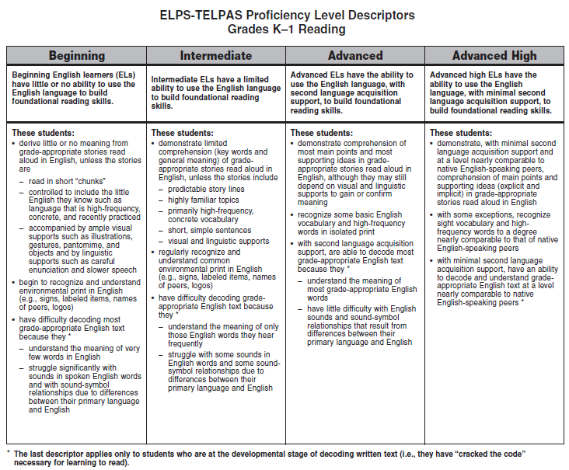
ELPS-TELPAS Proficiency Level Descriptors
Grades K–1 Reading
Notes:
Review the K–1 reading PLDs and note the overall English proficiency described in the summary statement for each level. Then examine the main features of each level and note how the descriptors bring greater definition to the summary statements, showing the continuum of English language development across the levels.
B little or no English ability
I limited ability
A ability with second language acquisition support
AH ability with minimal second language acquisition support
The K–1 reading rubric requires the rater to consider how well the student can use the English language to build foundational reading skills. Students in K–1 (whether ELs or not) vary widely in their early literacy development and may be at different developmental reading stages regardless of second language acquisition issues. For this reason, the K–1 reading rubric considers the extent to which the student can use the English language to build foundational reading skills through oral reading activities as well as through activities that require actual decoding of text.
The bulleted descriptors address the following features and show the continuum of English language development across the levels.
1st descriptor: comprehension of stories read aloud (oral reading)
2nd descriptor: recognizing/understanding simple environmental print, high-
frequency words, sight vocabulary
3rd descriptor: decoding grade-appropriate English text
Review the footnote at the bottom of the rubric concerning the fact that the third descriptor in each level applies only to students who are at the developmental stage of decoding written text. Students not yet at this stage should be rated on the basis of the first and second descriptors in each level. This means that the four proficiency level ratings are applicable to K–1 students who have not yet reached the developmental stage of decoding written text.

Slide 38
Reflect on how well the student understands the English used during activities such as:
Paired reading
Sing-alongs and read-alongs, including chants and poems
Shared reading with big books, charts, overhead transparencies, other displays
Guided reading with leveled readers
Reading subject-area texts and related materials
Independent reading
Cooperative group work
Reading response journals
Notes:
This list of activities is not exhaustive. Teachers may identify other appropriate activities for determining a student’s level of English language proficiency in reading.

Slide 39
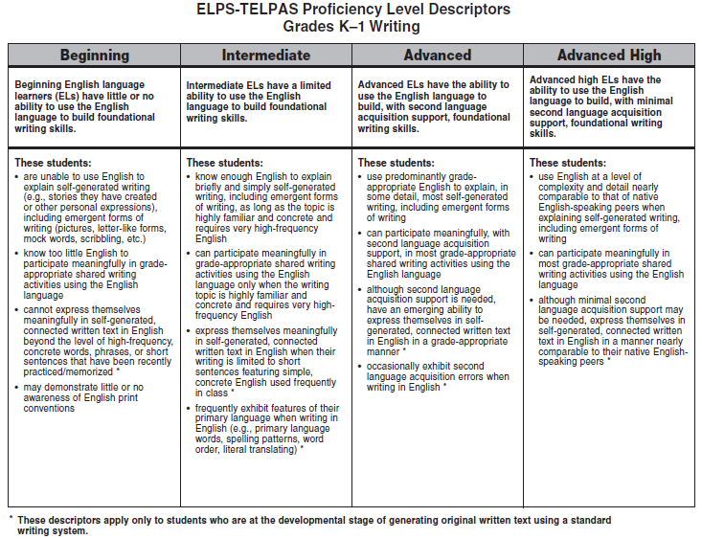
ELPS-TELPAS Proficiency Level Descriptors
Grades K–1 Writing
Notes:
Review the K–1 writing PLDs and note the overall English proficiency described in the summary statement for each level. Then examine the main features and note how the descriptors bring greater definition to the summary statements, showing the continuum of English language development across the levels.
B little or no English ability
I limited ability
A ability with second language acquisition support
AH ability with minimal second language acquisition support
The K–1 writing rubric (like the K–1 reading rubric) requires the rater to consider how well the student can use the English language to build foundational writing skills. Students in K–1 (whether EB students or not) vary widely in their early literacy development and may be at different developmental writing stages regardless of second language acquisition issues. For this reason, the K–1 writing rubric considers the extent to which the student can use the English language to build foundational writing skills through oral activities that are based on emergent forms of writing as well as through activities that involve self-generated, connected written text.
The bulleted descriptors address the following features and show the continuum of English language development across the levels.
1st descriptor: use of English to explain self-generated writing, including emergent forms of writing
2nd descriptor: use of English to participate in shared writing activities
3rd descriptor: use of English in self-generated, connected written text
4th descriptor: print awareness and primary language features
Review the footnote at the bottom of the rubric concerning the fact that the asterisked (*) descriptors in each level apply only to students who are at the developmental stage of generating original written text using a standard writing system. Students not yet at this stage should be rated on the basis of the other descriptors. This means that the four proficiency level ratings are applicable to K–1 students who have not yet reached the developmental stage of generating original text using a standard writing system.
Note that the writing proficiency level descriptors for grade 2 assume that students have reached the developmental stage of generating original text using a standard writing system.

Slide 40
Reflect on how well the students write in English during activities such as:
Journal writing for personal reflections
Shared writing for literacy and content area development
Language experience dictation
Organization of thoughts and ideas through prewriting strategies
Publishing and presenting
Making lists for specific purposes
Labeling pictures, objects, and items from projects
Cooperative group work
First drafts
Notes:
This list of activities is not exhaustive. Teachers may identify other appropriate activities for determining a student’s level of English language proficiency in writing.

Slide 41
Writing in Content Areas
Sample ELPS Student Expectations
Narrate, describe, and explain with increasing specificity and detail to fulfill content area writing needs as more English is acquired (c)(5)(G)
In science, this expectation can be addressed through writing assignments in which students, for example, observe, describe, and compare physical properties.
Write using newly acquired basic vocabulary and content-based grade-level vocabulary (c)(5)(B)
In math, this expectation can be addressed by having students, for example, write about the shapes they are studying and name items at home that are the same shapes.

Slide 42
Disclaimer
These slides have been prepared by the Student Assessment Division of the Texas Education Agency. You are encouraged to use them for local training.
If any of the slides are changed for local use, please hide or remove any TEA logos, headers, or footers. (You may need to edit the Master slide.)

