Slide 1
Texas Home Learning Model: Phase 2: Summer Learning Plans April 30, 2020

Slide 2
What is Texas Home Learning?
Texas Home Learning provides school districts with optional home learning models that provide continued instruction for students.
Texas Home Learning IS:
Texas Home Learning IS NOT:
Complete optional to use
Designed to engage students in meaningful content and mitigate student gaps in learning
Daily activities aligned to the TEKS
Family and student-facing resources for guiding students outside of classroom, without support of a full-time teacher
Customizable for districts to adapt and integrate into summer learning plan
A requirement of the state
A continuation of any particular district’s annual scope and sequence or a bridge to the next grade level
Alignment to the TEKS Resource System
An endorsement or recommendation of any particular resource or text

Slide 3
Texas Home Learning Phase 1
Vision: Create multiple home learning models that meet specific district needs and allow for contingency planning during school closures.
Home Learning 1.0
Finish out School Year
Home Learning 2.0
At-Home Summer School
Home Learning 3.0
2020-21 School Year
Purpose: To support students in finishing out school with daily and weekly schedules available online and in print format.
Approach: Prioritize identifying freely available, parent friendly resources, printable in high volumes.
Timing: 8 weeks of learning (approx. April – mid-June)

Slide 4
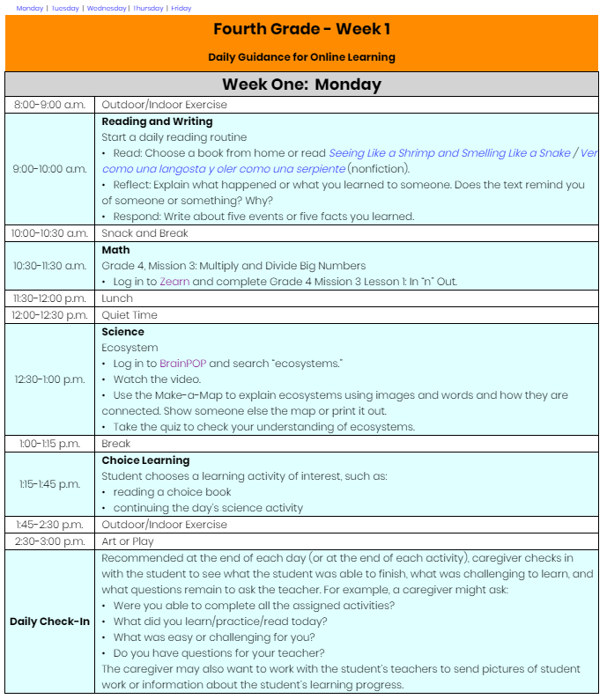
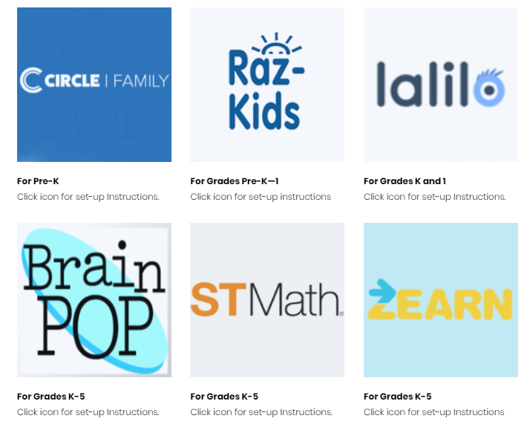
THL Phase 1: Access to Online and Printable Materials
THL Phase 1 Purpose: Provide a plug and play option to support students in finishing out the school year with daily lessons available online and in print format.
Online Materials
Daily Digital Lessons
No Cost Access to Online Curriculum
*All materials available in both English and Spanish*

Slide 5
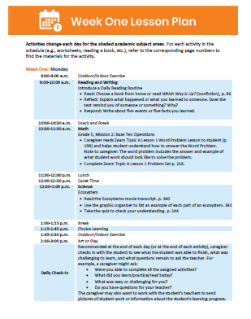
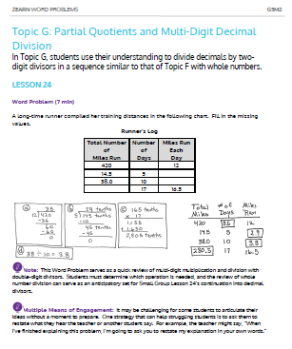
THL Phase 1: Access to Online and Printable Materials
THL Phase 1 Purpose: Provide a plug and play option to support students in finishing out the school year with daily lessons available online and in print format.
Online Materials
Printable Packets
Daily Digital Lessons
No Cost Access to Online Curriculum
PDF Packets w/ Daily Plans and Materials
Direct Shipping to Families
*All materials available in both English and Spanish*

Slide 6
THL Phase 1: What Was Right & What We Learned
The THL team conducted district outreach to learn about improvements that could be made to THL Phase 2. Districts liked the plug and play nature and quality of curriculum of Phase 1 but want more options for customization and ELAR improvements.
What Districts Liked
Plug and play nature of THL Phase 1 for both online and printed options
No cost and simple access to high quality curriculum included in THL Phase 1
Materials developed for in-home use and provided in both English and Spanish

Slide 7
THL Phase 1: What Was Right & What We Learned
The THL team conducted district outreach to learn about improvements that could be made to THL Phase 2. Districts liked the plug and play nature and quality of curriculum of Phase 1 but want more options for customization and ELAR improvements.
What Districts Liked
Plug and play nature of THL Phase 1 for both online and printed options
No cost and simple access to high quality curriculum included in THL Phase 1
Materials developed for in-home use and provided in both English and Spanish
What Could be Improved
Shortened and simplified learning plans for students and parents
Guidance for district customization to suit unique needs and to support for all learners
Improved text access for all grade levels including access to phonics instruction, anchor texts, and novels
Support implementation for teachers and administrators and provide guidance for special populations

Slide 8
2020 Summer Learning in Texas
Engaging students in summer learning can help mitigate learning loss from COVID-19.
Districts
Families
All Users
Districts have the option to decide whether or not to use at all; districts may also decided to provide resources without structured summer school.
Summer school expectations must be feasible for parents and families to implement.
THL is designed for a light touch by teachers and simple implementation for parents making it an easy plug and play resources to support during summer.

Slide 9
Introducing Texas Home Learning 2.0
THL 2.0 provides optional at-home summer learning resources to keep students engaged with and connected to high quality content
Shortened and Simplified Learning Plans
Guidance for District Customization
Implementation Support
Learning plans and schedules shortened to 4 weeks, organized by subject, and simplified for parents
Strategic and technical guidance to adapt learning plans for unique scheduling, academic, or student-specific needs
Support for district planning, launch, and implementation with guidance for supporting all learners
Improved Text Access
TEA is researching and evaluating options to provide districts with greater access to high quality texts

Slide 10
Introducing Texas Home Learning 2.0
THL 2.0 provides optional at-home summer learning resources to keep students engaged with and connected to high quality content
Shortened and Simplified Learning Plans
Guidance for District Customization
Implementation Support
Learning plans and schedules shortened to 4 weeks, organized by subject, and simplified for parents
Strategic and technical guidance to adapt learning plans for unique scheduling, academic, or student-specific needs
Support for district planning, launch, and implementation with guidance for supporting all learners
Improved Text Access
TEA is researching and evaluating options to provide districts with greater access to high quality texts

Slide 11
THL 2.0: Shortened and Simplified Learning Plans
Learning plans and schedules shortened to 4 weeks, organized by subject, and simplified for parent use
1
Scope & sequence designed for 4 week summer program with additional content available for extension or longer schedules
Learning schedules organized by subject area for district prioritization of summer learning goals
2
Instructions simplified to allow for quick start by parents
3
Select answer keys available to district personnel for quick student progress monitoring *TEA currently evaluating availability
4

Slide 12
THL 2.0: Sample Schedules for District Customization
Texas Home Learning Phase 2.0 includes several sample schedule options for districts to choose when planning and launching summer learning
Mon | Tues | Wed | Thurs | Fri
RLA | RLA | RLA | RLA | RLA
Math | Math | Math | Math | Math
Sci | Sci | Sci | Sci | Sci
SS | SS | SS | SS | SS
Mon | Tues | Wed | Thurs | Fri
RLA | OFF | RLA | OFF | RLA
Math |  | Math |  | Math
Sci |  | Sci |  | Sci
SS |  | SS |  | SS
Four Weeks, All Days, All Subjects
Districts, or parents themselves, can create a schedule that best meets the needs of parents and students
Six Weeks, Mon-Wed-Fri, All Subjects
Mon | Tues | Wed | Thurs | Fri
RLA | RLA | RLA | RLA | RLA
Math | Math | Math | Math | Math
Mon | Tues | Wed | Thurs | Fri
RLA | RLA | RLA | RLA | RLA
Four Weeks, All Days, ELAR & Math Only
Four Weeks, All Day, ELAR at Night Only

Slide 13
Introducing Texas Home Learning 2.0
THL 2.0 provides optional at-home summer learning resources to keep students engaged with and connected to high quality content
Shortened and Simplified Learning Plans
Guidance for District Customization
Implementation Support
Learning plans and schedules shortened to 4 weeks, organized by subject, and simplified for parents
Strategic and technical guidance to adapt learning plans for unique scheduling, academic, or student-specific needs
Support for district planning, launch, and implementation with guidance for supporting all learners
Improved Text Access
TEA is researching and evaluating options to provide districts with greater access to high quality texts

Slide 14
THL 2.0: Guidance for District Customization
Strategic and technical guidance to adapt learning plans for unique scheduling, academic, or student-specific needs
1
Sample Schedules provided for districts to choose daily or weekly plans for summer learning opportunities
2
Learning packets organized by content area for districts customization of areas of focus for summer learning
3
Packets posted in edit-friendly formats and guidance provided to districts for packet customization

Slide 15
Introducing Texas Home Learning 2.0
THL 2.0 provides optional at-home summer learning resources to keep students engaged with and connected to high quality content
Shortened and Simplified Learning Plans
Guidance for District Customization
Implementation Support
Learning plans and schedules shortened to 4 weeks, organized by subject, and simplified for parents
Strategic and technical guidance to adapt learning plans for unique scheduling, academic, or student-specific needs
Support for district planning, launch, and implementation with guidance for supporting all learners
Improved Text Access
TEA is researching and evaluating options to provide districts with greater access to high quality texts

Slide 16
District Implementation Support
Support for district planning, launch, and implementation with guidance for supporting all learners
Implementation Support for Planning, Launch, and Implementation
Guidance to Support for All Learners
To assist districts in implementation and to support for all learners, TEA will provide the following :
THL 2.0
Webinar Series
Training Tools, Guidance Documents, and Templates
Access to Curriculum-specific Resources

Slide 17
Introducing Texas Home Learning 2.0
THL 2.0 provides optional at-home summer learning resources to keep students engaged with and connected to high quality content
Shortened and Simplified Learning Plans
Guidance for District Customization
Implementation Support
Learning plans and schedules shortened to 4 weeks, organized by subject, and simplified for parents
Strategic and technical guidance to adapt learning plans for unique scheduling, academic, or student-specific needs
Support for district planning, launch, and implementation with guidance for supporting all learners
Improved Text Access
TEA is researching and evaluating options to provide districts with greater access to high quality texts

Slide 18
THL 2.0: Improved ELAR Options for Districts and Students
Curated ELAR information and options to assist districts in review and adoption of high quality ELAR materials
Anchor texts and text sets available from curated and organized vendor list for deeper ELAR engagement and access to TEA-negotiated prices and services
1
Phonics instruction packages for early learners available from curated and organized vendor list with access to TEA-negotiated prices and services
2

Slide 19
Introducing Texas Home Learning 2.0
THL 2.0 provides optional at-home summer learning resources to keep students engaged with and connected to high quality content
Shortened and Simplified Learning Plans
Guidance for District Customization
Implementation Support
Learning plans and schedules shortened to 4 weeks, organized by subject, and simplified for parents
Strategic and technical guidance to adapt learning plans for unique scheduling, academic, or student-specific needs
Support for district planning, launch, and implementation with guidance for supporting all learners
Improved Text Access
TEA is researching and evaluating options to provide districts with greater access to high quality texts

Slide 20
Texas Home Learning 2.0: Timeline
June 8th & Beyond
May 4th
May 11th
May 18th
May 25th
June 1st
THL Actions
Recommended THL actions assume June 8th summer school start
Print and Ship Packet Pre-Orders Available
Suggested Packet Order Date for 6/8 Start
Families Receive Packets 4-7 Days After Order
Students begin THL Summer Model
Ongoing District Supports
TEA Supports
Texas Home Learning Webinar Series
Monitor Student Progress, Support, and Improve
District Summer Planning Phases
Adapted From Instructional Continuity Framework
Create
Plan
& Team
Assess
Student
Access
Determine
At-Home
Model
Operationalize At Home
Learning Model

Slide 21
Questions and Next Steps
Pre-Order Summer Learning Packets Now!
To Pre-Order, Districts should
Complete the Phase 2 Pre-Order Form tab of the online order form at bit.ly/THLOrderForm
Enter the Subject: “Phase 2 Pre-Order”
Submit the online order form to TexasPackets@XanEdu.com
Questions?
Reach out to curriculum@tea.texas.gov with questions or feedback

Slide 22
Thank You!

