Slide 1
Balanced Calendar and Remote Learning
May 12, 2020

Slide 2
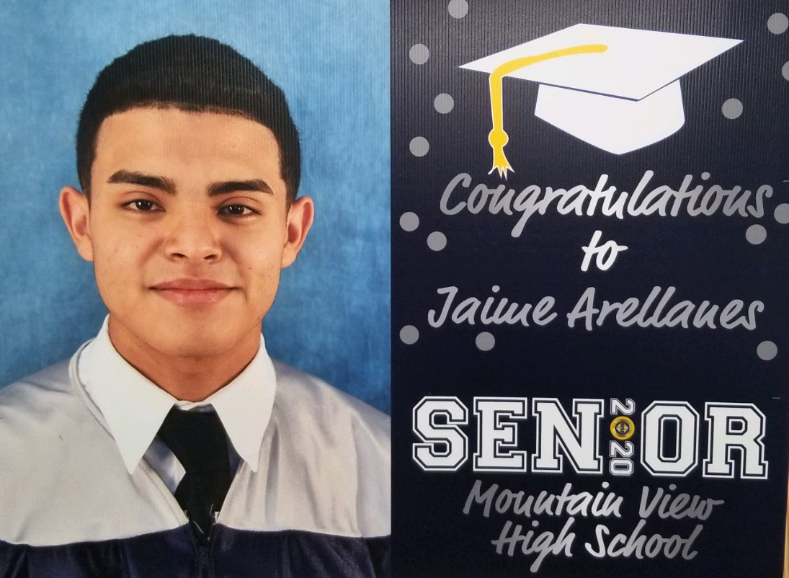
Celebrating Our Seniors

Slide 3
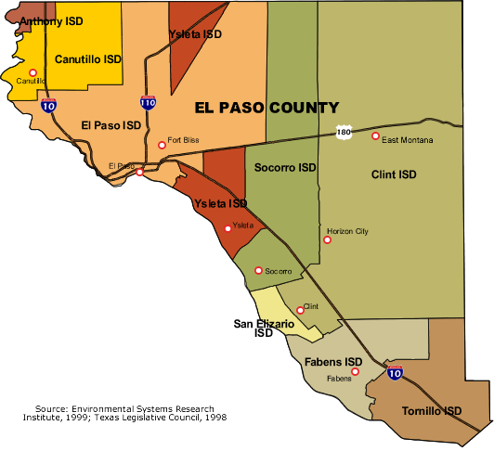
About Clint ISD
11,250 Students
14 Campuses
85% Economically Disadvantaged
63% At-Risk
39% English Language Learner
46% Bilingual Elementary Students

Slide 4
District of Innovation
Clint ISD became a District of Innovation in July 2017.
The Clint ISD District of Innovation Plan allows the district to change the first day of instruction to a date which may be before the fourth Monday of August.
Clint ISD decided to move to a Balanced Calendar for the
2019-2020 school year.

Slide 5
Research on Balanced Calendars
“School leaders are increasingly adjusting their calendars, with more than 3,700 public schools operating year-round in 2011, according to a 2014 Congressional report. In addition, at least 30 states have schools operating on the alternative calendar.”
“It’s a viable way to minimize the summer learning loss that occurs annually,”
The bulk of the research speaks to the fact that lower -income students do better on the balanced calendar.
District Administrator Article May 13, 2016

Slide 6
2019-2020 “Clint ISD Balanced Calendar”

Slide 7
Calendar Highlights - Fall Semester
Date | Event | Importance
July 27, 2020 | First Day of School | Will allow for intersessions for accelerated instruction
September 25, 2020 | End of First Nine Weeks | Fall Intersession starts after first 9-week grading period
September 28, 2020 – October 9, 2020 | Intersession 1 Elementary Extended Year | Student programs to enhance academic success
November 23, 2020 | Thanksgiving Break | Break
December 18, 2020 | Last Day of First Semester | Break

Slide 8
Calendar Highlights - Spring Semester
Date | Event | Importance
January 5, 2021 | First Day of School Second Semester | Early start to accommodate Intersession
March 5, 2021 | End of Third Nine Weeks | Spring Semester - 19 weeks (2 –Nine Week Periods) Catch up time for Scope and Sequence
March 8-19, 2021 | Intersession 2/Spring Break Elementary Extended Year | Accelerated instruction
June 3, 2021 | Last Day of School | Summer School programs begin June 8
June 7, 2021 – June 24, 2021 | Intersession 3 Elementary Extended Year | Accelerated instruction

Slide 9
2019-2020 Intersession Programs
Program | Focus Area | Level
K-1 LEP Program | Language Acquisition | Elementary
Reading and Math | Narrowing Gaps | Elementary
Writing | Narrowing Gaps | Elementary
Science | Narrowing Gaps | Elementary
Enrichment | Music, Reader’s Theater | Elementary
Targeted Grouping | STAAR Growth | Elementary

Slide 10
2019-2020 Intersession Programs
Program | Focus Area | Level
Technical Writing | Increase Writing Skills | Middle School
Reading and Math | Narrowing Gaps | Middle School
Science and Social Studies | Narrowing Gaps | Middle School
ESL Strengthening | Language Acquisition | Middle School
Algebra I Camp | Student Support | Middle School
Targeted Grouping | STAAR Growth | Middle School

Slide 11
2019-2020 Intersession Programs
Program | Focus Area | Level
AP and Dual Credit | Coursework Support | High School
CTE Certification | Narrowing Gaps | High School
Credit Recovery | Graduation Credits | High School
EOC Remediation | STAAR EOC Re-testers | High School
Graduation Requirements | FAFSA and Scholarships | High School
College Entrance Prep | SAT and TSI | High School

Slide 12
2020-2021
HB 3 Additional Days School Year Calendar Funding
October, March and June will be Extended Days for Elementary
K – 1 LEP Program is embedded throughout the Intersessions
Targeted Student Groups brought in to accelerate their learning.
CLINT ISD calendars: https://tx02216513.schoolwires.net/Page/162

Slide 14
Remote Learning
1:1 District – Devices for all students
Majority of Textbooks are online
Districtwide used of Google
Districtwide use of Nearpod
Elementary Students – Combination of assignments and projects both paper and online
Middle School Students - Assignments and Projects through online resources
High School Students – all enrolled in online coursework, projects in electives.
Challenge – not all of our students had Internet

Slide 15
Ensuring Internet Access – Hot Spots
Clint High School | 175
Mountain View High School | 180
Horizon High School | 194
Clint ISD Early College | 56
Clint Junior High School | 87
East Montana Middle School | 98
Horizon Middle School | 77
Ricardo Estrada Middle School | 60
C. T. Welch Elementary School | 114
Desert Hills Elementary School | 79
Frank Macias Elementary School | 232
Montana Vista Elementary School | 143
Red Sands Elementary School | 129
W. D. Surratt Elementary School | 190
TOTAL | 1814
*Hotspots distributed through April 7

Slide 16
2020-2021 District Initiative – I-LEARN
Instructional
Learning
Environment
Audio
Resource
Network
Will be active in 700 classrooms
by July 2020

Slide 17
I-LEARN Components – Remote Learning
Cameras in the Classroom – Professional Development
Interactive Media Panels – Installed in all classrooms
Sound Systems – allows the teacher and students to be heard clearly
Microphones for the Teachers and Students – students and teacher amplify their voices
Lesson Capture Capability- Microphone will record teacher and student as well as the presentation on the interactive media panel
Teachers Can Broadcast their Lesson capture through GoogleMeets
Remote Learning – Teachers can record lessons for students.

Slide 18
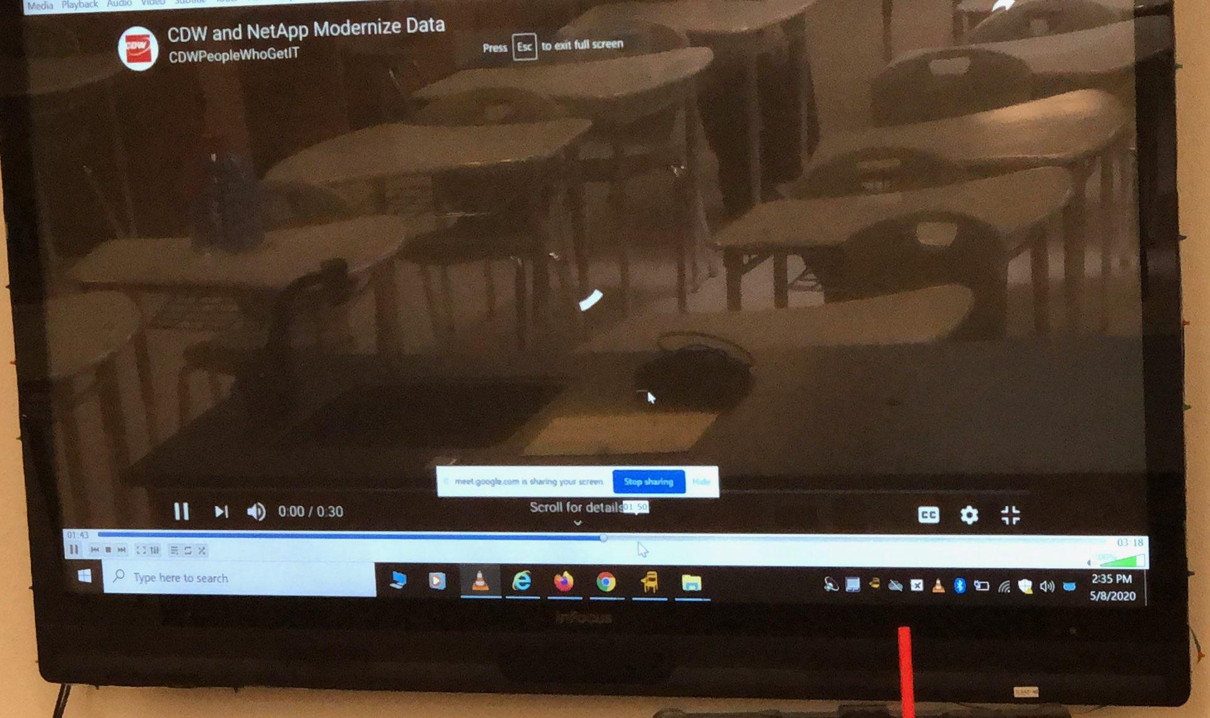
Integrated System – Speakers, Camera, Microphones

