Slide 1
2020 & Beyond Accountability System Development
Accountability Policy Advisory Committee Meeting
Texas Education Agency | Governance & Accountability | Performance Reporting
Texas Education Agency Governance & Accountability Performance Reporting

Slide 2
Meeting Goals
Make the most efficient use of our time.
Remain future focused.
Develop recommendations for the 2020 accountability system.
Discuss options for future accountability.

Slide 3
February 2020
ESSA Amendment

Slide 4
Proposed Closing the Gaps Graduation Rate Methodology
Did the student group meet the four-year long-term graduation rate target of 94.0%?
If #1 is no, did the student group meet the four-year interim graduation rate target of 90.0% and demonstrate improvement of at least 0.1% over the prior year rate?

Slide 5
Proposed Closing the Gaps Graduation Rate Methodology (cont.)
If #1 and #2 are no, did the student group meet its four-year graduation rate growth target?
94.0 (long-term target) – prior year four-year graduation rate
----------divided by--------- 10
current year four-year graduation rate – prior year four-year graduation rate
≥

Slide 6
Proposed Closing the Gaps Graduation Rate Methodology (cont.)
If #1, #2, and #3 are no, did the student group meet the six-year interim graduation rate target? (Appendix A of the ESSA State Plan would be amended to add an interim target of 92.0% and a long-term target of 96.0%.)

Slide 7
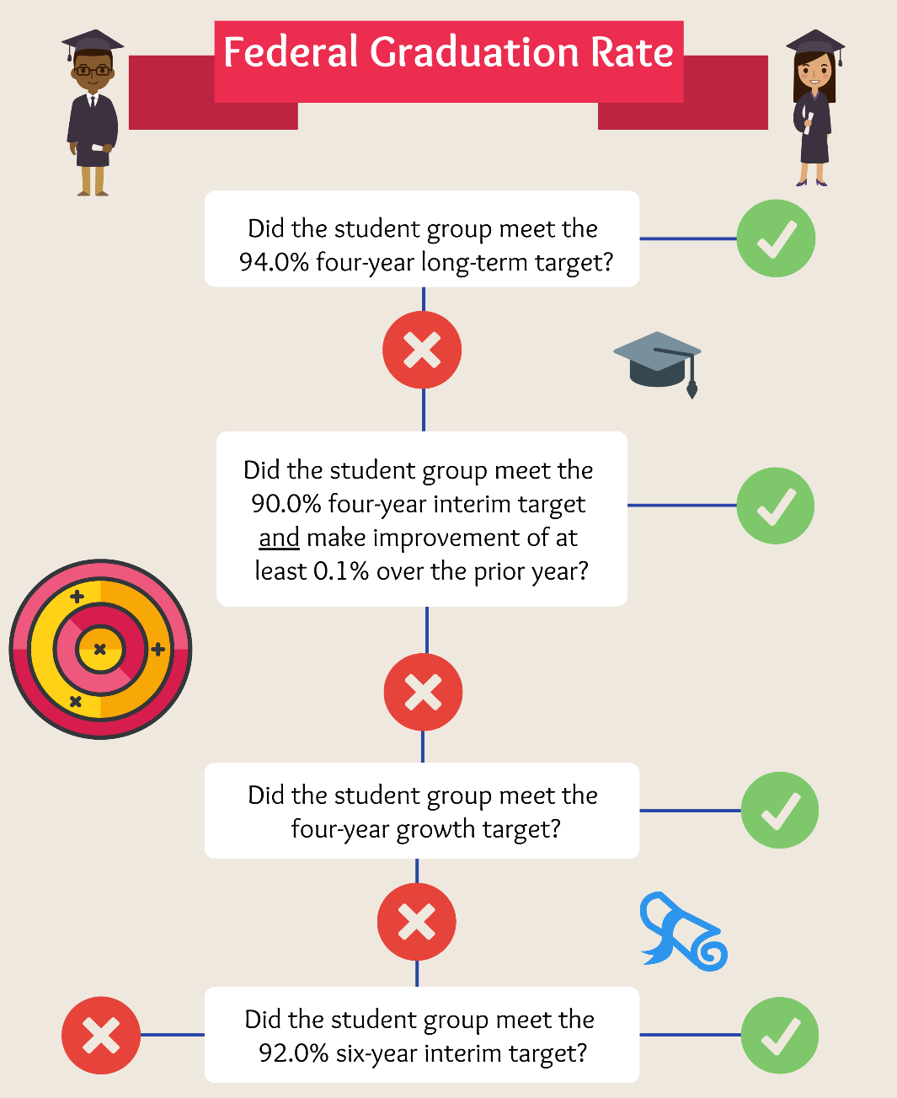
Proposed Closing the Gaps Graduation Rate Methodology (cont.)
1/15/2020 7
Texas Education Agency | Governance and Accountability | Performance Reporting

Slide 8
Proposed Closing the Gaps Graduation Rate Methodology (cont.)
Proposed Graduation Rate Methodology Example
Did not meet 94.0% 4-year long-term graduation target
Did not meet 90.0% 4-year interim graduation target and improve by 0.1%
Did meet 4-year growth target (i.e. a 10% decrease in difference between the prior year rate and the long-term target):
70.0 – 66.7 = 3.3 | > 2.73 = | 94.0 – 66.7
 |  | 10

Slide 9
Proposed Closing the Gaps Graduation Rate Methodology (cont.)
The proposed methodology has a positive impact on Closing the Gaps domain letter grades for campuses.
2019 Campus Closing the Gaps Domain Grade | Model Campus Closing the Gaps Domain Grade
 | A | B | C | D | F
A | 1246 | 0 | 0 | 0 | 0
B | 94 | 1589 | 0 | 0 | 0
C | 0 | 77 | 2952 | 0 | 0
D | 0 | 0 | 25 | 1069 | 0
F | 0 | 0 | 20 | 28 | 668

Slide 10
Proposed Closing the Gaps Graduation Rate Methodology (cont.)
The proposed methodology has a positive impact on Closing the Gaps domain letter grades for AEAs.
2019 Campus Closing the Gaps Domain Grade | Model Campus Closing the Gaps Domain Grade
 | A | B | C | D | F
A | 7 | 0 | 0 | 0 | 0
B | 3 | 15 | 0 | 0 | 0
C | 0 | 5 | 14 | 0 | 0
D | 0 | 0 | 8 | 12 | 0
F | 0 | 0 | 20 | 22 | 36

Slide 11
P-TECH/T-STEM Clarification
P-TECHs and T-STEMS will not require special processing for graduation rates.
T-STEM campuses are on a four-year graduation track.
P-TECH campuses will complete state graduation requirements and report students as graduates in four years.

Slide 12
Proposed School Improvement Identification Methodology
Comprehensive support and improvement identification for graduation rates less than 67% will be based on the 6-year graduation rate rather than the 4-year rate.
Using this methodology, 32 fewer campuses would be identified for comprehensive support and improvement, although some would still be identified as “comprehensive progress” because of prior year status.

Slide 13
Proposed School Improvement Identification Methodology
Additional targeted support campuses identified for three years will escalate to comprehensive support and improvement.
Implementation will be delayed until the 2021─22 school year.
Campuses Identified as Additional Targeted Support for Two Consecutive Years
AEA | 13
Non-AEA | 446
Total | 459

Slide 14
SAT/ACT Inclusion for Accelerated Testers
SAT/ACT results will be included in accountability calculations for accelerated testers beginning with August 2021 accountability ratings.
Prior to inclusion, performance levels that equate to the STAAR Approaches Grade Level, Meets Grade Level, and Masters Grade Level standards will be set.
These assessment results will also be included in participation calculations.

Slide 15
Other 2020 Topics for Consideration

Slide 16
School Progress, Part A: Academic Growth
What can we do for 109 campuses that only serve up to grade 3?

Slide 17
School Progress, Part A: Academic Growth Modeling
Modeling Methodology
Using 2018 and 2019 performance level data, calculate the following:
Percentage change in Approaches Grade Level or above, Meets Grade Level or above, and Masters Grade Level
Calculate the average percentage change for the three performance levels.
Calculate the difference in average percentage change (2019 result – 2018 result), and check the percentile.
Calculate the difference in average percentage change for all elementary schools with at least 10 grade 3 tests, check the percentile, and use it as reference to decide the cut off points for letter grade.
For the newly rated grade 3 campuses, compare School Progress, Part A results with Part B results.

Slide 18
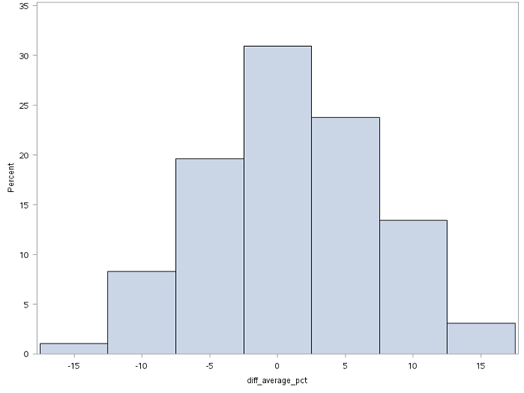
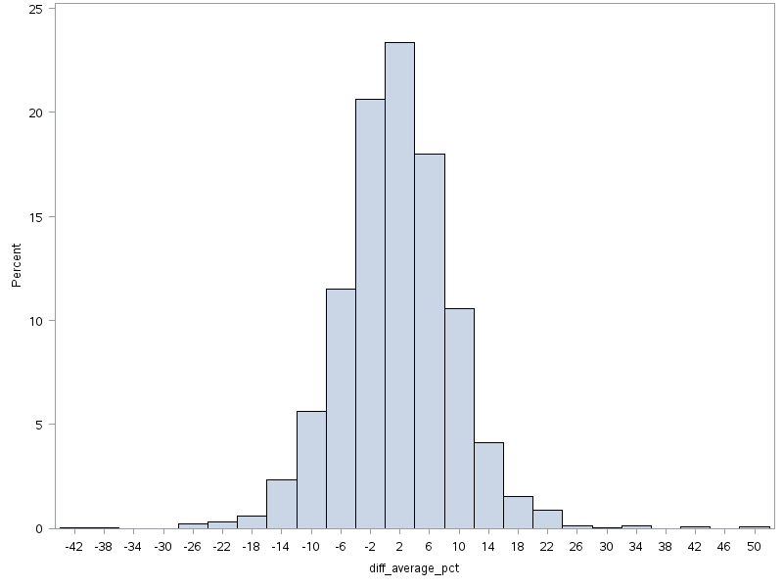
School Progress, Part A: Academic Growth Modeling
Total number of campuses serving up to grade 3=109
12 of them are new in 2019, so 97 are used in the model.
Total number of elementary campuses with at least 10 grade 3 tests=4220

Slide 19
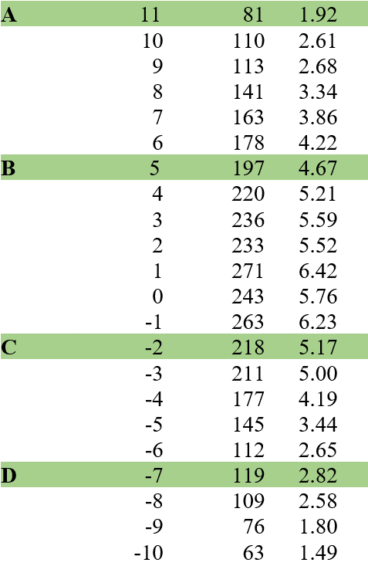
School Progress, Part A: Academic Growth Modeling
Scaling Excerpt
Average Percent Change
Frequency
Percent

Slide 20
School Progress, Part A: Academic Growth Modeling
Academic Growth Modeling Example
Elm Elementary School had a 2018 STAAR component score of 37% and a 2019 STAAR component score of 43%.
The percent change is 6%.
Using the scaling chart, this campus would earn an A for Academic Growth.

Slide 21
School Progress, Part A versus Part B Modeling
Outcomes for Campuses using Part A Modeling Methodology
 | 2019 Part B: Relative Performance
Modeled Part A: Academic Growth | A | B | C | D | F
A | 2 | 3 | . | . | .
B | 3 | 14 | 7 | 1 | .
C | 1 | 18 | 12 | 5 | 3
D | 2 | 8 | 5 | 3 | 1
F | . | 3 | 3 | 3 | .

Slide 22
School Progress, Part A: Academic Growth Modeling
ATAC expressed the following:
The proposed methodology does not evaluate the same group of students.
A cumulative effect could occur, and the expectations could continue to increase from year to year.
ATAC asked to see the same models for 4th grade as well in order to see whether the distributions and cut scores are the same.
ATAC indicated that there needs to be an aspect that gives campuses full credit for growth if the student is already very high performing (e.g., Masters Grade Level assessment results receive 1 point, regardless of growth).
ATAC does not want campuses changing grade spans based on potential accountability incentives.

Slide 23
School Progress, Part A: Academic Growth
Would a hold harmless provision be appropriate?

Slide 24
Partial Points for English Language Proficiency (ELP) Component
Currently, districts and campuses either earn 10 points or 0 points for the ELP component in the Closing the Gaps domain.
Should partial points be awarded depending on achievement toward the 36% target?
ELP Rate | Points
36 | 10
35 | 9
34 | 8
33 | 7
32 | 6
31 | 5
30 | 4
29 | 3
28 | 2
27 | 1

Slide 25
Relative Performance for Alternative Education Accountability (AEA)
ATAC requested modeling to show the feasibility of using Relative Performance for AEAs.
See the online binder for modeling.

Slide 26
Spanish to English Transition Proxy
Students who transition from the Spanish STAAR reading assessment to the English STAAR reading assessment currently do not receive a STAAR progress measure for use in Academic Growth.
A proxy was calculated for these students in the previous accountability system.
Overall, ATAC members were in favor of the idea of adding the transition proxy for 2020 accountability, noting that it would acknowledge the work of the schools and set the expectation that the language switch be made when kids are ready.

Slide 27
Spanish to English Transition Proxy
ATAC expressed concerns with the following:
Students will be instructed in the language in which they are tested. That could have a long-term negative impact.
The proxy may negatively impact some districts and campuses.

Slide 28
Accountability Reset

Slide 29
Graduation Rate Methodology
The current long-term four-year graduation rate is 94%, and the long-term six-year graduation rate is 96% for all student groups.
Should we consider establishing unique targets for certain student groups using baseline data?

Slide 30
District Rating Methodology
District ratings are not always representative of campus ratings.
How can we revise the district rating methodology so that district ratings accurately reflect outcomes for ALL students in the district?
Should campus outcomes contribute proportionately to district ratings?

Slide 31
District Rating Methodology
Example using Current Methodology
B 86
B 85
B 85
C 77
C 72
D 67

Slide 32
District Rating Modeling Methodology
Methodology using Proportional Weighting
Determine the number of students enrolled in grades 3─12 at each campus.
Sum the number of students enrolled in grades 3─12 at the district.
Divide the number of grades 3─12 students at the campus by the district total.
The resulting percentage is the weight that each campus will contribute to the district rating.
Multiply the campus scaled score by its weight to determine the points.
Sum the points for all campuses to determine the overall district score.

Slide 33
District Rating Modeling Methodology
Methodology using Proportional Weighting Presumptions
Enrollment counts would only include grades 3─12.
Not Rated and paired campuses would be excluded from calculations.
AEAs would be included in calculations.
To align with statutory requirements, the methodology would be applied to each domain and overall.

Slide 34
District Rating Modeling Methodology
Example using Proportional Weighting Methodology
Campus | 3 –12 Enrollment | Score | Weight | Points
Campus 1 | 334 | 85 | 13.8% | 11.7
Campus 2 | 990 | 85 | 41.0% | 34.9
Campus 3 | 62 | 77 | 2.6% | 2.0
Campus 4 | 761 | 72 | 31.5% | 22.7
Campus 5 | 270 | 67 | 11.2% | 7.5
District Rating |  |  |  | 79
C 79
1
2
3
4
5
B 85
B 85
C 77
C 72
D 67
334 students
990 students
62 students
761 students
270 students

Slide 35
Alternatives for STAAR Component in Closing the Gaps
The majority of states include chronic absenteeism in their federal accountability system.
Most states define chronically absent as missing 10% or more of the school year.

Slide 36
Alternative Education Accountability
Should AECs be their own campus type with different components, weights, and targets in the Closing the Gaps domain?
If so, what would that look like?

Slide 37
School Improvement Identification
Should comprehensive support and improvement campuses be determined by campus type (i.e., bottom 5% of elementary, bottom 5% of middle, etc.)?
Should comprehensive support and improvement campuses be identified every three years, rather than yearly?
Campus Type | Current (5% overall) | Modeling (5% for each campus type) | Difference
Elementary | 138 | 197 | 59
Middle | 96 | 58 | -38
High Schools/K-12s | 7 | 49 | 42
AEA | 50 | 50 | 0
Total | 291 | 354 | 63

Slide 38
School Improvement Identification
Should the targeted support and improvement identification methodology be revised to evaluate achievement gaps among student groups?
Idaho identifies targeted support and improvement campuses using the following methodology:
The percent proficient/advanced for each student group is compared to the percent proficient/advanced for all students not in that group for each indicator.
A consistently underperforming student group is any student group that has an achievement gap, relative to its non-group peers, of 35 percentage points or more in any indicator for three consecutive years.

Slide 39
School Improvement Identification
Should the additional targeted support identification methodology be revised to better align with comprehensive support and improvement?
Idaho identifies comprehensive support and improvement campuses every three years based on the all students group. They use the same methodology annually for each student group for the purpose of identifying schools for additional targeted support.

Slide 40
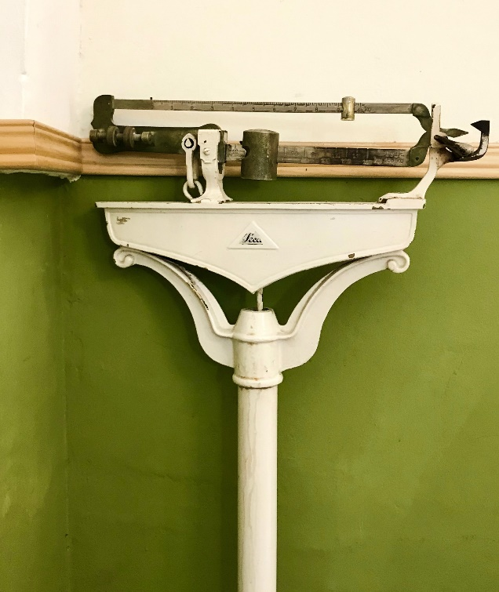
Closing the Gaps Domain Weighting
Stakeholders have communicated concerns regarding state accountability rating and school improvement identification alignment.
Should the Closing the Gaps domain weight increase for campuses identified for school improvement?

Slide 41
Accountability Open Forum
What concerns or suggestions do you have that were not discussed today?

