Slide 1
Educating the Children of Poverty Roundtable
September 12, 2015

Slide 2
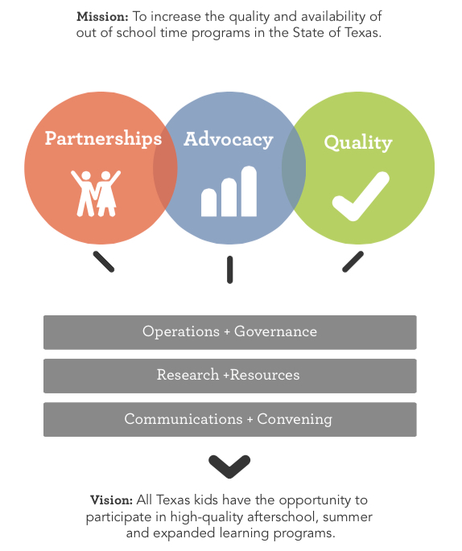

TXPOST is working to increase the availability and quality of afterschool and summer learning opportunities for Texas K-12 youth

Slide 3
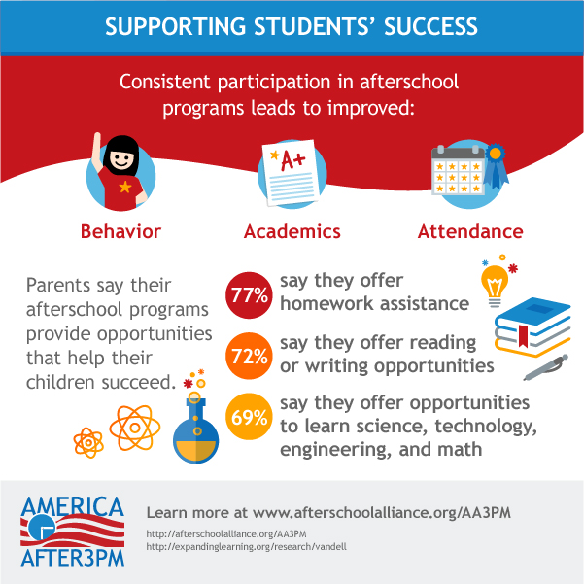
High quality afterschool programs accelerate student achievement and development

Slide 4
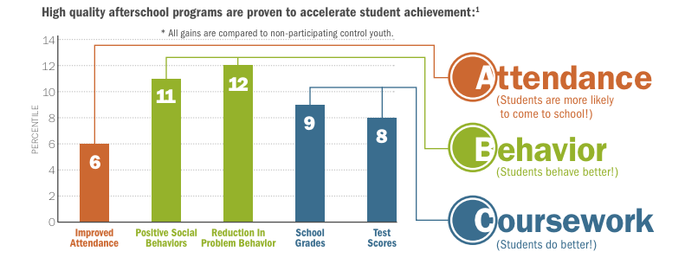
High quality afterschool programs accelerate student achievement and development
Durlak & Weissberg, Collaborative for Academic, Social and Emotional Learning;
Expanding Minds, p. 196

Slide 5

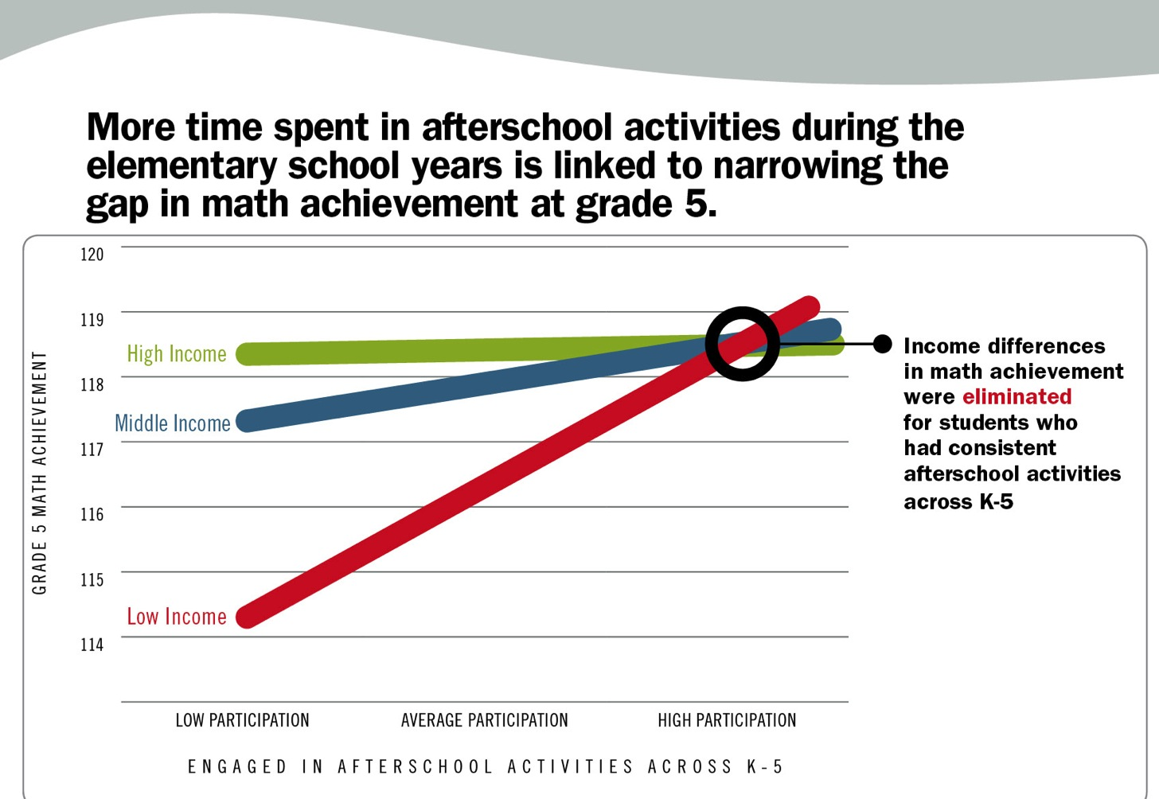
High-quality afterschool can close the achievement gap
Pierce, K. M., Auger, A. and Vandell, D. L. (April, 2013). Narrowing the Achievement Gap: Consistency and Intensity of Structured Activities During Elementary School. Unpublished paper presented at the Society for Research in Child Development Biennial Meeting, Seattle, WA.

Slide 6

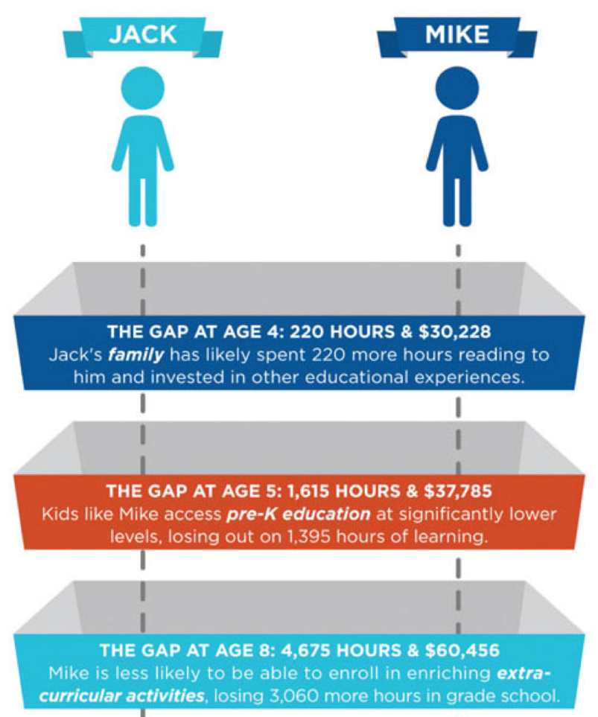

Opportunity really matters
The After-School Corporation (TASC)

Slide 7

National support for afterschool programs is strong

Slide 8

Texas has significant unmet demand for out of school time programs
18% (880,636) of Texas K-12 children participate in afterschool programs
37% (over 1.5 million) Texas K-12 children would participate if a program were available
74% of Texas parents agree that afterschool programs give working parents peace of mind
80% of Texas parents support public funding for afterschool programs

Slide 9













The OST Field is as Diverse as the State of Texas

Slide 10









6 Texas cities have coordinating entities

Slide 11
Federal Funds Total more than 12x State Funds Supporting Texas OST
$289.1 million
$23.4 million
Analysis of Public Funding Sources for OST in Texas, TXPOST 2013

Slide 12





Multiple State Agencies are Involved

Slide 13
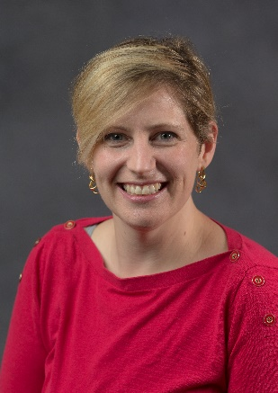


Thank you!
Alison Reis-Khanna
Executive Director
alison@txpost.org
512-800-1152
www.txpost.org
*Sign up for our e-newsletter! Follow us on Facebook and Twitter!
@tx_post
Texas Partnership for Out of School Time

