Slide 1
How should Students Study? (and How Should Educators Teach?) Evidence from Cognitive Science
Charles A. Weaver, III, Ph. D.
Chair, Department of Psychology and Neuroscience
Baylor University
Thanks to Mark McDaniel & Roddy Roediger, Washington University, Bob Bjork, UCLA, John Dunlosky & Katherine Rawson, Kent State,

Slide 2
Total Study Time = Learning
“Total Study Time = Learning”
Implicitly Adopted by Students
Expectation that grade is a function of time (or maybe time + effort….)
Implicitly Encouraged by Educator
We emphasize how much time students should spend studying, even ask about “time spent” on evaluations

Slide 3
Bjork’s “Desirable Difficulties”
Techniques that promote long-term retention even though they slow initial learning

Slide 4
What Does Work? General Principles
What Does Work? General Principles
Encourage Student-generated effort
Encourage Spaced (not Massed) Study
Incorporate Testing as a key part of Learning, not just as assessment
Maybe the most significant insight of the last decade

Slide 5
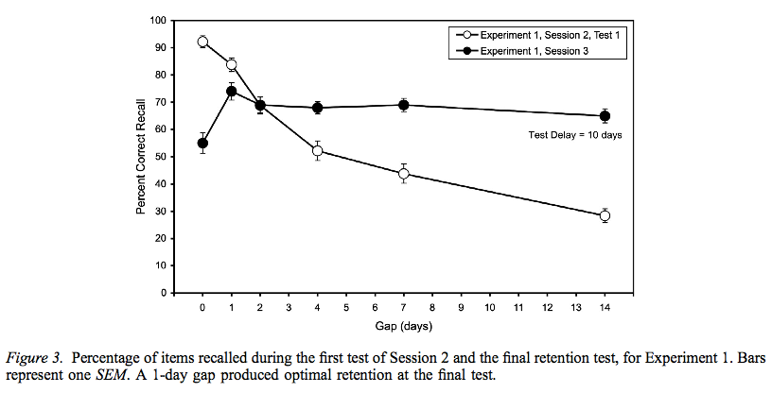
Massed v. Spaced Study
Cepeda et al (2009)

Slide 6
Roediger and Colleagues: Testing as an Important Teaching Tool
Roediger and Colleagues:
Testing as an Important Teaching Tool
Testing was considered assessment:
Study - Test Study - Test Study -Test . . .
Now, we recognize that testing produces large gains in learning

Slide 7
Roediger and Karpicke (2006) Compared Frequent study to Frequent Test
Roediger & Karpicke (2006) Compared “Frequent study” to “Frequent Test”

Slide 8
Roediger and Karpicke (2006) True even if testing time takes away from study time
Roediger & Karpicke (2006) True even if testing time takes away from study time!

Slide 9
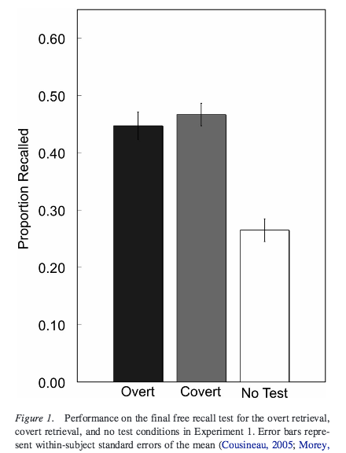
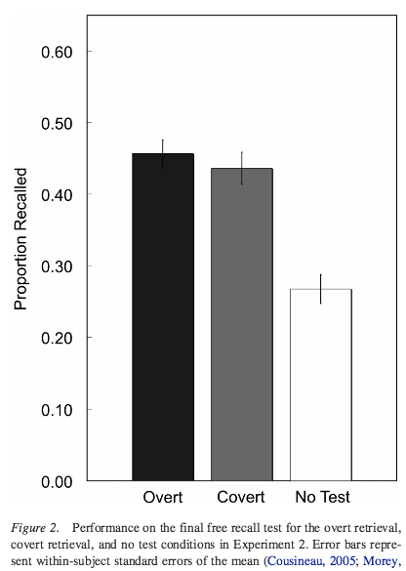
Smith, Roediger, & Karpicke (2013) True even if testing is “covert” (silent)
Smith, Roediger, & Karpicke (2013) True even if testing is “covert” (silent)

Slide 10
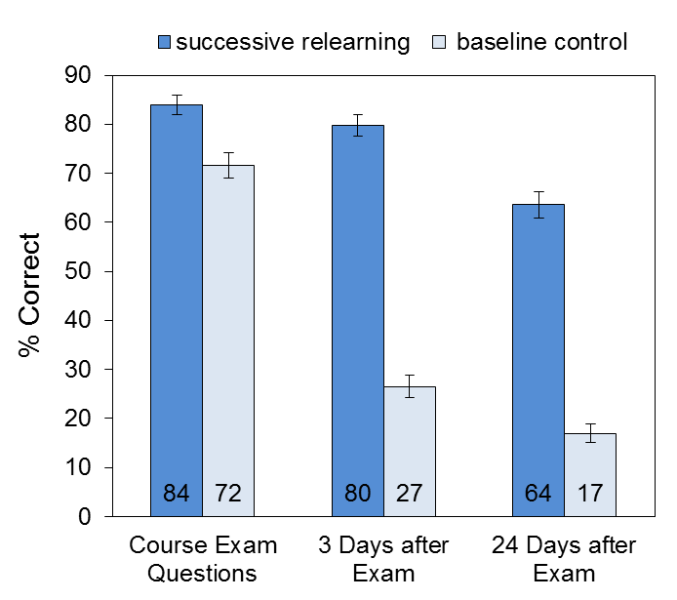
Rawson, Dunlosky, & Sciartelli
12%
53%
47%
Rawson, Dunlosky, & Sciartelli (2013, Educational Psychology Review)

Slide 11
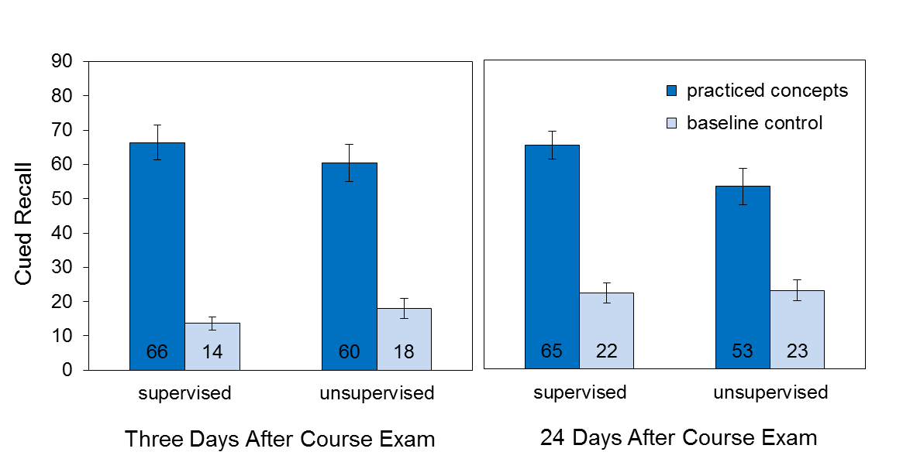
Combined Spaced, Test-driven Learning
Combined Spaced, Test-driven Learning
Works with automated, unsupervised teaching
Rawson, Dunlosky, & Sciartelli (2013, Educational Psychology Review)

Slide 12
Dismiss the Hype: Four Trendy Myths Not to Take Seriously
“Brain-Based Education”
“Brain-Training” (e. g., Lumosity)
“Study Skills” as cure-all
“Learning Styles”

Slide 13
Expecting too much from “Study Skills”
Reality:
Many students can benefit from instruction in “effective study techniques” (more to follow…)
But much mastery-related difficulty results from deficits of knowledge, not deficits of study skills

Slide 14
Study Skills
“Study Skills?”
Most significant contributor to knowledge acquisition is print exposure
Stanovich et al. (1995)
“Exposure to print was a significant predictor of vocabulary and declarative knowledge even after differences in working memory, general ability, and educational level were controlled. These results … suggest a more prominent role for exposure to print in theories of individual differences in knowledge acquisition…”

Slide 15
Differences in print exposure?
Differences in Print Exposure?
90%-ile 5th grade readers
vs.
10%-ile 5th grade readers
90th readers) have 200 times more print exposure
Difference increase as children get older

Slide 16
Serious Problem in Remedial Education
Serious Problem in Remedial Education
The “Matthew Effect”
"For everyone who has will be given more, and he will have an abundance. Whoever does not have, even what he has will be taken from him."
Matthew 25: 29
Good students benefit more from the same amount of instruction and practice: the “cognitively rich get richer”

Slide 17
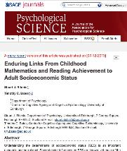
Matthew Effect
Matthew Effect
Ritchie and Bates (2013, Psych. Science)
“We tested the effects of mathematics and reading achievement at age 7 on attained SES by age 42…[emphasis added]
“ Mathematics and reading ability [at age 7] both had substantial positive associations with adult SES, above and beyond the effects of SES at birth, and with other important factors, such as intelligence."

Slide 18
The Myth of “Learning Styles?”
Hypothesis:
“Students with one learning style achieve the best educational outcome when given an instructional method that differs from the instructional method producing the best outcome for students with a different learning style. In other words, the instructional method that proves most effective for students with one learning style is not the most effective method for students with a different learning style.”
Pashler et al. (2009)

Slide 19
What about “Learning Styles?”
Conclusion:
“… ample evidence that children and adults will, if asked, express preferences about how they prefer information to be presented to them…and that people differ in [their] aptitudes for different kinds of thinking and for processing different types of information. However, we found virtually no evidence for the interaction pattern mentioned above, [which is] a precondition for validating the educational applications of learning styles.”
Pashler et al. (2009)

Slide 20
What study/teaching techniques are effective?

Slide 21
Techniques Examined slide 1 of 3
Elaborative interrogation 2. Self-explanation 3. Summarization 4. Highlighting/underlining 5. Keyword mnemonic | 6. Imagery for text 7. Rereading 8. Practice testing 9. Spaced practice 10. Interleaved practice

Slide 22
Techniques Examined slide 2 of 3
Elaborative interrogation 2. Self-explanation 3. Summarization 4. Highlighting/underlining 5. Keyword mnemonic | 6. Imagery for text 7. Rereading 8. Practice testing 9. Spaced practice 10. Interleaved practice

Slide 23
Techniques Examined slide 3 of 3
Elaborative interrogation 2. Self-explanation 3. Summarization 4. Highlighting/underlining 5. Keyword mnemonic | 6. Imagery for text 7. Rereading 8. Practice testing 9. Spaced practice 10. Interleaved practice

Slide 24
What do we tell students?

Slide 25
Specific Recommendations to Students
Specific Recommendations to Students
*Instead of taking notes, generate questions
When you study, answer the questions without looking at the answer
Study from every class several times each week. Don’t block subjects by day

Slide 26
Specific Recommendations
Specific Recommendations
Don’t take too many shortcuts (borrowing study guides, etc.)
Don’t test yourself right after studying
Don’t spend time on unnecessary activities (retyping notes, color-coding material, etc.)
Don’t cram for test.
Flashcards: It’s kinda complicated

Slide 27
Specific Recommendations continued
Specific Recommendations
Educators: Frequent Quizzes, and Comprehensive Final Exams should be non-negotiable.

Slide 28
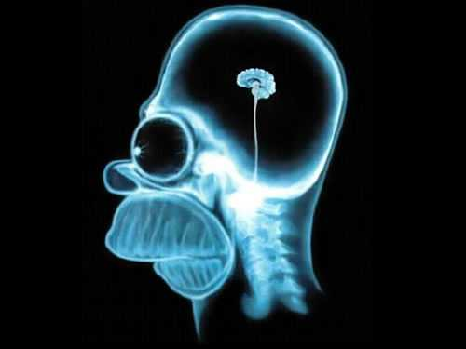
Thanks!
Thanks!
Questions, comments, handouts?
Email me: Charles_Weaver@Baylor.edu

