Slide 1
Discovery Education
TX State Board of Education
November 17, 2015
Scott Kinney, Senior Vice President

Slide 2
Emerging Trends
Emerging Trends
Our students, educators and school systems are beginning an unprecedented transition towards digital learning …

Slide 3
Our Schools Connectivity 2015-2016
Our Schools Connectivity
Futuresource Consulting Ltd reports:
By the 2015-2016 school year, mobile devices will be available for 1-to-1 computing for half of the US K-12 student and teacher population.
Source: Molnar, M. (2015, February 24). Half of K-12 Students to Have Access to 1-to-1 Computing by 2015-16. Retrieved March 2, 2015, from http://blogs.edweek.org/edweek/marketplacek12/2015/02/half_of_k-12_students_to_have_access_to_1-to-1_computing_by_2015-16_1.html

Slide 4
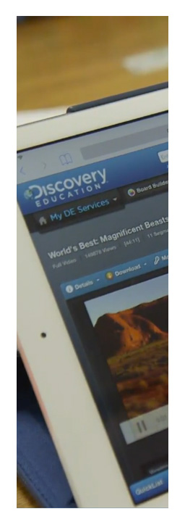
Our Schools Connectivity Survey
Our Schools Connectivity
According to a survey conducted by CoSN, AASA and MDR:
“Two years ago, 43% of high schools were described as not having wireless connectivity
…today just 1% of respondents reported their high school did not have wireless.”
Source: Herold, B. (2015, November 4). Fast, affordable internet remains challenge for many school, survey finds. Retrieved November 5, 2015, from http://blogs.edweek.org/edweek/DigitalEducation/2015/11/school_internet_Erate_survey_CoSN.html

Slide 5
Teachers and Content
Teachers & Content
Education Market Research/Simba reports:
“Teachers now are using more digital instructional materials than print materials in the classroom.”
Source: Fine, A. (2015, March 4). Digital instructional materials outpace print in the classroom. Retrieved March 4, 2015, from http://www.districtadministration.com/news/digital-instructional-materials-outpace-print-classroom

Slide 6
Assessment
Assessment
A research brief released by EdTech Strategies, LLC recently reported:
“The 2015-2016 school year will mark the first time that the majority of state mandated summative testing in US elementary/middle schools will be administered via technology and not in a paper and pencil format.”
Source: EdTech Strategies. (2015, November 5). Pencils down: The shift to online & computer-based testing. Retrieved November 5, 2015, from http://www.edtechstrategies.com/research-and-writing/usk-8-testing.

Slide 7
Interact
INTERACT WITH CONTENT DIFFERENTLY
WHY
DIGITAL?
STUDENTS

Slide 8
Students and Content
Students & Content
According to Common Sense Media, teens (13-18) today spend an average of 9 hours a day with media
Over 2 ½ hours a day watching TV
Almost 2 hours listening to music
Over an hour gaming
Source: Sabestian. (Producer). (2009). Joe's non-netbook [Web]. Retrieved from http://www.youtube.com/watch?v=SkhpmEZWuRQ
This does NOT include time spent at school or time spent doing homework
Source: The Common Sense Census: Media use by tweens and teens. (2015, November 4). Retrieved November 5, 2015.

Slide 9
Students and Content smartphone applications
Students & Content
Nearly 1 in 5 children ages 2-5 in the US, Canada, Japan, Australia, New Zealand, Czech Republic, France, Spain, Italy, Germany and the UK can use a smartphone application.
Less than 1 in 10...
can tie their shoes.
Source: ProCon.org. (n.d.). Tablets vs. textbooks. Retrieved from http://tablets-textbooks.procon.org

Slide 10
TEKS for English Language Arts and Reading
Texas Essential Knowledge and Skills for English Language Arts and Reading
The TEKS for ELA mentions “technology” and “media”…
over 140 times!

Slide 11
Digital Literacy today
Digital Literacy
In today’s world, you need broadband to find a job, apply for a job, and you need digital skills to keep most of today’s jobs...
Almost all Fortune 500 companies post job openings exclusively online.
And almost all require online job applications – from Wal-Mart and Target, to many small businesses.
FORMER FCC CHAIRMAN JULIUS GENACHOWSKI
Source: GENACHOWSKI, J. (2012, September). Comcast internet essentials event.
Source: Rane, G. (2015, January 15). Here is why social skills and digital literacy are 'must-have' skills for new age employees. . Retrieved June 5, 2015, from http://www.dnaindia.com/academy/report-here-is-why-social-skills-and-digital-literacy-are-must-have-skills-for-new-age-employees-1951028

Slide 12
Digital Literacy Recent
Digital Literacy
According to a recent Global Work Monitor Survey conducted by Randstad, social skills and digital literacy have become the top “must-haves” for employees.
Source: Rane, G. (2015, January 15). Here is why social skills and digital literacy are 'must-have' skills for new age employees. . Retrieved June 5, 2015, from http://www.dnaindia.com/academy/report-here-is-why-social-skills-and-digital-literacy-are-must-have-skills-for-new-age-employees-1951028

Slide 13
Chart about students
ACCESS TO CURRENT & RELEVANT INFORMATION
INTERACT WITH CONTENT DIFFERENTLY
STUDENTS

Slide 14
Current and Relevant
Current & Relevant
My 8-Year Old Textbook Still Thinks…
…George W. Bush is the president of the United States (January 2009)
Source:
The Solar System and Beyond
"Characteristics of a Planet"

Slide 15
Chart students
ACCESS TO CURRENT & RELEVANT INFORMATION
INTERACT WITH CONTENT DIFFERENTLY
STUDENTS
CONTENT TO MEET THE NEEDS OF ALL LEARNERS

Slide 16
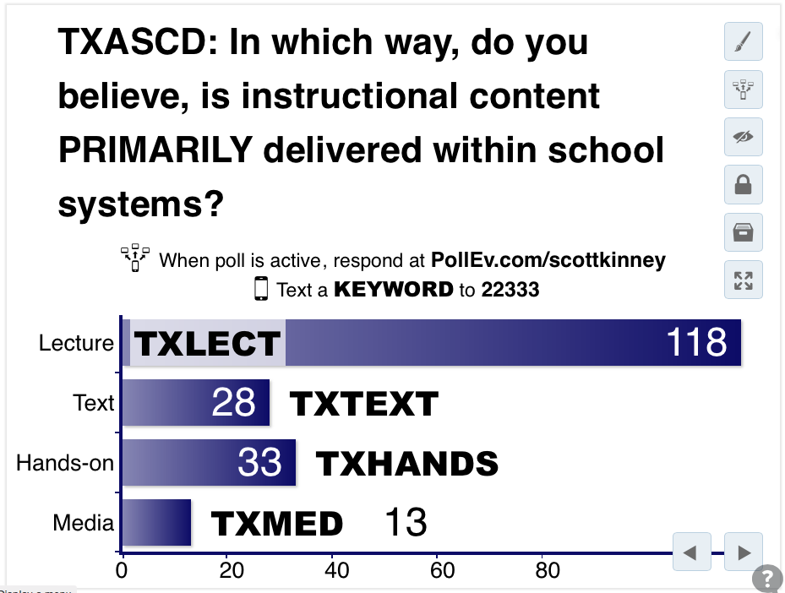
Answer the questions
Please take a moment
to answer the following question…
…and yes, standard text messaging rates apply.
Notes:
TXASCD: In which way, do you believe, is instructional content PRIMARILY delivered within school systems? https://www.polleverywhere.com/multiple_choice_polls/OQSoKuhsF7Clsc0

Slide 17
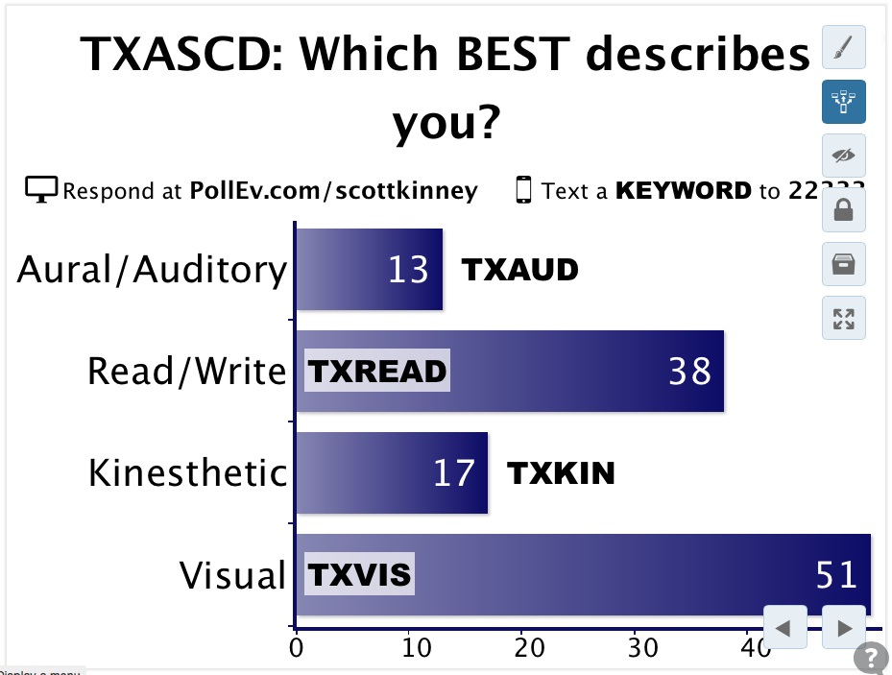
More questions
Please take a moment
to answer the following question…
…and yes, standard text messaging rates apply.
Notes:
TXASCD: Which BEST describes you? https://www.polleverywhere.com/multiple_choice_polls/SOaFTHbPM0JxfJR

Slide 18
Bar Graph – Deliver Content and Hot to Learn
Deliver Content
How We Learn
70.3%
56.3%
15.7%
16.3%
13.0%
10.9%
11.7%
5.8%
Text
Lecture
Media
Visual
Hands-on
Auditory
Read/Write
Kinesthetic

Slide 19
Life Cycles

Slide 20
Chart – Students
ACCESS TO CURRENT & RELEVANT INFORMATION
INTERACT WITH CONTENT DIFFERENTLY
STUDENTS
CONTENT TO MEET THE NEEDS OF ALL LEARNERS

Slide 21
Questions Educators Should Ask Their Digital Partner
Questions Educators Should Ask Their Digital Partner
Is it digital by design, or have you simply converted a static print textbook to digital?
How do you intend to support educators in making this transition?
Do you update your materials regularly?
Is it less expensive than traditional options?

