Slide 1
Turnaround Plan Implementation
AIE Conference
October 4,2016

Slide 2
Purpose
Provide updates and clarifications on turnaround plan implementation for 2016-17
Discuss resources for implementation planning

Slide 3
Agenda
Updates
New resources
Discussion/survey

Slide 4
Updates
Commissioner approval process
Submission timeline
Plans are due Oct 31 (3rd year+)… first PSP report due Nov 14
Additional board approval not required (unless local policy requires it)
All quarters should be completed
Turnaround implementation tab

Slide 5
New Resources

Slide 6
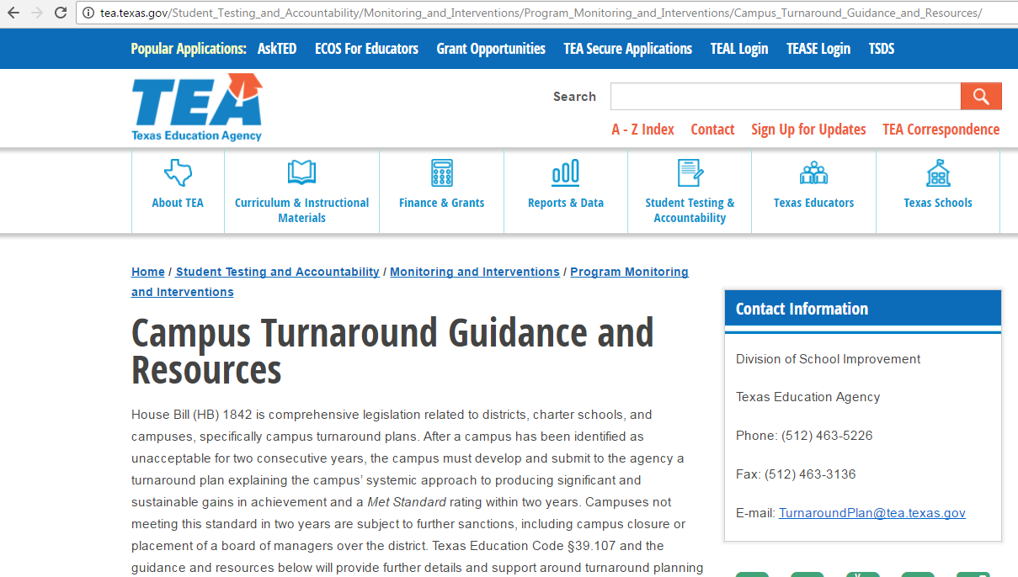
http://tea.texas.gov/Student_Testing_and_Accountability/Monitoring_and_Interventions/Program_Monitoring_and_Interventions/Campus_Turnaround_Guidance_and_Resources/
http://bit.ly/TurnaroundTEA

Slide 7
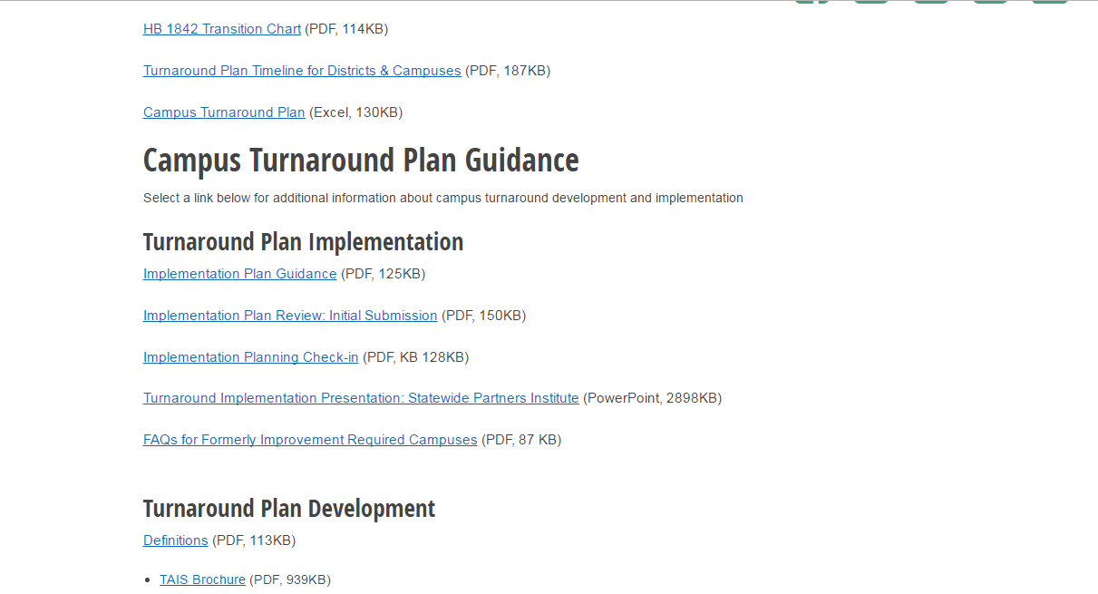

Slide 8
We’d like to hear from you!
Survey: http://bit.ly/TurnaroundSurvey
Questions for both turnaround plan development and implementation
Email: turnaroundplan@tea.texas.gov
Table Discussions and Share Out

Slide 9
Table Discussions and Share Out
What challenges is your campus facing in converting your turnaround plan to a turnaround implementation plan?
Is there anything you wish your campus had done differently in developing the turnaround plan now that you are working on implementation? What would you change?

Slide 10
Questions?
Survey: http://bit.ly/TurnaroundSurvey
Questions for both turnaround plan development and implementation
Email: turnaroundplan@tea.texas.gov

