Slide 1
Charter School Finance Update
Nora T. Rainey
Texas Education Agency
Division of State Funding
June 15, 2016
nora.rainey@tea.texas.gov
(512) 463-7298

Slide 2
Contact Information
State Funding Division
sfinance@tea.texas.gov (512) 463-9238 (512) 305-9165 Fax
Student Attendance Questions
attendance@tea.texas.gov
Al McKenzie - Director
Al.McKenzie@tea.texas.gov (512) 463-9186
Amy Copeland – Assistant Director
Amy.Copeland@tea.texas.gov (512) 463-8732
Nora T. Rainey - Charter School Finance
Nora.Rainey@tea.texas.gov (512) 463-7298
Ashley Behnke - State Comp Ed, OFSDP, OFYP
Ashley.Behnke@tea.texas.gov (512) 463-4834
Cassie Huggins – New Instructional Facilities Allotment (NIFA)
Cassie.Huggins@tea.texas.gov (512) 463-9232
Al Johnson - Staff Salary; FSP Application (TEA SE)
Al.Johnson@tea.texas.gov (512) 463-9260
Danny Sanchez - Transportation
Danny.Sanchez@tea.texas.gov (512) 463-9190

Slide 3
Agenda
House Bill 2610 Update
Waivers
Texas Education Agency Secure Environment (TEASE)
2016 – 2017 FSP Reports and Deadlines
2016 – 2017 State Compensatory Education (SCE)
2016 – 2017 Summary of Finances (SOF)

Slide 4
House Bill 2610 Update
House Bill 2610
Amends Texas education Code Section 25.081.
Replaces 180 days with 75,600 minutes.
Includes lunch, intermissions and recess.
Prior to HB 2610 charter schools had to comply with both the student basis of funding (2 to 4 hour rule) and the school basis of funding (180 days) in order to receive full funding.
Since HB 2610 passed, schools must comply with both the 2 to 4 hour rule for the student and the 75,600 minutes of school time offered to the student.
HB 2610 allows charter schools to extend school day instead of making up a missed school day.
Schools must build 2 days or 840 contingency minutes to initial calendar to use if needed to make up first two missed school days.
School year cannot end prior to May 15
One-Time waiver for 75,600 minute requirement is available for:
Alternative Education Programs (AEP)
Disciplinary Alternative Education Programs (DAEP)
Charter schools that provide an instructional day of less than 420 minutes
Prekindergarten programs that offer a school day of less than a 210 minutes but offer at least 120 minutes of instruction per day
Waiver application is required
Calendars will be submitted via Texas Student Data System (TSDS).
Charter Schools will no longer submit Calendars Track reports on the Foundation School Program (FSP) payment system.

Slide 5
Waivers
Calendar Track (s) on your local student attendance system must still be updated and accurate prior to generating the Six Week District Summary Report.
Apply for waivers as soon as possible and update local system calendar(s)
Staff Development
Missed School Days
Low Attendance
Early Release Days
House Bill 2610
Maximum minutes that can be waived for Staff Development, Missed School Days, Low Attendance and Early Release Days is 4,200.
For a list of your approved waivers, please go to the Waivers Online Report at : http://mansfield.tea.state.tx.us/Tea.Waivers.Web/Default.aspx.
For assistance with the waiver approval process, please select the following link: http://tea.texas.gov/Texas_Schools/Waivers/State_Waivers/Automated_Waivers_Application_Instructions/.

Slide 6
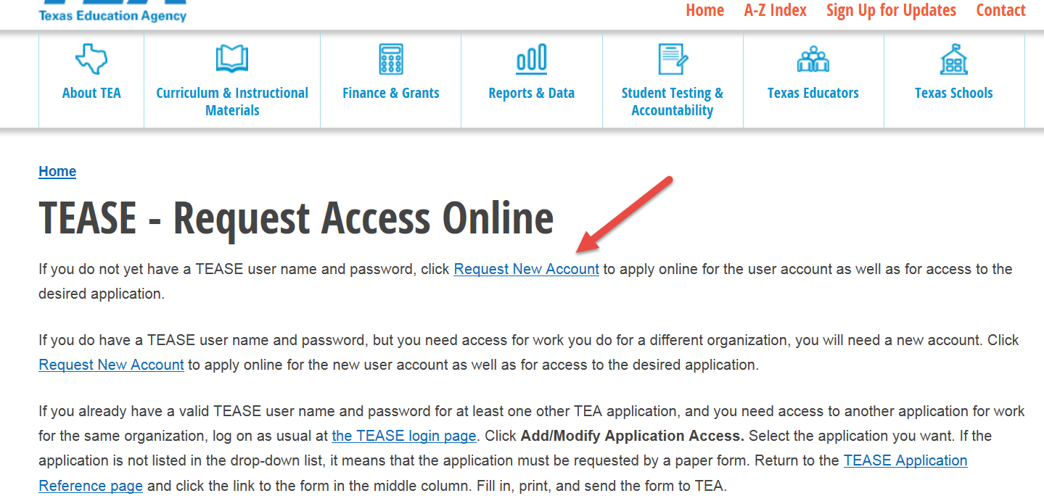
Texas Education Agency Secure Environment (TEASE)
Adding new staff or modifying existing TEASE user access to the Foundation School Program (FSP)
New Users
From the TEASE Request Access Online page, click Request New Account http://tea.texas.gov/About_TEA/Other_Services/Secure_Applications/TEASE_-_Request_Access_Online/
Existing Users
Login using current TEASE account
Select Add or Modify Application
Select Application
User Administration + (Superintendent Only)
Foundation School Program
Select Roles (District Approver, Charter User, Transportation User, SCE User, NIFA User, Pupil Projections User, Staff Salary User, etc.)
Send to District Approver
District Approver approves via the User Administration+ application and sends to TEA
Superintendent’s should also use the User Administration+ application to remove access of staff no longer employed with the organization.

Slide 7
FSP Reports and Deadlines
FSP Estimate Report (Opens July 1 due August 1)
District Approver must be familiar with Student Attendance Accounting Handbook.
http://tea.texas.gov/Finance_and_Grants/Financial_Compliance/Student__Attendance_Accounting_Handbook/
It is recommended that District Approver complete the 2016-2017 Estimate of State Aid Worksheet prior to completing the FSP Estimate Report.
http://tea.texas.gov/Finance_and_Grants/State_Funding/Charter_School_Funding/Charter__School_State_Funding_Worksheets/
The Estimate of State Aid Worksheet includes a worksheet specifically designed for estimating State Compensatory Education (SCE) enrollment.
Required for new charter schools.
Required for established charter schools with material increases or decreases in enrollment.
Estimate first six-week attendance only.
Expansion amendments must be approved by August 1.
Material increases will require detailed facility and enrollment information.
New campuses/sites must have approval by amendment and certificate of occupancy.
Major renovations and portable buildings require updated certificate of occupancy.
2015-2016 data is rolled over to 2016-2017 and pre-approved for prior year schools.
Estimate data will be used to calculate FSP payments until the first Six-Week District Summary report is approved.
To submit new estimates, select the REVISE button and a data entry column will appear.

Slide 8
FSP Reports and Deadlines
Student Attendance Accounting Handbook Audit Reports
Six-Week Student Detail Reports by Track
Should include reporting period beginning and ending dates from the calendar track.
Should include days taught from each reporting period in the calendar track.
Uses days taught from reporting period in the calendar track to calculate Average Daily Attendance (ADA) and Full-Time Equivalents (FTE).
Six-Week Campus/Principal Summary Report
Should include all calendar tracks on a campus.
Reporting period beginning and ending dates represent the earliest track beginning date and latest track ending date.
Should not include days taught in each reporting period.
Summarizes Days, ADA and FTE from Track Student Detail reports.
Six-Week District/Superintendent Summary Report
This report is used to submit data to Texas Education Agency State Funding Division via FSP Charter School module.
Includes all Campuses in a District/Charter.
Reporting period beginning and ending dates represent the earliest track beginning date and latest track ending date.
Should not include days taught in each reporting period.
Summarizes Days, ADA and FTE from Campus/Principal Summary Reports.

Slide 9
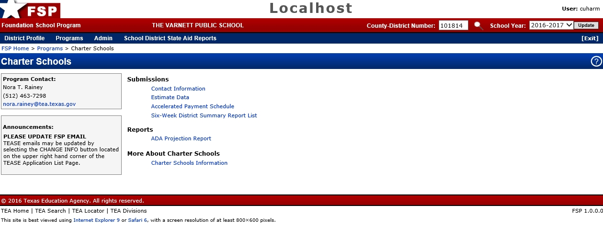
FSP Reports and Deadlines
FSP Charter School Home Page
New User Interface.
Please read announcements and update contact information.

Slide 10
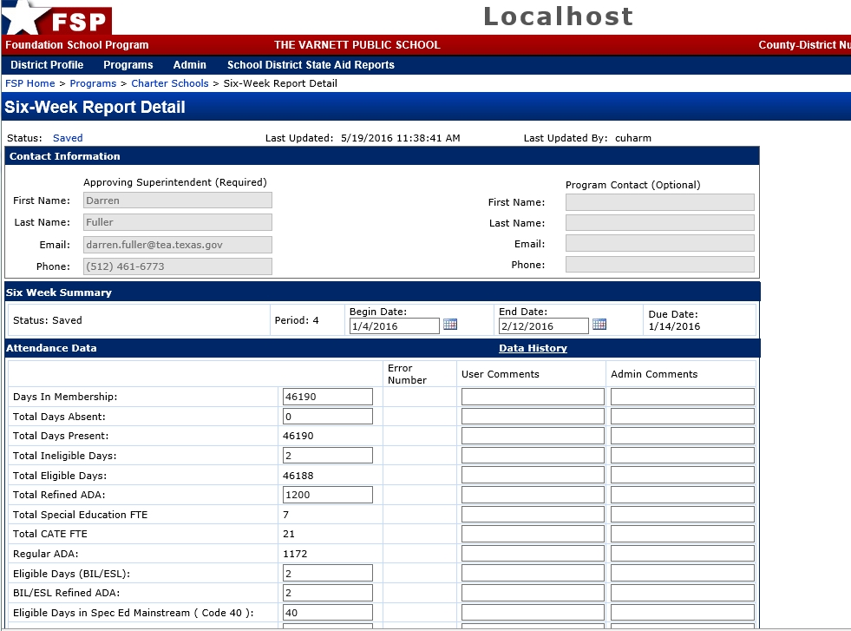
FSP Reports and Deadlines
Six-Week District (Superintendent) Summary Report
New User interface for 2016-2017
Due 10 days after last track completes the reporting period.
Charters will only submit six reports per year.
Charter Users will only be able to enter and save data cannot submit to TEA from this screen.
Charter Users will enter Days, ADA and FTEs.

Slide 11
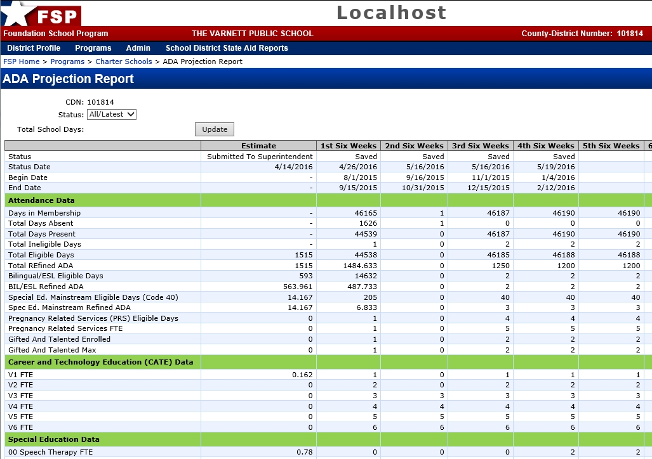
FSP Reports and Deadlines
ADA Projection Report
New Interface for 2016-2017
Includes FSP Estimate data for comparison.
Facilitates comparison between current reporting period and prior reporting period.
Submit Six-Week District Summary Report from this screen.
Requires District Approver to acknowledge that a Minimum of 75,600 is required for full funding.
Estimate of State Aid Template friendly.

Slide 12
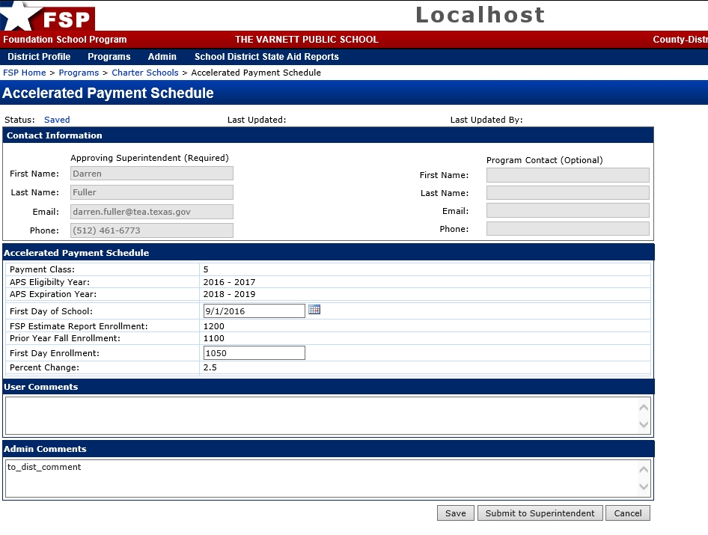
FSP Reports and Deadlines
Accelerated Payment Schedule Report
New FSP Application – due September 1
Only for charter schools with 10% or more increase in enrollment.
2016 – 2017 eligibility will be based on first day enrollment compared to prior year fall enrollment.
Eligible for 3 years.

Slide 13
FSP Reports and Deadlines
New Instructional Facility Allotment (NIFA) – due July 15, 2016
Provides $250 per ADA in funding for new campuses built from the ground up.
Renovations and additions not eligible.
May be used for equipment, furniture, other start-up costs for new facility.
Provides two years of funding per eligible campus.
2016 – 2017 1st year – ADA on eligible campus
2017 – 2018 2nd year – additional ADA on eligible campus (if funding is available)
Transportation
New application due July 15
Route Services due August 1
Operations Report due December 1
Staff Salary Report- due August 31
Applicable to charter holders that participated in the Teacher Retirement System (TRS) Active Care program in 2005–2006 school year
Report full-time and part-time employees only
Do not report administrators, teachers, librarians, registered nurses or counselors

Slide 14
FSP Reports and Deadlines
Attendance Projection Report - due December 15 of even numbered years
Attendance projections are estimates of student average daily attendance (ADA) or full-time equivalent (FTE) counts by program or instructional setting.
The Texas Education Agency (TEA) provides attendance projections to the Texas Legislature in March off odd numbered years.
The legislature uses these projections to determine the cost of public education for the next biennium (school years 2017–2018 and 2018–2019).
Attendance projections are not used to calculate charter school FSP payments.
This report should not be confused with the Estimate Data report.
State Compensatory Alternative due November 30
Not required if all campuses participate in the National School Lunch Program (NSLP) through the Texas Department of Agriculture (TDA).
Only used to report campuses not participating in the NSLP.
FSP SCE alternative reporting procedures available on the Charter School Finance web page.
http://tea.texas.gov/Finance_and_Grants/State_Funding/Additional_Finance_Resources/Alternative__Compensatory_Education_Allotment_Reporting_Procedures/

Slide 15
State Compensatory Education (SCE)
SCE Estimate is collected on the Charter School Estimate Data Report – due August 1
SCE is estimated on the SOF from September through January
Two methods for reporting actual data
National School Lunch Program (NSLP) via the Texas Department of Agriculture (TDA)
Alternative Basic Monthly Claims via the FSP SCE application – due November 30
TEA will collect prior federal fiscal year data (October 2015– September 2016) in January 2017 from FSP and TDA and update the SOF in February 2017.
If the charter school was in operation in 2015-2016, the 2016-2017 SCE actual enrollment is based on October 2015 – September 2016 highest six month’s average.
If the charter school was not in operation in the 2015-2016 school year and is a new charter school, TEA uses estimated data from October 2016 - September 2017 for the school’s first two years of operation 2016-2017 and 2017-2018.
New Charter Schools actual data for 2016-2017 and 2017-2018 will be updated in February 2018.
Notes:
Revenue at the Compressed Tax Rate (RACR) - Revenue at the compressed tax rate is based on the funding a school district would have received in 2009-2010 had HB 3646 not passed. The guaranteed increase in revenue of at least $120 per WADA districts received in 2009-2010 is maintained in 2010-2011. No district may receive an increase in revenue greater than $350 per WADA more than what the district actually received in 2009-2010.

Slide 16
2016 – 2017 Summary of Finances
Initial SOF (reports prior or June 15, 2016)
Uses data from the FSP Attendance Projection Report.
Do not use for cash flow projections or budget.
Preliminary
June 15, 2016 – Pre-approved rollover from 2015-2016 (except new schools).
September 10, 2016 - Revised Estimates
Used to calculate payments until First Six-Week District Summary Report is approved.
Updated monthly with Six-Week District Summary attendance between the 8th and 10th of each month.
Estimates with annual updates
State Compensatory Education updated February 2017
High School ADA updated October 2017 (near final settle-up)
Transportation and Staff Salary updated in October 2017 and April 2018 (near final settle-up)
Extended School Year (ESY) and Advanced Career Technology Education updated April 2018 (final settle-up)
Near Final Settle-Up
September/October 2017 (PEIMS data, Transportation actual, Staff Salary actual, HS ADA actual)
If FSP ledger balance is positive, payment will be made to charter school
If FSP ledger is negative, balance will be transferred to 2017-2018 school year and allocation for 2017-2018 will be reduced.
Final Settle-Up
March/April 2017 (ESY PEIMS data, Advanced CATE, SCE if new prior year)
If FSP ledger balance is positive, payment will be made to charter school
If FSP ledger is negative, balance will be transferred to 2017-2018 school year and allocation for 2017-2018 will be reduced.

